Slide 1
Lunar Calibration Workshop, 1~4 December, 2014
Lunar calibration of COMS visible channel using GIRO
2014. 12. 1.
Tae-Hyeong Oh (hyoung0203@korea.kr)
Dohyeong Kim (dolong@korea.kr)
National Meteorological Satellite Center (NMCS)
Korea Meteorological Administration (KMA)
Notes:
Good afternoon, everyone. I am Tae-Hyeong Oh on National Meteorological Satellite Center, Korea Meteorological Administration in Republic of Korea.
My talk title is the Lunar calibration of COMS visible channel using GIRO.

Slide 2
Radiometric Calibration System(IMPS) on NMSC
Notes:
First, I talk to radiometric calibration system(IMPS) on NMSC

Slide 3
MI radiometric calibration
Radiometric Calibration concept (IMPS *on NMSC)
COMS MI Digital Count (Level 0 data, 10bit) → Radiometric Correction
Radiance (Level 1A data, 14it) → Level 1A data (counts, 14bit)
Geometric Correction → Level 1B data (10 bit)
Spacecraft Effects
Radiance
@ Imager
Level 0
L1A
L1B
Orbit & Attitude/
Thermo-Elastic/Platform Jitter
Radiometric
Correction
R = m∙X + b
( W∙m⁻²∙sr ⁻¹∙μm ⁻¹ )
Instrument Effects
Geometric
Correction
Scan Mirror/Detector/
Focal Plane/Electronics
* IMPS : Image Preprocessing System
Notes:
This is COMS MI radiometric calibration.
Radiometric calibration concept is the conversion from COMS MI digital count to radiance.
Digital count is level 0 data and 10 bit.
Radiance is level 1a data and 14 bit. NMSC process to change 10 bit to 14 bit to get fine resolution of MI data

Slide 4
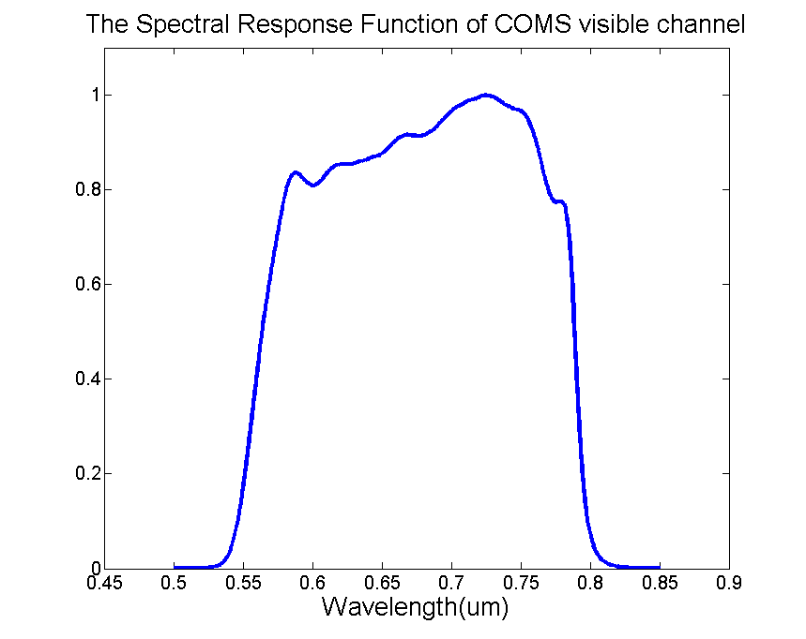
COMS MI visible channel
Radiance: R = m∙X + b ( W∙m⁻²∙sr ⁻¹∙μm ⁻¹ )
where m = linear calibration coefficient, i.e. the slope (pre-launch determined)
X = digital counts
b = intercept (measured by the count values of space-look data)
Channel | Center wavelength(㎛) | Spatial Resolution(km)
Visible | 0.67 | 1
Shortwave IR (IR4) | 3.7 | 4
Water Vapor (IR3) | 6.7 | 4
IR1 | 10.8 | 4
IR2 | 12.0 | 4
No on-board calibration for slope m
⇒ Ground calibration must be needed!!
Notes:
Radiometric equation is R = mx + b
where m is linear calibration coefficient, this coefficient is determined in the pre-launch test
x is digital count
and b is intercept that is measured by the count values of space look data
COMS MI has one Visible channel , center wavelength is 0.65 micron and resolution is 1 km
SRF is like figure.
COMS visible channel does not have on-board calibration target for slope m.
So ground calibration must be needed to monitor a degradation of visible channel.

Slide 5
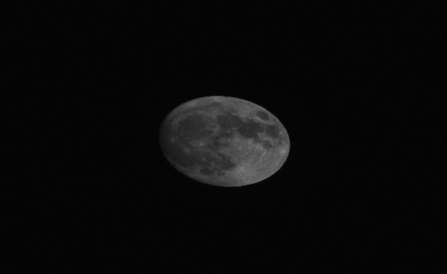
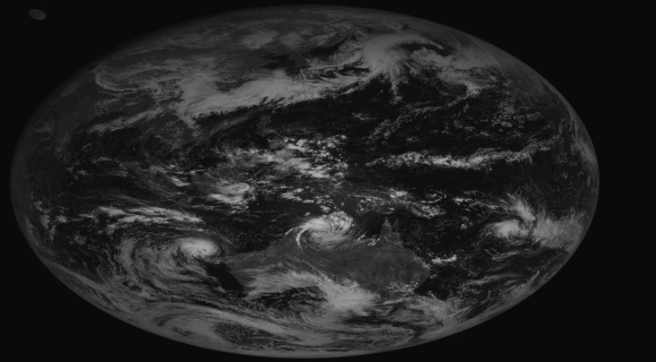
Moon Observation of KMA
COMS has observed moon monthly for visible channel monitoring moon calibration since April 2011.
For observing moon, KMA choose two kind of moon observation method by using Local Area observation mode for moon(direct) and Full disk observation with moon(indirect).
To process these observed data, KMA has used the Moon Processing system in IMPS for Moon Calibration.
* IMPS : Image Preprocessing System

Slide 6
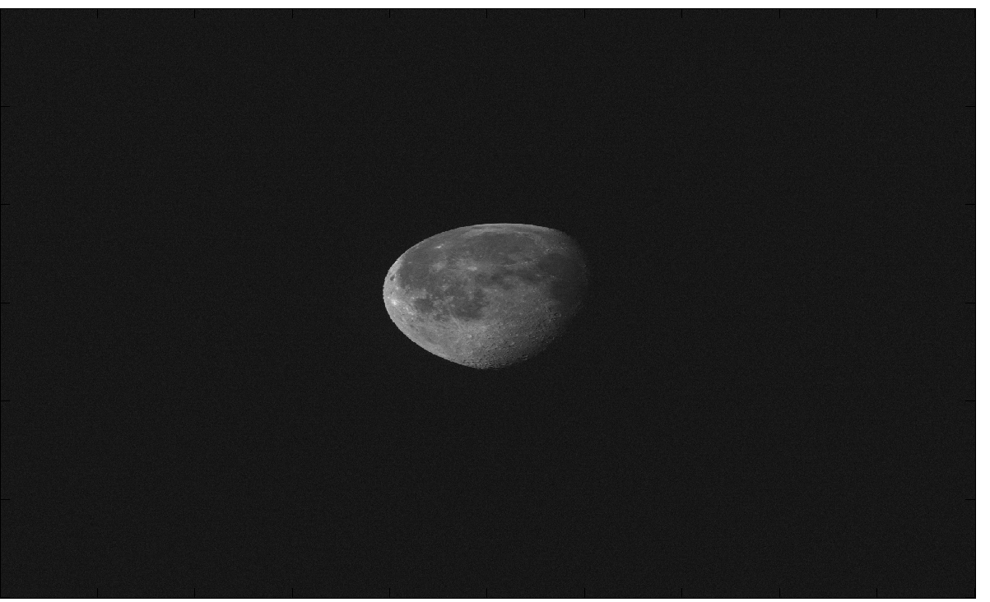
Lunar Calibration(IMPS) : Data and Method
COMS Moon observation L1A data
L1A Moon data (1200*2080)
Moon observation time
ROLO model of USGS(ver.311g)
COMS ephemerides data
- absolute phase angle
- Selenographic longitude of the sun
- Selenographic longitude of COMS
- Selenographic latitude of COMS
(b) IMPS moon area
Moon irradiance as measured by the COMS/MI
where
N_{P}: the total number of pixels in the lunar disk image
R_{P} : an individual radiance measurement(i.e. pixel) on the Moon
Ω: the solid angle of a pixel (sr), corresponding to one visible detector, i.e. 28 µrad
16/28: the over-sampling rate of MI along E-W axis
Moon irradiance computed from the ROLO
where
D_{m-v}: the moon-viewer distance in km i.e. Moon-satellite
D_{m-s}: the moon-sun distance in AU
Calculate a imager response the observed irradiance and ROLO irradiance
$$P= \frac{I_{Instrument}}{I_{Ref}}$$
Notes:
This slide show the flow of Lunar calibration in IMPS
First, find the moon pixel and define moon area from L1A data, then calculate moon irradiance.
ROLO irradiance is computed from the ROLO model of USGS (ver. 311) like this equation
Finally calculate a imager response the observed irradiance and ROLO irradiance

Slide 7
Lunar calibration results using GIRO
Notes:
Next, I talk to the Lunar calibration results using GIRO second release

Slide 8
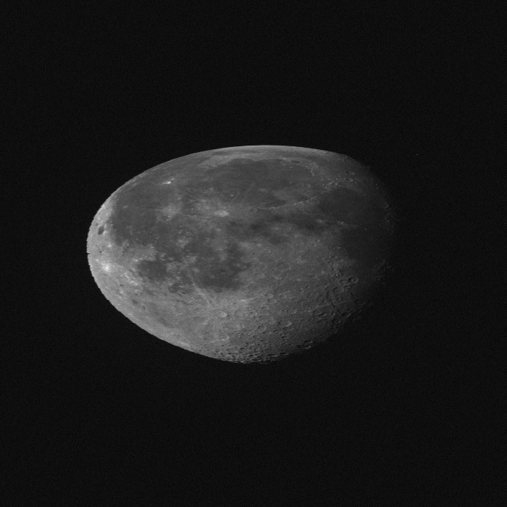
GIRO (GSICS Implementation of the ROLO model)
Observed Moon data (2016-06-17 07:43:13)
(a) L1A Moon data (699*699)
(b) GIRO moon pixel (699*699)
threshold : 900 counts
L1A Moon data (1200*2080)
Re-make a Moon data
(count and radiance, 699*699) from level 1 data
Figure (a)
Select moon pixels above a threshold (900 count)
Figure (b)
Calculate (sanity check)
the observed irradiance
the integrated DC signal
the DC offset
the number of pixels
Calculate a imager response with the observed irradiance and ROLO irradiance from the GIRO_secondrelease
$$P= \frac{I_{observed}}{I_{ROLO}}$$
Notes:
This slide show the flow of GIRO on NMSC
First re-make a lunar count and radiance data 699*699 pixels from level 1 data 1200*2080 pixel like figure (a).
And select moon pixel above a threshold 900 count like figure (b).
Then build NetCDF input file including observation time, satellite position, count and radiance data.
compare the result of NMSC and GIRO for the observed irradiance integrated DC count, DC offset and number of pixel.
then calculate a imager response with the observed irradiance and ROLO irradiance from GIRO_secondrelease.

Slide 9
The Dataset (GIRO)
Satellite | Time Coverage | Observations | channel | Phase-angle range [deg] | Useful Observation for ROLO calibration
COMS | April 2011 ~ September 2014 | 81 | 1 |  | 79
79 COMS MI - VIS observations available
Instrument | Channel | SRF in GIRO NetCDF format
COMS MI | VIS06 | Yes
9
Notes:
This slide show the dataset of COMS visible channel for GIRO

Slide 10
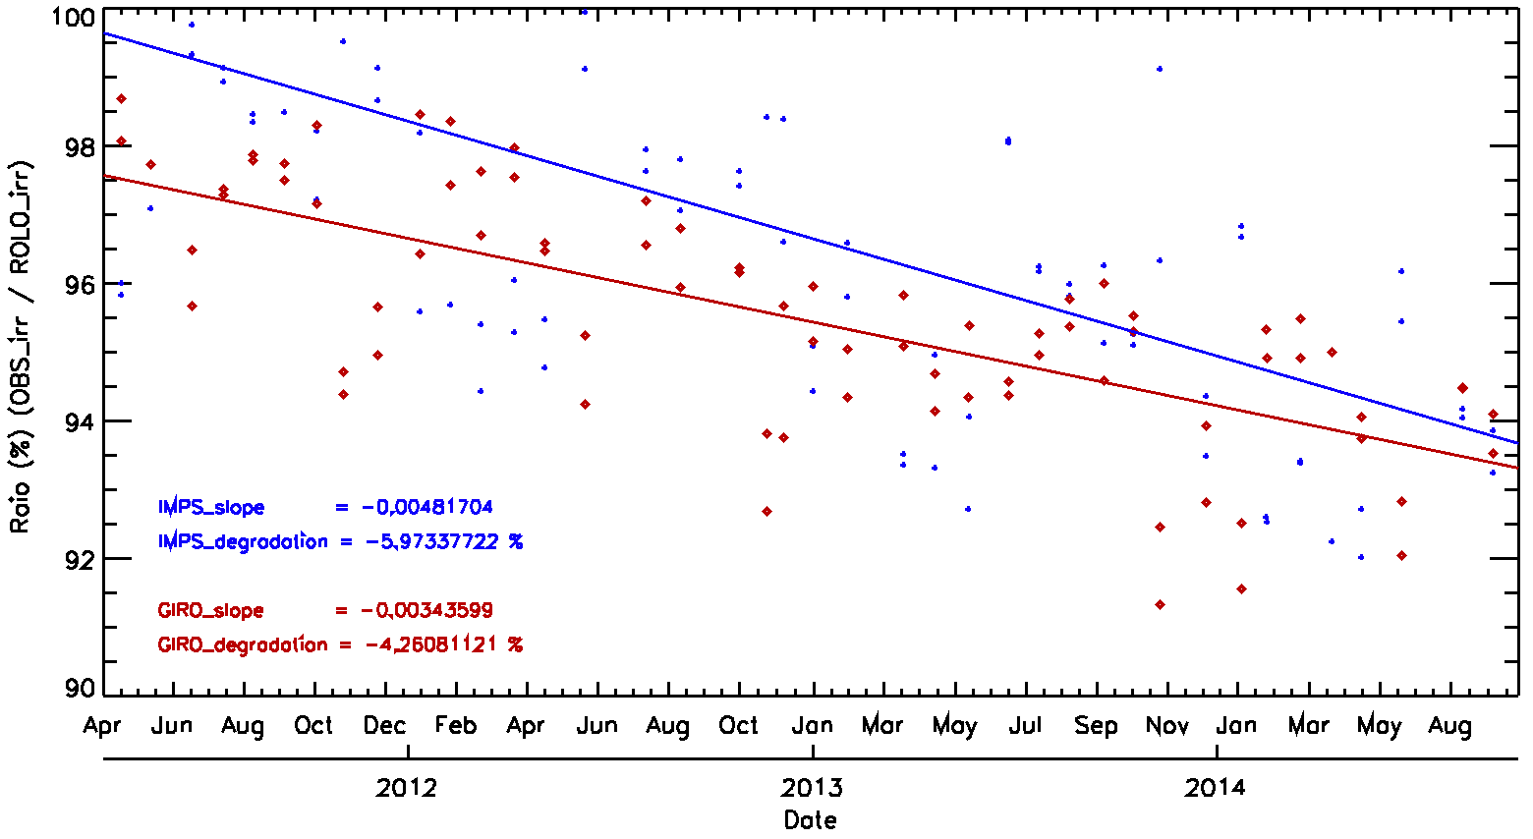
Result : time series
900
Compare the ratio using the result of IMPS and GIRO_secondrelease
${OBS}_{irr}$/${ROLO}_{irr}$(IMPS): degradation = -5.97 % (-1.41 %/year)
${OBS}_{irr}$/${ROLO}_{irr}$(GIRO): degradation = -4.26 % (-0.98 %/year)
917
IMPS_slope = -0.0048
IMPS_degradation = -5.97 (1.41%/yr)
GIRO_slope = -0.0034
GIRO_degradation = -4.26 (0.98%/yr)
Notes:
This figure show the ratio of IMPS and GIRO_secondrelease
As you see, ratio of IMPS is bigger than GIRO
IMPS’ Slope is -0.0048 per day and degradation is about 6 % in whole period (1.41 % /year)
But GIRO slope is -0.0034 per day and degradation is about 4.3 in same period (about 1%/ year)
To find the cause of this difference, I compare the ROLO irradiance of IMPS and GIRO.

Slide 11
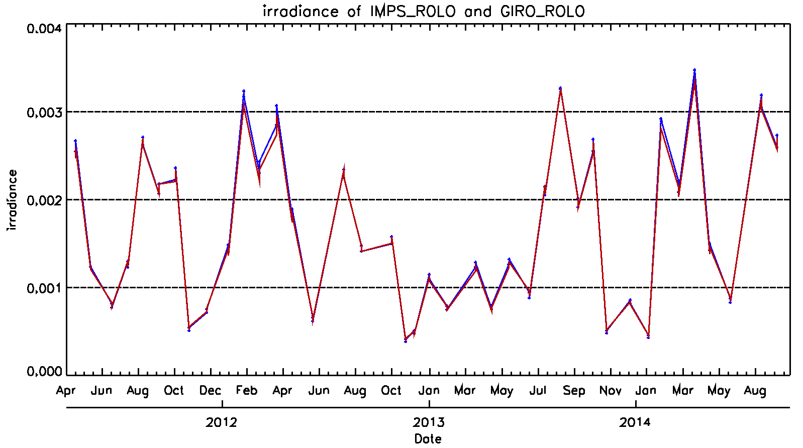
Result : ROLO(IMPS) vs. ROLO(GIRO)
900
Compare ROLO_IMPS and ROLO_GIRO
ROLO_IMPS: calculated ROLO irradiance from IMPS of NMSC
ROLO_GIRO: calculated ROLO irradiance from GIRO_secondrelease
917
Notes:
This slide show the ROLO irradiance of IMPS and GIRO
Blue line is calculated ROLO irradiance form IMPS and red line is ROLO irradiance from GIRO_secondrelease.
It is displayed a difference Obviously in red circle

Slide 12
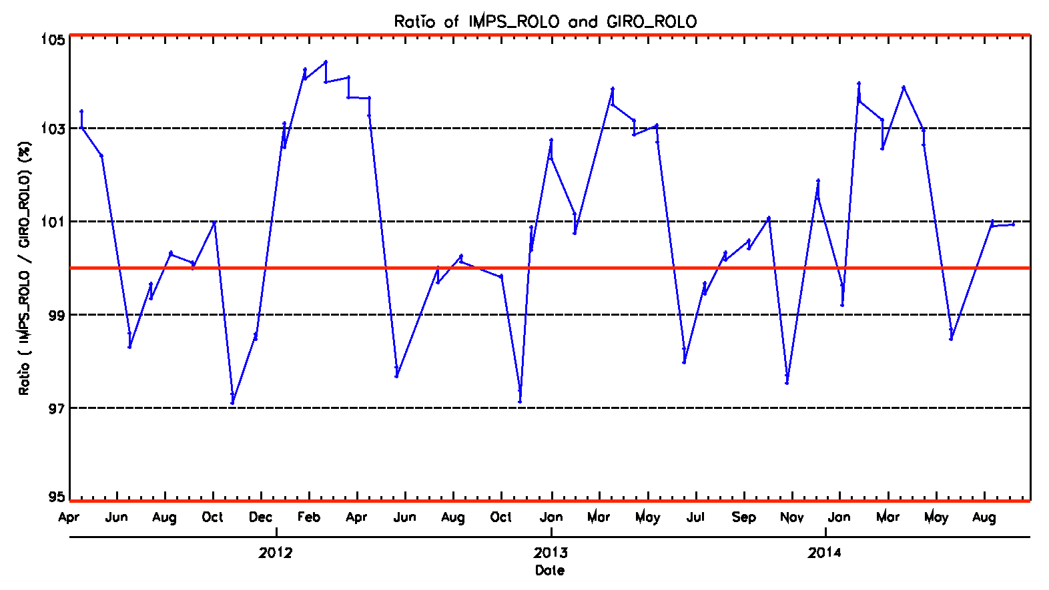
Result : ROLO_IMPS vs. ROLO_GIRO
900
Ratio between ROLO_IMPS and ROLO_GIRO
ROLO_irr_IMPS / ROLO_irr_GIRO
+5%
917
100%
-5%
Notes:
This slide show the ratio between ROL.O irradiance of IMPS and GIRO.
As in the previous page, see that the ratio value is greater.

Slide 13
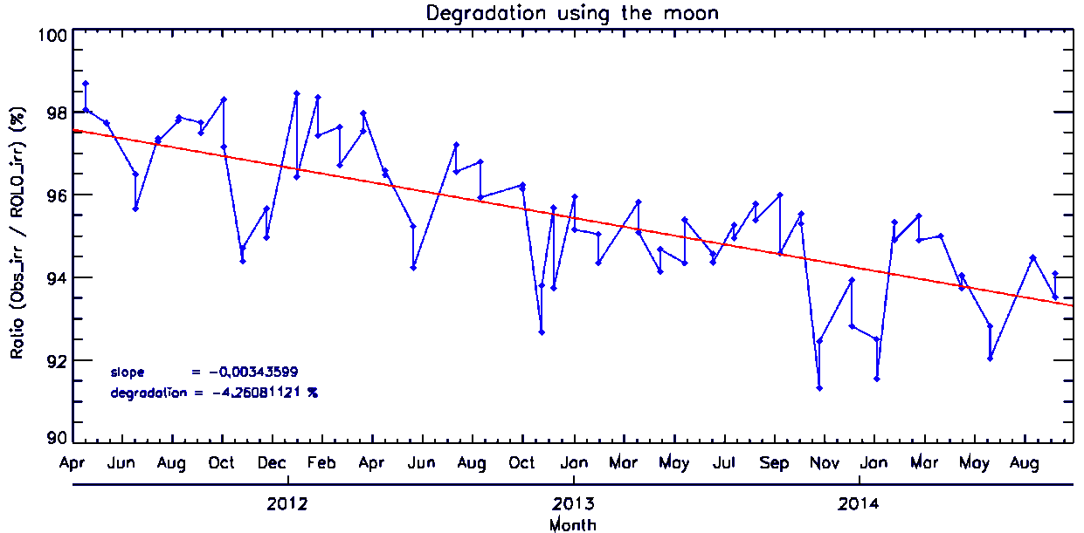
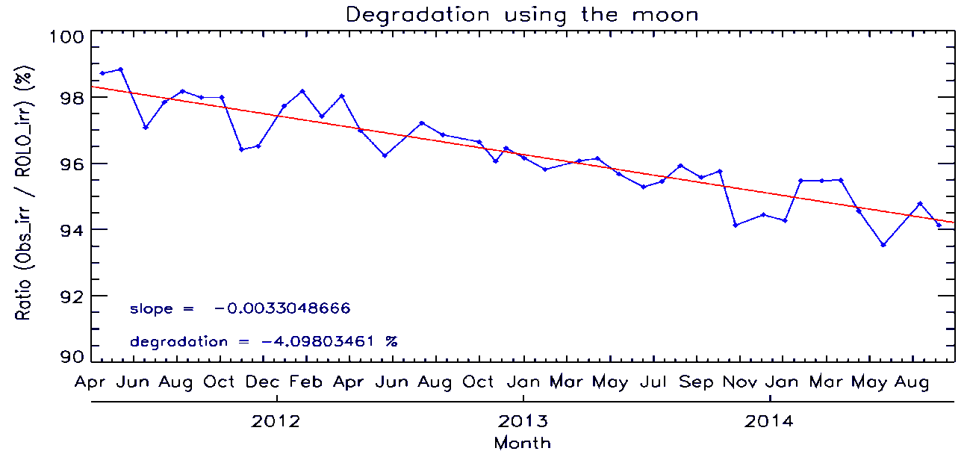
Result (degradation) of GIRO
Degradation of VIS channel
~ -4.26 % (0.98% /yr)
GIRO_slope = -0.0034
GIRO_degradation = -4.26 (0.98%/yr)
More smooth and
less slope and degradation
Monthly mean degradation of VIS channel
monthly mean of observed irradiance and ROLO irradiance
Get the ratio of Obs_irr/ROLO_irr
~ -4.098 % (0.94%/yr)
GIRO_slope = -0.0033
GIRO_degradation = -4.10 (0.94%/yr)
Notes:
Next, I compare degradation of Visible channel for each observation and monthly mean in whole period
as shown, degradation of visible channel is 4.26 % in whole period (about 1%/year)
But degradation of monthly mean is more smooth and less slope and degradation like below figure.
Monthly mean degradation is about 4.1%
As I will talk in the conclusion, this is first issue for lunar calibration.

Slide 14
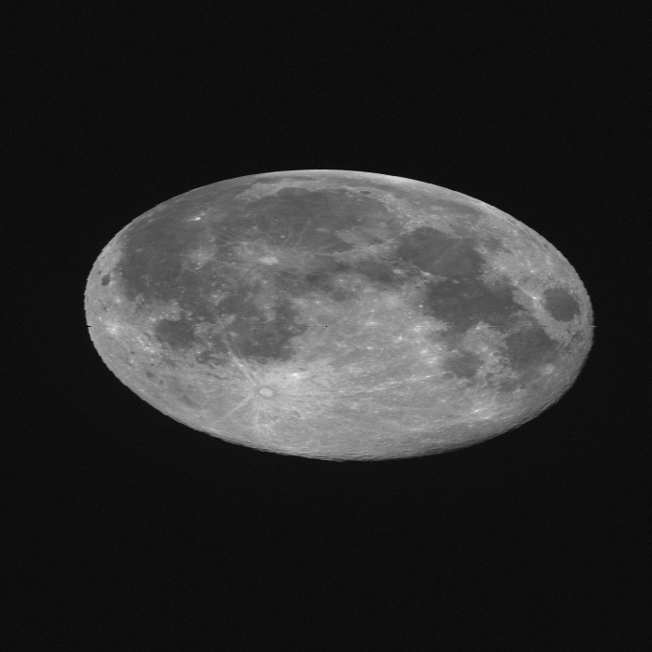
Sensitivity test through threshold
Observed Moon data (2014-08-11 03:13:12)
(a) threshold : 850 counts
(b) GIRO moon pixel (699*699)
threshold : 900 counts
Include space pixel
L1A Moon data (699*699)
(c) threshold : 950 counts
(b) threshold : 900 counts
Notes:
Next, this slide show the moon pixel area according to the threshold
If it is full moon like figure, moon area is almost similar.
According to the threshold, if threshold is less, it include space pixel around moon

Slide 15
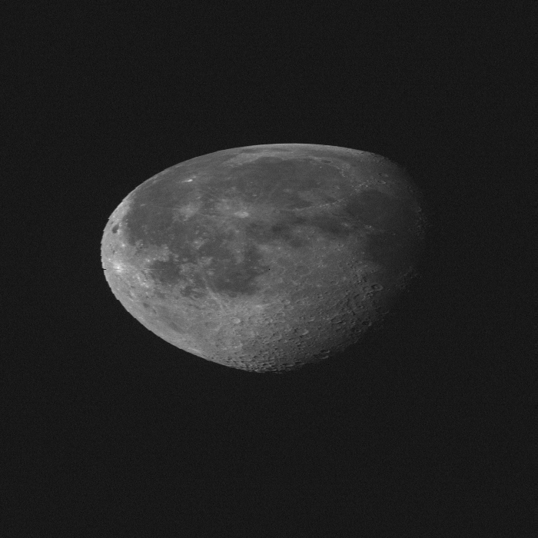
Sensitivity test through threshold
Observed Moon data (2014-06-17 07:43:34)
(a) threshold : 850 counts
L1A Moon data (699*699)
(c) threshold : 950 counts
(b) threshold : 900 counts
Notes:
But if moon is near half moon, This concerns in selecting the moon area
Figure a, b, and c is the moon area according threshold 850, 900, 950 respectively
as in figure, it appear much different from the boundary of the month.

Slide 16
Sensitivity test through threshold
Observed Moon data (2014-08-11 03:13:12)
 | 850 | 900 | 950
Observed Moon DC | 277948495 | 271572020 | 27127962
Moon pixel number | 142080 | 134676 | 134358
DC offset | 794.92449 | 794.92449 | 794.92449
Observed irradiance | 0.002989769 | 0.002980695 | 0.002979970
Observed Moon data (2014-06-17 07:43:34)
 | 850 | 900 | 950
Observed Moon DC | 120357585 | 114669705 | 111035963
Moon pixel number | 97158 | 90625 | 86684
DC offset | 793.29863 | 793.29863 | 793.29863
Observed irradiance | 0.000782881 | 0.000773766 | 0.000764601
Notes:
This slide show the sanity check according to each threshold for two observed moon data.

Slide 17
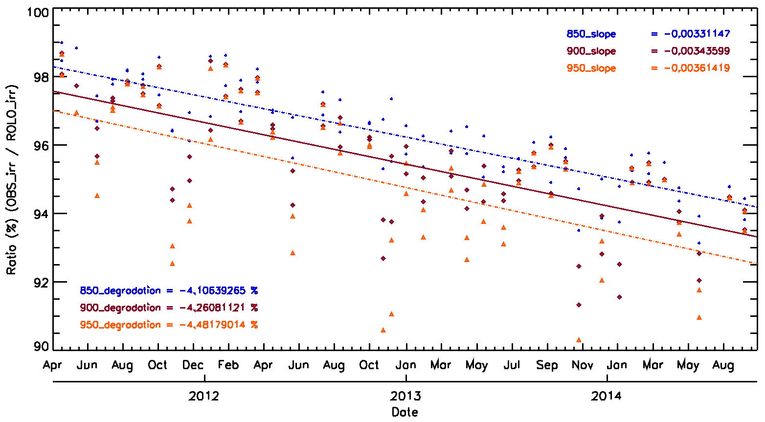
Sensitivity test through threshold
To define the Moon pixel
Calculate Observed irradiance through threshold (850, 900 and 950)
Use ROLO irradiance that is calculated GIRO_secondrelease
850_slope = -0.0033
900_slope = -0.0034
950_slope = -0.0036
850_degradation = -4.11 %(0.95%/yr)
900_degradation = -4.26 %(0.98%/yr)
950_degradation = -4.48 %(1.03%/yr)
Notes:
This slide show the result according the threshold
To define the moon pixel, calculate observed irradiance according threshold 850, 900, 950
And compute the ratio using ROLO irradiance that is calculated GIRO_secondrelease.
According to the threshold, degradations are 4.11, 4.26 and 4.48 respectively

Slide 18
Issues and future plans
Issues
To calculate monthly mean ratio (Obs_irr / ROLO_irr)
Two observations per month in KMA
Time interval : just 1~2 hour
→ should be no degradation but …
To define the Moon pixel
Need more test to define the threshold
Future plan
Run GIRO_fourthrelease.exe
Run GIRO_PERT.exe
Upload the COMS lunar data to the Dropbox ASAP.
ROLO model of IMPS (operational system on NMSC/KMA)
Need a update for the ROLO algorithm and coefficients
Notes:
This is last slide on my presentation, issues and future plans
As mentioned earlier, it is the first issue to calculate monthly mean ratio.
COMS observe two time per month, but time interval is 1 or 2 hour
So it should be no degradation but it is different.
Next issue is to define the moon pixel.
To determine the threshold, we need more test to the threshold.
Future plan is to run GIRO_fourthrelease and GIRO_PERT executive file
And I will upload the COMS lunar data to the dropbox ASAP
Finally, after more test and verification for GIRO, need a updata for ROLO algorithm and coefficients of IMPS on NMSC/KMA
Thank you

Slide 19
Thank you

Slide 20
Back-up Slide

Slide 21
Difference

Slide 22
Difference of monthly Ratio
 | ROLO ratio | ROLO_irr | OBS_irr | Absolute difference of ROLO ratio (%)
20120307014318 | 97.63536376 | 0.002206127 | 0.002153960 | 0.928350262
20120307025823 | 96.7070135 | 0.002343020 | 0.002265864
20130522001314 | 94.34561314 | 0.001224130 | 0.001154913 | 1.045640841
20130522011314 | 95.39125398 | 0.001287630 | 0.001228286
20140617064314 | 92.83162978 | 0.000887203 | 0.000823605 | 0.787696628
20140617074313 | 92.04393315 | 0.000840649 | 0.000773767
 | Satellite Position (x, y, z) (km)
20120307014318 | -2.608740048e+04 | 3.311935739e+04 | -9.098444799e+00
20120307025823 | -2.608983905e+04 | 3.311660843e+04 | -1.498865650e+01
20130522001314 | -2.606621613e+04 | 3.313687340e+04 | 1.346436683e+01
20130522011314 | -2.606804766e+04 | 3.313445828e+04 | 1.566377514e+01
20140617064314 | -2.608510769e+04 | 3.312330364e+04 | 3.500014916e+01
20140617074313 | -2.608689621e+0 | 3.312310677e+04 | 3.193191656e+01

Slide 23
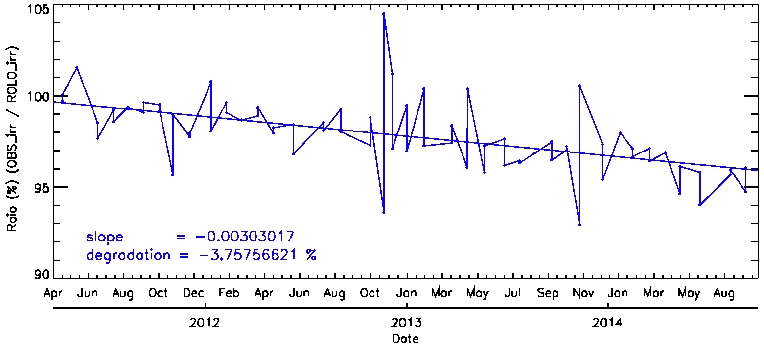
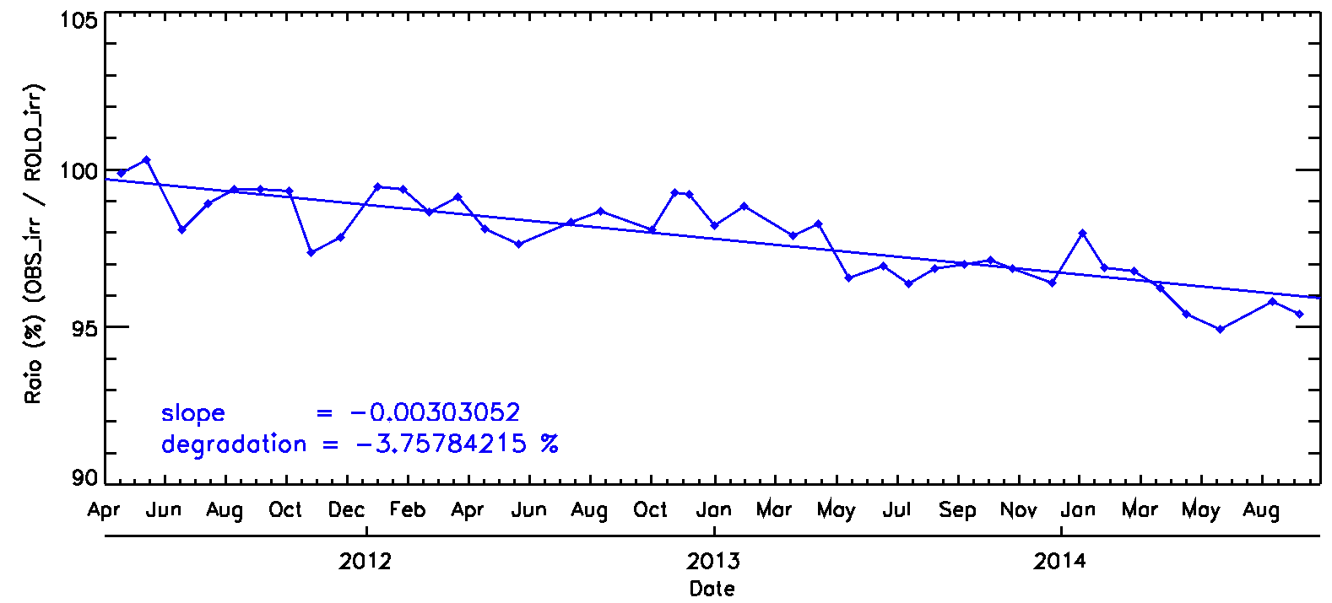
Test for total pixel
Ratio of total pixel (699*699)
Ratio of OBS_irr and ROLO_irr for each observation
Ratio of OBS_irr_monthly_mean and ROLO_irr_monthly_mean
slope = -0.00303
Degradation = -3.758
slope = -0.00303
Degradation = -3.758

