Slide 1

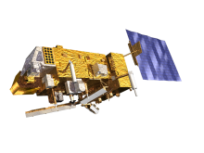

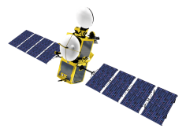
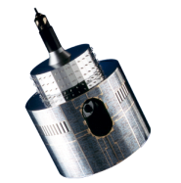
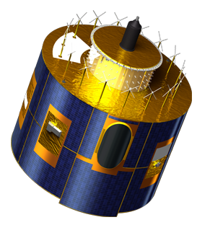
MooN DATA &
GIRO CALIBRATION RESULTS
Bartolomeo Viticchiè, Sebastien Wagner & Tim Hewison
Acknowledgments:
Tom Stone (USGS)

Slide 2
Contents
Brief Description of the EUMETSAT operational satellites
Moon identification and extraction procedure
Moon observation dataset
Calibration and monitoring of the VIS/NIR bands at EUMETSAT
  Vicarious calibration
  Description of the GIRO calibration results

Slide 3
EUMETSAT operating satellites
Satellite | Time span | Pixel resolution at SSP | Bands | VIS/NIR bands | Service
Meteosat 7 (MET7) | 1997-present | 2.5 km in VIS 5 km in WV and IR | VIS (0.3-1.05 µm) WV (5.4-7.5 µm) IR (10.0-13.1 µm) | VIS | 30 min repeat cycle 18.4 deg x 18.4 deg FOR
Meteosat 8 (MSG1) | 2002-present | 3 km low-res 1 km high-res | VIS006 (0.6 µm) VIS008 (0.8 µm) HRVIS (0.7 µm) NIR016 (1.6 µm) IR039 (3.9 µm) IR062 (6.2 µm) IR073 (7.3 µm) IR097 (9.7 µm) IR108 (10.8 µm) IR120 (12.0 µm) IR134 (13.4 µm) | VIS006 VIS008 HRVIS NIR016 | 15 min repeat cycle 18.4 deg x 18.4 deg FOR or 5 min cadence (RSS, reduced FOR centred on Europe)
Meteosat 9 (MSG2) | 2005-present
Meteosat 10 (MSG3) | 2012-present
COMING SOON! Meteosat 11 (MSG4) | 2015

Slide 4
EUMETSAT operating satellites
Satellite | Time span | Pixel resolution at SSP | Bands | VIS/NIR bands | Service
Meteosat 7 (MET7) | 1997-present | 2.5 km in VIS 5 km in WV and IR | VIS (0.3-1.05 µm) WV (5.4-7.5 µm) IR (10.0-13.1 µm) | VIS | 30 min repeat cycle 18.4 deg x 18.4 deg FOR
Meteosat 8 (MSG1) | 2002-present | 3 km low-res 1 km high-res | VIS006 (0.6 µm) VIS008 (0.8 µm) HRVIS (0.7 µm) NIR016 (1.6 µm) IR039 (3.9 µm) IR062 (6.2 µm) IR073 (7.3 µm) IR097 (9.7 µm) IR108 (10.8 µm) IR120 (12.0 µm) IR134 (13.4 µm) | VIS006 VIS008 HRVIS NIR016 | 15 min repeat cycle 18.4 deg x 18.4 deg FOR or 5 min cadence (RSS, reduced FOR centred on Europe)
Meteosat 9 (MSG2) | 2005-present
Meteosat 10 (MSG3) | 2012-present
COMING SOON! Meteosat 11 (MSG4) | 2015
All satellites are spin-stabilized GEO satellites with no dedicated observation of the Moon, i.e., the Moon “enters” the FOR and the user must look for it in the Level 1.0 raw data since the image processing keeps only the Earth.

Slide 5
EUMETSAT operating satellites
Satellite | Time span | Pixel resolution at SSP | Bands | VIS/NIR bands | Service
Meteosat 7 (MET7) | 1997-present | 2.5 km in VIS 5 km in WV and IR | VIS (0.3-1.05 µm) WV (5.4-7.5 µm) IR (10.0-13.1 µm) | VIS | 30 min repeat cycle 18.4 deg x 18.4 deg FOR
Meteosat 8 (MSG1) | 2002-present | 3 km low-res 1 km high-res | VIS006 (0.6 µm) VIS008 (0.8 µm) HRVIS (0.7 µm) NIR016 (1.6 µm) IR039 (3.9 µm) IR062 (6.2 µm) IR073 (7.3 µm) IR097 (9.7 µm) IR108 (10.8 µm) IR120 (12.0 µm) IR134 (13.4 µm) | VIS006 VIS008 HRVIS NIR016 | 15 min repeat cycle 18.4 deg x 18.4 deg FOR or 5 min cadence (RSS, reduced FOR centred on Europe)
Meteosat 9 (MSG2) | 2005-present
Meteosat 10 (MSG3) | 2012-present
COMING SOON! Meteosat 11 (MSG4) | 2015
Currently the identification and extraction of the Moon is performed on a monthly basis; this process started in 2013.
For the data acquired before 2013 a systematic analysis of the operational data archive has been performed to look for the Moon.

Slide 6
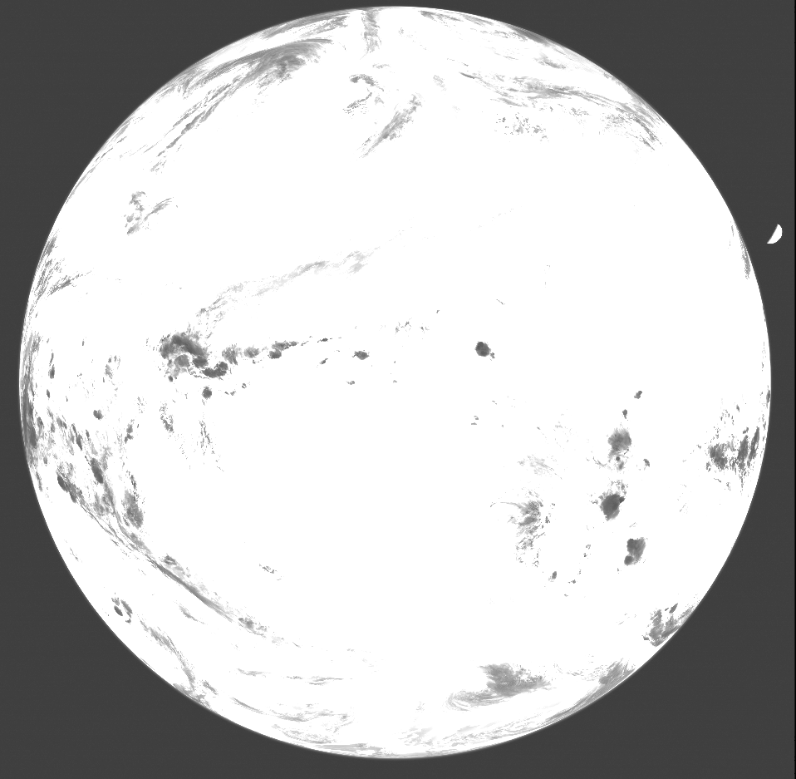
Moon observations from EUMETSAT operating satellites: MSGs
IR087 observation clipped between [min(Im), max(Im)/5]
Step 1 – Spot the Earth
Define a two-level image with 1 where the Level 1.0 pixel is above
Space Count_{IR087} + Std_dev Space Count_{IR087} (from the Trailer)
and 0 elsewhere. The two-level image has two patches at 1 (the Earth and the Moon) and one region at 0 (the deep-space). label_region.pro allows one to spot the patches at 1, the largest one is (for sure) the Earth.
Step 2 – Locate the off-Earth content of the image
From Step 1 one gets the Earth patch; what is out of this patch is considered the off-Earth content of the Level 1.0 data (the Moon is in this part of the image).
Step 3 – Spot the Moon
Use the off-Earth content of the Level 1.0 data to define a two-level image with 1 where the Level 1.0 pixel is above:
Space Count_{IR087} + 3 x Std_dev Space Count_{IR087} (from the Trailer) and 0 elsewhere. label_region.pro allows one to spot the patches at 1, the largest one is (for sure) the Moon, the other patches are residuals pixels.

Slide 7
Moon observations from EUMETSAT operating satellites: MSGs
Knowing the relative position of the channels on the focal plane one can use the information obtained in the IR087 to spot the Moon in the Solar Channels (VIS006, VIS008, NIR016 and HRVIS)

Slide 8
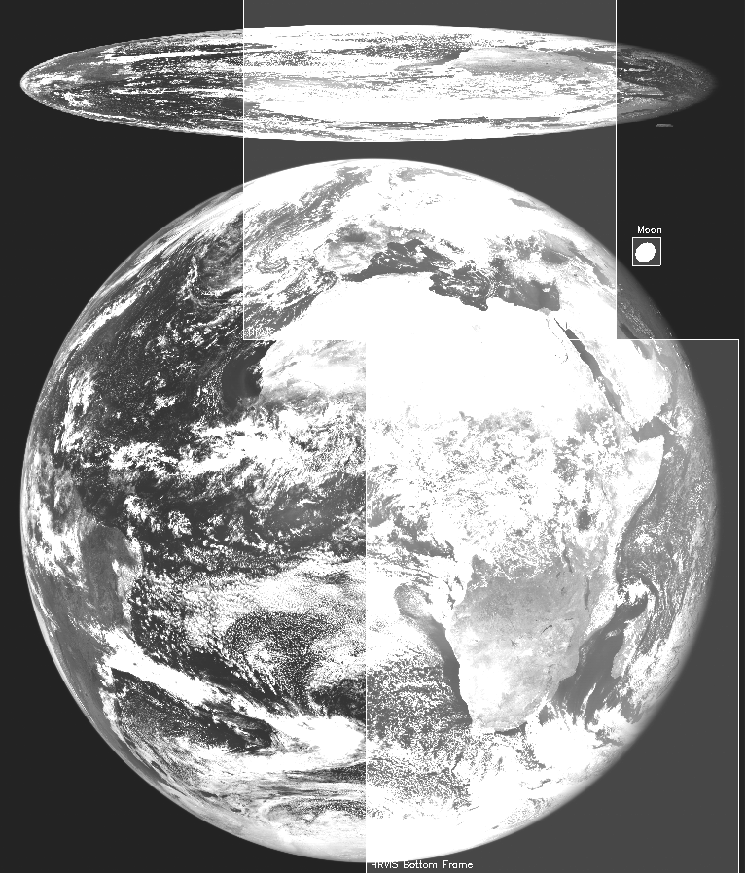
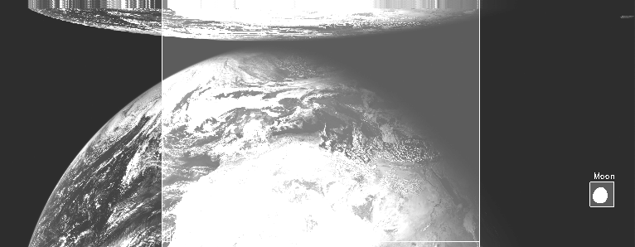
Moon observations from EUMETSAT operating satellites: MSGs
High-res observation and Moon detection
Low-res observation and Moon detection

Slide 9
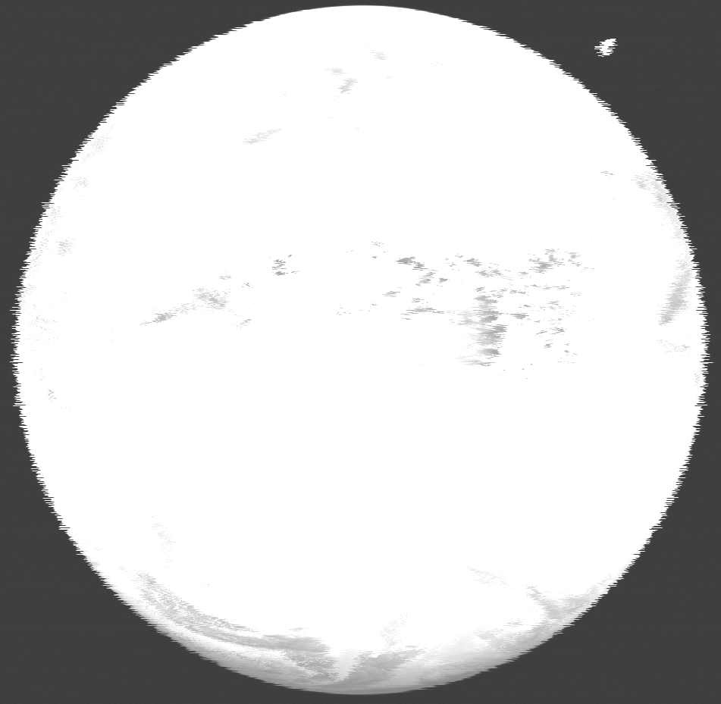
Moon observations from EUMETSAT operating satellites: MSGs
Complication due to acquisition anomalies:
strong jitter in Level 1.0 data
The shapes of both the Moon and the Earth are strongly affected by the anomaly, this can create problems in the identification and extraction!
IR087 observation clipped between [min(Im), max(Im)/5] affected
by the high jitter

Slide 10
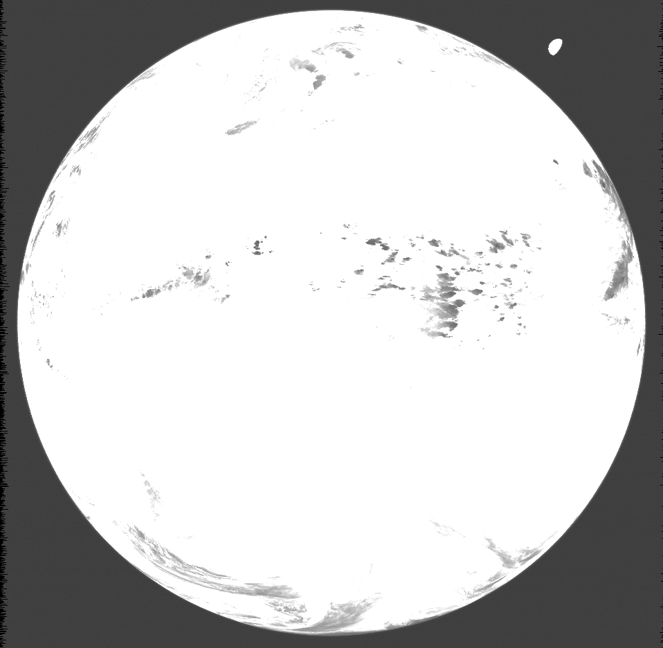
Moon observations from EUMETSAT operating satellites: MSGs
IR087 observation clipped between [min(Im), max(Im)/5] after the correction by using the jitter files provided by the image processing

Slide 11
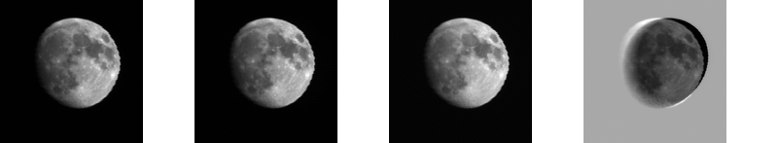
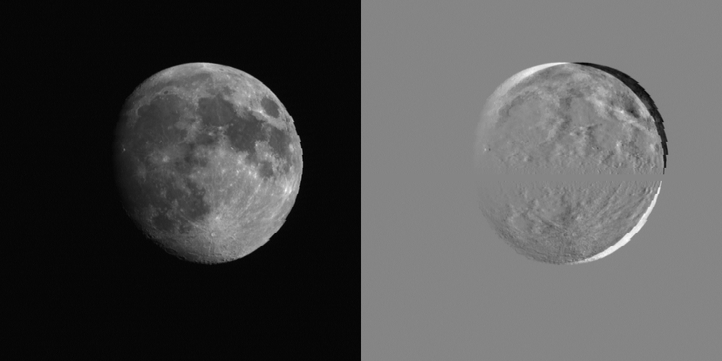
Moon observations from EUMETSAT operating satellites: MSGs
VIS006
VIS008
NIR016
HRVIS
Example of Level 1.0 DC (raw) imagettes from MSG1 VIS/NIR channels
(corrected for the relative motion satellite-Moon)

Slide 12
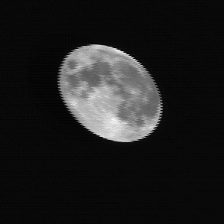
Moon observations from EUMETSAT operating satellites: MSGs
The same procedure has been applied successfully to Meteosat 7 data by using the IR channel as reference (imagette not corrected for the relative motion satellite-Moon).
VIS006
VIS008
NIR016
VIS
HRVIS
Example of Level 1.0 DC (raw) imagettes from MSG1 VIS/NIR channels
(corrected for the relative motion satellite-Moon)

Slide 13
Moon observations from EUMETSAT operating satellites
Satellite | Time span | Low-res | High-res | Phase-angle range [deg]
Meteosat 7 (MET7) | 1997-present | 360 useful 237 | - | -148 – 145
Meteosat 8 (MSG1) | 2002-present | 605 useful 386 | 80 useful 46 | -151 – 152
Meteosat 9 (MSG2) | 2005-present | 520 useful 331 | 91 useful 54 | -148 – 151
Meteosat 10 (MSG3) | 2012-present | 101 useful 58 | 14 useful 11 | -144 – 143

Slide 14
Moon observations from EUMETSAT operating satellites
Moon observations are available ONLY
in Level 1.0 data

Slide 15
Moon observations from EUMETSAT operating satellites: MSGs
Moon observations are available ONLY
in Level 1.0 data
Level 1.0 DC raw imagette

Slide 16
Moon observations from EUMETSAT operating satellites: MSGs
Moon observations are available ONLY
in Level 1.0 data
Level 1.0 DC raw imagette
Equalization and non linearity correction (LUT)
Level 1.5 DC
Process mimicking part of the image processing

Slide 17
Moon observations from EUMETSAT operating satellites: MSGs
Moon observations are available ONLY
in Level 1.0 data
Level 1.0 DC raw imagette
Equalization and non linearity correction (LUT)
Level 1.5 DC
Process mimicking part of the image processing
Level 1.5 Radiance imagette
Calibration equation (linear)

Slide 18
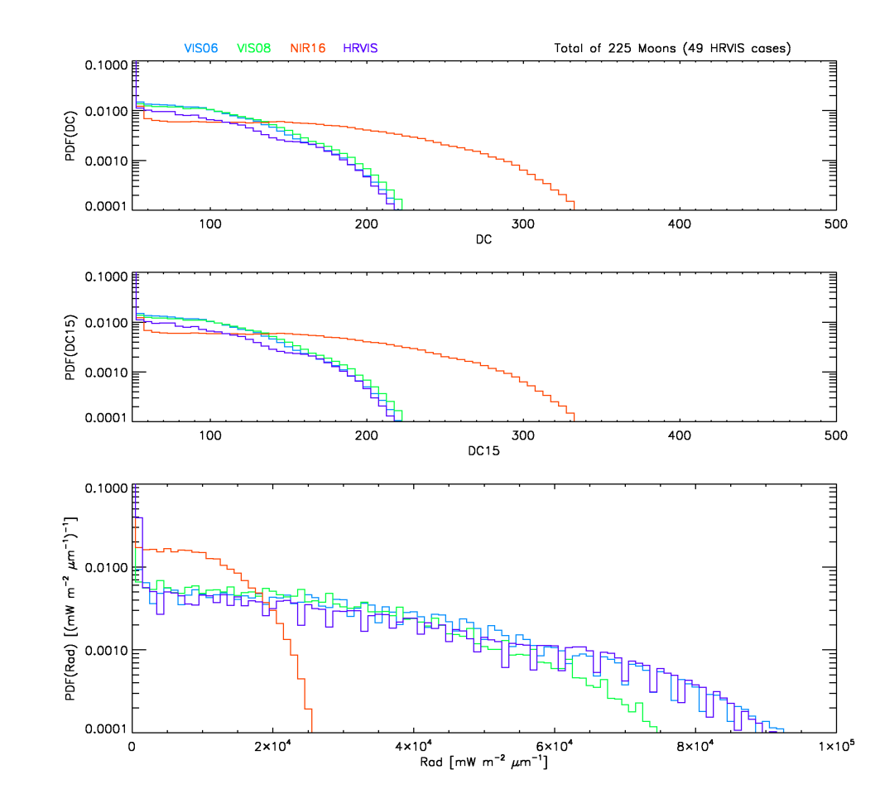
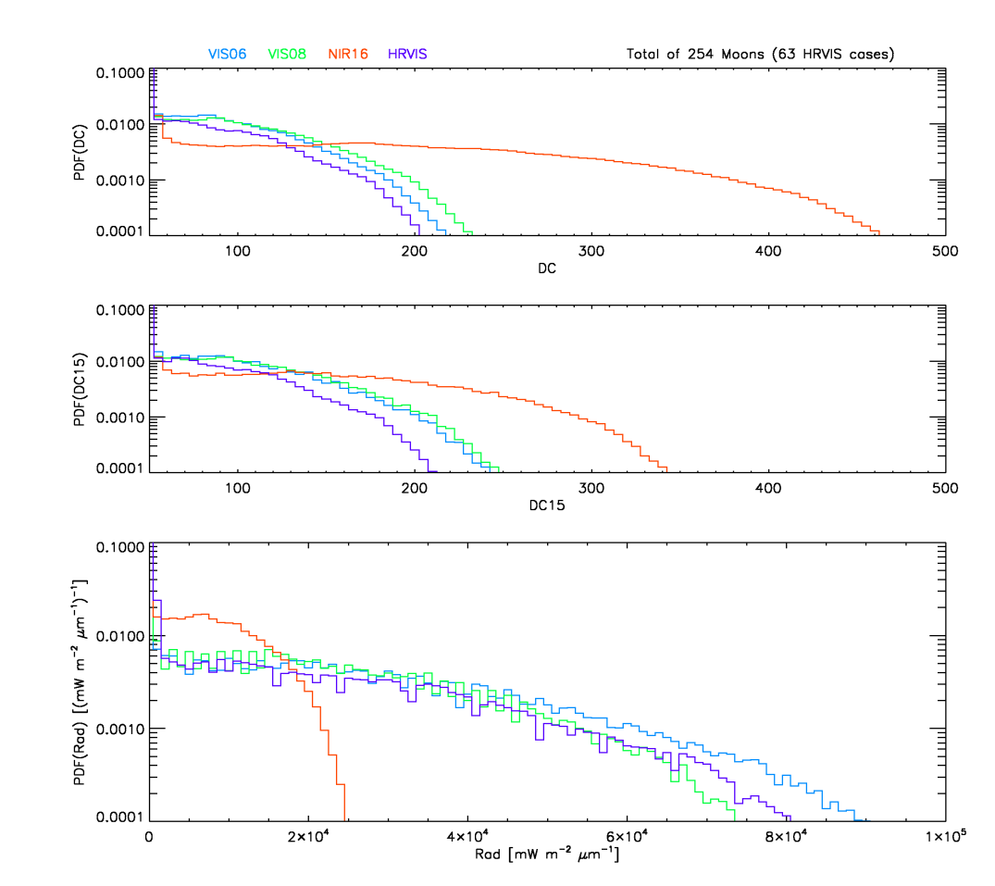
Moon observations from EUMETSAT operating satellites: MSGs
Moon observations are available ONLY
in Level 1.0 data
Statistics on the Moon observations from MSG1
Statistics on the Moon observations from MSG2
Level 1.0 DC raw imagette
Equalization and non linearity correction (LUT)
Level 1.5 DC
Process mimicking part of the image processing
Level 1.5 Radiance imagette
Calibration equation (linear)

Slide 19
Moon observations from EUMETSAT operating satellites: MSGs
Moon observations are available ONLY
in Level 1.0 data
Statistics on the Moon observations from MSG1
Statistics on the Moon observations from MSG2
Level 1.0 DC raw imagette
Equalization and non linearity correction (LUT)
Level 1.5 DC
Process mimicking part of the image processing
Level 1.5 Radiance imagette
Calibration equation (linear)

Slide 20
Moon observations from EUMETSAT operating satellites: MSGs
Moon observations are available ONLY
in Level 1.0 data
Statistics on the Moon observations from MSG1
Statistics on the Moon observations from MSG2
Level 1.0 DC raw imagette
Equalization and non linearity correction (LUT)
Level 1.5 DC
Currently for Meteosat 7 we use only Level 1.0 DC imagettes. No radiance imagettes are used.
Process mimicking part of the image processing
Level 1.5 Radiance imagette
Calibration equation (linear)

Slide 21
Moon observations from EUMETSAT operating satellites
Satellite | Time span | Low-res | High-res | Phase-angle range [deg] | Imagettes | Details
Meteosat 7 (MET7) | 1997-present | 360 useful 237 | - | -148 – 145 | Level 1.0 DC | Oversampling Factor at 1
Meteosat 8 (MSG1) | 2002-present | 605 useful 386 | 80 useful 46 | -151 – 152 | Level 1.0 DC and Level 1.5 Radiance | Oversampling Factor at 1
Meteosat 9 (MSG2) | 2005-present | 520 useful 331 | 91 useful 54 | -148 – 151
Meteosat 10 (MSG3) | 2012-present | 101 useful 58 | 14 useful 11 | -144 – 143

Slide 22
Calibration and monitoring of the VIS/NIR bands at EUMETSAT

Slide 23
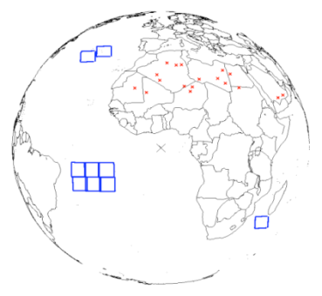
Vicarious calibration of EUMETSAT satellites
System in place for SEVIRI (Met-8, Met-9 and Met 10), but also for MVIRI (Met-2 - Met-7)
Vicarious calibration:
  Reference = RTM simulations of Top-Of-Atmosphere radiances
  Evaluated against well-calibrated polar-orbiting instruments (SeaWiFs, ATSR2, AATSR, VEGETATION, MERIS)
  Comparison with TOA measured signal
  2 target types used for comparison:
    Desert bright targets (18 targets)
    Dark sea targets (9 targets) (checking purposes)

Slide 24
Vicarious calibration of EUMETSAT satellites
System in place for SEVIRI (Met-8, Met-9 and Met 10), but also for MVIRI (Met-2 - Met-7)
Vicarious calibration:
  Reference = RTM simulations of Top-Of-Atmosphere radiances
  Evaluated against well-calibrated polar-orbiting instruments (SeaWiFs, ATSR2, AATSR, VEGETATION, MERIS)
  Comparison with TOA measured signal
  2 target types used for comparison:
    Desert bright targets (18 targets)
    Dark sea targets (9 targets) (checking purposes)
Requirements on the radiance measurements the solar channels:
  10 % for RT/NRT, and
  2 % (per year) for long-term stability.

Slide 25
Lunar calibration at EUMETSAT (using GIRO): observables
Refer to the imagette processing in the presentation of the GIRO implementation

Slide 26
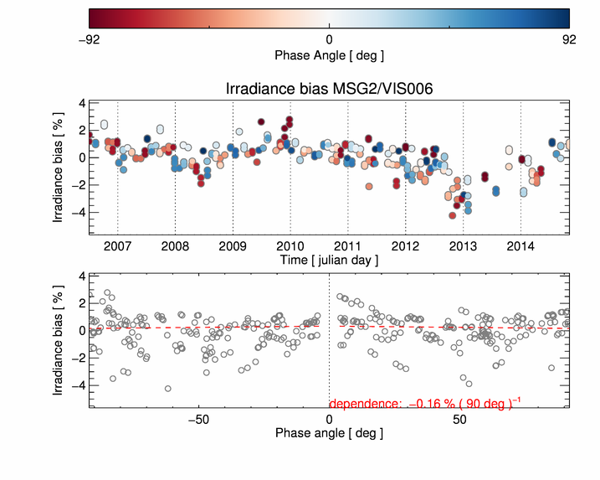
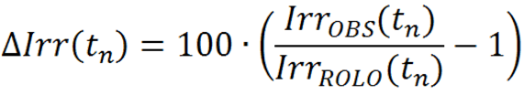
Lunar calibration at EUMETSAT (using GIRO)
MSG2/VIS006 time variation of the irradiance bias:
Calibration coefficients updated in time: monitoring of the instrument + calibration combined (no trend clearly visible)

Slide 27
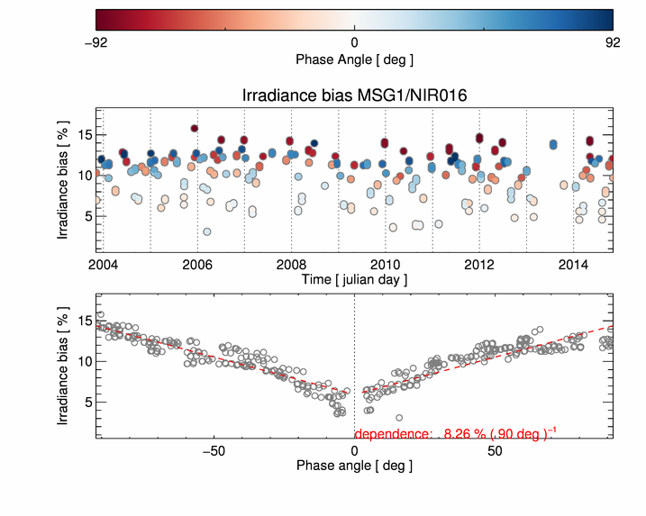
Lunar calibration at EUMETSAT (using GIRO)
MSG1/NIR016 time variation of the irradiance bias:
Phase dependence of the irradiance bias

Slide 28
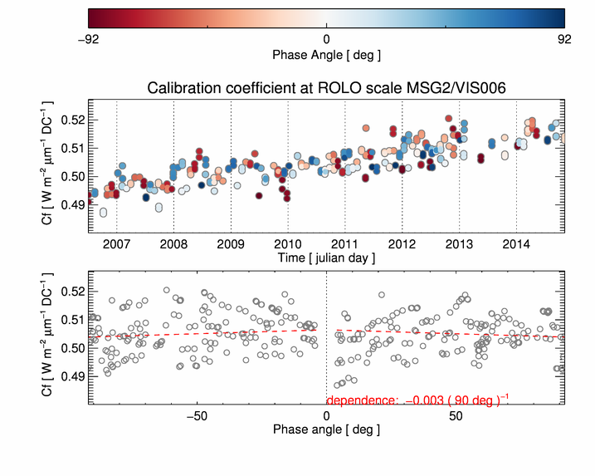

Lunar calibration at EUMETSAT (using GIRO)
MSG2/VIS006 time variation of the irradiance bias:
Calibration coefficient at the ROLO scale: monitoring of the detector
THE TREND IS CLEARLY VISIBLE

Slide 29
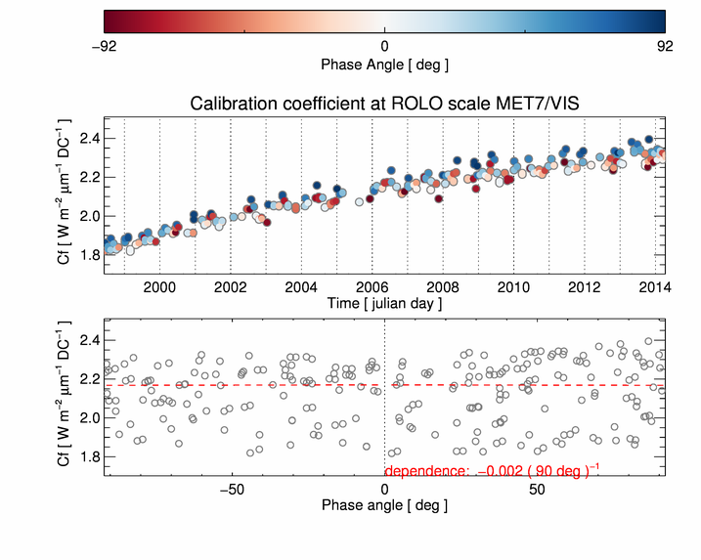
Lunar calibration at EUMETSAT (using GIRO)
Met7/VIS time variation of the irradiance bias:
Calibration coefficient at the ROLO scale: monitoring of the detector
QUADRATIC TREND IS CLEARLY VISIBLE

Slide 30
Conclusions
EUMETSAT Moon observation dataset:
Meteosat 7, Meteosat 8, Meteosat9, and Meteosat 10.
Unprecedented dataset for the completeness of the observational conditions: unique collection of observations covering a wide range of both phase and libration angles.
We keep extracting Moon observations on a monthly basis from all the EUMETSAT operational satellites; soon also MSG4 will be launched, and its observations will complement the existing archive.
GIRO calibration:
The GIRO calibration tool has been successfully tested on the Moon observation dataset available at EUMETSAT and it will be used in the future to monitor the satellite performances in an operational environment.

