Slide 1
JMA lunar calibration report [MTSAT-2 and GMS-5]
Masaya Takahashi¹, Bartolomeo Viticchie², and Sebastien Wagner²
¹Japan Meteorological Agency, ²EUMETSAT
Acknowledgement: Tom Stone (USGS)

Slide 2
Contents
Introduction
MTSAT-2/Imager lunar calibration
GMS-5/VISSR lunar calibration
Summary and future plans

Slide 3
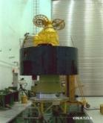
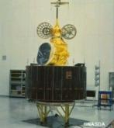
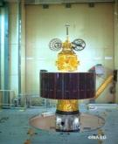
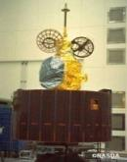
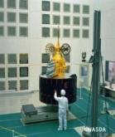
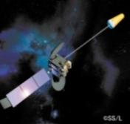
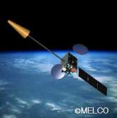
JMA geostationary (GEO) satellites
GMS (Geostationary Meteorological Satellite)
GMS
GMS-2
GMS-3
GMS-4
GMS-5
(GOES-9)
(Himawari)
(Himawari-2)
(Himawari-3)
(Himawari-4)
(Himawari-5)
Back-up operation of GMS-5 w/ GOES-9 by NOAA/NESDIS:
2003/05/22-2005/06/28
Satellite | Operation period
GMS | 1978 – 1981
GMS-2 | 1981 – 1984
GMS-3 | 1984 – 1989
GMS-4 | 1989 – 1995
GMS-5 | 1995 – 2003
GOES-9 | 2003 – 2005
MTSAT-1R | 2005 – 2010
MTSAT-2 | 2010 – 2015
Himawari-8 | 2015 – 2022
Himawari-9 | 2022 – 2029
ⒸNASDA
ⒸNASDA
ⒸNASDA
ⒸNASDA
ⒸNASDA
Jul 1977
Aug 1981
Aug 1984
Sep 1989
Mar 1995
MTSAT (Multi-functional Transport SATellite )
MTSAT-1R
MTSAT-2
(Himawari-6)
(Himawari-7)
Himawari
Himawari-8
Himawari-9
launched on
7 Oct. 2014!
ⒸSS/L
ⒸMELCO
2014
2016
Feb 2005
Feb 2006

Slide 4
Lunar observations of JMA GEO satellites
Satellite | SSP Lon | H. Reso. of VIS/NIR at SSP | # of bands | Operation | Period used in this study | # of Obs. (for ROLO/total) | Phage angle
Himawari-8 | ~140 E | 0.5/1/2km | VIS:3 NIR:3 IR:10 | 2015 – 2022 (planned) | N/A at present
MTSAT-2 | 145 E | 1km | VIS:1 IR:4 | 2010 – 2015 | 2010 – 2013 | 62/98 | [-138,147]
MTSAT-1R | 140 E | 1km | VIS:1 IR:4 | 2005-2014 (Incl. back-up operation) | N/A due to its scanning pattern
GMS-5 | 140 E | 1.25km | VIS:1 IR:3 | 1995 – 2003 | 1995 – 2003 | 48/50 | [-94,96]
# of lunar observations for MTSAT-2 and GMS-5 will increase
Lunar observations for past GMS satellites will be extracted in future

Slide 5
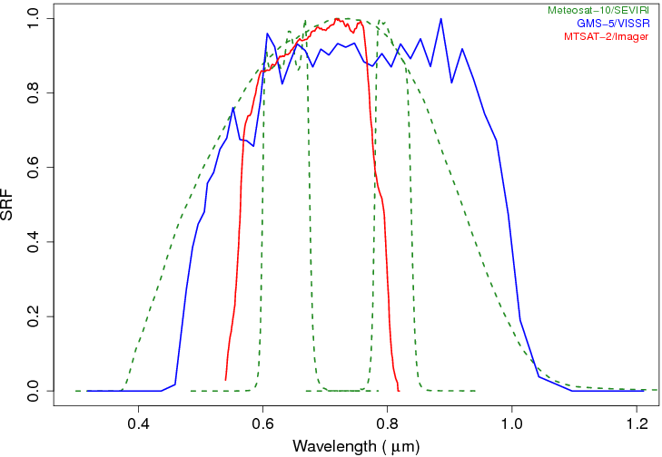
Spectral Response Functions
MTSAT-2/Imager
GMS-5/VISSR
MSG-3/SEVIRI

Slide 6
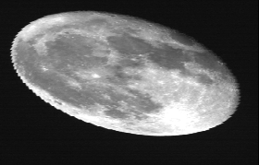
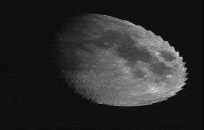
MTSAT-2/Imager lunar calibration: general
3-axis stabilized GEO satellite
Satellite position: from telemetry
Located at ~ 145 E
Instrument: VIS/IR optical imager
Similar to GOES/Imager
1 visible channel (0.68µm)
1 km horizontal resolution at SSP
8 detectors for N-S direction
10-bit (1024 digital counts)
Scanning: E-W direction
Hourly Full-disk obs. + NH/SH obs.
The Moon acquisition
NO maneuver, unscheduled
2-5 lunar observations / month
Visible channel calibration
Constant pre-launch values
Post launch cal. (not operationally used)
Vicarious calibration using RTM
Inter-calibration using deep convective clouds (DCCs)
2010-09-24T02:30Z
2012-02-09T04:15Z
2012-10-24T22:00Z

Slide 7
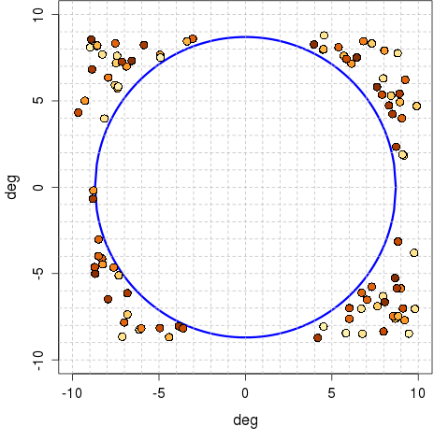
MTSAT-2/Imager lunar calibration: dataset
Absolute phase angle [deg]
0 30 60 90 120 150 180
Manual extraction of lunar observations
Predict the Moon position using JPL DE405
IR (10.8µm) image is used to find the Moon
62 of total 98 observations for the ROLO model
(Jul. 2010-Dec.2013)
Lunar observation: L1A equivalent data
Converted to L1B equivalent DC/radiance (i.e., detector equalization using pre-launch values)
Oversampling: 1.75 in E-W direction
( = IFOV:28µrad / sampling width: 16µrad )
Dark signal correction: N/A
Computation of observables
Same method used in the GIRO imagette processing
Full moon
Low illumination
Earth disk
Positions of the Moon wrt. the centre of the Earth for MTSAT-2/Imager (Jul.2010 – Dec.2013)

Slide 8
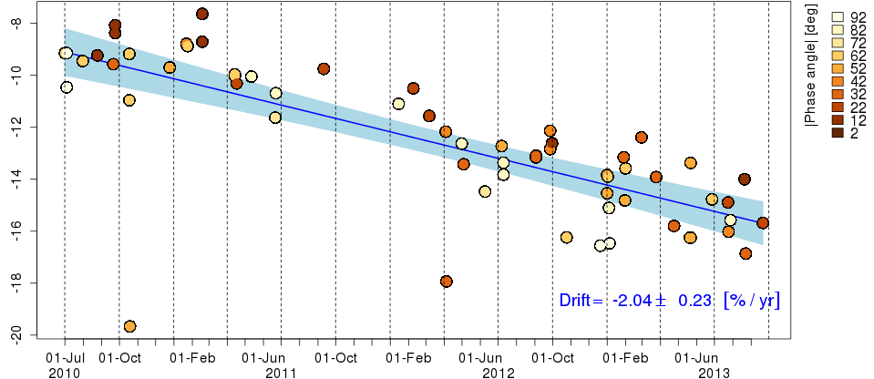
ΔIrr (Calibration + Instrument drift)
Difference between the observed Irradiance and the ROLO Irradiance (in %)
Visible calibration coefficients for MTSAT-2/Imager
Constant pre-launch values -> ΔIrr shows only instrument drift
Time series of ΔIrr for MTSAT-2/Imager
Hatch: 95% confidence interval of a linear regression line
Δirr [%]
Outliers

Slide 9
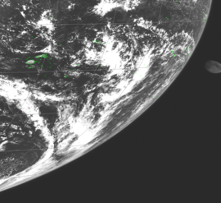
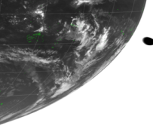
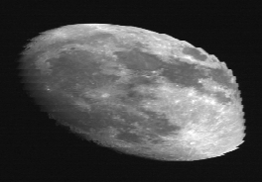
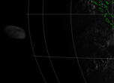
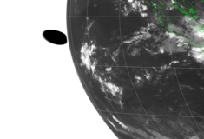
Outliers caused by incorrect extraction of lunar observations
Case #1
Case #2
Case #1: Careless extraction
Incomplete lunar disk image
Root cause of significant ΔIrr
IR1
(10.8 µm)
VIS
Case #2: Reasonable extraction at a glance
East portion of the Moon: behind the Earth
Difficult to find out the Earth edge from VIS image during the night time
IR1
(10.8 µm)
VIS

Slide 10
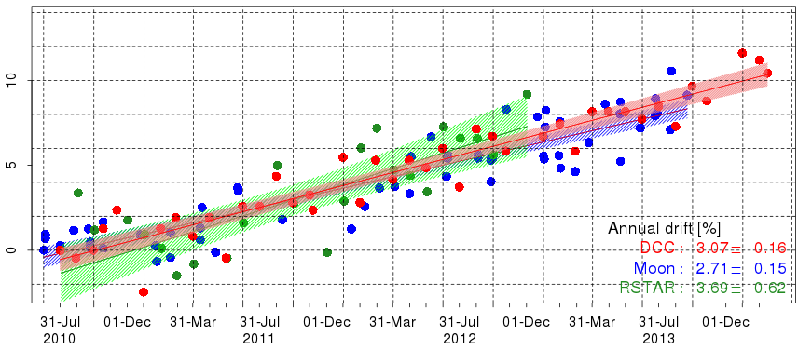
Calibration slope vs. the ROLO (on the relative scale) - A way to monitor the instrument drift and compare with other calibration results
F_{PIX} : Oversampling factor
Ω_{PIX} : Pixel solid angle [sr⁻¹]
Dc_{i} : Digital count of the Moon pixel
Off_{DC} : Averaged deep space DC
N_{PIX} : Number of the Moon pixels
[W m⁻² µm⁻¹ DC⁻¹]
Lunar calibration
Good agreements with RTM and DCC, the smallest uncertainty of a regression line
Time series of MTSAT-2/Imager calibration slope difference (each method is rescaled at the first calibration result)
Hatch: 95% confidence interval of a linear regression line
Δslope [%]
Annual drift [%/yr]
DCC: 3.07 ± 0.16
Moon: 2.71 ± 0.15
RTM: 3.69 ± 0.62

Slide 11
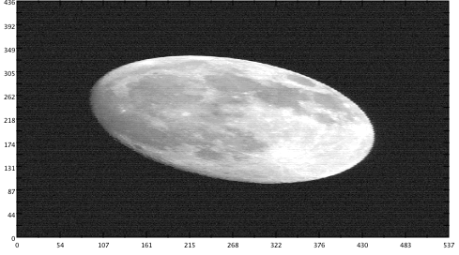
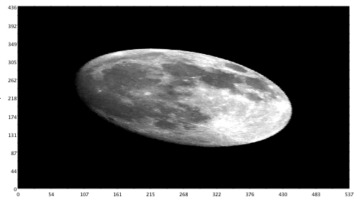
GMS-5/VISSR lunar calibration: general
Spin stabilized GEO satellite
Satellite position: from telemetry
Located at ~ 140 E
Instrument: VIS/IR optical imager
1 broad visible channel (similar to SEVIRI HRV)
1.25 km horizontal resolution at SSP
4 detectors for N-S direction
6-bit (64 digital counts)
Scanning: E-W direction
Hourly Full-disk observation
The Moon acquisition
NO maneuver, unscheduled
0-3 lunar observations / month
Visible channel calibration
Constant pre-launch values
Post launch cal. (not operationally used)
Vicarious calibration using RTM
Inter-calibration using deep convective clouds (DCCs)
Digital count Radiance
GMS-5/VISSR VIS 1996-05-02T00:53:40Z

Slide 12
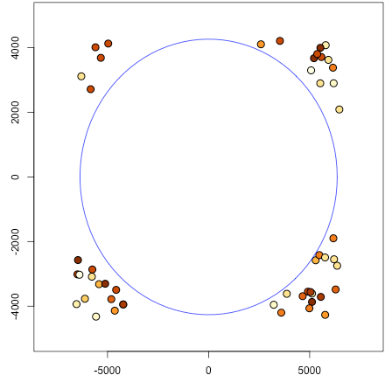
GMS-5/VISSR lunar calibration: dataset
Absolute phase angle [deg]
2 18 34 50 66 82 98
Lunar observation: L1A equivalent data
Conversion of DC to radiance/reflectivity
Based on LUT, no calibration equation
Equalized DC does not exist
Radiance: derived using calibration coefficients for each detector
Oversampling: 1.475 for E-W direction
Dark signal correction: N/A
48 of total 50 useful lunar observations for the ROLO model (Jul. 1995-Feb. 2003)
Computation of observables
Radiance for the Moon masking
Full moon
Low illumination
Pixel number
Positions of the Moon wrt. the centre of the Earth for GMS-5/VISSR
(Jul. 1995-Feb.2003)

Slide 13
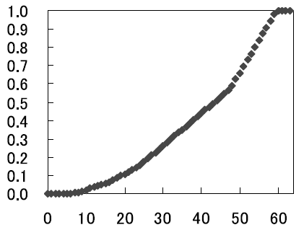
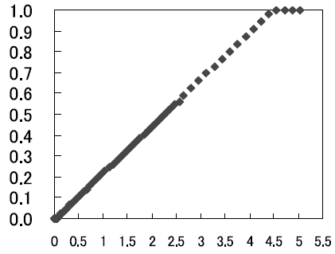
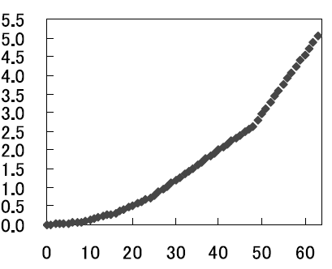
Digital counts handling in the GMS-5/VISSR lunar calibration
Sanity check file
Observed Irradiance: consistent, but not identical due to the Moon mask method
Radiance for “User”, DC for “Imgt Processing”
DC cannot be used because detectors are not equalized at count level
Observed DC, DC Offset and Total number of pixels: NO meaning in GMS-5/VISSR
GMS-5/VISSR VIS channel detector#2 signal-DC-reflectivity relationships
(a) (b) (c)
Reflectivity
Reflectivity
Detector signal [V]
Digital count Detector signal [V] Digital count
(Figures: Hashimoto et al. 2008)

Slide 14
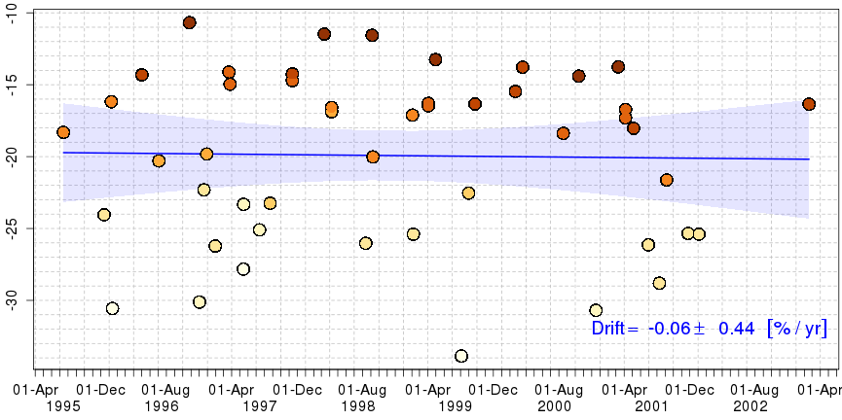
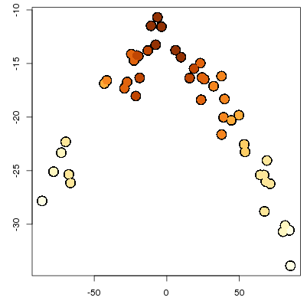
Phase angle dependence in ΔIrr
Difference between the observed Irradiance and the ROLO Irradiance (in %)
Clear phase angle dependence in ΔIrr may be caused by:
Incorrect computation of Irr_{OBS}
Stray light effect, scan mirror angle dependence
ROLO model
…
Time series of ΔIrr for GMS-5/VISSR
Δirr [%]
Δirr [%]
The Moon phase angle [deg]

Slide 15
Summary and future plans
Lunar calibration using the GIRO application
MTSAT-2/Imager
62 lunar observations (Jul. 2010 – Dec. 2013)
Calibration trend (annual drift) : consistent with other calibration method in terms of the uncertainty
GMS-5/VISSR
48 lunar observations (Jul. 1995 – Feb. 2003)
Need for the further investigation (phase angle dependence, detector equalization, usage of detector signals instead of digital counts, etc.)
Future plans
Application of GIRO apps. to Himawari-8/AHI 6 VIS/NIR bands
Combination of multiple calibration methods (DCC, desert, …)
Will be discussed/developed within the GSCIS framework

Slide 16
Thank you for your attention

Slide 17
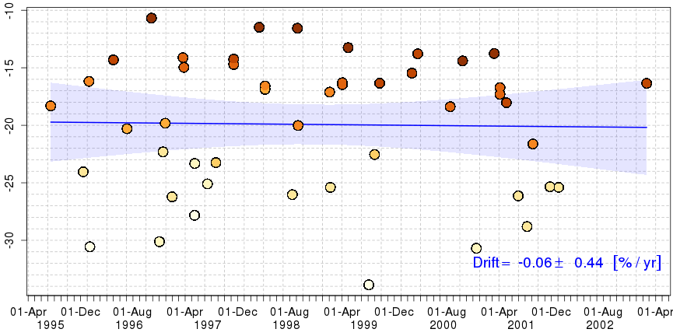
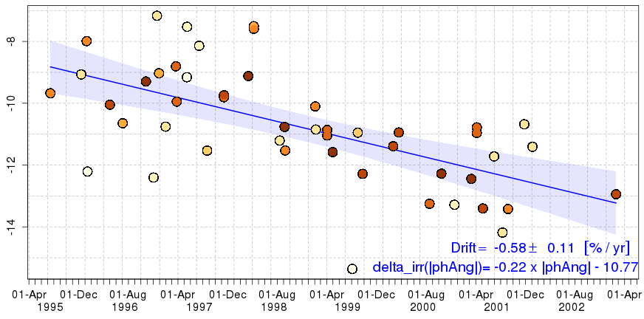
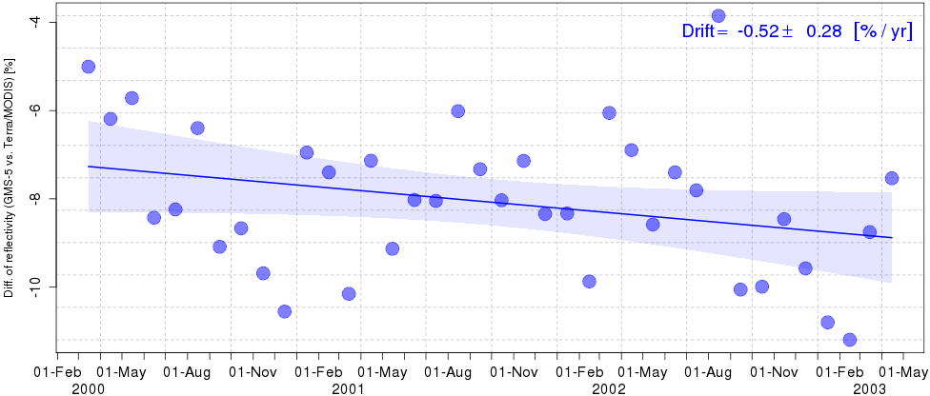
Correction of phase angle dependence
w/o correction
GIRO (w/ phase angle correction)
ΔIrr_{CORR} [%]
g : the Moon phase angle [deg]
ΔIrr_{CORR} : ΔIrr w/ phase angle correction
Drift: -0.58±0.11 [%/year]
Δirr [%]
Vicarious calibration using RTM and Terra/MODIS
Drift: -0.52±0.28 [%/year]
The Moon phase angle [deg]
Good agreement in annual drift
Uncertainty is still large

