Slide 1
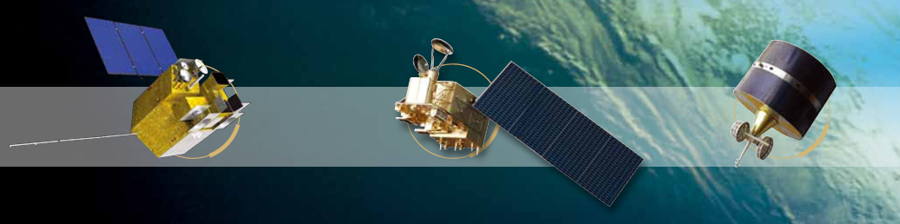


FY-3C/MERSI Lunar Data
Wu Ronghua
CMA
National Satellite Meteorological Centre

Slide 2
  content
  - General description of the sensor (spectral bands, orbit, resolution, etc.)
  - Description of the Moon acquisition (maneuver)
  - Example of an image: how does the Moon look like?
  - Dark signal correction
  - Absolute calibration (calibration methods)
  - Integration step
  - Oversampling consideration
  - Satellite position
  - Operation of the GIRO: status and calibration results
  - Feedback for discussions

Slide 3
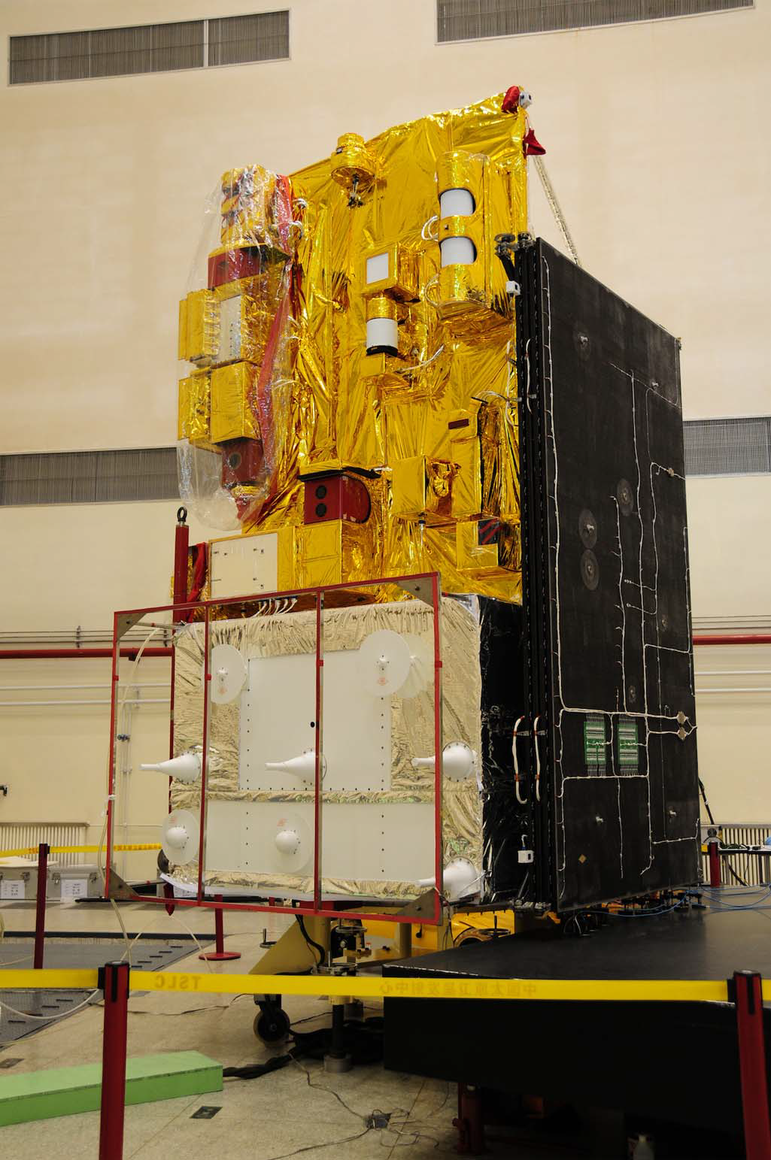
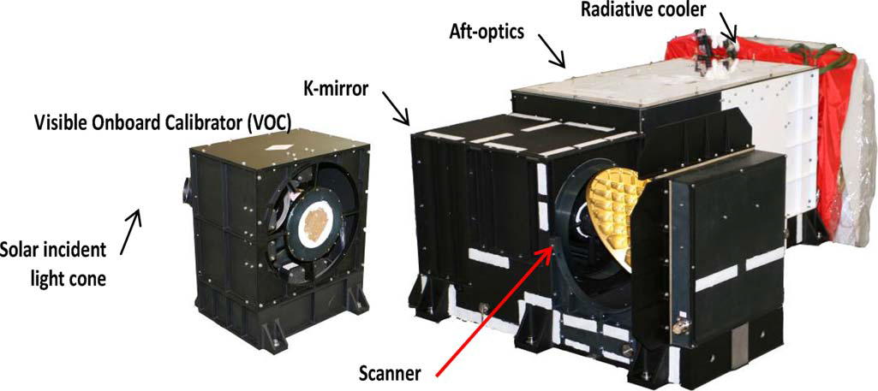
General description of MERSI
Real instrument photograph of two MERSI modules. (1) Left is the VOC seeing from the front.
(2) Right is the instrument main optical–mechanical
component.

Slide 4
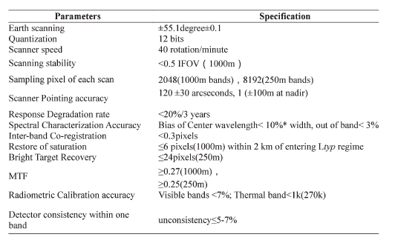
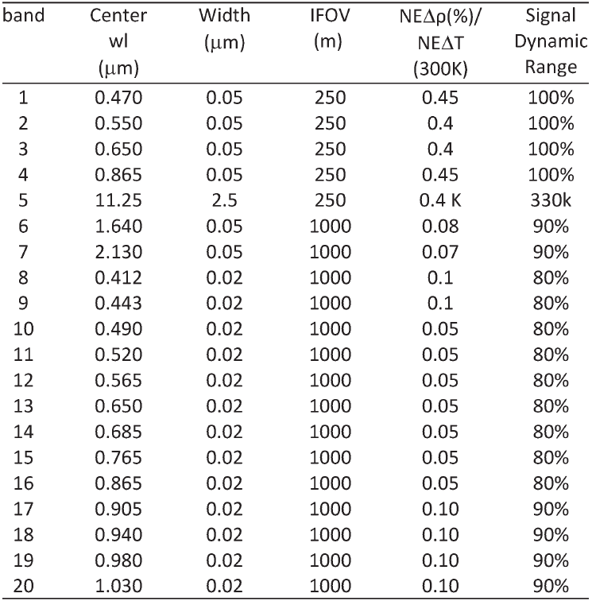
General description of MERSI

Slide 5
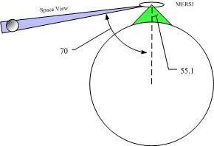
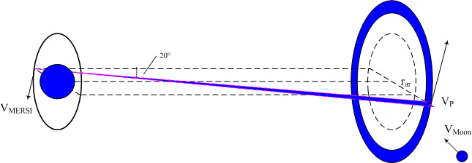
Description of the Moon acquisition
SV is on the right side along track and 70゜ to nadir
24 samples(@1000m)
96samples(@250m)
SV scans construct a circle

Slide 6
Example of an image
the geometry relationship of the sun-moon-satellite is very similar
phase angle varies not too much around 50゜

Slide 7
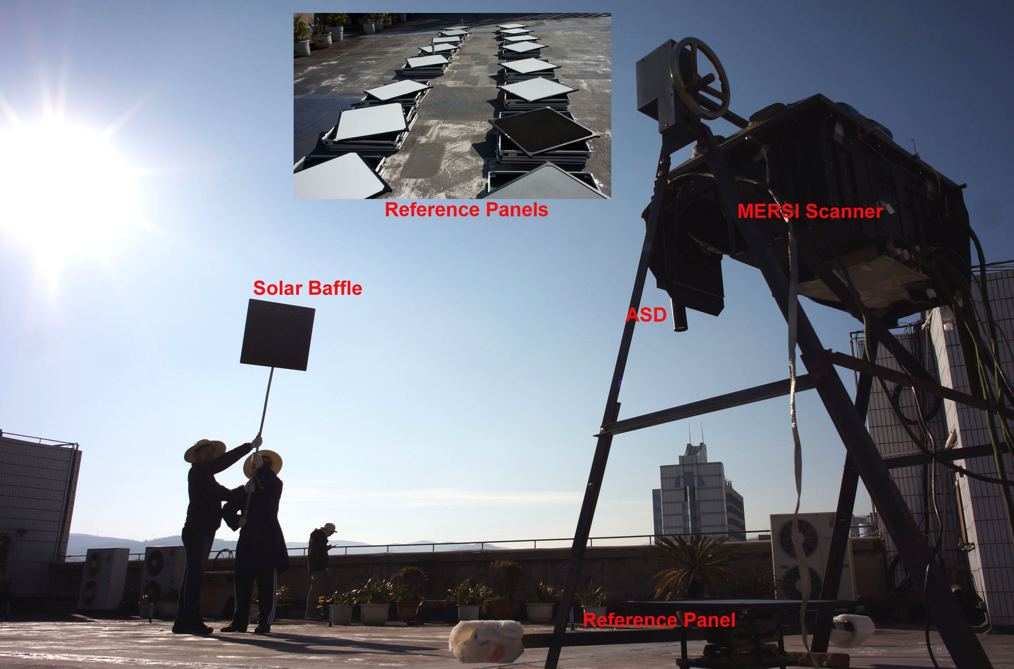
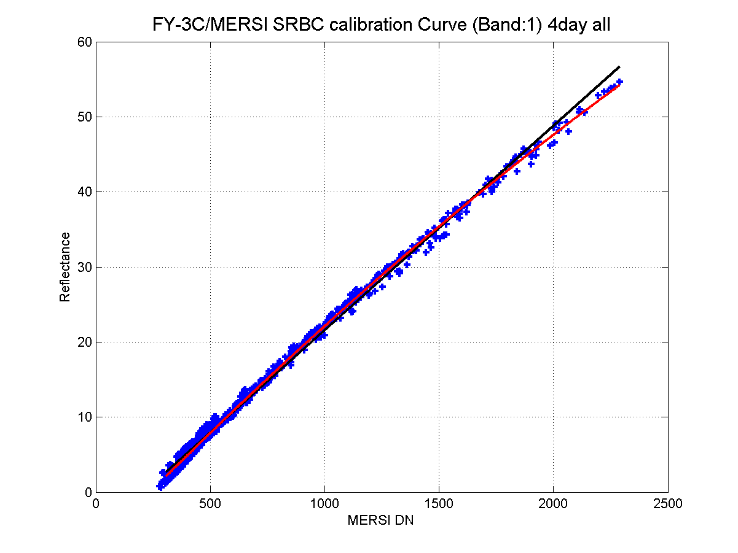
Absolute calibration
The photo of the pre-launch calibration for FY-3C/MERSI at Dali, on March, 2013

Slide 8
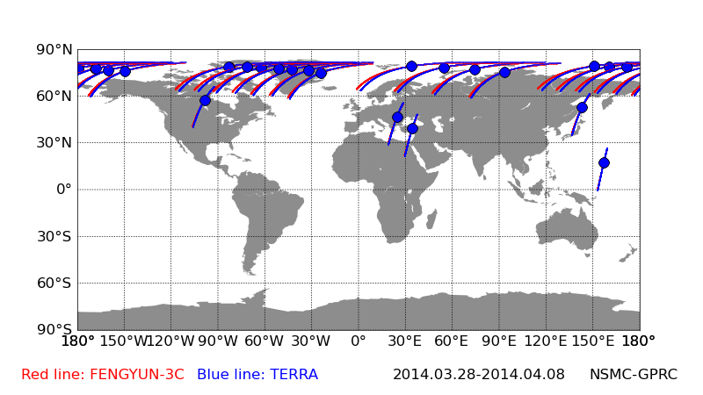
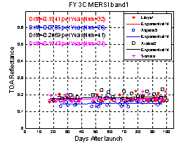
Absolute calibration
Multi-source calibration data to regress coefficient

Slide 9
Integration step
Extract reference detector data from each SV scan to rebuild moon image
Make moon mask using mean of dark digital number (DN) as the threshold
Calculate radiance of each moon pixel using calibration formula and coefficients.
Calculate the irradiance and integrate all of moon pixels.

Slide 10
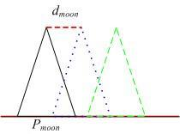
Oversampling consideration
pixel length on the moon ground is about 460km
distance between satellite footprint about 180km

Slide 11
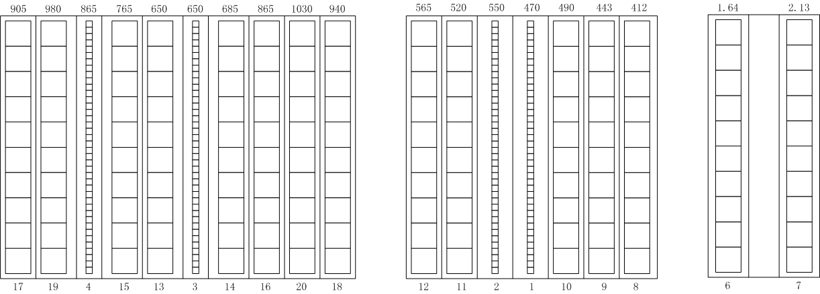



Moon Images
not all bands images contain the whole lunar disk
band 1\2\3\4\6\7 are collected

Slide 12
Moon images info
Phase angle range [43.18 57.08]
Moon pixel number varies .
Date | Absolutely Phase angle | Selenographic longitude (sun) | Selenographic longitude (observer) | Selenographic latitude (observer)
2013/10/23 | 48.21 | -46.43 | 1.64 | 3.92
2013/11/21 | 45.71 | -46.84 | -1.35 | 6.05
2013/12/21 | 43.18 | -46.88 | -3.92 | 6.72
2014/1/20 | 44.42 | -50.18 | -5.84 | 5.59
2014/6/17 | 57.08 | -54.6 | 2.47 | -4.94
2014/7/16 | 49.15 | -45.34 | 3.81 | -3.96
2014/8/14 | 47.39 | -42 | 5.4 | -1.56
2014/9/12 | 48.94 | -42.66 | 56.22 | 1.85
2014/10/12 | 49.58 | -43.74 | 5.68 | 4.73

Slide 13
Operation of the GIRO
Irradiance (MERSI)>(ROLO)
Ratio between MRESI and ROLO (band 3 4) (band1 2 6 7)
Ratio is not stable
All bands vary in a same pattern
Degradation from 2013.10;
Enhance in two separate periods

Slide 14
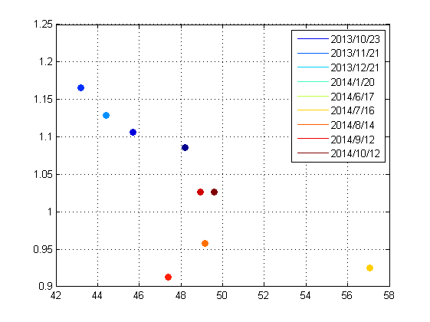
Operation of the GIRO
Normalized by the first data(2013.10)
All bands change in a same way
It seams some phase angle dependency
Wild value (2014.8)

Slide 15
Feedback for discussions
How to deal with those images containing part of moon?
Which factors should be considered when deciding to use multiple scans image or multiple detectors image?
When the oversample factor smaller than 1, is it suitable to use multiple scans image method?

Slide 16
Thank you

