Slide 1
Planning GSICS Annual Meeting 2023
Larry Flynn & Manik Bali
Nov 17, 2022

Slide 2
Disclaimer
"The contents of this presentation are those of the authors and do not necessarily reflect any position of the US Government or the National Oceanic and Atmospheric Administration."

Slide 3
Outline
Introduction
Accommodation and Lunch
Venue
NCWCP rooms
ESSIC rooms
Visa Support
Meeting weblinks and agenda

Slide 4
Hotels/Lunch available within 2 miles of NCWCP
Hotel Accommodation:
Can be booked directly online.
Visa Support
Let us know if you need supporting letters for obtaining visa

Slide 5
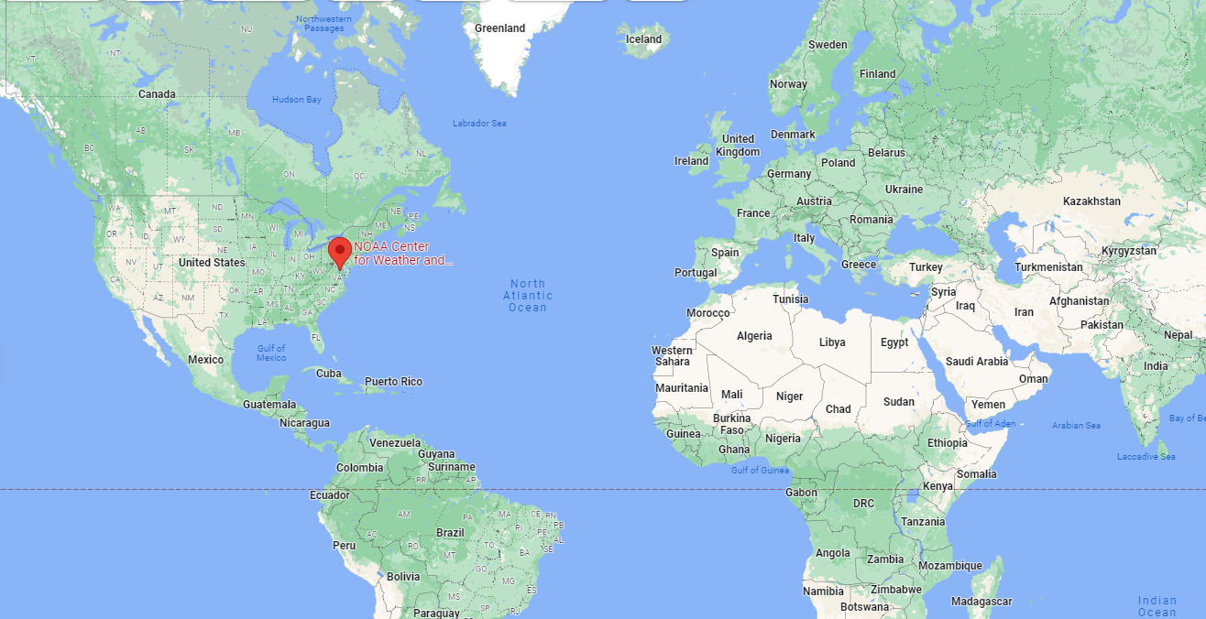
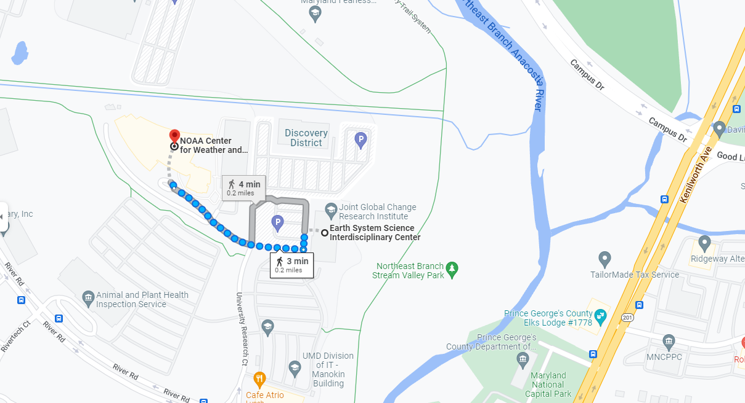
Venue:
GSICS Annual Meeting 2023 would be held in College Park, MD USA
Address: 5830 University Research Ct, College Park, MD 20740 (NCWCP )
5825 University Research Ct suite 4001, College Park, MD 20740 (ESSIC)
Meeting would be held partly in ESSIC and partly in NCWCP located
Within 4 mins of each other by walk

Slide 6
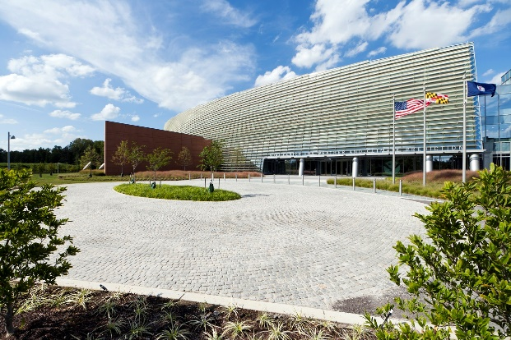
Conference rooms
NCWCP Conference rooms
ESSIC Conference rooms
Seating Capacity 40+
Both have the facility for remote attendance.
NCWCP remote is via NOAA Webex
ESSIC we have zoom as well.

Slide 7
Support
Do you need help hotel booking
Do you need for Visa ( supporting letters? )
Any other

Slide 8
Meeting weblinks and conference rooms
Web links for the meeting would be provided after the agenda has been finalized
To get the latest status of agenda and actions visit
Agenda Sheet
Actions Sheet
Details about conference rooms would be provide in due course

Slide 9
Thank you

