Slide 1
GSICS Research Working Group Ultraviolet Subgroup 6 February 2014
L. Flynn, NOAA/NESDIS

Slide 2
Agenda
Brief self-introduction of participants
Presentations on goals and possible products
Plan for UV subgroup session at annual GRWG in Darmstadt on March 27.
https://gsics.nesdis.noaa.gov/wiki/Development/20140324
Identification of nominees for chair
Identification of nominees for vice-chair
Selection of the chair and vice-chair from the nominees

Slide 3
Self-introduction for L. Flynn of NOAA NESDIS
I primarily work with measurements and products from the SBUV(/2), OMPS, OMI, and GOME-2 instruments.
I am interested in measurement and product validation and comparisons. I lead the OMPS product validation team and NESDIS Atmospheric Chemistry Product Oversight Panel.

Slide 4
Possible Goals/Topics for the UV Subgroup
1. Exchanges and traceability of standards
NIST and SIRCUS
Integrating Spheres, diffusers, lamps, lasers, etc.
2. Establish a library of solar measurements
Reference high resolution solar (SOLSTICE, SIM, Kitt Peak, etc.)
Mg II Index time series, Scale factors at resolution (new OMI)
3. Establish a library of instrument data bases
Bandpasses, calibration constants, wavelength scales
Day 1 solar, time series with error bars
Mg II Indices and scale factors
FOVs, Polarization sensitivity,
Reference papers, ATBDs, validation, Shift & Squeeze,
4. Establish a library Absorption data bases
O3 in the UV with wavelength and temperature dependence
at instrument resolution – from DOAS?
UV compared to Visible and IR
other species -- SO2, NO2, etc.
5. Standard climatologies; vicarious calibration & residual studies
Ozone and temperature profiles, covariances
Neural net, with tropopause information
Averaging kernels or efficiency factors, measurement contribution functions, and Jacobians
6. Analysis of on-board systems
Diffusers, stable orbits
White lights, spectral lamps, LEDs
Moon views
Stray light, linearity, gains, offsets, mirrors, polarisation, λ-scale, bandpass
7. Considerations for comparisons
Complications from diurnal variations, SZA, SVA, RAA
Zonal means
Simultaneous nadir overpass (Rad/Irrad or products)
Formation flying / Chasing orbits
No-local-time differences
Ice, desert and open ocean targets
Pacific Box
LEO to GEO to L1
8. Internal consistency techniques
Ascending/descending -- Langley methods
Pair justification
DOAS (and EOF analysis) (Closure polynomials)
Stray light correlation
Wavelength scale, shift and squeeze, etc.
Measurement Residuals, reflectivity range/distribution
9. Forward model and measurements
Rayleigh
Absorption
Spherical geometry
Inelastic scattering (Ring Effect), Stray light, solar activity
Aerosols
Polarization
TOMRAD, VLIDORT, SCIATrans, CRTM, etc.
V8 SBUV/2 and A Priori as transfer for Viewing conditions…
10. Reflectivity
Surface (database and snow/ice forecasts), Variations in surface reflectivity with season, sza and sva.
Surface pressure
Clouds (Cloud top pressure)
Cloud-optical-centroids (Ring Effect, 02-02, O2 A band)
11. Aerosols
Climatology/Type, height
Wavelength or polarization dependence (Aerosol Indices)
12. Nadir Instruments LEO
TropOMI, GOME(-2), OMPS, TOU/SBUS, OMS,
SCIAMACHY, OMI, TOMS, SBUV(/2)
12. Nadir Instruments GEO or L1
TEMPO, GEMS, UVN and EPIC
13. Limb instruments
SAGE III, ACE/MAESTRO, OSIRIS, MLS,
GOMOS, SCIAMACHY, OMPS-LP
14. Ground-based
WOUDC, Dobson, Brewer, Lidar, MW and Ozonesondes
Notes:
http://www.nesdis.noaa.gov/news_archives/dscovr.html
http://science.nasa.gov/media/medialibrary/2012/03/01/Nguyen-DSCOVR-Mission-Briefing-HPS-v01b.pdf

Slide 5
Three UV Projects for GSICS: Solar Spectra, Measurement Residuals & Effective Reflectivity / Aerosol Indices

Slide 6
Solar Measurement Project
High resolution solar reference spectra
Reference high resolution solar Spectra (SOLSTICE, SIM, Kitt Peak, etc. – Everybody has a favorite. How do they compare?)
Mg II Index time series, Scale factors at high resolution
Instrument data bases
Bandpasses, wavelength scales (Shift & Squeeze codes)
Day 1 solar, time series with error bars (new OMI product) (Formats, Doppler shifts, 1 AU adjustments)
Mg II Indices and scale factors at instrument resolution
Reference calibration and validation papers
Using the information from above we can compare spectra from different instruments and times
Notes:
Composite Mg II solar activity index for solar cycles 21 and 22
Matthew T. DeLand, Richard P. Cebula
DOI: 10.1029/93JD00421
Creation of a composite solar ultraviolet irradiance data set
Matthew T. DeLand, Richard P. Cebula
DOI: 10.1029/2008JA013401

Slide 7
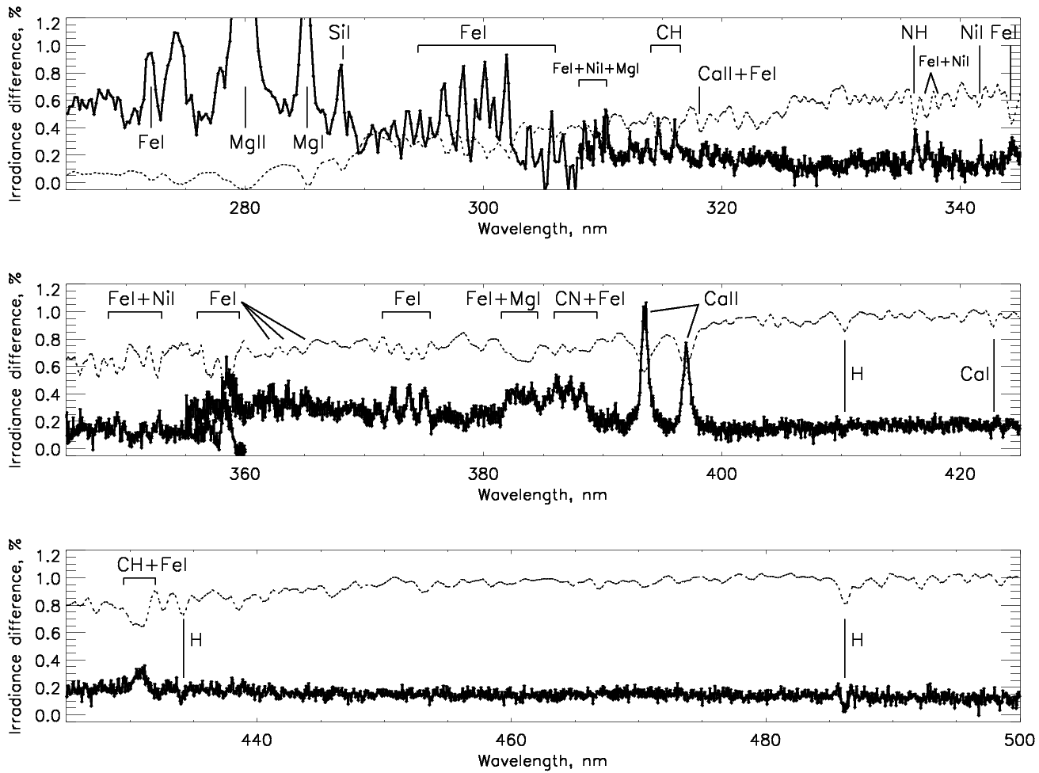
Time-averaged irradiance differences: (mid-y2012+y2013) vs.
(mid-y2007+y2008+mid-y2009)
Sun as a star Aura OMI: spectral irradiance changes in Cycle 24, S. Marchenko, M. DeLand
Dotted line: scaled Solar spectrum
Notes:
7

Slide 8
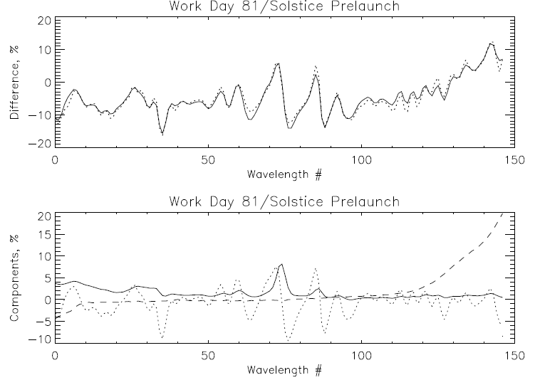
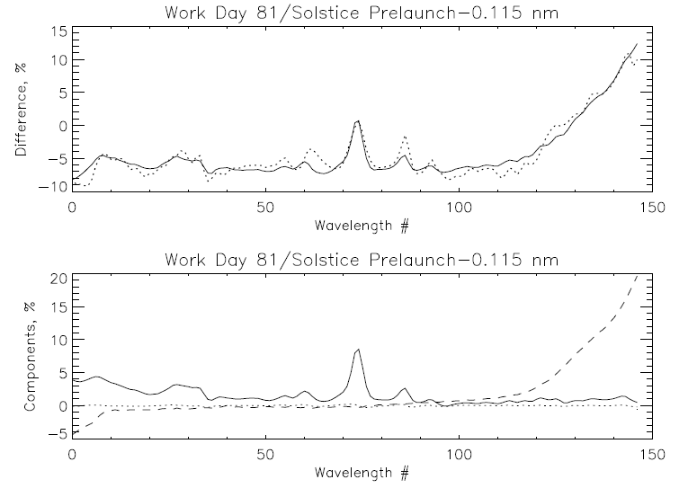
Comparison of OMPS NP Solar spectrum to synthetic from Solstice and prelaunch data. Fits of the differences with a model using three patterns of the form:
Meas/Synth = a0 + a1*WavelengthShift + a2*SolarActivity + a3*DihroicShift
Model
Measurement
Model
Measurement
250 nm 310 nm
250 nm 310 nm
Solar Activity
Dichroic Shift
Wavelength Shift
Solar Activity
Dichroic Shift
Wavelength Shift
250 nm 310 nm
250 nm 310 nm
Working Day 81 vs Solstice Synthetic (1.1% rmsr)
%offset %Mg II Shift nm Dich nm
-7.3 7.3 -0.127 -0.349
Working Day 81 vs Solstice Synthetic (1.1% rmsr)
%offset %Mg II Shift nm Dich nm
-7.5 7.7 -0.004 -0.347

Slide 9
Outline of an Approach for Comparisons of radiance/irradiance ratios from 240 nm to 300 nm
Compute the measurement residuals using a forward model with the effective scene reflectivity of the clouds and surface determined from longer channel measurements, and the ozone profile prescribed by the Version 8 a priori climatology. Viewing geometries and bandpasses are as reported for each instrument.
Compare residuals for channels λ1 and λ2 where S1*α1 = S2* α2, where S values give the path lengths and α values give the ozone absorption cross sections. That is, works with pairs of wavelengths where the measurement contribution functions are similar.
Perform comparisons (statistical trade off in quantity of matchups vs. quality)
Simultaneous nadir overpass matchups
Zonal means (and No-local-time differences zonal means)
Formation flying / Chasing orbits
Benign geographic regions (e.g., Equatorial Pacific Box)
Ascending/descending zonal means (In the Summer hemisphere, the same latitude is observed twice so one can obtain a set of internal comparisons.)
Forward model and measurements
V8 SBUV/2 forward model and A Priori as transfer for Viewing conditions
Complications from real diurnal variations in the ozone profiles
Measurement residuals’ correlation with scene reflectivity can disclose stray light contamination.
Notes:
I believe a similar method was used to check the GOME long-term calibration by assuming stable equatorial ozone profiles.

Slide 10
252 nm
273 nm
302 nm
306 nm
S1*α1 = S2* α2, Si = 1 + sec(SZAi) for nadir viewing
Notes:
Figure 2. Normalized weighting functions for SBUV/2 measurements for a standard 325 DU (0.325 atm.-cm.) ozone profile for two SZAs (Eight wavelengths from 252, 273, 283, 288, 292, 298, 302 to 306 nm)
The normalized single-scattering weighting functions, which show how sensitive the measurements are to ozone changes as functions of pressure, are given for eight wavelengths (252, 273, 283, 288, 292, 298, 302, and 306 nm) in Figure 2. The two sets of curves from top to bottom are for the wavelengths from short to long. This shows, for example, that the measurement by a space-based instrument looking down on a sunlit atmosphere of the radiance at 252 nm is primarily affected by changes in the ozone above 2.0 mbar while the measurement at 306 nm is affected by changes in ozone throughout the stratosphere. Ozone profile retrieval algorithms make use of this physical difference in the spectral measurements to obtain estimates of vertical ozone profiles.
The information at wavelengths measured by a BUV instrument shifts upward as the Solar Zenith Angle (SZA) or the Satellite Viewing Angle (SVA) increases and the path length of photons through the atmosphere increases. For the example in Figure 2, at 70° SZA, the 273 nm measurements responds to changes in the ozone vertical profile in almost the same manner as the 252 nm measurements do at 30° SZA. Notice that the second highest dotted curve and the highest dashed curve almost coincide.
The eight wavelengths in Figure 2 are the standard profiling wavelengths for normal SBUV/2 observations. They provide good coverage of the stratosphere. The gradual decrease in the weighting function (the lack of sharp cutoffs) limits the resolution of the vertical profile information. Even these eight wavelengths have some redundancy in their information and it remains to be seen how much new information will be obtained by denser spectral coverage.
Hyperspectral algorithms for profile retrievals are under development. The duplication of measurement information both spectral and spatial, should help to provide internal consistency and calibration checks. It will also help with methods for radiance comparisons between measurements for Cal/Val work.
Limb viewing produces a geometric magnification of layer response compared to nadir viewing, but with at the cost of a large increase in the optical path.

Slide 11
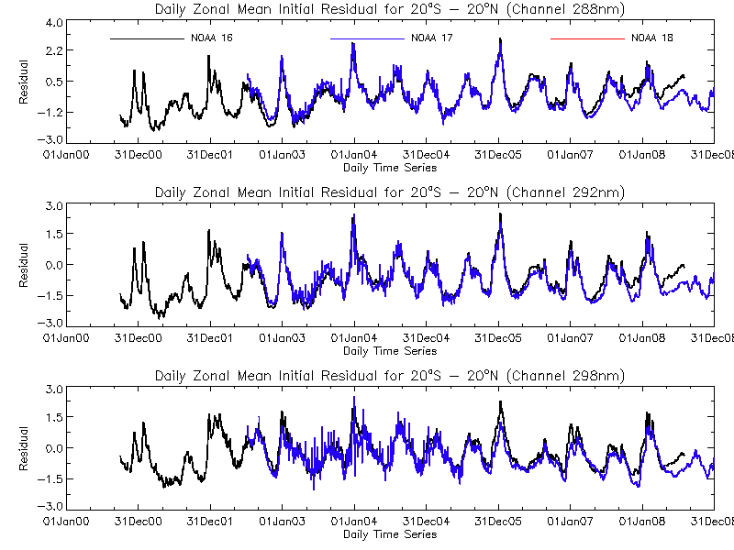
The figures show the initial measurement residuals for three profile wavelengths (Top 288 nm, Middle 292 nm, and Bottom 298 nm) for the V8PRO product for the equatorial daily zonal means (20N to 20S). The two sets of data are for the NOAA-16 SBUV/2 and the NOAA-17 SBUV/2. The units are N-values (~2.3%). The Version 8 algorithm a priori ozone profiles and forward model have been used to allow direct comparison of the radiance/irradiance ratios for the two instruments. NOAA-16 was an afternoon satellite and NOAA-17 was a morning satellite during this period. By the end of the record, the NOAA-16 satellite was in a late afternoon orbit.
Notes:
http://www.star.nesdis.noaa.gov/icvs/prodDemos/index.php

Slide 12
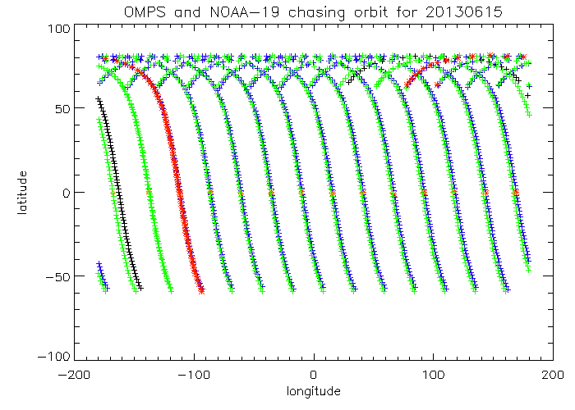
Well-matched Orbits for June 15, 2013
http://www.star.nesdis.noaa.gov/icvs/prodDemos/index.php

Slide 13
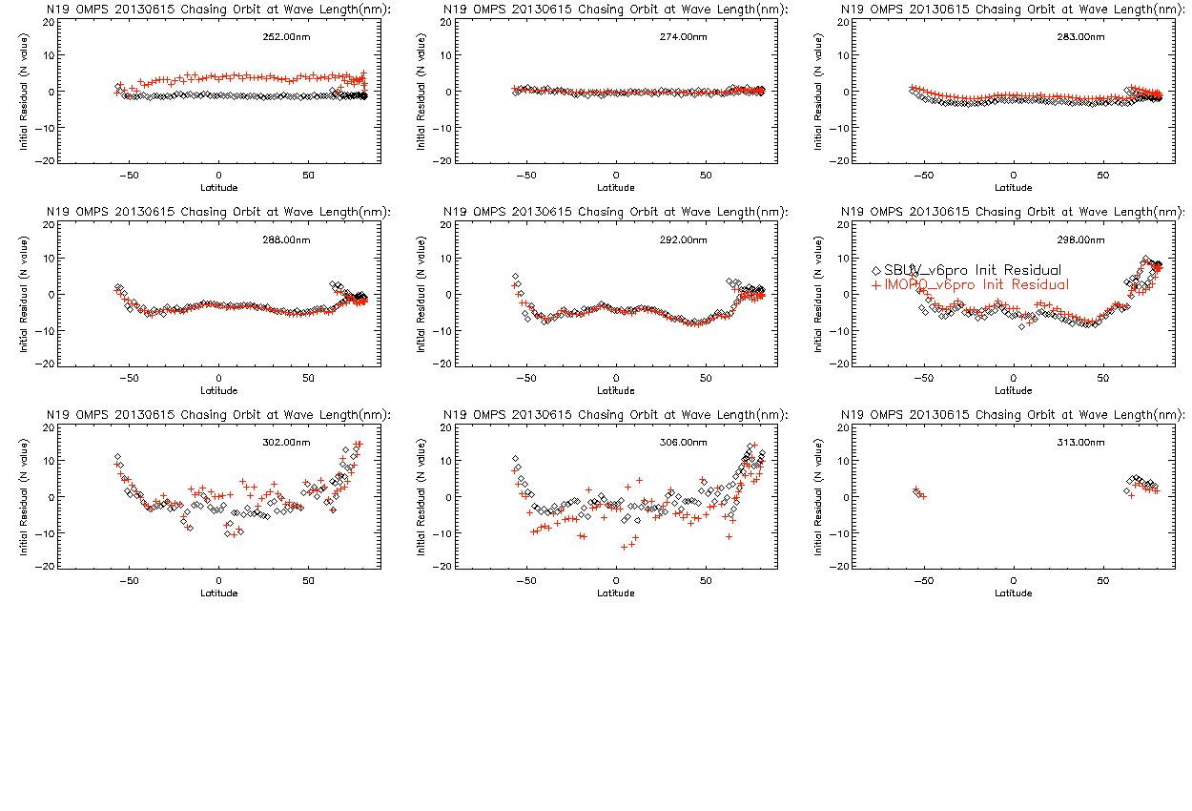
Comparison of Initial V6 Measurement Residuals for S-NPP OMPS NP and NOAA-19 SBUV/2
252 nm not on for OMPS
No Stray Light Correction
Mismatch in Reflectivity

Slide 14
Comparison of Initial V6 Measurement Residuals for S-NPP OMPS NP and NOAA-19 SBUV/2

Slide 15
Project to Compare Reflectivity Channels from 340 nm to 390 nm
Absolute Radiance/Irradiance check
Ice, desert and open ocean targets
reflectivity range/distribution, 1-percentile
Wavelength Dependence – Aerosol Indices
Complications
Surface pressure
Cloud free scenes
Viewing and Solar angle considerations
Sun Glint
Polarisation
Notes:
Glen Jaross ; Arlin J. Krueger, Ice radiance method for backscatter UV instrument monitoring
Proc. SPIE 2047, Atmospheric Ozone, 94 (November 2, 1993); doi:10.1117/12.163469
Changes in the Nimbus-7/TOMS instrument response at long wavelengths are monitored within 1% accuracy over the lifetime of the instrument.

Slide 16
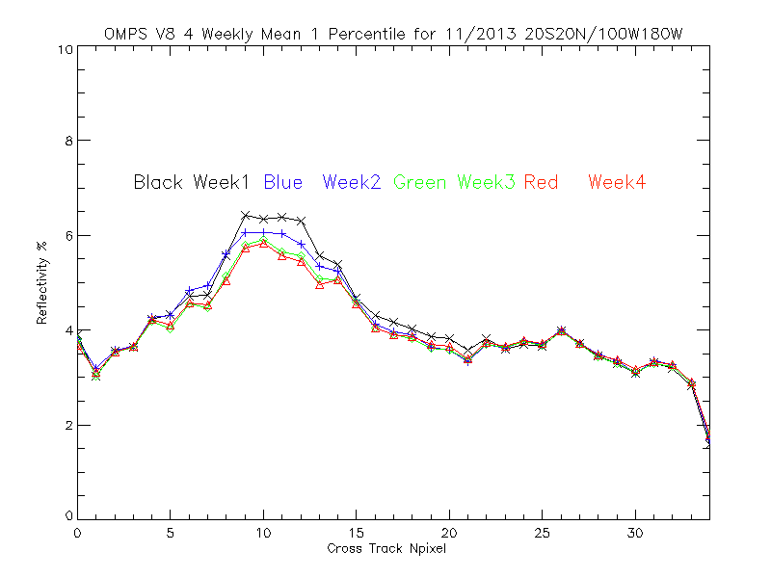
The lines show the S-NPP OMPS weekly, one-percentile effective reflectivity values for the Version 8 algorithm (331-nm channels) for November 2013 for all the data in a latitude/ longitude box in the Equatorial Pacific versus cross-track view position. (17 is the nadir position and 0 and 34 are the extreme viewing angles.) We expect the one-percentile effective reflectivity values to be approximately 4% for this region of the globe from climatological measurements made by other instruments. The cross-track variations for positions 5 to 15 are related to sun glint effects. Consistent deviations by position are from imperfections in calibration coefficients across the CCD array and intra-orbit wavelength scale shifts.

Slide 17
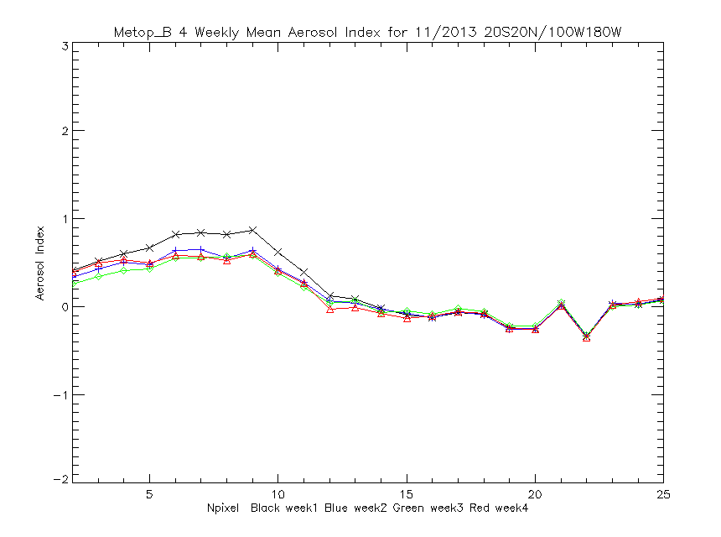
The lines show the MetOP-B GOME-2 weekly aerosol index values for the Multiple Triplet algorithm (measurement residuals for wavelengths in the 360-nm range using effective reflectivity calculated for the 331-nm range) for November 2013 for all the data in a latitude/ longitude box in the Equatorial Pacific versus cross-track view position. (12/13 are the nadir position and 2 and 25 are the extreme viewing angles.) We expect the aerosol index values to be approximately zero N-values for this region of the globe. The cross-track variations for positions 4 to 10 are related to sun glint effects. Consistent deviations by position are probably from calibration imperfections but are surprising given the scanning nature of GOME-2.

Slide 18
What are good and bad aspects of UV measurements?
Basic measurements are ratios of radiance to irradiance taken with the same instrument
For DOAS, the measurements are relative variations in these ratios with wavelength
The solar diffuser and the sun’s output are not constant, especially below 300 nm
We have good models of the solar spectrum and Mg II Scale factors
What conditions/components are different between Earth and Solar
Diffuser
Mirror angles
Location in orbit
Signal levels
Polarisation

Slide 19
Reasonable Goals for Comparisons
Agreement at 2% on solar spectra relative to bandpass-convolved high resolution spectra as transfer.
Agreement at 1% on cloud free scene reflectivity for 340 nm. (Desert, Equatorial Pacific, Polar Ice) (Does this require specified surface pressure and a forward model?)
Agreement at 1% on aerosol index – wavelength dependence of reflectivity. (Note closure polynomials may remove this dependence)
Agreement for TOZ channels? (Discrete versus DOAS)
Agreement at 2% for Profile channels by using the Version 8 A Priori Profiles with TOMRad and single scattering. We can use contribution function equivalences to compare measurements at appropriate wavelengths for different angles.

Slide 20
Reasonable Goals for Time Dependence
Long-term solar from OMI at 0.2% relative (with confirmation from Mg II Index and scale factors)
Long-term reflectivity channels at 0.5% (Ice characterization of BRDF and stability, Minimum sea reflectivity, pressure variations, angular and wind dependence)
Profiling??

Slide 21
Reasonable Goals for Internal Consistency
Wavelength registration – 0.01 nm. (1% BP FWHM?)
Reflectivity channels – 1%
TOZ channels – 1% over 5-nm separation discrete channels, 0.05% 10-nm relative DOAS patterns after closure polynomial
Long term stability
In-orbit sources WLS, Spectral, Moon, LED,

Slide 22
Comparison Considerations
Different spectral and spatial resolution
Forward models can remove these dependencies
Chasing orbits
Every 12 days NOAA-19 and S-NPP orbital tracks are within 27*110/(14*12) KM of each other
SNO for AM with PM (+product comparisons?)
No-local-time difference zonal means
Asc/Desc Langley –> S1*alpha1 = S2*alpha2

Slide 23
Products and Calibration
Rad/Irr, Pairs, DOAS,
Accuracy, Stability, Overlap
RT for transfer – residuals (View, BP, etc.)
Repeat earlier Forward Model Comparison studies
Requirements,
Orbital stability

Slide 24
Future
LEO to GEO
LEO and GEO to L1

Slide 25
Backup material

Slide 26
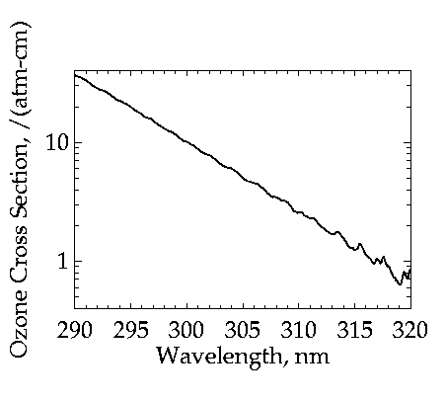
Notes:
Range of absorption /atm.-cm (DU = milli-atm.-cm, 300 DU is an average total column.)
Rayleigh scattering like 1/lambda^4, Optical depth is 1.4 for the full atmosphere RS at 290 nm.
Other absorption about 600 nm, see limb talk by J. Larsen.
Power law for ozone and drop in absorption. Stops at peak in stratosphere.
Good for us, but not for measurements.
For long wavelengths, ozone layer and atmosphere.
Start off simple, will get to problems later.
Looking ahead at retrievals:
Pairs of absorbing and non-absorbing channels.
DOAS uses small scale relative variations.
Atmospheric ozone provides a shield from solar ultraviolet (UV) irradiance by absorbing almost all of the UV irradiance below 290 nm and by absorbing most of the irradiance from 290 to 310 nm. The UV absorption properties are expressed in terms of cross sections which relate the decrease in transmitted flux to the amount of ozone in an atmospheric layer. Figure 1 gives a plot of the ozone absorption as a function of wavelength. (The absorption also depends on the air temperature and a representative value was used to create this graph.) Sunlight is also scattered, both toward the surface and back toward space, by the atmosphere. The most important type of scattering for UV wavelengths is Rayleigh scattering. Differential scattering of visible wavelengths of sunlight is responsible for the blue sky.

Slide 27
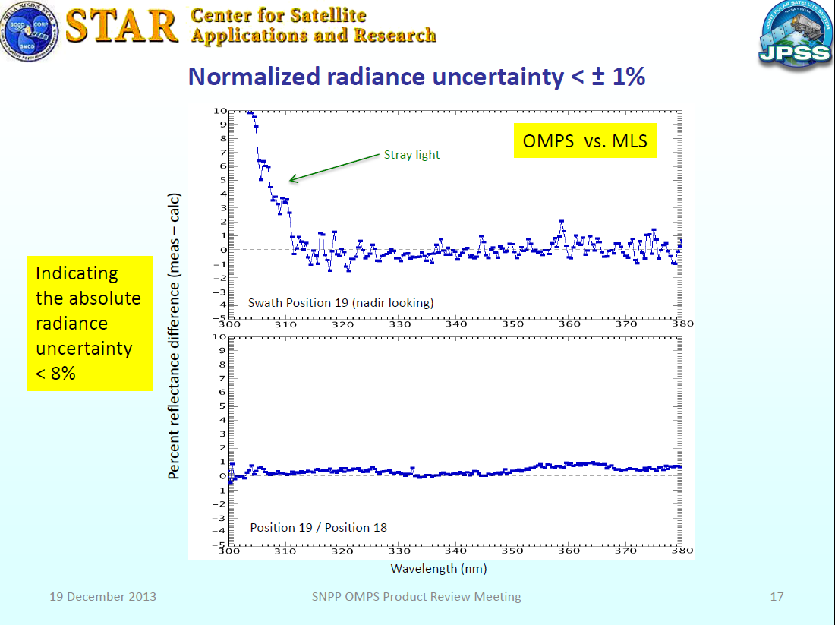
How good are forward models?
From C. Seftor, SSAI NASA NPP Science Team.
The top panel shows the Measurement Residuals with respect to radiance predicted by using TOMRAD, the 340 nm effective reflectivity, and a matchup MLS ozone profile.
The bottom panel compares the measurement residuals for two adjacent cross-track FOVs.
The TOMRAD calculation did not include inelastic scattering.
Notes:
From C. Seftor, SSAI NASA NPP Science Team. Prediction using TOMRAD, 340 nm reflectivity, and a matchup MLS ozone profile.

Slide 28
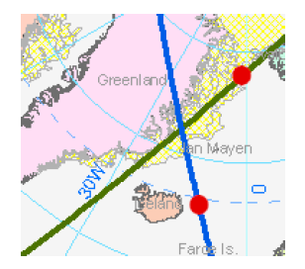
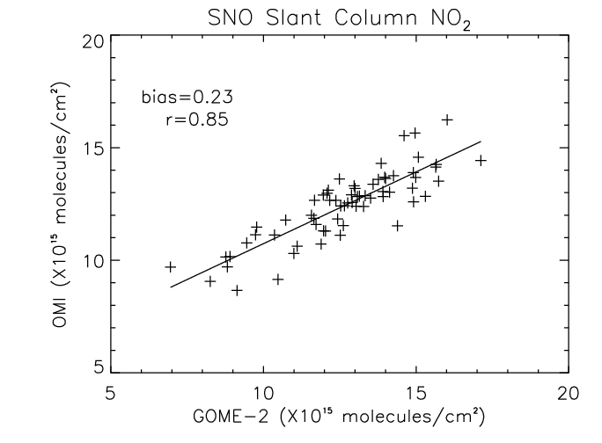
Validation by comparison to OMI. 15 months of GOME-2 and OMI slant column NO₂ data (2008-2009) were compared using SNO analysis. Number of matchups for this analysis were 77.
SNO matchup criteria
± 2 minutes overpass
Solar zenith angles less than 80º
View zenith angles less than 40º (nadir)
OMI row anomaly flag used
Results
Mean bias is 0.23 (~ 2%)
Correlation coefficient is 0.85

Slide 29
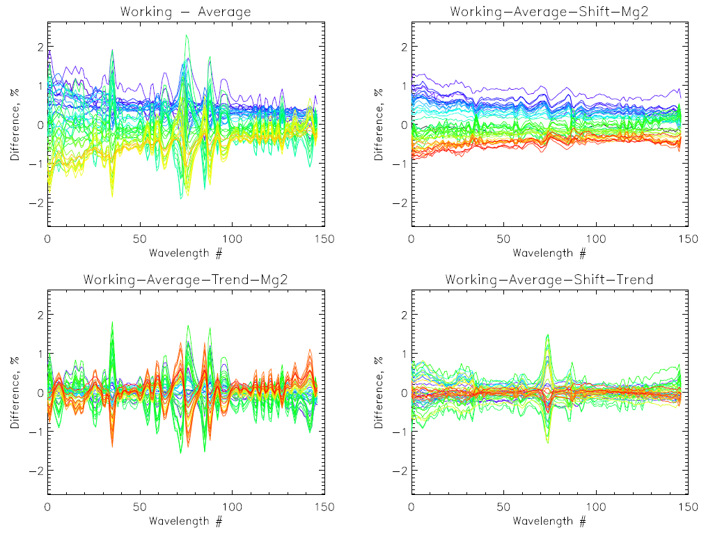

Slide 30
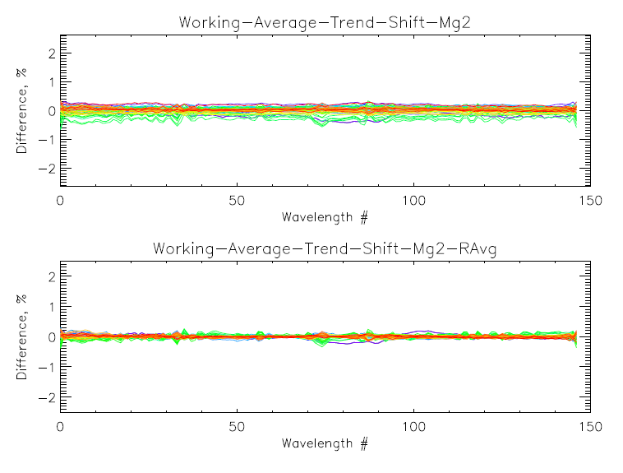
OMPS NP Working Solar residuals after fits

Slide 31
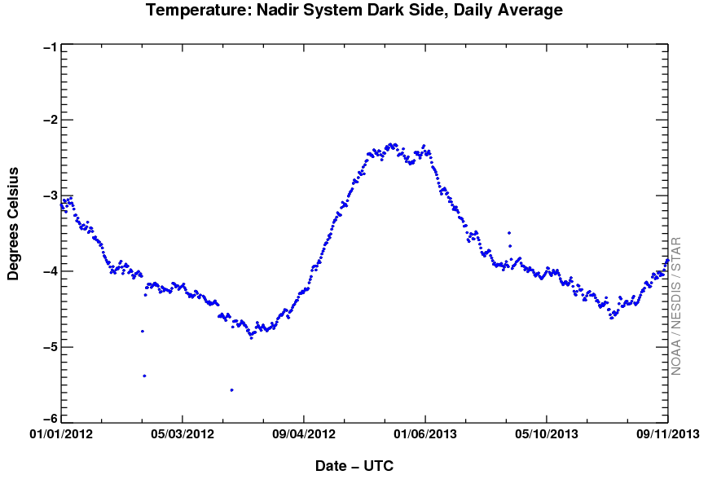
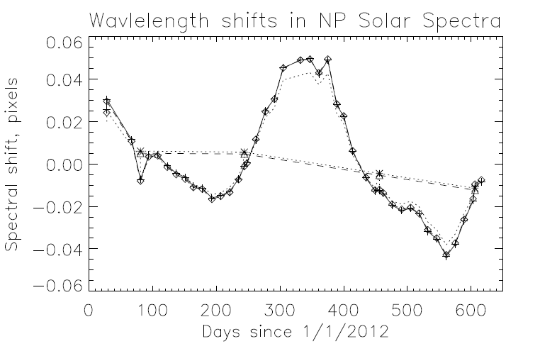
Comparison of OMPS NP Solar and Earth Wavelength Shifts & Temperatures
From Earth-view for
different Latitude bands
Nadir Temperature
0.01 nm
From Solar
* Ref, +Work

Slide 32
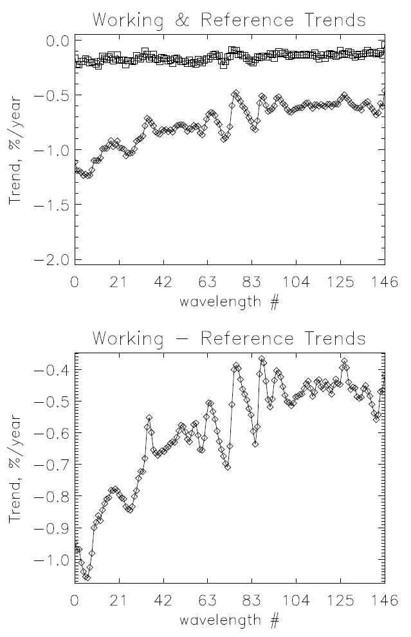
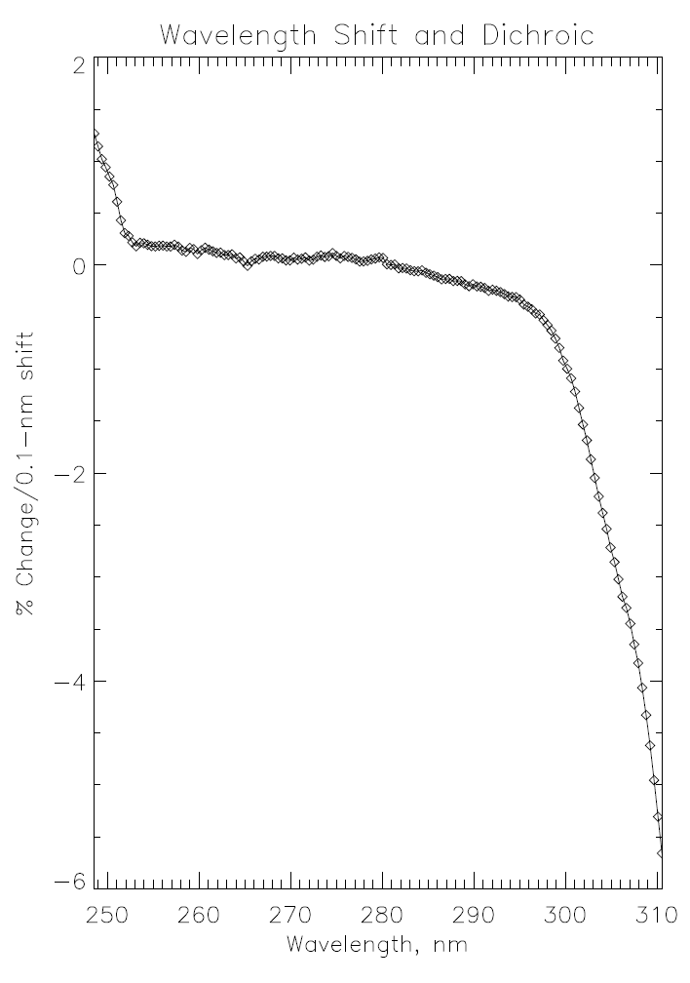
Trends in Solar from model fits and counts to radiance wavelength

Slide 33
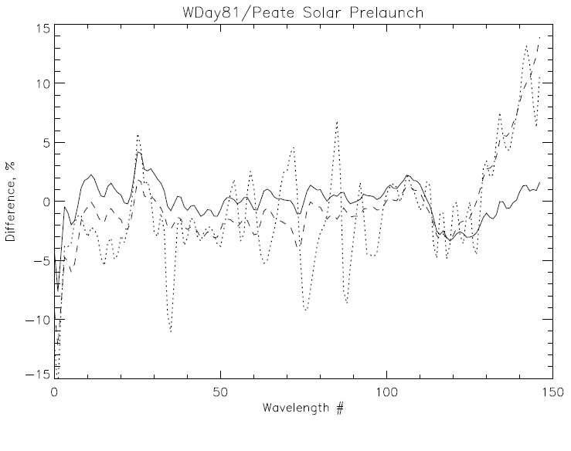
%offset %Mg II Shift nm Dich nm
-1.5 1.0 -0.116 -0.242
Synthetic solar created from the PEATE high resolution spectrum compared to the day 81 of 2012 Working Diffuser solar measurement using the pre-launch wavelength scale.
The dotted line is the relative difference (measured/synthetic - 1). The dashed line is after a uniform -0.12-nm shift of the wavelength scale without accounting for the dichroic. The solid line is after removing a -1.5% offset, a -1.0% Mg II activity term, a -0.242-nm counts to radiance shift (dichroic and other influences), and an additional 0.004-nm wavelength shift.

Slide 34
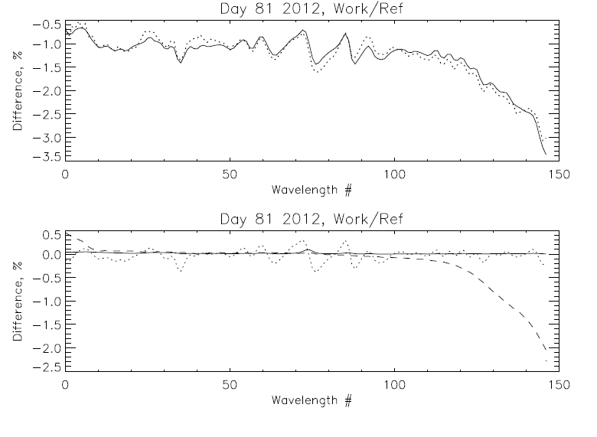
Working Day 81 vs Reference Day 81 (0.1% rmsr)
%offset %Mg II Shift nm Dich nm
-1.1 0.1 -0.005 0.036

Slide 35
Profile comparisons between OMPS & SBUV/2 V6Pro
The figures on the next four slides show comparisons of the ozone profile retrievals estimates between IMOPO and the NOAA-19 SBUV/2 processed with the Version 6 ozone profile retrieval algorithm. The data are from another single pair of orbits on June 15, 2013 where the two satellites are flying in formation (orbital tracks within 50 KM and sensing times with 10 minutes). The first of the four slides shows the orbital tracks. The second compares the initial measurement residuals at the nine profiling wavelengths.
The third compares the ozone profile retrievals in 12 pressure layers in Dobson Units versus Latitude. The 12 layers are defined by the following 13 layer boundaries:
[0.0,0.247,0.495,0.99,1.98,3.96,7.92,15.8,31.7,63.3,127.0,253.0,1013] hPa.
The top three layers’ results are in the top row with the topmost layer on the upper left. The lowest layer’s results are in the figure on the bottom right. The OMPS Nadir Profiler values are in Red and the SBUV/2 are shown in Black. A significant number of the OMPS Nadir Profilers contain fill values because of Error Codes incorrectly set to 20.
The fourth shows the results of comparison for the ozone mixing ratios at 19 pressure levels: [0.3,0.4,0.5,0.7,1.0,1.5,2.0,3.0,4.0,5.0,7.0,10.,15.,20.,30.,40.,50.,70.,100.] hPa.
The arrangement from top to bottom follows the same convention as for the layers.
The two last sets of figures show similar results with general agreement between the retrievals for the two instruments but with the OMPS NP retrieving much smaller values at the top of the profiles. This is due to the inaccuracies in the initial calibration of the shorter wavelength channels and out-of-band of stray light in the shorter wavelength channels providing information at those levels.

Slide 36
Well-matched Orbits for June 15, 2013

Slide 37
Comparison of Initial V6 Measurement Residuals for S-NPP OMPS NP and NOAA-19 SBUV/2
252 nm not on for OMPS

Slide 38
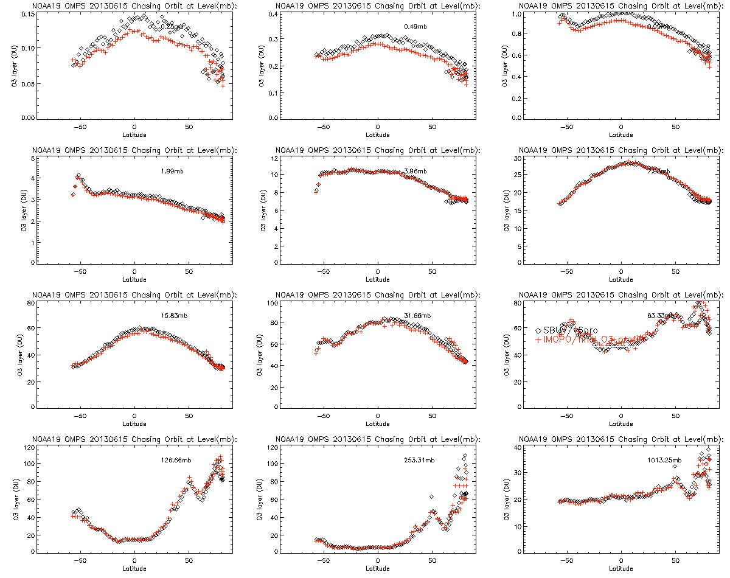
Chasing orbit comparisons of SBUV/2 & OMPS-NP Version 6 Ozone Profiles

Slide 39
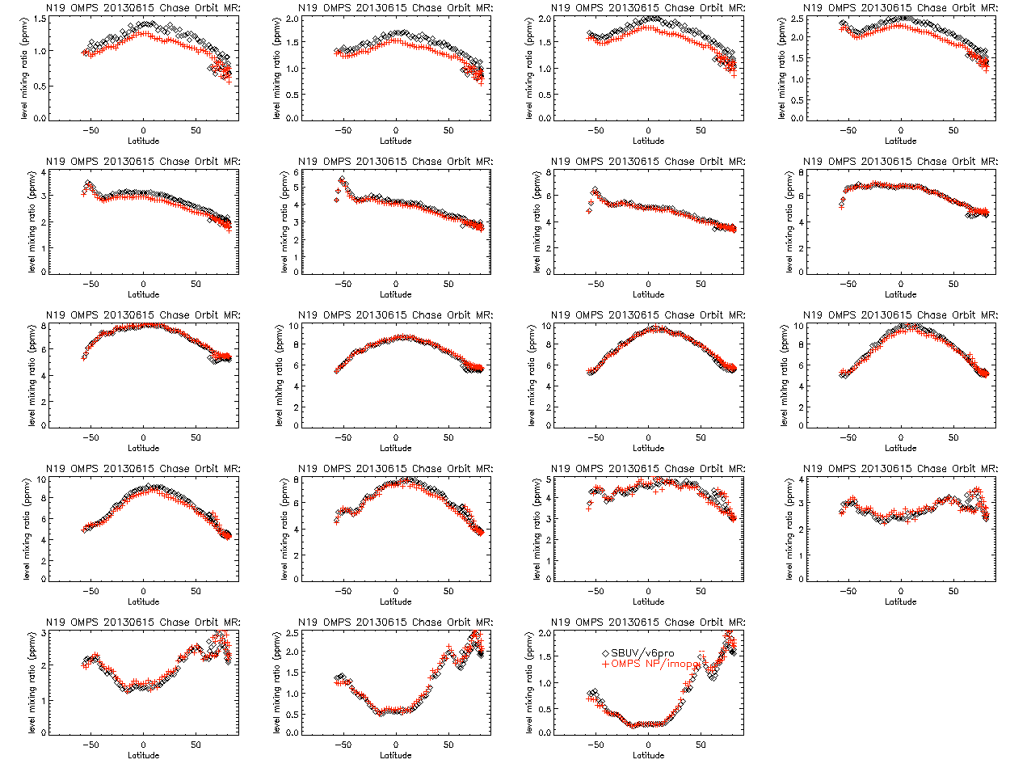
Upper layers are most affected by stray light and 252 nm channel use.
[0.3,0.4,0.5,0.7,1.0,1.5,2.0,3.0,4.0,5.0,7.0,10.,15.,20.,30.,40.,50.,70.,100.] hPa.

Slide 40
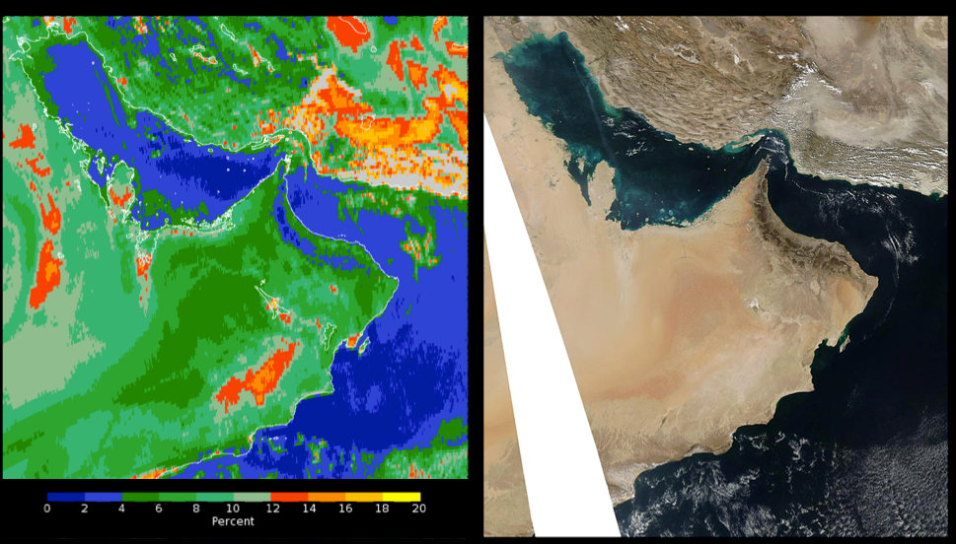
Figure 1. High-Spatial-Resolution Geolocation Comparison.
The image on the left shows a false color map of the OMPS effective reflectivity (from a single Ultraviolet channel at 380 nm) over the Arabian Peninsula region for January 30, 2012 when the instrument was making a special set of high-spatial-resolution measurements with 5×10 km² FOVs at nadir. The color scale intervals range from 0 to 2 % in dark blue to 18 to 20 % in yellow. The image on the right is an Aqua Moderate Resolution Imaging Spectroradiometer (MODIS) Red-Green-Blue image for the same day.
The instrument is very stable, extremely flexible, and has excellent SNRs.
Notes:
Provided by C. Seftor.

Slide 41
All, I want to advance my earlier ideas to the next stage. I am not certain what the next steps should be.
Right now I envision a two or three day workshop with 40 to 50 20-minute talks. The talks together with data sets, analysis programs and additional images would be collected and organized for distribution to participants on DVDs (perhaps six months after the event). I can see a need for an organizing committee, a program committee and an editorial committee (or one over-arching committee). I invite discussion on the place, the program and the product.
Larry Flynn
Attach sample paper on stray light investigation. Tutorial for graduate students Exchange of information for practitioners Creation of book and DVD
In-flight Calibration and Characterization for Remote Sensing Satellite Instruments
A wide variety of methods and procedures have been developed for post-launch calibration and characterization of remote sensing > measurements from satellite-based instruments over the last 40 years. These methods are often described, at best, in gray literature or institutional reports. Even if they are described in scientific > papers, the presentations are often more phenomenological than algorithmic or prescriptive.
The field of research on improving the understanding of measurements from instruments operating beyond our reach is now mature. Researchers have developed many techniques which work and work well. This volume will collect examples of these methods in practical applications. The applications will include case studies demonstrating the use of analysis and programming tools with real data sets. The topics will cover methods using internal consistencies, vicarious calibrations, scene variations, physical distributions, retrieval evaluations, and measurement correlations, residuals, variations and periodicities. Methods for both long-term monitoring of measurements and anomaly resolution will be included.
Possible questionnaire to categorize contributions:
What type of detector is used?
PMT Radiometer Linear array detector CCD array Bolometers Spectrometer FTS Interferometer Filter radiometer
What spectral region is observed?
MW, Radar UV Visible IR
How is the Earth observed?
Occultation Emission Back-Scattering Limb-Scattering Reflectivity Absorption Active (Lidar, GPS, Radar)
What analysis methods are used?
Does the method use ground-based prelaunch data?
Does the method use a forward model?
Does the method use residuals?
Does the method use truth data?
Does the method use correlations of measurements with measurements?
Does the method use correlations of measurements with other data?
Does the method compare retrievals using different measurements?
Does the method use EOFs (SVD)? Does the method use angular dependencies?
Does the method use physical limits or distributions of observations?
Does the method model with additive or multiplicative errors?
Does the methods use spatial or spectral redundancy?
Does the method use distributional analysis?
Does the method compare radiances to radiances?
Does the method use space looks?
Does the method use on-board calibration sources?
Does the method look for long-term instability?
Does the method compare to models or forecasts?

Slide 42
What complications are in the measurements:
Stray light. (OOB, OOF, lobes)
Noise.
Cross-talk
SAA, auroral activity.
Platform or other instrument interference/cross talk.
Optical throughput or detector sensitivity change.
Non-linearity.
Dark current or offset variations.
Wavelength scale drift or change, grating drive errors.
Bandpass/filter change.
Hysteresis.
Black Body changes.
Contaminated space or solar views.
Moon or other source in FOV.
Digitization or rounding.
Binning or integration or summing. \
Degrading or changing components.
Additional Notes
Chen, H.S., 1996, Remote Sensing Calibration Systems - An Introduction, ISBN 0-937194-38-7, A. Deepak Publishing, Hampton, Virginia, USA.
Bruegge, C., and J. Butler, Eds., 1996, Special Issue on Earth Observing System Calibration, Journal of Atmospheric and Oceanographic Technology, 13(2):273-544.
Price, J.C., Ed., 1987, Special Issue on Radiometric Calibration of Satellite Data, Remote Sensing of Environment, 22(1): 1-158.
Nithianandam, J., Guenther, B.W., and Allison, L.J. , 1993, "An Anecdotal Review of NASA Earth Observing Satellite Remote Sensors and Radiometric Calibration Methods," Metrologia, 30:207-212
National Academy Report 1.7 Communicating Instrument Performance Finding:
Instrument problems that do not exceed design specifications can be significant for the construction of CDRs. Information regarding changes in, or new knowledge of, instrument health and performance is difficult for climate investigators to obtain and apply. Investigators have also found instrument problems that were difficult to communicate back to NESDIS.
Recommendation: NESDIS should create a web site that includes information on spacecraft and instrument condition and changes that are of interest for the construction of CDRs. In addition to the official NESDIS TIROS Operational Anomaly Reports (TOAR), this site should be interactive to allow climate investigators to communicate their findings and opinions concerning the behavior of specific instruments and/or channels. The site should be well organized, with cross-referencing by category, and should include a good search capability to enable interested parties to find what they want. An attempt should be made to hierarchically construct the site so that issues judged by NESDIS to be of greatest importance to the climate record are most prominently featured. The information contained on this web site would become part of the permanent metadata record for each instrument.
Residuals Spatial Spectral Temporal Anomaly resolution

Slide 43
In-flight Calibration and Characterization for Remote Sensing Satellite Instruments A wide variety of methods and procedures have been developed for post-launch calibration and characterization of remote sensing measurements from satellite-based instruments over the last 40 years. These methods are often described, at best, in gray literature or institutional reports. Even if they are described in scientific papers, the presentations are often more phenomenological than algorithmic or prescriptive. The field of research on improving the understanding of measurements from instruments operating beyond our reach is now mature. Researchers have developed many techniques which work and work well. This volume will collect examples of these methods in practical applications. The applications will include case studies demonstrating the use of analysis and programming tools with real data sets. The topics will cover methods using internal consistencies, vicarious calibrations, scene variations, physical distributions, retrieval evaluations, and measurement correlations, variations and periodicities. Methods for both long-term monitoring of measurements and anomaly resolution will be included.

