Slide 1
GSICS Impacts on Applications Reporting works by some GSICS Users Fred Wu NOAA/NESDIS/STAR

Slide 2
Outline
Some work by colleagues are presented
T. Omai (JMA)
T. Zhu (NOAA)
X. Hu (CMA)
Some work will be presented separately
A. Mitra (CIMSS)
T. Schreiner (CIMSS)
Some work are still in progress
R. Allegrino (NOAA)
B. Rossow (ISCCP)
My fault if mispresented

Slide 3
GSICS Impacts on MTSAT-2 WV CSR
Takahito Omai and H. Owada (JMA)
GSICS Correction for MTSAT-2 water vapor channel clear sky radiance …
… and comparison with JMA NWP monitoring

Slide 4
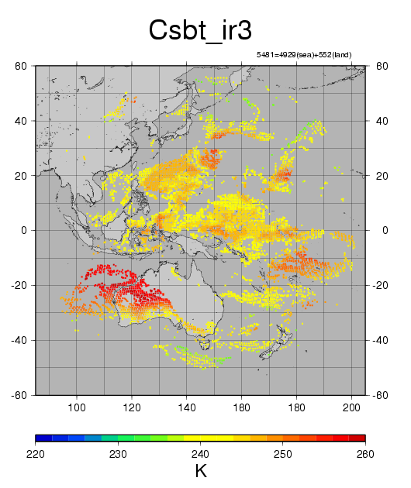
MTSAT-2 WV Channel’s Clear Sky Radiance (CSR)
WITHOUT GSICS Correction

Slide 5
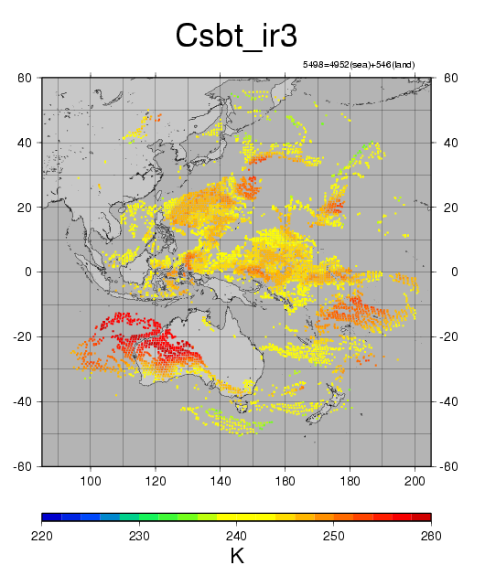
MTSAT-2 WV Channel’s Clear Sky Radiance (CSR)
WITH GSICS Correction
Slightly more coverage
Slightly warmer …

Slide 6
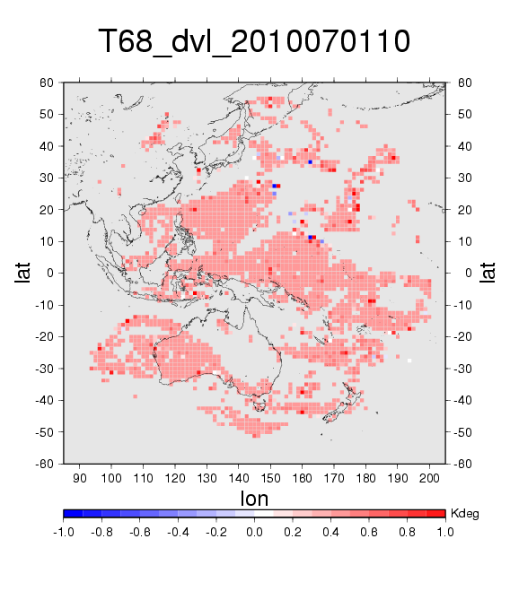
MTSAT-2 WV Channel’s Clear Sky Radiance (CSR)
DIFFERENCE of (with) – (without) GSICS Correction
Slightly more coverage
Slightly warmer …
… by ~0.5K …

Slide 7
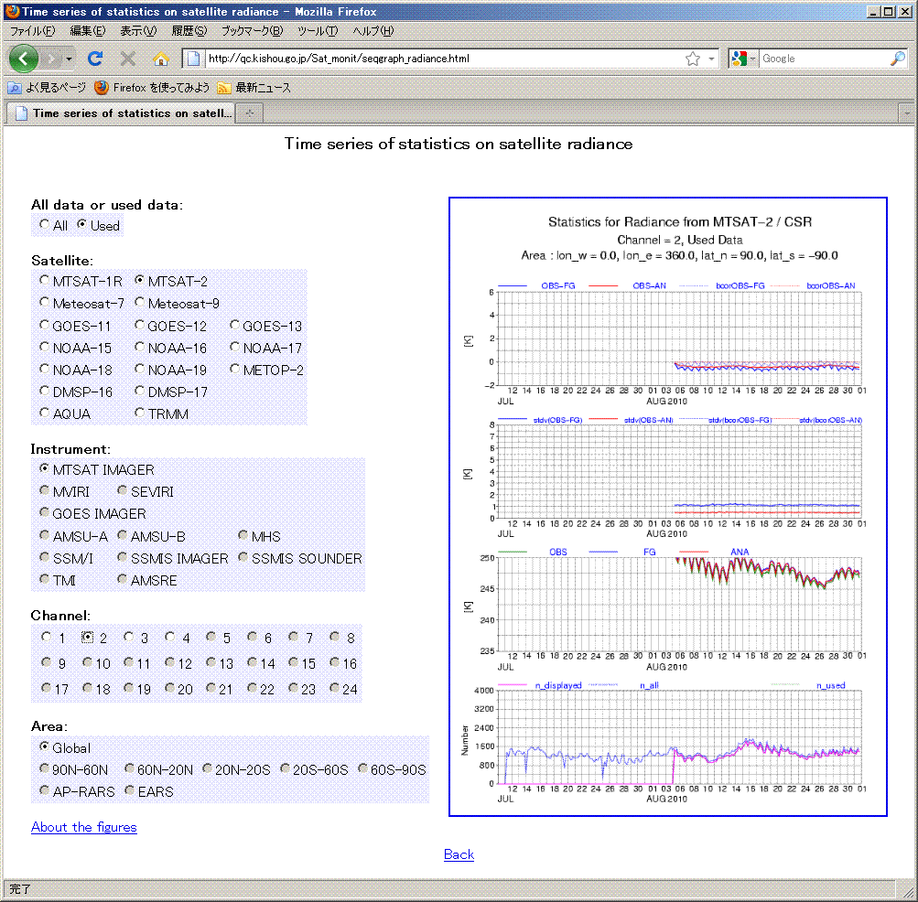
MTSAT-2 WV Channel’s Clear Sky Radiance (CSR)
BIAS as monitored by JMA NWP
Illustrates the sophistication of the users and, therefore, the challenges to calibration. These motivated the GSICS.
Slightly more coverage
Slightly warmer …
… by ~0.5K …
… confirmed by JMA NWP bias monitoring

Slide 8
GSICS Impact on Global Forecast System (GFS)
T. Zhu and F. Weng (NOAA)
GSICS Correction for SEVIRI and GOES-12 Imager radiances reduced the O-B biases.

Slide 9
Impact of GSICS Correction on GOES-12 Imager radiance
Compared to CRTM, GOES-12 Imager Channel 6 bias was reduced from -2.55K before GSICS correction to -0.11K after

Slide 10
Global Forecast System (GFS)
What does that mean to GFS?
In various time scale
Tropics vs. NH
For SEVIRI and GOES

Slide 11
Experiments Design
GDAS FY09 with T382 resolution
GFS one month simulations: 20 May – 20 June, 2008
Control run: conventional data + all current sensors (e.g. AMSU-A/B, HIRS, AIRS, SSMI, MHS, GOES sounder)
Exp1 run: Control run + GOES-12 imager
Exp2 run: Control run + GOSE-12 imager + GSICS correction.

Slide 12
Experiments Design
GDAS FY09 with T382 resolution
GFS one month simulations: 1-30 November 2008
Control run: conventional data + all current sensors (e.g. AMSU-A/B, HIRS, AIRS, SSMI, MHS, GOES sounder)
Exp1 run: Control run + SEVIRI CSR
Exp2 run: Control run + SEVIRI CSR + GSICS correction.

Slide 13
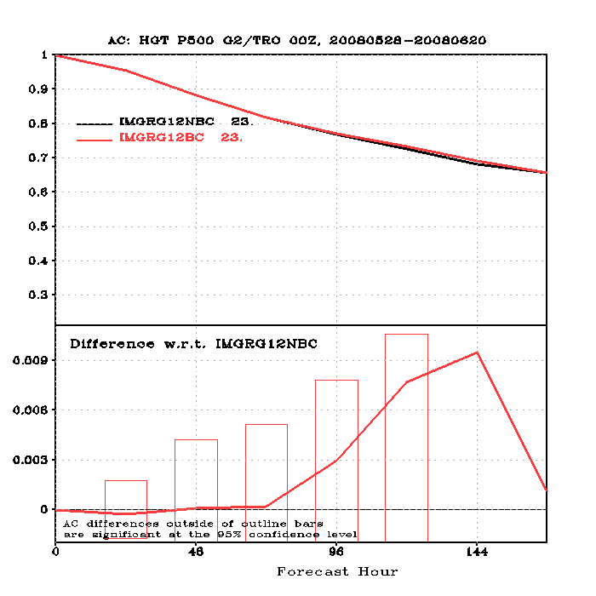
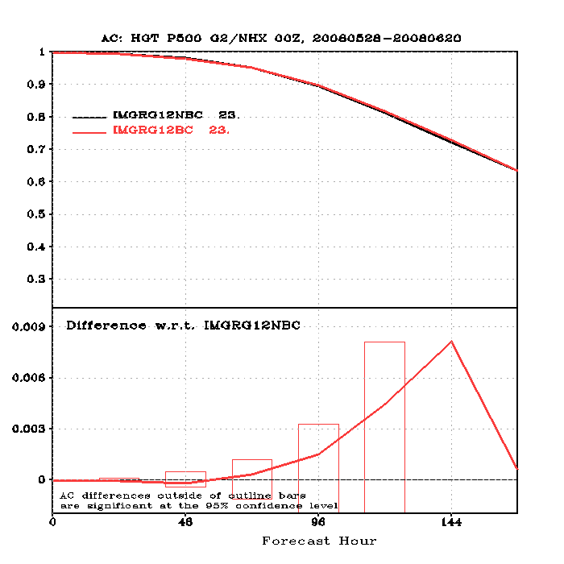
Impacts of GSICS Correction for GOES-12 Imager on GFS Forecast
GOES-12 imager with and without GSICS bias correction
Anomaly Correlation for 500 mb height over tropics (left) and NH (right)

Slide 14
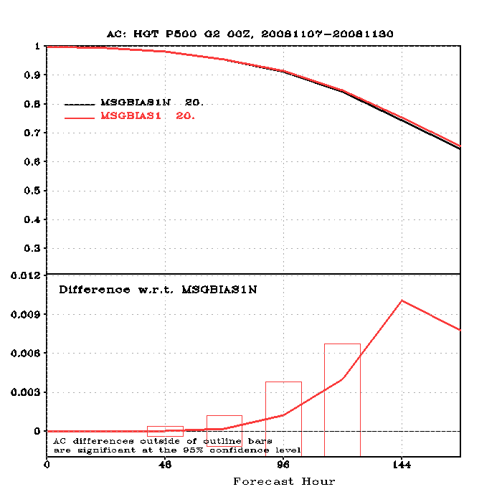
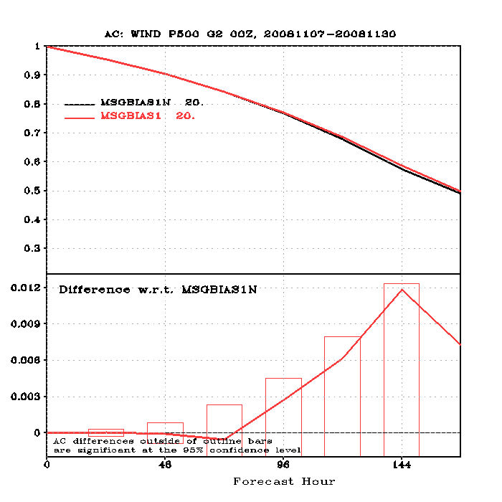
Impacts of GSICS Correction for SEVIRI on GFS Forecast
MSG SEVIRI CSR with and without GSICS bias correction
Anomaly Correlation for 500 mb height over tropics (left) and NH (right)

Slide 15
Summary
GSICS Correction for SEVIRI and GOES-12 Imager radiances reduced the O-B biases.
One-month GFS simulation experiments found that the GFS were improved
For 5-7 day forecast
In both tropics and NH
For both GOES-12 and SEVIRI

Slide 16
GSICS Impact on FY-2X IR Channel Radiances
X. Hu, P. Zhang, Y. Zhang (CMA)
Dramatic improvements

Slide 17
FY-2 IR Calibration BEFORE GSICS

Slide 18
FY-2 IR Calibration AFTER GSICS
Probably due to navigation anomalies

Slide 19
Still in progress
A. Allegrino and J. Daniels (NOAA)
Apply GSICS Correction to GOES
Evaluate the impact on GOES retrieval of TPW
Validate with ground-based GPS retrieval of TPW
W. Rossow and J. Ferrier (GISS)
Apply GSICS Correction to selected period of time
Evaluate the impact on ISCCP products

Slide 20
Summary
Users start to be interested in GSICS Correction
Impacts are generally positive
Some are quite significant
Need to help users
To know about GSICS Correction
Many users did not learn about it from us – good or bad
To use GSICS Correction
Learn about user service
To design tests for evaluation
Inappropriate tests may end up with misleading results

