Slide 1

Use of GSICS to Improve Operational Radiometric Calibration
F. Yu, X. Wu, MK. Rama Mundakkara, L. Wang, Y. Li, G. Rancic and M. Grotenhuis
Sept. 21, 2010
GSICS 2nd Users’ Workshop
Cordoba, Spain

Slide 2
Outline
AIRS/IASI calibration inter-comparison
GOES Imager
  Correction for operational calibration
  Identify and diagnose calibration anomaly
    GOES-12 Imager decontaminations
    Spectral response function (SRF) shift and updates
  Evaluate operational calibration algorithm
    MBCC, diurnal calibration variation
    Scan angle calibration residual
    Stray-light effect
GOES Sounder
  Radiometric Cal. evaluation

Slide 3
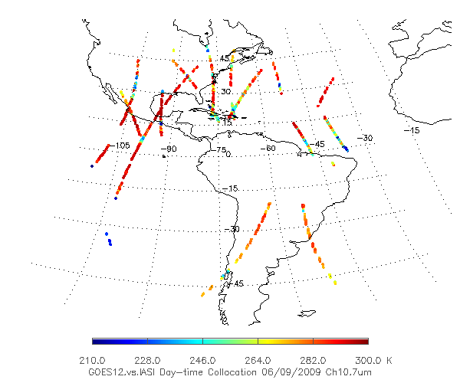
NOAA GPRC GEO-LEO Baseline Calibration Algorithm
Large temperature range
  Provide calibration correction for “all-sky” data
  Evaluate overall calibration uncertainty
Multiple ascending/descending LEO orbits per day
  MBCC evaluation
  Diurnal calibration variation
Large geo-spatial coverage
  Scan angle calibration residual
GOES-12 vs. IASI collocation distribution on Jun. 9, 2009 for Ch4(10.7µm)

Slide 4
AIRS/IASI
IASI – AIRS Tb difference at GOES IR channels
SNO
Double difference with GSICS data
Both double difference with GSICS data and SNO method shows that AIRS and IASI are radiometrically stable within 0.1K difference at the spectra of the five GOES IR channels.
L. Wang et al. submitted for JGR

Slide 5
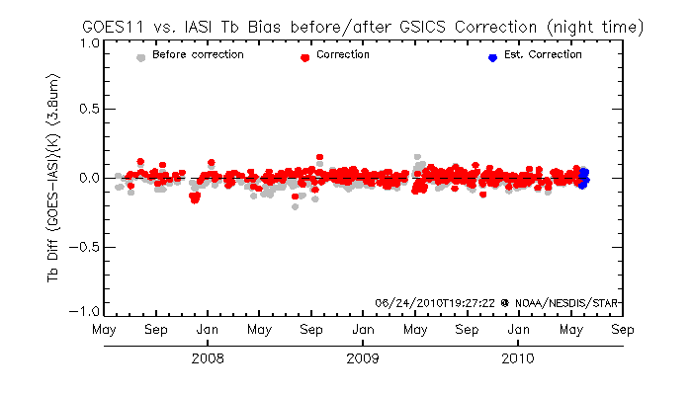
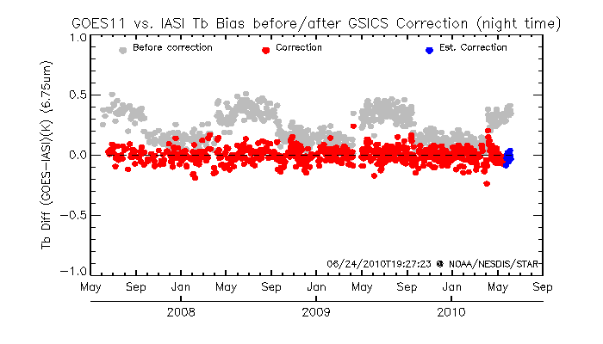
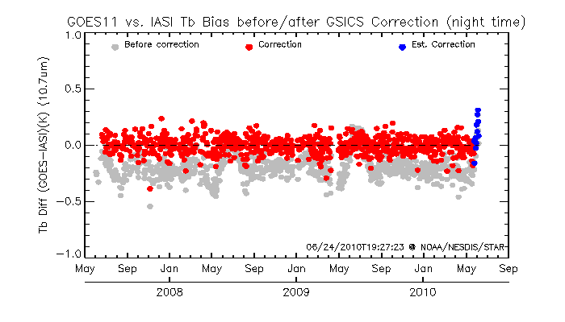
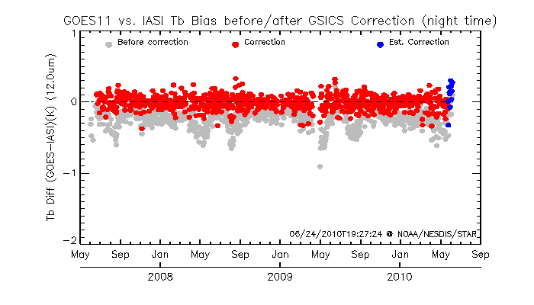
GSICS GEO-LEO Correction
Correction is based on the linear relationship between GOES and IASI spectral radiance at night time collocation data.

Slide 6
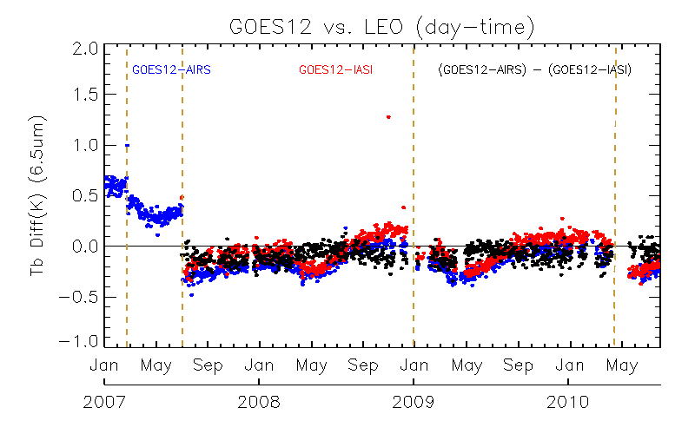
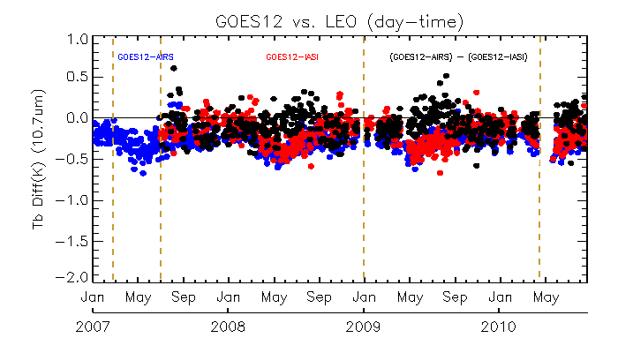
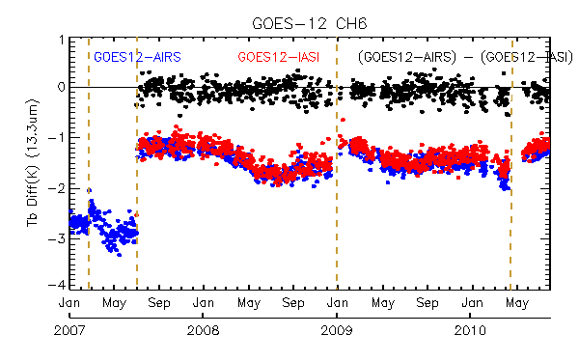
GOES-12 Imager Decontaminations
6.5um
10.7um
13.3um
GOES-12 Imager experienced four decontamination events
Absorptive IR channels are more sensitive to the decontaminations

Slide 7
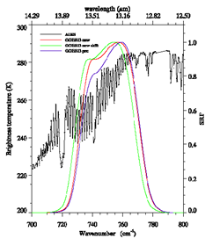
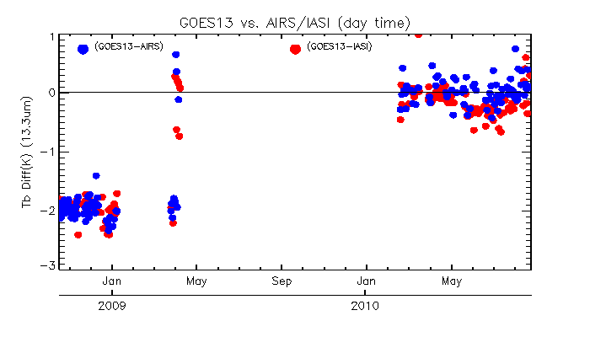
Shift the Spectral Response Function for GOES-13 Imager Ch6 (13.3µm)
ITT original
Operationally Implemented
ITT revised
Identified that the bias cold was caused by the SRF uncertainty
Shifted GOES-13 Imager Ch6 (13.3um) with GOES-13 vs. AIRS data
The shifted SRF greatly reduced the Tb bias.

Slide 8
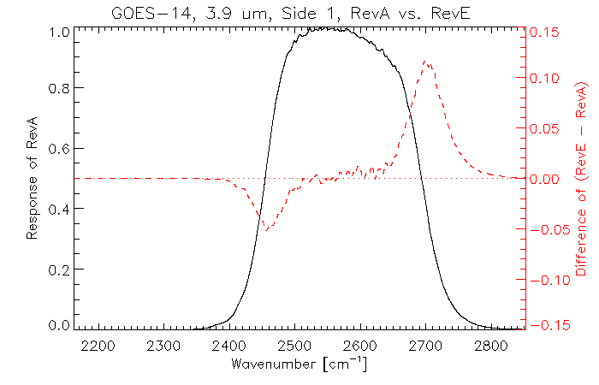
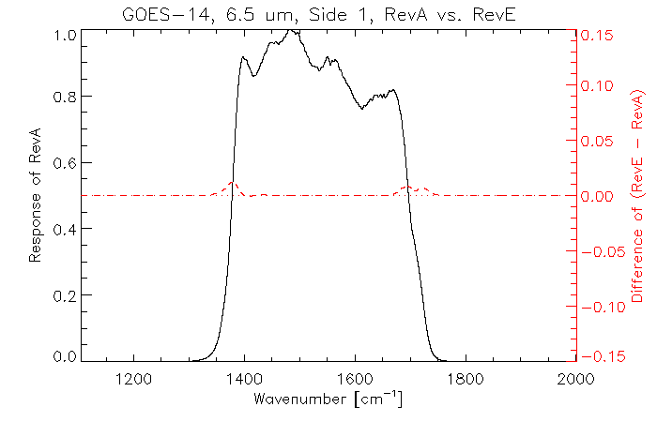
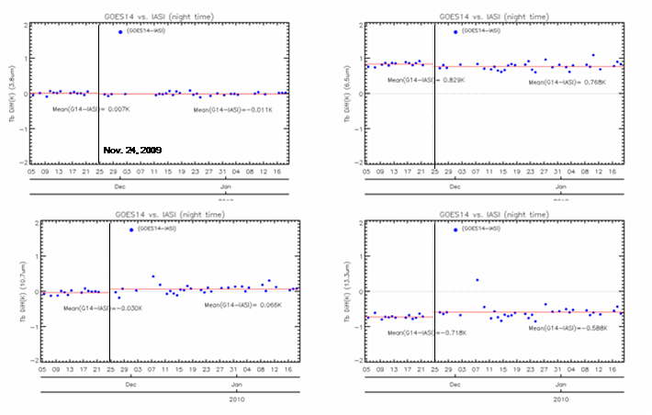
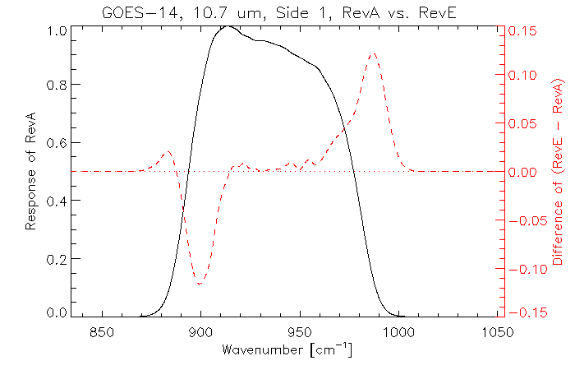
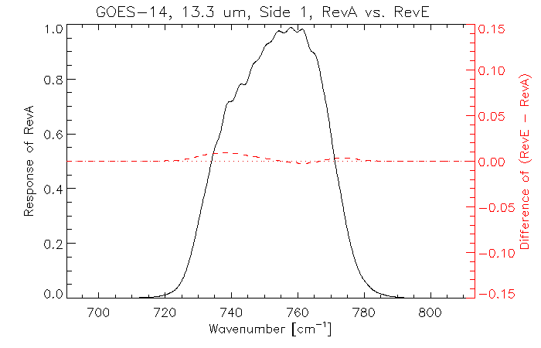
Updates of GOES-14 Imager Spectral Response Functions
Change of Spectral Response Functions
GOES-14 vs. IASI Tb bias at night time
GOES-14 Imager SRFs were updated during the GOES-14 PLT period
Impact of SRF updates in general is very small and negligible (<0.1K).

Slide 9
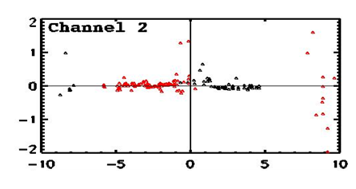
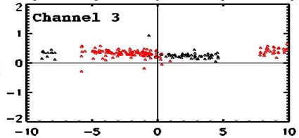
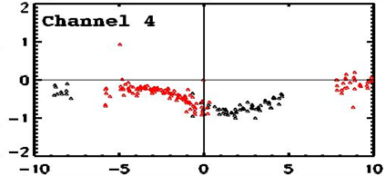
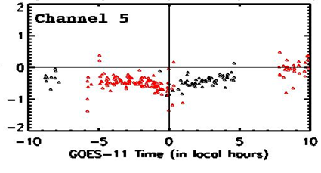
Evaluation of Midnight Blackbody Calibration Correction
Data: Aug. 2008
G11-IASI G11-AIRS
G11-IASI G11-AIRS
GOES11 – (AIRS/IASI) (K)
G11-IASI G11-AIRS
G11-IASI G11-AIRS
MBCC improves the midnight calibration accuracy at GOES-11 Imager Ch2 (3.9µm) and Ch3(6.75µm)
Uncertainty remains around the midnight time at the long-wavelength IR channels

Slide 10
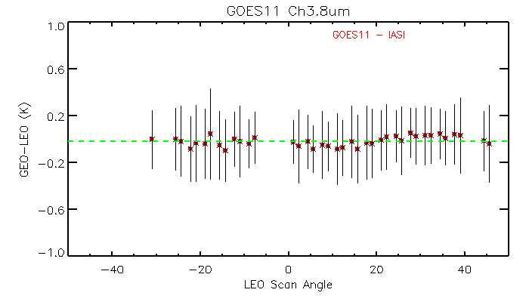
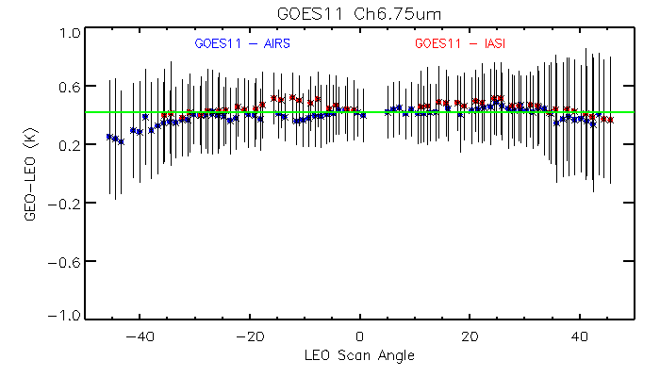
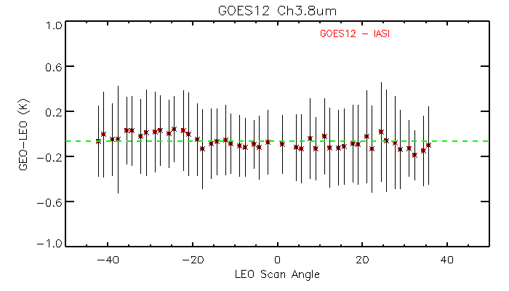
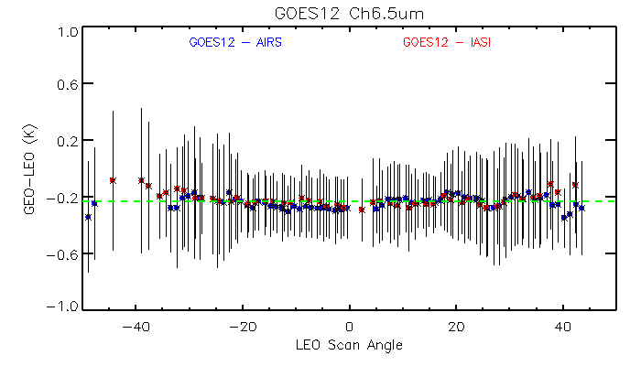
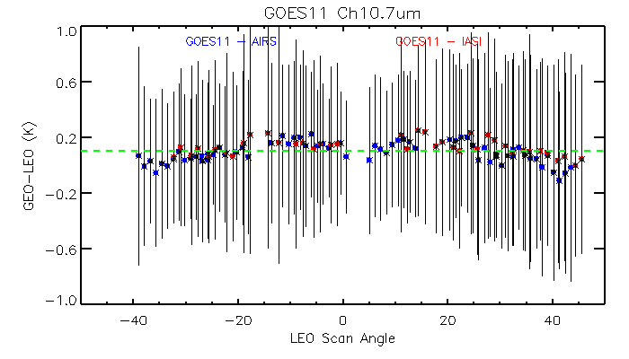
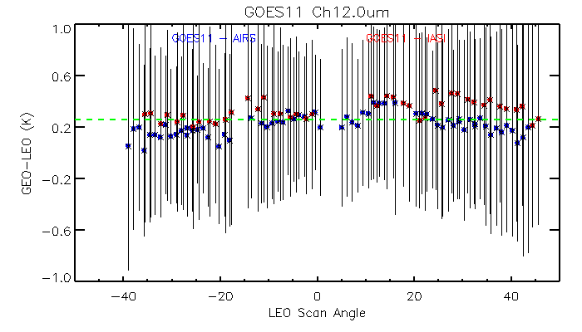
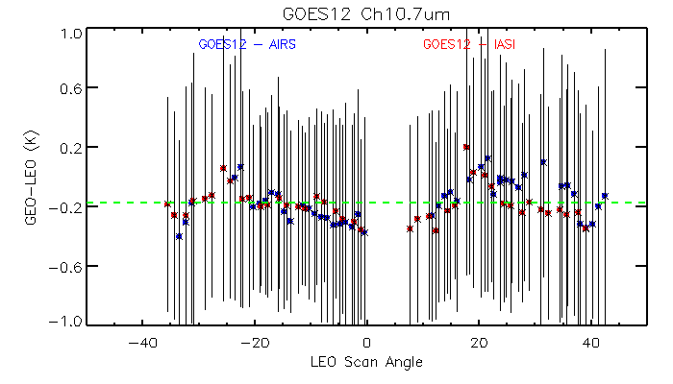
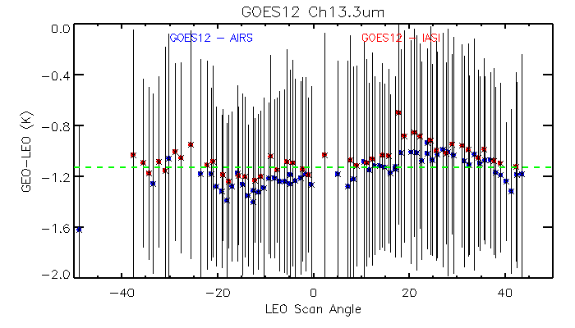
GOES Imager IR Scan Angle Cal. Residuals
Data: 6/1/2010 – 8/15/2010
GOES-11
GOES-12
Day-time
Day-time
Night-time
Night-time
Day-time
Day-time
Day-time
Day-time
GEO vs. AIRS/IASI scan-angle dependent Tb biases in general trace each other very well.
Small scan-angle dependent cal. residual for the GOES IR channels (<±0.3K).

Slide 11
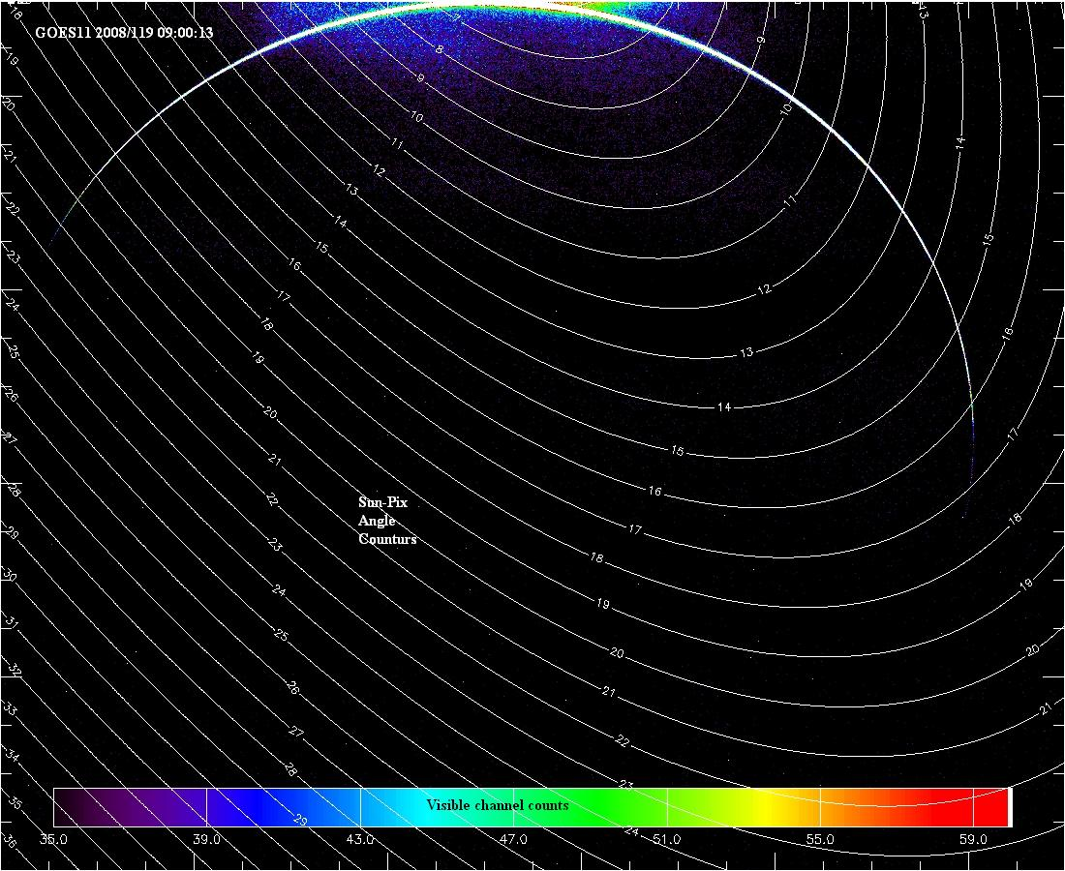
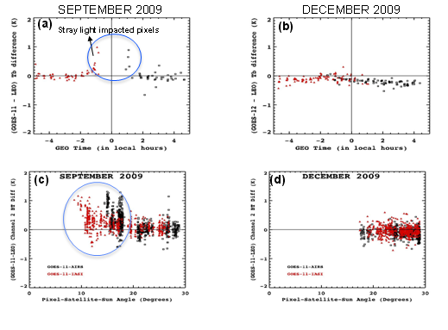
GOES Imager Stray-light Evaluation
GOES-11 Imager Ch2 - AIRS/IASI Tb bias
GOES-11 Imager NH visible imager on 04/28/2008
GOES Imager and Sounder are vulnerable to stray light contamination around midnight during equinox seasons
The stray-light can affect pixels at up to ~18º line-of-sight (LOS) away from the Sun.
By Wu, X. M.K. Rama Mundakkara, and G. Rancic, 2010, GSICS Quarterly

Slide 12
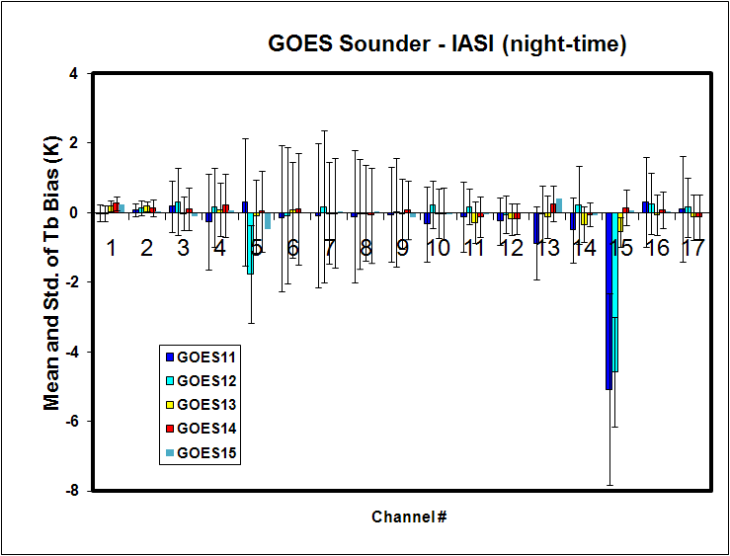
GOES Sounder
Extended GSICS GEO-LEO inter-calibration capability.
Served as a critical tool during the GOES-14 PLT test
Has been implemented for monitoring the current operational GOES sounders’ calibration
GOES-13/14/15 have better sounder calibration accuracy (e.g., ch.15), compared to GOES-11 and 12
Mean and standard deviation of GOES-11 through 15 sounder brightness temperature bias, reference to night-time IASI data

Slide 13
Summary
GSICS is a powerful tool in evaluating the calibration performance, detecting calibration anomaly and improving the calibration accuracy
  Evaluate the operational calibration algorithm
    MBCC, when implemented, can improve the calibration accuracy of short-wavelength and water vapor channels
    GOES Imager IR channels have small angular dependent calibration residual
    GSICS GEO-LEO data can be used to evaluate the stray-light effect
  Provide empirical correction to improve the operational satellite calibration accuracy
  Diagnose the root causes of calibration uncertainty and help to make the corresponding correction or improvement in instrument design
    shift of spectral response function at GOES-13 Imager Ch13.3µm.

Slide 14
Backup slides

Slide 15
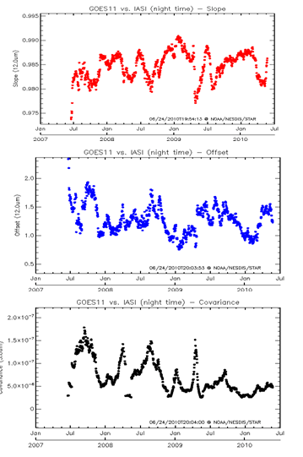
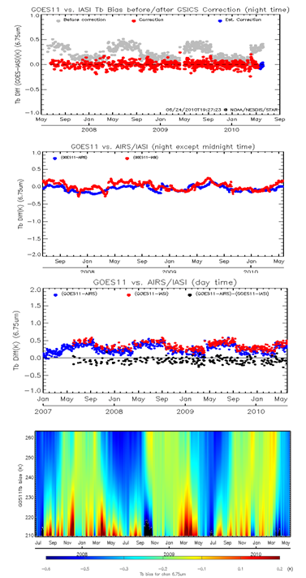
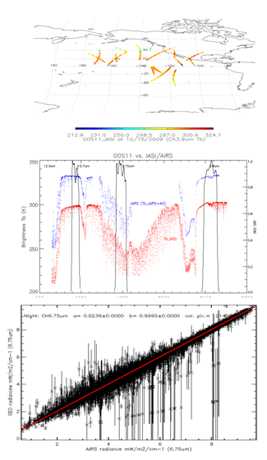
NOAA GPRC Correction Products and Monitoring Website
NOAA GPRC wiki web site: https://cs.star.nesdis.noaa.gov/GPRC
  Correction products
  Correction and bias monitoring
Wiki web-site designed by H. Qian

