Slide 1
GSICS Product Development Plan for Microwave Instruments
Cheng-Zhi Zou¹, Tim Hewison²,
David Walker^{3,} Fuzhong Weng^{1,} Likun Wang (presenter)^{1 ,}
Bob Iacovazzi¹, Emily Liu⁴, Tom Wilheit⁵, Keiji Imaoka⁶
(1) NOAA (2) EUMETSAT, (3) NIST, (4) NASA
(5) Texas A&M University, (6) JAXA

Slide 2
GSICS Microwave Strategy
0. Form microwave sub-group of GRWG
Review Existing Calibration Activities
Scope Users’ Requirements
Identify Requirements met by Existing Activities
  Work with developers towards GSICS compliance
Identify Requirements not met by Existing Activities
  Consider development of new products within GSICS
Define Inter-Calibration References and Traceability
  Work together with NIST to develop standards & guidelines
Ensure Consistency between Different Products
  Through traceability

Slide 3
1. Existing Calibration Activities
Already much work on microwave inter-calibration
Microwave Sounders (i.e. MSU/AMSU)
  Radiance level products (level 1c)
  NOAA : SNO
  NCAR: GPSRO
Microwave Imagers
  GPM X-cal: Windsat-TMI-AMSRE by Vicarious Calibration
  NOAA: SSM/I by SNOs
Bias Monitoring
  NWP Centres: Bias monitoring system for data assimilations
  NOAA: Double-differences and SNOs
Notes:
Check SSM/I?

Slide 4
NOAA CDR Updates
NESDIS/STAR released version 2.0 of SNO-recalibrated 30-year MSU/AMSU FCDR
  Mid-Troposphere (TMT), Tropopause-Stratosphere (TTS), Lower-Stratosphere (TLS) Temperatures
  SNO recalibrated MSU data have been assimilated into NCEP CFSR and NASA MERRA reanalysis systems
  NOAA TLS product has been, for the first time, independently validated by NCAR using GPS-RO calibrated MSU/AMSU products.
SSM/I and SSMIS CDR development plan:
  1) Checking SSM/I Earth Incident angle (EIA) uncertainty
  2) Correction of radio frequency interference (RFI) in the data sets
  3) Correction of SSMIS antenna emission anomaly
  4) Documentation of SSM/I and SSMIS level 1b base files for the community
  5) SSMIS imaging channel recalibration for GPCP and climate user community, etc.
Notes:
Check RFI Radio frequency interference

Slide 5
GPM X-cal interaction with GSICS
GPM X-cal activities are well-developed for Windsat-TMI-AMSRE
Group has been facing issues common to GSICS:
  But not concentrated on operational products yet
  E.g. Whether to issue re-calibrations/corrections
Plan to extend analysis to include AMSR-E before SSM/I
  While starting to look at sounders
Also interested in NWP Double-differencing
  EUMETSAT can share dataset from UKMO study

Slide 6
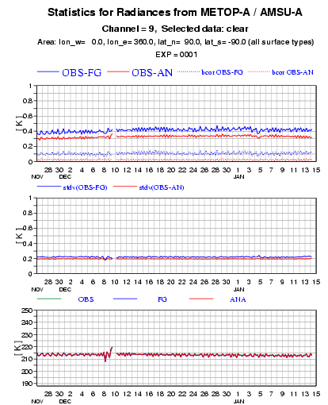
NWP Bias Monitoring
Statistics
1st Step of Data Assimilation:
Observations compared with RTM simulations using NWP model fields
  Quality Control
  Bias Correction
Find Sensitivity to
  Latitude, Longitude,
  Scan Angles
  Time of day, Date
  Radiance, etc...
Find areas with stable bias:
  Clear sky, ocean, night, nadir
Example of NWP Bias Monitoring Statistics for AMSU
From ECMWF

Slide 7
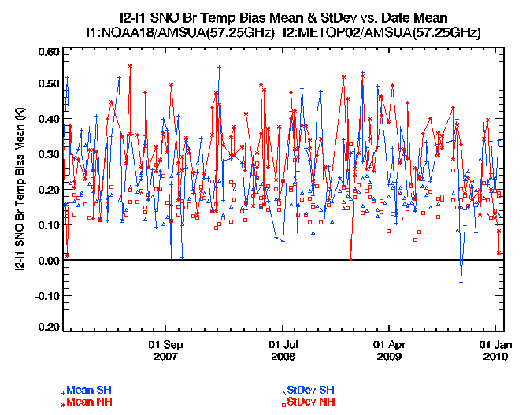
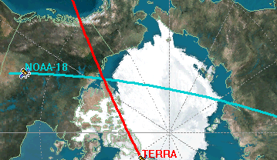
SNOs for Bias Monitoring
Allows direct comparisons
Observations at same
  Location
  Time
  Viewing geometry
Only in polar regions for sun-synchronous satellites
  Highly variable emissivity
  Very few collocations
  Strongly dependent on orbits
  Misses highest radiances
Define collocation thresholds
  Based on variability
Paths of sun-synchronous polar-orbiting satellites cross in polar regions
every few days, giving
Simultaneous Nadir Overpasses
Example Analysis of SNOs for AMSU-A Ch9 on NOAA18 and Metop-A. From NOAA’s GSICS website: http://www.star.nesdis.noaa.gov/smcd/spb/calibration/icvs/new/n18-metopa-amsua.html

Slide 8
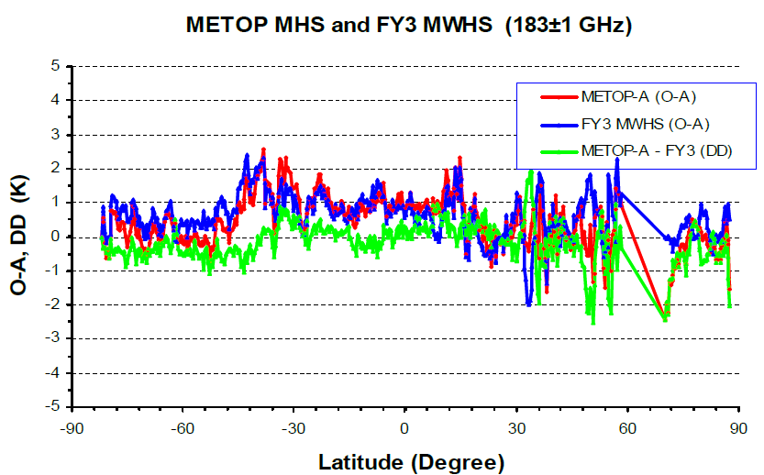
Double Differences for Bias Monitoring
Can compare two Instruments
  Using “Double Differences”
  (Obs1-Model)-(Obs2-Model)
Model Errors ~Cancel Out
Accounts for SRF differences
Covers range of conditions
Relies on NWP model, etc.

Slide 9
NOAA Workshop on Climate Data Record from Satellite Microwave Radiometer
NESDIS/STAR hosted Workshop on CDRs from Satellite Microwave Radiometers: March 2010
Covered topics on instrument calibration and CDR development
  Long-term microwave observations on NOAA, NASA, NAVY, EUMESAT operational polar-orbiters
  Including MSU, AMSU, SSU, SSM/I and SSMIS
Allowed CDR developers to respond interact with users on key concepts and concerns to ensure CDRs are both highly useful and up-to-date
Provides mechanism for running NOAA transparency program to gain community acceptance and credibility by formally and openly describing the NOAA CDR approaches
More than 50 scientists and program mangers attended the workshop, representing more than 20 national/international weather operational canters, research and academic institutes
Workshop presentations reviewed the current status of a few major national/international programs such as the National Climate Service, the NOAA CDR and GSICS programs
Presentations from different institutes reviewed progresses on calibration technique, CDR accuracy evaluation, CDR format requirement, and other issues in CDR development
Issues & recommendations toward developing community consensus CDR products discussed
Presentations : http://www.star.nesdis.noaa.gov/star/meeting_MSU_AMSU_SSU2010.php

Slide 10
2. Scope Users’ Requirements
Who are GSICS users? – Consult at Users’ Workshops
  Internal – to generate level 2 products & Re-processing
  NWP centres reanalysis development
  SCOPE-CM projects
  Satellite Application Facilities (CM-SAF) and NOAA CDR program produce TCDRs & ECVs
What do the GSICS users want?
  Which instruments/channels/time periods, etc...?
    e.g. MSU/AMSU, SSM/I
    Recalibrated radiances?
  What is not met by existing activities?
  We can approve external products meeting GSICS standards
GSICS Products:
  GSICS Bias Monitoring
  GSICS Correction – Near Real-Time or Re-Analysis?
  Inter-calibrated level 1c radiances
    For MSU/AMSU, only available: NOAA SNO recalibrated level-1c products
Notes:
Check scope-cm

Slide 11
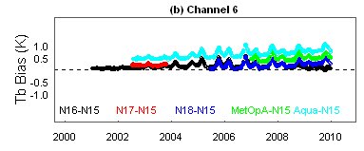
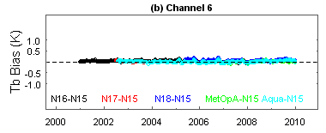
3. Requirements met by Existing Activities
NOAA SNO recalibrated level-1c FCDR can successfully removed the time-varying inter-satellite bias, which may cause spurious climate signals when these satellite measurements are used for climate product retrievals and reanalysis data assimilation.
NOAA SNO recalibrated level-1c FCDR have been assimilated into the new generation of NCEP CFSR and NASA MERRA reanalyses; improved bias correction pattern were achieved.

Slide 12
4. Requirements not met by Existing Activities
For historic microwave observations, there is no absolute calibration standard and hence inter-comparison is required to determine the absolute truth (cannot be resolved by inter-calibration)
For future microwave observations, SI traceable standard that meets climate accuracy requirements is needed (See next slides)

Slide 13
5. Microwave references and traceability
NIST is interested in developing standards & guidelines
  Microwave Brightness Temperature Standard Blackbody
    SI traceable
  Standard Reference Microwave Radiometer
    Well-characterised
  Improving evaluation & documentation of uncertainty
  Best Practice document
    To aid designers in standardizing procedures & analysis
True SI traceability is the long-term goal
  Steps towards that are now achievable

Slide 14
6. Future Activities
NOAA expects to submit MSU/AMSU-A historical inter-calibration products to the GPPA for demonstration mode distribution within a few months.
In the planned next GSICS web meeting:
  Cheng-Zhi Zou (NOAA) will present his algorithm
  Bob Iacovazzi (NOAA) to follow up with a presentation on his analysis of near-realtime AMSU-A SNOs

Slide 15
7. Summary
GSICS Microwave Sub-group
Scope:
  Coordination
  Rapportage
  Review
  Certification of external products as GSICS-compliant
  Development of GSICS Products
To Review:
  Different calibration methods
    SNO
    Statistical Analysis Method (regional/global)
    NWP Double-Differencing Method
  Requirements met by the activities
  Reference Instruments/Traceability
Membership
  Internal: from GSICS from GRWG/GCC
  External: to represent each major activity in microwave inter-calibration

Slide 16
Thank You
Any Questions?

Slide 17
Backup Slides

Slide 18
Vicarious and Statistical
Inter-Calibration Methods
Vicarious Calibrations
Global/Regional Statistics
Can identify invariant targets as vicarious references
Min T_{b} observed over sea
  Conditions?
  Model Reference?
Dense forest canopies
  Emissivity ~1.00 Ts=?
Compare 2 instruments’ obs of vicarious targets
aka Histogram Equalization
Commonly used for long-term climate monitoring
Compare Mean T_{b}s observed
  Over long periods
  Over large areas
Need to account for known causes of variance
  Orbital/Geometry changes
  Thermal changes

