Slide 1
SCOPE-CM Statement of Needs
John Bates (NOAA, SCOPE-CM Executive Panel Chair)
Lothar Schüller (EUMETSAT, SCOPE-CM Secretariat)

Slide 2
WMO’s SCOPE-CM initiative: goals and structure
Aim: to address the requirements of GCOS in a cost-effective, coordinated manner, capitalising upon the existing expertise and infrastructures.
Objective: continuous and sustained provision of high-quality Essential Climate Variables satellite products (Climate Data Records) on a global scale
Structure: The SCOPE-CM Network will be:
        Based on activities of existing initiatives (GOS, GCOS and GSICS)
        Build upon existing operational infrastructures
        Serve users and other organisations (e.g. WMO Regional Climate Centres RCC, National Weather Services)

Slide 3








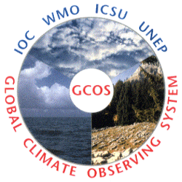
WMO’s SCOPE-CM initiative: goals and structure
Initial Participants of the SCOPE-CM Network
Operational Satellite operators:
  NOAA
  JMA
  CMA
  EUMETSAT (Central Facilities and CM SAF)
Stakeholder
  WMO Space Programme
  GCOS
  CEOS
  CGMS/GSICS
  WCRP/GEWEX-RP
  GEO

Slide 4






SCOPE-CM Pilot Projects
 | Sensors | Parameters and topics | Lead | Contributors
1 | AVHRR | Clouds and Aerosols
2 | SSM/I | Water vapour, clouds, precipitation
3 | GEO | Surface albedo, clouds and aerosols
4 | GEO | Winds and clear sky radiances
5 | GEO | Upper tropospheric humidity

Slide 5
Assumptions
GSICS will provide corrections (w.r.t. selected references) that can be applied to generate FCDRs
SCOPE-CM generates FCDRs and related TCDRs
GSICS
SCOPE-CM
Corrections
FCDR
TCDR
Needs

Slide 6
High level Requirements
SCOPE-CM high level needs from GSICS:
Development of corrections (and/or correction methodology) applied to recent/current data.
Development of corrections, that would allow a seamless integration/comparability of existing correction schemes (applied to historic data)
Provision of the most appropriate corrections for the sustained extension of FCDRs in the future.

Slide 7
General Need 1:
Development of corrections (and/or correction methodology) applied to recent/current data.

Slide 8
General Need 2:
Development of corrections, that would allow a seamless integration/comparability of existing correction schemes (applied to historic data)

Slide 9
General Need 2:
Development of corrections, that would allow a seamless integration/comparability of existing correction schemes (applied to historic data)

Slide 10
General Need 3:
Provision of the most appropriate corrections for the sustained extension of FCDRs in the future

Slide 11
Distributed responsibilities
GSICS: Construction and maintenance of pillars and cables;
SCOPE-CM: Building train tracks (=FCDRs);
Scientific community and SCOPE-CM:
Providing trains that ride on the bridge (=TCDRs);
SCOPE-CM: Providing track maintenance and extensions;
Scientific community and SCOPE-CM:
Providing assessments of pillars and tracks as well as of trains;
Scientific bodies such as GEWEX-RP:
Assessment of outcomes and provision of guidance for GSICS and SCOPE-CM.

Slide 12
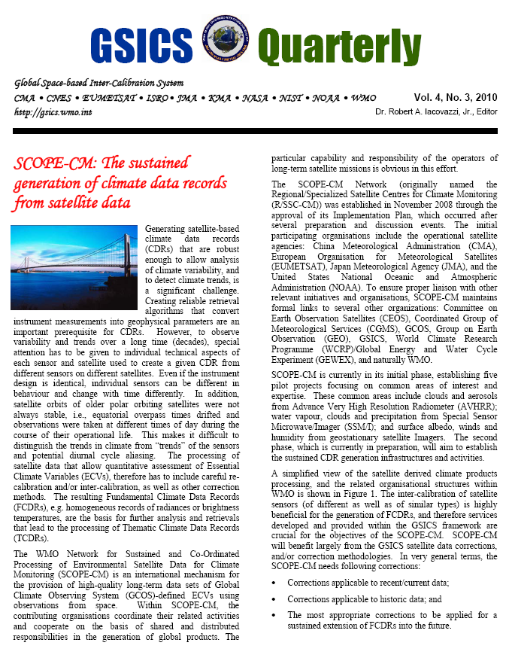
See article on the recent GSICS Quarterly Issue

Slide 13
Preliminary statement of needs
SCOPE-CM Executive Panel Meeting in May 2010:
    SCOPE-CM will collect specific “Statement of Needs” from its Pilot Project and formally provide it to GSICS.
Preliminary statement of needs:
Pilot 1: AVHRR Clouds and Aerosols
Thermal calibration of TIROS-N and future AVHRR sensors
support to further extend and archive the AVHRR clock error values
...

Slide 14
Preliminary statement of Needs
Pilot 3: Surface albedo from GEO Sensors
Calibration coefficients, The actual sub-satellite point during the acquisition, acquisition time and geolocation of all pixels,
The VIS band spectral response and associated uncertainty
The inter-calibration verification of the VIS band between to adjacent GEO satellites.
....

Slide 15
Preliminary Statement of Needs
Pilot Project 5: Upper Tropospheric Humidity
Development of a Geo/Leo correction based on IASI for complete MVIRI/SEVIRI-HIRS/IASI series.
Check if this is consistent with Meteosat overlaps of MVIRI (0°/IODC)
Evaluation of cross calibration of IR 6.x μm vs. AMSU-B 183GHz
How can errors due to satellite drift in polar orbiters be corrected?
....

Slide 16
Way forward
Consolidation of SoN at next SCOPE-CM Meeting (October 2010)
SCOPE-CM SoN to GSICS as planning and coordination mechanism
Updates of SoN according to SCOPE-CM Evolution and Extension
Continue to cross walk with GEWEX RP intercalibrations (e.g., ISCCP, GPCP, etc.
....

