Slide 1
Users' Feedback on GSICS Products in Demonstration Phase
Fangfang Yu
On behalf of GSICS Coordination Center
06 September 2011

Slide 2
Welcome users feedback, now or after workshop.
Fuzhong Weng, GCC Director, has nominated Xiuqing (Scott) Hu as Acting Deputy Director.

Slide 3
GSICS Procedure for Product Acceptance (GPPA) – Current Product Status
Progress of Candidate Products in Demonstration Phase
GL01.1.0 - GSICS Correction for EUMETSAT IR Channels based on IASI
GL02.1.0 - GSICS Correction for MTSAT IR Channels based on AIRS and IASI
GL03.1.0 - GSICS Correction for GOES Imager IR Channels based on AIRS and IASI
Achieved flow of near-real time data and re-analysis data to GSICS Servers
ATBD and Traceability to SI Standards documents were accepted as of March 3, 2011
Documentation of use of associated radiative transfer models and cal/val supporting measurements under review
Testing by two or more potential users of product
GL04.1.0 – GSICS Correction for GOES Sounder IR Channel based on IASI
  Achieved flow of near-real time data to GSICS Servers
LL01.1.0 - Patmos-X AVHRR solar reflective channel corrections based on MODIS
Achieved flow of near-real time data to NOAA GSICS Server
Under testing by three or more potential users of product
Submitted ATBD and Traceability to SI Standards documents
LL01.2.0 – Consistent level-1C radiances and upper airs deep-layer temperature climate data records from MSU/AMSU observation
Submitted ATBD

Slide 4
Progress in GSICS Product Evaluation During Demonstration Phase
GCC Director to collect and disseminate users feedback regarding product's data usability and format.
  External users’ feedback for EUMETSAT/JMA/NOAA GEO-LEO products have been received

Slide 5
Users’ Feedbacks
Internal users vs. external users
  Internal users – calibration community
External Users’ Feedback – GEO-LEO IR
  ATBD – for Imager IR
  Data (calibration coefficients etc) – for Imager IR
  Impacts on the products – both formal and unformal
Internal Users
  Evaluate, monitor and diagnose calibration accuracy
    Midnight calibration anomaly
    decontaminations
    Spectral response function correction

Slide 6
Feedback on ATBDs
Clarify
  generally well understood, straightforward and could be produced without problem
Utility
  The method was fully adequate for the tested product.
Reproducibility
  well documented, so it would be no difficulty to reproduce the results.

Slide 7
Feedback on the Product Data
Data Accessibility
  Intuitive, the download extremely fast
Data Availability
  No problem
Data Ease of Use
  Applicability of the GSICS correction was ensured, no problems encountered concerning the metadata.
  Some users may need to learn how to read the netCDF files
  Some users ask for the brightness temperature (Tb) dependent products
    Solutions: the instruction to read the netCDF and conversion between radiance to Tb are provided at the FAQ&Tools web-page
Product Suitability
  Did not find any problems
Product Reliability
  No problem here

Slide 8
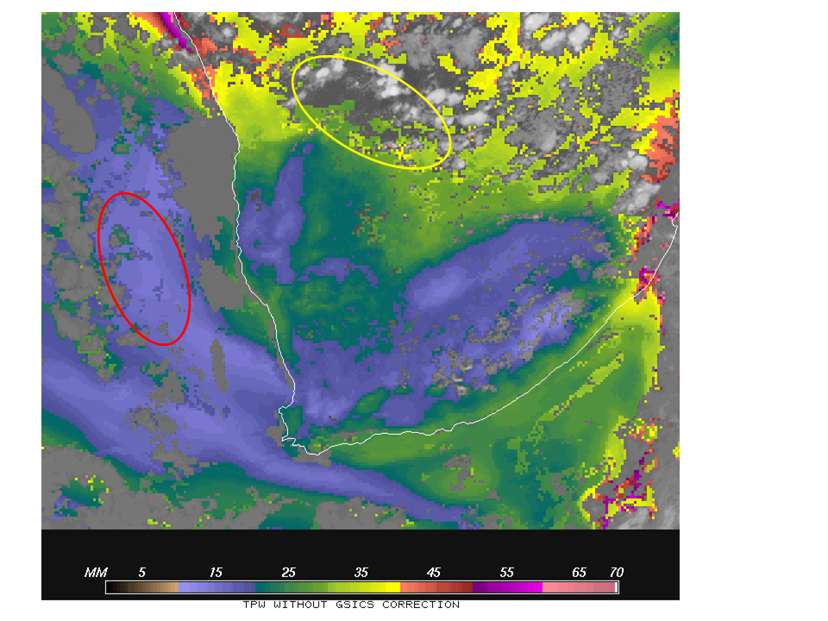
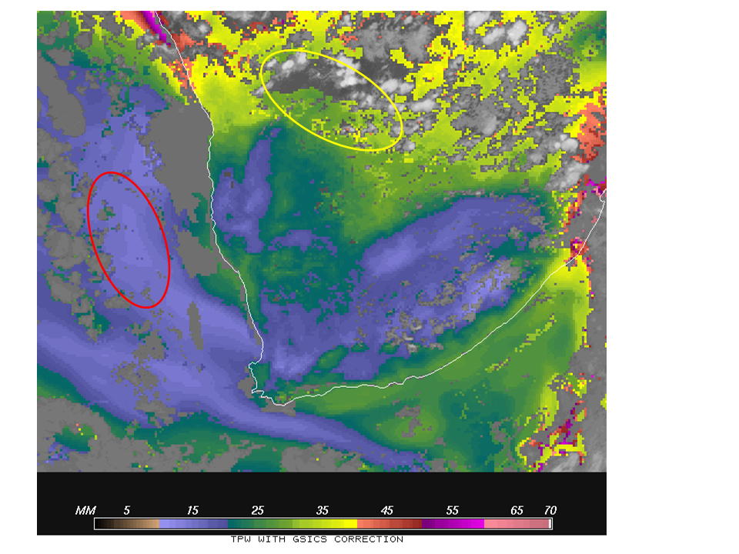
EUMETSAT – Products
Global Instability Indices Product
TPW derived with nominal MET9 radiance
TPW derived with GSICS corrected radiance
With thanks to Marianne König (EUMETSAT)
Notes:
Global Instability Indices – Total Precipitable Water product

Slide 9
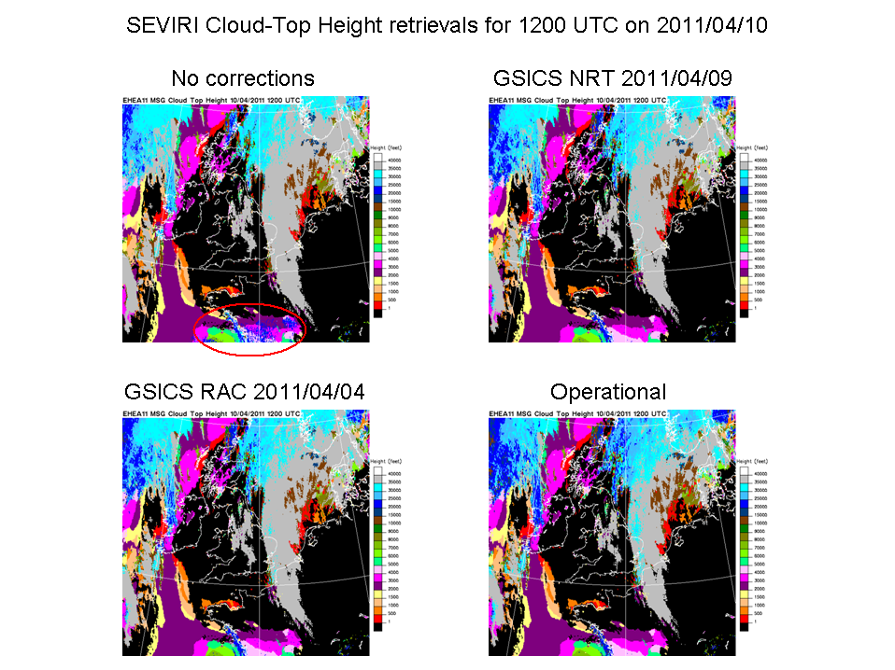
EUMETSAT – Products
Cloud Top Height Retrieval
With thanks to Pete Francis (Met Office)
Notes:
CTH: cloud-top height
Operational: Tt bias correction applied account for the relative biases between the measured radiances and those calculated from the background model first-guess.

Slide 10
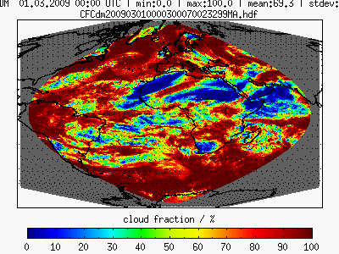
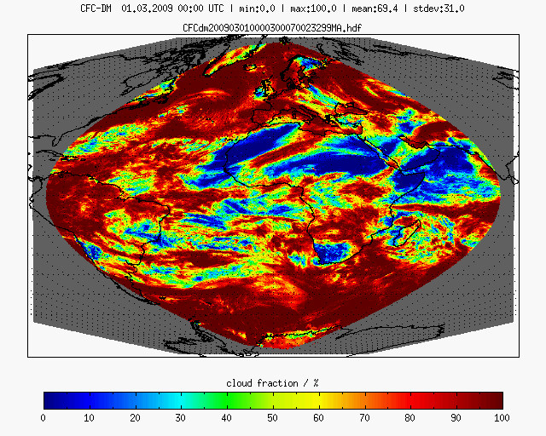
EUMETSAT – Products
Effect of GSICS calibration on CM SAF’s cloud products
original
calibrated
Cloud Fractional Cover: daily mean
With thanks to Anke Kniffka (DWD)

Slide 11
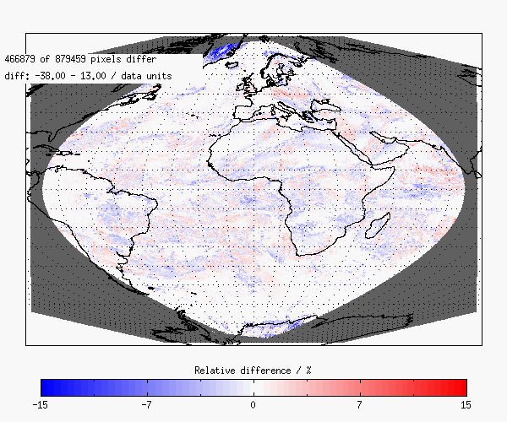
EUMETSAT – Products
Effect of GSICS calibration on CM SAF’s cloud products
Negative values:
More clouds with calibration
With thanks to Anke Kniffka (DWD)

Slide 12
EUMETSAT – Products
Effect of GSICS calibration on CM SAF’s cloud products
Cloud mask statistics
original
calibrated
Some pixel are flagged as clear now (cloudy before), about twice as much crop up (clear before)
Equally distributed in space
With thanks to Anke Kniffka (DWD)

Slide 13
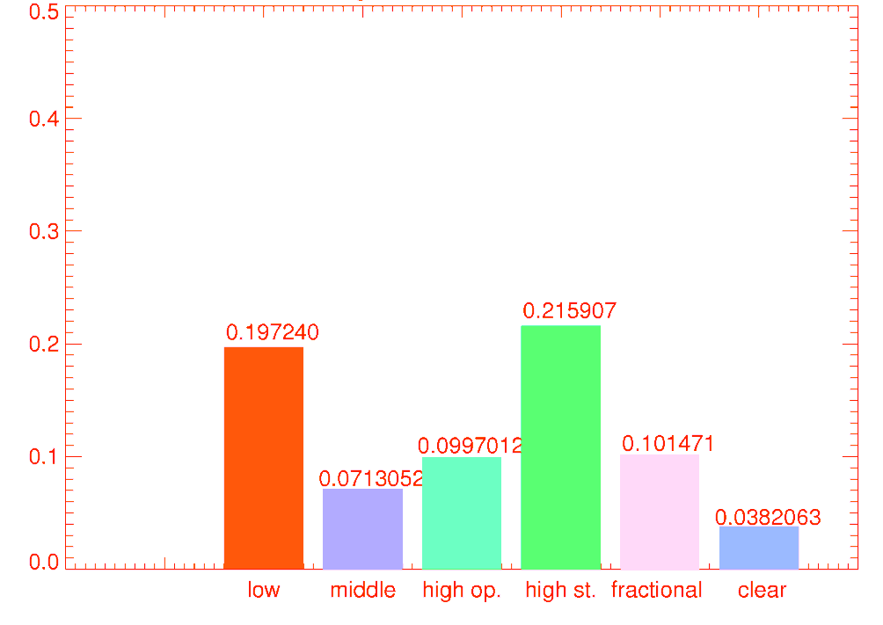
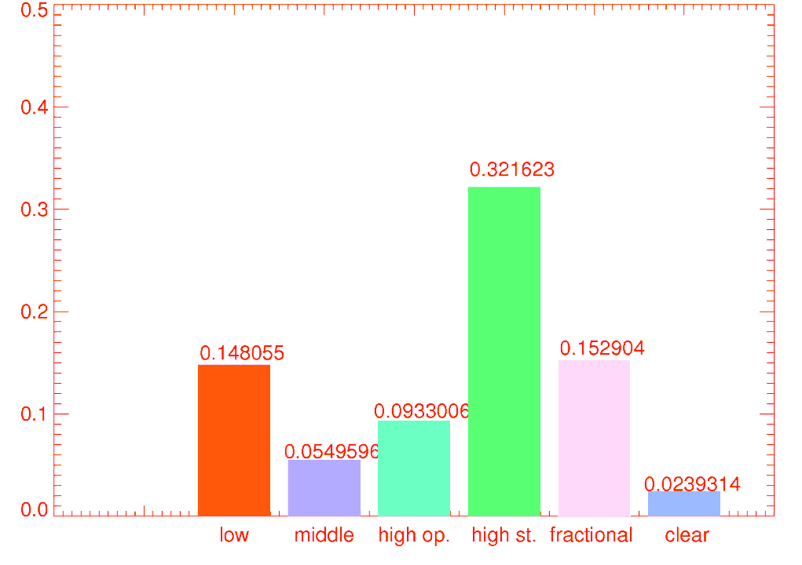
EUMETSAT – Products
Effect of GSICS calibration on CM SAF’s cloud products
Cloud fraction for different cloud types
original
calibrated
More cloudy pixel
Noticeable rise of high semitransparent cloud class
With thanks to Anke Kniffka (DWD)

Slide 14
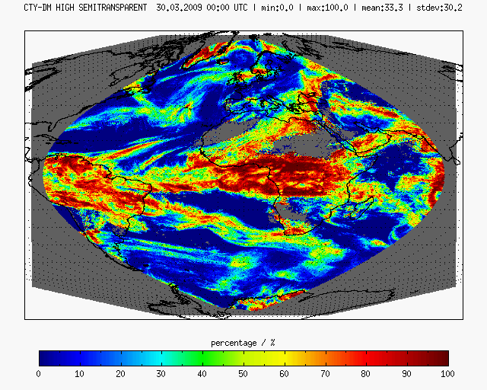
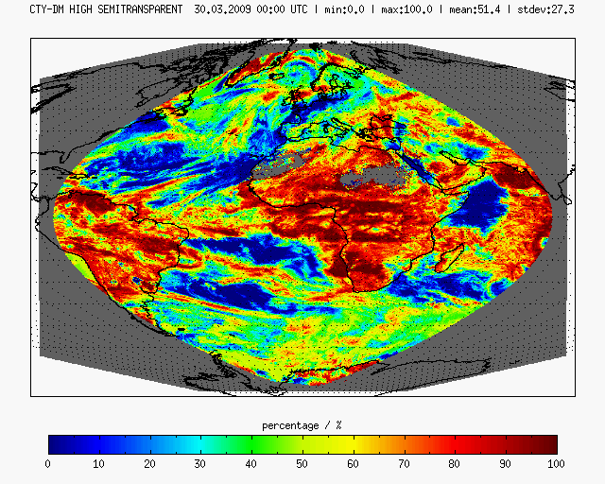
EUMETSAT – Products
Effect of GSICS calibration on CM SAF’s cloud products
original
calibrated
No calibration for visible channels so far -> effect on thresholds for cloud type determination
With thanks to Anke Kniffka (DWD)

Slide 15
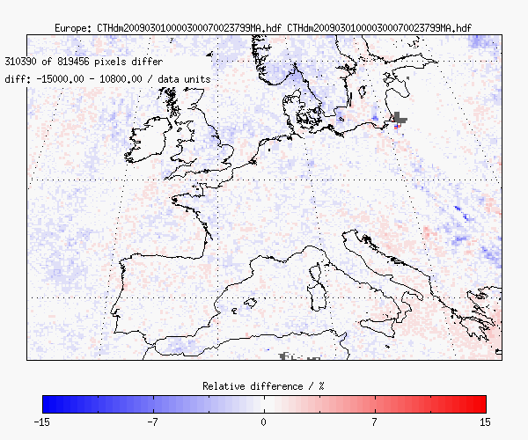
EUMETSAT – Products
Effect of GSICS calibration on CM SAF‘s cloud products
neg. values refer to higher clouds with calibration
With thanks to Anke Kniffka (DWD)

Slide 16
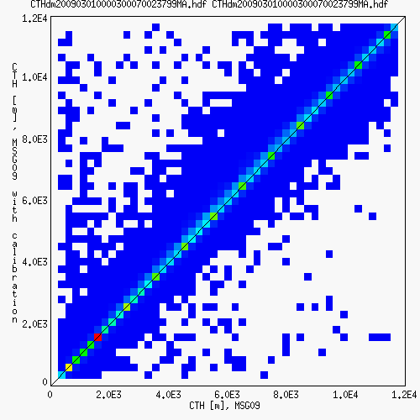
EUMETSAT – Products
Effect of GSICS calibration on CM SAF‘s cloud products
With thanks to Anke Kniffka (DWD)

Slide 17
EUMETSAT – Products
Effect of GSICS calibration on CM SAF’s cloud products
Request for calibration in visible channels -> Can cause problems with consistency
Validation with ground based data will be carried out

Slide 18
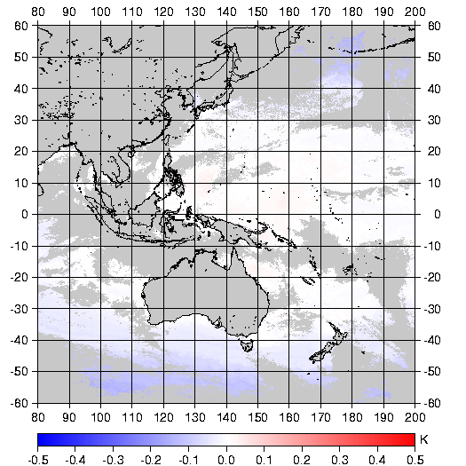
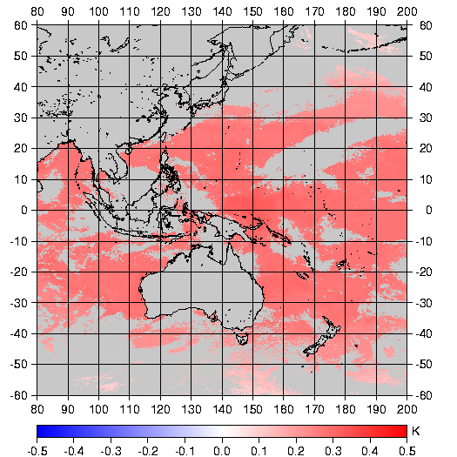
JMA – Products
SST Retrieval
Fig-1 Differences between SSTs with and without GSICS correction (corrected SST – non corrected SST)
Left shows the result for 2011.1.8 and right shows it for 2011.3.1.
With thanks to Yukio Kurihara(JMA)

Slide 19
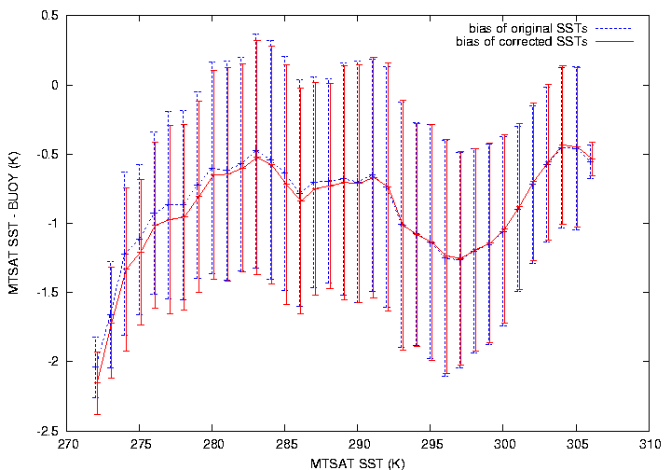
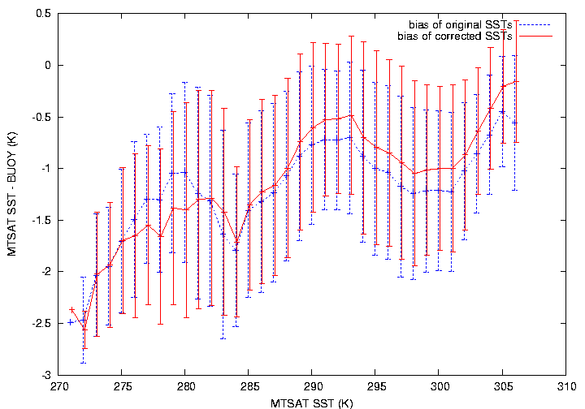
JMA – Products
SST Retrieval
Fig-2 Mean differences (MTSAT SST minus in-situ SST) and standard deviations against in-situ SSTs
Statistics for the SSTs with and without GSICS correction are plotted with red and blue, respectively. Left shows the result for 2011.1.8 and right shows it for 2011.3.1.
With thanks to Yukio Kurihara(JMA)

Slide 20
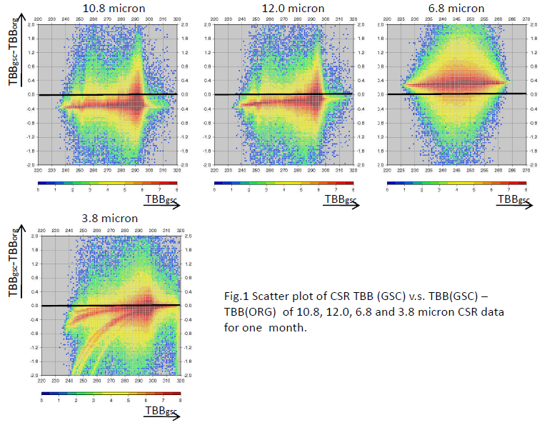
JMA – Products
Clear sky radiance products
With thanks to Takahito Imai (JMA)

Slide 21
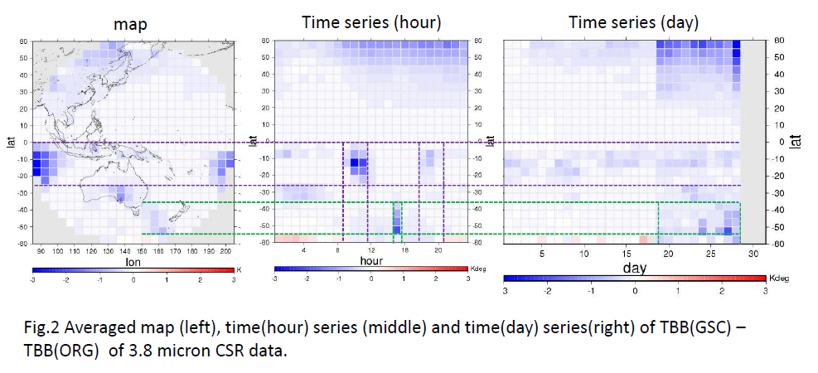
JMA – Products
Clear sky radiance products
With thanks to Takahito Imai (JMA)
Notes:
In the map of TBB(GSC) – TBB(ORG) (Fig.2 left), there are large bias area at (1) east and west edge near equator and (2) south edge near New Zealand. Bias (1) seems to concern with reflected sunlight, since it occurred at 09-11 and 17-20UTC of almost everyday in time series figures (Fig.2 middle and right). Bias (2) seems to concern with stray light, since it occurred at 15 UTC of last ten days which are close to eclipse time period.

Slide 22
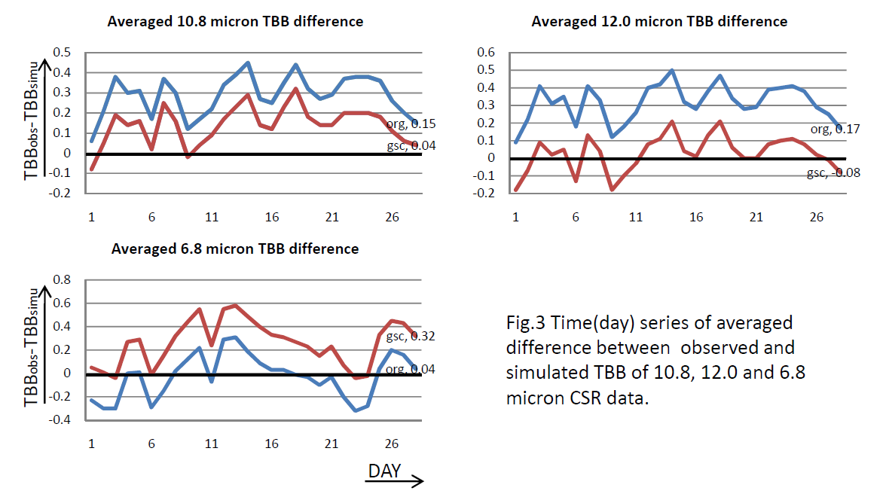
JMA – Products
Clear sky radiance products
With thanks to Takahito Imai (JMA)
Notes:
Fig.3 shows comparison against simulated CSR TBB data (SIMU) which is calculated from JCDAS (Climate Data Assimilation System) GPV data using RTTOV 10. Comparisons are done for every 6 hourly data. 3.8 micron is absent, since calculations taking sun light into account are not done. Figures shows that GSC is closer to SIMU than ORG in 10.8 and 12.0 micron CSR TBB, and GSC is far from SIMU than ORG in 6.8 micron CSR TBB.

Slide 23
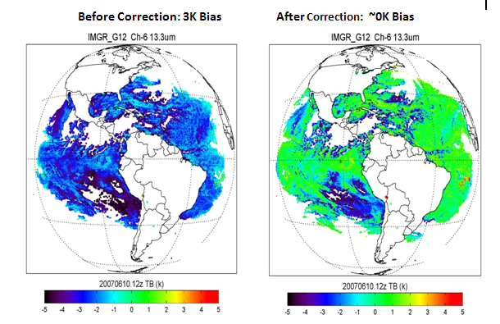
NOAA – Products (CRTM)
Tb difference to RTM results
Notes:
The difference between observed and calculated brightness temperatures for GOES-12 13.3 μm channel before and after the GSICS correction is applied. The GSICS correction is determined from the GOES- AIRS differences in the upper panel.
the difference between observed brightness temperatures (BTs) and brightness temperatures computed using a radiative transfer model and the
National Centers for Environmental Prediction (NCEP) analysis atmospheric state parameters for GOES-12 channel 6, before and after the correction,
respectively. The bias is reduced from 3 K to nearly zero, a significant improvement for both weather and climate users.

Slide 24
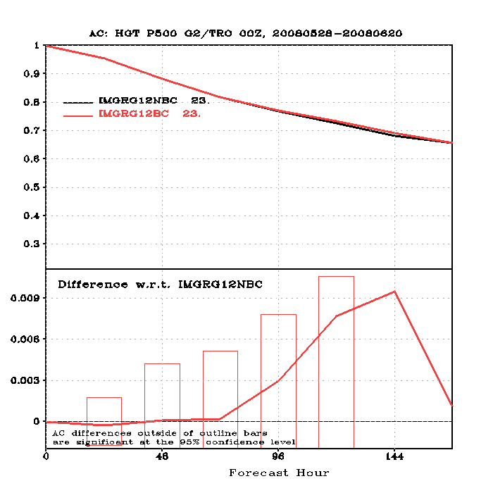
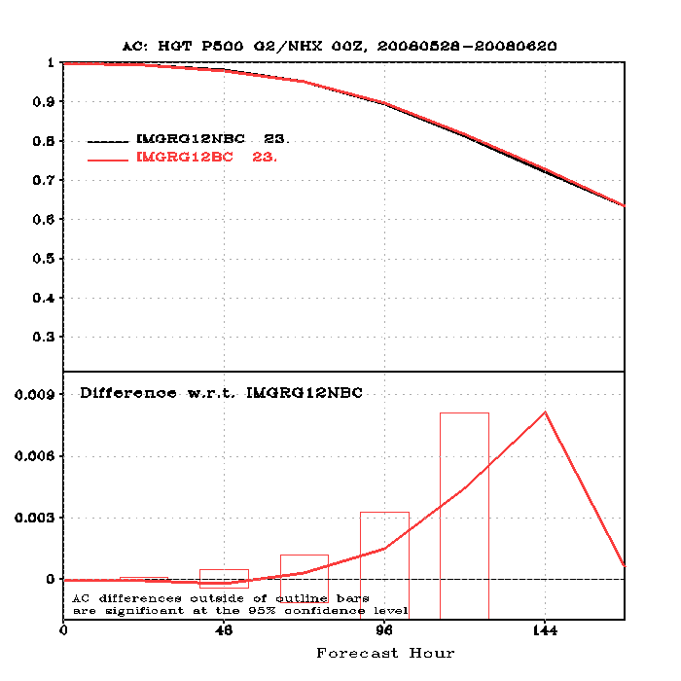
NOAA –Products
GFS Simulation Experiments
Figure. Anomaly correlation for 500 hPa geopotential height over (a) Tropical, (b) North Hemisphere. Black line is the anomaly correlation for the simulation without GSICS calibration correction and the red line is for the simulation with GSICS calibration correction.
Notes:
One-month GFS simulation experiments have been performed to study GOES imager impacts with and without GSICS correction. It was found that 7-day GFS forecasts were improved after using GSICS calibration correction algorithm.
The outline bar is the 95% confidence level. If the red line above this bar, it means that the GSICS correction has significant positive impacts. In these two figures, the red lines close to this bar, so we can say GSICS correction can give good positive impacts.

Slide 25
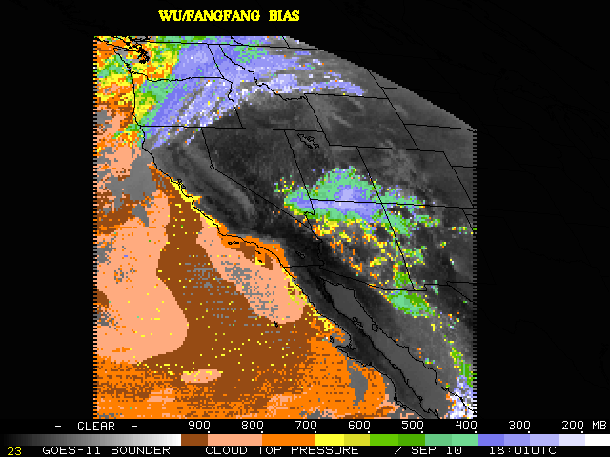
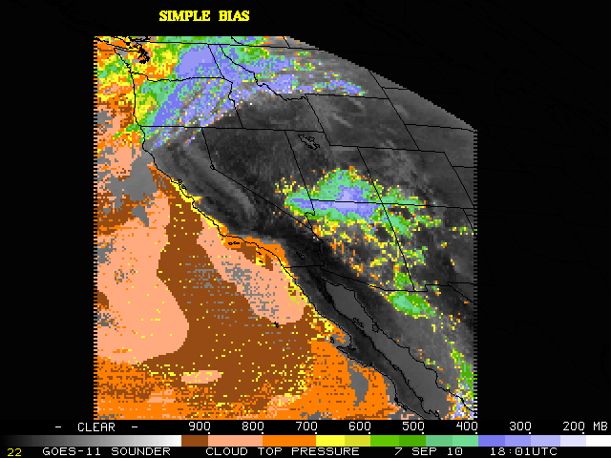
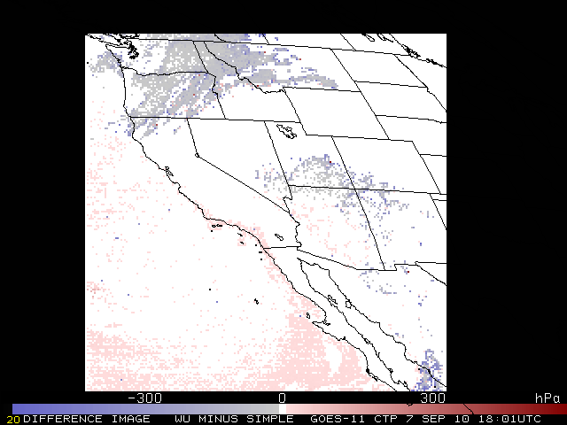
GOES-11 Sounder Cloud Top Pressure for 7 September 2010, nominal 18UTC image, generated using:
GSICS coefficients as bias correction.
The “Simple Bias” correction.
The difference (GSICS-Simple) in the bias correction methods, which demonstrates that with the GSICS bias some of the high clouds (north, southeast portions of the image) get higher and some of the lower clouds (Pacific) get lower (higher pressure). It also appears that the GSICS bias takes out more of the noise.

Slide 26
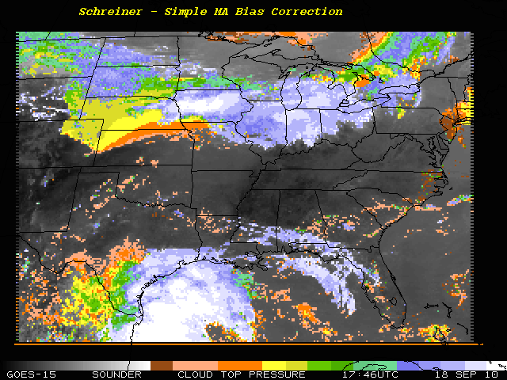
GOES Sounder Cloud-top pressure
Fairly noisy higher cloud pixels
GSICS seems to improve (less noise) upon the simple bias correction method for this case, although the masks seems to be adversely affected.

Slide 27
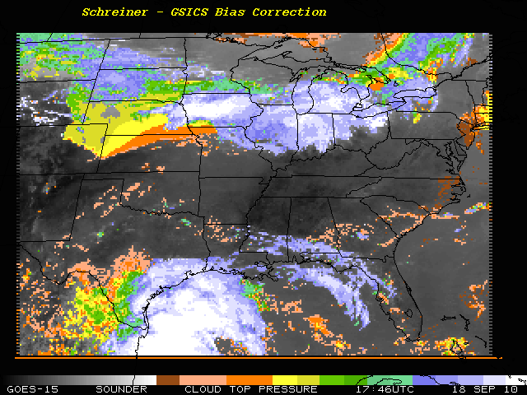
GOES Sounder Cloud-top pressure
More uniform cloud pixels

Slide 28
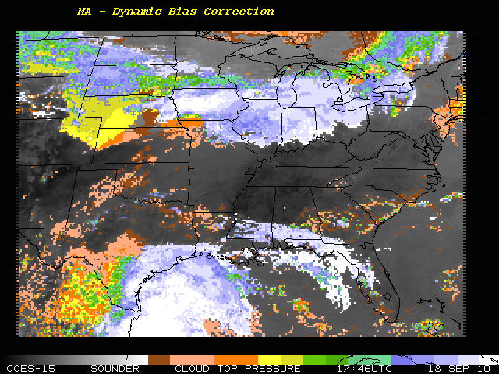
GOES Sounder Cloud-top pressure
Fairly noisy higher cloud pixels and missing clouds
GSICS seems to improve (less noise) upon the dynamic bias correction method for this case.
Notes:
Dynamic bias correction is the current NOAA NESDIS version.

Slide 29
GOES Sounder Cloud-top pressure
More uniform cloud pixels and more low cloud

Slide 30
Internal Users
Evaluate radiometric calibration accuracy
Identify and correct the root cause that compromise calibration accuracy, e.g., revising the system spectral response function, decontamination, midnight calibration anomaly.

Slide 31
FY-2C/2D/2E
bias@220K
Notes:
Calibration accuracy increases at the FY-2C/2D/2E series.

Slide 32
Internal Users - KMA
TB vs. ΔTB(COMS – AIRS)
Notes:
was launched in June, 2010

Slide 33
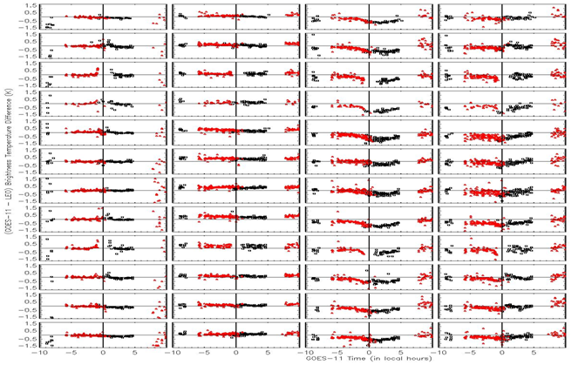
Internal Users – Midnight Calibration Anomaly
GOES-12
MTSAT-2
Jan
Feb
Mar
Apr
May
Jun
Jul
Aug
Sep
Oct
Nov
Dec
3.9μm
6.5μm
10.7μm
13.3μm
3.9μm
6.5μm
10.7μm
12.0μm
Courtesy of JMA GSICS GPRC

Slide 34
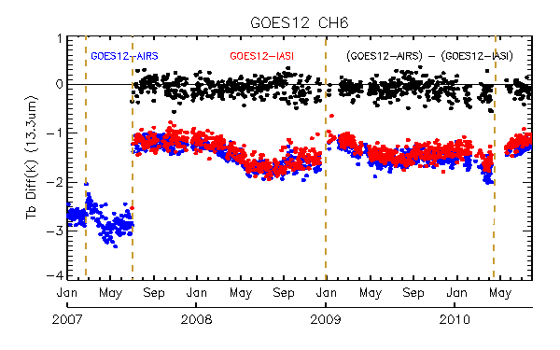
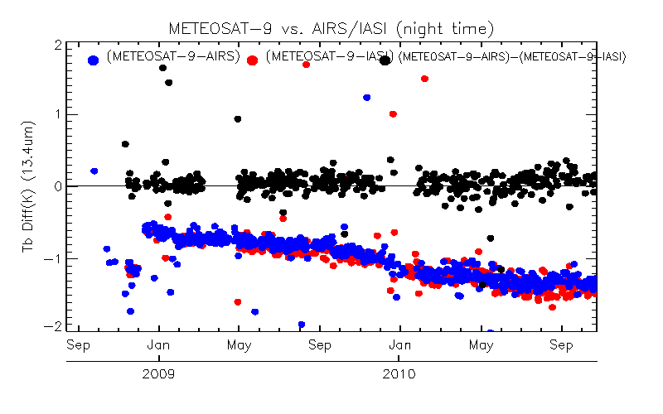
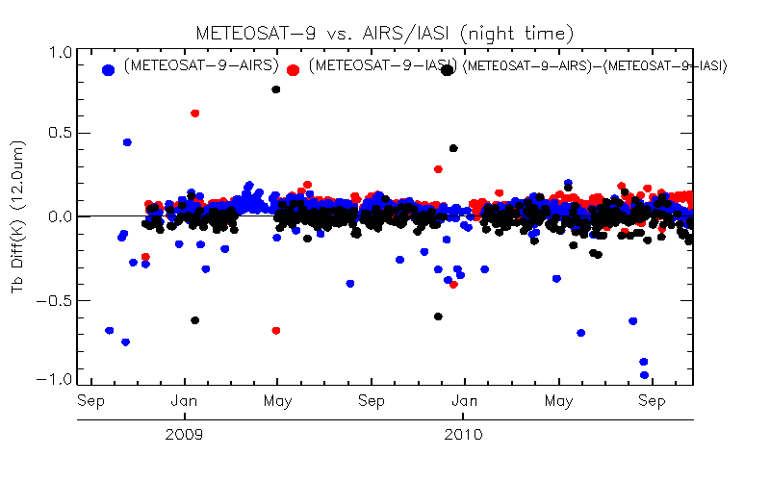
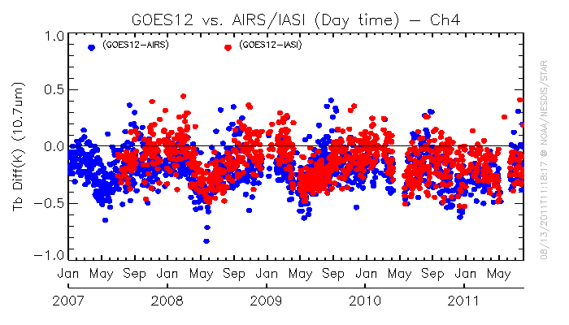
Internal Users - Decontaminations
GOES-12 Imager
MET-9 SEVIRI

Slide 35
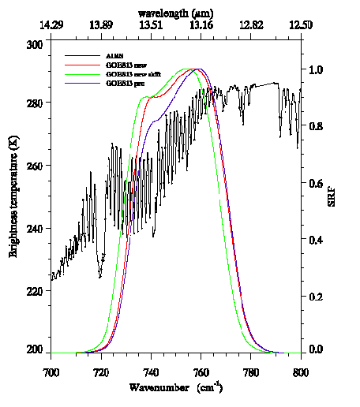
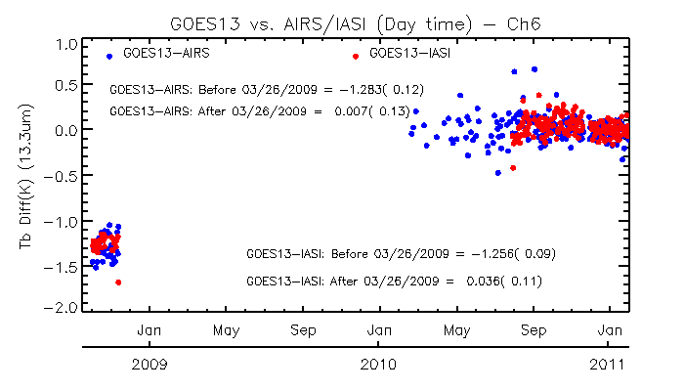
NOAA – Shifting the SRFs
GOES-13 Imager Ch6 (13.3μm)
Notes:
GOES-13 Ch6 SRF shifted in 2009

Slide 36
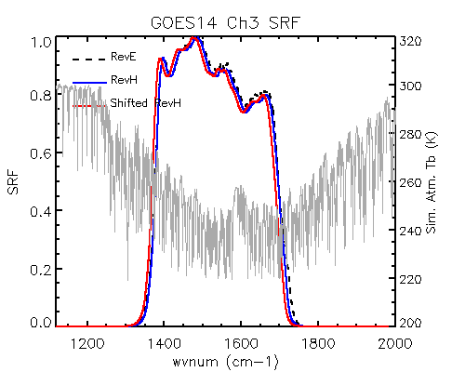
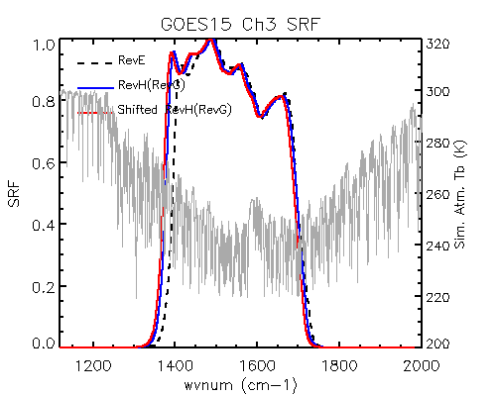
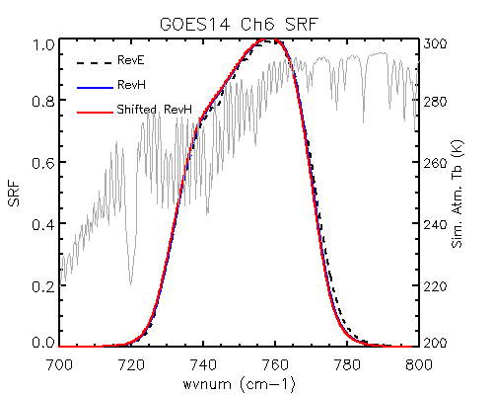
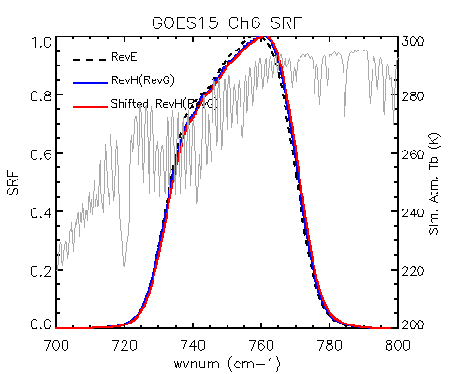
NOAA – Shifting the SRFs
GOES-14 Imager Ch3 (6.5μm) and Ch6 (13.3μm)
GOES-15 Imager Ch3 (6.5μm) and Ch6 (13.3μm)
Notes:
RevE, RevH, and shifted RevH spectral response functions of GOES-14/15 Imager Ch3 and Ch6 (dash black, blue solid and red solid lines), together with the IASI simulated TOA Tb for a clear tropical atmospheric profile (gray lines at second y-axis). Note that RevG and RevH SRFs are identical for GOES-15 Imager IR channels

Slide 37
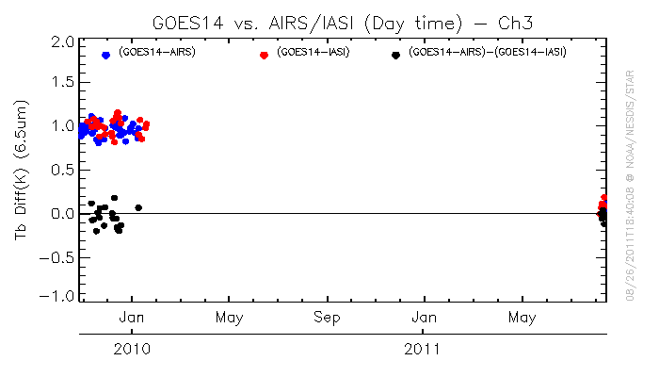
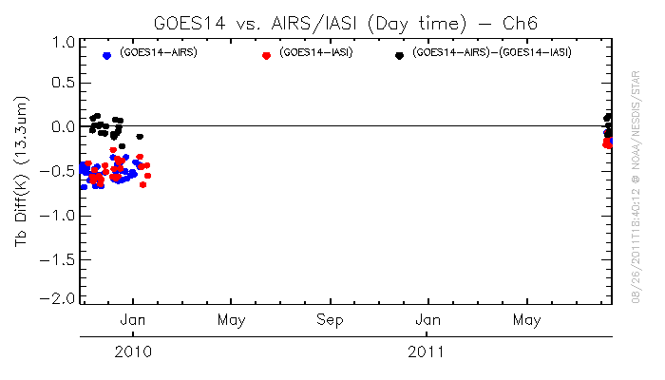
NOAA - Evaluations of Shifted SRFs
GOES-14 Tb bias to AIRS/IASI Before/After SRF shifts
G14 Ch3
G14 Ch6

Slide 38
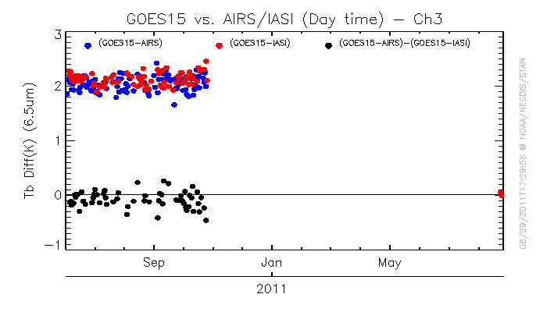
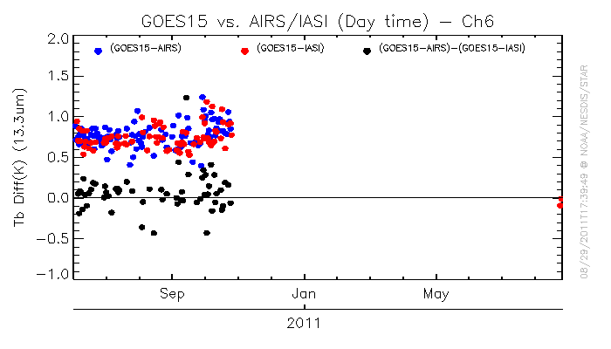
NOAA - Evaluations of Shifted SRFs
GOES-15 Tb bias to AIRS/IASI Before/After SRF shifts
G15 Ch3
G15 Ch6

Slide 39
Conclusions
External users
  Outside users have very positive feedbacks on the ATBDs and correction data availability.
  Imager:
    Apparent impacts of the products relied on the MET-9 and GOES-12 13.3μm channel data.
    Also may have impacts on the SST retrieval
    Correction for the visible channel is requested for the CMSAF cloud products
  Sounder:
    Initiative results of cloud top pressure is encouraging

Slide 40
Conclusions
Internal users
  Each agent use it to evaluate, monitor and diagnose the calibration accuracy
  More successful examples to shift the SRF to improve the radiometric calibration accuracy.

Slide 41
Backup Slides

Slide 42
Progress in GSICS Product Evaluation During Demonstration Phase
GSICS Product Acceptance Team (GPAT) and product providers to examine and remediate the submitted documents (radiative transfer models and cal/val supporting measurements) being consolidated into one document for all GEO-LEO IR GSICS Correction products.

Slide 43
Back Process Plan @ Univ. Wisconsin
GEO-LEO Back Processing @ Univ. Wisconsin
AIRS
IASI
Aug2003
Jun2007
105W
GOES-8
GOES-10
Jun06
Jun06
Jan07 Jan08 Jan09 Jan10 Jan11
GOES-11
GOES-12
Jun/07
Meteosat-7
Aug/08
Jan2004
Meteosat-8
Aug/08
Jun2005
MTSAT-1R
Oct2004
Nov/09
FY-2C

Slide 44
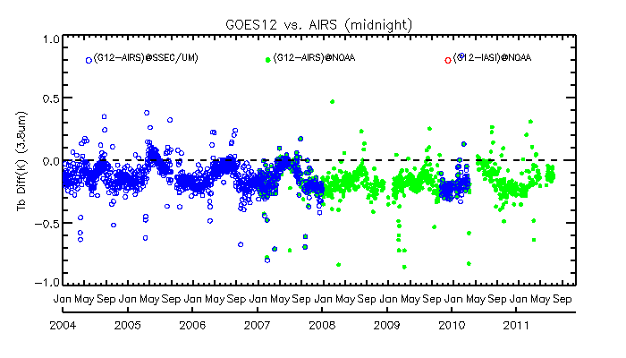
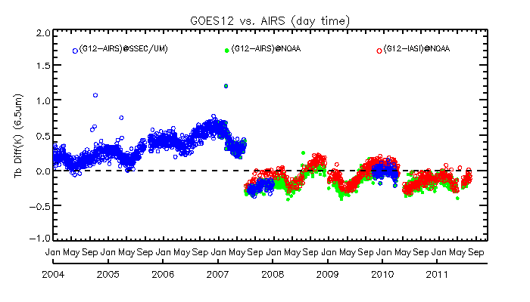
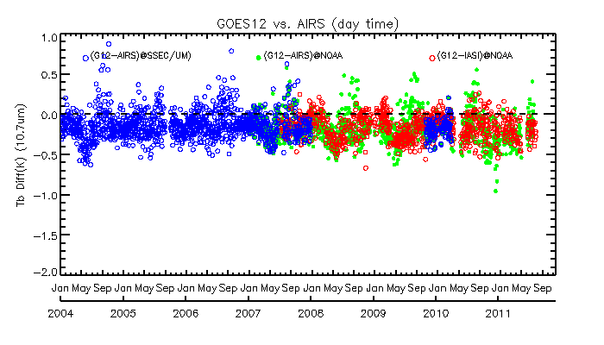
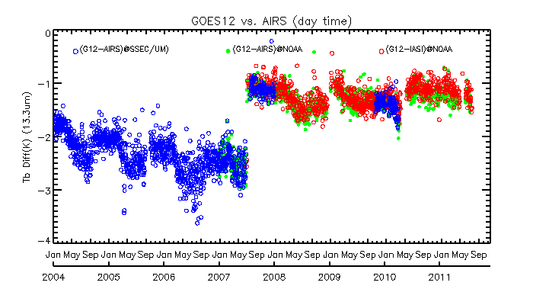
Inter-comparisons the GOES-12 vs. AIRS/IASI collocated data conducted at NOAA and Univ. of Wisconsin
G12 Ch2 (3.9μm, midnight)
G12 Ch3 (6.5μm, daytime)
G12 Ch4 (10.7μm, daytime)
G12 Ch6 (13.3μm, daytime)

Slide 45
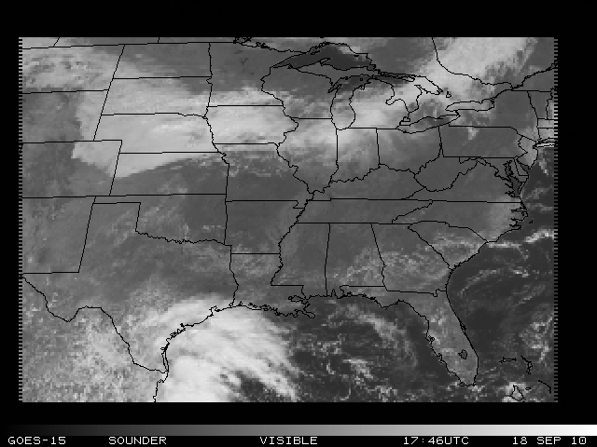
GOES Sounder Visible band
Low cloud coverage

Slide 46
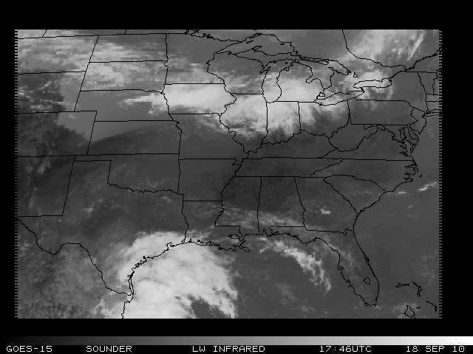
GOES Sounder Longwave Infrared
High clouds embedded in this low level cloud bank
Notes:
The red circle is included for two reasons. First, the Schreiner-GSICS version tends to be more "smooth" less high clouds embedded in this low level cloud bank. As will be noted in the second circle, this tends to be one of the strengths of the GSICS Bias Coefficients over the "Simple Bias Correction" and the "Dynamic Bias Correction" methods. One curiosity in the red circle region is the large "donut hole" in the northern region of the circle for the "GSICS". None of the other two GOES-15 derived products demonstrate this "hole", and the LWW and VIS show no obvious reason for the hole either.
The white circle in large part also demonstrates the "smooth" nature of the GOES Sounder Cloud Product using the "GSICS" compared to the other two GOES-15 Sounder derived Products. Yet the "Schreiner-GSICS" still keeps the lone high cloud in the south-southwestern sector of the white circle. This "high cloud" is also indicated in the LWW image.

