Slide 1
GPM Intersatellite Calibration (“X-CAL”) Status & Cooperation with GSICS
Tom Wilheit
Texas A&M University
&
Arthur Hou
NASA/GSFC

Slide 2
GPM Intersatellite Working Group (aka X-CAL)
Make Radiances from Constellation Radiometers Physically Consistent
Differences of Frequencies/Incidence Angles
Clean Up Other Problems (Pre-Screening)
Variety of Methods To Generate Two Point Recalibrations
Unified set of Deltas
Tb_{new} = A*T_{bold} + B
Could Be More Complex Where Necessary.
Currently Have Consensus Calibration based on Windsat and TMI
Use TMI as Transfer Standard. (CC_1.1) (75% Windsat—25% TMI)

Slide 3
Consensus Calibration
Warm End Variance TMI a little more than twice as large as WS (K**2)
Cold End Variance TMI a little more than three times as large as WS
Keep the numbers simple and round
Windsat Gets 3 times the weight of TMI (i.e. 75%WS/25%TMI)
Consensus Calibration 1.1
75% of Unified Deltas
TMI_CC_1.1
10V 10H 19V 19H 21V 37V 37H
0.23K -1.25 -0.46 -2.40 -1.42 -2.43 -1.81
@ 163K 85 188 109 200 206 135
-0.57K -0.69 -0.90 -1.07 -2.53 -2.38 2.37
@ 281K 280 285 284 284 281 281
Negative #’s indicate TMI cold relative to Windsat

Slide 4
Models
No model is absolute truth. (Love/Hate Relationship)
Atmosphere: Rosenkranz
Ocean Surface: Elsaesser
Use Double Differences to Minimize Sensitivity to Model Choices
However: Some Algorithms (i.e. TAMU, CSU) Tune to Models to Some Degree
If we use Goodness-of-Fit Metrics to Evaluate How Well We’re Doing
TMI CC_1.1 Works Better Than Uncorrected Windsat
WS CC_1.1 Works WORSE Than Uncorrected Windsat
We’re Wrestling with Tuning Issue

Slide 5
From Steve Bilanow’s Presentation at March 2011 X-CAL meeting TMI Pointing Uncertainty Effects
“Prelaunch measure of TMI 10 V and10H boresight alignment offsets from a 49 degrees scan cone were reported at 0.555 and 0.185 degrees respectively. “
Memorandum from Jim Shiue, 12/11/97”
When you do the trigonometry, this translates to increases of the Earth Incidence Angle for the two 10.7 GHz channels of 0.649° and 0.216°. (OK, a few too many significant figures)
Is it real? (Yes)
Does it matter? (Some and it Depends)
Recalibration Will Paper Over this Sort of Problem to Some Degree

Slide 6
TMI CC_1.2
We have CC_1.1 to work with now, can take necessary time for CC_1.2
More Rigorous/Defensible
Error Model-Based Weights for Unified Deltas
More Consistent Data Handling
Include 10 GHz Angle Issue
Investigate Use of Other Radiative Transfer Models
(e.g. CRTM)

Slide 7
Other Imaging Radiometers
AMSR-E
Prescreening Completed Small Scan Angle Dependence (ca. 0.25K P-P)
Preliminary Set of Deltas
Finalize by November 2011 Meeting
SSM/I (F13, 14 &15)
Beginning Prescreening, Many Wild Points
Refined Geolocation/Incidence Angles
Beta Intercalibration Referenced to F13
SSMIS
Awaiting FCDR from CSU
Future
Anxiously awaiting Megha-Tropique & GCOM-W

Slide 8
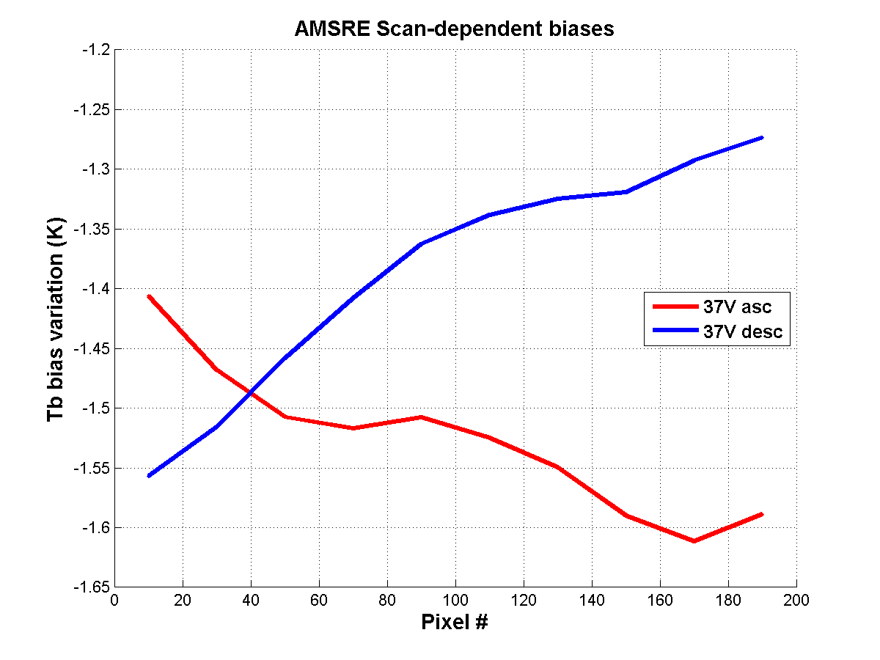
University of Central Florida Results

Slide 9
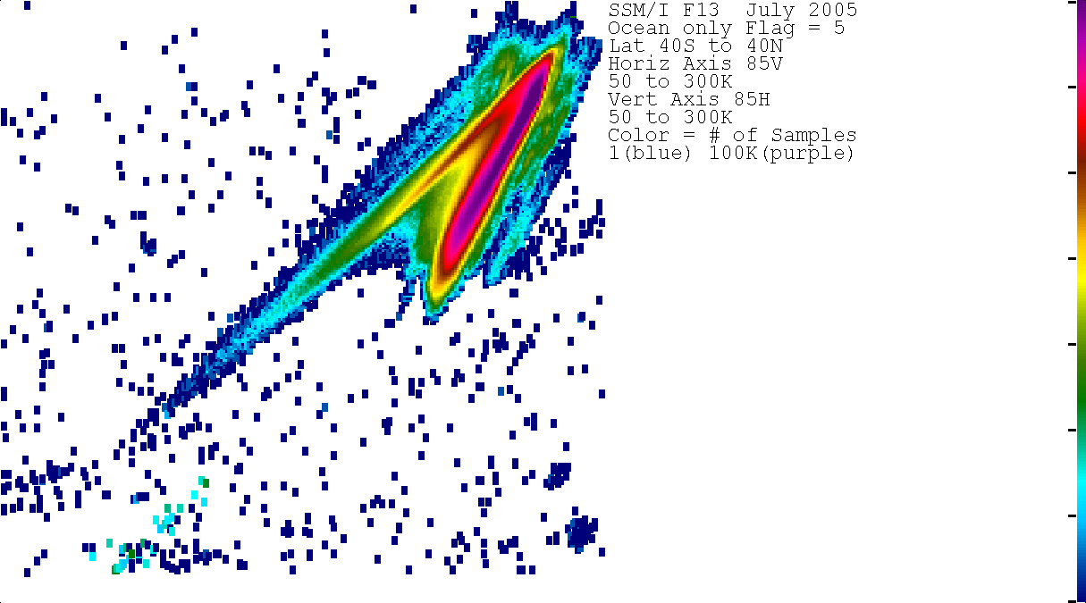

Slide 10
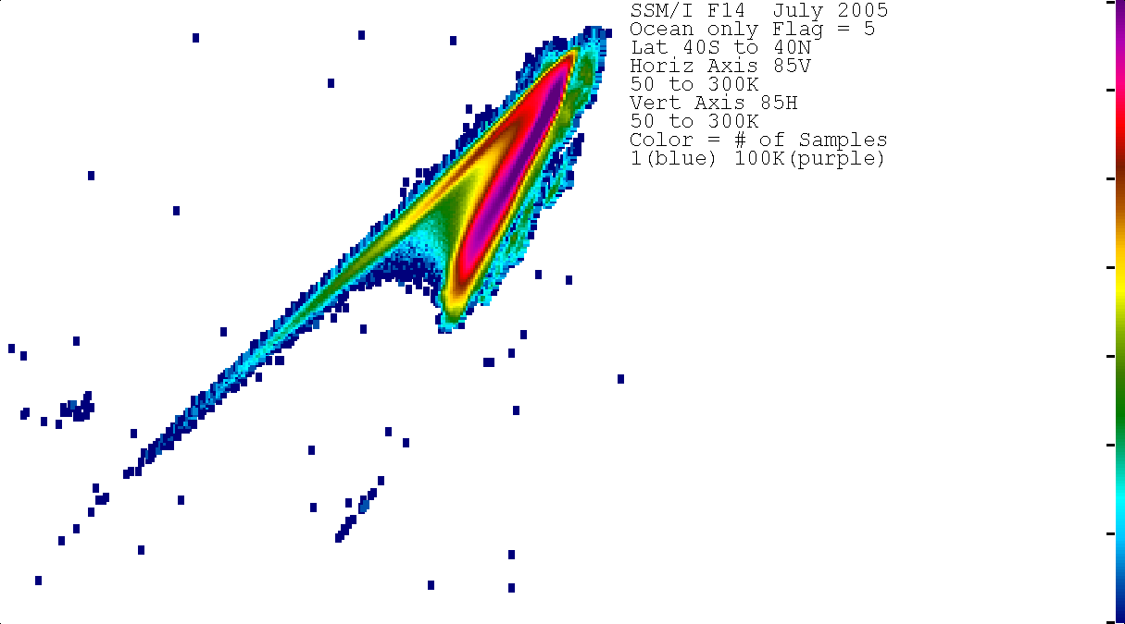

Slide 11
Water Vapor Sounders
Peter Bauer supplied data set from ECMWF Interim Analysis
Observations, Corrections, Computed Tbs from Analysis and Forecast
Intercomparisons of Operational Water Vapor Sounders Looked Quite
Consistent
NOAA 15 was a mess.
Jim Wang Used DOE/ARM Data for Forward Calculations
Bulk Comparisons Differed from ECMWF
NOAA 15 Not So Bad
Detailed Comparisons showed Observations weren’t the Same
Different Data Versions
Versions May be More than a Nuisance Issue.

Slide 12
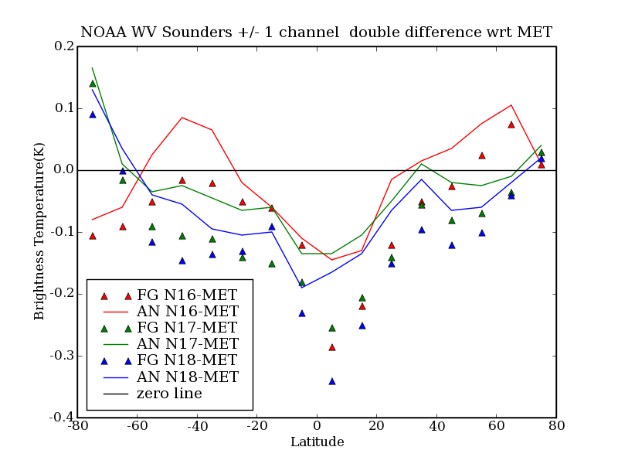

Slide 13
X-CAL /GSICS Cooperation
X-CAL Will Share Data, Models, Documentation, Results
Level 1-C Recalibrated Product Publically Available
Earlier Steps may have Externally Applied Restrictions
Will Answer Reasonable Level of Questions
Will Assist in Data Transfer (e.g. Take a Hard Drive to a Meeting)
We each can reduce our efforts in any area where it appears the other’s effort will serve our purposes. This can certainly be negotiated.

