Slide 1
NOAA’s Satellite Climate Data Record Program
Jeffrey L. Privette
CDRP Chief Scientist
NOAA’s National Climatic Data Center
Asheville, North Carolina

Slide 2
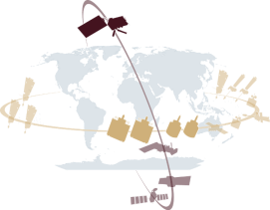
Sustained Climate Information Flow Emerging International Architecture
Satellite & In Situ
Observations
Near Real Time
Long-term Information Preservation
Observing system
performance
Monitoring
and automated
corrections
Archives
Fundamental
Climate Data
Records
(FCDRs)
Satellite data
Inter-calibration
Re-calibration
Inter-calibration
Reprocessing
Essential
Climate Variables
[Thematic
Climate Data
Records 1,2,…
(TCDRs)]
Sustained Coordinated Processing
Environmental
Data Records
Interim
Climate Data
Records
(ICDRs)
Data conversion
User Services
SCOPE-CM
Climate
Information
Records
Major
model-based
Reanalysis
Sustained Applications
Short scale
physical phenomena
monitoring
Operational Climate
Monitoring supporting
Climate Services
Longer term climate variability
& climate change analysis
Adaptation
+ mitigation planning
(decision making)
2

Slide 3
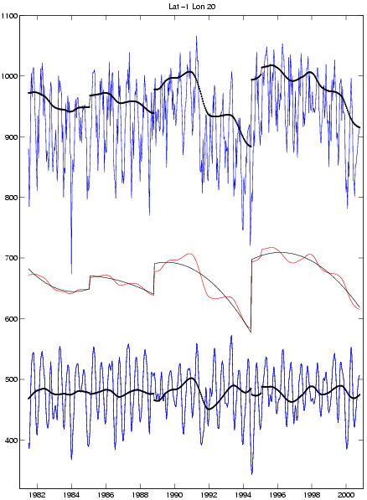
CDRs Require Consistent (Re-)Application of Advanced Algorithms Over Many Satellites and Situations
Uncorrected Data Time Series Contain Both Environmental Information and Satellite-induced Artifacts
Operational weather and hazard products are produced rapidly to potentially save life and property
Top of Atmosphere Vegetation Index
New satellite launched
Vegetation Greenness Index
Climate Data Records (CDRs) provide long term product consistency through rigorous reprocessing with advanced algorithms, ancillary data and evolved instrument understanding.
Climate Information Records (CIRs) provide specific information about environmental phenomena of particular importance to science and society (e.g., hurricane trends, drought patterns)
Top of Canopy Vegetation Index
Time (year)

Slide 4
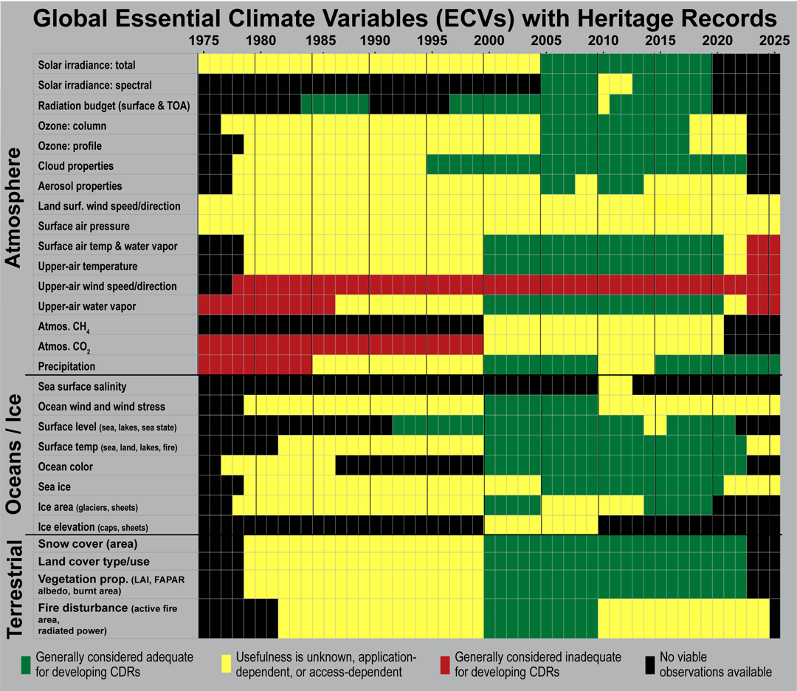
Merging NASA/NOAA/USGS Data Will Provide Information at Climate Time Scales and Quality
4

Slide 5
Maturity Matrix Identifies Milestones and Research-to-Operations Transition Points
v. June 2010
Level | Sensor Use | Code Stability | Metadata & QA | Documentation | Validation | Public Release | Science & Applications | MilestoneReviews
1 | Research Mission | Significant changes likely | Incomplete | Draft ATBD | Minimal | Limited data availability to develop familiarity | Little or none
2 | Research Mission | Some changes expected | Research grade (extensive) | ATBD Version 1+ | Uncertainty estimated for select locations/times | Data available but of unknown accuracy; caveats required for use. | Limited or ongoing | ATBD Review
3 | Research Missions | Minimal changes expected | Research grade (extensive); Meets international standards | Public ATBD; Peer-reviewed algorithm and product descriptions | Uncertainty estimated over widely distribute times/location by multiple investigators; Differences understood. | Data available but of unknown accuracy; caveats required for use. | Provisionally used in applications and assessments demonstrating positive value. | NOAA Operations Review
4 | Operational Mission | Minimal changes expected | Stable, Allows provenance tracking and reproducibility; Meets international standards | Public ATBD; Draft Operational Algorithm Description (OAD); Peer-reviewed algorithm and product descriptions | Uncertainty estimated over widely distribute times/location by multiple investigators; Differences understood. | Source code released; Data available but of unknown accuracy; caveats required for use. | Provisionally used in applications and assessments demonstrating positive value.
5 | All relevant research and operational missions; unified and coherent record demonstrated across different sensors | Stable and reproducible | Stable, Allows provenance tracking and reproducibility; Meeting international standards | Public ATBD, Operational Algorithm Description (OAD) and Validation Plan; Peer-reviewed algorithm, product and validation articles | Consistent uncertainties estimated over most environmental conditions by multiple investigators | Source code portable and released; Multi-mission record is publicly available with associated uncertainty estimate | Used in various published applications and assessments by different investigators | CDR Certification Review
6 | All relevant research and operational missions; unified and coherent record over complete series; record is considered scientifically irrefutable following extensive scrutiny | Stable and reproducible; homogeneous and published error budget | Stable, Allows provenance tracking and reproducibility; Meeting international standards | Product, algorithm, validation, processing and metadata described in peer-reviewed literature | Observation strategy designed to reveal systematic errors through independent cross-checks, open inspection, and continuous interrogation | Source code portable and released; Multi-mission record is publicly available from Long-Term archive | Used in various published applications and assessments by different investigators

Slide 6
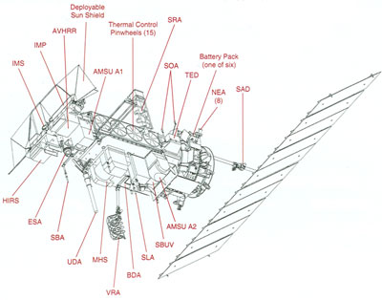
18 Development Efforts Funded Since 2009 (+7 smaller efforts continued from prior years – SDS)
NOAA POES Satellite Platform
AVHRR (VIIRS)
Cloud Properties (Kato)
Snow/Ice (Key)
VNIR Cal./Clouds (Minnis)
Thermal Calibration (Mittaz)
Land/Carbon (Vermote)
Ocean Fluxes (Clayson)
Visible Calibration (Stone)
AMSU (ATMS)
Hydro Cycle (Ferraro)
Upper Air Temp (Ho)
Water Vapor (Luo)
Temp. Profile (Zou)
Other Satellites
GOES: Imager (ABI)
VNIR Cal./Clouds (Minnis)
ISCCP Fluxes (Zhang )
SORCE, Glory (TSIS)
Solar Irrad. (Pilewskie)
DMSP: SSM/I, /IS (AMSR2)
Calibration (Kummerow)
Snow/Ice (Key)
Water Vapor (Luo)
GPCP (Adler)
HIRS (CrIS)
FCDR/Intersensor calibration (Cao)
Water Vapor (Luo)
Cloud Properties (Menzel)
ERBS: ERBE (CERES)
Radiation Budget (Kato)
SBUV (OMPS)
Ozone (Flynn)
GPS RO (Various)
Temp. Profiles (Ho)
Arrows identify key climate sensor on NOAA polar platform (POES)
Altimeters (Jason 3)
Calibration (Callahan)

Slide 7
CDR Developers Organizing Into Thematic Teams For Production Efficiency & Coherent Products
Thematic CDR Teams
Atmospheric Profiles
Ocean
Solar Irradiance
Clouds & Aerosols
Land
Radiation Budget
Ozone & Trace Gases
Cryosphere
Fundamental CDR Teams
Precipitation
Clouds
Clouds
Clouds
Sensor (Level 1) Calibration Teams

Slide 8
Possible CDRP – GSICS Interaction Areas
Extend modern sensor calibration backwards (e.g., Heidinger using MODIS to start of AVHRR record)
Develop routine calibration comparison processes for Interim CDRs
Address multiple approaches to same product (anti-”consensus coding”!)
Intercomparison guidelines and studies
Helping define ‘acceptance’
Build consistent and readily useable Level 1 (RDR) data sets (e.g., AVHRR; SSM/I; NPP/JPSS)
Guidelines on static ancillary data sets (e.g., land-water masks at different scales) – toward product suite consistency

Slide 9
Concerns
“This paper should clearly state … future efforts to incorporate [GSICS] results.”
“Why is the Global Space-based Inter-Calibration System (GSICS) not front and center in this paper?”
Some scientists reporting that some peer reviewers are requiring that GSICS
Work be described
Articles be referenced
Data sets be used for comparison and assessment
Submission to GSICS acceptance tests, or use of GSICS-approved data sets, must not become a litmus test for publication
A GSICS education campaign may be needed (Fred helped greatly in most recent dust-up… where a relevant GSICS product did not yet exist!)

