Slide 1
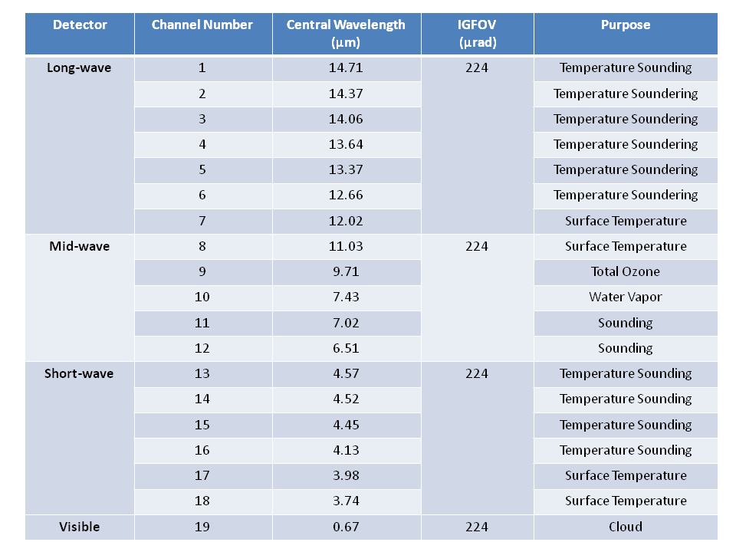
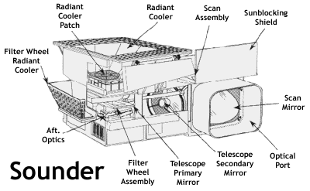
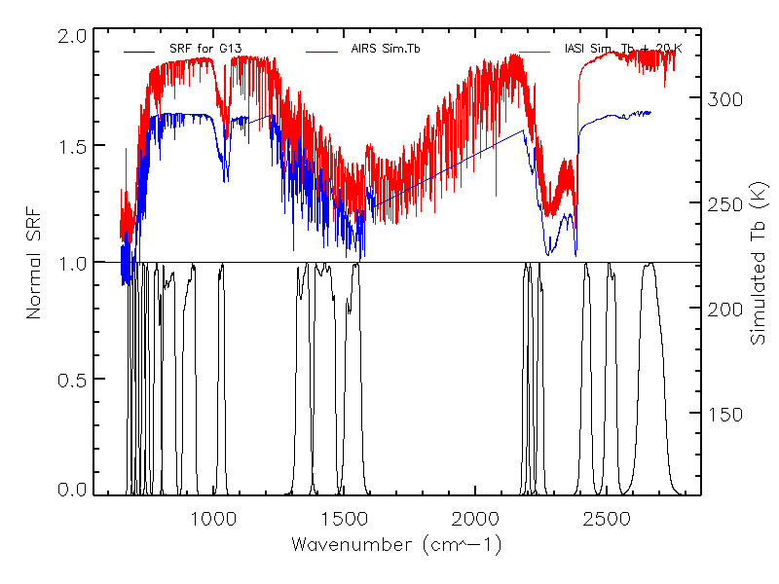
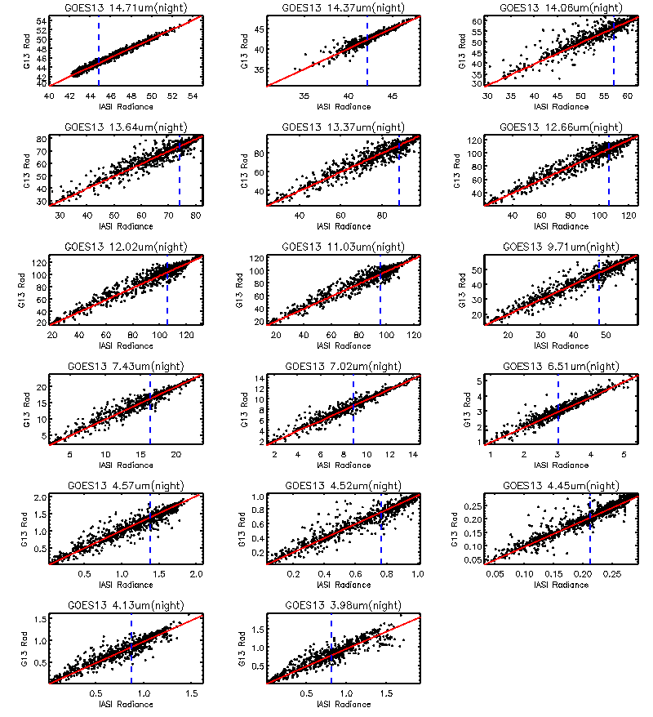
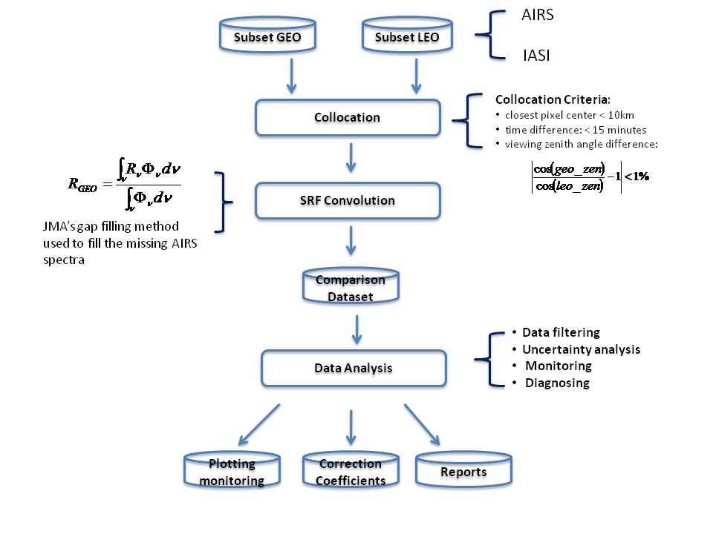
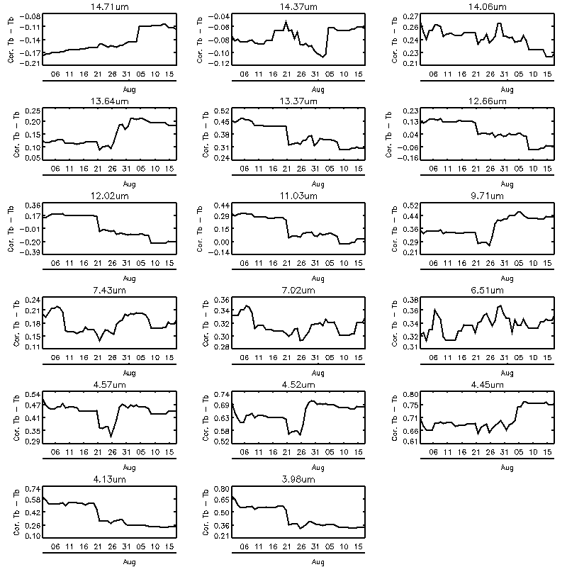
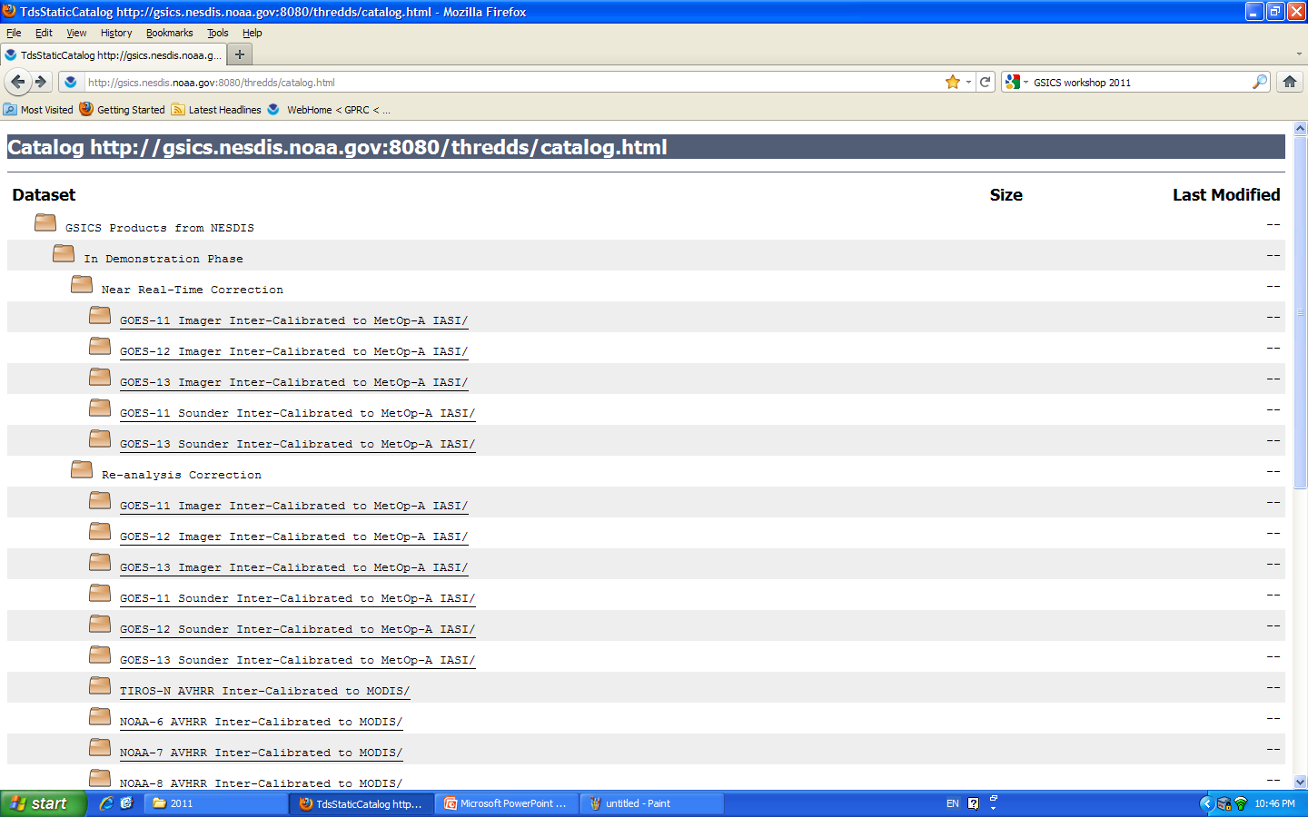
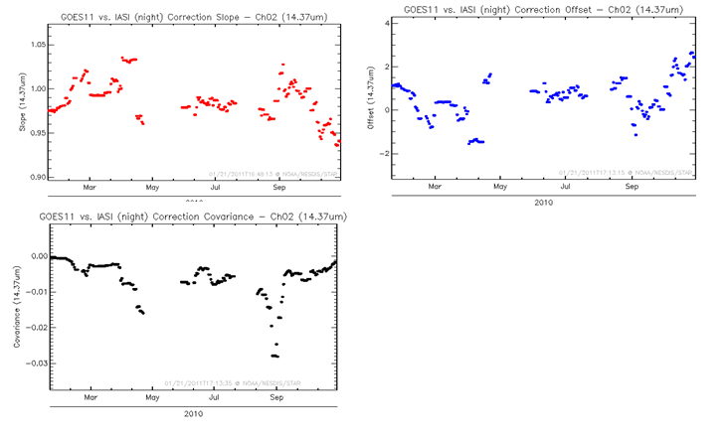
Developing GSICS Products for GOES Sounder
Fangfang Yu¹, and Xiangqian Wu²
1: ERT, Inc. @NOAA/NESDIS/STAR; 2: NOAA/NESDIS/STAR
Introduction
The National Oceanic and Atmospheric Administration (NOAA) operates a series of Geostationary Operational Environmental Satellite (GOES) to provide continuous streams of satellite data for weather monitoring and forecasting operations of the US and its neighboring environments. Each GOES carries an Earth-atmosphere imager and an atmospheric sounder. The Sounder has 18 thermal infrared (IR) channels plus a visible channel. The field of view is 8km at sub-satellite points and sampled every 10 km and the radiance data is transmitted with 13 bits. The specification of radiometric calibration accuracy is 1.0K absolute accuracy and 0.3K relative precision. The GSICS GEO-LEO inter-calibration provides an opportunity to evaluate, monitor and improve the Sounder IR calibration accuracy to the reference instrument level. This poster describes the method and the GSICS correction products for the GOES Sounder IR channels.
Fig. 1. GOES Sounder sensor module
Table 1. GOES Sounder radiometric channels (from NOAA-GOES OGE) Table 3-2)
Methodology
Fig. 3. Spectral response functions (SRF) of Sounder IR channels, together with AIRS/IASI spectra. Note that neither AIRS nor IASI spectra covers the full range of Ch8 SRF.
Fig. 2. Flowchart to generate the Sounder GSICS GEO-LEO inter-calibration correction coefficients, following the procedure for the GEO-LEO inter-calibration Imager data.
Data filtering:
Reference data: IASI night-time collocated data
Smoothing period: 2 months
Fig. 4. Linear regression relationship between the collocated night-time IASI and GOES Sounder.
Fig. 5. The number of GOES-13 Sounder vs. IASI collocation pixel s between 7/15/2011 and 8/15/2011 at the satellite local time
Products
Fig. 6. Near real-time and re-analysis correction coefficients are available at GSICS server: http://gsics.nesdis.noaa.gov:8080/thredds/catalog.html
Fig. 7. Monitoring of the correction coefficients and the covariance.
Fig. 8. Example of Tb correction at the typical scene for GOES-13 Sounder.
Uncertainty Components
Different SRF between the four detectors per IR channel
In-sufficient collocation scenes for the all-sky correction – smoothing period -> two months
Uncertainty caused by the atmospheric profiles/surface/viewing and illumination difference between the observation time
Sounder diurnal calibration variation
Uncertainty of the GSICS GEO-LEO inter-calibration correction for Sounder is currently undergoing.

