Slide 1
Update on GSICS Product Development
Tim Hewison¹ and all GSICS Developers
EUMETSAT

Slide 2
Global Space-based Inter-Calibration System
What is GSICS?
Global Space-based Inter-Calibration System
Initiative of CGMS and WMO
Effort to produce consistent, well-calibrated data from the international constellation of Earth Observing satellites
What are the basic strategies of GSICS?
Improve on-orbit calibration by developing an integrated inter-calibration system
Initially for GEO-LEO Inter-satellite calibration
Being extended to LEO-LEO
Using external references as necessary
Best practices for prelaunch characterisation (with CEOS WGCV)
This will allow us to:
Improve consistency between instruments
Reduce bias in Level 1 and 2 products
Provide traceability of measurements
Retrospectively re-calibrate archive data
Better specify future instruments
EUMETSAT | CNES | JMA
NOAA | CMA | KMA
ISRO | NASA | WMO
USGS | NIST | JAXA
ROSHYDROMET | IMD | ESA
Notes:
Well, what is GSICS?
The Global Space-based Inter-Calibration System (GSICS) is an initiative of CGMS and WMO, which aims to ensure consistent calibration and inter-calibration of operational meteorological satellite instruments.
One of the basic strategies of GSICS is to develop an integrated on-orbit cal/val system - initially by LEO-GEO Inter-satellite/inter-sensor calibration.
This will then allow us to provide corrections to improve the consistency between instruments, produce less biased level 1, and therefore, level 2 data, and ultimately, retrospectively re-calibrate archive data, which is of great interest in the climate monitoring community

Slide 3
GSICS Principles
Systematic generation of inter-calibration products
for Level 1 data from satellite sensors
to compare, monitor and correct the calibration of monitored instruments to community references
by generating calibration corrections
with specified uncertainties
through well-documented, peer-reviewed procedures
based on various techniques to ensure consistent and robust results
Delivery to users
Free and open access
Adopting community standards
To promote
Greater understanding of instruments’ absolute calibration, by analysing the root causes of biases
More accurate and more globally consistent retrieved L2 products
Inter-operability for more accurate environmental, climate and weather forecasting products
TRACEABILITY / UNBROKEN CHAINS OF COMPARISONS

Slide 4
Outline of Presentation
Introduction to Types of GSICS Products
GSICS Correction – RAC, ARC, NRTC (embedded & standalone)
GSICS Bias Monitoring – new tool
GSICS Reports & Guidelines – Special Issue
Status of GSICS Products’ Development
GEO-LEO IR hyperspectral
GEO-LEO VIS/NIR
LEO-LEO Microwave - NOAA-developed (A)MSU inter-calibration products
Development of Archive Re-Calibration products:
Meteosat-HIRS at EUMETSAT
Update on LEO-LEO VIS products – PATMOS-x

Slide 5
Outline of Presentation
Introduction to Types of GSICS Products
GSICS Correction – RAC, ARC, NRTC (embedded & standalone)
GSICS Bias Monitoring – new tool
GSICS Reports & Guidelines – Special Issue
Status of GSICS Products’ Development
GEO-LEO IR hyperspectral
GEO-LEO VIS/NIR
LEO-LEO Microwave - NOAA-developed (A)MSU inter-calibration products
Development of Archive Re-Calibration products:
Meteosat-HIRS at EUMETSAT
Update on LEO-LEO VIS products – PATMOS-x

Slide 6
GSICS Products
GSICS Bias Monitoring
Routine comparisons of satellite radiances against reference
Visualised as time series plots of calibration bias with respect to reference
New web-based bias plotting tool – see Pete
GSICS Correction
Function to correct issued radiances
For consistent calibration with reference
For Near-Real-Time and Re-Analysis applications of operational L1 data
For Archive Re-Calibration of reprocessed datasets to generate FCDRs
GSICS Reports & Guidelines
Recommendations to modify practices
Design and Operation of future satellite instruments
Special Issue

Slide 7
GSICS Product Types: Bias Monitoring
Routine comparisons of satellite radiances against reference
Visualised as time series plots of calibration bias with respect to reference
Published on GPRC websites
New web-based bias plotting tool – see Pete
Example of GSICS Bias Monitoring
From EUMETSAT: Time Series of Meteosat9-IASI Standard Biases [K]

Slide 8
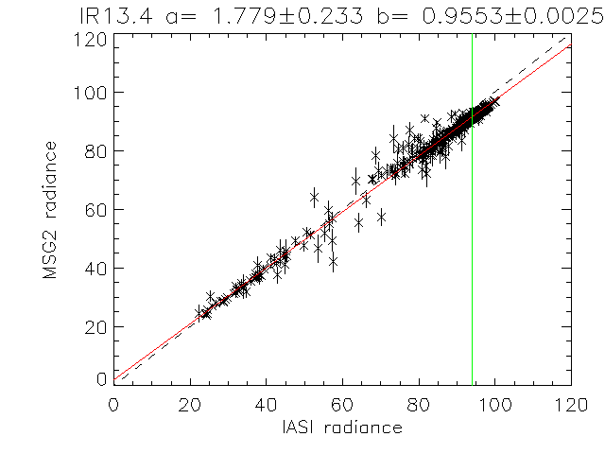
GSICS Product Types: GSICS Corrections
The GSICS Correction, g(L), is a function to convert radiances observed by a monitored instrument, L, to be consistent with the calibration of the reference,
For Near-Real-Time & Re-Analysis Correction of operational L1 data
For Archive Re-Calibration of reprocessed datasets to generate FCDRs
Coefficients supplied with uncertainties
Supplied as netCDF files
On GSICS Servers
NRTC can be embedded in L1 data streams
Example of GSICS Correction derived from regression of collocated radiances from Meteosat-9/ SEVIRI and Metop-A/IASI

Slide 9
GSICS Products: Guidelines
Underlying assumption of GSICS Correction:
Small errors (e.g. SRF errors, blackbody temperature, ...) introduce small departures from ‘true’ calibration
If these are linearly related a predictor (radiance, time, ...) we can apply empirical correction based on inter-calibration
Can analyse GSICS products
to diagnose root causes of calibration errors
Derive recommendations to modify
operating practices (e.g. adopt new SRF definition),
pre-launch characterisation, etc.
These GSICS Guidelines are distributed as written reports

Slide 10
Special Issue on Satellite Inter-Calibration
IEEE Transactions on Geoscience and Remote Sensing
On inter-calibration of satellite instruments
5 Guest GSICS/IVOS Editors
54 papers submitted
From CAS, CMA, CNES, ESA, EUMETSAT, ISRO, JAXA, KMA, JMA, MIT, NASA, NOAA, SDSU, USGS, etc.
Covering AVHRR, AMSU, (A)ATSR, CLARREO, ETM+, FY-2 & -3B, GOES, HIRS, Hyperion, IASI, Jason-2/OSTM, MODIS, PROBA, SCAIMACHY, Sentinel-2, etc.
Publication ETA: Early 2013

Slide 11
Outline of Presentation
Introduction to Types of GSICS Products
GSICS Correction – RAC, ARC, NRTC (embedded & standalone)
GSICS Bias Monitoring – new tool
GSICS Reports & Guidelines – Special Issue
Status of GSICS Products’ Development
GEO-LEO IR hyperspectral
GEO-LEO VIS/NIR
LEO-LEO Microwave - NOAA-developed (A)MSU inter-calibration products
Development of Archive Re-Calibration products:
Meteosat-HIRS at EUMETSAT
Update on LEO-LEO VIS products – PATMOS-x

Slide 12
GEO-LEO IR Product Status 2012-09
GPRC | Monitored Instrument | Reference Instrument | GSICS NRT Correction | GSICS Re-Analysis Correction | GSICS Bias Monitoring
EUMETSAT | Meteosat-9 } Meteosat-8 }-- Meteosat-7 } | IASI | Demonstration | Demonstration | Prototype
JMA | MTSAT-1R } MTSAT-2 } | IASI (+ AIRS) | Demonstration | Demonstration | Prototype
NOAA | GOES-11 Imager GOES-12 Imager | IASI (+ AIRS) | Demonstration | Demonstration | In development
 | GOES Sounder | IASI (+ AIRS) | In development | In development | Prototype
CMA | FY2C } FY2D } -- FY2E } | IASI (+ AIRS) | In development | In development | Prototype
KMA | COMS | IASI (+ AIRS) | In development | In development | In development
ISRO | Kalpana | IASI | In development | In development | In development

Slide 13
Further Development of GEO-LEO IR
Extensive documentation in Special Issue
Promotion to Pre-Operational Status – ETA: RSN
EUMETSAT resolving inconsistency in operational implementation
NOAA & JMA working on uncertainty analysis
Handling Diurnal Cycle & Midnight problems
Addition of AIRS as transfer standard
To cover 01:30, 13:30 local times
Migrating reference instruments
e.g. Metop-A/IASI to Metop-B/IASI

Slide 14
GEO-LEO VIS/NIR
Pseudo Invariant Targets
To transfer calibration from reference (currently Aqua/MODIS)
Deep Convective Clouds --->>>
Dave Doelling (NASA) wrote ATBD for GEO-MODIS
GPRCs are currently implementing this
NASA to provide centralised processing of MODIS data.
First demonstration GSICS products expected 2014
Rayleigh Scattering
CNES writing ATBD for GEO-MODIS inter-calibration
Lunar Calibration
Several GPRCs investigating Moon as invariant target
NIST to try tying ROLO model to absolute standards

Slide 15
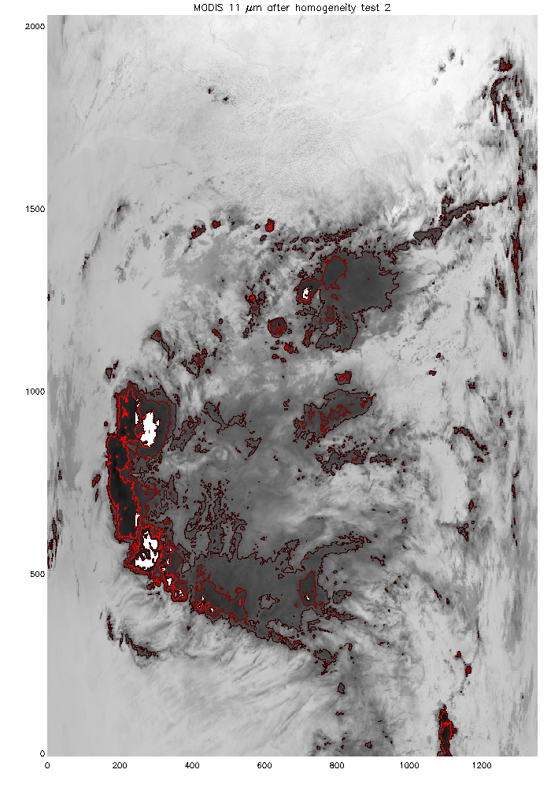
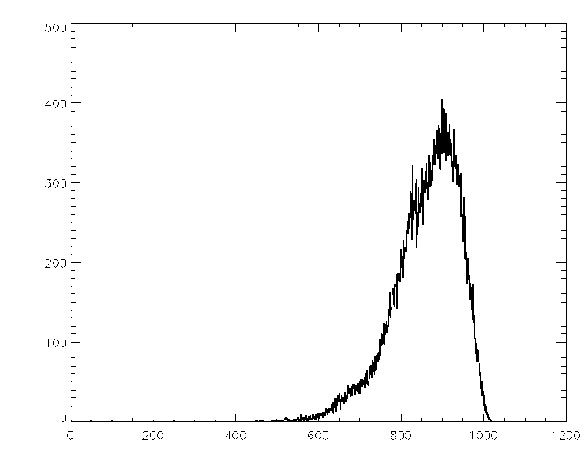
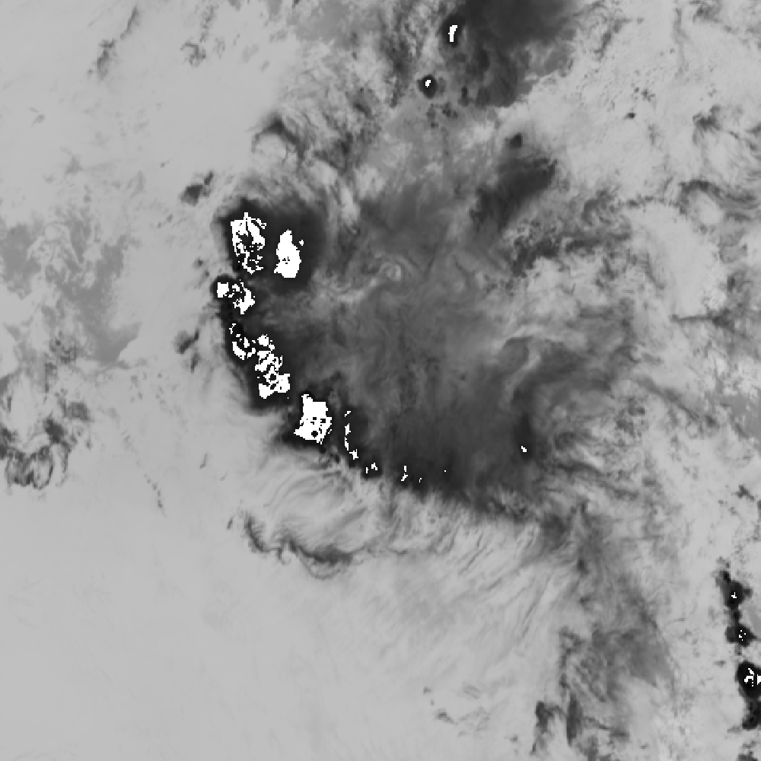
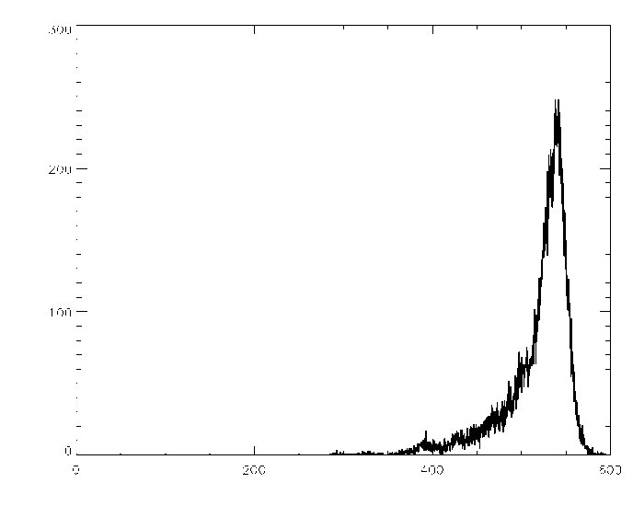
Inter-calibration against MODIS/Aqua using DCCs
Implementing the GSICS ATBD for calibrating SEVIRI against MODIS/Aqua
Overshooting Deep Convective Cloud Tops
Uniform reflectance
Select DCC pixels based on IR threshold & homogeneity
Generate PDFs from both instruments over monthly periods
Compare modal reflectances from SEVIRI and MODIS
SEVIRI’s pseudo counts
January 2012
Test on the view zenith angle
MODIS pseudo radiances
January 2012
Gain derived for January 2012 = 0.647942
SEVIRI – 12:57
MODIS 13:00
FINAL DCCs for both MODIS Aqua and SEVIRI (Met 9)

Slide 16
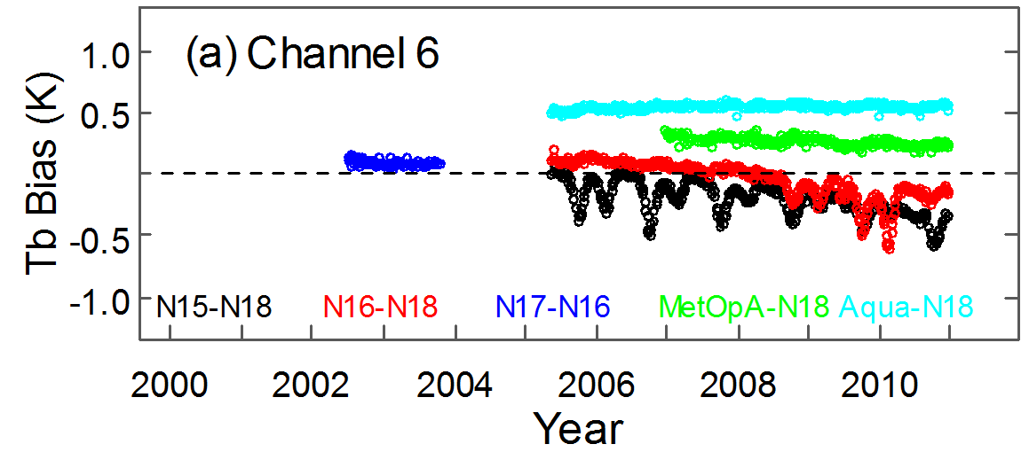
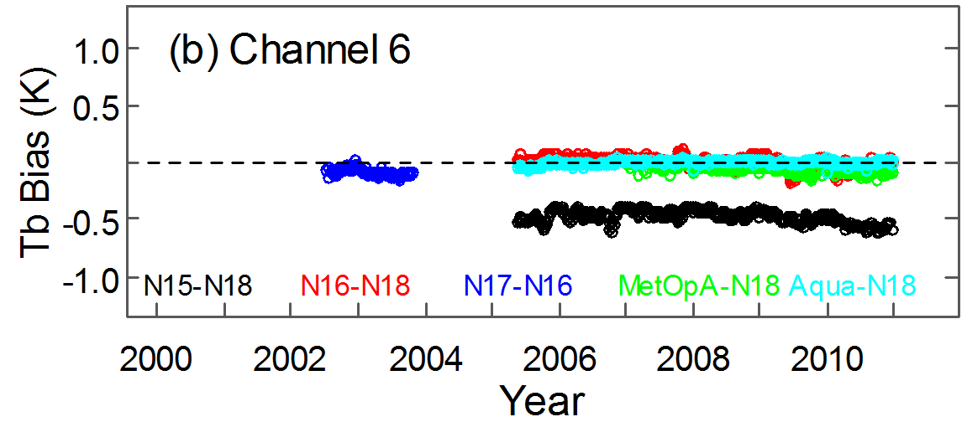
(A)MSU inter-calibration products
Promoted to demonstration phase on 2012-08-16
LL.02.1.0 NOAA (A)MSU
FCDR
Remove or minimizes inter-satellite biases
using STAR-Integrated Microwave Inter-Calibration Model (STAR-IMICM)
Requires special handling of the product at the GSICS server
will provide a link to the current product server
GSICS Archive Re-Calibration product

Slide 17
Archive Re-Calibration products
Re-Calibration of Archive Datasets
Consistent processing and calibration of whole data set
Developed in parallel with archive re-processing activities
to generate Fundamental Climate Data Records (FCDRs)
Examples:
(A)MSU inter-calibration product developed at NOAA
PATMOS-x AVHRR visible channel
Meteosat-HIRS in development at EUMETSAT
Questions:
Continuously updated? Version control?
Provided as Re-calibrated datasets or Corrections?

Slide 18
Thank You
Any Questions?

Slide 19
Future GSICS Products
GEO-LEO Solar Channels
Strategy: Combine various invariant targets (DCCs, deserts, etc) and direct comparison of ray-matched collocated observations
Currently conducting error analysis of each method
Aim for demonstration products in 2011
HIRS-IASI
Direct comparisons to allow use of HIRS as reference
Conical scanning microwave imagers:
SSM/I through GPM X-cal
Cross-track scanning microwave sounders:
MSU/AMSU through NOAA/NESDIS
LEO-LEO imagers:
AVHRR through NOAA/CIMSS
These products will contribute to the SCOPE-CM pilots

Slide 20
Outline of Presentation
Introduction to Types of GSICS Products
GSICS Correction
GSICS Bias Monitoring
GSICS Reports & Guidelines
IR channels of GEO imagers
Current Status of GEO-LEO IR hyperspectral inter-calibration products
Data Access
Plans to Migrate References
Handling diurnal cycles & midnight calibration problems
Summary

Slide 21
Combining Multiple References
Advantages
Disadvantages
Robustness
In case of failure of one reference
Allows transition between references – e.g. MetopA->B
Greater coverage of diurnal cycle
Both scene and instrument calibration variability
Important for 3-axis stabilized spacecraft
Political
Segal's law:
"A man with a watch knows what time it is. A man with two watches is never sure." [Bloch, Arthur (2003). Murphy's Law. Perigee. p. 36.]
It refers to the potential pitfalls of having too much conflicting information when making a decision.
User confusion
Metrological Traceability Problems
as the references can never be perfectly consistent
Define only one as the calibration reference
All others are regarded as calibration transfer standards

Slide 22
GSICS Correction using Reference 1
GSICS Correction for Monitored Instrument
Based on Reference 1
Function with uncertainty

Slide 23
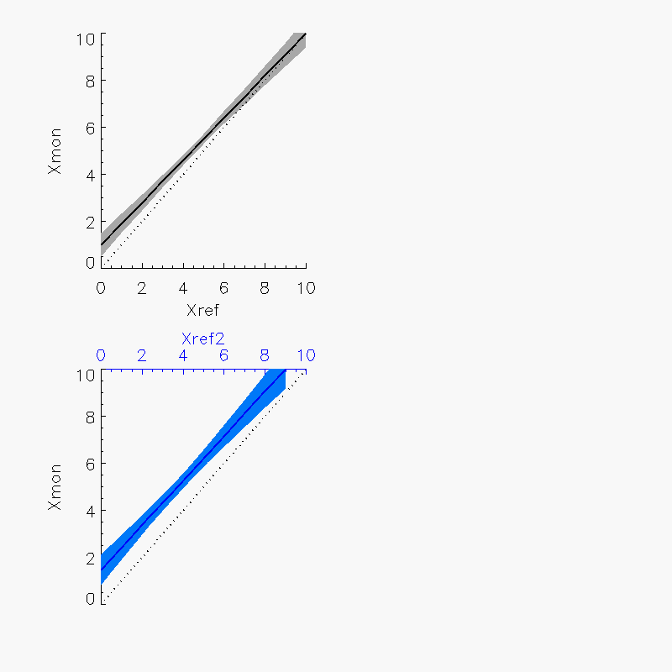
GSICS Correction using Reference 2
GSICS Correction for Monitored Instrument
Based on Reference 2
Different function with different uncertainty

Slide 24
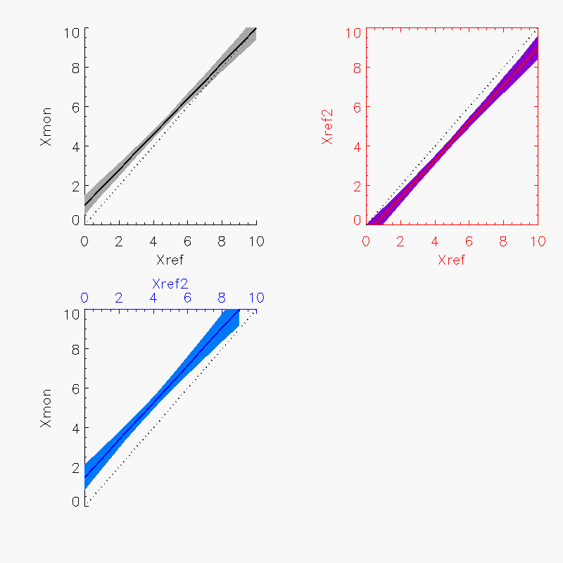
Delta Correction Reference 2->1
GSICS Correction for Reference 2
Based on Reference 1
Function with uncertainty

Slide 25
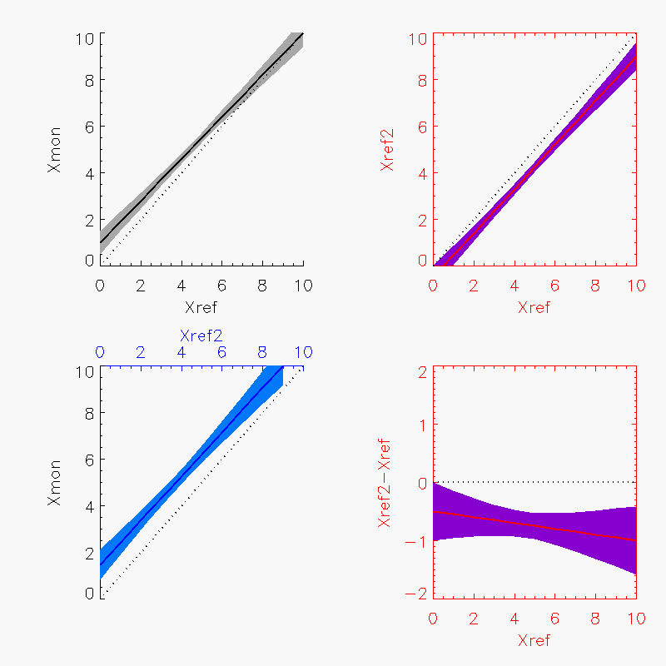
Delta Correction Reference 2->1
Delta GSICS Correction for Reference 2
Based on Reference 1
Function with uncertainty

Slide 26
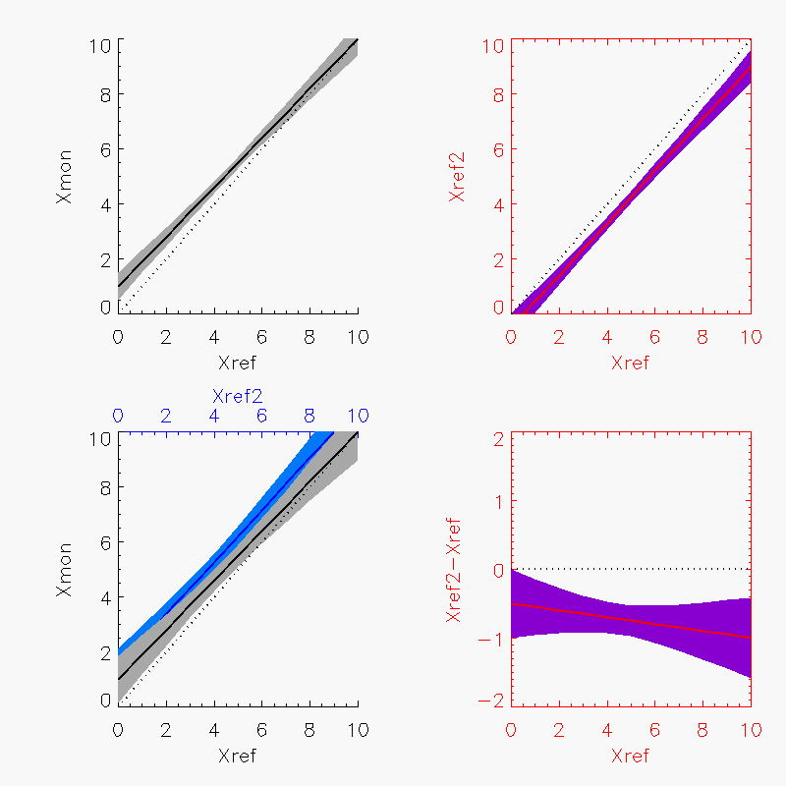
GSICS Correction using Reference 2->1
Add Delta Correction to Reference 2
Maps GSICS Correction based on Reference 2 to Reference 1
Consistent function, but larger uncertainty

Slide 27
Implementation
GSICS Correction
Correction using Reference 1
Correction using Reference 2
Delta Correction Reference 2-1

Slide 28
Handling Diurnal Variations
Some GEO-LEO IR GSICS Corrections show significant diurnal variations
Mostly related to the midnight blackbody calibration problem
Could produce separate corrections for different periods of the diurnal cycle
Users' Guides should clearly specify the range of conditions over which they are valid
in particular, the periods of the diurnal cycle
Based on recent analysis by Fangfang Yu

Slide 29
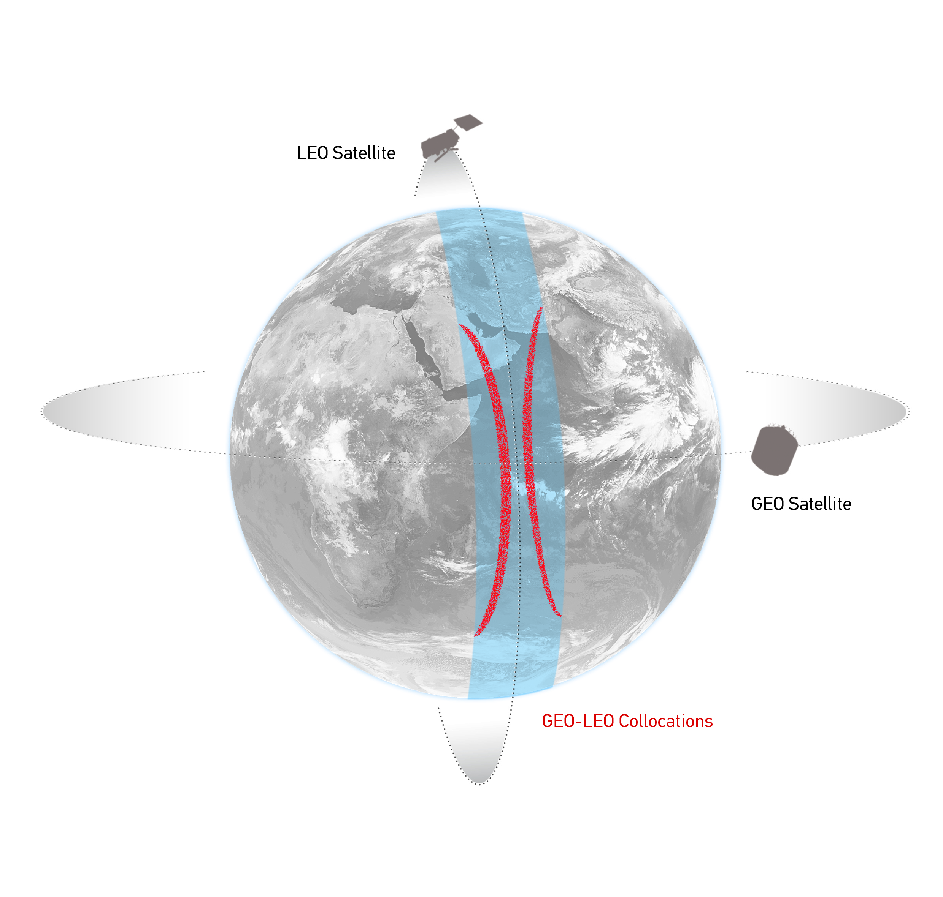
Comparison of Collocated Radiances
Simultaneous near-Nadir Overpass
of GEO imager and LEO sounder
Collocation Criteria:
ΔLat<35° ΔLon<35°
Δt < 5 mins
Δsecθ < 0.01 (Atmospheric path diff.)
Concentrated in tropics
~1000 collocations/orbit
~1-4 orbit/night
Schematic illustration of the geostationary orbit (GEO) and polar low Earth orbit (LEO) satellites and distribution of their collocated observations.

Slide 30
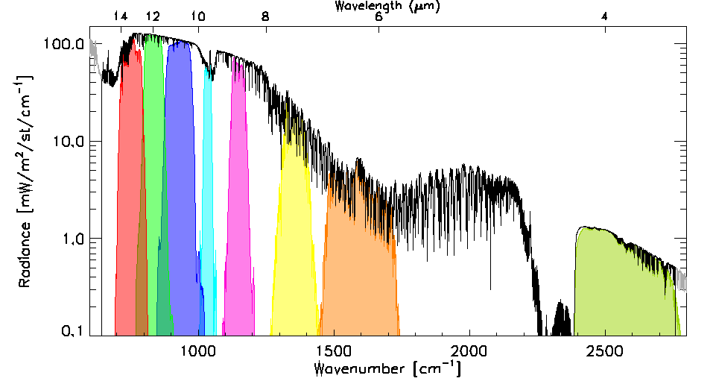
Data Transformations (Spectral and Spatial)
Spectral Convolution:
Convolve LEO Radiance Spectra with GEO Spectral Response Functions
to synthesise radiance in GEO channels
Spatial Averaging:
Average GEO pixels in each LEO FoV
Estimate uncertainty
due to spatial variability
as Standard Deviation of GEO pixels
Use in weighted regression
LEO FoV~10km
~ 3x3 GEO pixels
Example radiance spectra measured by IASI (black) and modeled by LBLRTM (grey), convolved with the Spectral Response Functions of SEVIRI channels 3-11 from right to left (colored shaded areas). n.b. The IASI observations (645 – 2760 cm⁻¹) do not quite cover the full spectrum observed by SEVIRI.
Illustration of spatial transformation. Small circles represent the GEO FoVs and the two large circles represent the LEO FoV for the extreme cases of FY2-IASI, where nxm=3x3 and SEVIRI-IASI, where nxm=5x5.
Notes:
The next step is to transform the collocated data to allow direct comparisons between the instruments.
Firstly, the IASI radiance spectra is convolved with the Spectral Response Functions of the Meteosat channels, to calculate the expected radiance in each Meteosat channel.
Then the Meteosat pixels within each IASI iFoV are averaged.
Their variance is also calculated to quantify the uncertainty due to spatial variability and
is used to weight each collocation in a linear regression …

Slide 31
Quality Indicators in GSICS Products
GSICS Correction Coefficients include quality indicators
Estimates of uncertainties and covariances
From weighted linear regression
Using spatial variance and radiometric noise of each collocated observation as weighting
Shown as error bars in GSICS Bias Monitoring plots
But many other processes introduce uncertainty
Systematic and Random

Slide 32
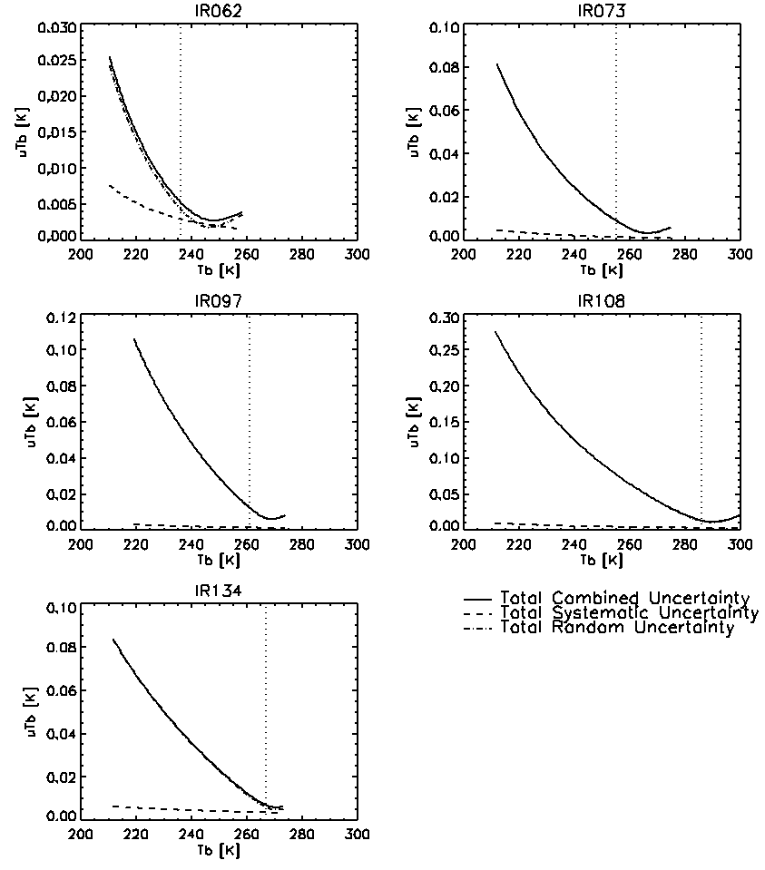
GEO-LEO IR Uncertainty Evaluation
Extended Error Budget for Meteosat-IASI GSICS Corrections
Following QA4EO / GUM
Processes at each step of ATBD introducing
Random Uncertainties
Dominated by spatial/temporal variability
over 3km/300s
Validated using time series statistics
Systematic Uncertainties
Dominated by spatial/temporal mismatches
Total uncertainties depend on radiance
Mostly dominated by random processes
Errors much lower in WV channels
Validated quoted errors as Quality Indicators

