Slide 1
GSICS Data Management and Availability to Users
Peter Miu¹ on Behalf of the
GSICS Data Management Working Group
EUMETSAT

Slide 2
Outline of Presentation
Introduction to the GSICS Data Management Working Group
Who We Are.
What We Do.
GDWG Developments
Collaboration Servers; Each Partner’s GSICS Data and Products Server
Accessing GSICS Products (Demo)
Products Plotting Tool (Demo)
Users Messaging Service
Products Catalogue (Demo)
Future Developments

Slide 3
GSICS Data Management Work Group (GDWG)
The GSICS Executive Panel, consisting of representatives of the participating agencies who sets strategic priorities, and monitors and evaluates GSICS evolution and operations.
Like the GSICS Research Working Group (GRWG), the GDWG comprises of at least one data management expert from each of the GSICS participating agencies.
The GDWG advises the GSICS Executive Panel of the data management needs of the GSICS project as well assist in the planning and implementation of these activities.
In other words, the GDWG is responsible for:
Discussing and agreeing on GRWG & User requirements on how to support new Data Management and other technical needs of the project from software and hardware point of view.
Discuss and agree on inter-operable elements such as formats, conventions and standards to adopt.
Review the existing and developing GSICS system to ensure they still fulfil their requirements.
Come to a census on priorities, responsibilities and agree on the work plan for this support.
EUMETSAT | CNES | JMA
NOAA | CMA | KMA
ISRO | NASA | WMO
USGS | NIST | JAXA
ROSHYDROMET | IMD | ESA
Notes:
Well, what is GSICS?
The Global Space-based Inter-Calibration System (GSICS) is an initiative of CGMS and WMO, which aims to ensure consistent calibration and inter-calibration of operational meteorological satellite instruments.
One of the basic strategies of GSICS is to develop an integrated on-orbit cal/val system - initially by LEO-GEO Inter-satellite/inter-sensor calibration.
This will then allow us to provide corrections to improve the consistency between instruments, produce less biased level 1, and therefore, level 2 data, and ultimately, retrospectively re-calibrate archive data, which is of great interest in the climate monitoring community

Slide 4
GDWG Developments: Collaboration Servers
What are the GSICS Collaboration Servers?
Individually, the servers are also known as Data and Products server provide a set of services for the GSICS user community to support data exchange and access to relevant products to support the calibration of satellite data.
Who has implemented one of these servers?
EUMETSAT has a fully operational server receiving comparable satellite data sets from the EUMETSAT and JMA. Pre-operational GSICS products are sent daily to the server for validation by experts in the GSICS community. These should be finalised this year and the products shall be archived by a participating agency (for example, the EUMETSAT Data Centre Archive).
NOAA has implemented a GSICS server providing another operational node for the GSICS collaboration servers network. The server references source and Intermediate Data Sets from the EUMETSAT GSICS server as well as offer pre-operational GSICS Products.
CMA are in the process of implementing their own GSICS servers to be part of the GSICS collaboration servers network.

Slide 5
GDWG Developments: Data and Products Server

Slide 6
GDWG Developments: Collaboration Servers

Slide 7
GDWG Developments: Accessing GSICS Products
Currently:
All products are accessed manually via one of the Collaboration Servers.
http://gsics.eumetsat.int (Demo)
http://gsics.nesdis.noaa.gov:8080/thredds/catalog.html
Future:
Real time products availability notification plus additional tools for automated download.
Ordering of GSICS products from a participating partners’ data archive.

Slide 8
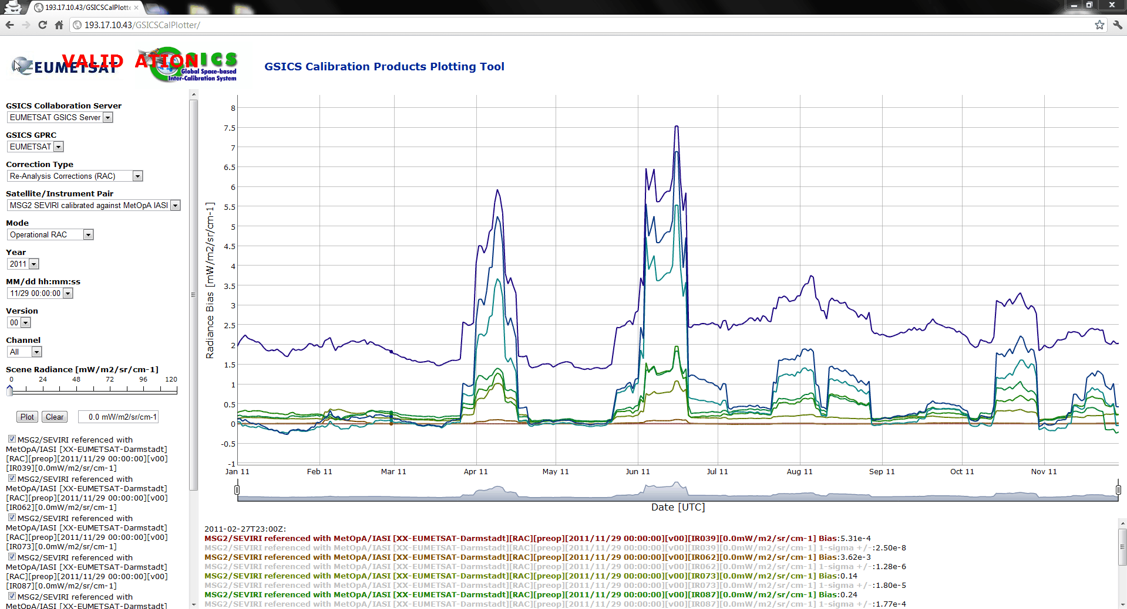
GDWG Developments: Products Plotting Tool
The tool plots the contents of GSICS products.
Its purpose is to allow product developers and users to quickly assess the GSICS products during their development. Once the products are operational, visually see the changes in the monitoring instruments.

Slide 9
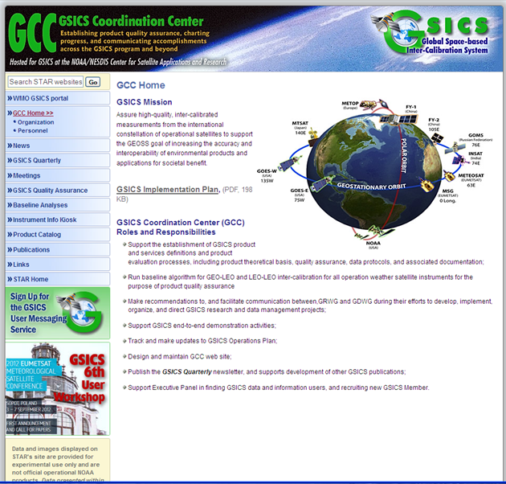
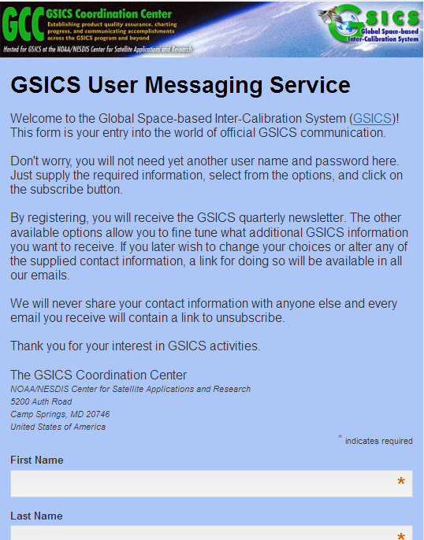
GDWG Developments: Users Messaging Service
Registering with the GSICS User Messaging Service to gain access to all official GSICS communication ; News letters, Product Updates, ...
http://
http://

Slide 10
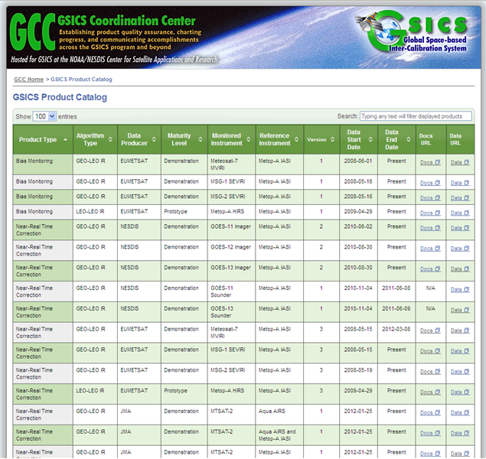
GDWG Developments: GSICS Products Catalogue
This catalogue lists information related to all GSICS products.

Slide 11
Future Developments
Automating Products Distribution; to investigate how to efficiently distribute GSICS products to our users in a timely fashion.
Archiving of the GSICS Products; who does it and what is archived.
Instrument History Presentation: what attributes are to be recorded for an instrument and how to present these in the most useful manner for the user (visually, database search,...).
Operations; investigate how to conduct in an efficient manner support to users’ requests and enquiries across different international agencies.
Operations; investigate how to coordinate efficiently join developments across different international agencies.

Slide 12
Users Feedback
GSICS is progressing towards an Operational system
User feedback is very important to us, it helps with focusing on where to concentrate our resources.
Tell us what products you would like to see.
How we can improve our services to you.
Users are encouraged to register with the User Messaging Service to receive the latest information; this will help with who to contact regarding support and requests.
GSICS Home Website is:
http://gsics.wmo.int/

Slide 13
Thank You
Any Questions?

