Slide 1
Sensitivity of UTH from Geostationary Water Vapor Channels to Calibration Bias
Masaya Takahashi
Meteorological Satellite Center,
Japan Meteorological Agency

Slide 2
Table of Contents
Motivation
SRF of GMS-5 WV channel
Impact of Correction of GMS-5 Water Vapor (WV) Spectral Response Function (SRF)
Observing System Experiments (OSEs) for reprocessed CSR data using JRA-55 (JMA Re-Analysis)
Impact on Forecast Accuracy
Summary

Slide 3
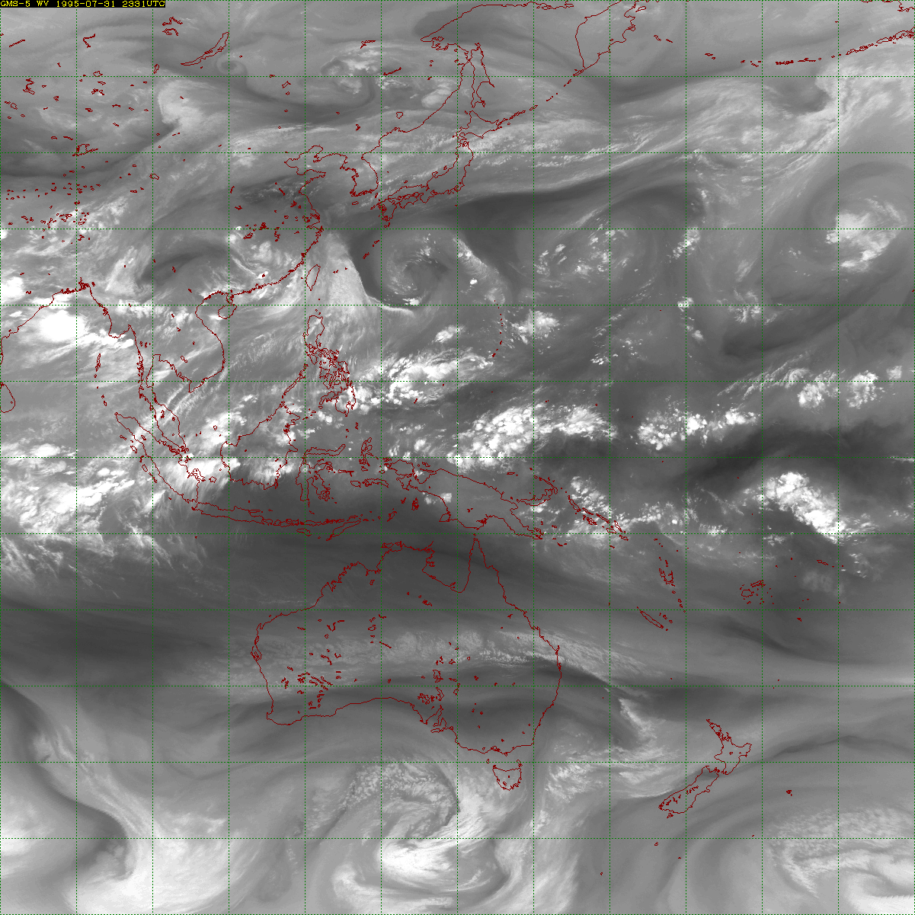
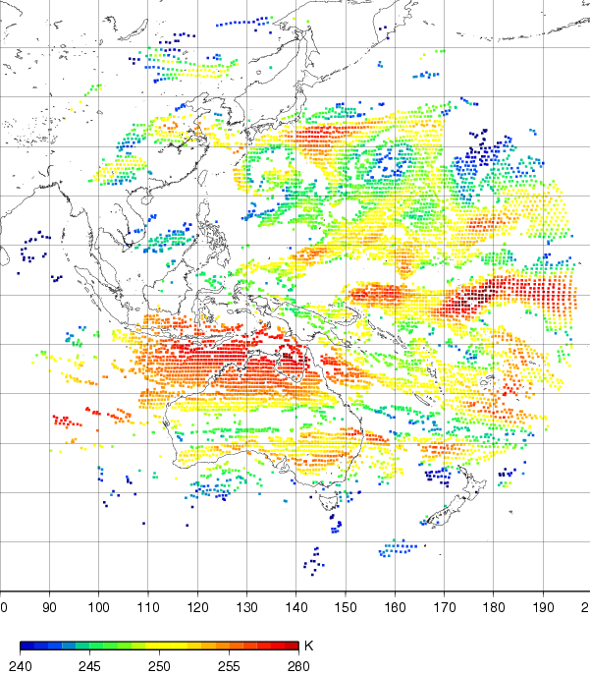
Motivation
The Clear Sky Radiance (CSR) provides area average radiances for cloud-free pixels
Spatial resolution : 80 x 80 km² for GMS-5
Time resolution : 1 hour
Providing information not only on the Upper Tropospheric Humidity (UTH) but also on the upper tropospheric wind field
SRF of GMS-5 WV channel is contaminated by water vapor, so reprocessed CSR data from corrected SRF is evaluated.
Although the correction of SRF is not a GSICS Correction, it can indicate the impact and importance of a calibration which is relevant to GSICS Correction.
Example of CSR for the GMS-5 WV
channel at 00UTC 1 Aug. 1995
Takahito Imai (MSC/JMA)

Slide 4
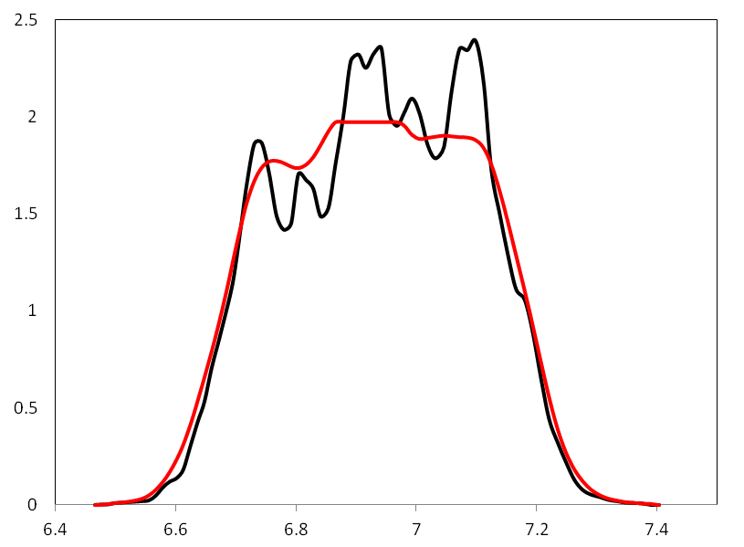
SRF of GMS-5 WV channel
SRF of GMS-5 WV channel (area normalized)
[Breon,1999] pointed that SRF of the GMS-5 WV channel contains an error.
Erroneous SRF throw off the blackbody calibration.
-- Original
-- Corrected
It looks like absorption lines by water vapor.
Wavelength [um]
Breon et al., 1999: Evidence of atmospheric contamination on the measurement
of the spectral response. J. Atmos. Oceanic. Technol., 16, 1851-1853.

Slide 5
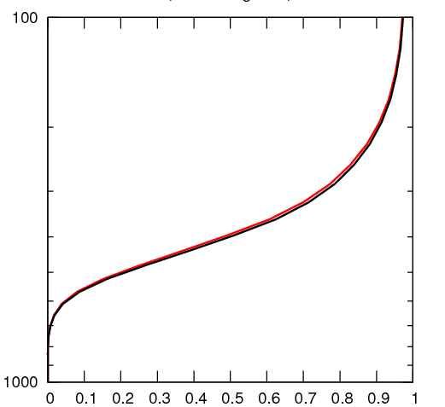
Update of Calibration Table and RTTOV Coefficients
Corrected calibration tables are computed according to modified SRF by [Breon,1999], and provided to JRA-55 (JMA Re-Analysis) team.
JRA-55 team obtained RTTOV parameters based on the corrected SRF thanks to Dr. Saunders (UK Met Office), and performed impact tests.
Transmittance of GMS-5 WV channel
Relationship between brightness temperature, observed radiance and digital counts
RTTOV-10
Mid-latitude
Radiance
Dcorr
Dorg
Pressure (hPa)
Acorr
BT=243.454K (original)
BT=242.877K (corrected)
Difference ≈ 0.5 K
Aorg
255
T0
Lsp
Lsh
Transmittance
BT (K) Digital count
Shinya Kobayashi (CPD/JMA)

Slide 6
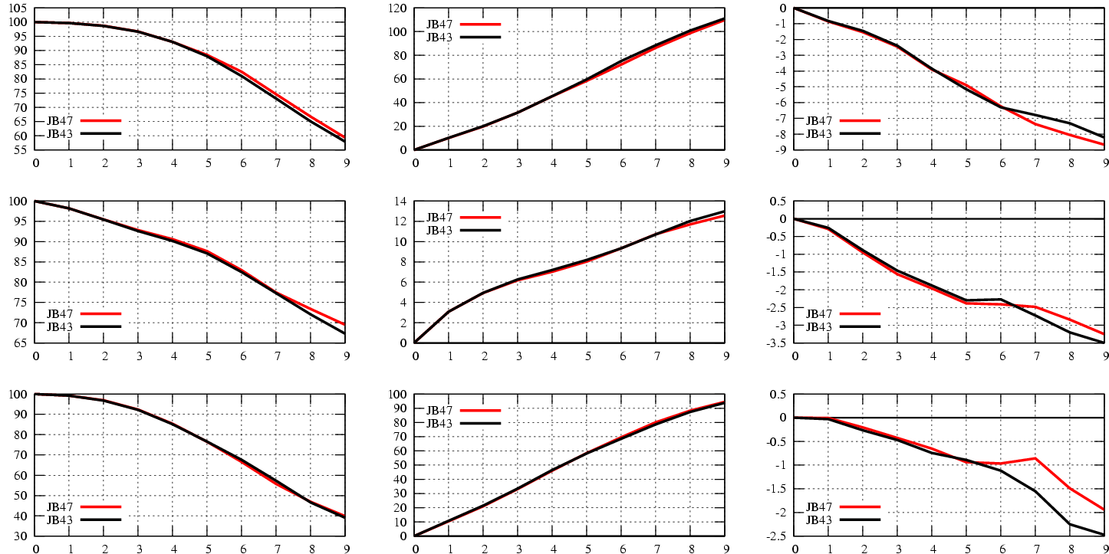
Impact of SRF Correction on Forecast Accuracy (studied in the JRA-55 project)
500hPa geopotential height forecast scores for January 1996
Anomaly correlation
RMSE (m)
Bias (m)
N. H.
Trop.
S. H.
Day
Day
Day
Original SRF w/ old LBL Corrected SRF w/ updated LBL
Shinya Kobayashi (CPD/JMA)
6

Slide 7
Summary
Original SRF of GMS-5 WV channel is contaminated by water vapor. Corrected SRF is evaluated by updated parameters for RTTOV and calibration table.
OSEs using the JRA-55 system demonstrate that reprocessed CSR data using correct SRF improve Re-Analysis products.
Re-calibration of GSICS Correction is also expected to provide positive impact on UTH analysis.

Slide 8
Thank you for your attention

