Slide 1
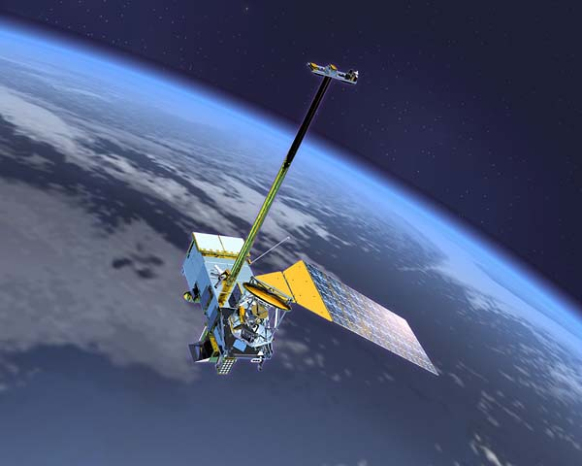
Part 1 PATMOS-x AVHRR Solar Reflectance Update
Andrew Heidinger
NOAA/NESDIS/STAR@CIMSS
Mike Foster, Christine Molling and William Straka
UW/SSEC/CIMSS
Supported by NCDC CDR Program

Slide 2
Accomplishments
Extended the PATMOS-x approach (Heidinger et al, 2010) approach to data from 2010 – 2011.
Implementing a near real-time monitoring of the reflectances (for NCDC)
Extended the MODIS-SNO Analysis for the 1.6 μm values through 2011.
Awaiting MODIS Collection 6 level-1b data so we make a new version (or explore the impact).

Slide 3
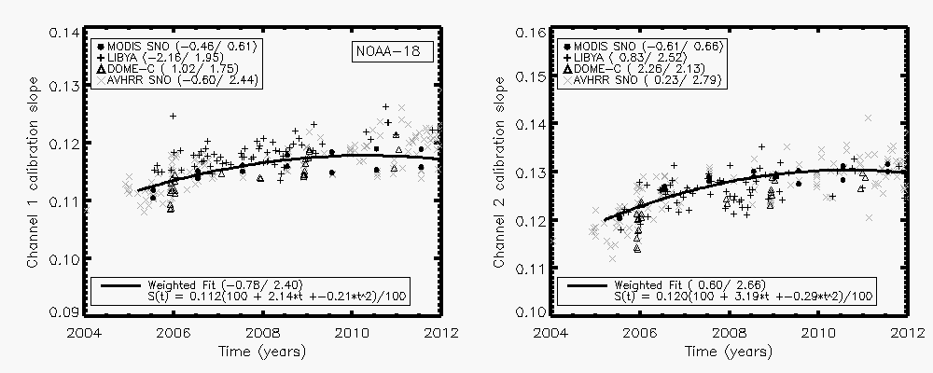
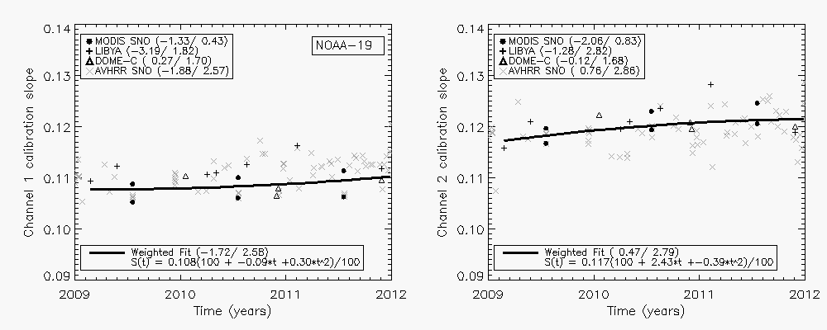
NOAA-18 and NOAA-19 Calibration Extension

Slide 4
METOP-A Impact of Calibration Extension

Slide 5
NOAA-18 Impact of Calibration Extension

Slide 6
NOAA-19 Impact of Calibration Extension

Slide 7
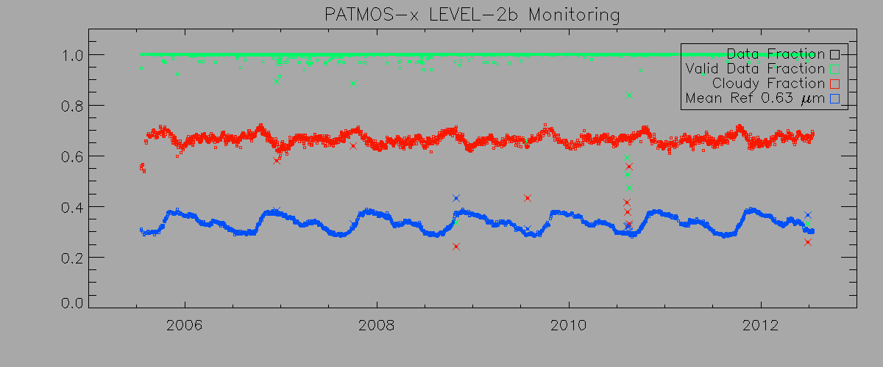
Quality Assurance Approach (daily)
NOAA-18 Ascending Node Results for Entire Operational Life
Notes:
We have qa tools developed specifically for the NCDC CDR program. Here is a dashboard configuration to quickly see the percent pixels that fall within valid data ranges. Each vertical line segment represents a single level2b daily file. Ascending nodes are located above descending nodes for each sensor channel shown. Green line mean >95% of the data in the daily file is valid, yellow means between 95% and 50%, red means between 50% and 0%, and black means that there is no valid data or the file is missing completely. This figure shows one entire year of data for the NOAA-18 AVHRR.

Slide 8
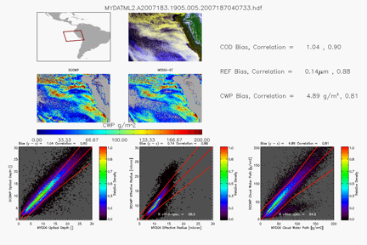
Quality Assurance Approach
Instantaneous comparisons to MODIS during period of simultaneous data provide FCDR and product assessments over a wide dynamic range. MODIS data is MCST C5.
Longer-term comparison to demonstrate stability of FCDR and derived products (cloud optical depth)
Notes:
Validation against independent data sets. Here we directly compare against MODIS, both with the MYD06 products as well as with raw measurements integrated into PATMOS-x.

Slide 9
Part 2 Status of CIMSS Support for STAR GSICS Activities for 2012
Mat Gunshor, Scott Lindstrom
University of Wisconsin
Tim Schmit
NOAA/NESDIS/STAR/ASPB
Madison, WI USA

Slide 10
CIMSS/GSICS Progress Report CIMSS is processing GSICS comparisons with AIRS vs GEOs for the NESDIS archive
Local AIRS data access issues were resolved and processing caught up.
GOES vs AIRS retrospective GSICS processing done, delivered to NOAA-NESDIS (see next slide)
Meteosat Second Generation (MSG) vs AIRS code installed and working at CIMSS
Proposed order for back-processing of non-GOES imagers:
MSG (MET-8, -9)
MET-5, -7
MTSAT (GMS-5)
FY-2C
FY-2D
FY-2E
MET-8 and MET-9 begun
Wisconsin archive currently contains the original MSG data (pre June 2008).
Processing to date post-June 2008, using new radiance definition MSG.
More IR bands means processing each day is slower than with GOES.

Slide 11
GOES Imager GSICS Back-processing
 | GOES-08 | GOES-09 | GOES-10 | GOES-11 | GOES-12
Days | 148 | 854 | 2,366 | 1,976 | 2,260
Date Ranges | 2002244-2003090 | 2003113-2005321 | 2002244-2009334 | 2006152-2011340 | 2003091-2010364
Date ranges are not always continuous. The goal was to back-process all GOES/AIRS overlap cases prior to operational NESDIS GSICS processing.
Maybe some data from this summer still needs to be processed due to NESDIS move to new building?
GOES-14 currently operating (non-operational mode) – mid-August through October. Is anyone looking at this? Should Wisconsin?

Slide 12
SEVIRI radiance definition change
The Wisconsin MSG data archive contains data prior to June of 2008 with the original definition of radiance used prior to that date.
The EUMETSAT archive has updated all of their data to what is referred to as the “Level 1.5 Image Product Radiance Definition”.
What should we do for the NESDIS GSICS archive?
Wisconsin thinks that they should obtain the Level 1.5 data for their archive and keep parallel versions.
Obtaining the data may take a while; we hope to resolve this as quickly as possible and in the mean time perhaps process other GSICS data first.
We should compare GSICS results (perhaps for a few months) with the original data and 1.5 data to see what the impact is.
Has this already been done?

Slide 13
CIMSS/GSICS Future Projects
Back-process GOES Sounders
Repeat process with IASI?
Assess impacts of GSICS corrected radiances on current GOES products?
Remains unfunded. Should we put this at a higher priority and request current funding source fund this instead of work with Sounders or IASI? Or continue to try to identify funding source?
What about COMS? Wisconsin is getting COMS data currently.
?

