Slide 1
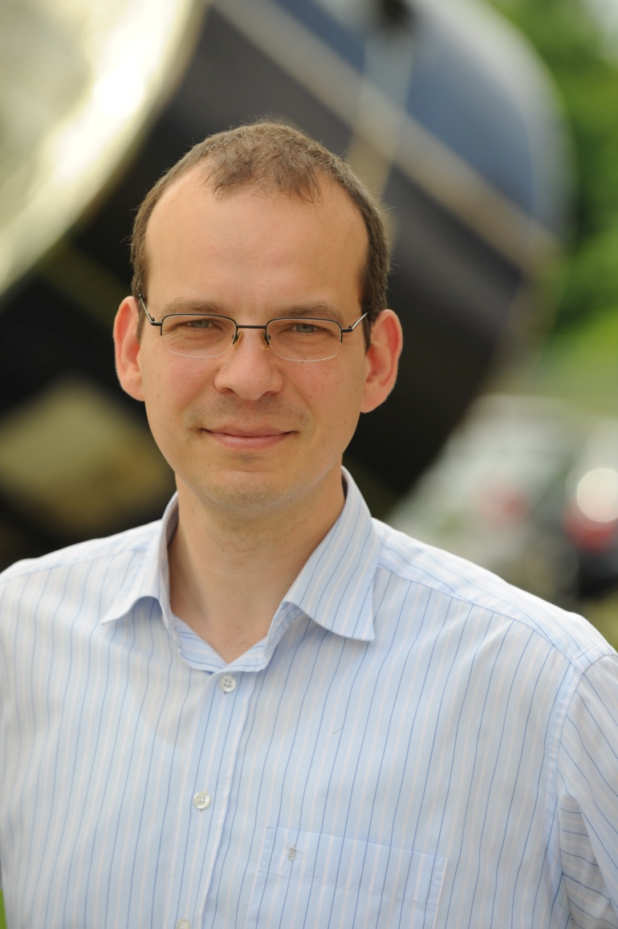
SCOPE-CM
Sustained, Co-Ordinated Processing of Environmental Satellite Data for Climate Monitoring
Lothar Schüller
EUMETSAT and SCOPE-CM Secretariat

Slide 2
Outline
Background and concept
Phase 1 – Establishing International Collaborations
Phase 2 – Sustained Production of Climate Data Records
Invitation to Participate
Conclusions

Slide 3
Background
The aim of the Sustained, Co-Ordinated Processing of Environmental Satellite Data for Climate Monitoring (SCOPE-CM) is to enable a network of facilities ensuring continuous and sustained provision of high-quality Climate Data Records (CDRs) from satellite observations.
The foundation of SCOPE-CM is the network of relevant space agencies and other organisations (including GSICS) with the aim to develop, extend and preserve the capabilities and skills of generating and re-generating CDRs.

Slide 4












WMO’s SCOPE-CM Initiative
  Coordinated international network to produce CDRs from multi-agency mission data in operational environment addressing GCOS requirements
Current Participants of the SCOPE-CM Network
Operational Satellite operators:
  NOAA, JMA, CMA, EUMETSAT
Stakeholder:
  WMO Space Programme, GCOS, CEOS, GEO, CGMS/GSICS, WCRP/GEWEX, ESA (observer)
Notes:
Additional message for this slide:
SCOPE-CM currently prepares for Phase-II
Lessons learned from the five pilot projects will result in a structural change that makes SCOPE-CM more open for scientific groups.
SCOPE-CM will consist of a sustained structure maintained by basic funding of space agencies and Principal Investigator driven projects that lead developments towards sustained CDR generation.

Slide 5
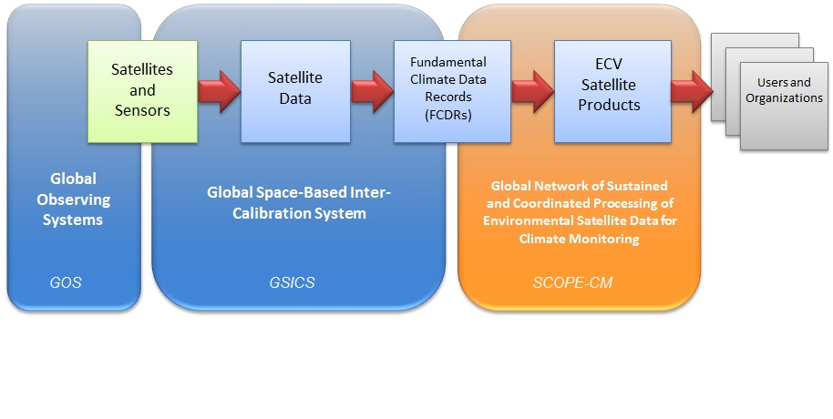
Background
SCOPE-CM Conceptual Framework

Slide 6
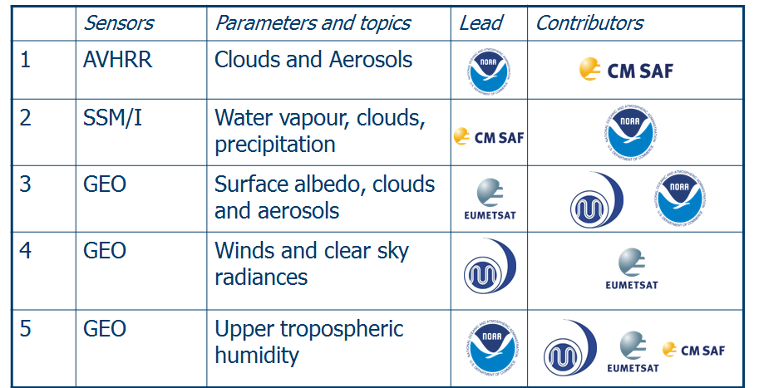
SCOPE-CM Phase 1
Establishing International Collaborations
The primary activities accomplished in Phase 1 of SCOPE-CM include:
  Establishing the initial network and structure
  Agreeing on principles and standards
  Establishing the first pilot projects on selected subjects
  Assessing current capabilities
  Establishing feedback mechanisms with users

Slide 7
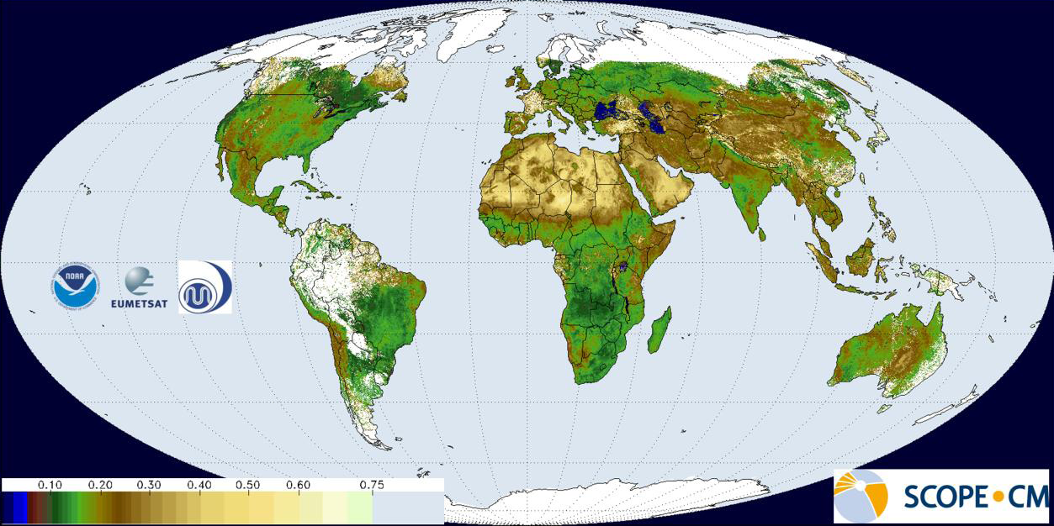
SCOPE-CM Global Surface Albedo
High Volume, Distributed Processing
Global Surface Albedo software from EUMETSAT (JRC) successfully ported and implemented at JMA and NOAA NCDC
Collaborative, distributed processing of high volume Geostationary data at operational centers

Slide 8
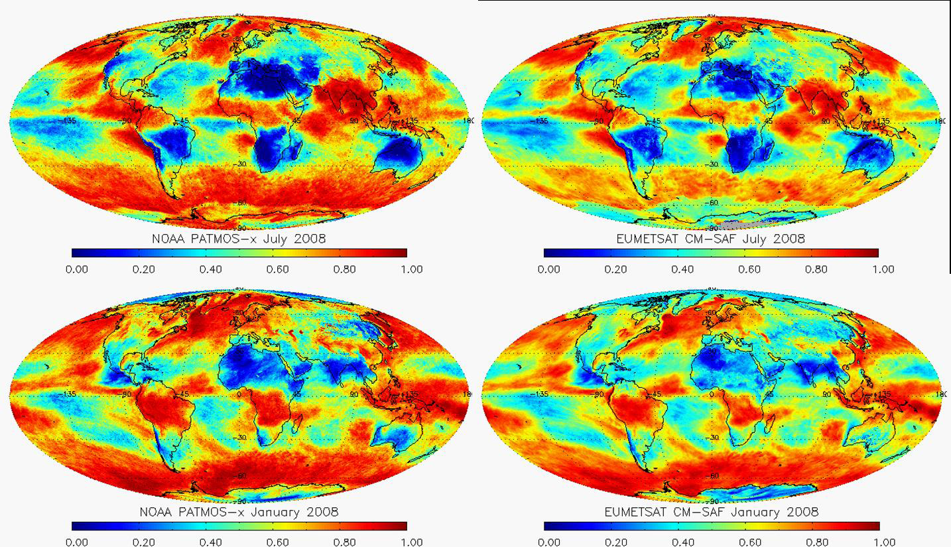
SCOPE-CM Global Cloudiness Coordinated Processing of AVHRR data
Phase 1 concentrated on processing of polar orbiter satellites (20 years AVHRR record)
Phase 2: collaboration in providing the Fundamental Climate Data Records (Radiances)

Slide 9
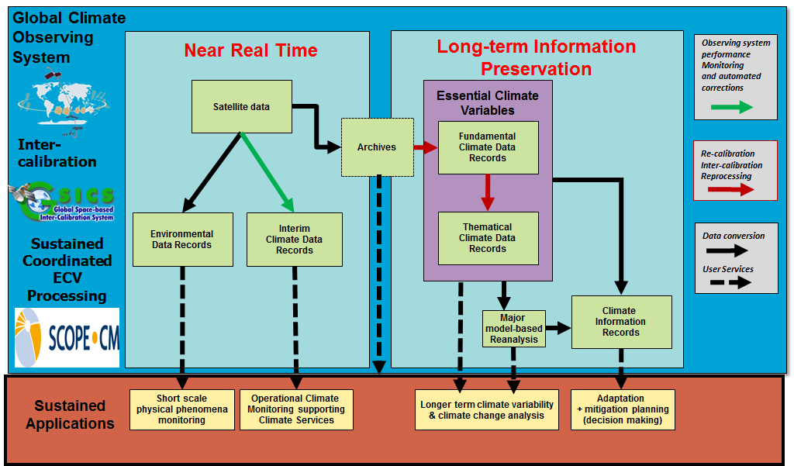
Sustained Applications Drive the
Climate Architecture Required

Slide 10
SCOPE-CM Phase 2 -Sustained Production of Climate Data Records (CDRs)
Establish a systematic approach to increase the sustainability (maturity) of CDR generation capabilities
Establishment of structures for sustainable generation of Fundamental CDRs and Thematic CDRs
  Generation of first SCOPE-CM CDR products
  Increased coverage of products in terms of ECVs, time and spatial dimension
  Fostering extension of the network to additional partners
A Maturity Matrix assessment will help organize elements of the CDR life cycle

Slide 11
A Maturity Matrix for Assessing the Completeness of Climate Data Records
Where can products easily be found?
What methods were used to create the product?
How do we ensure authenticity of the product?
What original observations were used in the product?
What methods were used to create the product?
What original observations were used in the product?
SCOPE-CM Portal
11
Digital Signature
Let’s define a Maturity Matrix (1=low; 6=high)
that sets expectations and assesses progress
Software Readiness | Metadata | Documentation | Product Validation | Public Access | Utility
Are algorithms under configuration management and how mature? | How full and complete are the metadata and quality assessment? | Is the Operational Algorithm Description full, complete, and peer reviewed? | How complete is the validation? | Are the data, algorithms and software open and available to the Public? | How extensive is the peer reviewed literature and how varied are the applications?

Slide 12
Maturity Matrix Model
Main text
Or bullet points here...

Slide 13
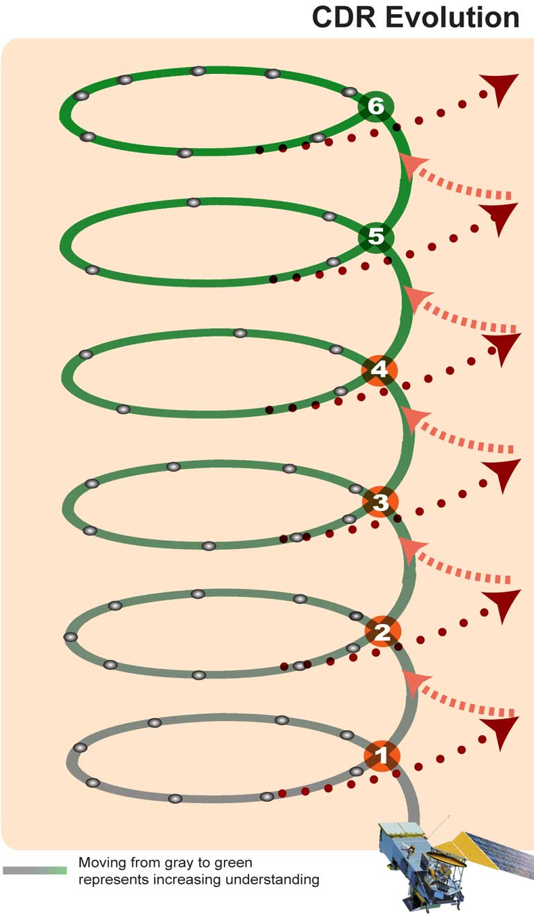
SCOPE-CM Climate Data Record Life Cycle Based on Maturity Matrix
The CDR life cycle is iterative, with improved understanding and utility as maturity increases

Slide 14
SCOPE-CM Climate Data Record Life Cycle Based on Maturity Matrix
The CDR life cycle is iterative, with improved understanding and utility as maturity increases
SCOPE-CM Project:
Elevating a CDR generation capability to a higher maturity

Slide 15
SCOPE-CM Climate Data Record Life Cycle Based on Maturity Matrix
The CDR life cycle is iterative, with improved understanding and utility as maturity increases
Sustaining CDR generation through a series of SCOPE-CM Projects

Slide 16
SCOPE-CM Climate Data Record Life Cycle Based on Maturity Matrix
High Maturity
SCOPE-CM Projects
Moderate Maturity
SCOPE-CM Projects
Initial Maturity
SCOPE-CM Projects

Slide 17
SCOPE-CM Climate Data Record Life Cycle Based on Maturity Matrix
Generic SCOPE-CM projects process

Slide 18
Invitation to Participate in SCOPE-CM Phase 2
Once the implementation plan for Phase 2 is completed, SCOPE-CM will issue an invitation for organizations to participate in the sustained development and production of CDRs
Some candidate CDRs for Phase 2 have already been identified:
  GEO tapestry, targeting a consistent inter-calibrated geostationary data record (FCDR) employing GSICS methodology.
  Surface Albedo (geostationary and polar platforms)
  Microwave cloud Liquid Water Path (LWP)
  Free Tropospheric Humidity (GEO and LEO sensors)
  Your project here…

Slide 19
Conclusions
SCOPE-CM has successfully completed Phase 1 with Pilot Projects and implemented algorithms at different operational processing centers for climate
Phase 2 will use the concept of a Maturity Matrix to organize development and sustaining CDRs into initial, moderate and high maturity to better characterize CDRs for the user community
GSICS activities are fundamental for FCDR generation, specific interaction and cooperation being planned.
Additional participation is welcomed for Phase 2

