Slide 1
GSICS Future Users’ Workshop
Fangfang Yu, on Behalf of GCC

Slide 2
Forthcoming: Another Venue of GSICS Users’ Workshop in USA
Next users’ workshop is planned to be held in the first NOAA Satellite Conference
A merging of Direct Readout, GOES/POES and GOES-R/JPSS Users
Where: College Park, Maryland (NCWCP)
When: in one of the afternoon, April 8-12, 2013
No registration fee for general attendance to the conference
Good hotel(s) for discounted rate of $129/night (with shuttle service)
Meeting URL: http://satelliteconferences.noaa.gov/2013/
Please stay tuned for the further notice

Slide 3
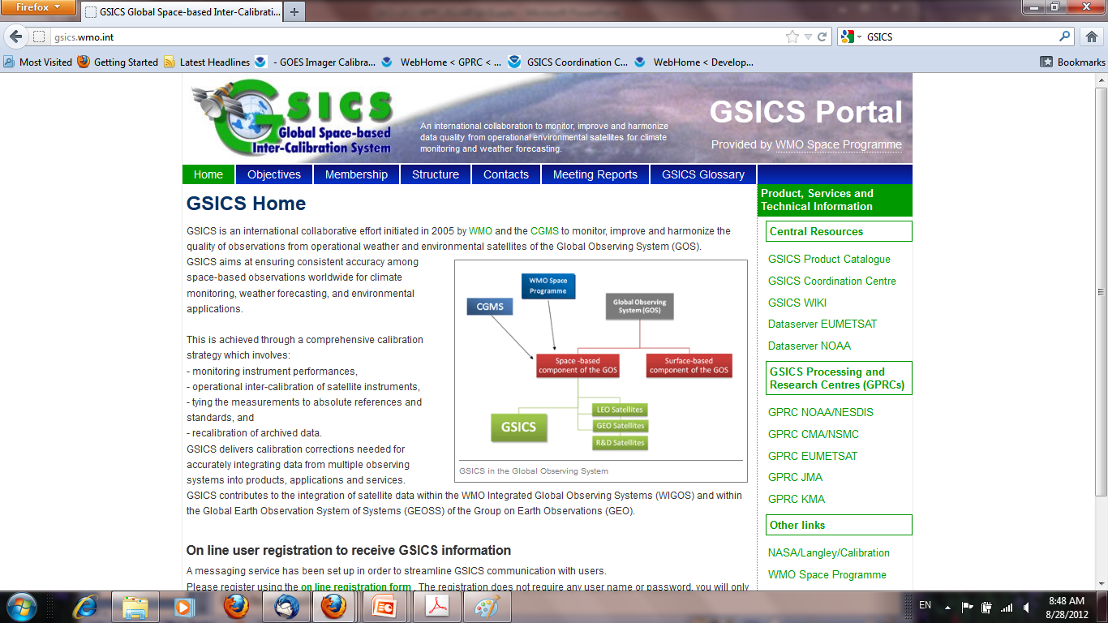
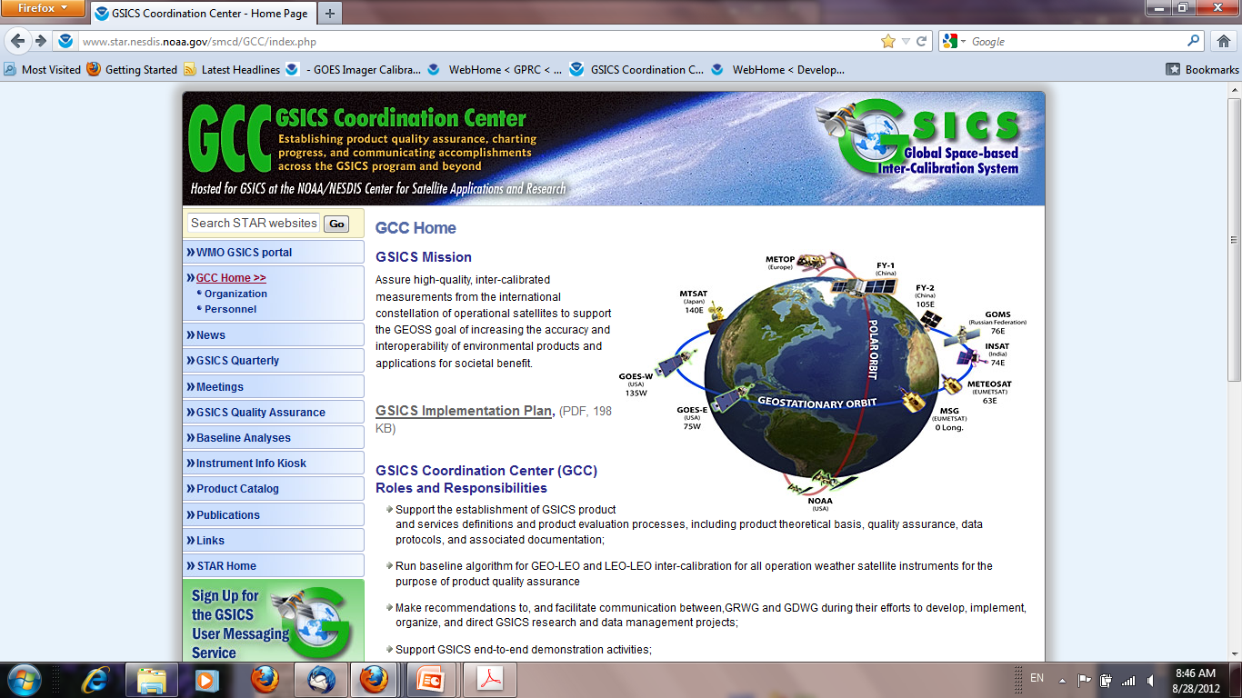
GSICS Users Messaging Service
Linked at WMO GSICS portal and GSCIS GCC website
http://gsics.wmo.int
http://www.star.nesdis.noaa.gov/smcd/GCC/index.php

Slide 4
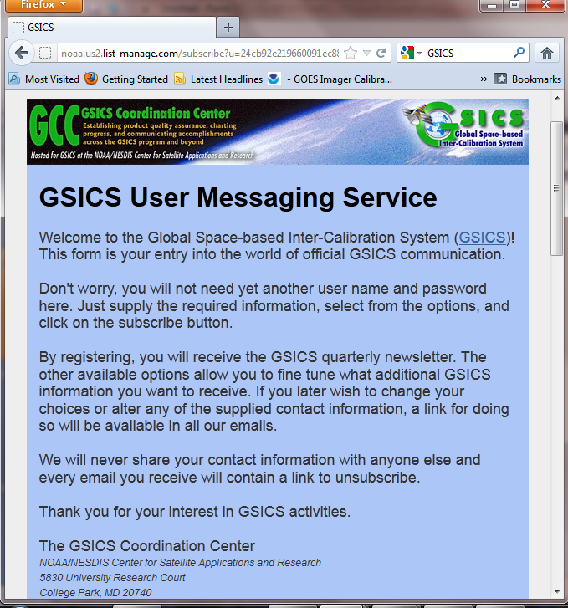
GSICS Users Messaging Service
Register with Name, email, and organization
Receive messages about
GSICS Quarterly newsletter
Options for other GSICs information

