Slide 1
Overview of the WMO Global Space-based Inter-Calibration System (GSICS):
Strategy, Implementation, and Benefits
Mitch Goldberg, NOAA/NESDIS
GSICS Executive Panel chair
NOAA/NESDIS
2013 GSICS Users Workshop
NCWCP, College Park, MD
Notes:
Visible Infrared Scanner (VIRS) on the Tropical Rainfall Measuring Mission (TRMM) is used as the reference instrument.

Slide 2
GSICS Overall Objective
To intercalibrate critical components of the global observing system to climate quality benchmark observations and/or reference sites
Why?? Supports a much more encompassing strategy for Earth Observations.
2

Slide 3
Larger Strategy
Use Earth Observations for the benefit of mankind by providing essential information needed to make decisions.
To accomplish this:
  International partnerships because the information needed is on all spatial, temporal, spectral scales.
  Agencies contribute to this strategy by providing a portion of the needed earth observations.

Slide 4
Implement this strategy
Use Earth Observations for the benefit of mankind by providing essential information needed to make decisions
Need common capabilities across agencies through capacity building (learn from each other)
Foundation of Earth Observations for any application is the quality of the fundamental observations – calibrated measurements.
All Earth Observations are not created equal when it comes to accuracy and long-term stability.
Part of the Global Observation System (GOS) must have climate quality sensors
Satellite agencies must become experts in calibration and product development and work with users for application development.
Data Democracy – free and open data access, but we need to foster open application development to benefit all users.

Slide 5
GSICS Mission
To provide sustained calibration and validation of satellite observations
To intercalibrate critical components of the global observing system to climate quality benchmark observations and/or reference sites
To provide corrected observations and/or correction algorithms to the user community for current and historical data
Goal: In global framework, Agency A to provide the best characterized data tied to
reference instruments to other Agencies,, enabling immediate consumption for a
variety of applications - Weather, Environmental, Climate
5

Slide 6
How do you achieve this goal?
Capacity building - each operator is responsible for implementation of their GSICS correction (intercalibration) algorithms which are developed and vetted within the GSICS community
GSICS has a product acceptance procedure which requires all algorithms to be documented by the developer, and datasets reviewed by the GSICS community and users.

Slide 7
GSICS Official Members
NOAA
NIST
NASA
EUMETSAT
CNES
CMA
JMA
KMA
WMO
ISRO
IMD
JAXA
USGS
Roshydromet
ESA (observer)
GSICS current focus is on the intercalibration of operational satellites,
and makes use of key research instruments such as AIRS and MODIS
as reference instruments for the operational instruments
7
Notes:
7

Slide 8
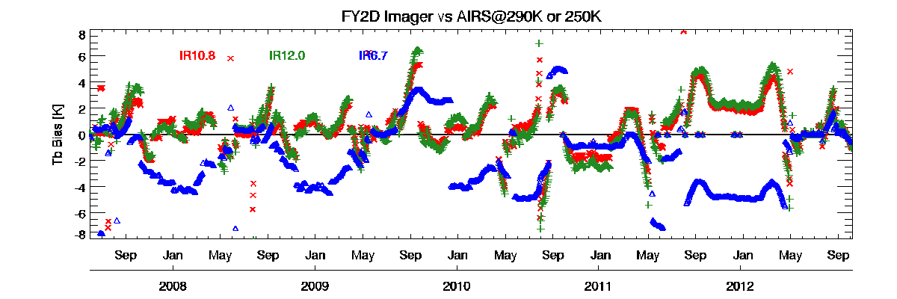
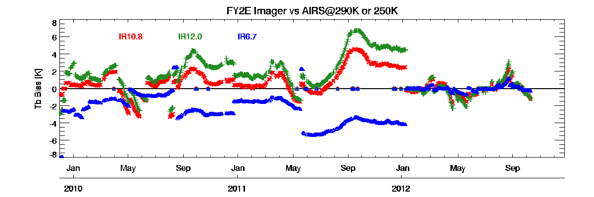
GSICS Contribution to FY-2D/2E Cal
FY-2 vs AQUA/AIRS
Operational calibration of FY-2D/2E was upgraded using GSICS inter-calibration algorithm in 2012-04 and 2012-01 separately. The calibration biases were sharply decreased, and reduced to about 0.5~1K@290K (@250K）without eclipse period.
Before upgrade, calibration bias of FY-2D was about 1~2K@290K in split window channels, and 3~4K@250K in WV channel. Tbb bias presents a significant cyclical fluctuation ,and reaches 4-6 K every September during the Autumn eclipse phase.
Before upgrade, calibration bias of FY-2E was about 1~3K@290K in split window channels (IR2 is larger than IR1). TBB bias in WV channel@250K is similar large as FY-2D but without seasonal fluctuation.
Eclipse Phase
Time series of calibrated TBB bias for IR1~3 channels vs AQUA/AIRS
reference scenes (290 K for IR1 and IR2, 250 K for IR3).

Slide 9
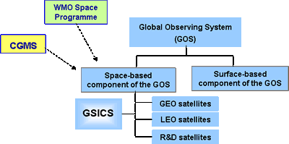
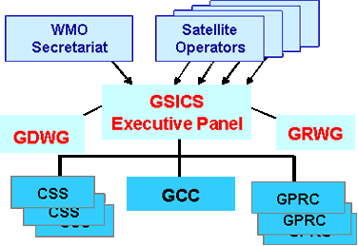
GSICS organization
Priorities established by GSICS Executive Panel
Algorithms shared, reviewed and developed by the GSICS Research Working Group (GRWG)
(Tim Hewison, EUMETSAT – Chair)
GSICS Data management Working Group
(Aleksander Jelenak, NOAA - Chair)
GSICS Coordination Centre (GCC)
  operated by NOAA/NESDIS
  (Fuzhong Weng – NOAA – Director)
    establish procedures
    assist in implementation
    configuration management
    issue quarterly newsletter
Processing & Research Centres (GPRC)
  operated by each satellite operator
Calibration Support Segments (CSS)
  including field sites and laboratories
GSICS as an element of the space-based component of the Global Observing System
Coordination Center
Calibration Support Segments
(reference sites, benchmark measurements, aircraft, model simulations)
Regional Processing Research Centers at Operational Space
Agencies
Notes:
GSICS activities rely on a GSICS Coordination Centre (GCC) operated by NOAA/NESDIS, several GSICS Processing and Research Centres (GPRC) operated by each satellite operator, and will benefit of Calibration Support Segments including field sites and laboratories.
Activities are overseen by a GSICS Executive Panel assisted by a Research Working Group and a Data management Working Group.

Slide 10
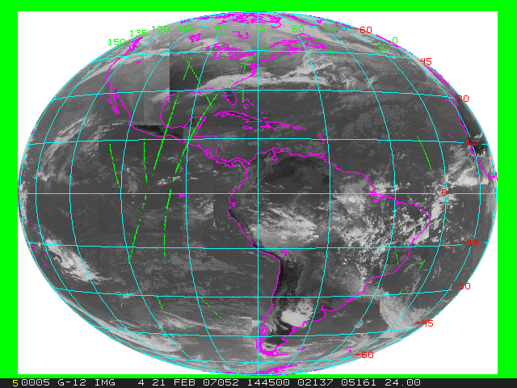
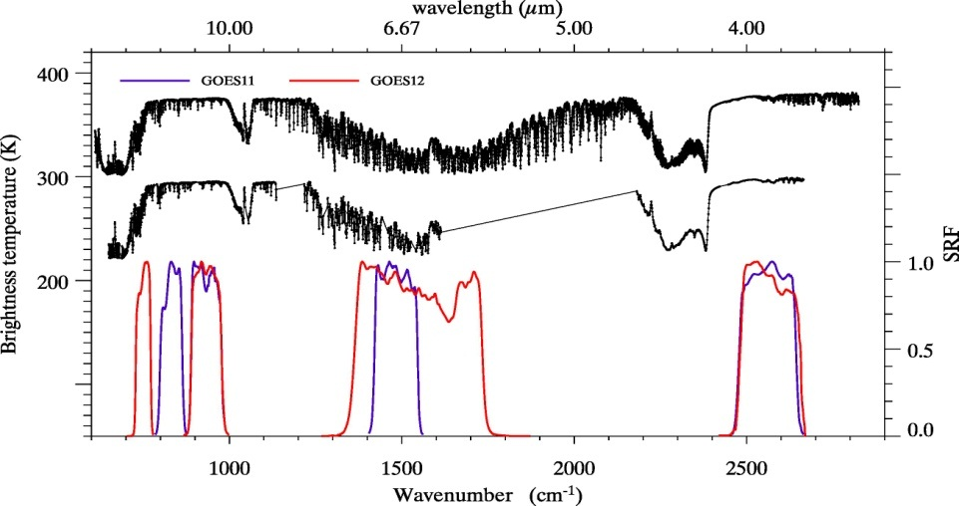
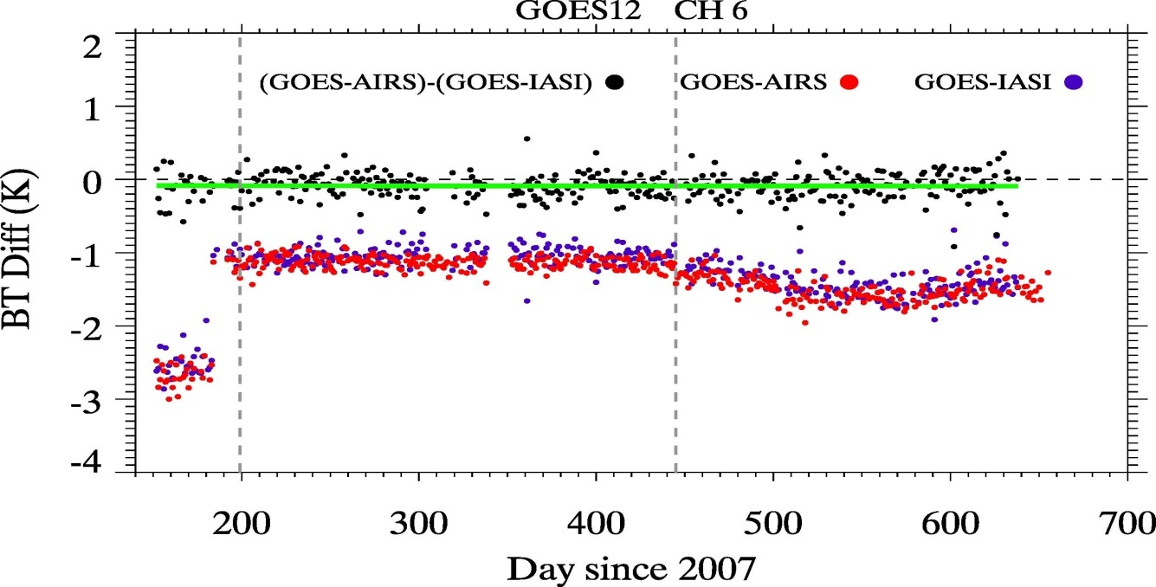
First international coordinated GSICS project is the
intercalibration of geostationary infrared channels
with IASI and AIRS
IASI
AIRS
Ch4
Ch2
Ch6
Ch3
Web Accessible
10
10
Notes:
10

Slide 11
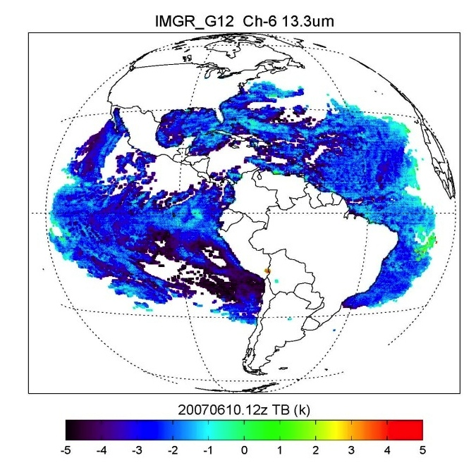
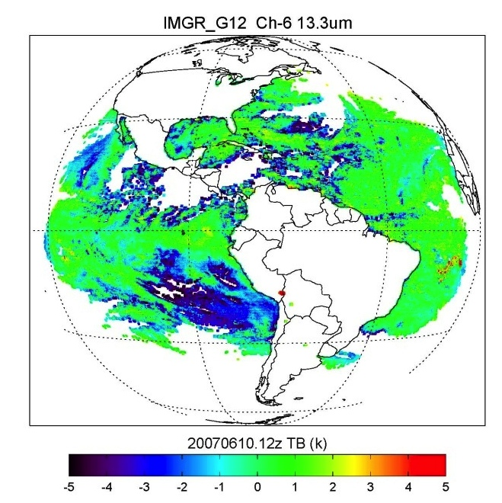
GSICS Correction Algorithm for Geostationary Infrared Imagers
GSICS will provide correction coefficients for all GEOs
from 2003 (beginning of AIRS record) to present
The first major deliverable to the user community is the GSICS correction algorithm for geostationary satellites.
The user applies the correction to the original data using GSICS provided software and coefficients.
The correction adjusts the GOES data to be consistent with IASI and AIRS.
The figures to the left show the difference between observed and calculated brightness temperatures (from NCEP analysis) before and after correction
The bias is reduced from 3 K to nearly zero.
Before 3K Bias
After: ~ 0K Bias
11

Slide 12
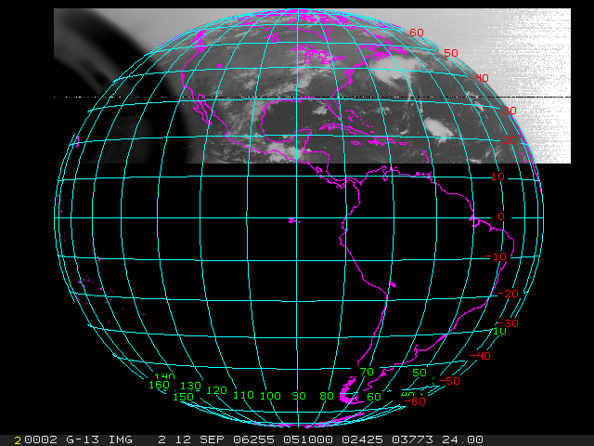
Characterization of Midnight Blackbody Calibration Anomaly
3.9
6.7
10.7
12
IASI AIRS

Slide 13
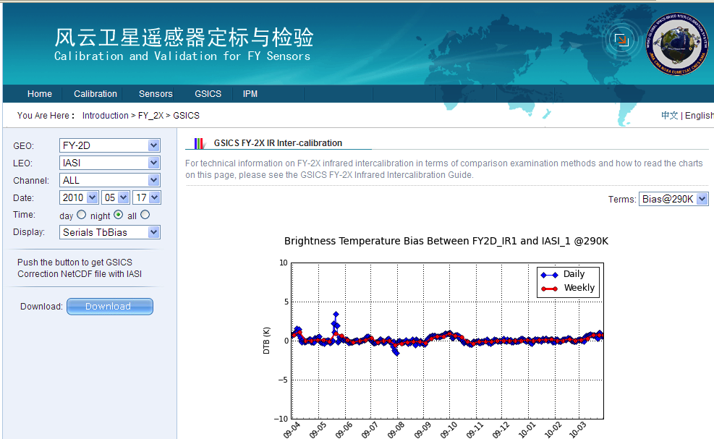
Example of GSICS Bias Monitoring
From CMA: Time Series of FY2D-IASI Standard Biases [K]

Slide 14
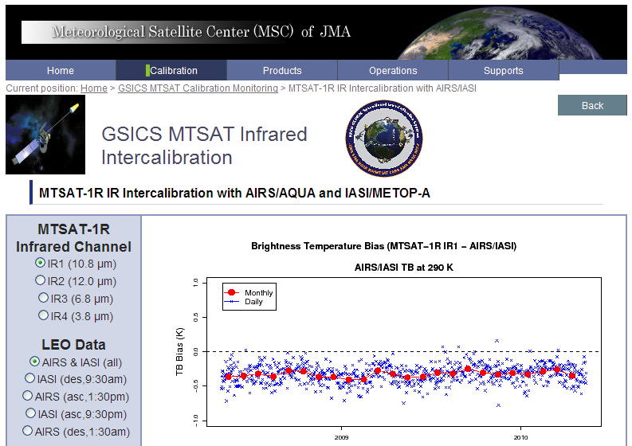
Example of GSICS Bias Monitoring
From JMA: Time Series of MTSAT-1R-IASI/AIRS Standard Biases [K]

Slide 15
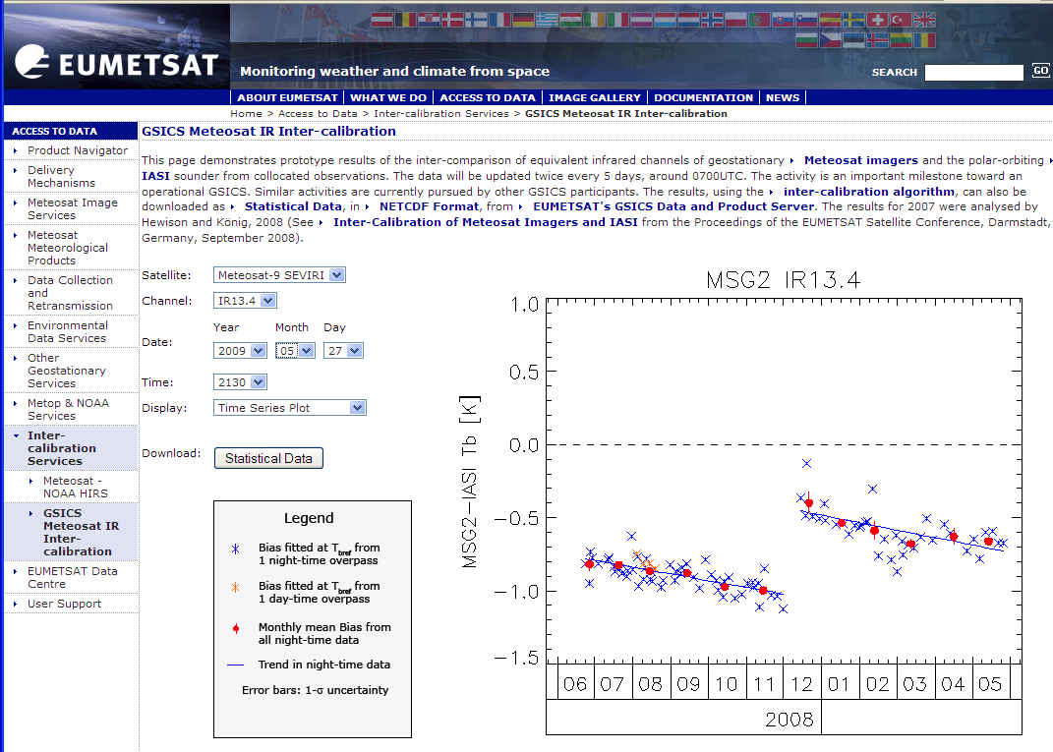
Example of GSICS Bias Monitoring
From EUMETSAT: Time Series of Meteosat9-IASI Standard Biases [K]

Slide 16
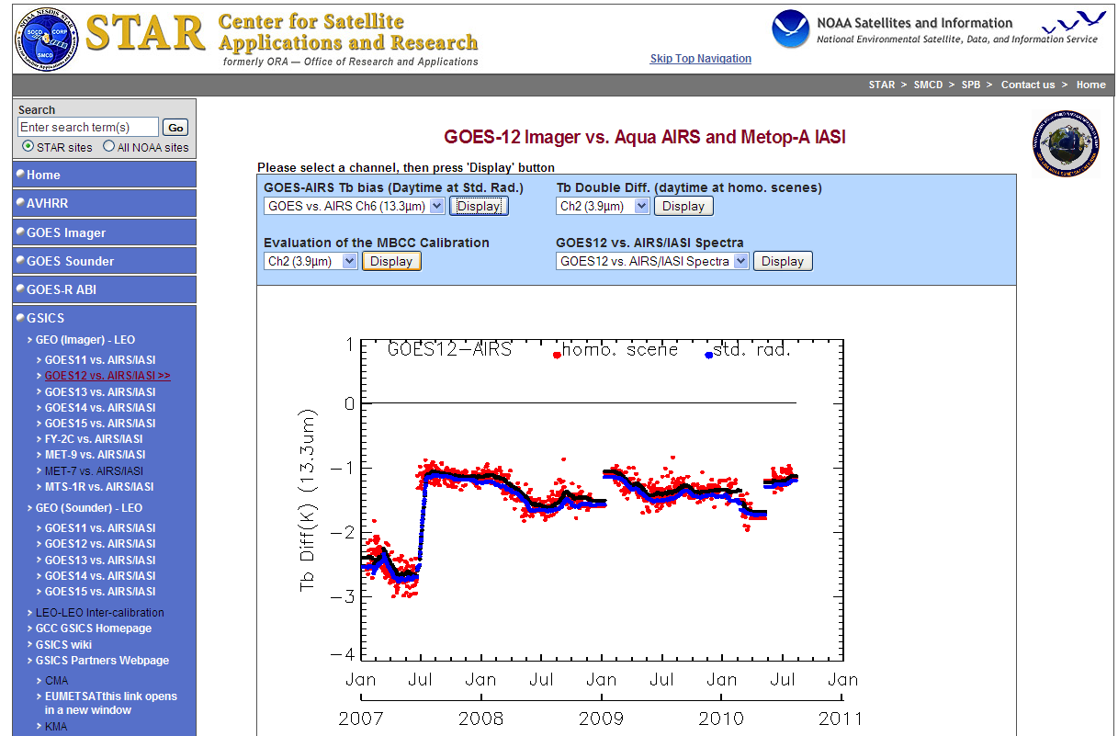
Example of GSICS Bias Monitoring
From NOAA: Time Series of GOES12-AIRS Standard Biases [K]

Slide 17
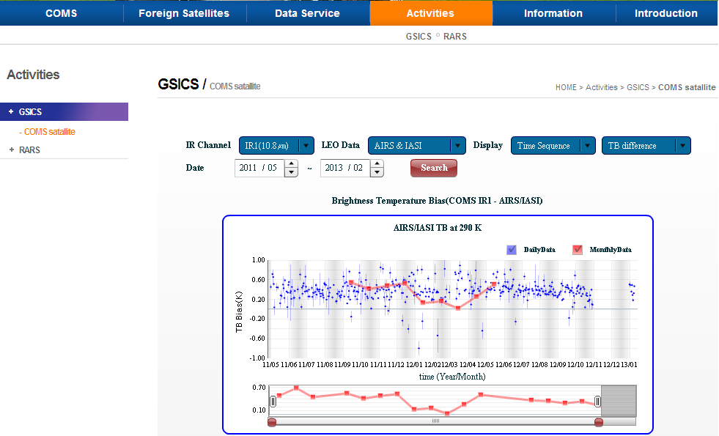
GSICS KMA
http://nmsc.kma.go.kr/html/homepage/en/testoperate/gsicsIR.do
Time sequence (TB difference)
Regression coefficients between COMS radiance and IASI radiance
Scatter plot (COMS rad. vs. IASI rad. and IASI TB – COMS TB)
Notes:
KMA has provided the GSICS activity via the following NMSC website address. (→ pointing homepage address box)
You can find the time sequence, regression coefficients between COMS radiance and IASI radiance, scatter plot on our website in near real time.

Slide 18
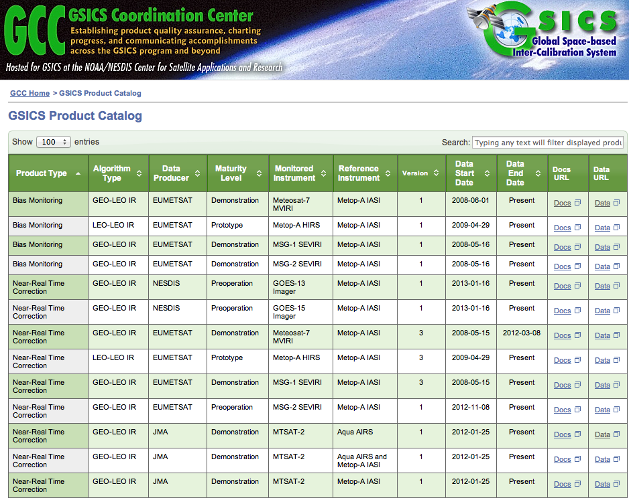

Slide 19
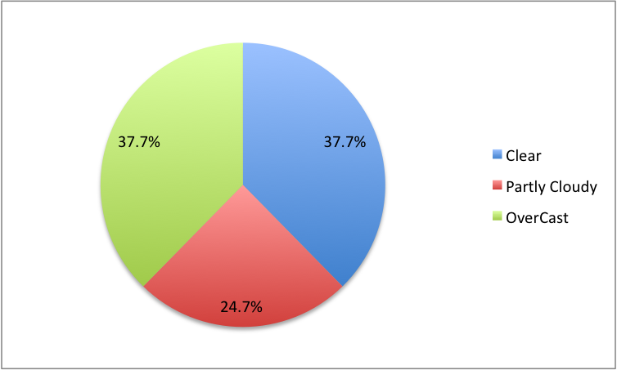
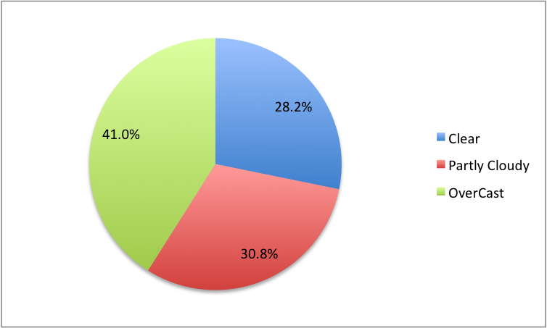
IMPACT on Cloud Coverage Classification
MSG March 2009
Before GSICS correction
After GSICS correction

Slide 20
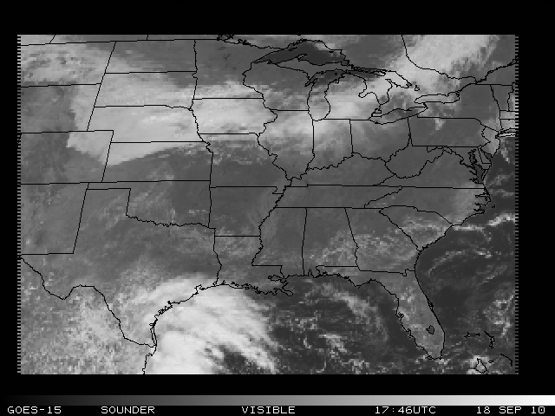
GOES Sounder Visible band
Low cloud coverage

Slide 21
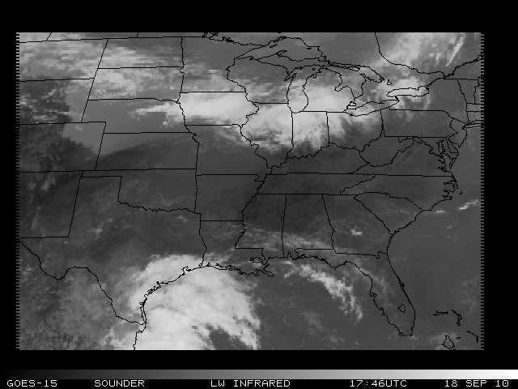
GOES Sounder Longwave Infrared
High clouds embedded in this low level cloud bank
Notes:
The red circle is included for two reasons. First, the Schreiner-GSICS version tends to be more "smooth" less high clouds embedded in this low level cloud bank. As will be noted in the second circle, this tends to be one of the strengths of the GSICS Bias Coefficients over the "Simple Bias Correction" and the "Dynamic Bias Correction" methods. One curiosity in the red circle region is the large "donut hole" in the northern region of the circle for the "GSICS". None of the other two GOES-15 derived products demonstrate this "hole", and the LWW and VIS show no obvious reason for the hole either.
The white circle in large part also demonstrates the "smooth" nature of the GOES Sounder Cloud Product using the "GSICS" compared to the other two GOES-15 Sounder derived Products. Yet the "Schreiner-GSICS" still keeps the lone high cloud in the south-southwestern sector of the white circle. This "high cloud" is also indicated in the LWW image.

Slide 22
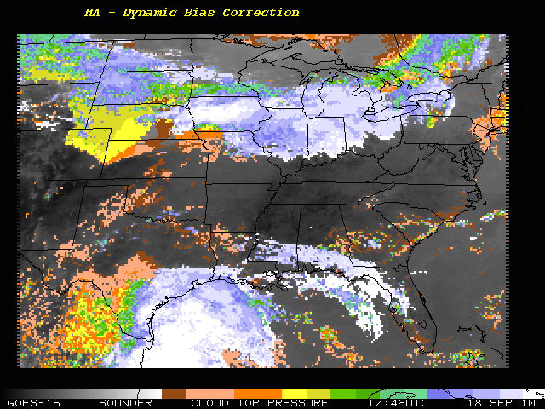
GOES Sounder Cloud-top pressure
Fairly noisy higher cloud pixels and missing clouds
GSICS seems to improve (less noise) upon the dynamic bias correction method for this case.
Notes:
Dynamic bias correction is the current NOAA NESDIS version.

Slide 23
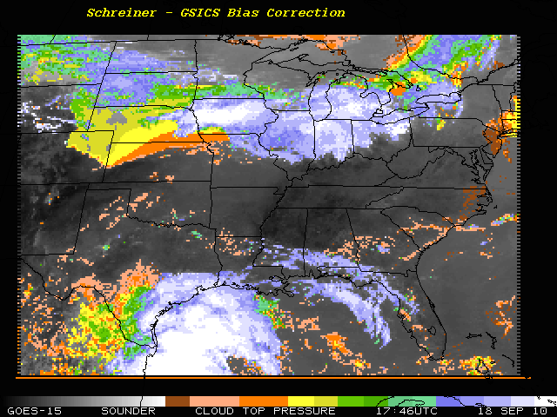
GOES Sounder Cloud-top pressure
More uniform cloud pixels and more low cloud

Slide 24
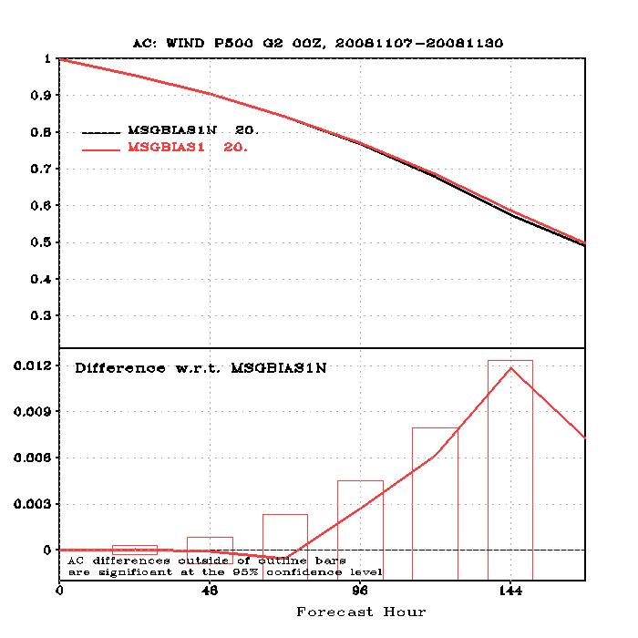
Impacts of GSICS Correction for SEVIRI on GFS Forecast
MSG SEVIRI CSR with and without GSICS bias correction
500 mb Anomaly Correlation fover NH

Slide 25
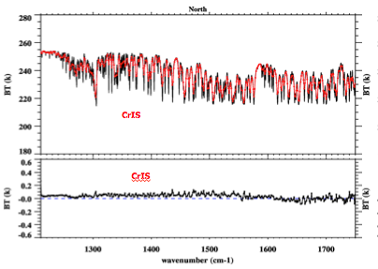
Current focus of GSICS
Interagency collaboration on algorithms (GRWG) and data exchange and formats(GDWG)
Product acceptance and documentation requirements, metadata standards, data formats, website standards
Routine intercalibration (monitor and correct) of all operational GEO Infrared imagers using IASI and AIRS
  MODIS, Deep Convective Clouds, Moon, STARs for visible channels
Intercalibration of LEO instruments
  HIRS, SSMI, AMSU, MHS, AVHRR, AIRS, IASI, FY3,
  GOME-2, OMI, SBUV
  Expanding to include NPP
Traceability
  Campaigns
  Key collocation datasets
  Requirements for pre-launch calibration
Root causes and corrections
CriS - IASI
25
25
Notes:
25

Slide 26
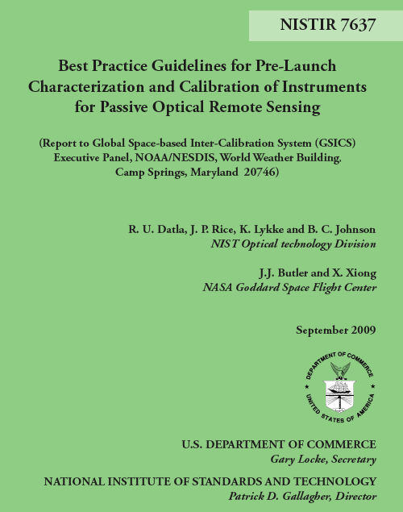
First GSICS
Guideline document
Best Practice Guidelines for Pre-Launch Characterization and Calibration of Instruments for Passive Optical Remote Sensing
Report to GSICS Executive Panel
R.U. Datla, J.P. Rice, K. Lykke and B.C. Johnson (NIST)
J.J. Butler and X. Xiong (NASA)
September 2009

Slide 27
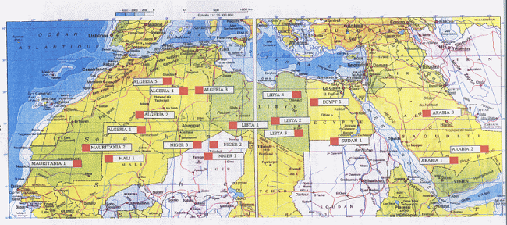
CNES SADE Data Base
Time series of the ratio of the ESA MERIS to
NASA MODIS 0.665 micron visible channel
reflectance from observations at 19 desert sites
in North Africa and Saudi Arabia.
The results show very good agreement and
stability between the two sensors
19 sites selected over North Africa and Arabia

Slide 28
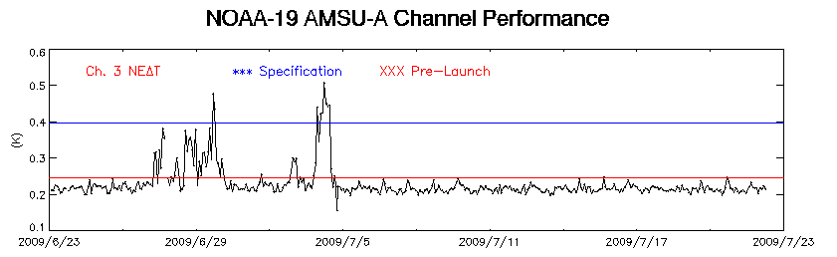
Promoting access to instrument performance monitoring is also part of GSICS
GSICS beginning to develop observing system monitoring tools for all GSICS partners. Above is example of NOAA tool for NOAA-19 OV and long-term monitoring
The system has detected instrument anomalies, provided an important tool for diagnoses, data quality assurance, and for short and long term applications
Courtesy of F.Weng
Notes:
28
To better support the operations, we have developed comprehensive on-orbit verification for newly launched satellites and an integrated cal/val system.

Slide 29

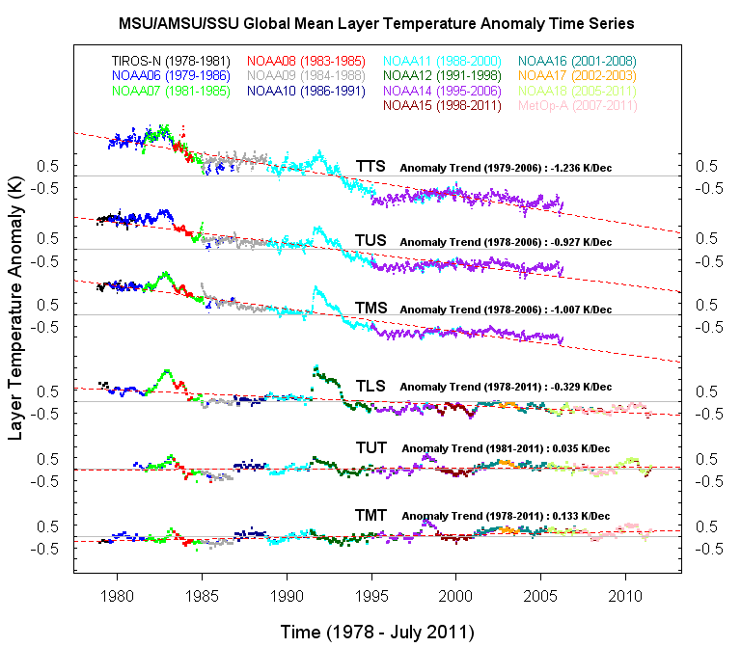
Monitoring Global Upper-Air Temperature Trends
1982 Eruption of
Chichon Volcano
1991 Pinatubo
Eruption
1998 El Nino
2010 El Nino
SSU derived TTS, TUS, and TMS: Temperatures of top stratosphere, upper-stratosphere, and mid-stratosphere
MSU/AMSU derived TLS, TUT, and TMT: Temperatures of lower-stratosphere, upper-troposphere, and mid-troposphere
Notes:
This slides show atmospheric temperature trends derived using our well-merged 5-day averaged global mean MSU/AMSU time series. TMT show are warming trend of ~0.15 K/dec, very little trend was observation in TTS, which large cooling trend exist for TLS.

Slide 30
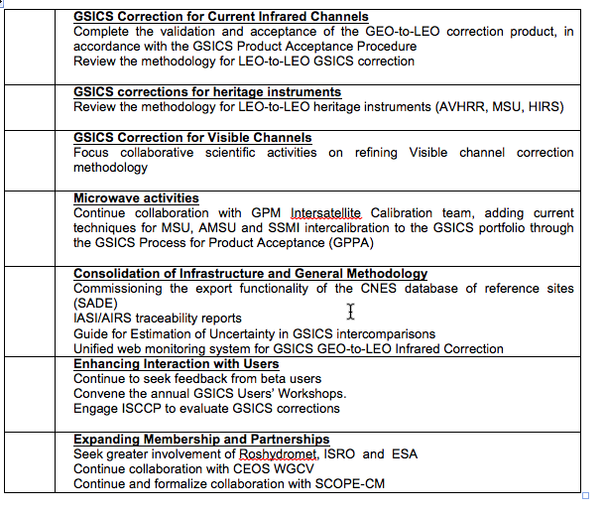
Current High Level Priorities

Slide 31
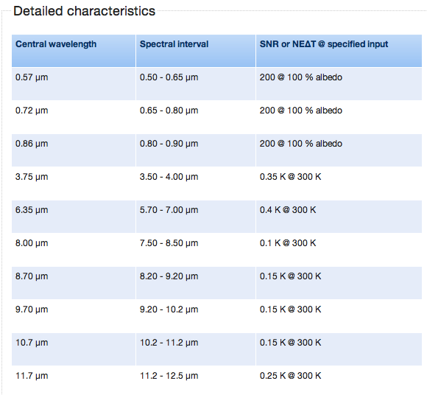
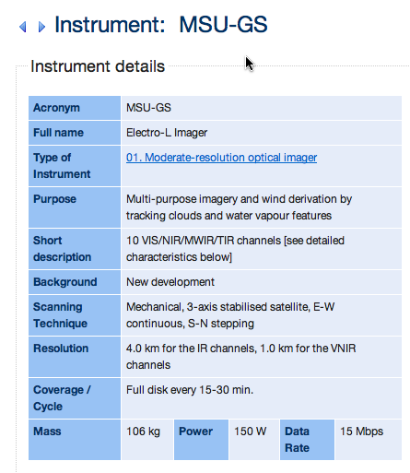
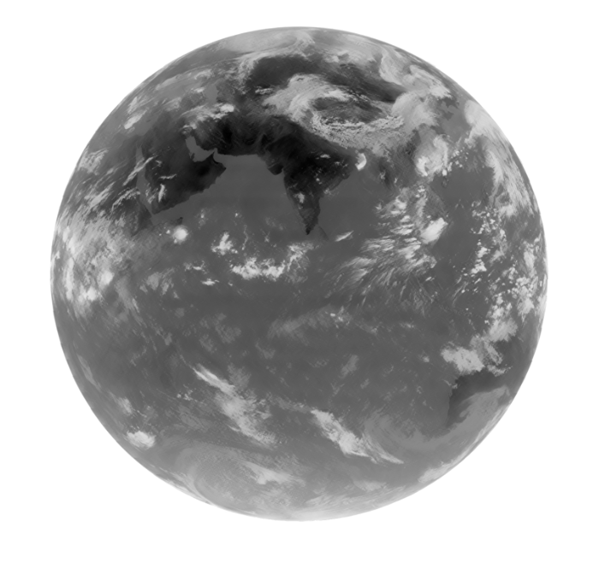
RUSSIA’s ELECTRO-L
Channel 9 10-11 microns

Slide 32
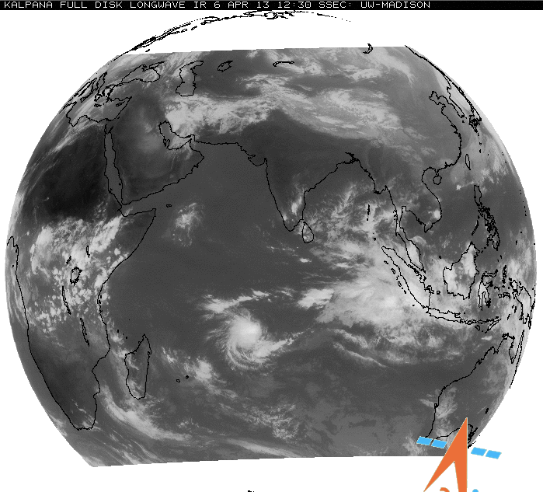
INDIA - IMD
The normalized calibration technique is attempted in order to re-calibrate the Kalpana-1 Infrared data and remove the effect of the temporal non-linearity of sensor response due to degradation of the sensor based on ISCCP (International satellite cloud climatology project) procedure over the Indian Ocean.
Table- KALPANA-1 Satellite Specification
Payload | Channels | Bandwidth | Resolution
VHRR (Very High Resolution Radiometer) | Visible Infrared Water vapour | 0.55µm-0.75µm 10.5µm-12.5µm 5.7µm-7.1µm | 2km x 2km 8km x 8km 8km X 8km
DRT ( Data Relay Transponder) | ----- | ----- | ------

Slide 33
Summary
GSICS is Global Space-based Inter-Calibration System!
  Focuses on Level 1 data => FCDR
GSICS does not (generally) re-calibrate archives of data
  But provides products to correct calibration of real-time and archive data to be consistent with reference instruments
  Also provides tools to monitor biases in near real-time
To date, GSICS have concentrated on current GEO imagers
Developed Procedure for Product Acceptance
  Thorough documentation with traceability
  May be applied to 3rd party products
GSICS ensures consistency between products
  For different instruments – contemporary and historic

Slide 34
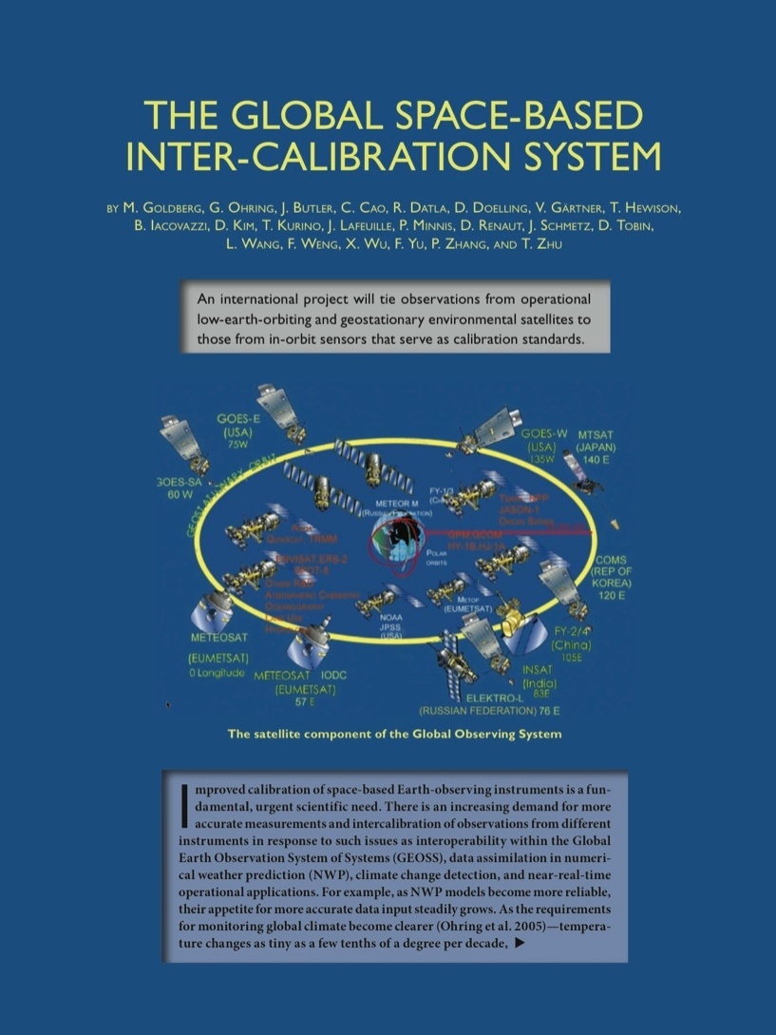
BAMS April 2011

