Slide 1
GSICS Product Development
Tim Hewison¹
EUMETSAT
On behalf of GSICS Research Working Group

Slide 2
Global Space-based Inter-Calibration System
What is GSICS?
Global Space-based Inter-Calibration System
Initiative of CGMS and WMO
Effort to produce consistent, well-calibrated data from the international constellation of Earth Observing satellites
What are the basic strategies of GSICS?
Improve on-orbit calibration by developing an integrated inter-calibration system
Initially for GEO-LEO Inter-satellite calibration
Being extended to LEO-LEO
Using external references as necessary
Best practices for prelaunch characterisation (with CEOS WGCV)
This will allow us to:
Improve consistency between instruments
Reduce bias in Level 1 and 2 products
Provide traceability of measurements
Retrospectively re-calibrate archive data
Better specify future instruments
EUMETSAT | CNES | JMA
NOAA | CMA | KMA
ISRO | NASA | WMO
USGS | NIST | JAXA
ROSHYDROMET | IMD | ESA
Notes:
Well, what is GSICS?
The Global Space-based Inter-Calibration System (GSICS) is an initiative of CGMS and WMO, which aims to ensure consistent calibration and inter-calibration of operational meteorological satellite instruments.
One of the basic strategies of GSICS is to develop an integrated on-orbit cal/val system - initially by LEO-GEO Inter-satellite/inter-sensor calibration.
This will then allow us to provide corrections to improve the consistency between instruments, produce less biased level 1, and therefore, level 2 data, and ultimately, retrospectively re-calibrate archive data, which is of great interest in the climate monitoring community

Slide 3
GSICS Principles
Systematic generation of inter-calibration products
for Level 1 data from satellite sensors
to compare, monitor and correct the calibration of monitored instruments to community references
by generating calibration corrections
with specified uncertainties
through well-documented, peer-reviewed procedures
based on various techniques to ensure consistent and robust results
Delivery to users
Free and open access
Adopting community standards
To promote
Greater understanding of instruments’ absolute calibration, by analysing the root causes of biases
More accurate and more globally consistent retrieved L2 products
Inter-operability for more accurate environmental, climate and weather forecasting products
TRACEABILITY / UNBROKEN CHAINS OF COMPARISONS

Slide 4
Who are the targeted users?
Any activity requiring well calibrated Level 1 data acquired by the satellites covered by GSICS
Level 2 products (geophysical parameters)
Climate applications
Example of user = the SCOPE-CM initiative (Sustained Coordinated Processing of Environmental Satellite Data for Climate Monitoring)
Scope ➔ generate multi-mission and global satellite climate data records (Fundamental CDRs & Thematic CDRs)
➔ The way toward operational production of high quality ECVs on a global scale
GOS
GSICS
SCOPE-CM
Level 1b/c Data
(Radiances)
Corrections
FCDR
TCDR
Statement of Needs
Notes:
GSICS provides corrections (with respect to selected references) that can be applied to generate FCDRs
SCOPE-CM generates FCDRs and related TCDRs

Slide 5
GSICS User Community
Satellite Application Community
CDR generation for climate monitoring “SCOPE-CM” framework, national/international programs WCRP/ISCCP - (Planned beta-testing of GEO GSICS Corrections)
Reanalysis community for climate modelling (ECMWF reanalysis – 2012/15)
Operational NWP: direct radiance assimilation
Other users interested in accurate/consistent calibration
Satellite Operators
Prelaunch instrument characterization guidelines
Cal/Val Plans
Best practices for instrument monitoring and improved calibration
Affiliation with partner programmes
CEOS WGCV, GPM X-cal, GHRSST, GRUAN, etc...

Slide 6
GSICS Products
GSICS Bias Monitoring
Routine comparisons of satellite radiances against reference
GSICS Correction
Function to correct issued radiances
For consistent calibration with reference
GSICS Reports & Guidelines
Recommendations to modify practices
Design and Operation of future satellite instruments
For Operational Environmental Satellites
✓ Infra-red recalibration (GEO and LEO) ✓ Pre-Operational & Demo status
(current operational satellites) ✓ Near real-time and re-analysis
✓ Visible and near-infrared recalibration (GEO and LEO) ✓ In development within GSICS
✓ Microwave – Conical & Cross-track Scanners (LEO) ✓ In development with GPM XCAL
✓ Historic Instruments ✓ In development at EUMETSAT…

Slide 7
GSICS Procedure for Product Acceptance
Products progress from
Demonstration Mode
Through
Pre-Operational Mode
To
Operational Mode
By a series of reviews
Over period of ~1.5yr
Subject to meeting acceptance criteria

Slide 8
GSICS Products
Developed by GSICS:
GEO-LEO IR – Prototype-Demonstration-Pre-Op
GEO-LEO VIS – In Development
GEO-LEO Archive Re-Calibration – In Development
Developed by 3rd parties:
PATMOS-X
AMSU-MSU
GPM XCAL?

Slide 9
GEO-LEO IR Product Status 2013-04
GPRC | Monitored Instrument | Reference Instrument | GSICS NRT Correction | GSICS Re-Analysis Correction | GSICS Bias Monitoring
EUMETSAT | Meteosat-10} Meteosat-9 } -- Meteosat-8 } Meteosat-7 } | IASI | Pre-operational Demonstration | Pre-operational Demonstration | Prototype
JMA | MTSAT-1R } MTSAT-2 } | IASI (+ AIRS) | Demonstration | Demonstration | Prototype
NOAA | GOES-13 & -15 Imager GOES-11 & -12 Imager | IASI (+ AIRS) | Pre-operational | Pre-operational Demonstration | Prototype
 | GOES Sounder | IASI (+ AIRS) | In development | In development | In development
CMA | FY2C } FY2D } -- FY2E } | IASI (+ AIRS) | In development | In development | Prototype
KMA | COMS | IASI (+ AIRS) | In development | In development | In development
Full GSICS Product Catalog available at http://www.star.nesdis.noaa.gov/smcd/GCC/ProductCatalog.php

Slide 10
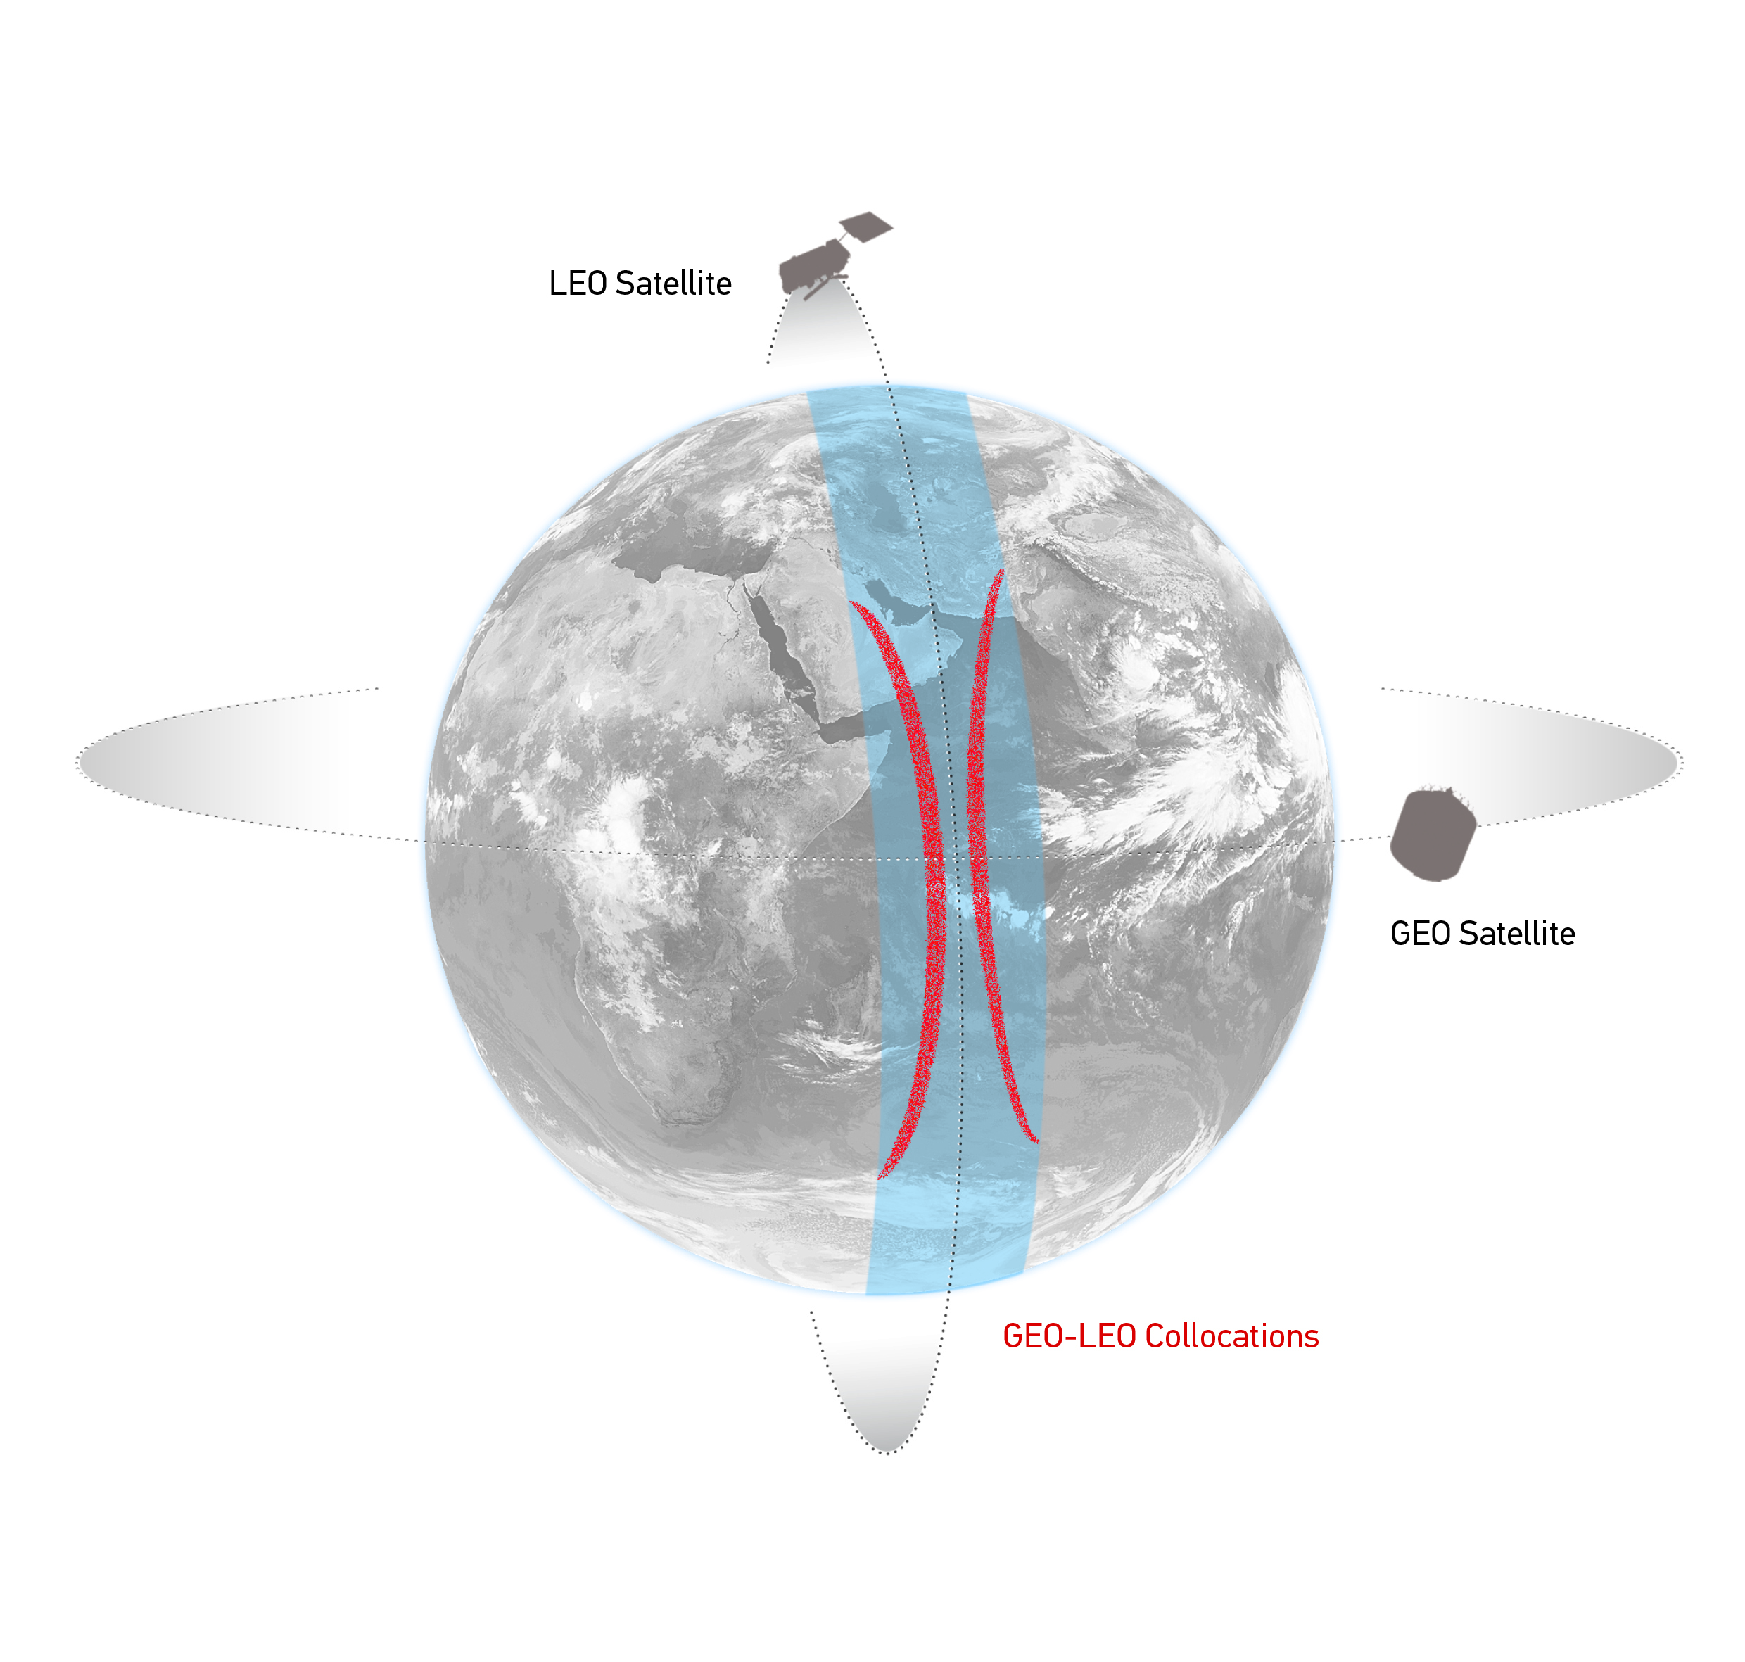
Comparison of Collocated GEO-LEO Radiances
Simultaneous near-Nadir Overpass
of GEO imager and LEO sounder
Collocation Criteria:
ΔLat<35° ΔLon<35°
Δt < 5 mins
Δsecθ < 0.01 (Atmospheric path diff.)
Concentrated in tropics
~1000 collocations/orbit
~1 orbit/night
Schematic illustration of the geostationary orbit (GEO) and polar low Earth orbit (LEO) satellites and distribution of their collocated observations.

Slide 11
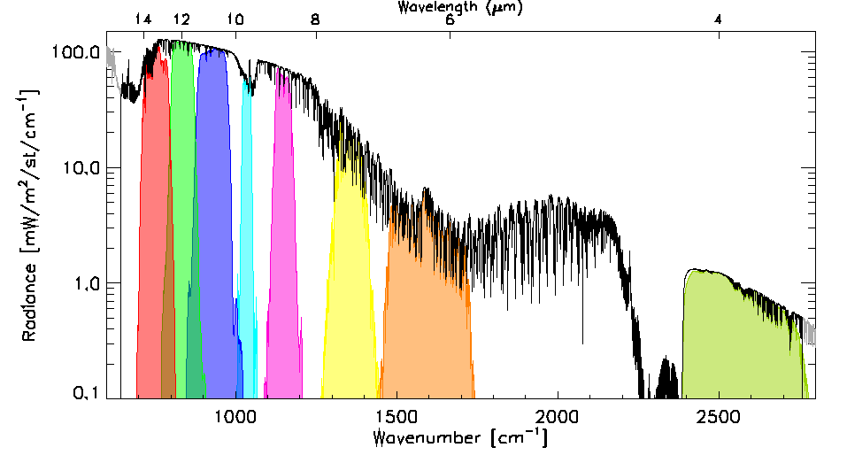
Data Transformations (Spectral and Spatial)
Spectral Convolution:
Convolve LEO Radiance Spectra with GEO Spectral Response Functions
to synthesise radiance in GEO channels
Spatial Averaging:
Average GEO pixels in each LEO FoV
Estimate uncertainty
due to spatial variability
as Standard Deviation of GEO pixels
Use in weighted regression
LEO FoV~10km
~ 3x3 GEO pixels
Example radiance spectra measured by IASI (black) and modeled by LBLRTM (grey), convolved with the Spectral Response Functions of SEVIRI channels 3-11 from right to left (colored shaded areas). n.b. The IASI observations (645 – 2760 cm⁻¹) do not quite cover the full spectrum observed by SEVIRI.
Illustration of spatial transformation. Small circles represent the GEO FoVs and the two large circles represent the LEO FoV for the extreme cases of FY2-IASI, where nxm=3x3 and SEVIRI-IASI, where nxm=5x5.
Notes:
The next step is to transform the collocated data to allow direct comparisons between the instruments.
Firstly, the IASI radiance spectra is convolved with the Spectral Response Functions of the Meteosat channels, to calculate the expected radiance in each Meteosat channel.
Then the Meteosat pixels within each IASI iFoV are averaged.
Their variance is also calculated to quantify the uncertainty due to spatial variability and
is used to weight each collocation in a linear regression …

Slide 12
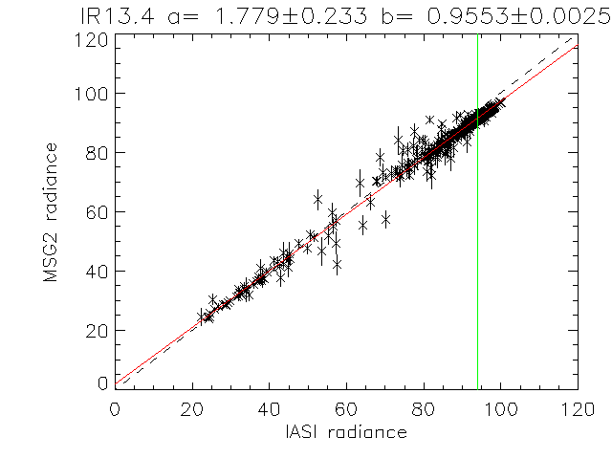
Comparison by Regression
Compare collocated obs:
GEO radiance
Spatially averaged
Regressed against
LEO radiance spectra,
convolved with GEO SRF
Using Variance of GEO radiances + Noise
to estimate uncertainty on each collocation
Weighted linear regression of L_{GEO|REF} and <L_{GEO}> for Meteosat-9 13.4μm channel based on single overpass of IASI

Slide 13
GSICS Products: (1/3) Bias Monitoring
x_{MON}
Comparing samples of x_{MON} , x_{REF}
− Over fixed domain
− Period (e.g. 1 orbit/1 day)
− Typically ~ 1000 comparable samples/day
Regression
Calc bias, ∆x=x_{MON}-x_{REF}
− ∆x at standard scene, x_{STD}
− with uncertainty
Plot time series of bias ∆x
− Compare recent results with long-term trend
− Valuable for instrument monitoring
∆x
x_{STD}
x_{REF}
∆x
t
Notes:
13

Slide 14
Example of GSICS Bias Monitoring
From EUMETSAT: Time Series of Meteosat10-IASI Standard Biases [K]

Slide 15
GSICS Products: (2/3) GSICS Correction
Compare all x_{REF} , x_{MON} samples
− over smoothing period (e.g. 2 weeks)
Regression coefficients
with uncertainty (covariance)
Provide a function users can apply
to convert level 1 data, x_{MON}
to be consistent with calibration of reference, x_{REF}
Two versions:
Near Real-Time (asymmetric time window)
Re-Analysis (symmetric time window)
x_{MON}
GSICS Correction function
x_{REF}

Slide 16
GSICS Products: (3/3) Guidelines
Underlying assumption of GSICS Correction:
Small errors (e.g. SRF errors, blackbody temperature, ...) introduce small departures from ‘true’ calibration
If these are linearly related to a predictor (radiance, time, ...) we can apply empirical correction based on inter-calibration
Guidelines can analyse GSICS products
to diagnose root causes of calibration errors
Can derive recommendations to modify
operating practices (e.g. adopt new SRF definition),
pre-launch characterisation, etc.
These GSICS Guidelines are distributed as written reports

Slide 17
Quality Indicators in GSICS Products
GSICS Correction Coefficients include
Estimates of uncertainties and covariances
For GEO-LEO IR:
From weighted linear regression
Using spatial variance and radiometric noise of each collocated observation as weighting
Shown as error bars in GSICS Bias Monitoring plots
But many other processes introduce uncertainty
Systematic and Random
Need to validate these quality indicators

Slide 18
GSICS Product Developments 2012
GSICS Corrections for GEO-LEO IR
Now Pre-Operational for Meteosat (EUMETSAT) & GOES (NOAA)
Nearly Pre-Operational for MTSAT (JMA)
Using MetopA/IASI as reference
Developing GSICS Products for GEO-LEO VIS:
Deep Convective Clouds (DCC)
Ocean Targets (Rayleigh Scattering)
Lunar & other methods (deserts, liquid water cloud, …)
Special Issue

Slide 19
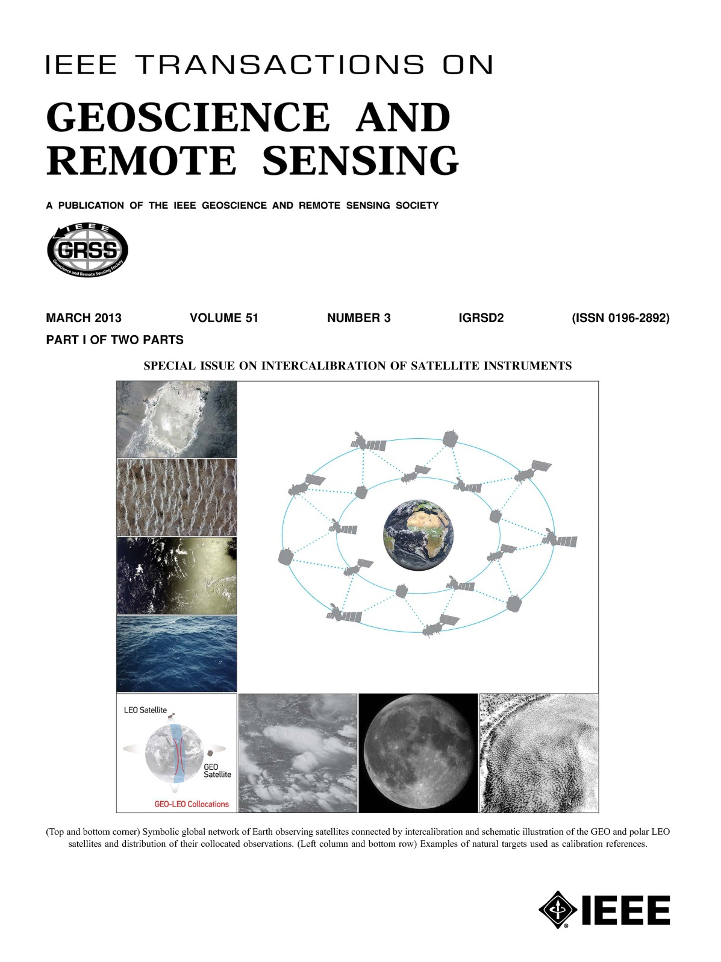
Special Issue on Satellite Inter-Calibration
IEEE Transactions on Geoscience and Remote Sensing
On inter-calibration of satellite instruments
5 Guest GSICS/IVOS Editors
40 papers – incl. 13 Open Access
From CAS, CMA, CNES, ESA, EUMETSAT, ISRO, JAXA, KMA, JMA, MIT, NASA, NOAA, SDSU, USGS, etc.
Covering AVHRR, AMSU, (A)ATSR, CLARREO, ETM+, FY-2 & -3B, GOES, HIRS, Hyperion, IASI, Jason-2/OSTM, MODIS, PROBA, SCAIMACHY, Sentinel-2, etc.
Published March 2013

Slide 20
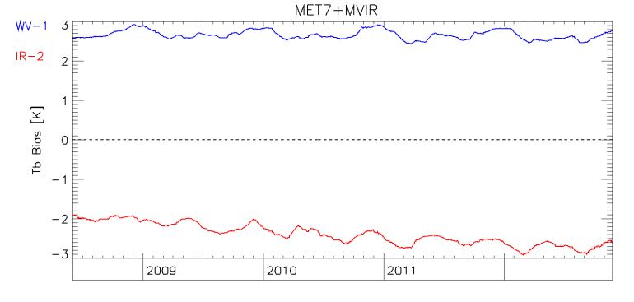
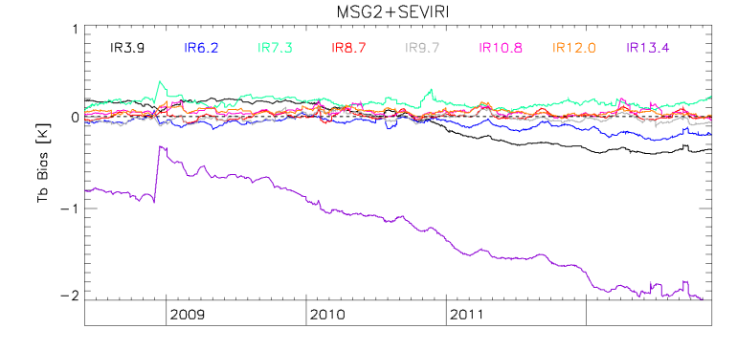
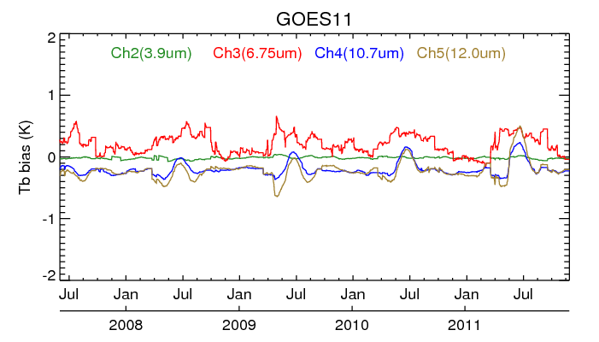
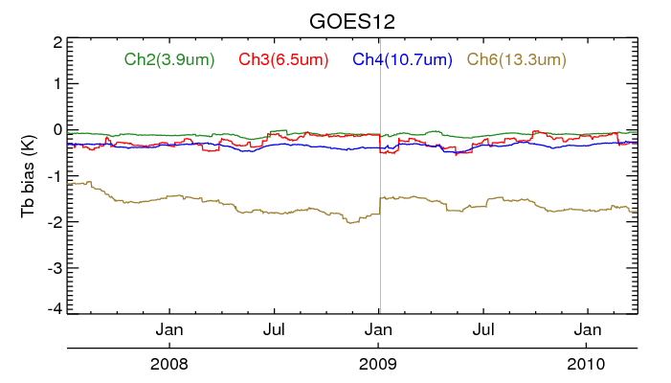
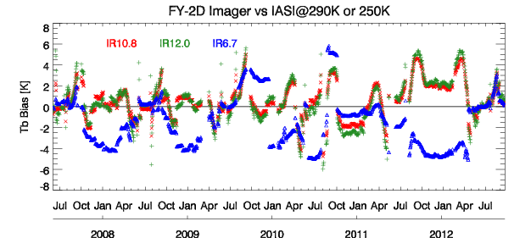
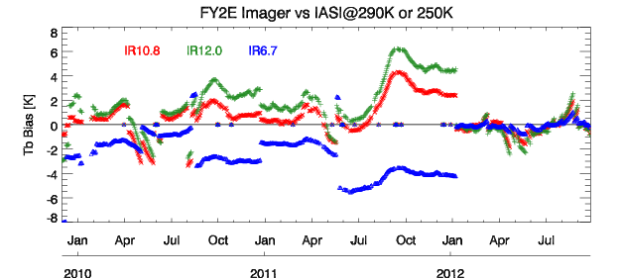
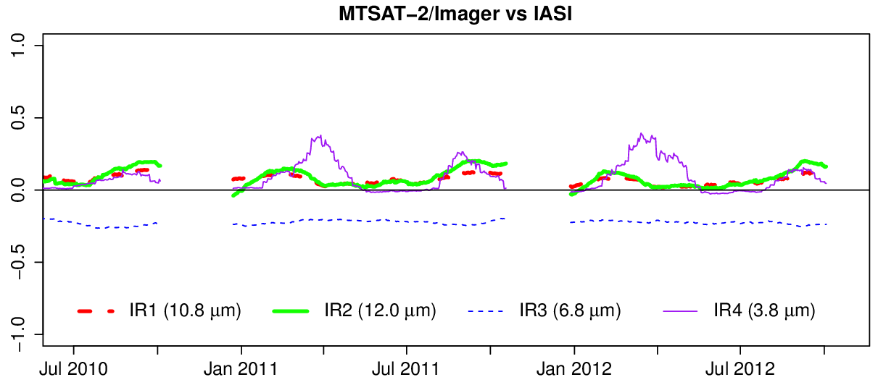
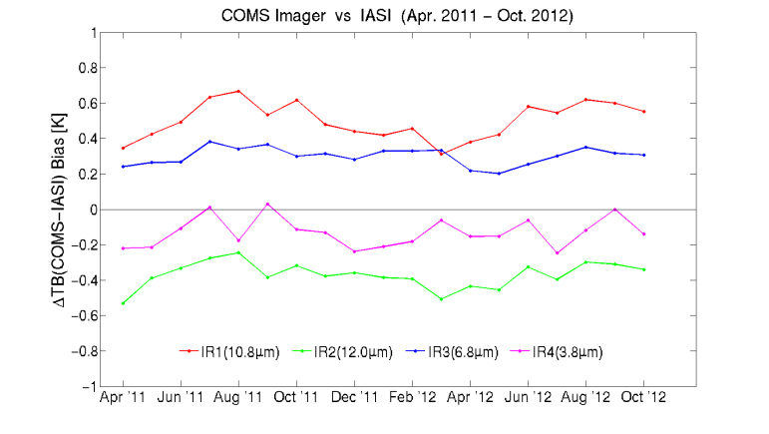
GSICS Correction for GEO-LEO IR

Slide 21
GSICS Product Development Plan 2013
GSICS Corrections for GEO-LEO IR:
Operational Mode for Meteosats, GOES & MTSAT
Prototype for other GEOs
Delta Correction to transfer MetopA/IASI to MetopB/IASI
Quantifying diurnal cycle uncertainties
GSICS Products for GEO-LEO VIS:
Deep Convective Clouds (DCC) -> Demonstration Mode
Lunar -> Prototype
Ocean Targets (Rayleigh Scattering) + LEO-LEO -> Prototype
Other methods -> continue developments
GSICS Guidelines:
How to select a reference instrument
How to specify Spectral Band Adjustment Factors (IR+VIS)

Slide 22
EUMETSAT’s GSICS Product Development Plan
GEO-LEO IR
DRAFT

Slide 23
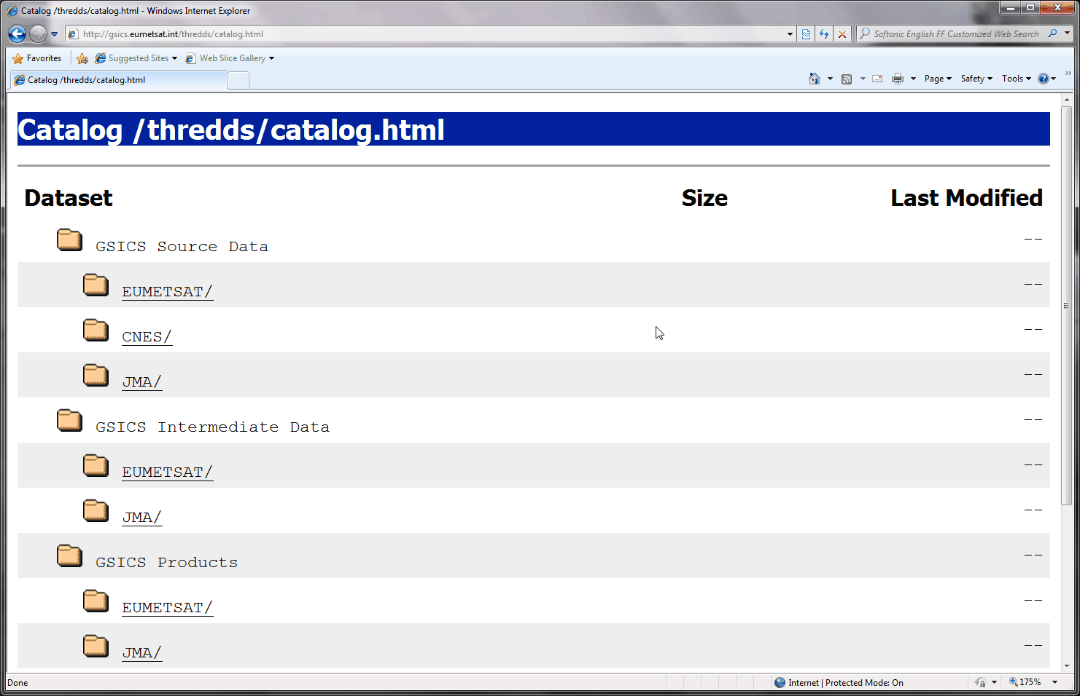
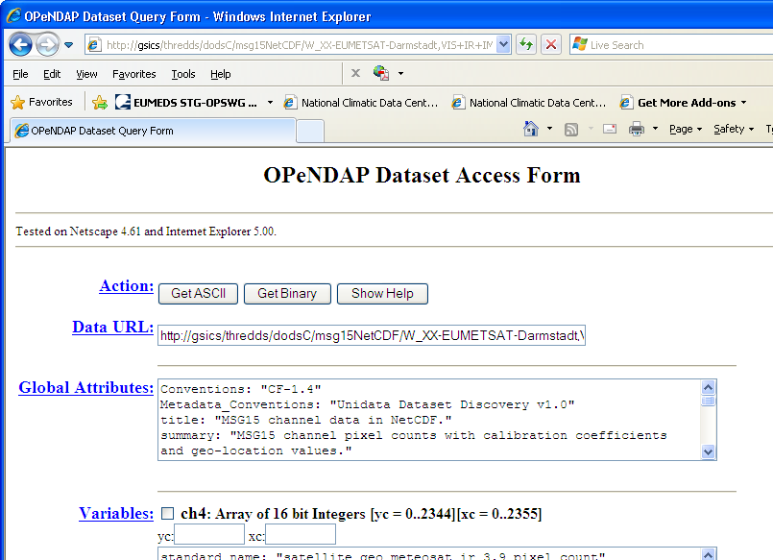
Where to get the data?
GSICS Bias Monitoring (prototype)
Hosted on websites of GSICS Processing & Research Centres (GPRCs)
GSICS Corrections
GSICS Data & Products Servers
THREDDS-based system
− NetCDF format
− WMO GTS standard file names
− Unidata & CF conventions
See gsics.wmo.int for links
GTS = Global Telecommunication System
CF = Climate and Forecast

Slide 24
Thank You

