Slide 1
GSICS Coordination Center Report
Fangfang Yu, Fuzhong Weng, Fred Wu and George Ohring
NOAA/Center for Satellite Applications and Research
8 April, 2013

Slide 2
Outlines
GCC Organization
GCC Communication co-ordinations
Support of product baseline development and implementation
Support of products quality assurance
Support of instrument inter-calibration and instrument performance monitoring activities
GCC publications
Future of GCC

Slide 3
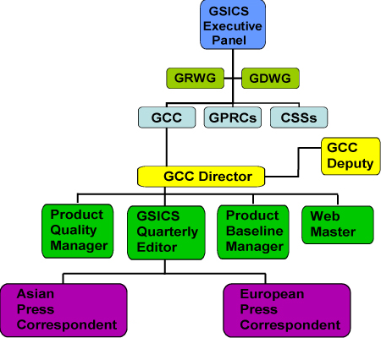
GCC Organization
GSICS Coordination Center
Chair: Fuzhong Weng
Deputy (current): Fangfang Yu
GSICS Quarterly Editor (current): George Ohring
Consultant: Fred Wu

Slide 4
GCC Communication Roles
Support GSICS end-to-end demonstration activities
Make recommendations to, and facilitate communication between GRWD and GDWG during their efforts to develop, implement, organize and direct GSICS research data management projects
Support Executive Panel in finding GSICS data and information users, and recruiting new GSICS members
Make recommendations to, and support executive panel in developing future GSICS activities
Track and make updates to GSICS Operations Plan

Slide 5
Baseline Product Development and Implementation Support
Run baseline algorithm for GEO-LEO infrared (IR) inter-calibration for all operation weather satellite instruments for the purpose of product quality assurance during the protocol product development period
Harmonize the baseline algorithm implementations at each GPRC.

Slide 6
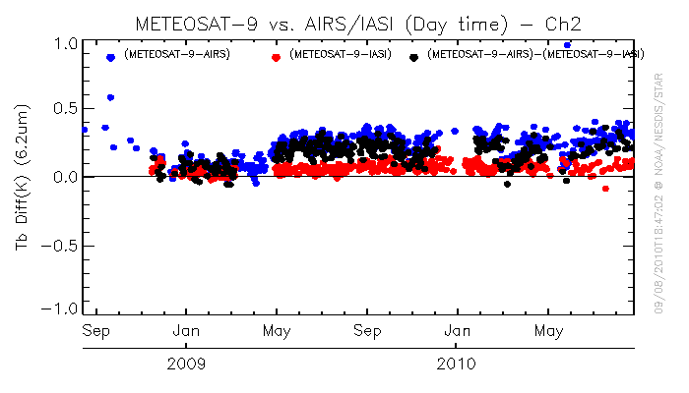
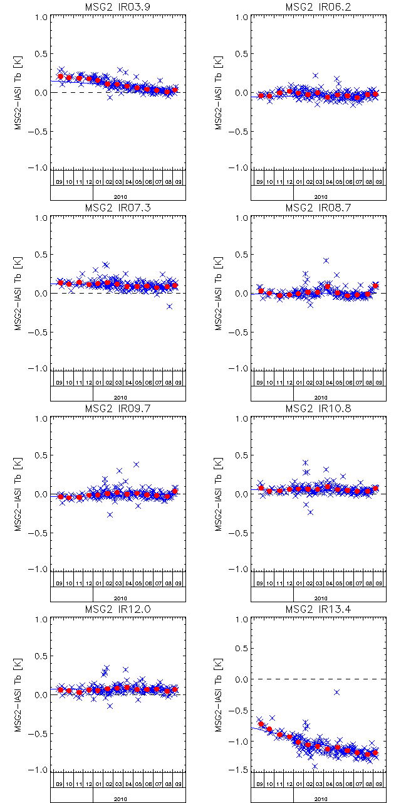
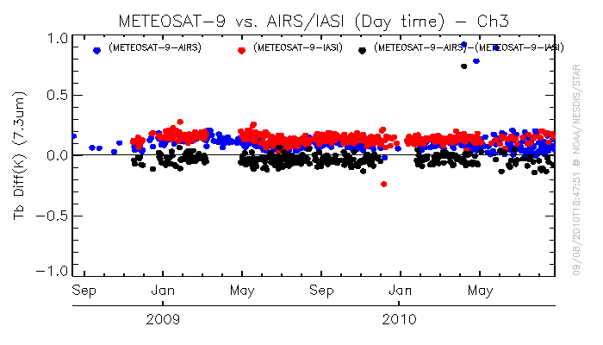
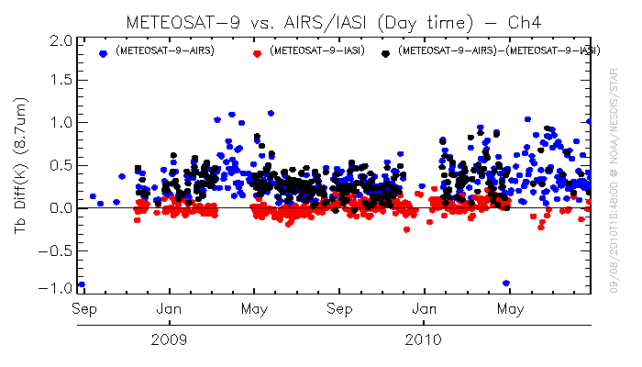
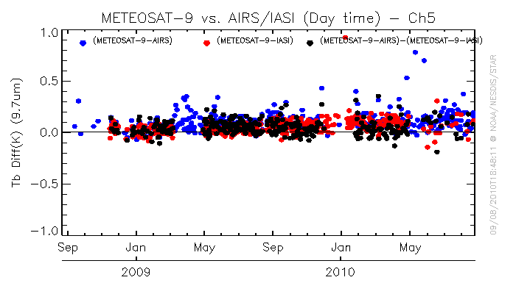
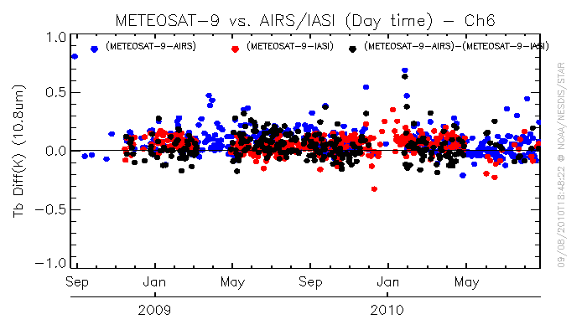
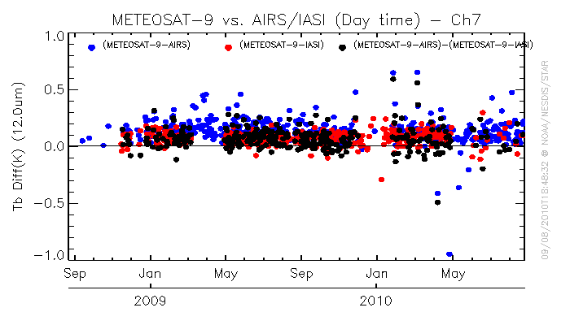
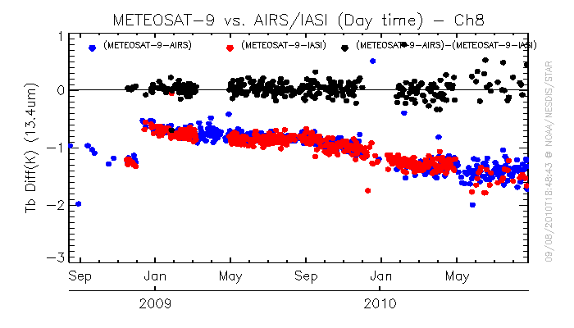
Tb Bias for Meteosat-9
http://www.eumetsat.int/Home/Main/DataProducts/Calibration/Inter-calibration/GSCISMeteosatIRInter-calibration/
Baseline Algorithm:
In general agree well in the Tb bias changing patterns and magnitude
6
Homogeneous Scenes
Standard Scenes

Slide 7
Support of Product Quality Assurance
Develop and revise the GSICS Procedure for Product Acceptance (GPPA), and coordinate reviews, through the GSICS Product Acceptance Team (GPAT), of potential GSICS products

Slide 8
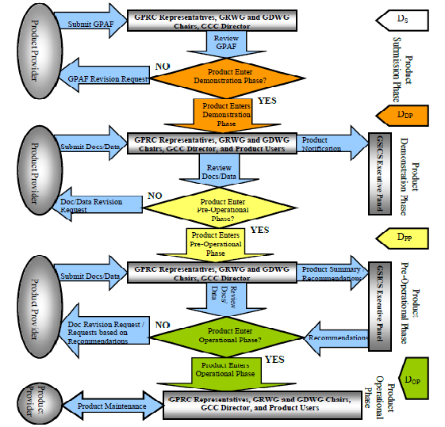
GSICS Procedure for Product Acceptance
Prototype/Preparation Phase
(GPAT review)
Demonstration Phase
(GPAT and external users’ reviews)
Pre-operational Phase
(GPAT and external users’ reviews)
EP approval
Operational Phase

Slide 9
Current Status of GSICS Products
GEO-LEO IR products
EUMETSAT SEVIRI-IASI IR products in pre-Op phase
NOAA GOES Imager-IASI IR products in pre-Op phase
JMA MTSAT2-AIRS/IASI IR in Demo phase, near to pre-Op phase
LEO-LEO Products
NOAA Patmos-X AVHRR solar reflective channel corrections based on MODIS
NOAA MSU/AMSU re-calibrated radiance/Tb products
Forthcoming new products
GEO-LEO inter-calibration products for solar band products, traceable Aqua MODIS C6 data
LEO-LEO inter-calibration products for the IR channels
LEO-LEO inter-calibration for the hyperspectral radiometers
LEO-LEO inter-calibration for the microwave instruments
LEO-LEO inter-calibration for UV instruments

Slide 10
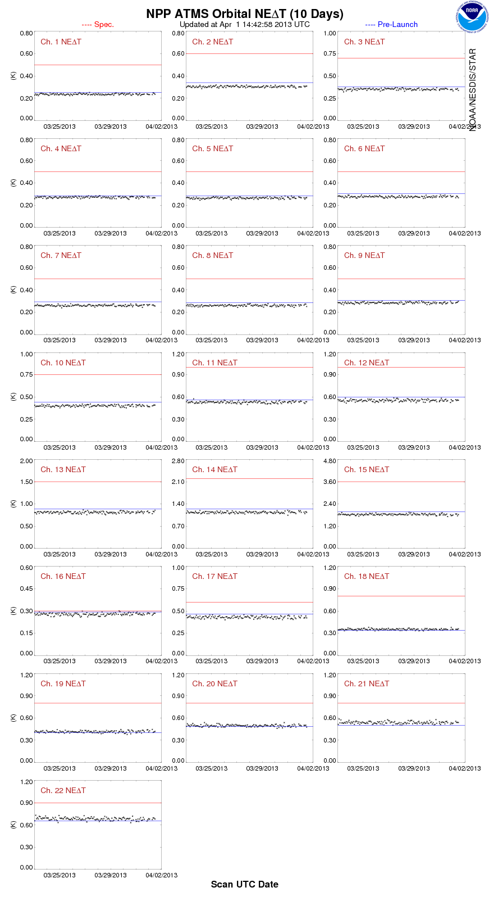
Support of Instrument Inter-Calibrations and Performance Monitoring Activities
Support the training of visiting scientists from the other GSICS members (e.g. CMA) to implement the GEO-LEO IR inter-calibrations and instrument calibration and validation system (ICVS)
ICVS: http://www.star.nesdis.noaa.gov/icvs/index.php

Slide 11
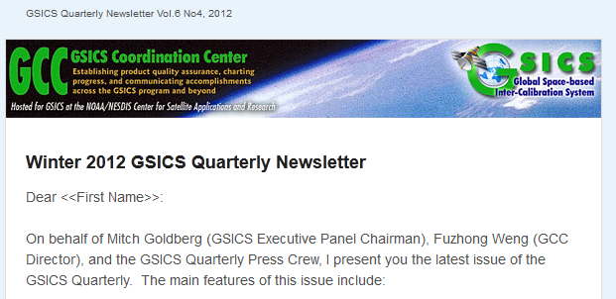
GSICS Quarterlies
GSICS Quarterlies are distributed using the GSICS mailing system
Recent satellite inter-calibration research activities at each GPRC
Calibration/validation of reference instruments/standard
News on satellite instrument calibration events
GSICS related publications
Other GSICS related significant activities, e.g. meetings/workshop/product promotions

Slide 12
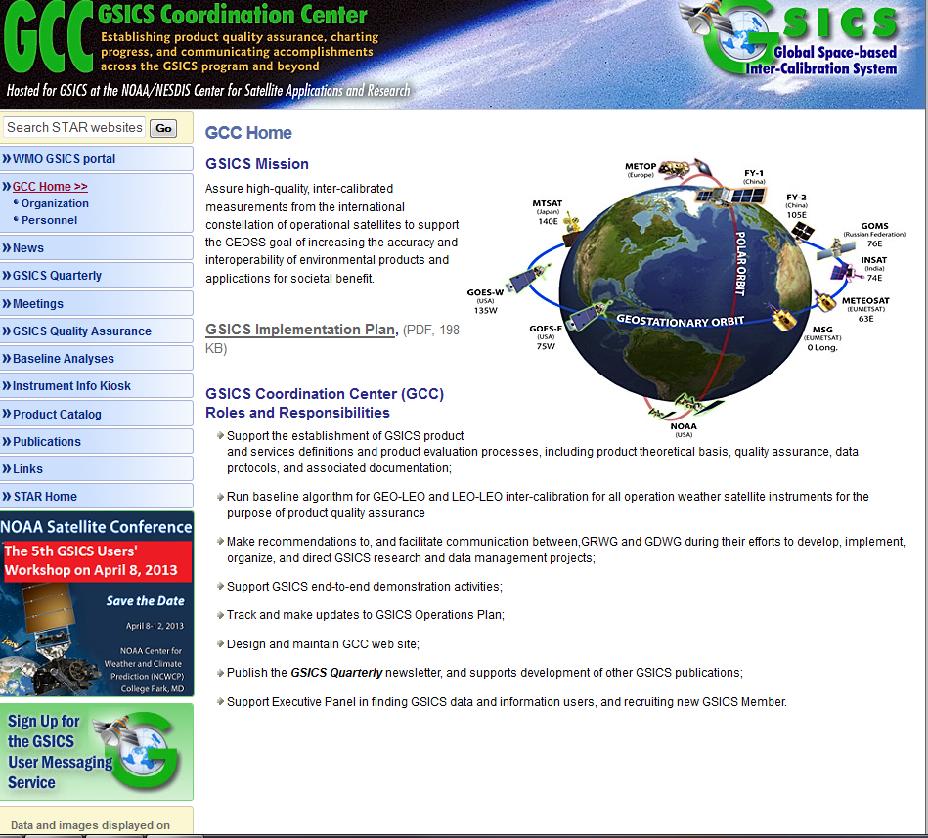
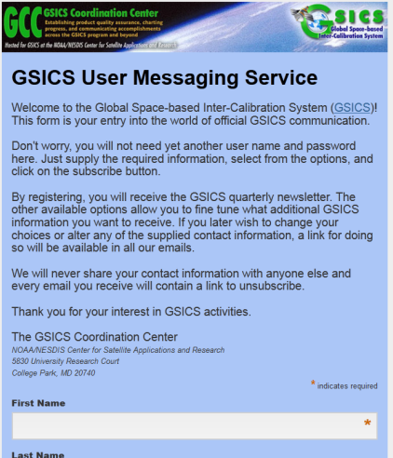
GCC Website/Signup for the GSICS User Messaging Service
GCC website:
http://www.star.nesdis.noaa.gov/smcd/GCC/index.php
To Sign up for the GSICS User Messaging Service
http://noaa.us2.list-manage.com/subscribe?u=24cb92e219660091ec8836edc&id=ce8328da86

Slide 13
Future of GCC Activities
Continue all the current GCC roles and responsibilities
Support the formulations of GSICS sub-working groups
UV
Visible
IR
MW
Work with GSICS Executive Panel to strengthen the GCC

Slide 14
Acknowledgements
GCC would like to thank the supports from GRWG, GDWG, WMO and the users’ community.
We are looking forward to more feedback and comments from the users’ community

Slide 15
Posters in the 2013 Workshop
Ten posters related to the satellite inter-calibration
Position | Leading Author | Title
T-15 | Tim Hewison | Migrating from Metop-A/IASI to Metop-B/IASI as GSICS inter-calibration reference for Geostationary IR Imagers
T-22 | Amit Angal | Sensor calibration inter-comparison using Sonoran Desert sites
T-23 | Wenze Yang | Inter-Calibration of AMSU-A Window Channels
T-38 | Wenhui Wang | AMSU-A Atmospheric Temperature TCDRs
T-45 | Fangfang Yu | Analysis of GOES Imager Infrared Radiometric Calibration Accuracy toward Long-term Climate Data Record
T-50 | Sebastien Wagner | Inter-calibration of the SEVIRI VIS0.6 channel with MODIS Aqua, using Deep Convective Clouds as transfer targets
T-55 | Xingming Liang | Sensitivity of CRTM coefficients towards quantitative cross-platform consistency analysis in MICROS
T-62 | Fangfang Yu | A Combined Calibration Method for GOES Imager Visible Channel
T-71 | Haifeng Qian | Application of DCC targets with GOME-2 observation for vicarious calibration of visible channels of NOAA GOES instruments
T-79 | Likun Wang | Inter-Comparison of S-NPP/CrIS Radiances with AIRS and IASI toward Infared Hyperspectral Benchmark Measurements

