Slide 1
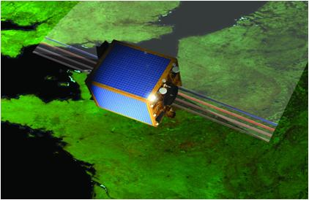
The PROBA-V Mission
Sindy Sterckx, Wouter Dierckx, Tanja Van Achteren, Stefan Adriaensen and the PROBA-V team
GSICS Users' Workshop, 2013

Slide 2
Content
The PROBA-V mission
  Objective
  Design
User involvement
CAL/VAL

Slide 3

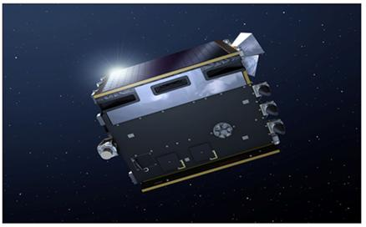
Belgian-ESA mission
Mission objective :
  Continuity of SPOT VEGETATION data
    4 spectral bands: B, R, NIR, SWIR
  Daily global coverage of land masses
    Total swath width 2295 km
    14 near polar orbits per day @ 820 km
Launch :
  End of April 2013, Kourou
  VEGA launcher

Slide 4
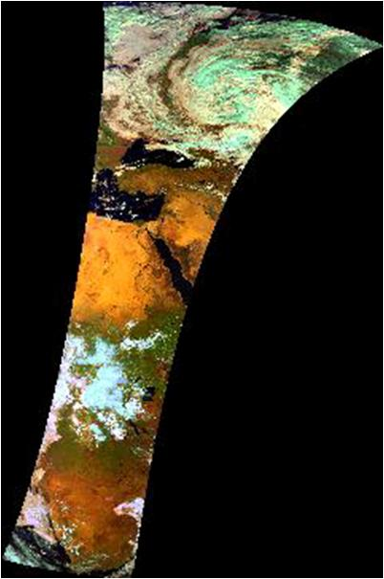
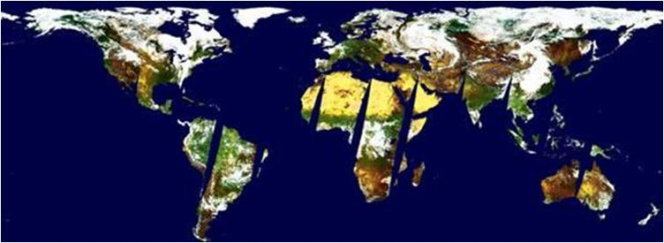
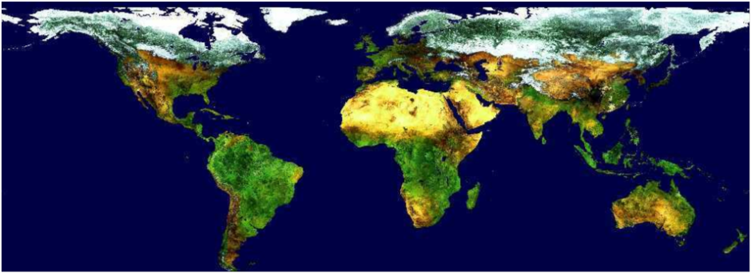
15 years SPOT VEGETATION
Daily global vegetation monitoring (1 km)
daily synthesis
P-product (segment)
10-daily synthesis
global world archive since 1998 www.spot-vegetation.com

Slide 5
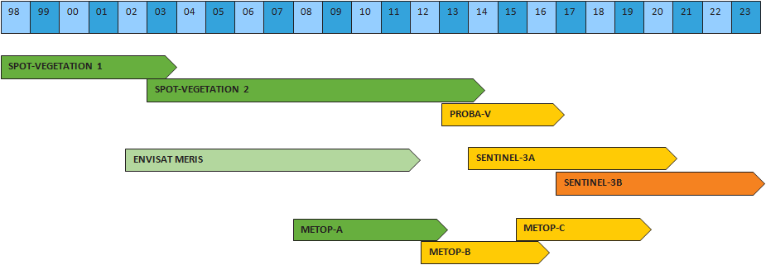
CONTINUITY (1km and 330m)
Daily global vegetation monitoring

Slide 6
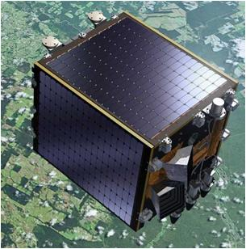
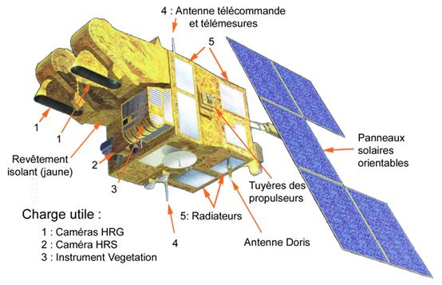
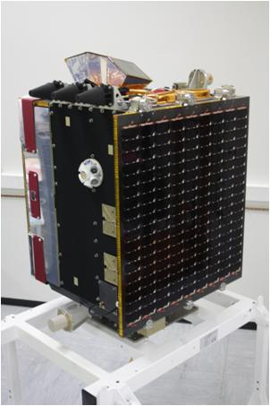
PROBA-V is not SPOT
 | SPOT-4 | SPOT-5 | PROBA-V
volume | 2x2x5.6 m³ | 3.1x3.1x5.7 m³ | 0.8x0.8x1 m³
mass | 2760 kg | 3 000 kg | 160 kg
power | 2100 W | 2100 W | 153 W
> 200 x smaller
> 20 x lighter

Slide 7
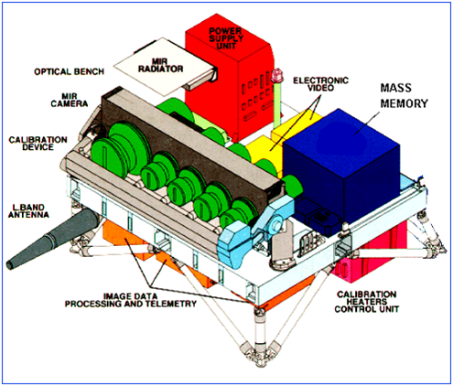
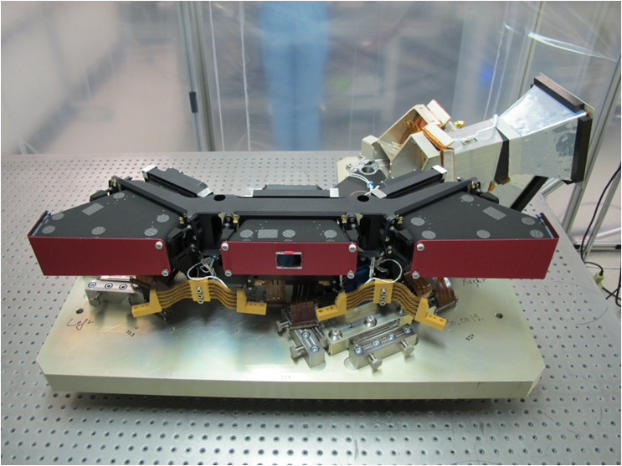
And the instruments are not the same
The PROBA-V Payload
Mass: 33.3 kg [20% of total]
Dimensions: 0.2x0.8x0.4 m³
Three imagers, TMA concept
No active thermal control
No on-board calibration lamp

Slide 8
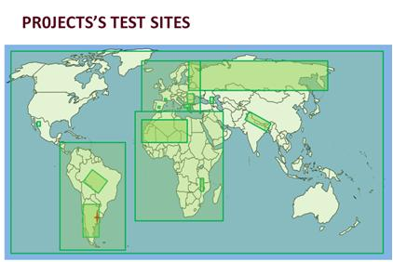
User involvement
Through the PROBA-V Preparatory Programma
Purpose:
  to asses PROBA-V as a continuity mission to VGT1/2
  to get future users acquainted with the data of the PROBA-V “continuity mission” by using simulated data
  to prepare the full exploitation of Proba-V data sets
22 teams involved
    Thematic (Change detection, Crop monitoring, …)
    Methodological (Data fusion, impact studies, …)

Slide 9
User involvement
Through the Proba V International Users Committee - IUC
What : Group of experts with expertise in global monitoring, image analysis, ground segment operations, calibration
Purpose : assist the project team in refining and adapting the characteristics of the system
Topics : Products, Geolocation budget, straylight, compression, atmospheric correction, cloud detection, PROBA-V – VGT spectral response differences, ….

Slide 10


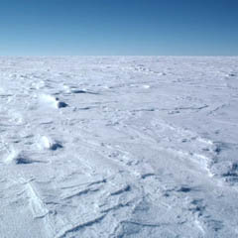
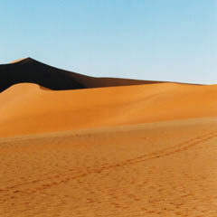

RC – IQC: Vicarious Calibration Concept
Sun Glint
Oceans
Antarctica/Greenland
Deserts
DC Clouds
Temporal
Interband
Multi Angular

Slide 11
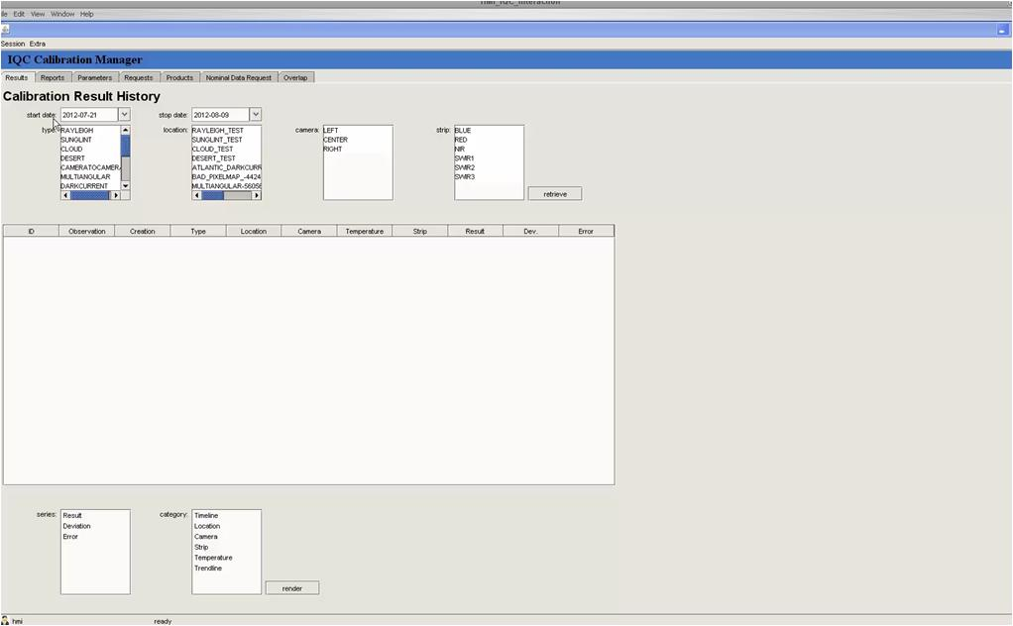
RC- Image Quality Center: HM
fully automated image workflows and statiscal processing
View at the database using Graphical User Interface
Full traceability new instrument calibration parameters updates
Automated distribution towards production

Slide 12


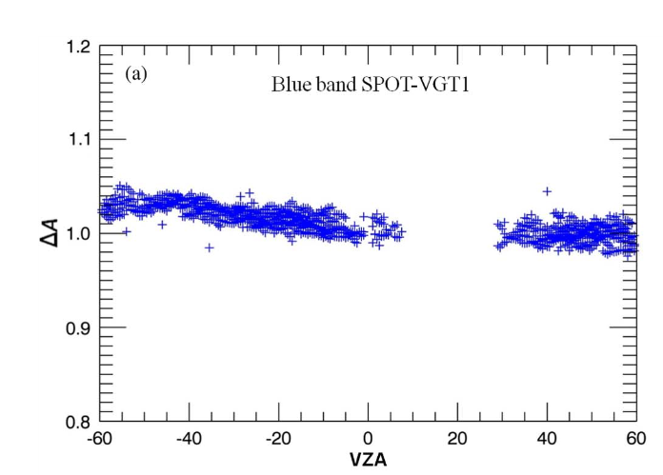
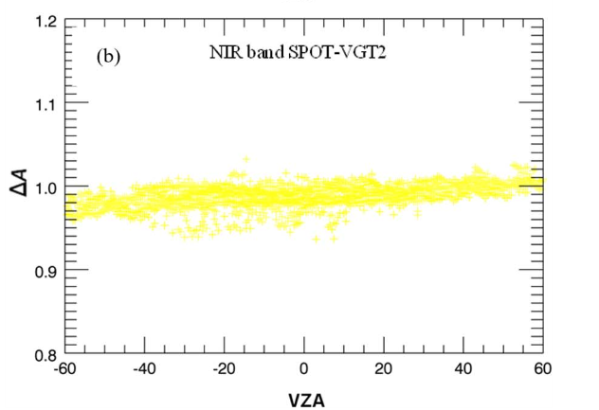
Method validation activities on VGT data
Rayleigh Calibration DCC calibration
Sterckx S., Adriaensen S., Livens S.,TGARS, 2013

Slide 13
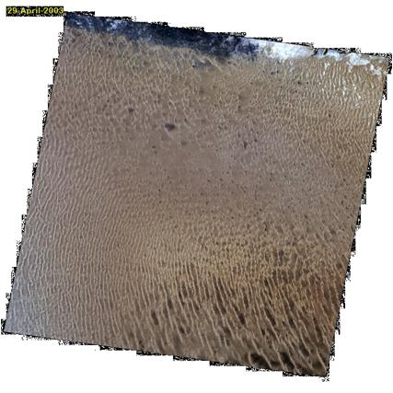
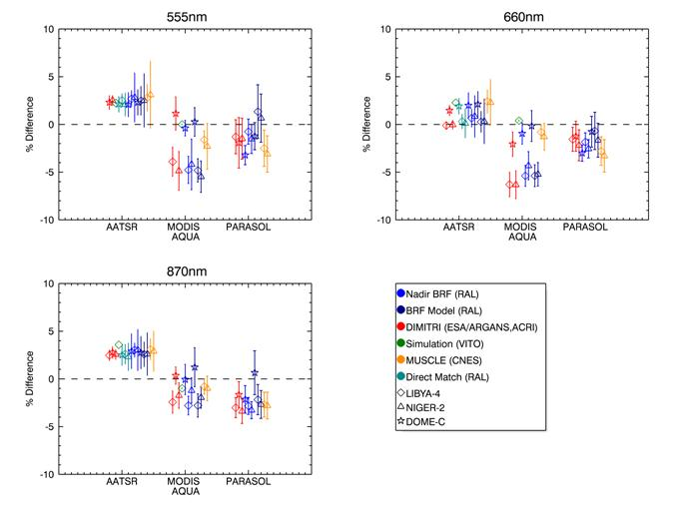
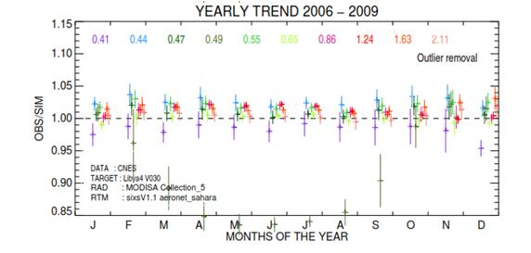
CEOS method intercomparison activity
Calibration over stable desert sites
LIBYA 4
Govaerts, Y., Sterckx S. and Adriaensen S., 2013, Remote Sensing Letters.

Slide 14
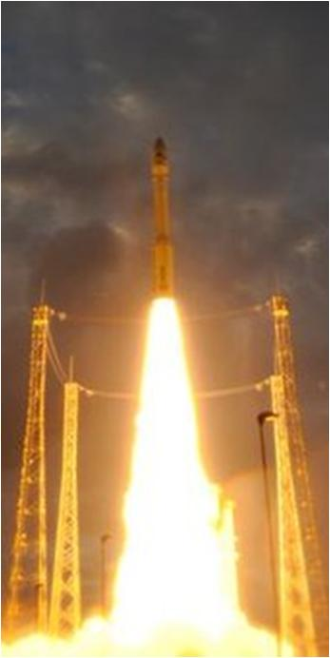

Launching soon…
Launch
20 april
Start of in-flight calibration
End of June
Data service operational
Beginning of November
First Proba-V Conference
4 -5 July, 2013

Slide 15
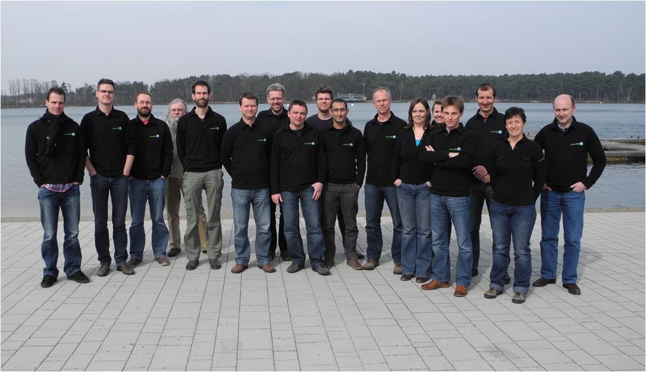
Thank you for listening!
The VITO PROBA-V team

