Slide 1
Manik Bali Jonathan Mittaz
Radiometric Accuracy of IASI and AATSR IR Channels
01/2008 -03/2011
CICS/ESSIC/University of Maryland
8 April 2013

Slide 2
Contents
Introduction
Expected Accuracy and Stability of EO instruments.
Target Instruments
Questions that we seek to answer
Inter-comparison Method
Inter-comparison Results
IASI ATSR inter- comparison
The 11 Micron Comparison
The 12 Micron Comparison
Is SRF Shift a solution ? Possible Solutions
Temporal variability of IASI ATSR difference.
Impact of change in ENVISAT orbital parameters
Conclusion

Slide 3
Introduction
Magnitude of climate signals
Expected Accuracy and Stability of EO instrument
~±( 0.1 K–0.2 K)
(Allen et al. 1994, Kidwell 1998)
Temperature trends as
small as 0.1⁰ C/dec
Accuracy Criterion
~ 0.1K( 1 w/m2).
Stability criterion
~0.05 K ( 0.3 w/m2/dec).
GCOS(2011)
Leroy et al, 2007 , 34 Yrs of continuous observation at this level of accuracy to get climate signal.
Instruments that conforms to these accuracy and stability criterion are called Climate Ready
Notes:
The fundamental aim of the CDR is to fuel the research on climate change.

Slide 4
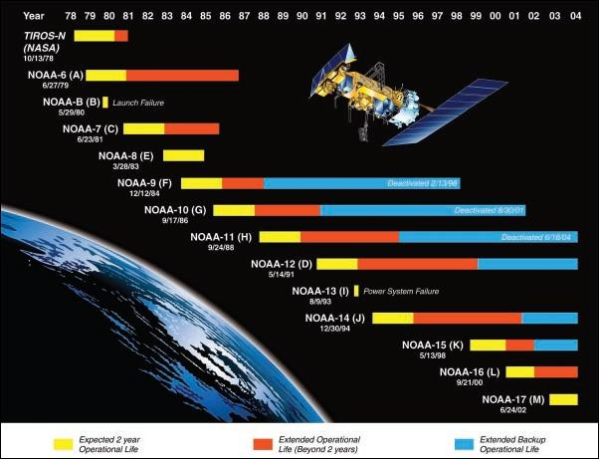
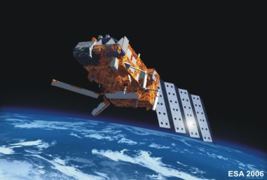
Introduction
ENVISAT
IASI
2006
Since 1978 TOA measured by instruments on board EO satellites

Slide 5
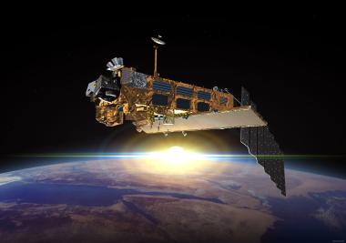
Introduction
Are Modern EO instruments climate ready ?
AATSR is thought to be climate ready but is it really?
Would be used as a reference in AVHRR re-calibration project.
Indications are that IASI is stable but independent check on large temporal scales not available.
Used as a benchmark by GSICS
IASI
AATSR
Channels
Scan Angle
Temperature Range
ENVISAT METOP-A

Slide 6
Questions
Introduction
Is there a temperature dependence on the AATSR- IASI bias?
Does the difference change over time?
Impact of change in orbital parameters
Collocation data base spans 01/2008-03/2011

Slide 7
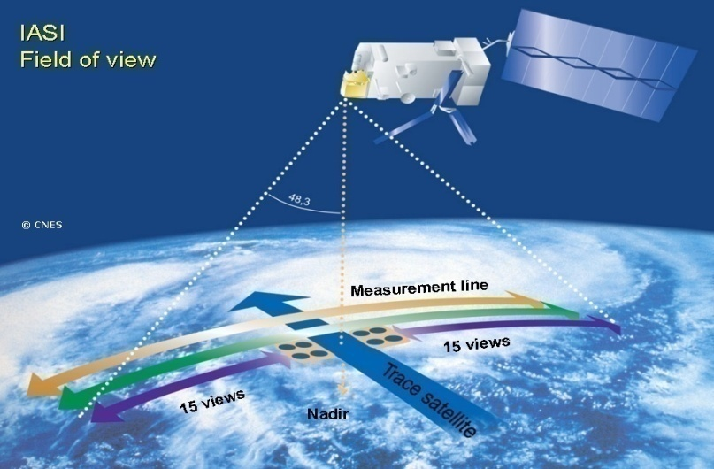
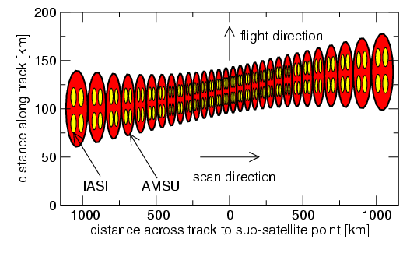
Infrared Atmospheric Sounding Interferometer (IASI)
Introduction
Hyper-spectral instrument launched on board Metop A in 2006
Recognized by GSICS as a benchmark for inter- comparison.
Swath 2200 km
In orbit stability ???
Band | Wavenumbers (cm⁻¹) | Wavelength (µm)
1 | 645.0 – 1210.0 | 8.26 – 15.50
2 | 1210.0 – 2000.0 | 5.00 – 8.26
3 | 2000.0 – 2760.0 | 3.62 – 5.00

Slide 8
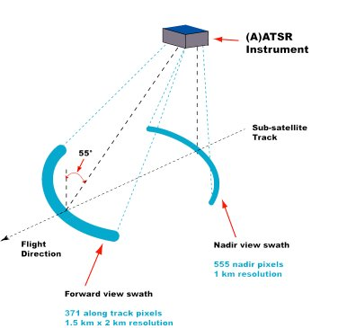
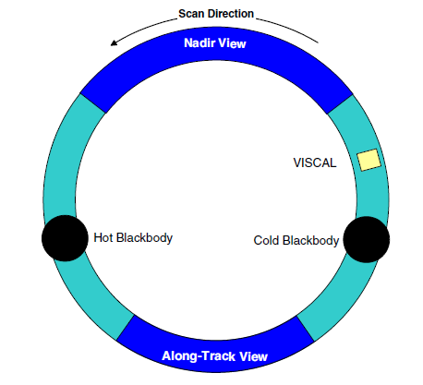
Advanced Along Track Scanning Radiometer (AATSR)
Introduction
Conical scan views earth in two swaths one at Nadir ( just below the satellite)
Another at an angle of ~55deg
IR channels ,3.7 µm, 11 µm, 12 µm
Swaths : 500km
Extremely stable. Two SI-traceable black bodies reduce calibration errors in SST region

Slide 9
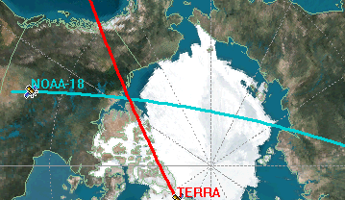
Method
Simultaneous Nadir Overpass Method
Method aims to identify collocated pixels i.e. those locations that are observed at nearly the same time by two satellites.

Slide 10
Method
THRESHOLDS
SD Collocated Pixels | < 0.5
SD Perimeter | < 1
Time Difference | < 15 Mins
Time Span | 2008-03/2011
Sat Zenith Angle difference | 1º
Ensure scene uniformity.
Ensures TOA measurement by the two instruments, at nearly the same time.
Ensures impact of clouds moving into the area of interest is minimized.

Slide 11
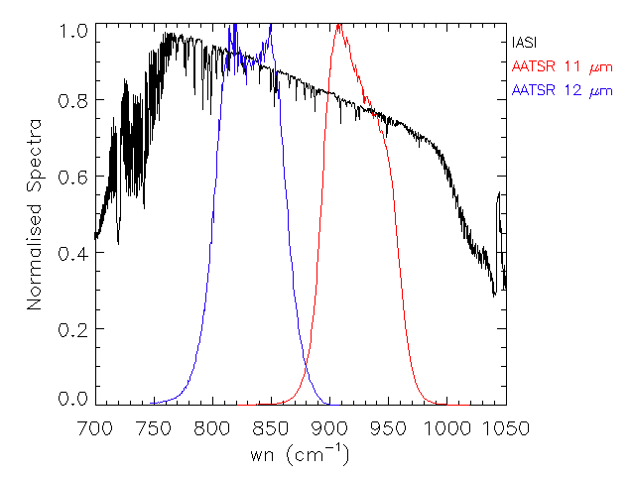
Method
Interp ATSR response values on IASI wn to get ATSR response(SRFVAL)
IASI Rep Rad =
Compare

Slide 12
Present status of IASI-AATSR comparison
Pre-Launch AATSR calibration
Smith, et,al 2012(JRS)
Pre-Launch
Shows infrared radiometric accuracy to within 0.05 K attained in full swath and different thermal conditions. But there are trends at low temp.
In-orbit conditions
In orbit 11 Micron BT offset is of the order of 0.05 K (Illingworth, Reimidios and Parker ,2009)
In orbit there is a known bias problem 12 Micron channel of the order of 0.2K ( Nightingale,2004)

Slide 13
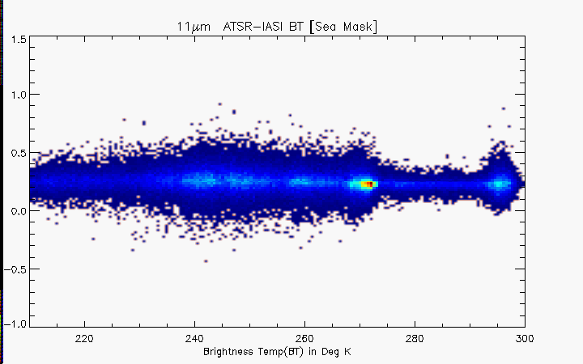
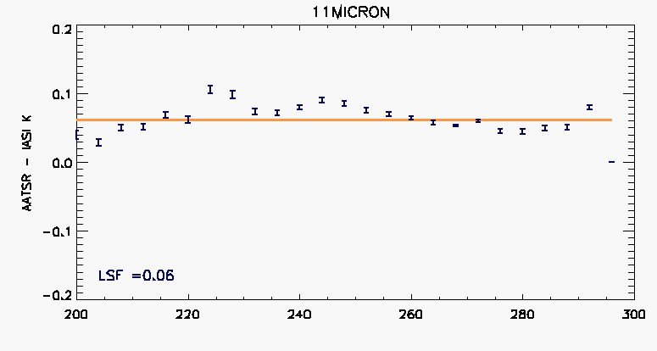
Temp dependence 11 Micron (Post Launch)
AATSR – IASI (K)
Brightness temp (K)
11 Micron: IASI nearly as stable as pre-launch AATSR references
Tail at low temp is similar to pre-launch, does not appear in ATSR-AVHRR comparisons

Slide 14
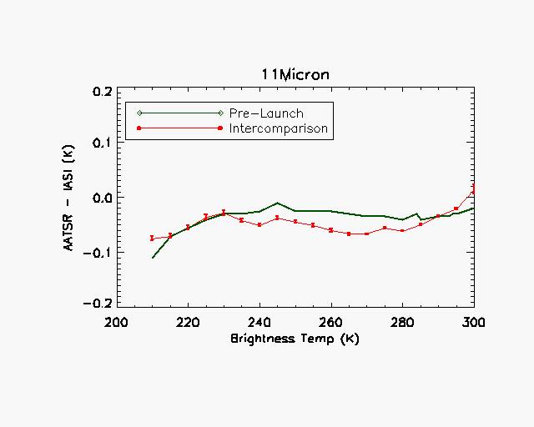
Prelaunch Vs Post Launch
IASI captures some of the prelaunch features
IASI relates well with SI –traceable standard
Notes:
State why the offset was made???

Slide 15
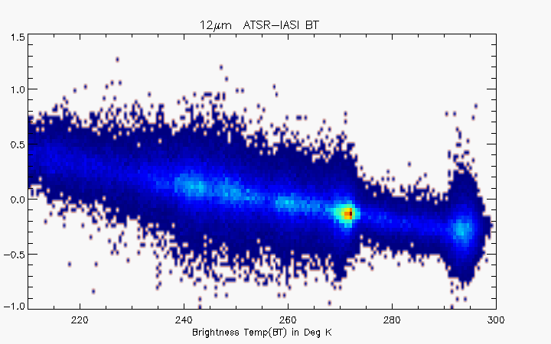
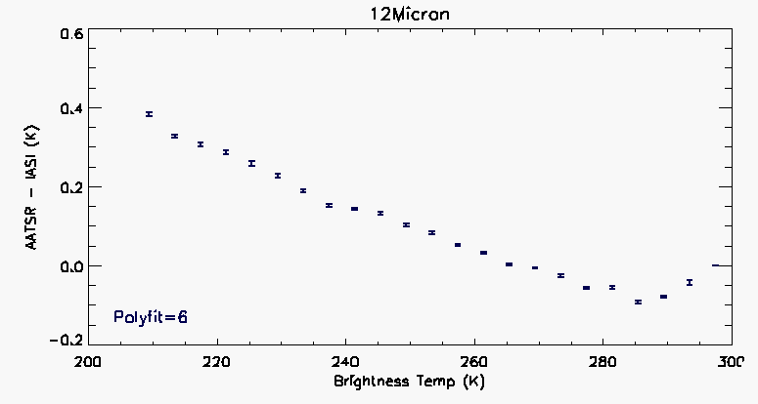
Temp dependence 12 Micron
AATSR – IASI (K)
BT offset stable but more than previous estimates.

Slide 16
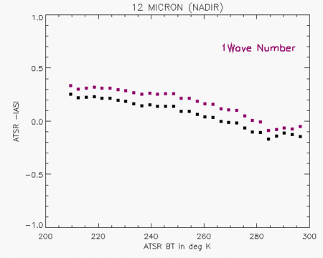
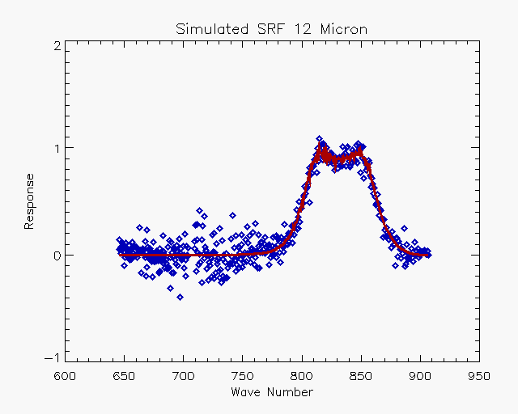
Is SRF shift a solution for 12 Micron bias
Shifting the SRF does not remove the temperature dependent bias
Developed a method that exploits the fact that IASI is as good as a pre-launch reference and simulates the SRF from AATSR- IASI inter- comparison.

Slide 17
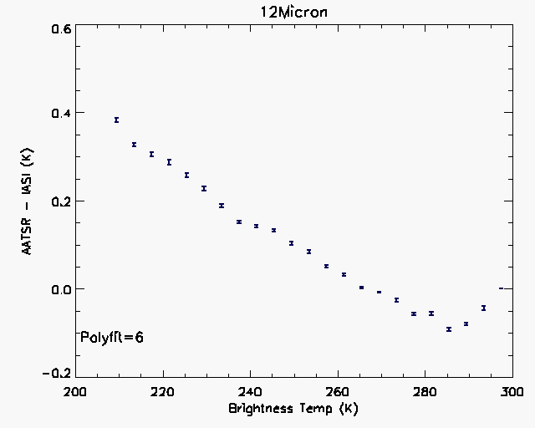
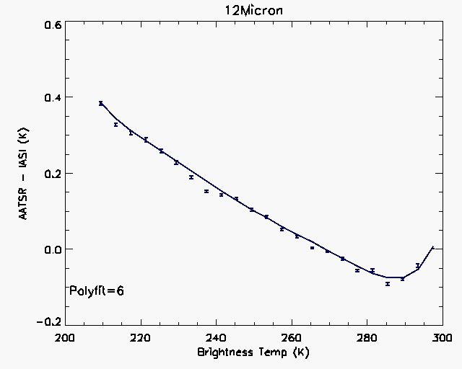
Bias is stable, empirical solution is possible
Empirical approach …

Slide 18
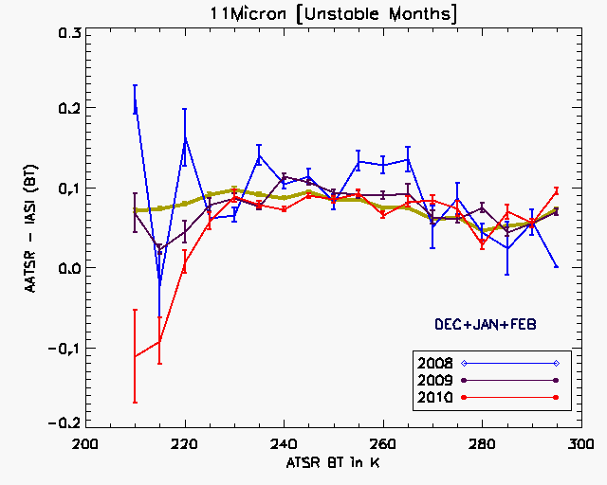
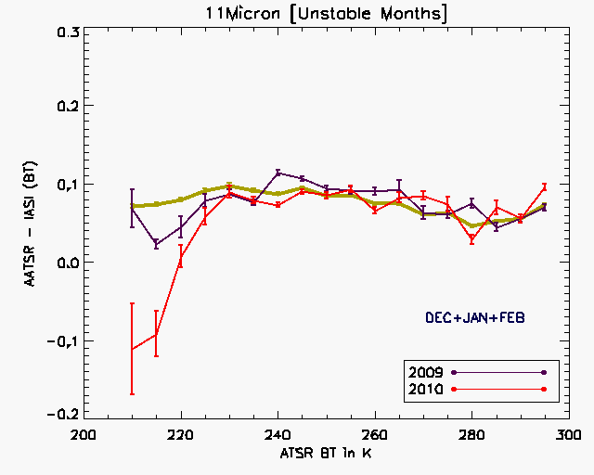
Time Variability of AATSR – IASI bias
NADIR
NADIR
Plots show the variation with temperature for unstable months and stable months. The thick green line is the mean bias variation over all the years. In the unstable months plot, Year 2008 has Jan & Feb of 2008 only , rest of the years have Dec of that year along with Jan and Feb of year+1, in order to club unstable months together.
The instability in bias is mainly confined to T < 230K .
The 2010-2011 bias stands out as it increases much more rapidly with decreasing temp.

Slide 19
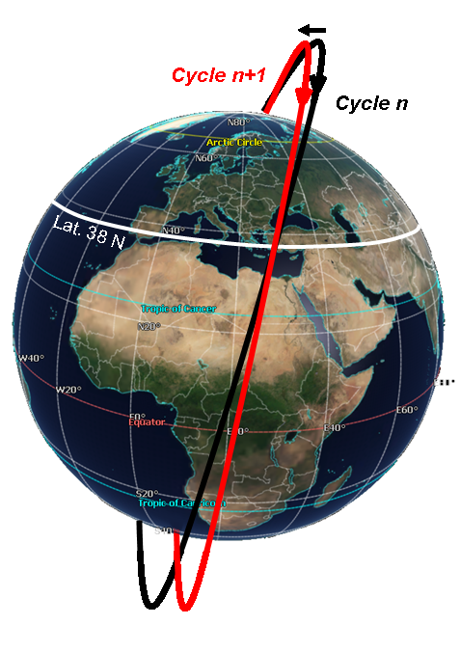
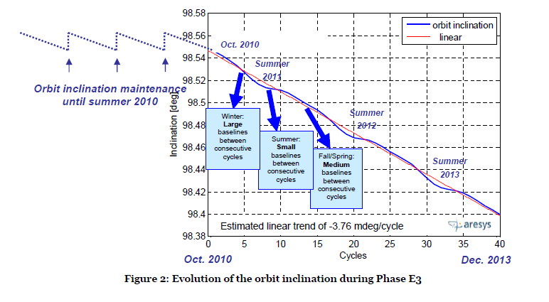
Changes applied on Envisat in oct 2010
Orbit lowered by 17.4Km, results in 30 day repeat cycle.
Discontinue orbit inclination control.
Results in decreasing inclination as shown below and global image on left.
It was envisaged that this orbital maneuver will not impact the TOA observations

Slide 20
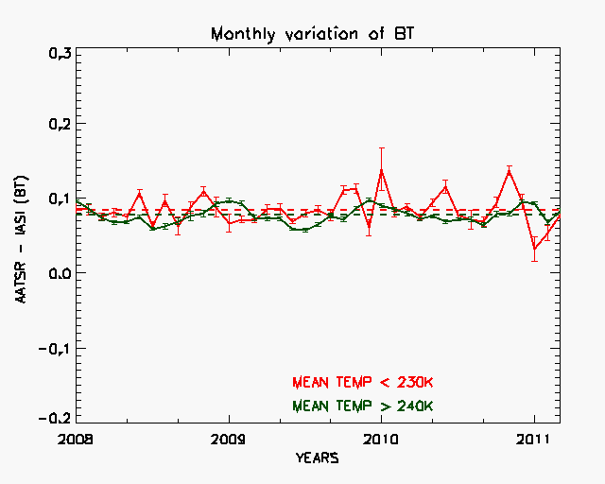
NADIR
For Temp < 230 K, the JAN, FEB , and DEC appear more biased than rest of the months)
For Temp > 240 K shows stability of bias in all the months.
Bias appears more unstable immediately after orbital parameters were changed in Oct 2010 but recovers in March 2011.
MEAN Temp < 230 K
 | 01/2008 -10/2010 Before orbit maneuvering | 11/2010 -03/2011 After maneuvering
SD of bias | 0.022 | 0.031
Mean bias | 0.086 | 0.062
ENVISAT Orbital parameter changed in 10/2010.
MEAN Temp > 240 K
 | 01/2008 -10/2010 Before orbit maneuvering | 11/2010 -03/2011 After maneuvering
SD of bias | 0.010 | 0.012
Mean bias | 0.078 | 0.084

Slide 21
Conclusions
The IASI is a good reference for measuring in-orbit stability, seems to be comparable to prelaunch reference.
Calibration methodology of AATSR works well over the SST range but needs re-thinking in 200K-240K range.
12 Micron bias is stable but shows higher BT offset than previous estimates.
SRF shift does not reduce the bias and empirical correction can make it climate ready.
For AATSR the 200k-240k range there is a time variable, temperature dependent bias that may be related to seasonal effects. However no time variability in bias in the SST range.
Work in progress ATSR 2 Vs AIIRS comparisions

Slide 22
THANK YOU

Slide 23
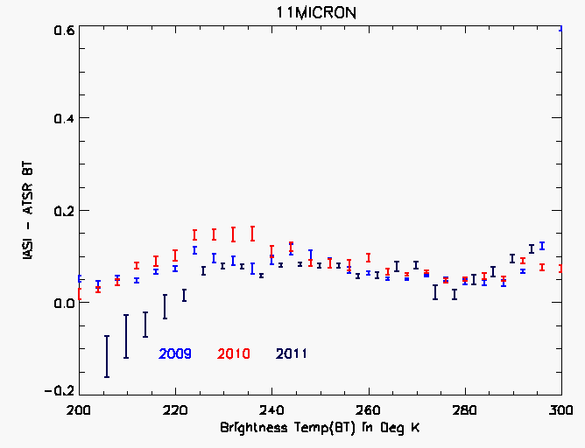
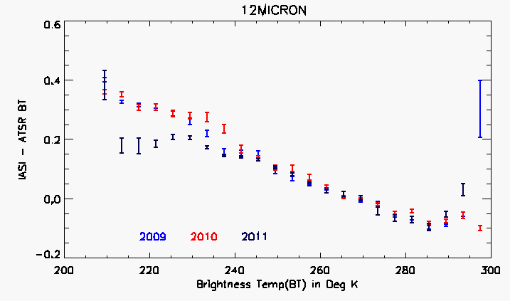
Bias change of bias over time ?
AATSR –IASI
AATSR –IASI
Strong time variable bias low temperatures
240K-290K is stable => IASI is stable in SST range
Summer (2009,2010)
Winter (2011)

Slide 24
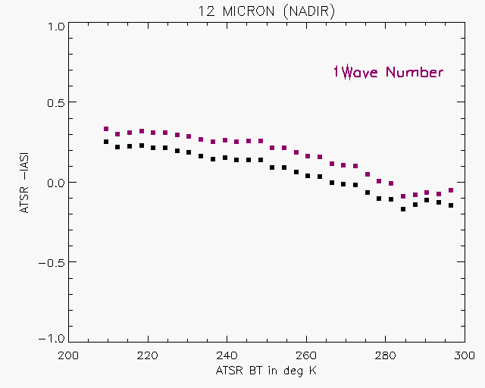
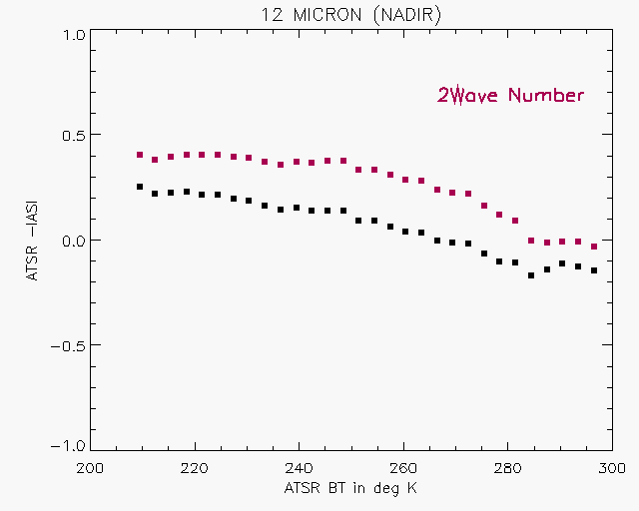
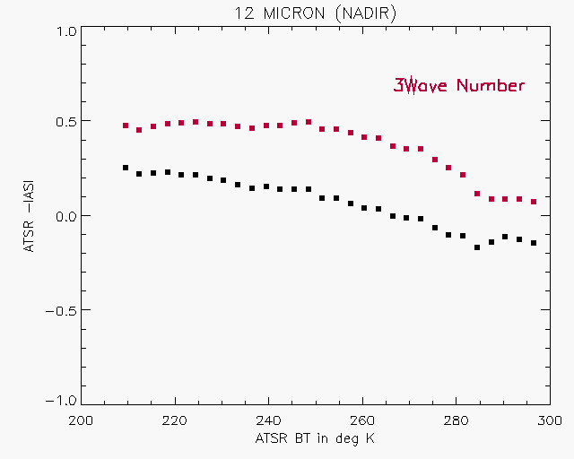
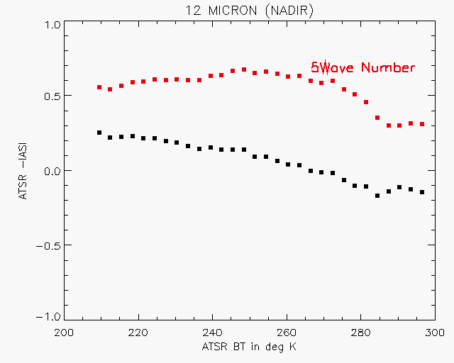
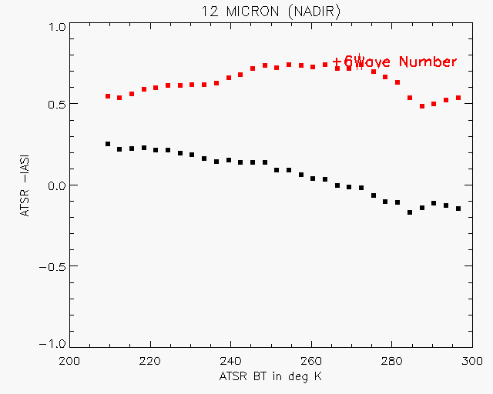
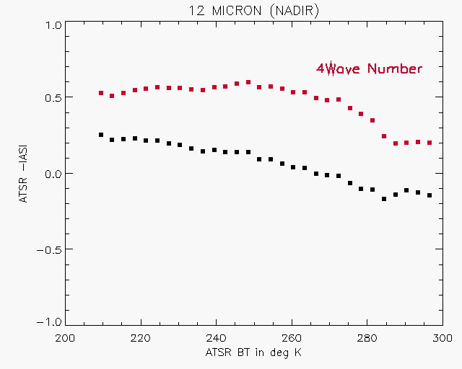
Is shifting the SRF a possible solution ?

Slide 25
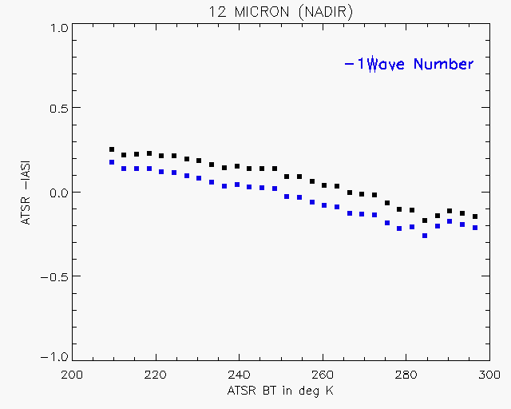
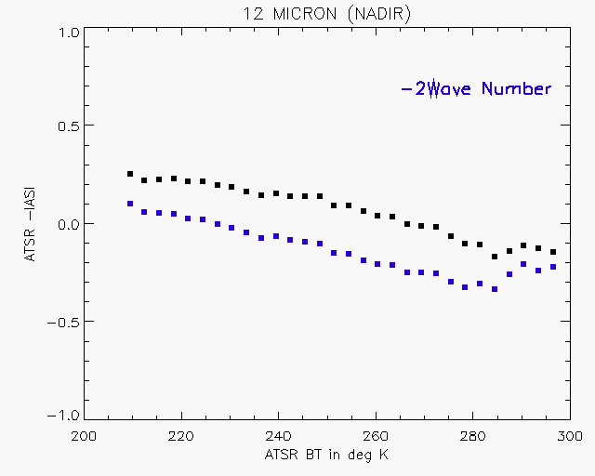
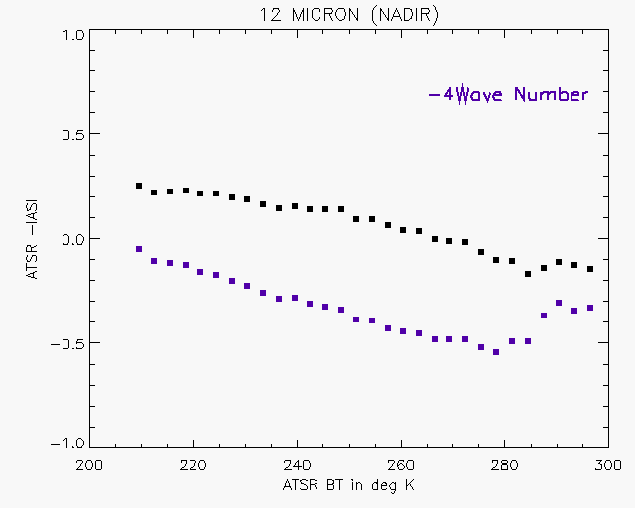
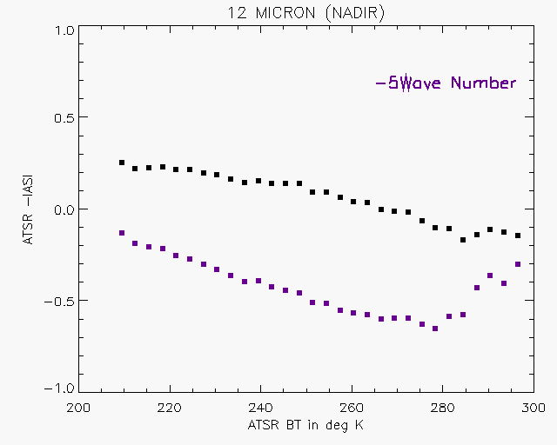
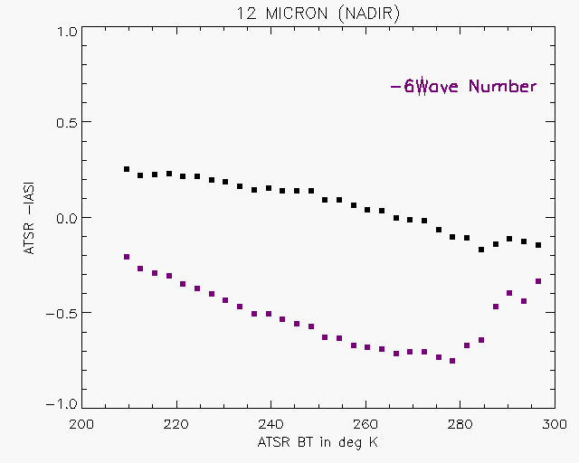
Is shifting the SRF a possible solution ?

Slide 26
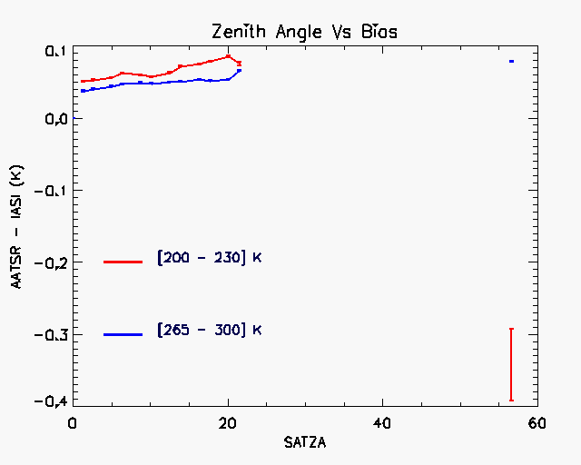
Does the bias depend on scan angle ?
See intermediate temperature ranges
At NADIR , the RVS bias is within design limits.
Is not similar to the scan angle bias of the AVHRR( Mittaz Harris).

Slide 27
Mittaz and Harris. 2011
Does the bias depend on scan angle ?
Zenith Angle Vs Bias ( AVHRR)
Is this an IASI effect or an AVHRR effect ???

