Slide 1
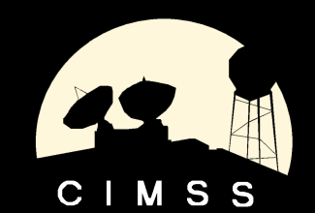
PATMOS-x AVHRR Solar Reflectance Calibration Update
Andrew Heidinger, NOAA/NESDIS/STAR, Madison, WI
Mike Foster and William Straka, UW/CIMSS, Madison, WI

Slide 2
Accomplishments
Extended the PATMOS-x approach (Heidinger et al, 2010) approach to AVHRR data from 2012 using MODIS C5 data to support data delivery to NCDC. (not shown)
Modifying calibration tools to operate on Level-2b (0.1º) rather than Level-3 (0.5º). Level-2b is our official data-set at NCDC.
Ingested 2010 TERRA and AQUA MODIS C6 data and testing impacts.
Implementing a near real-time monitoring of the reflectances (for NCDC)

Slide 3
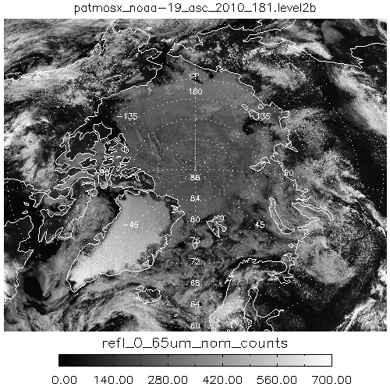
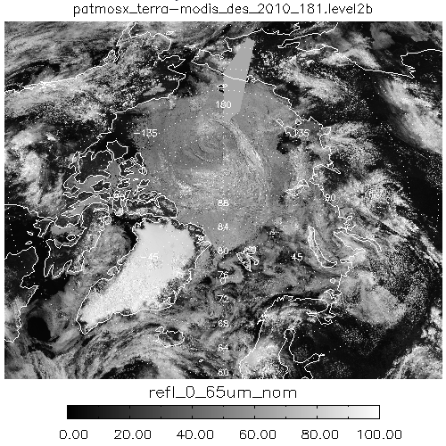
Example of PATMOS-x Level-2b
These images illustrate the 0.1º resolution Level-2b data used in this analysis
NOAA-19 AVHRR 0.65 μm Counts
TERRA-MODIS 0.65 μm Reflectance

Slide 4
Benefits of Level-2b Calibration
Level-2b provides more dynamic range for slope computation
Level-2b data is at NCDC so the AVHRR-side of this analysis can be repeated by anyone.
Level-2b stores pixel data so that additional pixel-level filtering is possible (space counts, heterogeneity, …).
Level-2b avoids the averaging of pixels across the dual-gain boundary.
This comes at the cost of more noise in the SNO comparisons

Slide 5
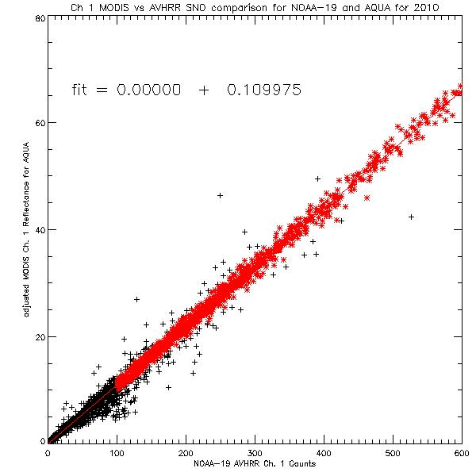
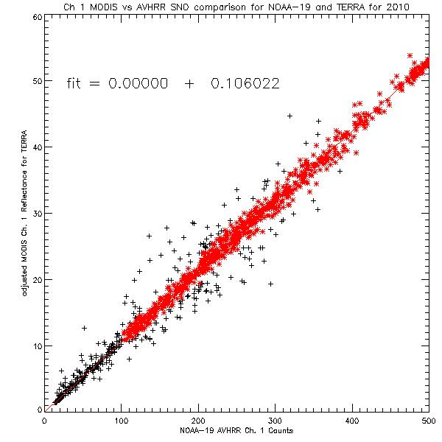
MODIS C5 Results for NOAA-19 2010 (Old)
AQUA is ≈4% > TERRA
AQUA
TERRA

Slide 6
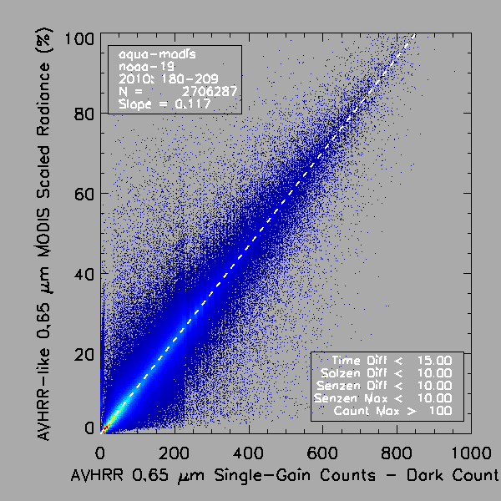
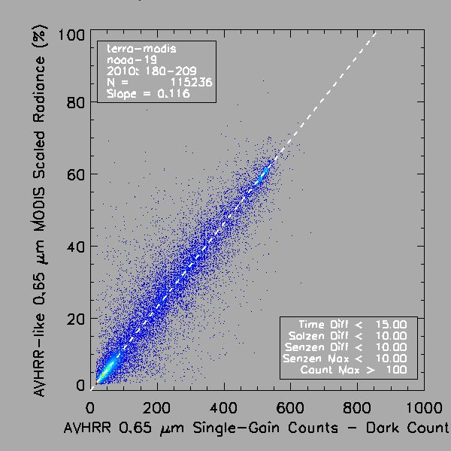
MODIS C6 Results for NOAA-19 2010 (NEW)
AQUA is ≈1% > TERRA

Slide 7
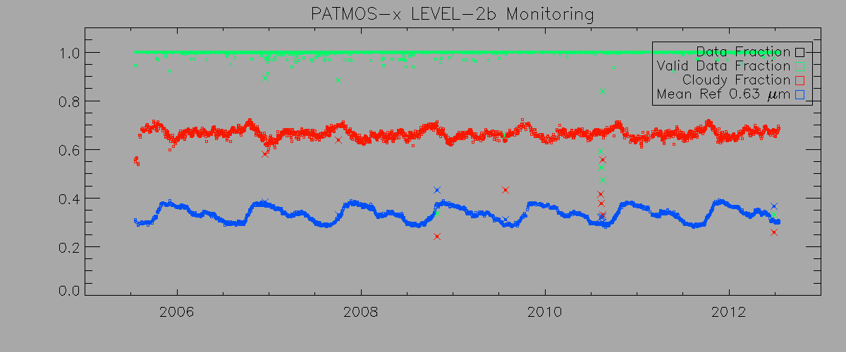
Near Real-time Reflectance Monitoring
NOAA-18 Ascending Node Results for Entire Operational Life
Notes:
We have qa tools developed specifically for the NCDC CDR program. Here is a dashboard configuration to quickly see the percent pixels that fall within valid data ranges. Each vertical line segment represents a single level2b daily file. Ascending nodes are located above descending nodes for each sensor channel shown. Green line mean >95% of the data in the daily file is valid, yellow means between 95% and 50%, red means between 50% and 0%, and black means that there is no valid data or the file is missing completely. This figure shows one entire year of data for the NOAA-18 AVHRR.

Slide 8
Conclusions
PATMOS-x MODIS C5 Calibration extended into 2012 and AVHRR Level-2b CDR will be updated at NCDC.
Modified calibration tools to work on Level-2b (sampled pixels) rather than Level-3 (averaged pixels)
Began testing impacts of MODIS C6 calibration and results are promising.
Real-time PATMOS-x solar calibration monitoring implemented at CIMSS.
Sun-Glint calibration developed for GOES appears to also add benefit for AVHRR.

