Slide 1
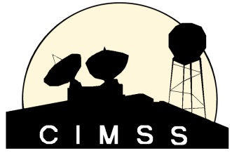
Potential GEO Products/Users
Timothy J. Schmit (tim.j.schmit@noaa.gov)
Andrew Heidinger
NOAA/NESDIS/Satellite Applications and Research
Advanced Satellite Products Branch (ASPB)
Madison, WI
Mathew M. Gunshor, Anthony J. Schreiner, James P. Nelson III, CIMSS
2013 GSICS Users' Workshop
College Park, MD
April 8, 2013

Slide 2
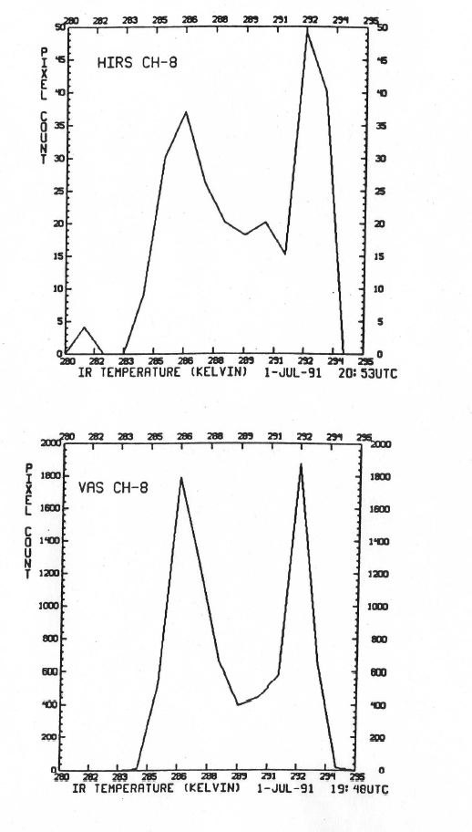
Outline
Simple Option?
Real-time need
GOES-R
With and without
GOES Sounder
MTSAT
Summary
Discussion
…polar-orbiting [satellites]… offers a fixed reference for all the geostationary satellites…. (circa 1991)
Notes:
NOAA Tech Report #73.

Slide 3
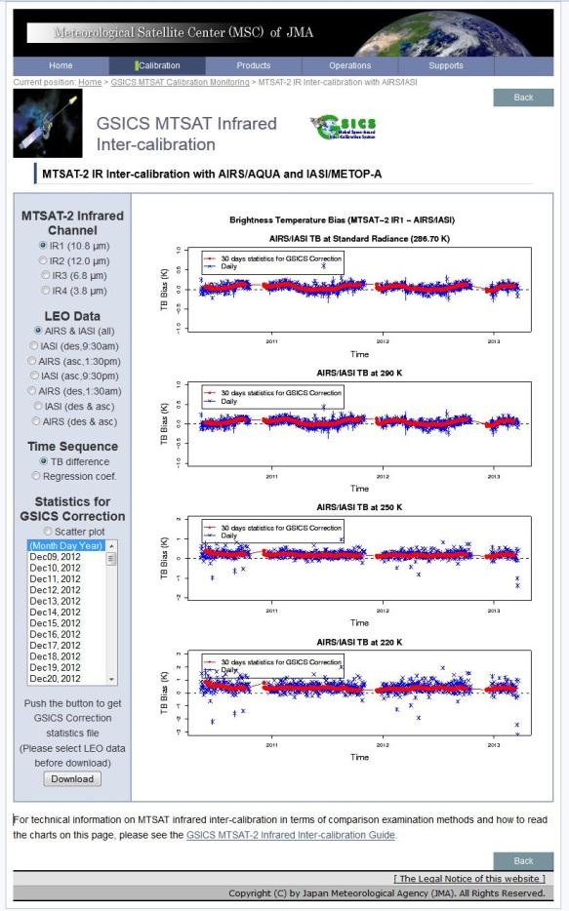
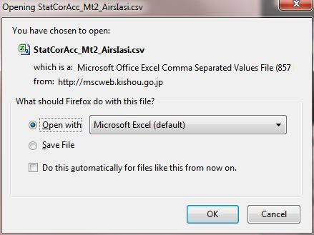
ASCII
Consider a ‘simple’ option as well as netCDF
For example, ASCII
http://mscweb.kishou.go.jp/monitoring/gsics/ir/gsir_mt2.htm

Slide 4
Misc.
Consider an option to be applied to brightness temperatures
Applying the correction in radiance-space might be better, but some users might already just use brightness temperatures in their level-2 product generation.
Goal would be a ‘similar user experience’ from satellite provider to provider
consistent naming convention
c0, c1, slope intercept, etc.
Explain within file a1, a2, a3 and other variables
Consistent way to organize coefficients between satellites

Slide 5
Wish List
Can detector-level coefficients be generated?
The sounder especially is susceptible to striping in various bands (true of all GOES) which affects products (you can see it in the CTP images in parts of the Pacific).
The average correction, not just individual days
Provide a weekly or monthly correction?
Provide a ‘running mean’ over the last several day.
What’s the correct time to apply these over?
Reprocess with a ‘centered’ day?
Different implementation for operational vs re-processing?

Slide 6
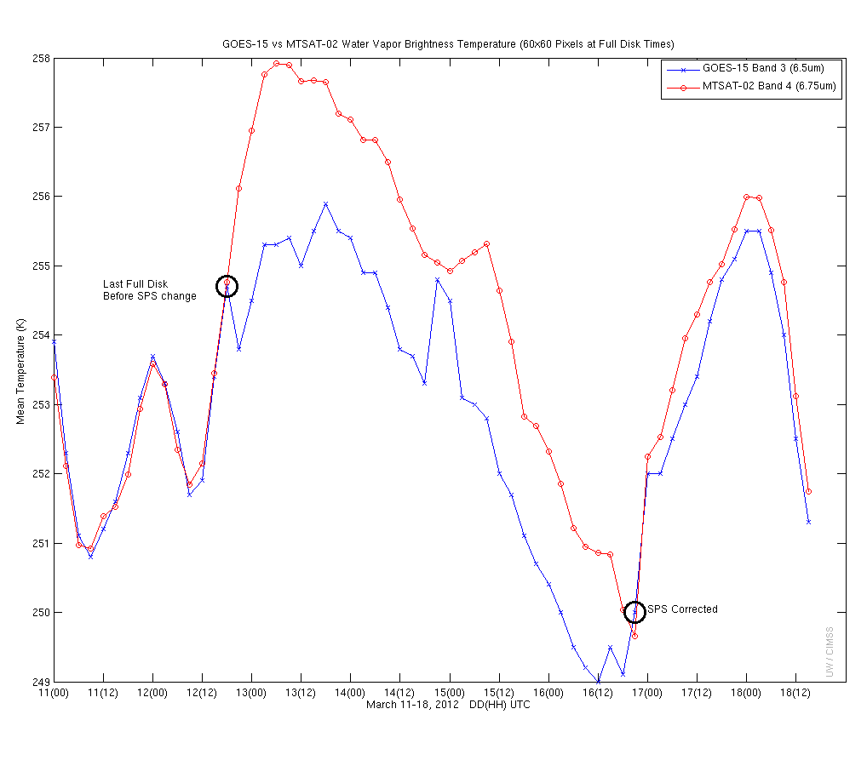
GOES-15 Imager Calibration Anomaly
STAR assisted with resolving the GOES-15 Imager calibration anomaly:
Lasted from 2045 UTC on March 12, to 2045 UTC on March 16, 2012
Band 3 (“water vapor”) brightness temperatures were about 5% too cool
Notified GOES engineers of the anomaly.
First contacted by ECMWF
Verified that SPS changes corresponded to the various anomalies.
CIMSS Satellite blog entry:
- http://cimss.ssec.wisc.edu/goes/blog/archives/9995
The NESDIS component of the GSICS was not functioning at the time.
Operational Review Board planned.
GOES-15 Imager water vapor band compared to co-located MTSAT values. Note large brightness temperature differences beginning near 21UTC on March 12, 2012. Credit: CIMSS.
Satellite providers should be the first to report anomalies, ideally not notified by our users!
Notes:
ECMWF= European Center for Medium range Weather Forecasting
SPS = Sensor Processing Subsystem
CIMSS = Cooperative Institute for Meteorological Satellite Studies
GSICS= Global Space-based Inter-Calibration System
MTSAT = Multi-functional Transport Satellite
GOES = Geostationary Operational Environmental Satellite

Slide 7
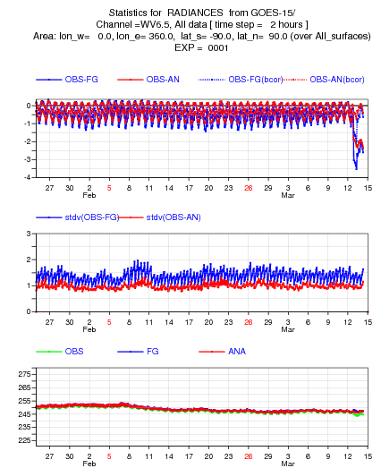
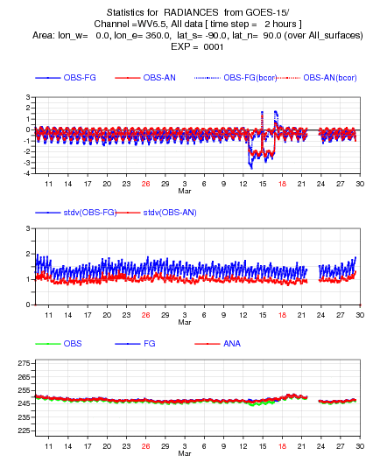
GOES-15 Imager Calibration Anomaly
(monitored by ECMWF)
Large observation minus calculation
“Calc” versus “Obs” is a good monitoring tool!
Beginning of the anomaly
Encompassing the anomaly

Slide 8
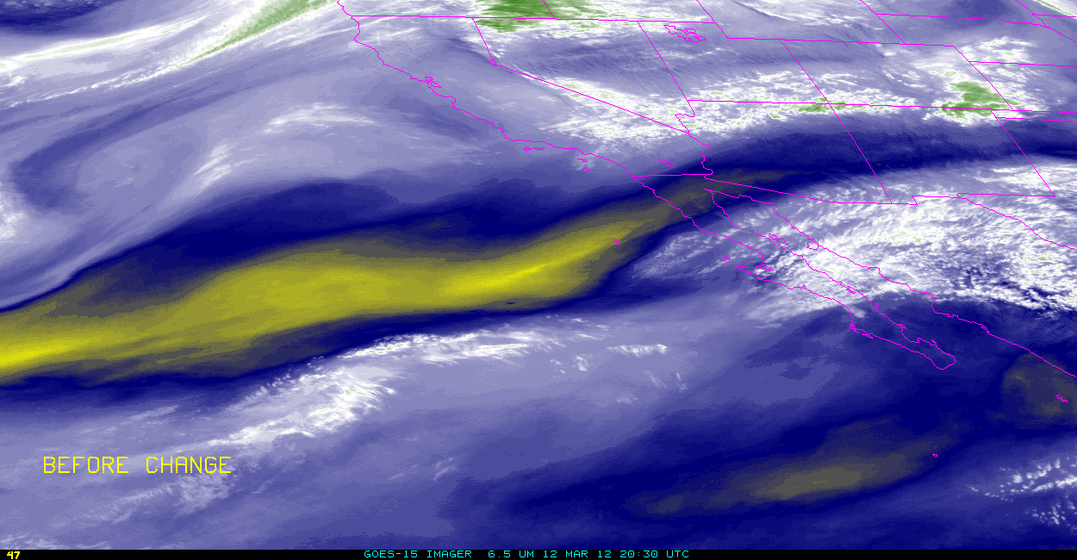
GOES-15 Imager Calibration anomaly
http://cimss.ssec.wisc.edu/goes/blog/archives/9995
Reasonable, although incorrect brightness temperature values
GOES-15 Imager 6.5 micrometer band
(before and after SPS change)
Image from Scott Lindstrom, CIMSS
animation

Slide 9
GOES-15 Imager Calibration Anomaly (by SPS)
SPS: 9 4 7 4 9
Database error on different processing units caused the mis-calibration
GOES-15 Imager water vapor band compared to co-located MTSAT values. Note large brightness temperature differences beginning near 21UTC on March 12, 2012. Plus, the SPS unit used for the generation of GVAR is noted (obtained from the GVAR signal). Image from: CIMSS and STAR.
Notes:
ECMWF= European Center for Medium range Weather Forecasting
SPS = Sensor Processing Subsystem
CIMSS = Cooperative Institute for Meteorological Satellite Studies
GSICS= Global Space-based Inter-Calibration System
MTSAT = Multi-functional Transport Satellite
GOES = Geostationary Operational Environmental Satellite

Slide 10
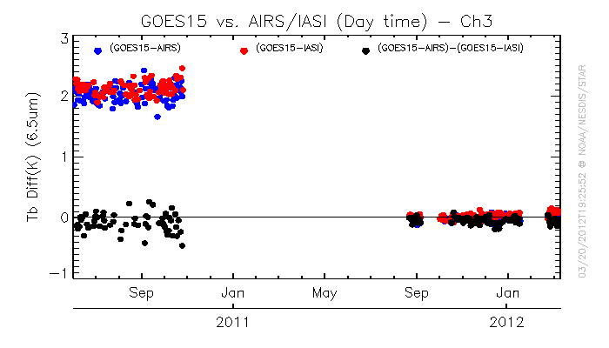
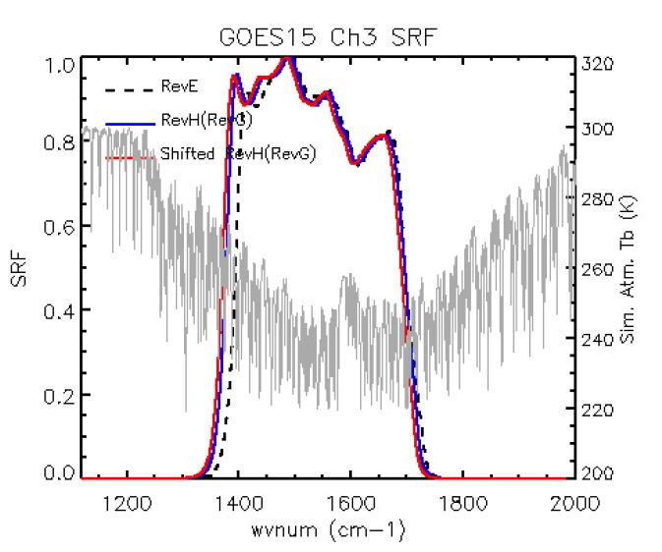
GSICS Monitoring
(GOES-15 Imager)
Note the huge improvement after the SRF were shifted.
Details at:
http://www.oso.noaa.gov/goes/goes-calibration/goes-imager-srfs.htm
Image from FangFang Yu
Need realtime monitoring, this plot doesn’t cover the time of the anomaly, even after a week.
Figure 4.32 from Hillger and Schmit.
Notes:
Figure 4.32 from Hillger and Schmit. Hillger, D.W., and T.J. Schmit, 2011: Imager and Sounder Radiance and Product Validation for the GOES-15 Science Test, NOAA Technical Report, NESDIS 141, (November), 101 pp.

Slide 11
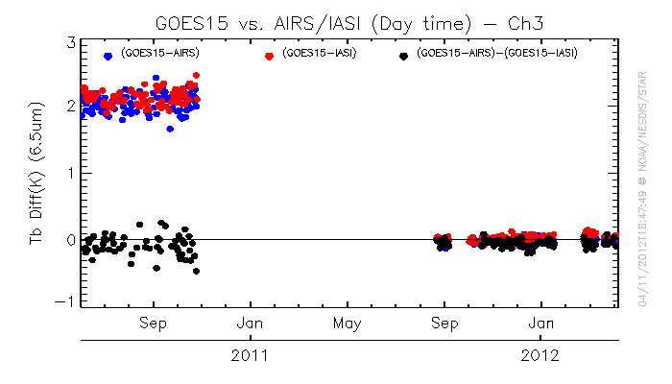
GSICS Monitoring
(GOES-15 Imager)
Missing data during the time of the major anomaly.
Image from FangFang Yu

Slide 12
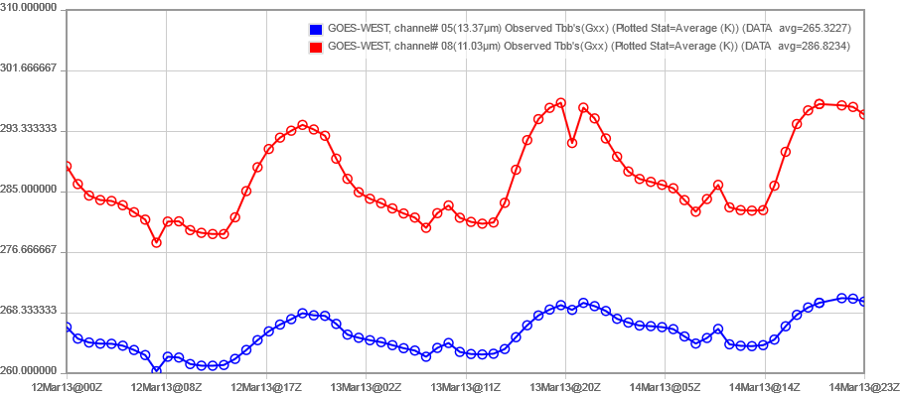
Hourly Averages of Observed Clear Brightness Temperatures (K)
GOES 15 Sounder CONUS Sector
12 March 2013 00UTC through 14 March 2013 2300UTC
Band 5 (13.37µm, Blue) & Band 8 (11.03µm, Red)
21UTC on 13 March 2013
(Sounder Patch Temperature Change
occurred at 20:45UTC)
Brightness temperature changes during recent patch temperature increase.

Slide 13
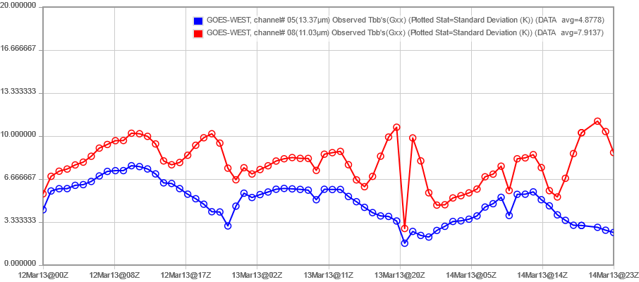
Hourly Standard Deviations of Observed Clear Brightness Temperatures (K)
GOES 15 Sounder CONUS Sector
12 March 2013 00UTC through 14 March 2013 2300UTC
Band 5 (13.37µm, Blue) & Band 8 (11.03µm, Red)
21UTC on 13 March 2013
(Sounder Patch Temperature Change
occurred at 20:45UTC)
Brightness temperature changes during recent patch temperature increase.

Slide 14
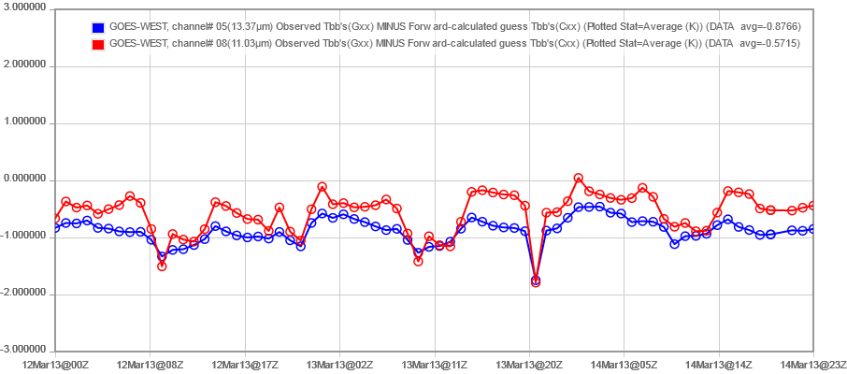
Hourly forward-Calc Guess vs Observed Clear Brightness Temperatures (K)
GOES 15 Sounder CONUS Sector
12 March 2013 00UTC through 14 March 2013 2300UTC
Band 5 (13.37µm, Blue) & Band 8 (11.03µm, Red)
21UTC on 13 March 2013
(Sounder Patch Temperature Change
occurred at 20:45UTC)
Effect also seen in the Calculation vs Observation.

Slide 15
GOES-R
Need to detect any anomaly before users
For example, real-time comparisons
Who is to cover ‘calc vs obs’?
“Check” on-orbit system SRF as soon as possible after launch
Monitor for any RTE biases
Path for funding products applied with and without GSICS?
Consider best way for GSICS, GOES-R Calibration Working Group (CWG) and others (OSPO, PLT, CCT) to interact during the entire GOES-R series lifetime.
Not just a GOES-R Post-Launch Test issue

Slide 16
GOES-R ABI Products
Baseline Products
Future Capabilities
Advanced Baseline Imager (ABI)
Aerosol Detection (Including Smoke and Dust) Aerosol Optical Depth (AOD) Clear Sky Masks Cloud and Moisture Imagery Cloud Optical Depth Cloud Particle Size Distribution Cloud Top Height Cloud Top Phase Cloud Top Pressure Cloud Top Temperature Derived Motion Winds Derived Stability Indices Downward Shortwave Radiation: Surface Fire/Hot Spot Characterization Hurricane Intensity Estimation Land Surface Temperature (Skin) Legacy Vertical Moisture Profile Legacy Vertical Temperature Profile Radiances Rainfall Rate/QPE Reflected Shortwave Radiation: TOA Sea Surface Temperature (Skin) Snow Cover Total Precipitable Water Volcanic Ash: Detection and Height
Advanced Baseline Imager (ABI)
Absorbed Shortwave Radiation: Surface Aerosol Particle Size Aircraft Icing Threat Cloud Ice Water Path Cloud Layers/Heights Cloud Liquid Water Cloud Type Convective Initiation Currents Currents: Offshore Downward Longwave Radiation: Surface Enhanced “V”/Overshooting Top Detection Flood/Standing Water Ice Cover Low Cloud and Fog Ozone Total Probability of Rainfall Rainfall Potential Sea and Lake Ice: Age Sea and Lake Ice: Concentration Sea and Lake Ice: Motion Snow Depth (Over Plains) SO₂ Detection Surface Albedo Surface Emissivity Tropopause Folding Turbulence Prediction Upward Longwave Radiation: Surface Upward Longwave Radiation: TOA Vegetation Fraction: Green Vegetation Index Visibility
Almost all GOES-R ABI products can be improve with an improved bias correction.

Slide 17
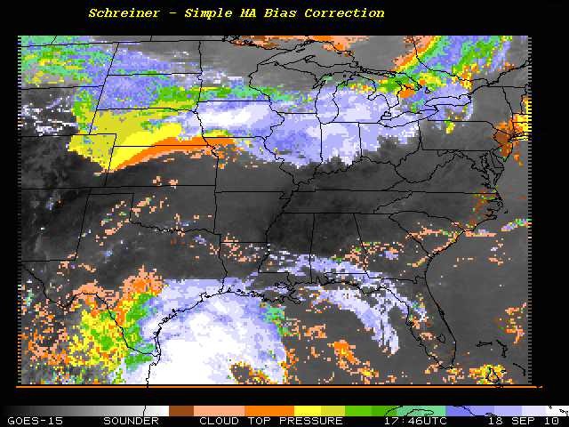
GOES-15 Sounder: Simple bias correction

Slide 18
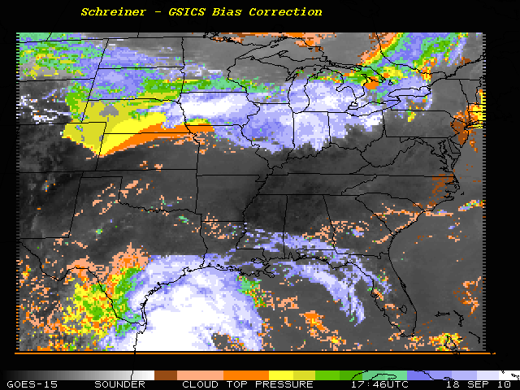
GOES-15 Sounder: GSICS bias correction

Slide 19
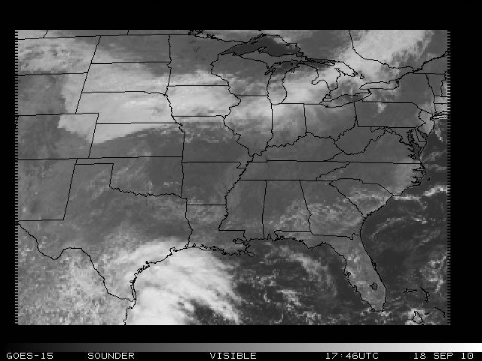
GOES-15 Sounder: Visible band

Slide 20
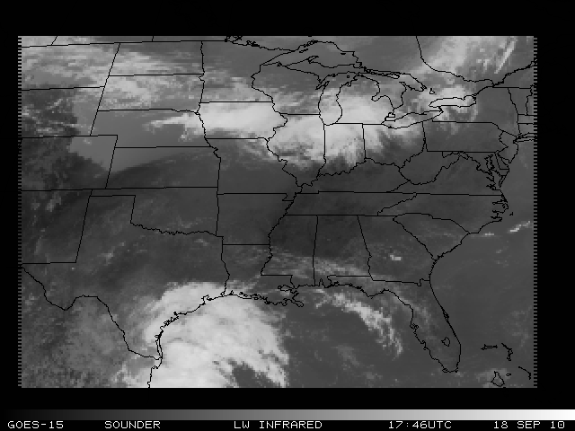
GOES-15 Sounder: Infrared band

Slide 21
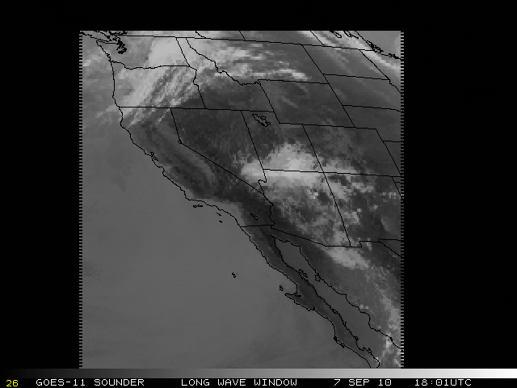
GOES-15 Sounder: Infrared band

Slide 22
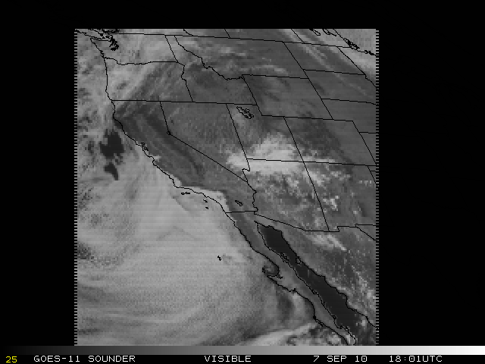
GOES-15 Sounder: Visible band

Slide 23
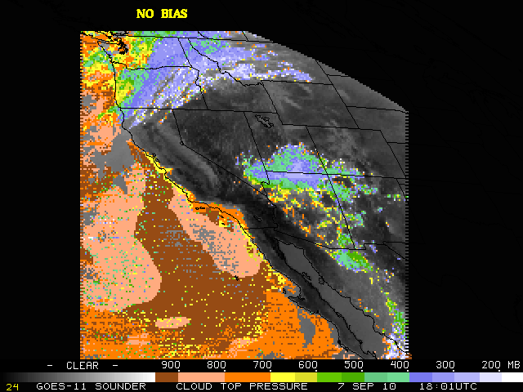

Slide 24
Notes:
Flipping between the simple bias and this GSICS bias shows that with the GSICS bias some of the high clouds (north, southeast portions of the image) get higher(from green to blue, from blue to white) and some of the lower clouds (Pacific) get lower. (from yellow to orange) What we like seeing here is that it appears that the GSICS bias takes out even more of the noise! We’ve only looked at this one case, but so far we’re impressed… and we’re not even sure we’re applying it in the most ideal way.

Slide 25
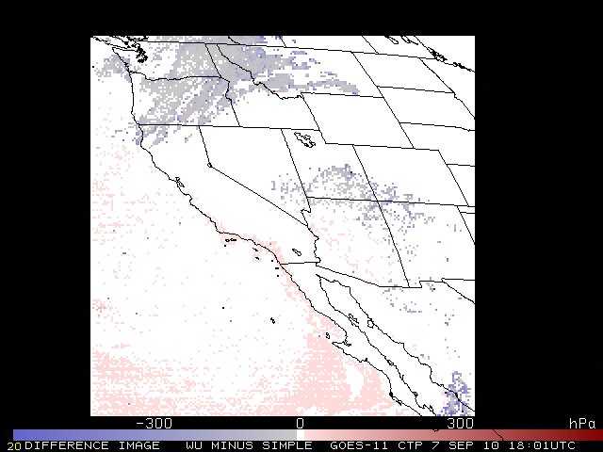
GOES-15 Sounder: CTP Difference image
Notes:
‘Mixed bag’ when applying the GSICS correction, but reduces some of the cloud ‘noise’

Slide 26
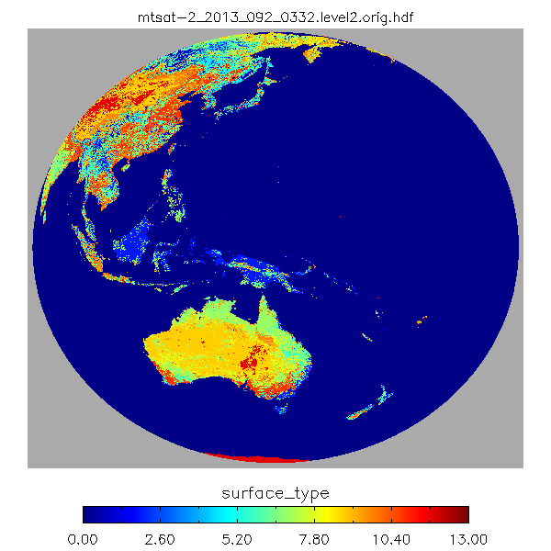
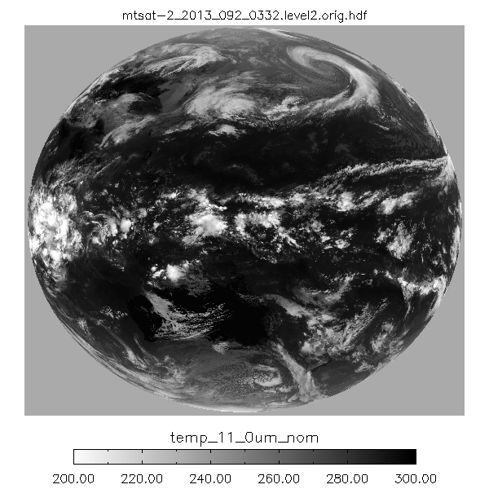
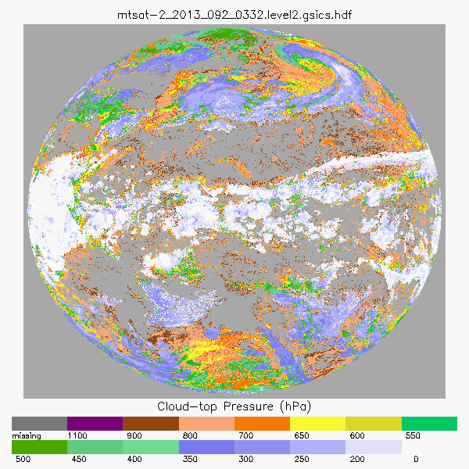
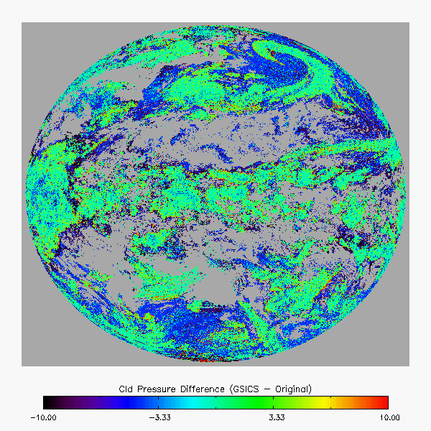
Impact of GSICS Calibration on MTSAT Cloud Pressures from NOAA PATMOS-x
PATMOS-x runs the AWG Cloud Height Algorithm (ACHA)
On MTSAT, ACHA uses the 6.7, 11 and 12 μm
Using the latest GSICS correction results in the following impacts
Very small pressure increases for ice clouds.
Small (4 hPa) pressure decrease for water clouds.
Edges of cirrus are retyped as cirrus and give lower pressures (this is an improvement).
Processed by Will Straka, CIMSS
Notes:
Thanks to Will Straka, CIMSS.

Slide 27
Summary
GSICS corrections are important to improve the use of both radiances and products.
The corrections need to be done in near realtime and relatively easy for someone outside of GSICS to implement.
2013 GSICS Users' Workshop
College Park, MD
April 8, 2013

