Slide 1
GOES-R Program Instrument and L1b Product Calibration/Validation
GSICS Users’ Conference
April 8, 2013
Bob Iacovazzi, Jr.
GOES-R Program Systems Engineering (PSE) Cal/Val Lead
Notes:
To-Do:

Slide 2
Importance of Calibration & Validation
Calibration: The process to determine factors for converting and correcting raw detector measurements into science data units (e.g., radiance) with the specified level of accuracy.
  Calibration is applied to GOES-R raw instrument data to transform them into L1b measurements … the fundamental building blocks for all L2+ products.
Validation: The process of determining that the deliverable item satisfies its intended use in its intended environment.
  Validation provides user confidence that GOES-R data can be used for their intended purpose, e.g., weather forecasting or numerical weather prediction.
GOES-R cal/val requirements are integrated into mission requirements!
Notes:
To-Do:

Slide 3
GOES-R Cal/Val Scope
  Pre-launch calibration/L1B validation
    Observe, and validate results of, pre-launch instrument-level calibration tests
    Evaluate instrument performance risks and waiver requests
    Provide subject matter expert (SME) review of L1b algorithm design and implementation
    Develop Cal/Val related Post-Launch Test (PLT) planning
    Develop tools for post-launch validation and anomaly resolution of L1b science data quality
  Validate expected results from pre-launch system level testing of L1b algorithm using synthetic L0 data
  Analyze PLT cal/val data results and provide SME support of science data anomaly resolution
  Coordinate cal/val activities through PLT and Handover
  Prepare NOAA satellite calibration scientists and engineers for monitoring, analyzing and maintaining GOES-R series instrument calibration and product integrity after Handover
GOES-R cal/val enhances understanding of data quality, and encourages “Day-1” operational readiness and long-term user confidence.
Notes:
To-Do:

Slide 4
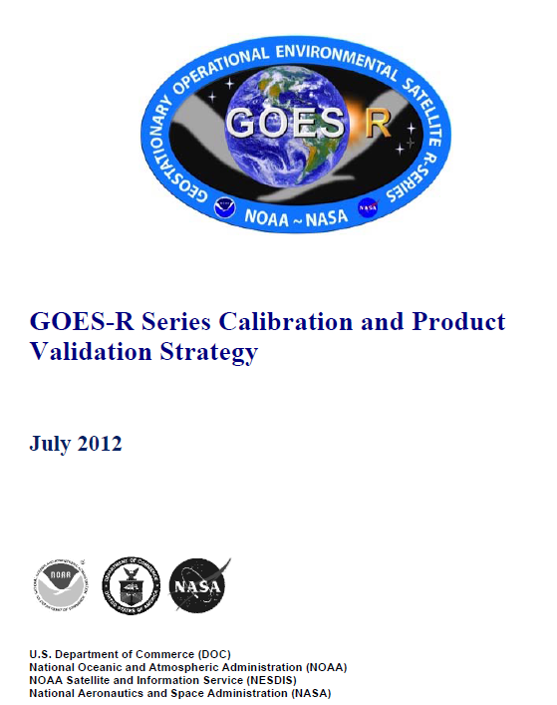
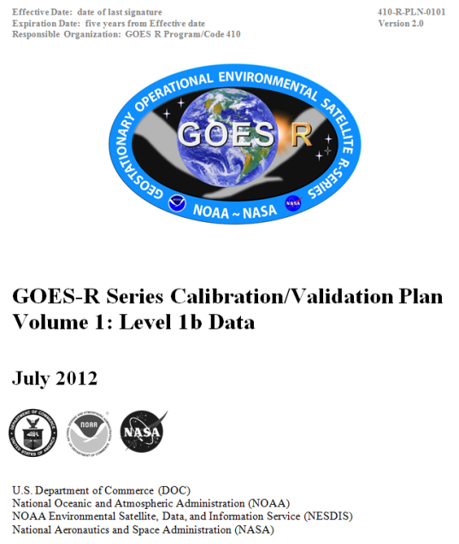
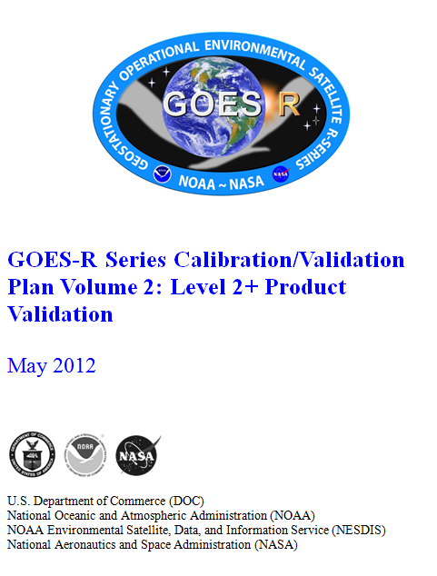
GOES-R Program Cal/Val Documents
Calibration and Product Validation Strategy
Cal/Val Plan Vol. 1: L1b Data
Cal/Val Plan Vol 2: L2+ Product Val
Scope, Organizations & Working Groups, Roles & Responsibilities, Resources, and Schedules
Cal/Val Methods and Processes
All documents at CDR-level - Scope defined, technical methods mature, organizational role and responsibilities and processes defined, resources allocated, and schedules defined.
Notes:
To-Do:

Slide 5
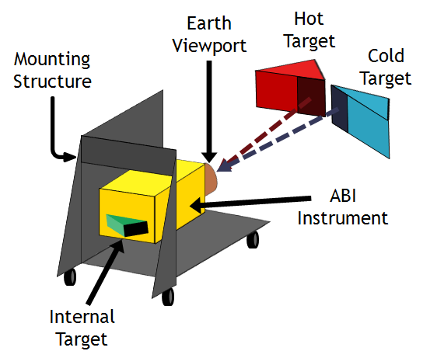
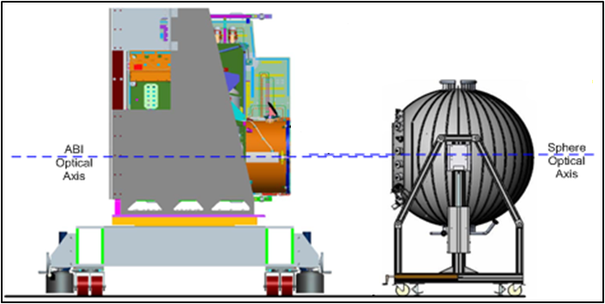
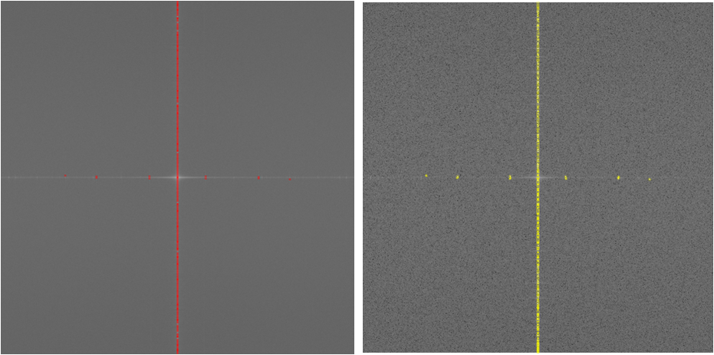
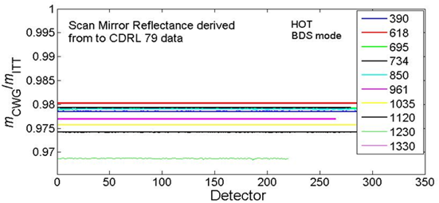
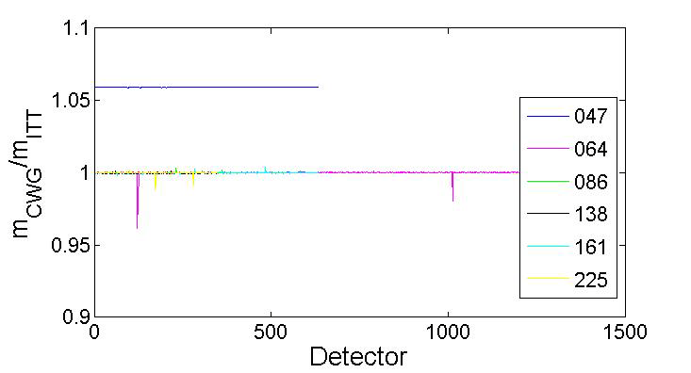
Instr Cal and Cal Test Report Review:
ABI
CWG conducted detailed data analysis on pre-launch tests for proto-type model (PTM)
Reflective and emissive channel calibration
Coherent noise
Irradiance calibration
MTF-Focus-Registration
Exelis
CWG
Emissive (top) and Reflective (bottom) channel calibration test arrangement
Coherent noise test results
Anomalies caused by not using actual scan mirror reflectance value
Government analysis of vendor cal testing reports scrutinizes reproducibility of results and provides valuable feedback to the testing process.
Emissive (left) and reflective (right) channel calibration test results - ratio of CWG to Exelis cal coefficient

Slide 6

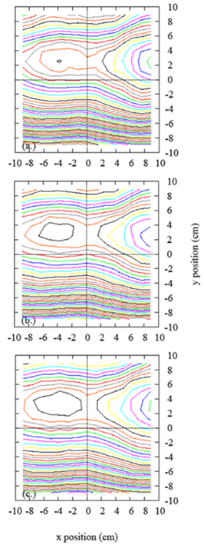
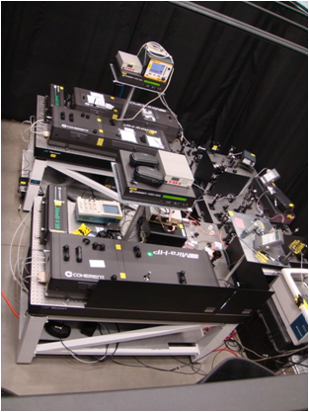
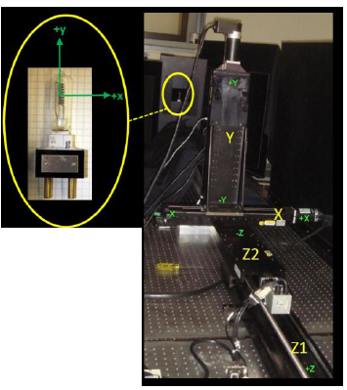
Instr Cal and Cal Test Report Review: NIST support for ABI and EXIS
Witness filter characterization (ongoing)
Reflective channel radiance scale validation via visible transfer radiometer (VXR) (planning)
FEL-based irradiance scale validation: uniformity test (completed)
Spectral response and irradiance characterization via SIRCUS (completed)
Characterization of external blackbody via thermal transfer radiometer (TXR) (completed)
EXIS testing at Synchrotron Ultraviolet Radiation Facillity-III (completed)
0.1% contours
Spatial uniformity setup
Traveling SIRCUS (Spectral Irradiance and Radiance Responsivity Calibration Using Uniform Sources)
Spatial uniformity results at three distances, z.
NIST testing provides independent validation of instrument performance and in some cases traceability to international standards.

Slide 7
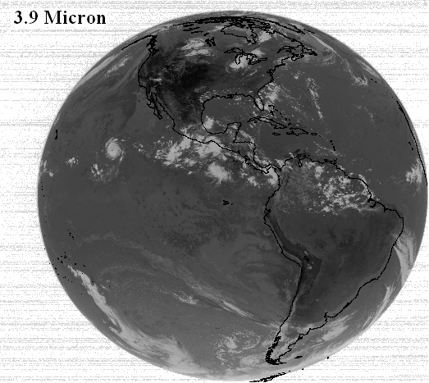
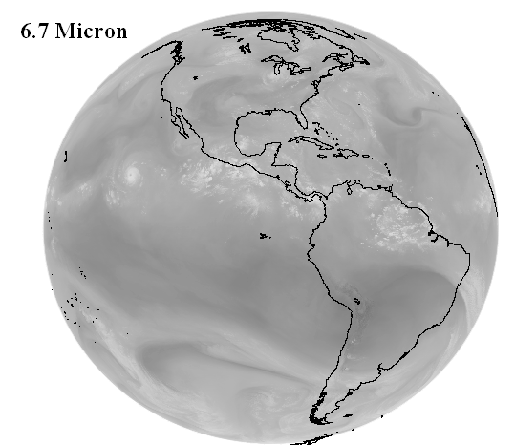
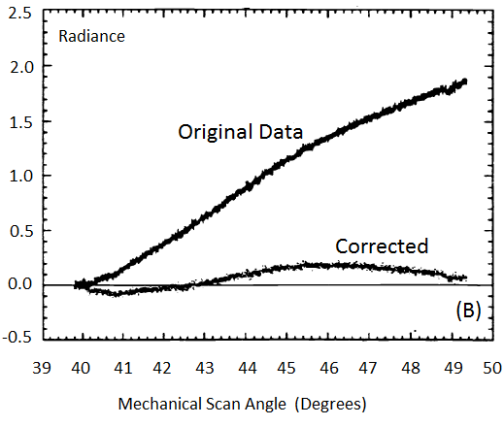
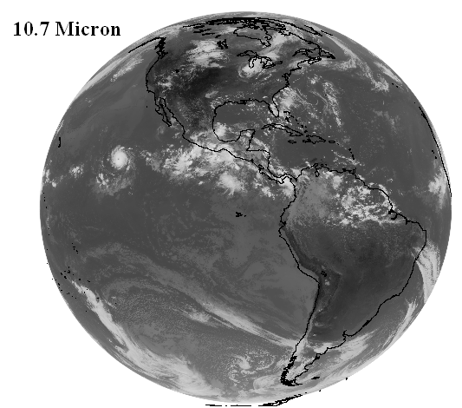
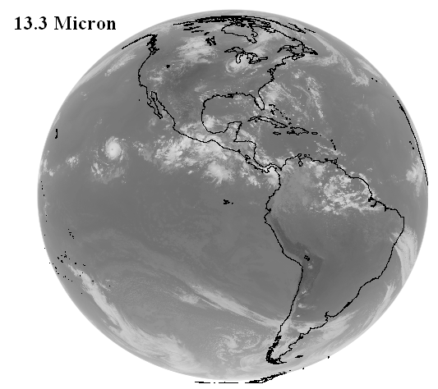
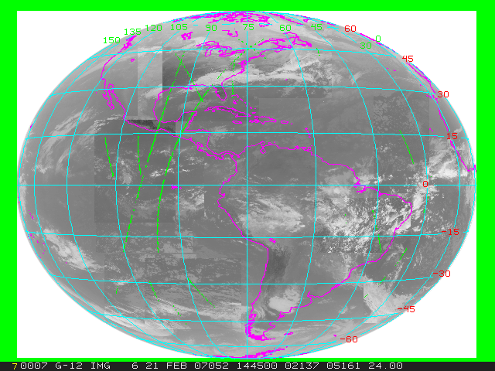
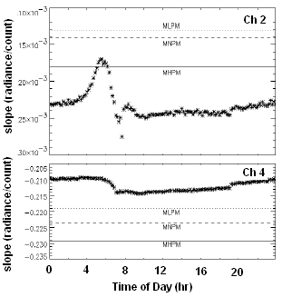
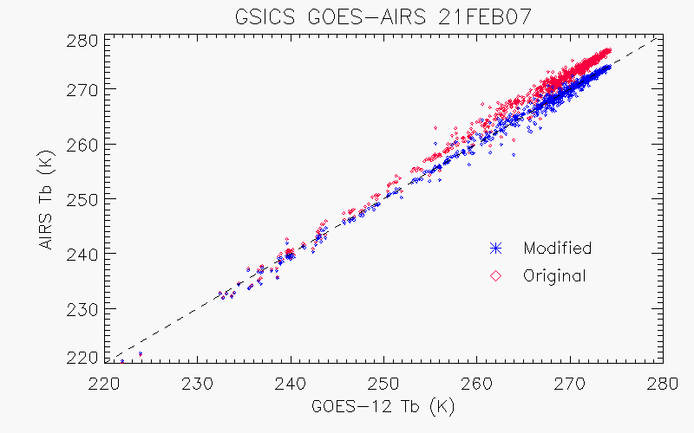
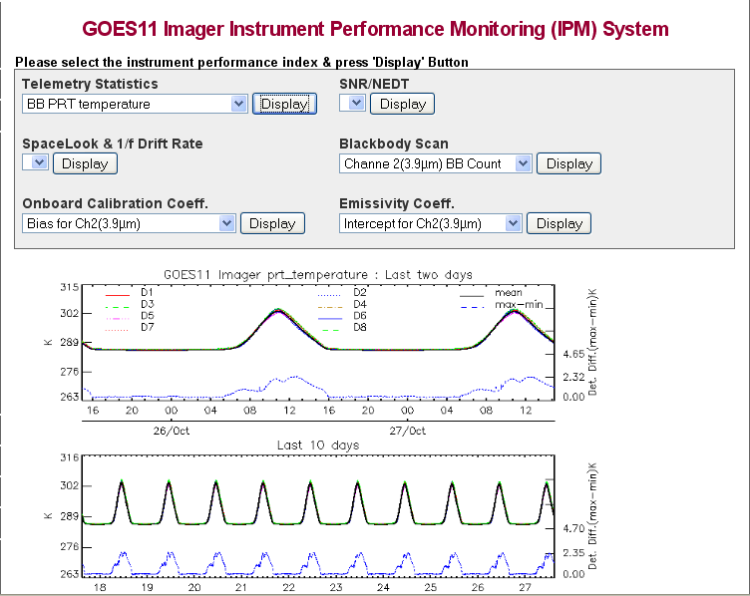
Post-launch Testing On-orbit Checkout
KPP product quality evaluation
Calibration input parameter evaluation
Radiance [mW/(m^2-sr-cm^-1)]
GOES-10 Ch. 4A Corrected and uncorrected Radiance vs. scan angle. (Beaucom et al., Proceedings of SPIE, 1999)
GOES-13 Hemispheric Image Tiles
On-board calibration system evaluation
Instrument Noise, Blackbody Temp and Cal Slope Monitoring
LEO Hyperspectral Sounder vs. GEO Inter-comparison (Courtesy of Wu et al.)
Notes:
To-Do:

Slide 8
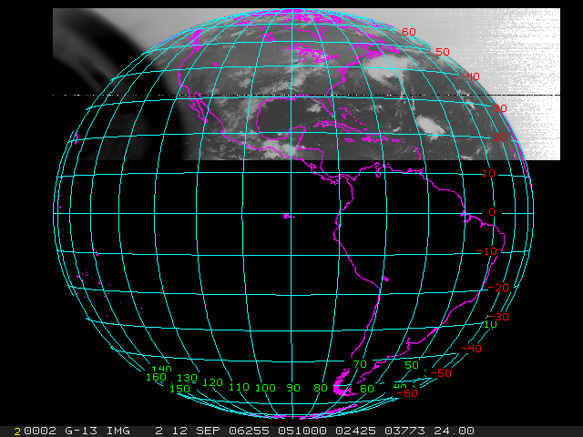
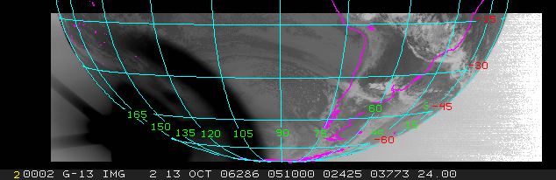
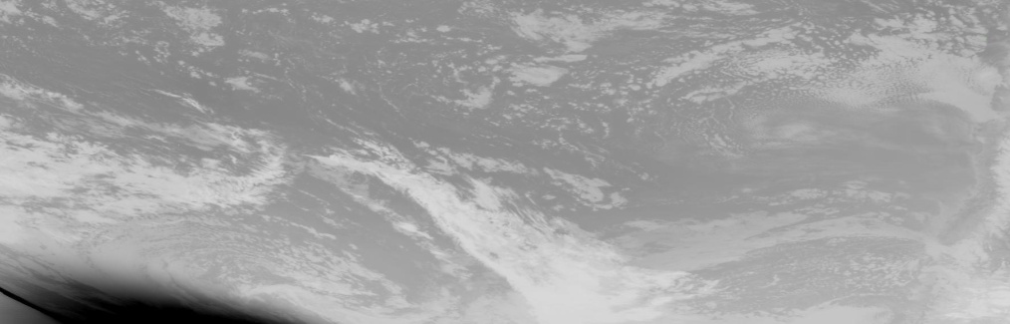
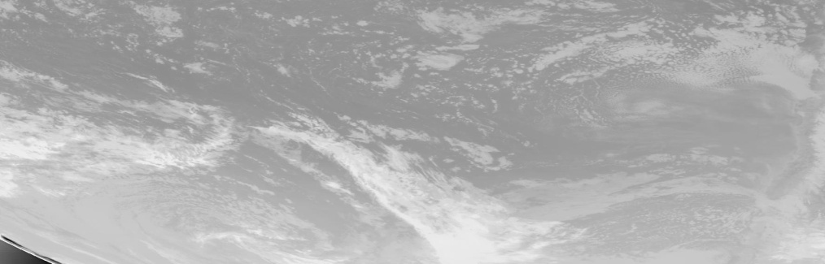
Post-launch Anomaly Resolution
Stray Light
GOES-13 Eclipse Season Stray Light
Strongly coordinated efforts between Cal Collaborators will be essential to success of post-launch instrument and L1b performance anomaly resolution efforts.
GOES-13 Eclipse Season Stray Light Before Fix (Top) and After Fix (Bottom) (Courtesy of J. Paul Douglas, OSPO)

Slide 9
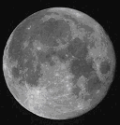
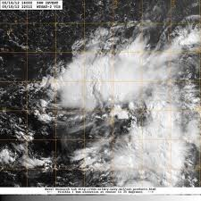
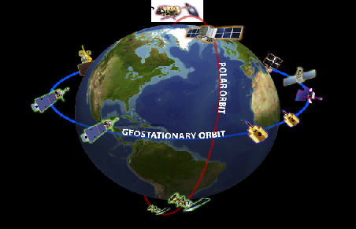
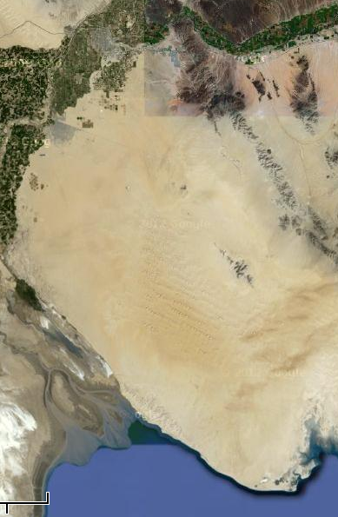
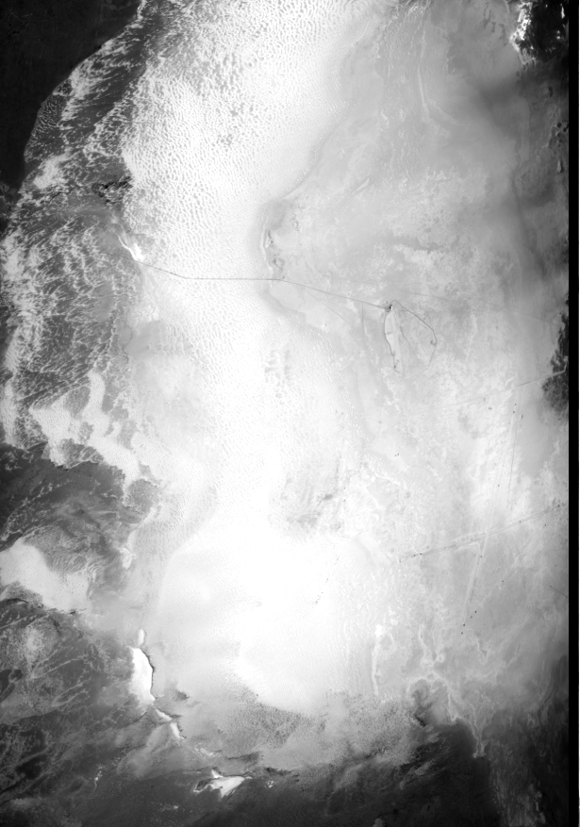
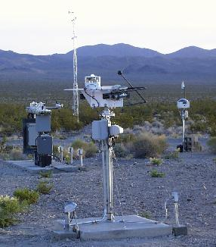
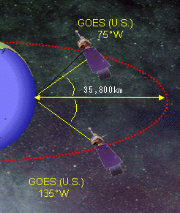
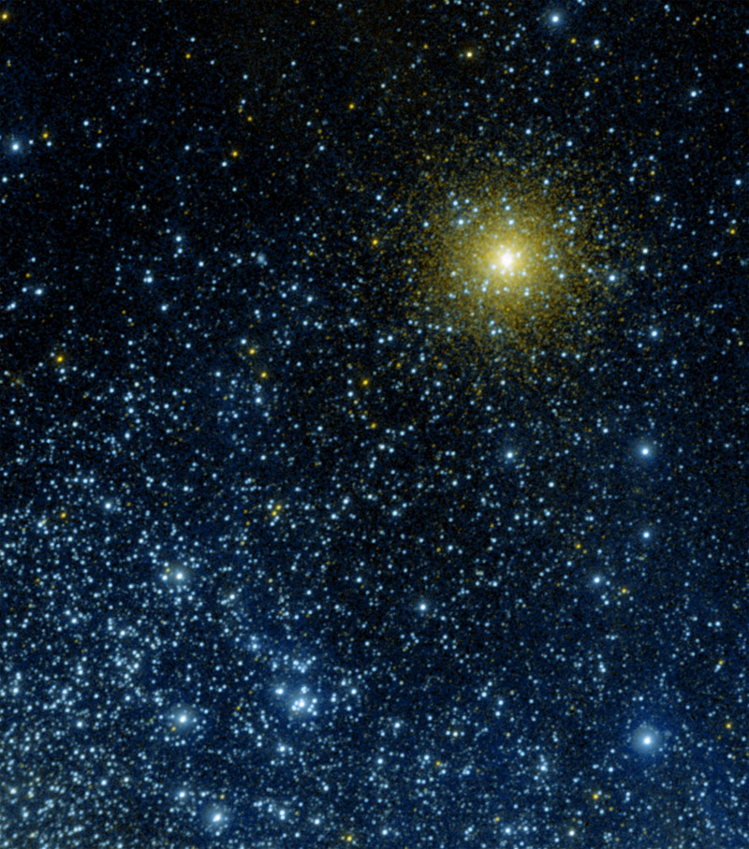
Post-Launch Testing Environmental Calibration Initialization
Activity near the end of PLT for L1b validation and creating a “state-of-the-cal” snapshot for long-term calibration trending
Vicarious Calibration
Satellite Inter-Calibration
Moon ABI Radiometric Cal, MTF and Band-to-band Registration
Deep Convective Clouds ABI and GLM Radiometric Cal
GEO-LEO ABI and GLM Radiometric Cal and INR
Sonora Desert
White Sands Missile Range
ARM and SURFRAD
GEO-GEO ABI and GLM Radiometric Cal and INR
Stars ABI Radiometric Cal
Desert and Instrumented Sites ABI Radiometric Cal

Slide 10
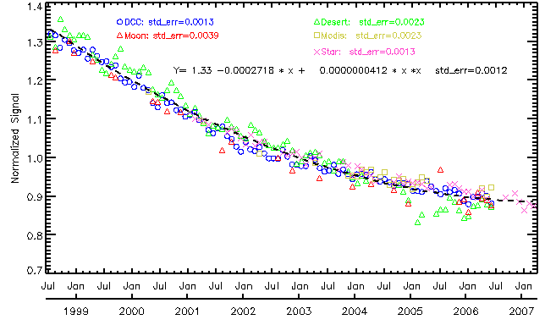
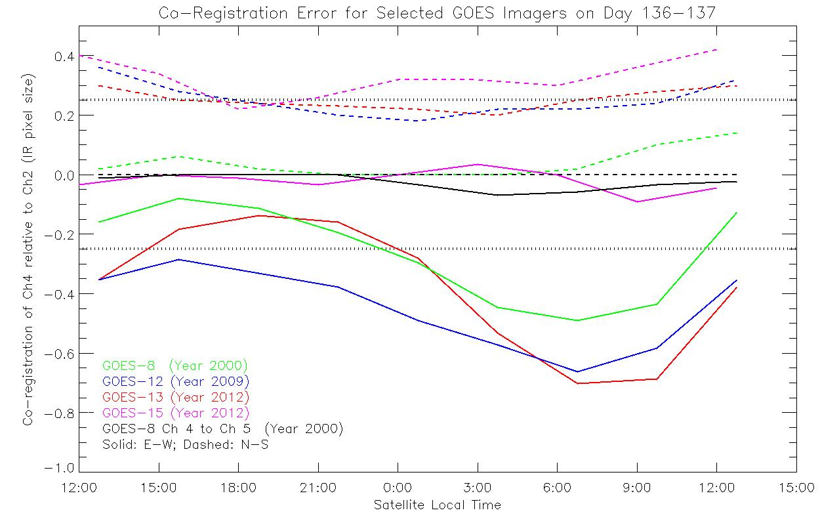
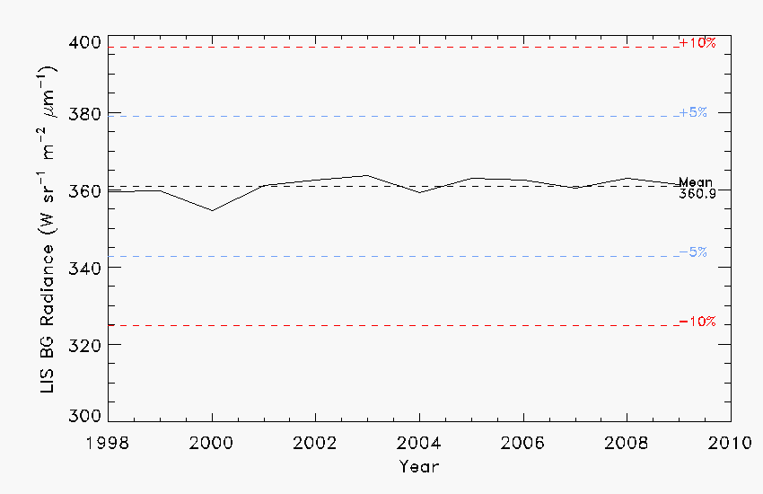
Mission-life sensor parameter and derived product trending
Application of ABI Long-term Radiometric Performance tool to GOES-10. (Wu et al., GSICS Monthly Web Seminar, Dec. 2011, https://gsics.nesdis.noaa.gov/wiki/ Development/20111213)
GOES-10
Application of ABI Co-Registration Validation tool to the GOES Imager. (Grotenhuis, Proc. SPIE 8510, 85101T 2012.)
Tropical Rainfall Measurement Mission Lightning Imaging Sensor (LIS)
Cal activities required during GOES-R acquisition enables long-term monitoring, analysis and maintenance of GOES-R product quality after Handover.
Application of GLM Long-term Radiometric Performance tool to LIS (Buechler et al., Atmos. Res., 2012)

Slide 11
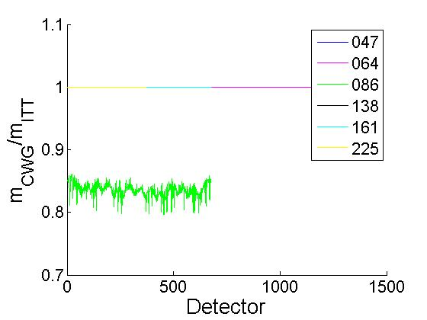
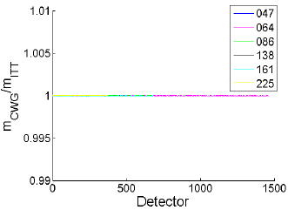

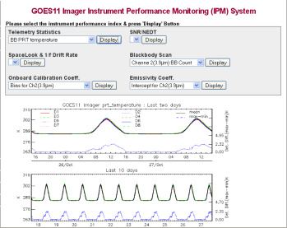
GOES-R Program Calibration and Validation
Poster Session I: 10:15 am Tuesday April 9.
Robert A. Iacovazzi, Jr.* (1), Edward C. Grigsby (1), Steve Goodman (2), Changyong Cao (3), Jaime Daniels (3), and Kathleen McIntyre (1)
NASA (1), NOAA/NESDIS/GOES-R (2), and NOAA/NESDIS/STAR (3)
E-mail-Robert.A.Iacovazzi@nasa.gov Physical Address - NASA GSFC, Code 410.0, 8800 Greenbelt Rd, Greenbelt, MD 20771
Focus on GOES-R Instrument Calibration/ Validation (Cal/Val) and L1b Product Val
Before (left) and after (right) Government-Vendor reconciliation of scan mirror reflectance value used in ABI test data analysis.
  Pre-launch Cal/Val
    Vendor instrument calibration testing
    Government team validation of testing results
    L1b algorithm design and implementation
  Post-Launch Testing (PLT) Cal/Val
    GOES-R observatory cal/val assets
    Product quality evaluation
    On-board calibration system evaluation
    On-orbit calibration and L1b product anomaly resolution
Example comparison between GOES-R CWG and Vendor cal test analyses: Ratio of CWG to Exelis cal coefficients for ABI reflective channels.
Determine and Correct Scan-Angle Dependent Radiance (e.g., Beaucom et al., Proceedings of SPIE, 1999)
GOES-10 Ch. 4A
GOES-13 Hemispheric Image Tiles
Instrument Noise, Blackbody Temp and Cal Slope Monitoring
GOES-13 eclipse season stray light before fix (left) and after fix (right)
(Courtesy of J. Paul Douglas, OSPO)
Notes:
To-Do:

Slide 12
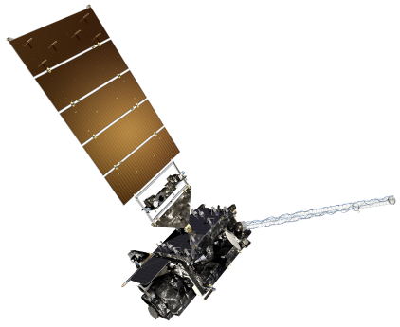
GOES-R Pre-Launch Milestones
 | 2010 | 2011 | 2012 | 2013 | 2014 | 2015
Program/System
Flight Segment
Ground Segment
System Design Review complete
Mission PDR Part I
Launch Readiness Oct. 2015
Mission PDR Part II
Mission CDR
Spacecraft
S/C PDR complete
S/C SDR complete
S/C CDR
ABI Delivery
Instruments
ABI Delta CDR complete
EXIS Delivery
GLM Delivery
All instruments have passed CDR
MAG Delivery
SEISS Delivery
SUVI Delivery
Core GS PDR completed
Core GS CDR
RBU/NSOF/WCDAS installation
Antenna System CDR
Antenna System PDR completed
GS Project PDR complete
WCDAS complete
ESPDS CDR
RBU complete
100 % delivery of baseline product algorithms
CLASS CDR
NSOF complete
GS Project CDR
Development Integration and Testing
Notes:
To-Do:

