Slide 1



Inter-Sensor Comparison for
Soumi NPP CrIS
Likun Wang¹, Yong Han^{2*}, Denis Tremblay³, Fuzhong Weng², and Mitch Goldberg⁴
1. CICS/ESSIC/University of Maryland, College Park, MD; wlikun@umd.edu
2. NOAA/NESDIS/STAR, College Park, MD
3. Earth Resources Technology, Inc., Laurel, MD
4. NOAA/NESDIS/JPSS Program Office, Greenbelt, MD
* CrIS SDR Team Lead
GSICS Web Meeting on 02/26/2013

Slide 2
Outline
CrIS Operational Concept
NPP/CrIS Post-launch Calibration
Inter-sensor comparison
  Validation of Radiometric Calibration
    Cross-satellite: CrIS versus IASI/AIRS
    Same Platform: CrIS versus VIIRS
  Validation of Geolocation
    CrIS versus VIIRS
Conclusion remarks

Slide 3
CrIS SDR Science Team
NOAA – Y. Han (team lead), D. Tremblay, X. Jin, Y. Chen, L. Wang and C. Barnet
NASA – D. Johnson
Space Dynamics Laboratory/Utah State University (SDL) – D. Scott, G. Bingham, M. Esplin, V. Zavyalov and M. Greenman
University of Wisconsin (UW) – H. Revercomb, D. Tobin, B. knuteson, J. Taylor and L. Borg
University of Maryland Baltimore County (UMBC) – L. Strow, S. Hannon, H. Motteler and P. Schou
Massachusetts Institute of Technology/Lincoln Labs – D. Mooney
Exelis (ITT) – J. Predina, M. Cromp and L. Suwinski
Northrop Grumman Aerospace Systems (NGAS) – D. Gu, D. Hagan, L. Wang and C. Wang
Raytheon – W. Ibrahim

Slide 4


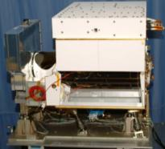
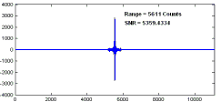

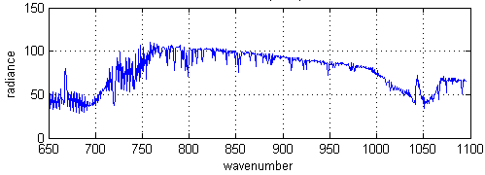
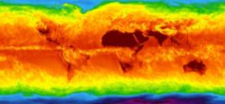
CrIS Operational Concept
CrIS on NPP
RDR = Raw Data Record
SDR = Sensor Data Record
EDR = Environmental Data Record
±50°
Cross track Scans
Downlink
RDRs
RDRs
Decode Spacecraft Data
30 Earth Scenes
Interferograms
Ground Station
SDRs
2,200 km Swath
CrIS SDR Algorithm
Calibrated / Geolocated Spectra
3x3 Array of CrIS FOVs (Each at
14-km Diameter)
EDRs
Co-Located ATMS SDRs
NWP, EDR Applications
Global Temperature, Moisture, Pressure Profiles
Figures from ITT Exelis

Slide 5
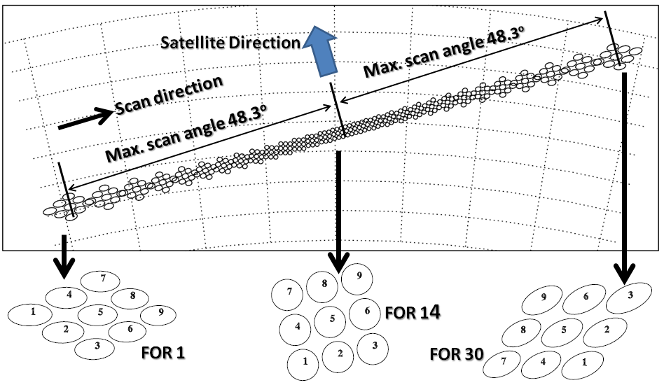
Scan, FOR & FOV Position
North
(~50km, nadir)
FOV – Field OF View
FOR – Field OF Regard
FOV (14km, nadir)
Swath is 2200 Km (FOR1 to FOR 30).
CrIS acquires 1 scan line every 8 seconds.
CrIS measures 8.7 million spectra per day.

Slide 6
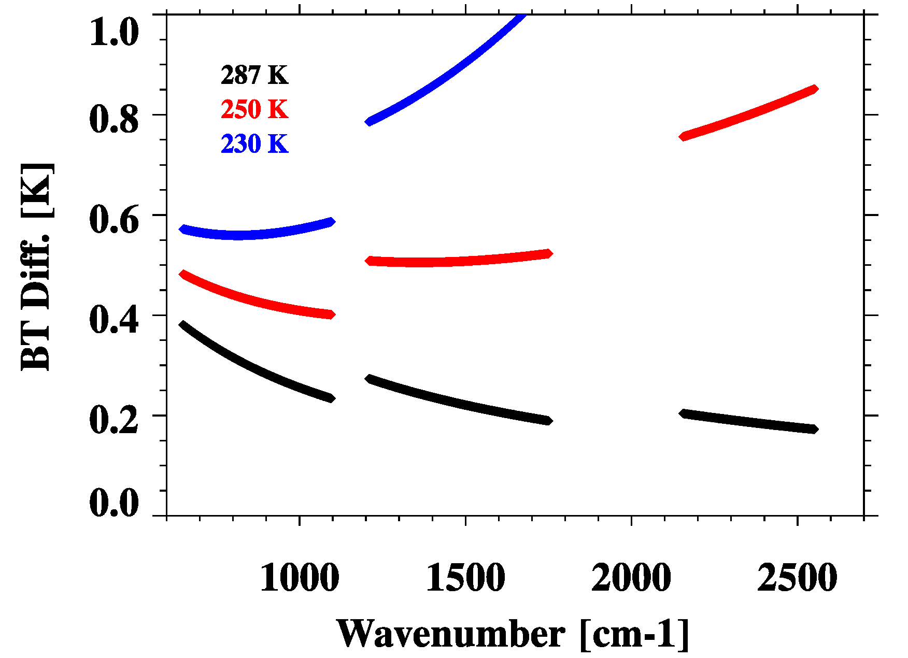
NPP CrIS Sensor Data Record
Calibration Uncertainty Specifications
SDR Calibration Uncertainty
Band | Spectral range (cm⁻¹) | N. of chan. | Resolution (cm⁻¹) | FORs per Scan | FOVs per FOR | NEdN @287K BB mW/m²/sr/ cm⁻¹ | Radiometric Uncertainty @287K BB (%) | Spectral (chan center) uncertainty ppm | Geolocation uncertainty km
LW | 650-1095 | 713 | 0.625 | 30 | 9 | 0.14 | 0.45 | 10 | 1.5
MW | 1210-1750 | 433 | 1.25 | 30 | 9 | 0.06 | 0.58 | 10 | 1.5
SW | 2155-2550 | 159 | 2.5 | 30 | 9 | 0.007 | 0.77 | 10 | 1.5
Radiometric uncertainty specification converted to that expressed in brightness temperature
NEdT, ⁰K
From Vladimir Zavyalov of SDL

Slide 7
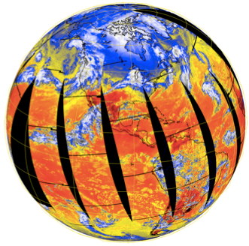
CrIS Cal/Val Milestones
January 18th 2012: CrIS was powered up; team started instrument checkout and optimization.
February 8th : Engineering packet v32 was uploaded (PGA setting and bit trim mask updates).
February 22nd : Full spectral resolution RDRs (0.8 cm maxOPD for all bands) were collected.
April 11th : Engineering packet v33 was uploaded (spectral calibration parameters, nonlinearity coefficients and ICT emissivity table updates).
April 18th: A new FIR digital filter was uploaded to replace the corrupted one.
May 15th : CrIS SDR product reached Beta maturity level .
October 15th : CrIS Gelocation errors are fixed
October 23rd , CrIS SDR Provisional Review
Validated product: 2013
Jan. 25: First light image, 900 cm⁻¹ BT 20-Jan-2012 12:54 to 23:57 UTC from CCAST SDR processing system from UW/UMBC

Slide 8
CrIS Cal/Val Milestones
January 18th 2012: CrIS was powered up; team started instrument checkout and optimization.
February 8th : Engineering packet v32 was uploaded (PGA setting and bit trim mask updates).
February 22nd : Full spectral resolution RDRs (0.8 cm maxOPD for all bands) were collected.
April 11th : Engineering packet v33 was uploaded (spectral calibration parameters, nonlinearity coefficients and ICT emissivity table updates).
April 18th: A new FIR digital filter was uploaded to replace the corrupted one.
May 15th : CrIS SDR product reached Beta maturity level .
October 15th : CrIS Gelocation errors were fixed
October 23rd , CrIS SDR Provisional Review
Validated product: 2013
Black: before a2 and ILS parameter updates
Blue: after a2 updates but before ILS parameter change
Red: after both a2 and ILS parameter updates
Figure from Yong Chen of STAR CrIS Team

Slide 9
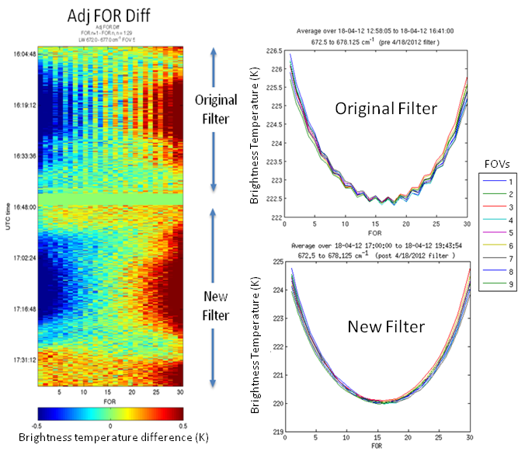
CrIS Cal/Val Milestones
January 18th 2012: CrIS was powered up; team started instrument checkout and optimization.
February 8th : Engineering packet v32 was uploaded (PGA setting and bit trim mask updates).
February 22nd : Full spectral resolution RDRs (0.8 cm maxOPD for all bands) were collected.
April 11th : Engineering packet v33 was upload (spectral calibration parameters, nonlinearity coefficients and ICT emissivity table updates).
April 18th: A new FIR digital filter was uploaded to replace the corrupted one.
May 15th : CrIS SDR product reached Beta maturity level .
October 15th : CrIS Gelocation errors were fixed
October 23rd , CrIS SDR Provisional Review
Validated product: 2013
Figures from Dave Tobin of UW CrIS Team

Slide 10
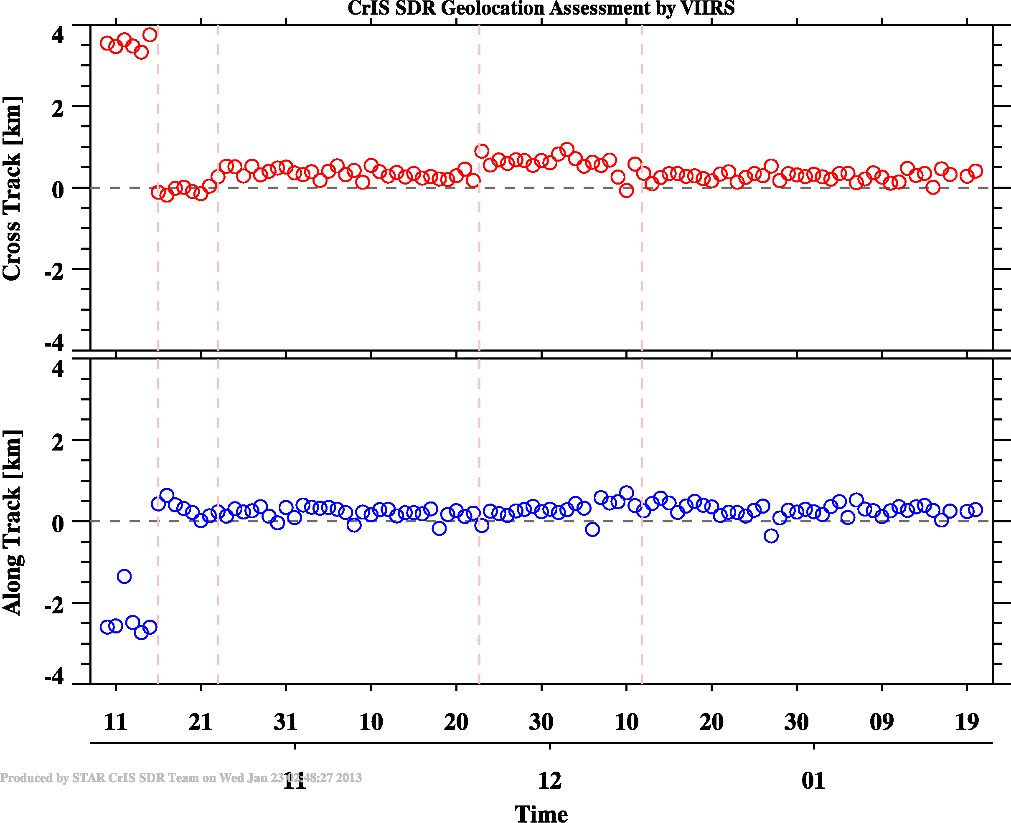
CrIS Cal/Val Milestones
January 18th 2012: CrIS was powered up; team started instrument checkout and optimization.
February 8th : Engineering packet v32 was uploaded (PGA setting and bit trim mask updates).
February 22nd : Full spectral resolution RDRs (0.8 cm maxOPD for all bands) were collected.
April 11th : Engineering packet v33 was upload (spectral calibration parameters, nonlinearity coefficients and ICT emissivity table updates).
April 18th: A new FIR digital filter was uploaded to replace the corrupted one.
May 15th : CrIS SDR product reached Beta maturity level .
October 15th : CrIS Gelocation errors were fixed
October 23rd , CrIS SDR Provisional Review
Validated product: 2013
M6.3x released, code bugs are fixed
Geolocation error were caused by the code bugs in SDR processing software that applied IAR to SSMR rotation matrices twice.

Slide 11
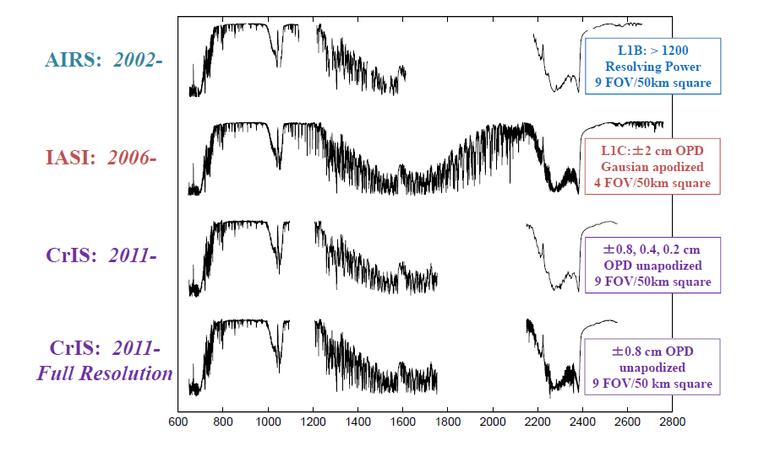
Radiometric consistency between CrIS and IASI/AIRS
Spectral Coverage and Resolution of AIRS, IASI, and CrIS
From Hank Revercomb

Slide 12
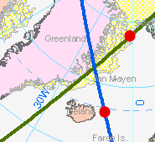
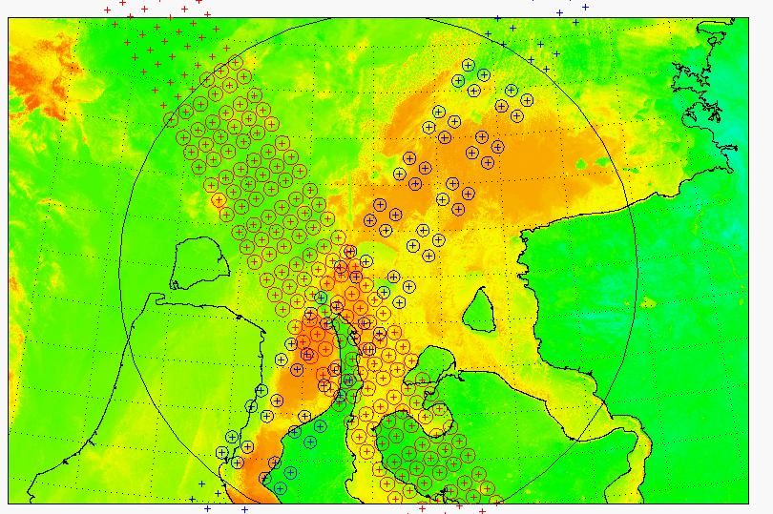
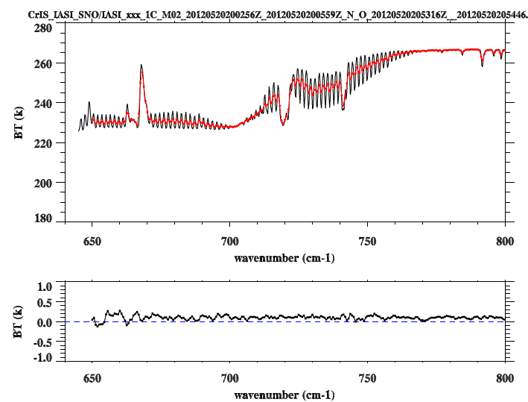
Simultaneous Nadir Overpass (SNO) from 10/22-10/24 and 12/10-12/14: a total of 125 cases
CrIS
Time Difference: <= 120 Sec
Pixel distance difference: <=(12+14)/4.0 km = 6.5 km
Angle Difference: ABS(cos(a1)/cos(a2)-1) <= 0.01
IASI
All data are from IDPS.
Only nadir and uniform scenes were selected.
Using the same collocation algorithms to collocate CrIS/IASI with VIIRS.

Slide 13
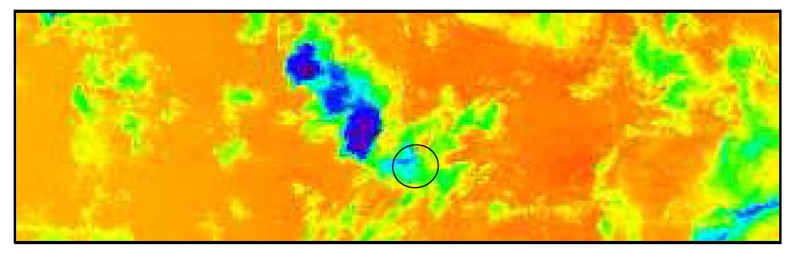
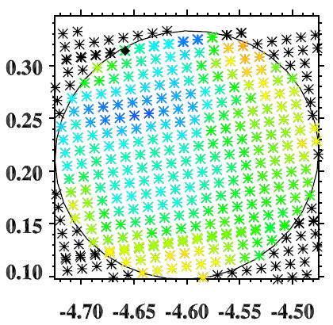
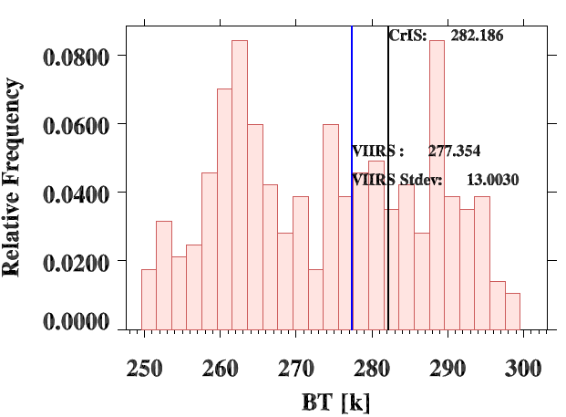
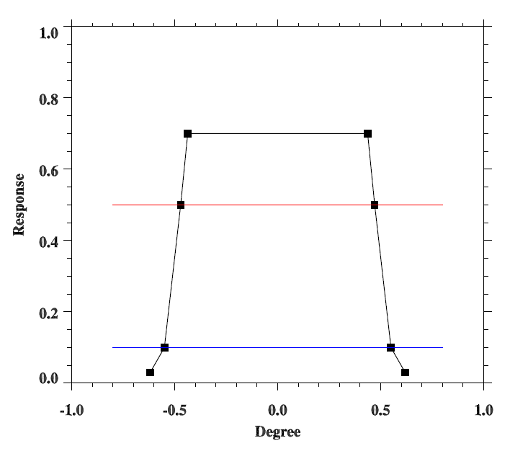
Collocate VIIRS with CrIS/IASI
VIIRS Pixels
CrIS FOV footprint
CrIS/IASI FOV Spatial Response
50%
Histogram of VIIRS M16 radiances in CrIS FOV

Slide 14
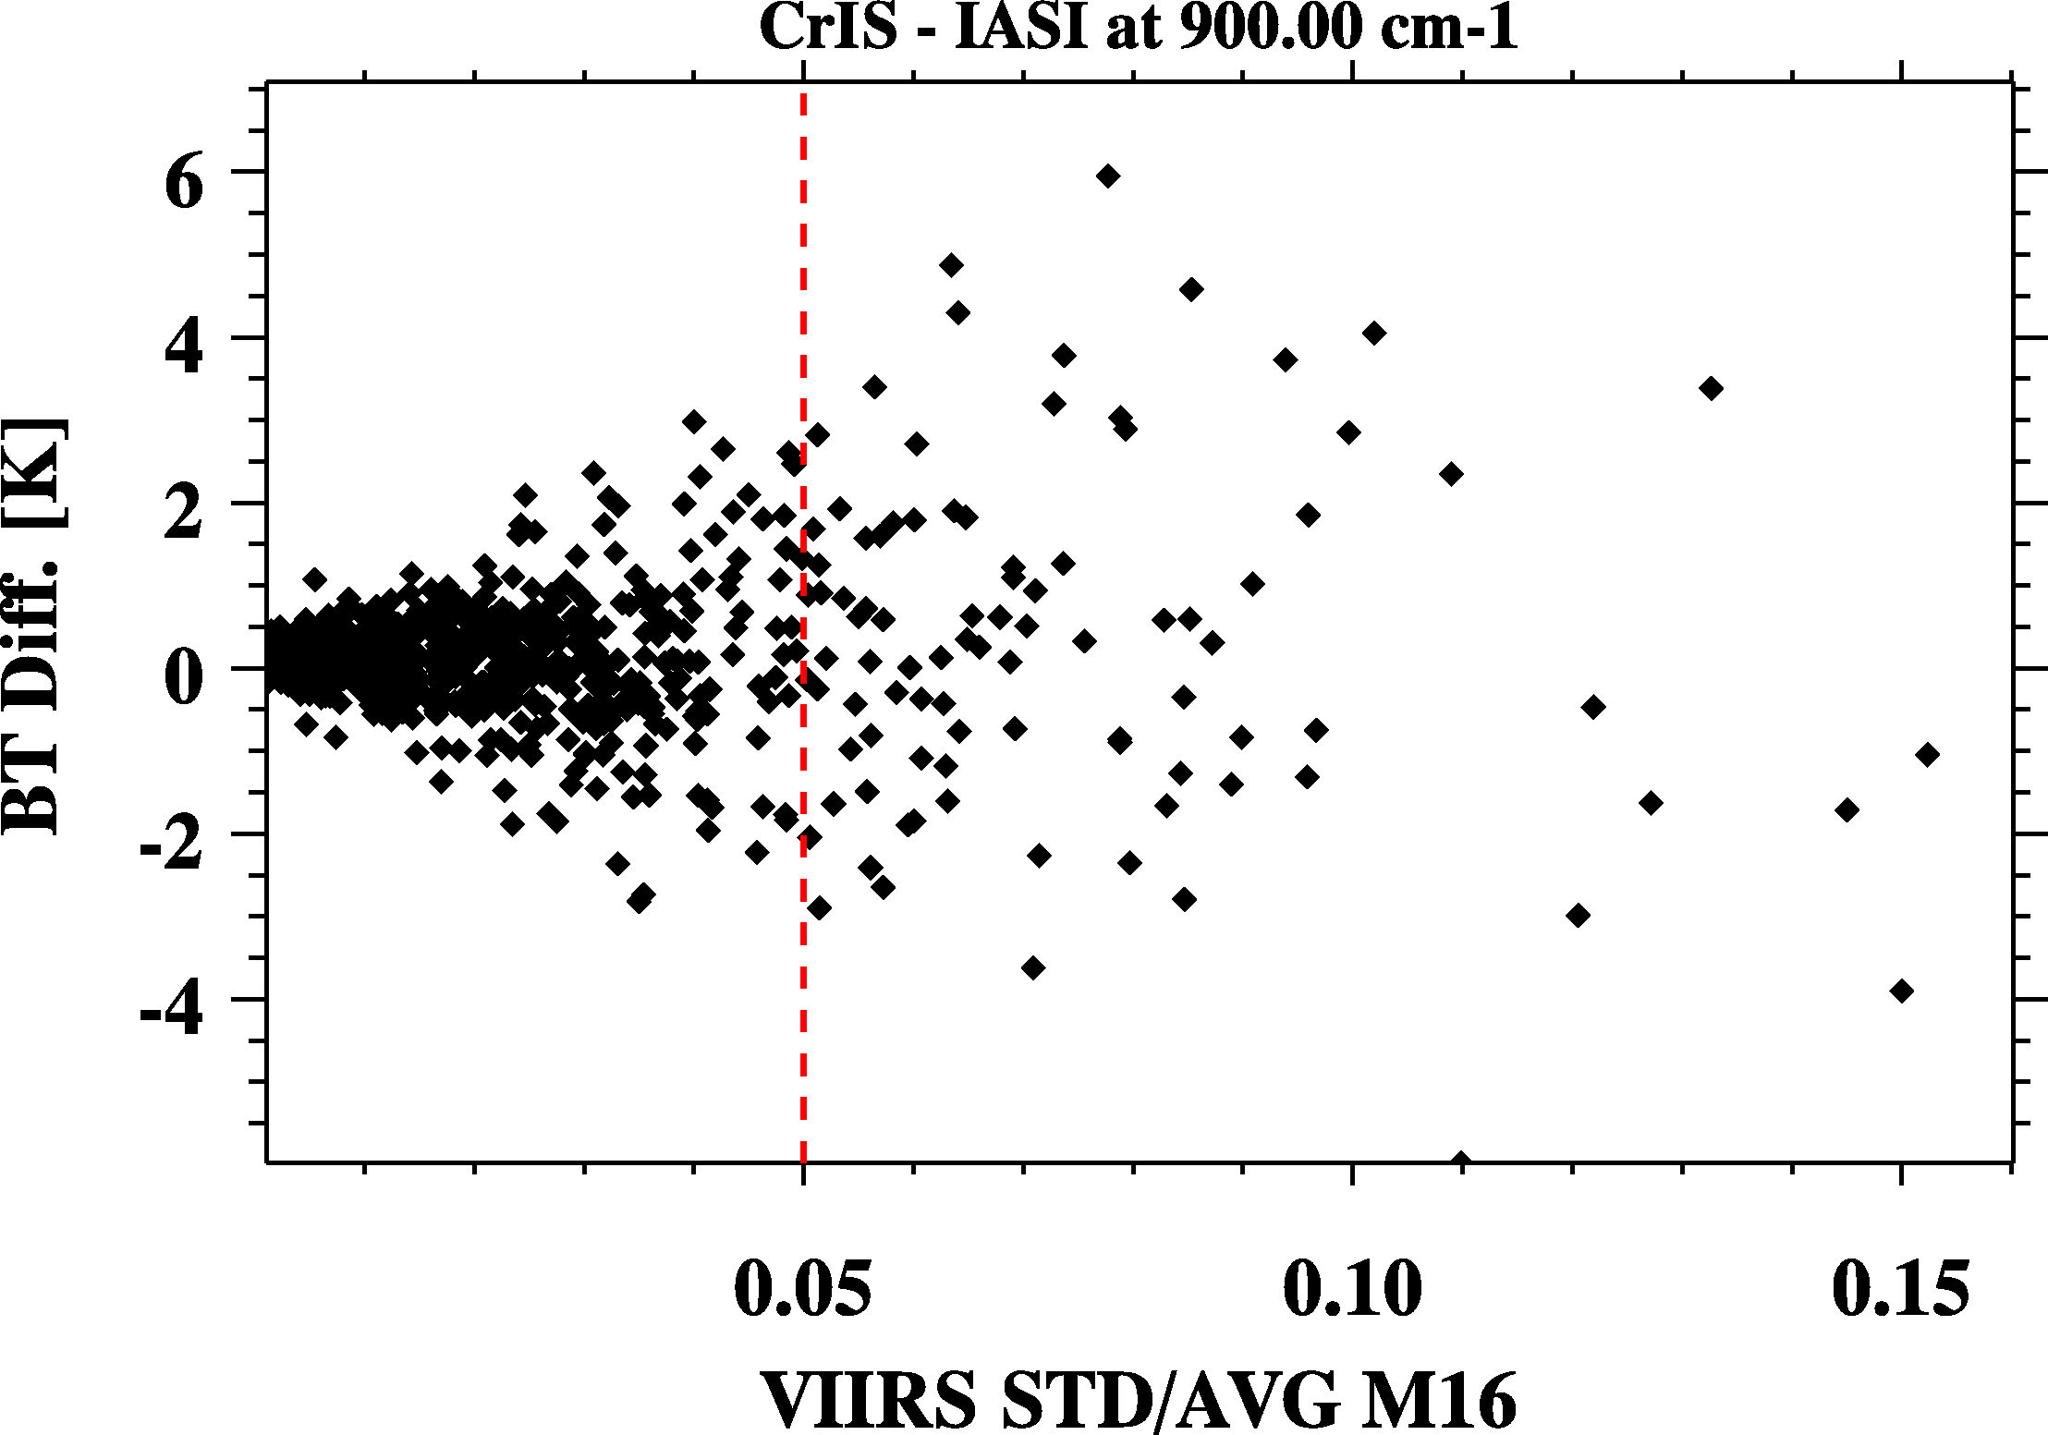
Scene Uniformity

Slide 15
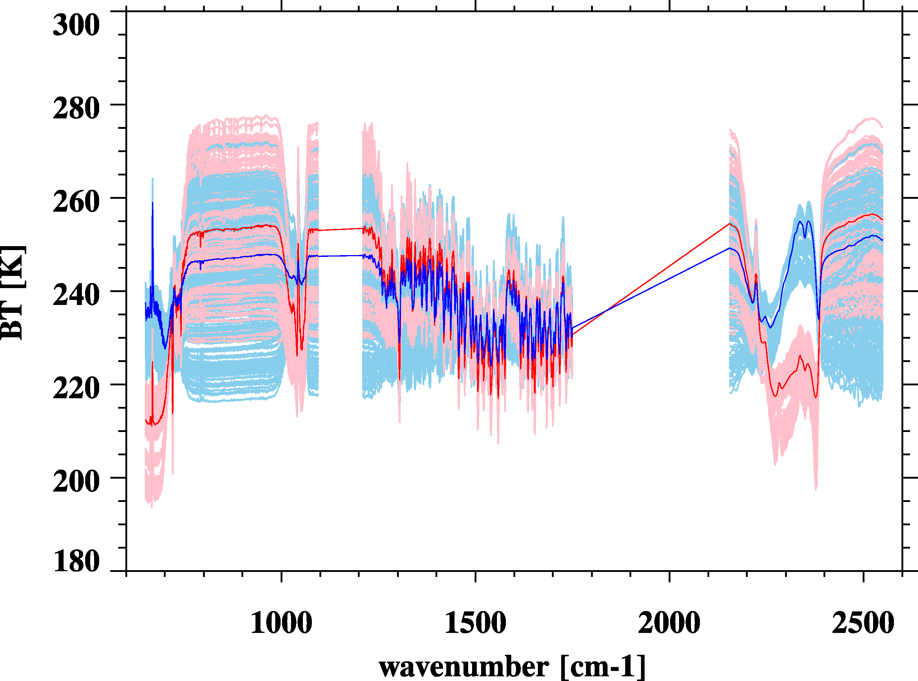
SNO Spectra: 770 Pairs
Average Spectra
North (339)
South (431)

Slide 16
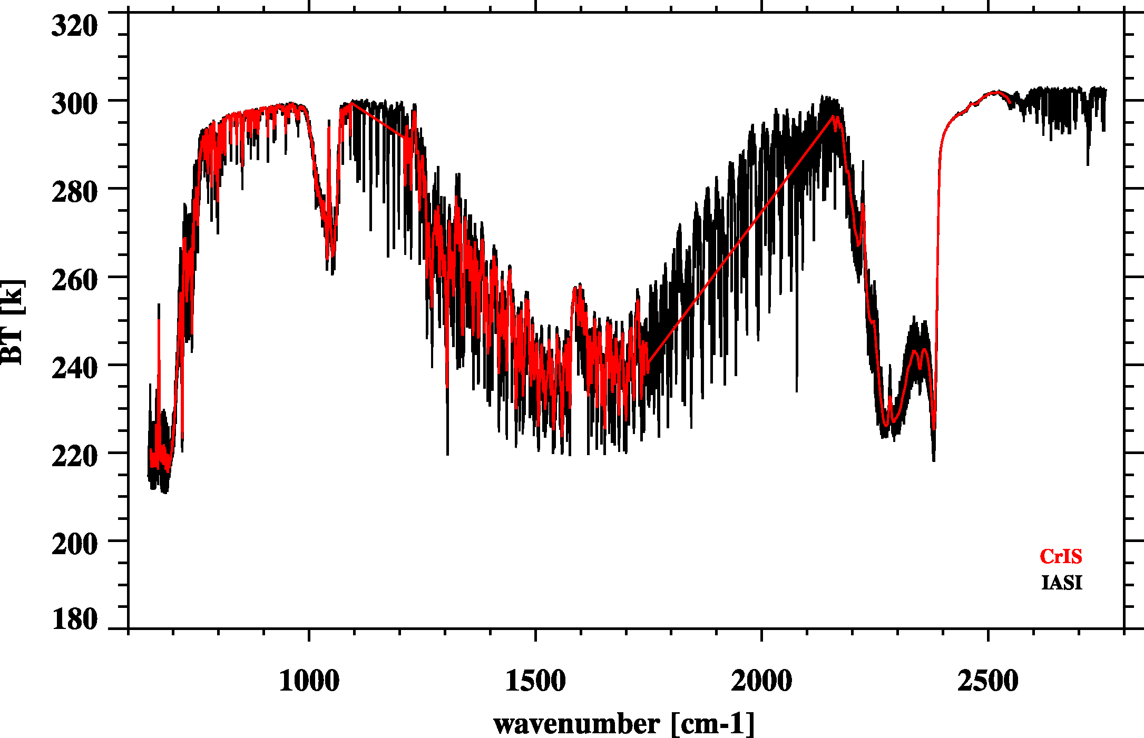
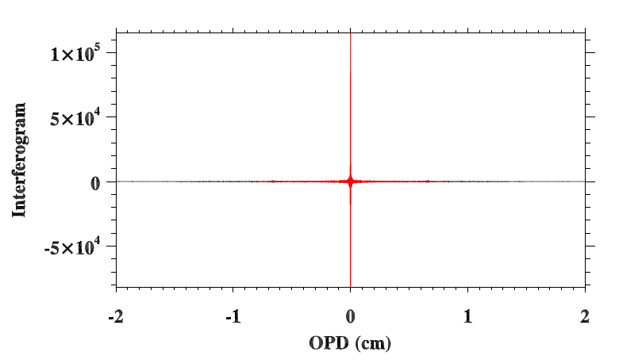
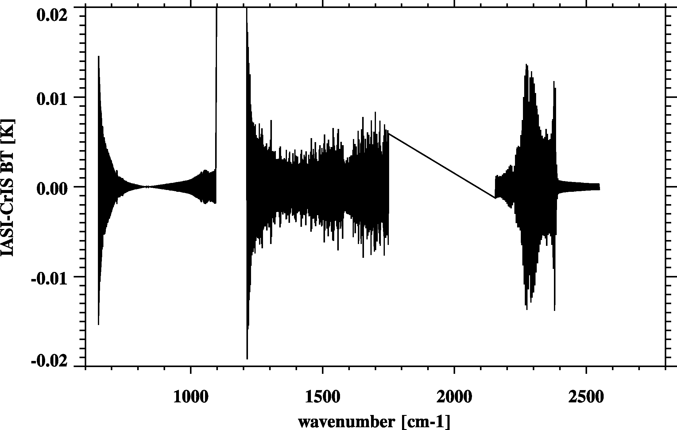
Resample IASI to CrIS
Fourier Transform
De-Apodization
2) Truncation
3) Apodization
CrIS – IASI
Re-sampling error very small
Inverse Fourier Transform

Slide 17
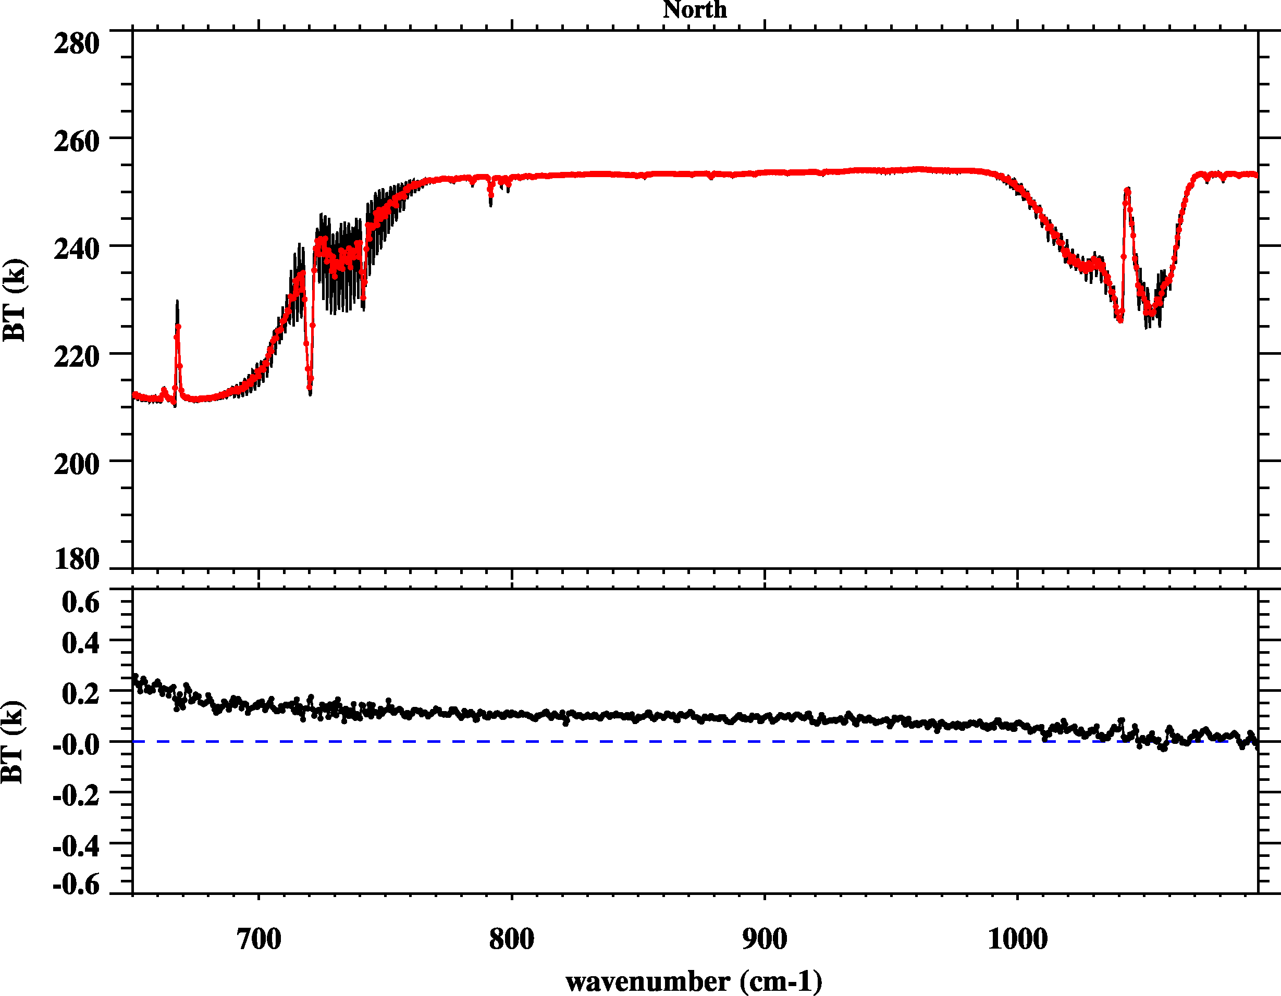
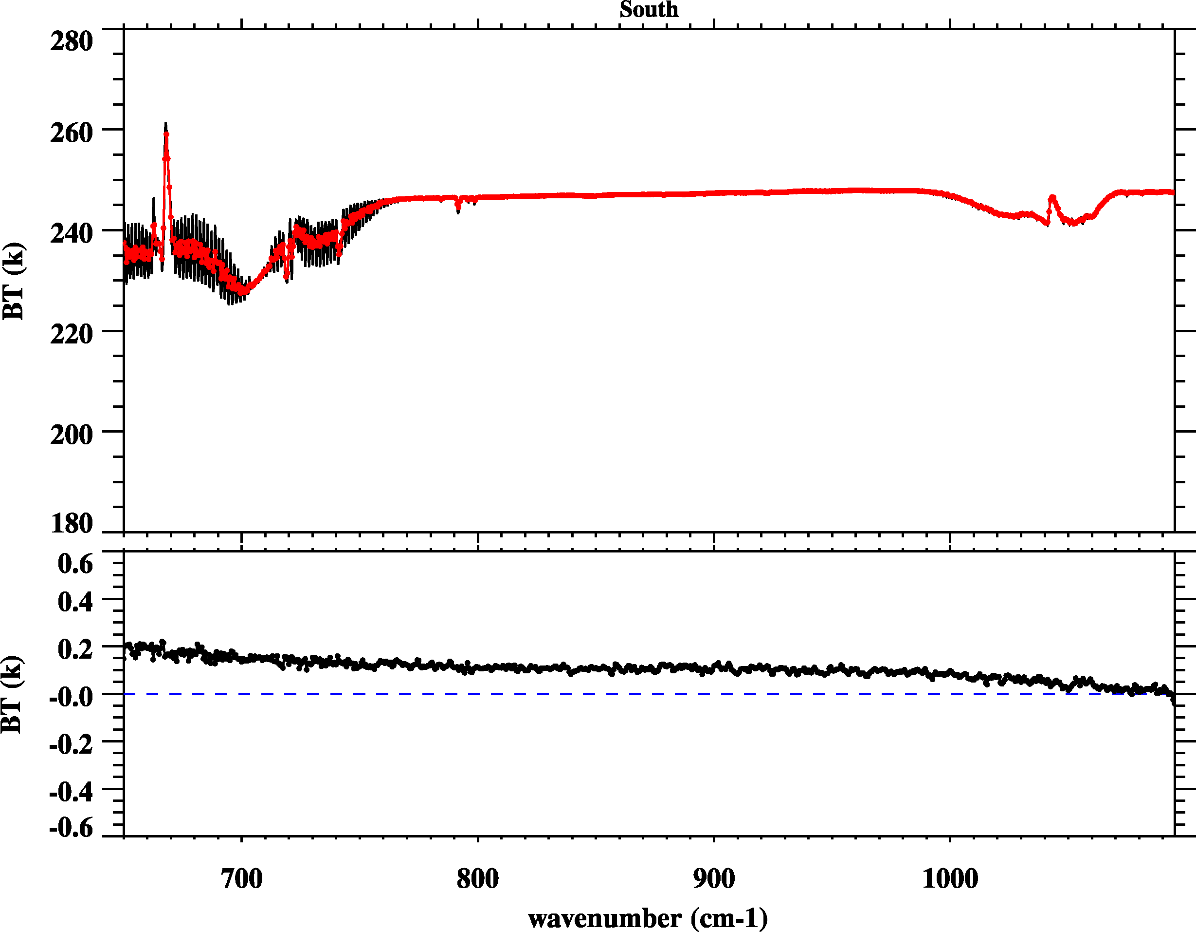
CrIS vs. IASI: CrIS Band 1
North Pole
South Pole
CrIS
IASI
CrIS-IASI
At band 1, CrIS is slightly warmer than IASI.
CrIS-IASI BT differences show the slope feature and BT differences decrease with wavenumbers.

Slide 18
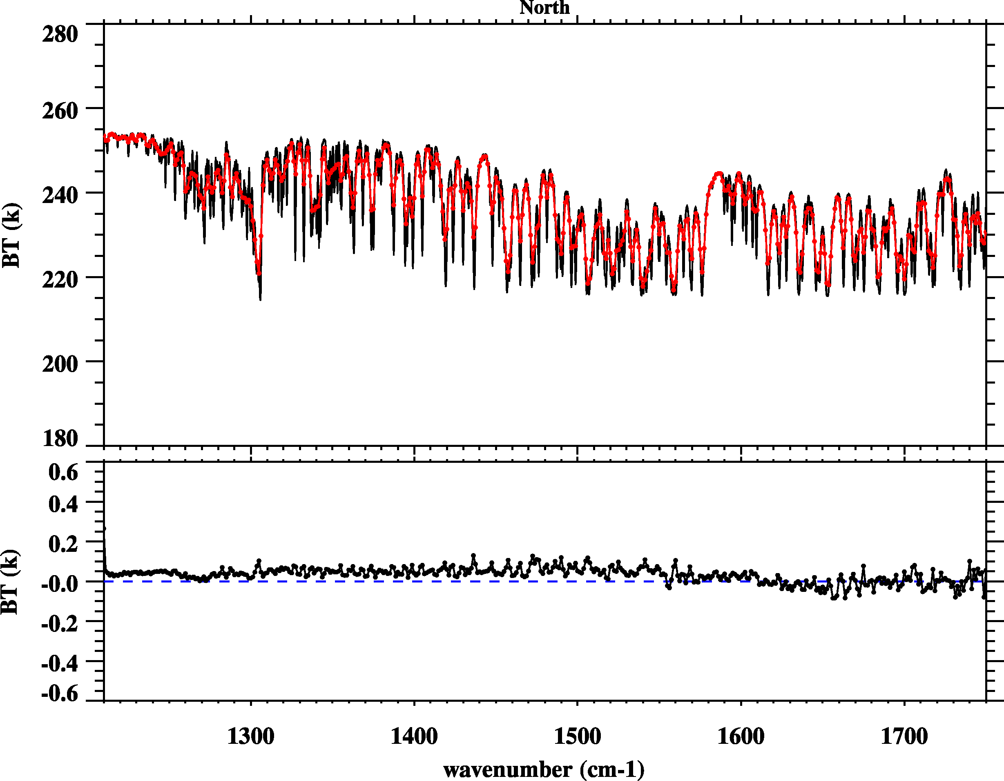
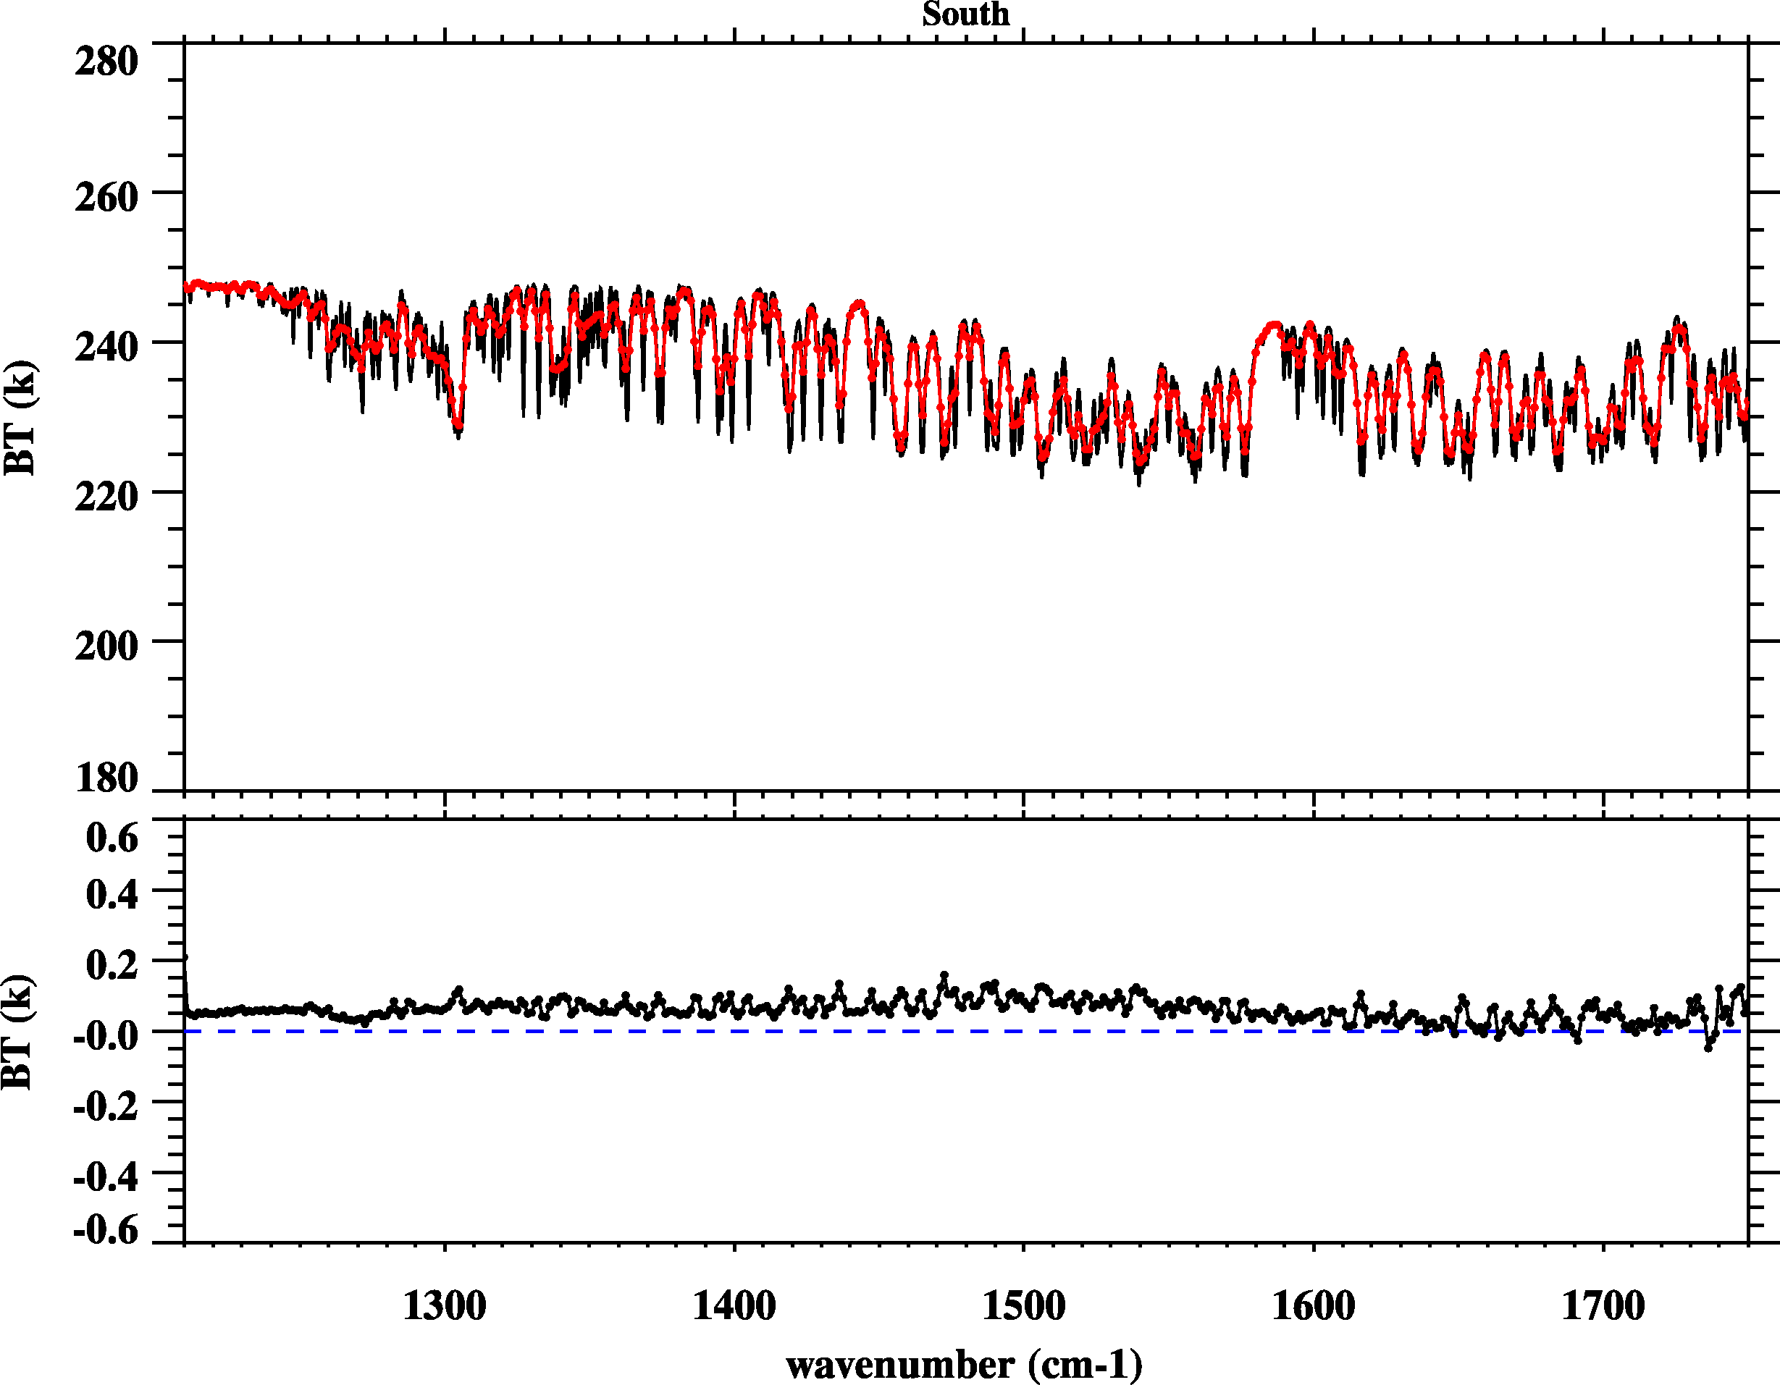
CrIS vs. IASI: CrIS Band 2
North Pole
South Pole
CrIS
IASI
CrIS-IASI
For band 2 at water vapor absorption region, CrIS and IASI are well consistent and the BT difference is less than 0.1 K.

Slide 19
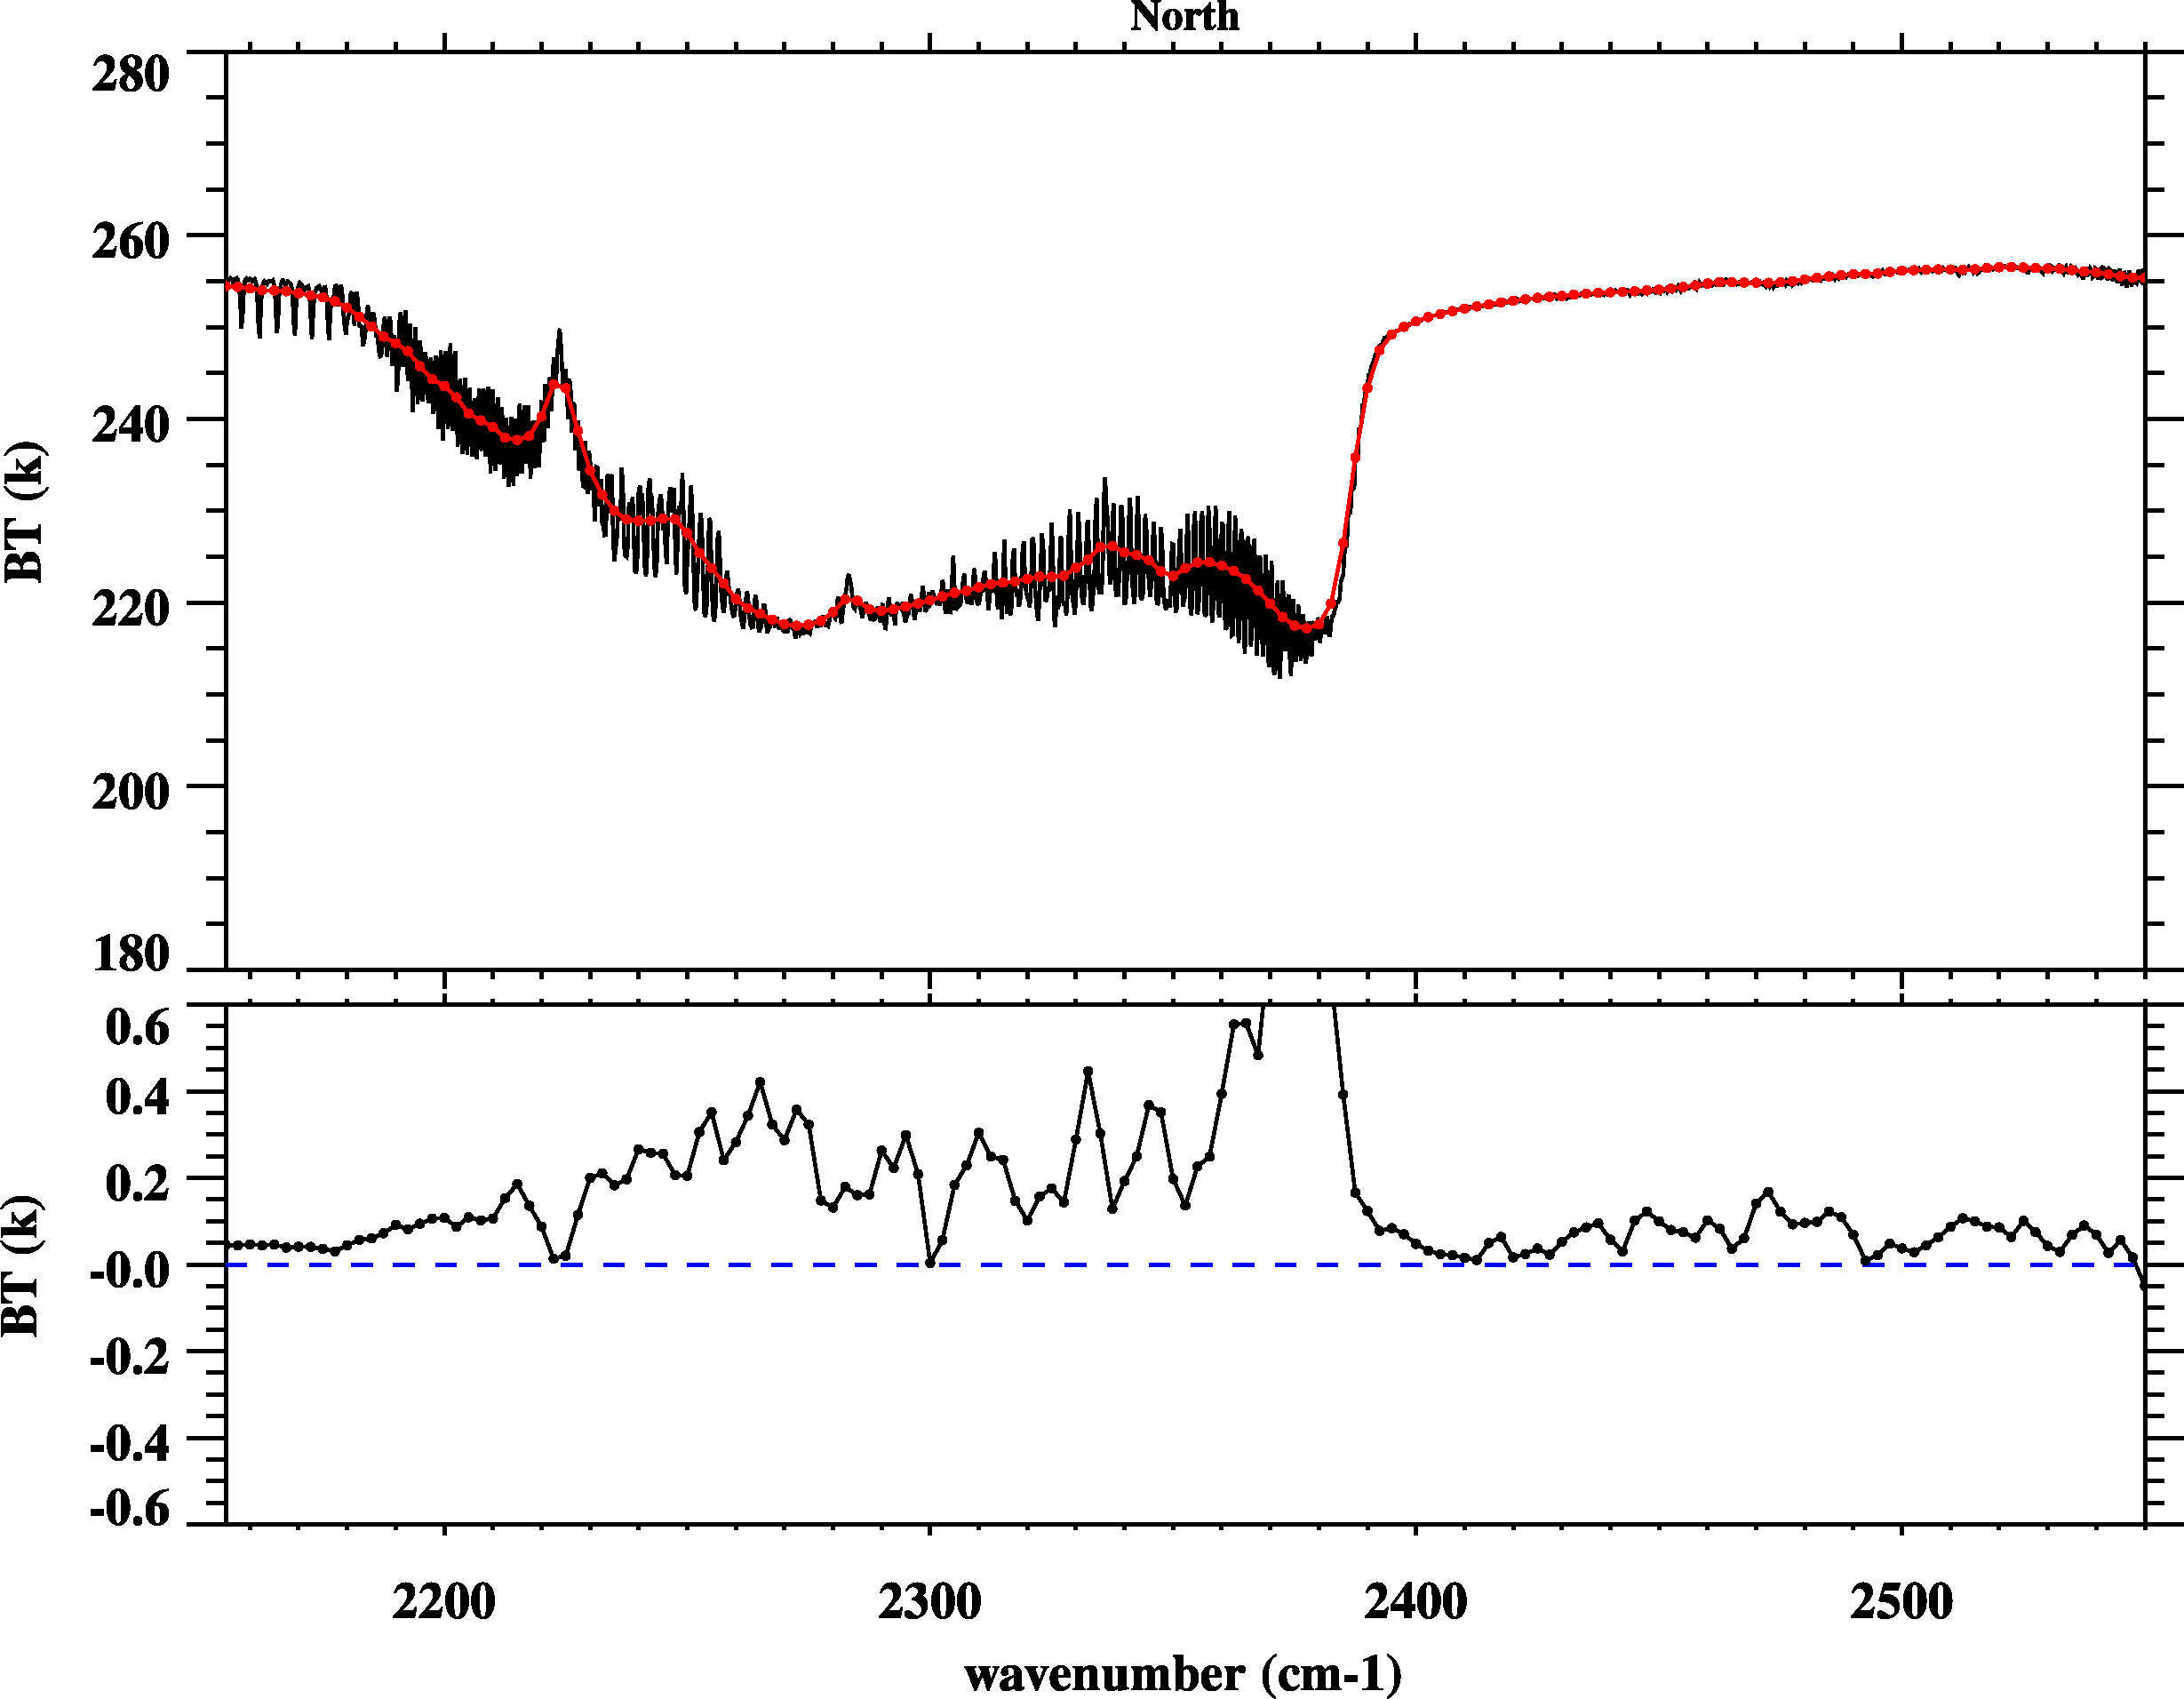
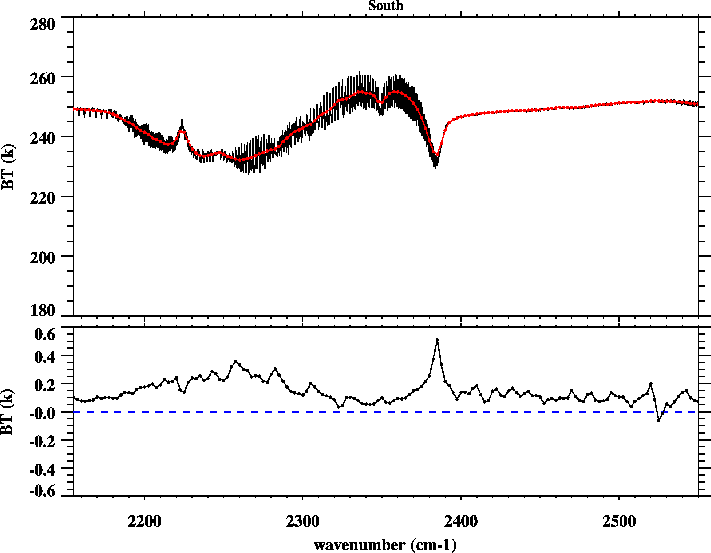
CrIS vs. IASI: CrIS Band 3
North Pole
South Pole
CrIS
IASI
CrIS-IASI
At band 3, CrIS is warmer than IASI .
BT differences are large at the spectral transition region (~2380 cm-1)

Slide 20
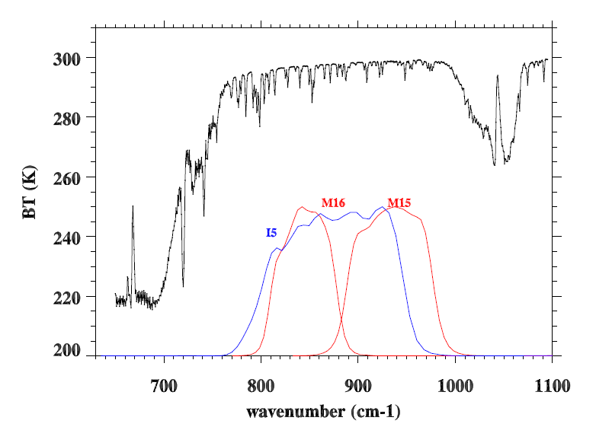
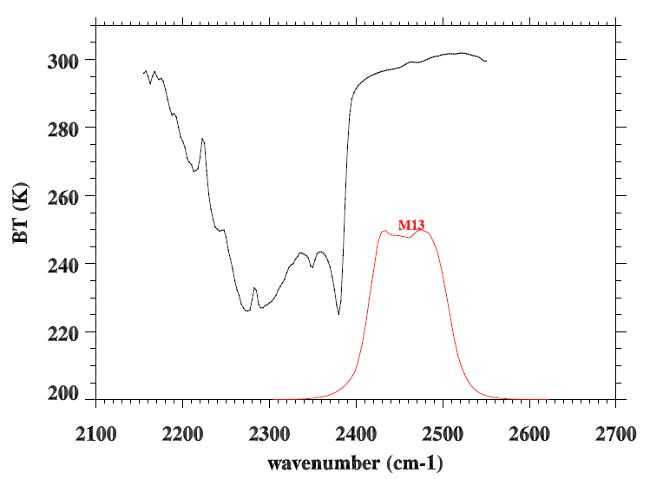
How about CrIS/IASI versus VIIRS?
CrIS/IASI spectra are overlapped with VIIRS SRFs for M13, M15, and M16, and I5
12.0 µm
10.8 µm
4.05 µm

Slide 21
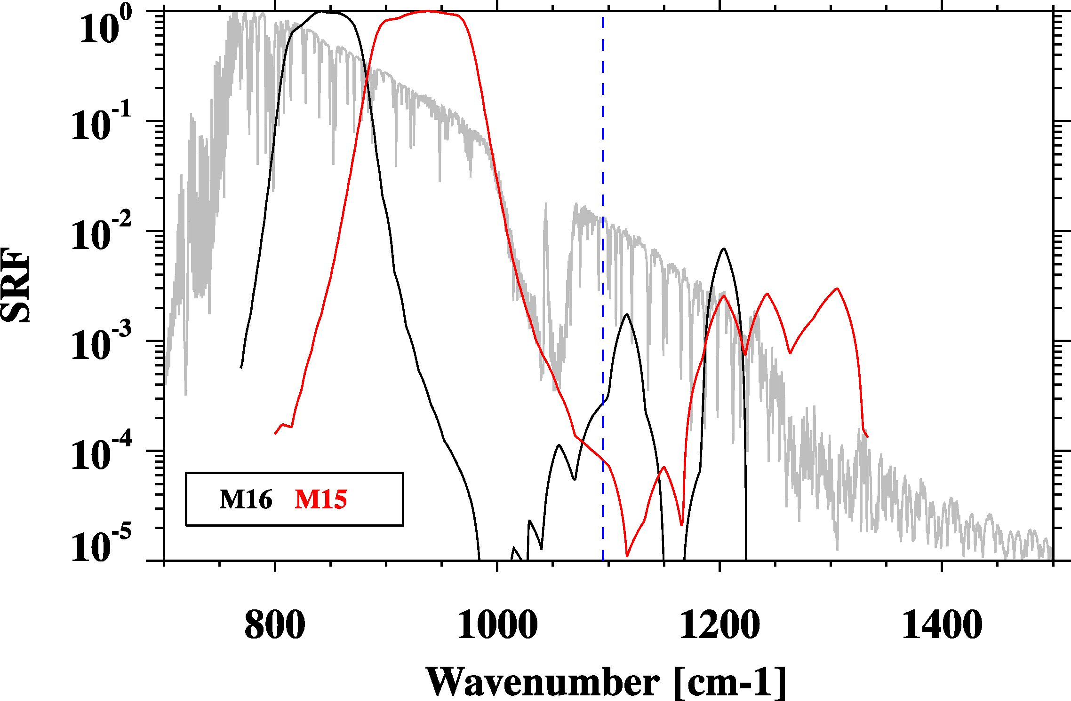
Be careful for out-of-band response!
CrIS Band 1 end point
Center wavenumber and band correction coefficients are calculated using the above SRFs.

Slide 22
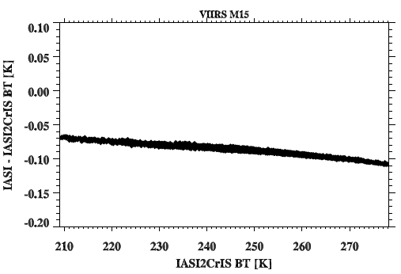
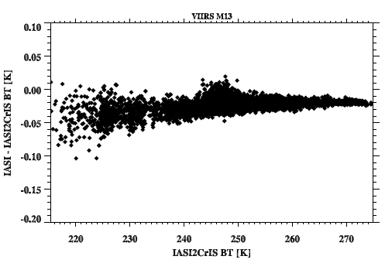
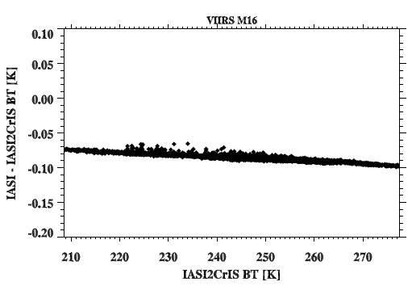
OOB effects in BTs
IASI-IASI2CrIS vs. IASI2CrIS
M15
M15
M13
M16
M16
This relationship is used to compensate
CrIS convolution results.

Slide 23
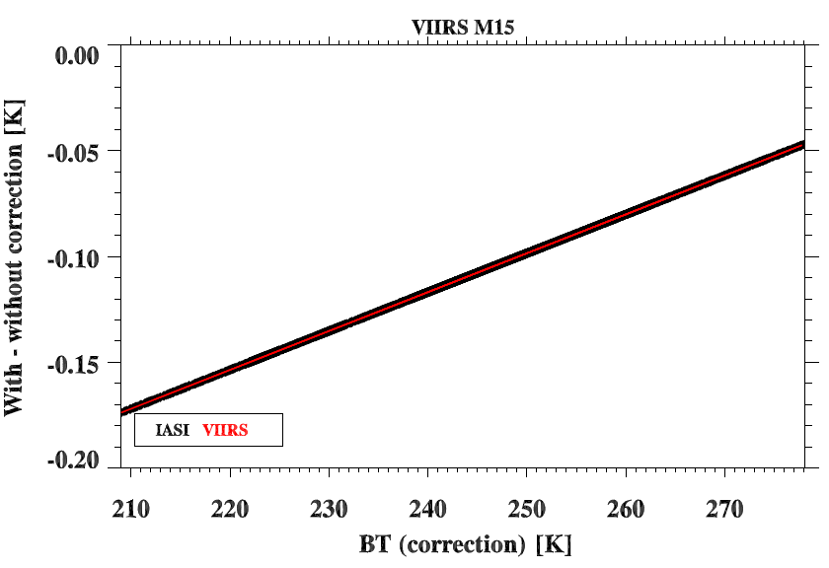
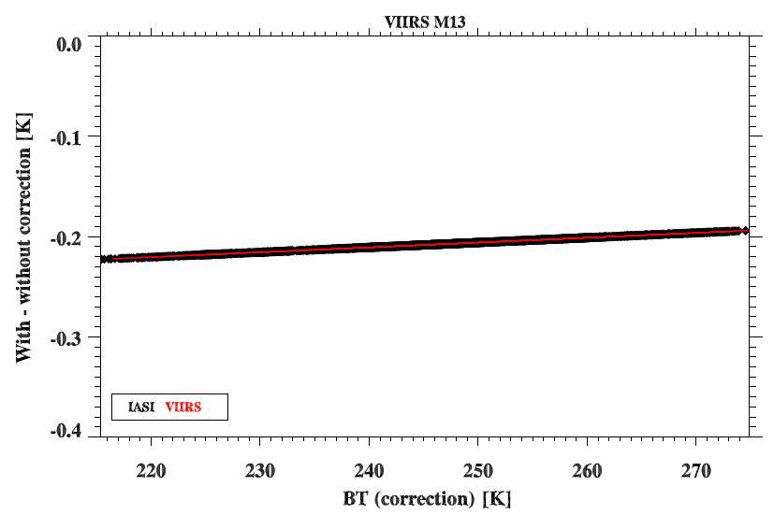
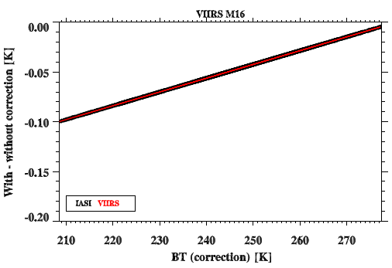
Band Correction
M15
M13
From VIIRS radiances to BTs
    Unit: [wm-2 sr-1 μm-1]
From CrIS/IASI radiances to BTs
    Unit: [mw m-2 sr-1 cm-1]
Band correction on BT domain should give identcal values.
M16

Slide 24
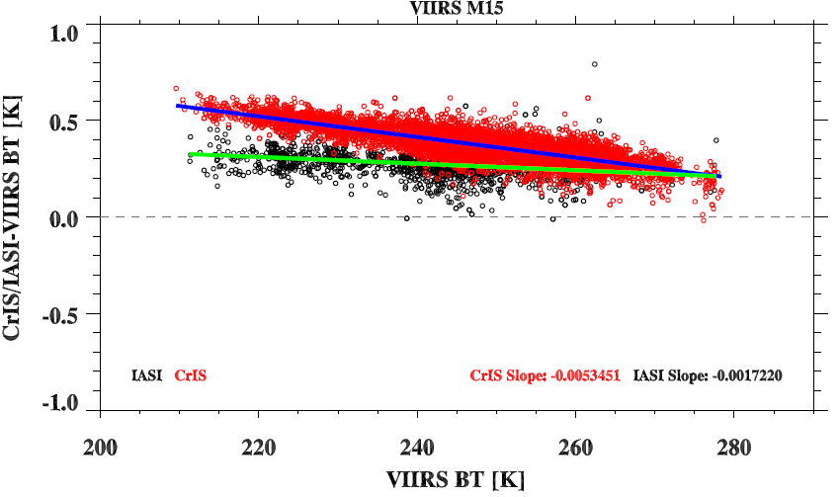
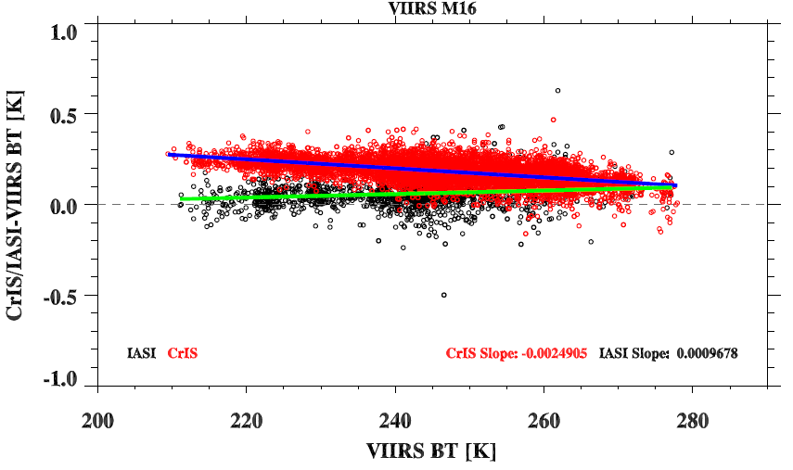
CrIS/IASI versus VIIRS
CrIS is warmer than all sensors; CrIS-VIIRS at Band 15 has larger scene-dependence than M16
IASI seems close to VIIRS and does not show scene dependence features.
Using VIIRS as a reference, CrIS is warmer than IASI , especially for cold scenes.
M15
M16
Notes:
CrIS is warmer than all the sensors, Band 15 have more large scene-dependence than M16
IASI seems close to VIIRS and doesn’t show scene dependence bias.
CrIS and IASI

Slide 25
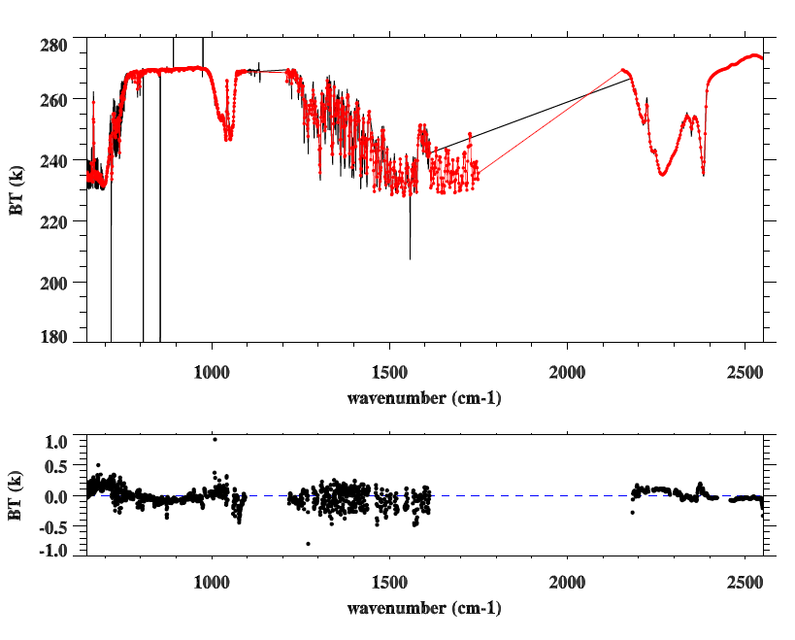
AIRS vs. CrIS
: North Pole SNOs
CrIS
AIRS
CrIS-AIRS

Slide 26
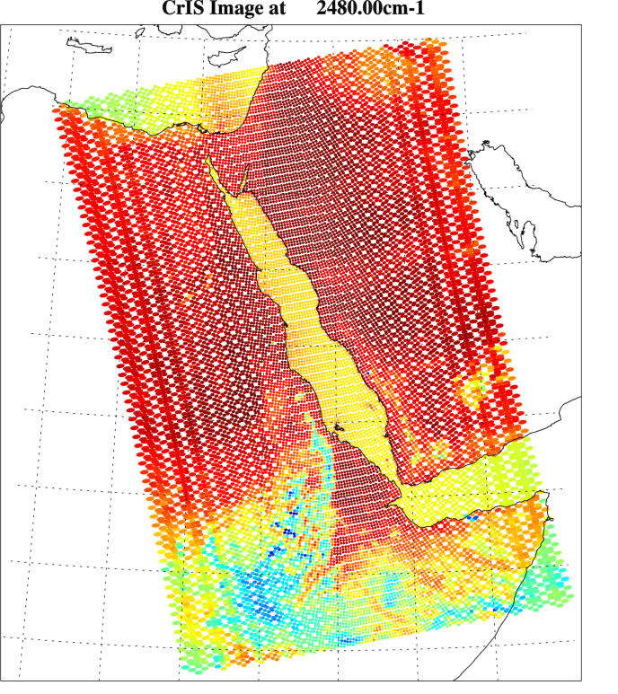
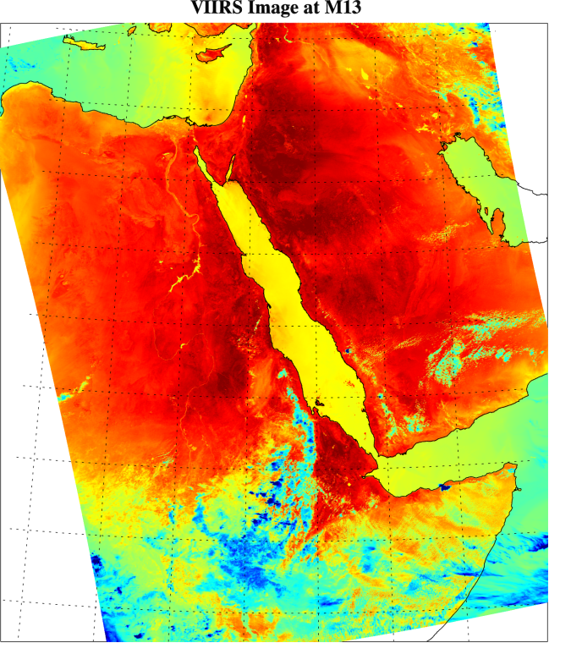
Can Inter-comparison help for assessing
CrIS Geolocation?
14km
750m
Convolve CrIS spectra into
VIIRS Band radiances
Spatially average VIIRS radiances for each CrIS FOVs

Slide 27
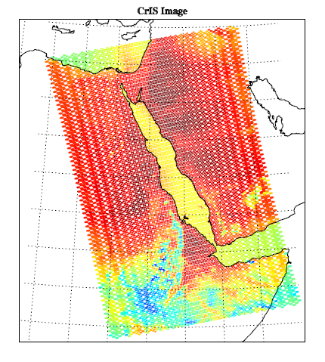
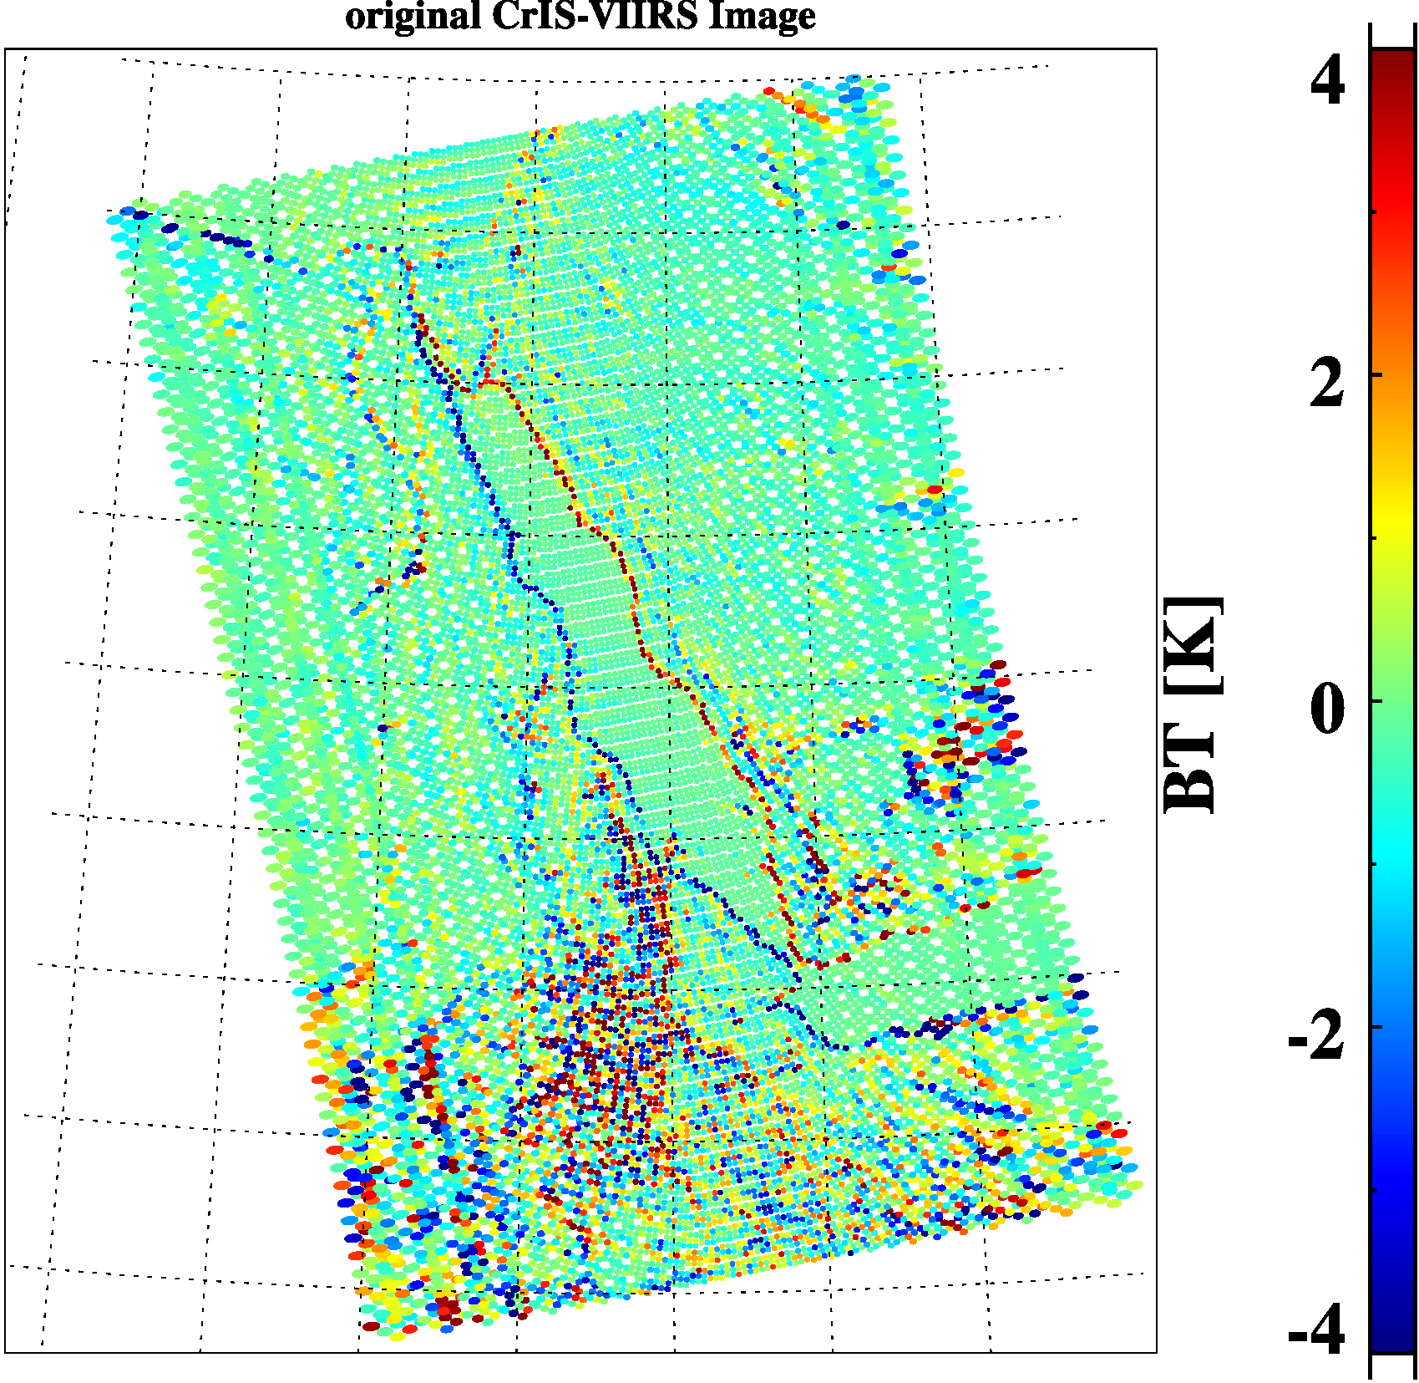
CrIS-VIIRS BT Images
CrIS-VIIRS BT difference for M13

Slide 28
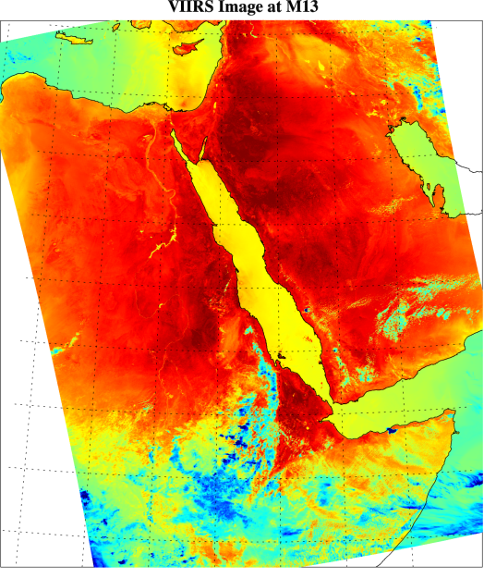
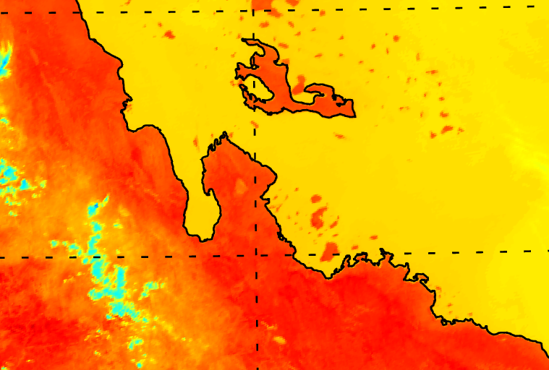
Is VIIRS geolocation good?
VIIRS geolocation is very accurate!
The problem could be caused by CrIS geolocation

Slide 29
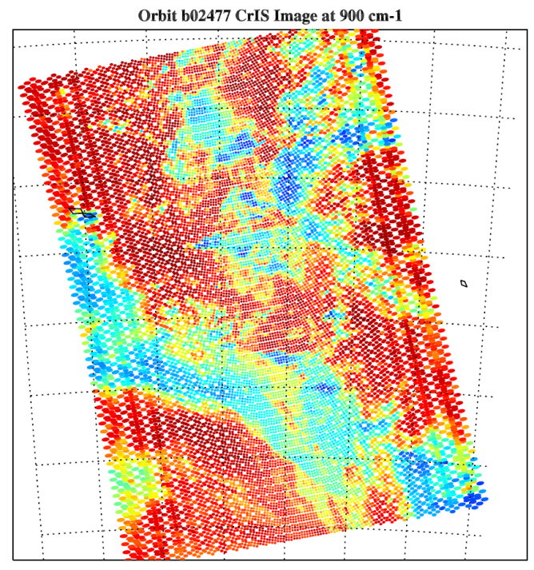
Can we quantitatively identify the errors?
Choose un-uniform (better for cloud scene) CrIS granules over tropical region (large dynamic range)
Collocate VIIRS with CrIS nadir FOVs (FOR 13-16) and then compute spatially averaged radiances
Convert CrIS spectra into VIIRS band radiances using VIIRS spectral response functions (SRFs)
Define the cost function as Root Mean Square Errors (RMSE) of CrIS-VIIRS BT difference
Shift VIIRS image toward along- and cross- track direction to find the minimum of the cost function, which represent best collocation between VIIRS and CrIS
Along Track Direction
VIIRS Scan Direction
CrIS Scan Direction
Orbit 02477 on April 20 2102

Slide 30
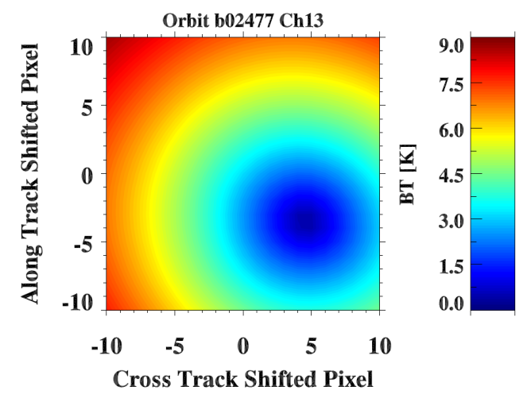
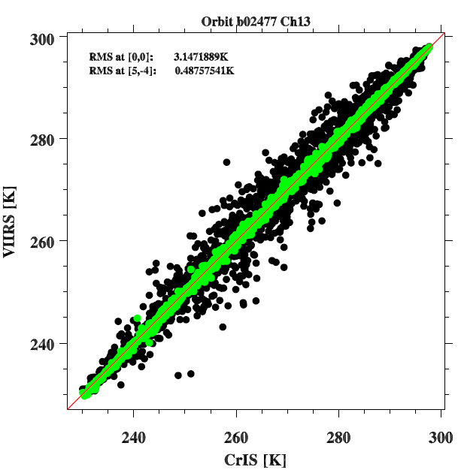
Cost Function for M13
Scatter plot of CrIS and VIIRS BTs
+
+
Original
Collocation
at (0, 0)
Collocation after shift at minimum of cost fction (5, -4)

Slide 31
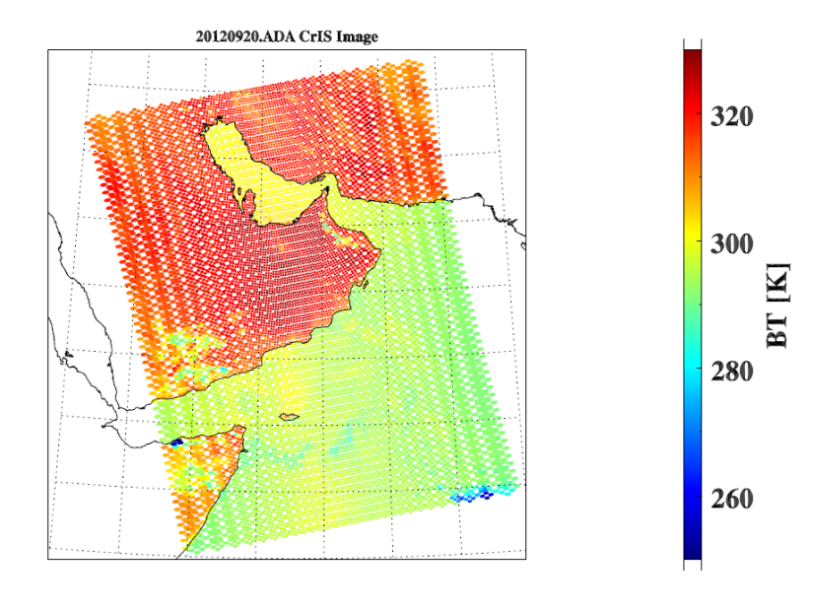


Before and After correction
Software bug was discovered in the operational code.
Code fix was engineered by STAR and delivered to IDPS for implementation.
Without correction
With correction
CrIS
CrIS-VIIRS
CrIS-VIIRS
Geolocation code has been fixed and implemented in MX6.3 (10/16/2012)
Geolocation accuracy is estimated to be 1.0 km within 30° scan angles.

Slide 32
Conclusion Remarks
Inter-comparison of CrIS with IASI indicate that the consistency between CrIS and IASI is around 0.1-0.2 K at most spectral regions.
Given current consistency level (0.1-0.2K), it is very hard to find the root causes of the differences. However, in order to generate long-term climate data records, some issues still need further investigation:
  CrIS is warmer than IASI at the longwave band, especially for cold scenes
  CrIS-VIIRS scene-dependent features at M15
  Spectral inconsistency for shortwave sharp transition regions between CrIS and IASI
Looking forward: we really need MetOp-B IASI data to join in inter-comparison, which will facilitate the diagnosis.
Inter-comparison of CrIS with VIIRS for inhomogeneous scenes can help for assessment of CrIS geolocation.

Slide 33
Paper prepared for JGR
CrIS and Sensor Data Record Calibration and Validation Overview and Data Record Quality – Team lead + Team members
Radiometric Calibration and Validation - UW lead + ...
Spectral Calibration and Validation – UMBC lead + …
Noise Performance – SDL lead + …
Geolocation Validation – STAR lead + …

Slide 34
Thank you

