Slide 1
Introduction to GSICS
Special Issue of the IEEE TGRS on “Inter-Calibration of Satellite Instruments”:
Special Issue of the IEEE TGRS on “Inter-Calibration of Satellite Instruments”:
Jérôme Lafeuille
WMO Secretariat (Secretary of the GSICS Executive Panel)

Slide 2
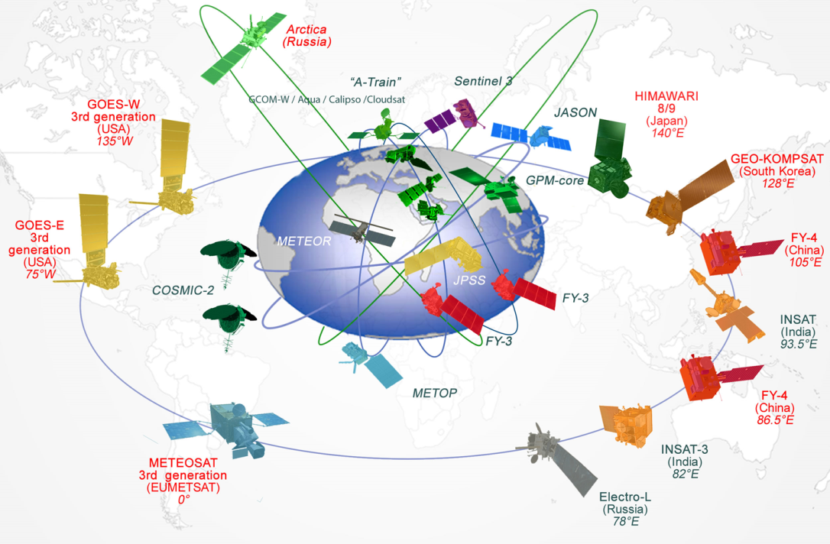
Why a Global Space-based Inter-Calibration System (GSICS)?
Space-based observations are provided by multiple satellite missions operated over decades by different agencies around the world
These data sources must be carefully calibrated with similar methods and common references in order to be reliable and interoperable for weather and climate applications

Slide 3
Our goals
GSICS was established by WMO and CGMS in 2005 to foster collaboration among satellite operators on best practices for accurate & consistent calibration throughout the global constellation
The outcome is an integrated inter-calibration system enabling:
Better consistency between instrument data
Lower bias in derived products
Traceability of measurements
Re-calibration of archive data
Better specification of future instruments

Slide 4
GSICS Members and observers
EUMETSAT | CNES | JMA
NOAA | CMA | KMA
ISRO | NASA | WMO
USGS | NIST | JAXA
ROSHYDROMET | IMD
ROSCOSMOS | CNSA | ESA
http://gsics.wmo.int
15 satellite operators (3 observers)
+ NIST and WMO
Notes:
Well, what is GSICS?
The Global Space-based Inter-Calibration System (GSICS) is an initiative of CGMS and WMO, which aims to ensure consistent calibration and inter-calibration of operational meteorological satellite instruments.
One of the basic strategies of GSICS is to develop an integrated on-orbit cal/val system - initially by LEO-GEO Inter-satellite/inter-sensor calibration.
This will then allow us to provide corrections to improve the consistency between instruments, produce less biased level 1, and therefore, level 2 data, and ultimately, retrospectively re-calibrate archive data, which is of great interest in the climate monitoring community

Slide 5
CGMS satellite operators
CGMS satellite operators
CGMS satellite operators
CGMS satellite operators
WMO
GSICS Exec Panel
GSICS Coordination Center
GSICS Research Working Group
GSICS Data Working Group
UV Sub-Group
IR Sub-Group
WGCV IVOS
WGCV MWSG
GPM X-CAL
CEOS ACC
WGCV ACSG
VIS/NIR Sub-Group
Microwave Sub-Group

Slide 6
Who are the targeted users?
Satellite users interested in accurate/consistent calibration
Stable Level 2 product generation, Level 3 multi-satellite products
Climate Data Record generation (e.g. “SCOPE-CM”, WCRP/ISCCP )
Reanalysis
Assimilation in NWP models: bias characterization of radiances
Satellite operators sharing developments, best practices, and tools
Prelaunch instrument characterization
In-orbit commissioning and Cal/Val plans
Instrument monitoring, detection/analysis of anomalies
Improved calibration
Partner programmes: CEOS WGCV, GPM X-cal, GHRSST, GRUAN, etc...

Slide 7
GSICS Principles for GSICS “products”
Systematic generation of inter-calibration products through
monitoring Level 1 data from satellite sensors
comparing with community references
calculating correction functions for the calibration of monitored instruments
with specified uncertainties and traceability (unbroken chain of comparisons)
through well-documented, peer-reviewed procedures
based on various techniques to ensure consistent and robust results
Delivery to users
Free and open access
Adopting community standards

Slide 8
GSICS Procedure for Product Acceptance
Products progress
From Demonstration Mode
To Pre-Operational Mode
To Operational Mode
By a series of reviews
Subject to acceptance criteria
Over period of ~1.5yr

Slide 9
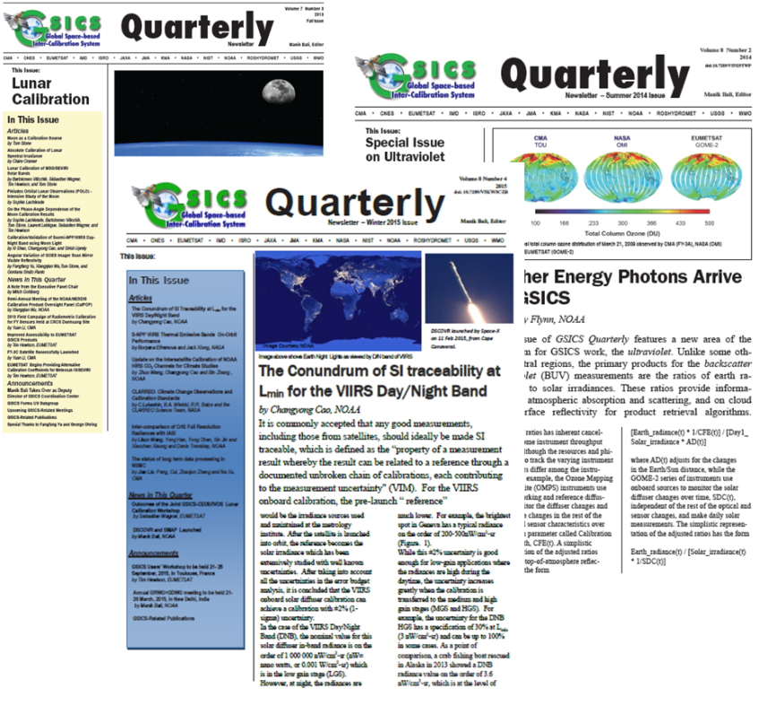
User services provided/coordinated by the GCC
Growing audience of GSICS user messaging service
Widely disseminated GSICS Quarterly
GSICS User Workshops

Slide 10
Evolving scope of GSICS
Started with IR calibration corrections (GEO, LEO)
Continued with VIS/NIR domain
Now addressing also the UV and MW domains
Started with Near Real-Time correction functions
Added «a posteriori» corrections for re-processing)
Considering now a wider variety of deliverables dpending on user requirements

Slide 11
Definition of GSICS Deliverables
GSICS Products for users of satellite data, including calibration corrections/coefficients
GSICS Algorithms, which describe inter-calibration processes, (described by ATBD)
GSICS Monitoring Reports, assessments
GSICS Reference datasets, including Solar spectrum, …
GSICS Tools for use by inter-calibration developers, (GIRO, SBAF, …)
GSICS recommended standards, conventions and guidelines,
GSICS User Services, information
Pro- ducts corrections
Intercalib. Algorithms
Monitoring assessmentreports
Calibration datasets
Software and hardware tools
Standards, conventions,
Calibration references

Slide 12
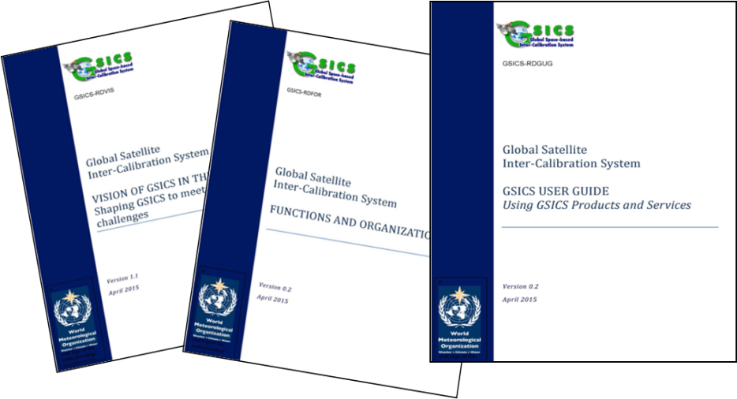
New challenges
Formalize GSICS user requirements for products/deliverables
User requirements for pre-launch characterization data ?
Review the products and services to be delivered by GSICS
Maintain requirements for calibration references: in-orbit, ground targets, Moon observatories
Recognize GSICS as an element of the WMO Integrated Global Observing System (WIGOS)
Highlight GSICS’ contribution to the Architecture for climate monitoring
Complete Reference Documentation

Slide 13
Thank You
Notes:
13

Slide 14
Variety of GSICS holdings and deliverables
 | Holdings or Deliverables | Examples
Products | Analysis, monitoring results, assessments | Updated SRF; assessment of bias, of non-linearity, polarization sensitivity,
 | Calibration methodologies/algorithms | ATBD for NRT correction or re-calibration
 | Routine operational corrections | Near Real Time or delayed corrections
Resources | Calibration references and databases | GIRO lunar model, ground sites Solar irradiance spectrum
 | Software and hardware tools | Plotting tool, THREDDS servers, product generation environment, wiki
 | Standards, conventions, guidelines | Formats, etc.
Services | Information on GSICS &calibration | Science publications, GSICS Quarterly, Outreach material
 | User registration, product subscription
 | Web services

