Slide 1
Infrared Inter-Calibration Product Announcements
Special Issue of the IEEE TGRS on “Inter-Calibration of Satellite Instruments”:
Special Issue of the IEEE TGRS on “Inter-Calibration of Satellite Instruments”:
Tim Hewison
(EUMETSAT) (GRWG Vice-Chair)
(IR Sub-Group Chair)

Slide 2
Overview
GSICS GEO-LEO IR Products
Intro to Hyperspectral SNO with MetopA/IASI
Product Status
Plotting Tool
Development of Prime GSICS Corrections
Issues for GSICS Users
Product Update Frequency
GEO-GEO Test Case

Slide 3
Overview
GSICS GEO-LEO IR Products
Intro to Hyperspectral SNO with MetopA/IASI
Product Status
Plotting Tool
Development of Prime GSICS Corrections
Issues for GSICS Users
Product Update Frequency
GEO-GEO Test Case

Slide 4
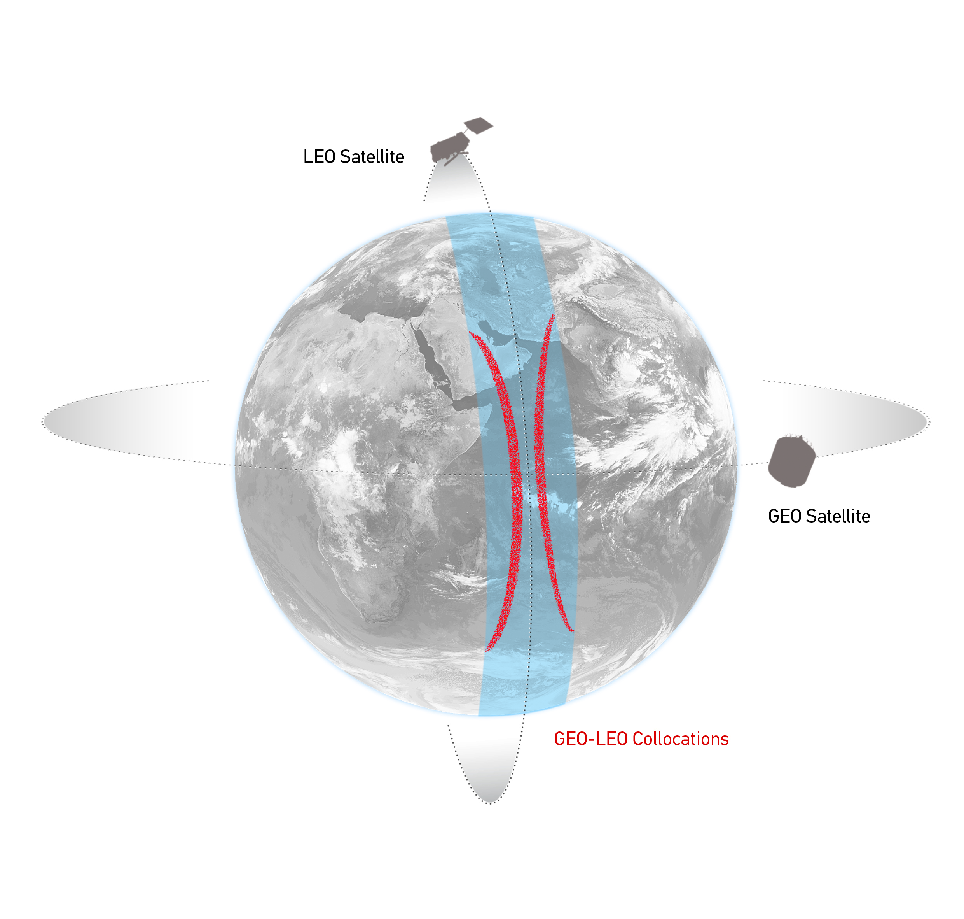
GEO-LEO IR - Hyperspectral SNO
Simultaneous near-Nadir Overpasses
of one GEO imager and one LEO sounder
Select Collocations
Spatial, temporal and geometric thresholds
Schematic illustration of the geostationary orbit (GEO) and polar low Earth orbit (LEO) satellites and distribution of their collocated observations.

Slide 5
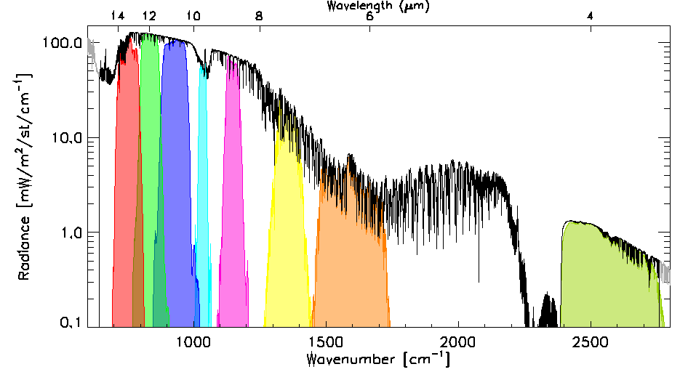
GEO-LEO IR - Hyperspectral SNO
Simultaneous near-Nadir Overpasses
of one GEO imager and one LEO sounder
Select Collocations
Spatial, temporal and geometric thresholds
Spectral Convolution:
Convolve LEO Radiance Spectra with GEO Spectral Response Functions
to synthesise radiance in GEO channels
Example radiance spectra measured by IASI (black), convolved with the Spectral Response Functions of SEVIRI channels 3-11 from right to left (colored shaded areas).

Slide 6
GEO-LEO IR - Hyperspectral SNO
Simultaneous near-Nadir Overpasses
of one GEO imager and one LEO sounder
Select Collocations
Spatial, temporal and geometric thresholds
Spectral Convolution:
Convolve LEO Radiance Spectra with GEO Spectral Response Functions
to synthesise radiance in GEO channels
Spatial Averaging
Average GEO pixels in each LEO FoV
Standard Deviation of GEO pixels as weight
LEO FoV~10km
~ 3x3 GEO pixels
Illustration of spatial transformation. Small circles represent the GEO FoVs and the two large circles represent the LEO FoV for the extreme cases of FY2-IASI, where nxm=3x3 and SEVIRI-IASI, where nxm=5x5.

Slide 7
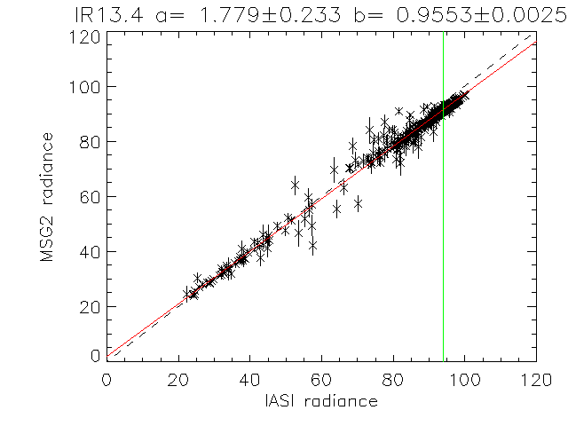
GEO-LEO IR - Hyperspectral SNO
Simultaneous near-Nadir Overpasses
of one GEO imager and one LEO sounder
Select Collocations
Spatial, temporal and geometric thresholds
Spectral Convolution:
Convolve LEO Radiance Spectra with GEO Spectral Response Functions
to synthesise radiance in GEO channels
Spatial Averaging
Average GEO pixels in each LEO FoV
Standard Deviation of GEO pixels as weight
Weighted Regression of LEO v GEO rads
Evaluate Bias for Standard Radiance Scene
Weighted linear regression of L_{GEO|REF} and <L_{GEO}> for Meteosat-9 13.4μm channel based on single overpass of IASI

Slide 8
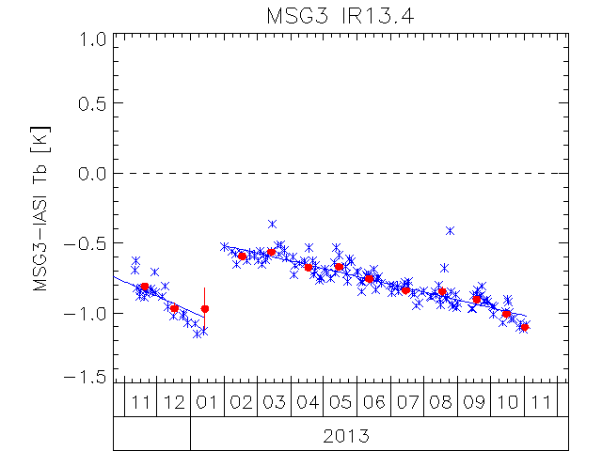
GEO-LEO IR - Hyperspectral SNO
Simultaneous near-Nadir Overpasses
of one GEO imager and one LEO sounder
Select Collocations
Spatial, temporal and geometric thresholds
Spectral Convolution:
Convolve LEO Radiance Spectra with GEO Spectral Response Functions
to synthesise radiance in GEO channels
Spatial Averaging
Average GEO pixels in each LEO FoV
Standard Deviation of GEO pixels as weight
Weighted Regression of LEO v GEO rads
Evaluate Bias for Standard Radiance Scene
Plot time series of Bias
Establish timescale for GSICS Corrections
Over which instrument calibration is stable
Time Series of Bias from inter-calibration of 13.4μm channel of Meteosat-10/SEVIRI with Metop-A/IASI
expressed in Brightness Temperature Bias for Standard Scene Radiance
Blue x = Daily Result, Blue Line=trend
Red dot = Monthly Average

Slide 9
GEO-LEO IR - Hyperspectral SNO – GSICS Correction
Compare all x_{REF} , x_{MON} samples
− over smoothing period (e.g. ±2 weeks)
Regression coefficients
with uncertainty (covariance)
Provide a function users can apply
to convert level 1 data, x_{MON}
to be consistent with calibration of reference, x_{REF}
Two versions:
Near Real-Time (asymmetric time window)
Re-Analysis (symmetric time window)
x_{MON}
GSICS Correction function
x_{REF}

Slide 10
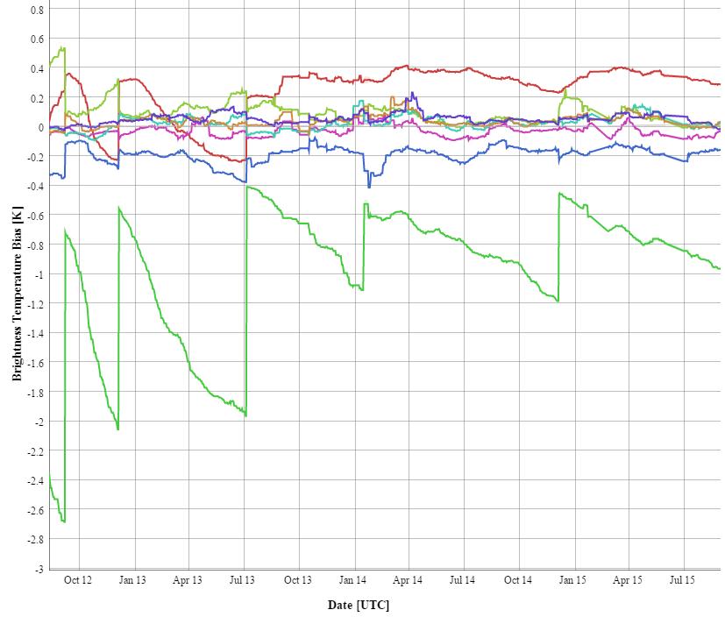
GEO-LEO IR - Hyperspectral SNO – Plotting Tool
GSICS Plotting Tool: http://gsics.tools.eumetsat.int/plotter/
Reads GSICS Re-Analysis Corrections
From GSICS Data and Products Servers
Calculates bias for given scene radiance
Converts to brightness temperature
Plots time series of Biases
Allows comparison of:
different channels
different instruments

Slide 11
GSICS GEO-LEO IR Product Status 2015-09
GPRC | Monitored Instrument | Reference Instrument | GSICS NRT Correction | GSICS Re-Analysis Correction | GSICS Bias Monitoring
EUMETSAT | Meteosat-8 – 10 } Meteosat-7 | Metop-A/IASI | Operational Demo | Operational Demo | Plots RAC
JMA | MTSAT-1R MTSAT-2 Himawari-8/AHI | IASI (+ AIRS) | Prototype Demo Prototype | Prototype Demo Prototype | Plots RAC
NOAA | GOES-13 & -15 Imager GOES-11 & -12 Imager | IASI (+ AIRS) | Pre-op Demo | Pre-op Demo | Plots RAC
 | GOES Sounder | IASI (+ AIRS) | Development | Development
CMA | FY2C – E | IASI (+ AIRS) | Development | Development | Plots RAC
KMA | COMS-1 | IASI | Prototype | Prototype
ISRO | INSAT-3D | IASI | Development | Development
Full GSICS Product Catalog available at http://www.star.nesdis.noaa.gov/smcd/GCC/ProductCatalog.php

Slide 12
Overview
GSICS GEO-LEO IR Products
Intro to Hyperspectral SNO with MetopA/IASI
Product Status
Plotting Tool
Development of Prime GSICS Corrections
Issues for GSICS Users
Product Update Frequency
GEO-GEO Test Case

Slide 13
Current Situation
GSICS Inter-Calibration Products
Defined by (1 Monitored – 1 Reference) Instrument
GEO-LEO IR Products based on MetopA/IASI
Based on SNO method
Submitted to Operational mode
+ Aqua/AIRS as transfer to characterise diurnal variations
GEO-LEO VIS Products based on Aqua/MODIS
Based on DCC method
Submitted to Demonstration mode

Slide 14
Motivation for Prime GSICS Products
New reference instruments becoming available
MetopB/IASI, SNPP/CrIS, ...
VIIRS, ...
Need to define Archive Recalibration Corrections
To support generation of FCDRs
Aim to blend multiple references
After bias adjustment
Define a Primary GSICS Reference by consensus
More methods becoming available
DCC, Lunar, Rayleigh, ...
Ultimately aim to combine multiple methods

Slide 15
Requirements
Long-term continuity of GSICS Products
Without calibration jumps between references
Although their uncertainty will change...
Ensuring Traceability
back to single Primary Reference
For each Spectral Band
Radiometric Consistency
Cover a broad range of applicability

Slide 16
Introducing Prime GSICS Corrections
Define one Primary GSICS Reference
For each spectral band/application
By consensus agreement within GSICS
Use others as Transfer References
Blend corrections from all references
After modifying Corrections to Primary GSICS Reference
Ensures long-term continuity
Without calibration jumps
Ensures Traceability
back to single Primary Reference
Simplifies users’ implementation
Could also blend multiple methods?

Slide 17
Correcting the Corrections and Blending References
Reference-1 (Primary)
Monitored Instrument
Reference-2
(Transfer)
GSICS Correction, g₁ Mon➔1
GSICS Correction, g₂ Mon➔2
-
Derived by GSICS
Delta
Correction, g_{1/2}
2➔1
+
Corrected
Correction, g_{2,1/2}
Mon ➔2➔1
g̅
Prime GSICS Correction, g₀ Mon➔1
Applied
by User
Mon➔1

Slide 18
Users’ Application of Prime GSICS Correction
Monitored Instrument
Prime GSICS Correction, g₀ Mon➔1
Mon➔Ref1

Slide 19
Overview
Status of GSICS GEO-LEO IR Products
Hyperspectral SNO with MetopA/IASI
Plotting Tool
Development of Prime GSICS Corrections
Issues for GSICS Users
Product Update Frequency
GEO-GEO Test Case

Slide 20
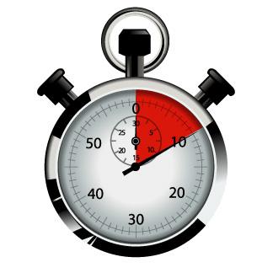
Routine Generation of GSICS Products
Decision: GSICS should aim to provide users with the most recent available calibration data
at the highest available update frequency,
allow users to decide how to apply it for their applications.
For example:
Considering calibration changes driven by long-term drift:
Users interested in long-term trends may want to apply frequent updates to the calibration corrections (expected to be smaller) to avoid large, artificial jumps in the calibration time series,
Users interested in near real-time applications may want to apply the updates less frequently (e.g. only when it exceeds a certain threshold) to avoid additional calibration noise.

Slide 21
Simple Example – Daily Weigh-Ins
Mr X weighs himself daily:
at home on poor scales
at work on good scales
His weight varies
Day-to-day
Long-term trends
Periodic oscillations

Slide 22
Simple Example – Correcting Scales
Mr X weighs himself daily:
at home on poor scales
at work on good scales
Compare home-work weights
to generate calibration corrections for home scales
But Corrections are noisy

Slide 23
Simple Example – Corrected Weights
Mr X weighs himself daily:
at home on poor scales
at work on good scales
Compare home-work weights
to generate Calibration Corrections for home scales
But Corrections are noisy
For absolute weight, apply daily corrections (Slight increase in variability)
For day-to-day weight changes, apply corrections infrequently (Danger of long-term drift!)

Slide 24
Routine Generation of GSICS Products
Decision: GSICS should aim to provide users with the most recent available calibration data
at the highest available update frequency,
allow users to decide how to apply it for their applications.
For example:
Considering calibration changes driven by long-term drift:
Users interested in long-term trends may want to apply frequent updates to the calibration corrections (expected to be smaller) to avoid large, artificial jumps in the calibration time series,
Users interested in near real-time applications may want to apply the updates less frequently (e.g. only when it exceeds a certain threshold) to avoid additional calibration noise.

Slide 25
Overview
GSICS GEO-LEO IR Products
Intro to Hyperspectral SNO with MetopA/IASI
Product Status
Plotting Tool
Development of Prime GSICS Corrections
Issues for GSICS Users
Product Update Frequency
GEO-GEO Test Case

Slide 26
Putting the G in GSICS
6 GPRCs are preparing GEO-LEO IR GSICS products:
EUMETSAT and NOAA -> Operational mode
JMA -> pre-operational mode
ISRO, CMA, KMA -> demonstration mode
For the first time we will be able to inter-calibrate the geostationary ring to the same reference!

Slide 27
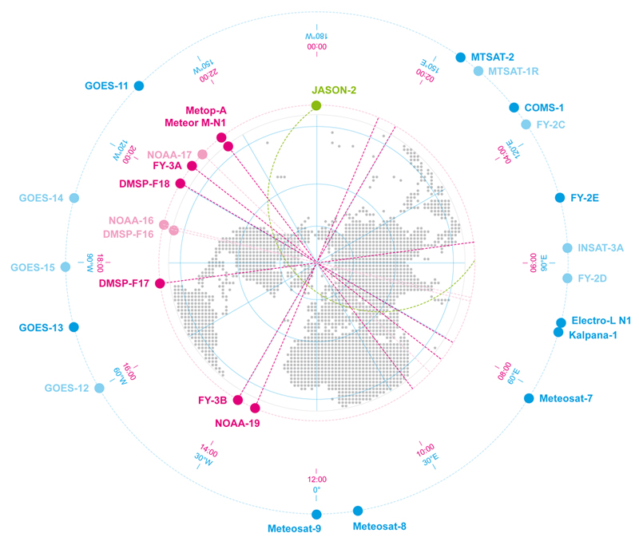
Linking the GEO ring
Schematic Example of GEO and LEO Earth Observing Satellite
Showing GEO sub-satellite longitude and equator crossing time for sun-synchronous LEO satellites

Slide 28
Linking the GEO ring
GSICS Corrections for GEO-LEO IR
All using Metop/IASI as hyperspectral references
Solid lines = Pre-Operational
Dashed lines = Demonstration
Dotted lines = Prototype

Slide 29
Linking the GEO ring
GEO-GEO Comparisons
Based on collocated observations
GEO imager pairs
Need SBAFs

Slide 30
Linking the GEO ring
Comparing GEO-LEO and GEO-GEO Differences
To Validate Uncertainty estimates
Ensure consistency
Generate global L2 products
Ensure consistency

Slide 31
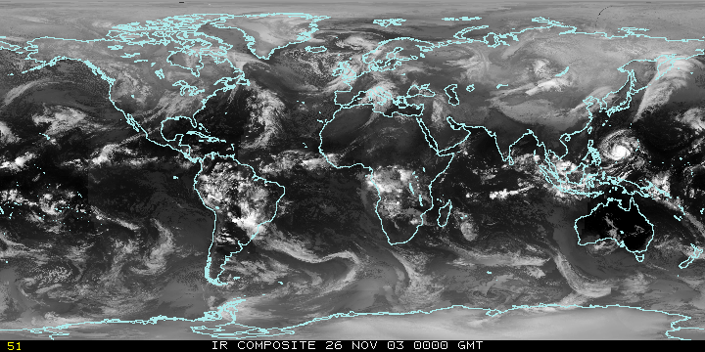
Closing the GEO ring – Test Case
Identify test dataset
Common 24 hr period, every 3 hr
Define Spectral Band Adjustment Factors
To account for GEOs’ different SRFs
Apply GSICS Corrections
Analyse:
Characterise diurnal calibration variations
Validate SBAFs
Validate GSICS Corrections’ uncertainties
Generate global composite L1 datasets
Compare with NWP Bias Monitoring?
Users’ participation?
E.g. Global composite L2 datasets?
Animated infrared imagery that covers 2-1/2 days using all geostationary satellites and NOAA AVHRR data to cover the poles.
[SSEC, U Wisc]

Slide 32
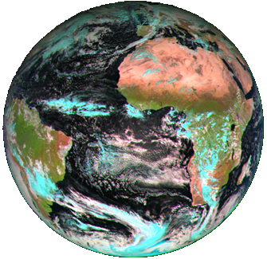
Thank You!

