Slide 1
How to access GSICS data products? Servers, Catalogs, and Tools
Manik Bali, Tim Hewison, Lawrence.E. Flynn
GSICS Users Workshop
Sept 22, 2015, Toulouse, France

Slide 2
Outline
Introduction-GSICS Products.
How do we access GSICS products
GSICS Products Types.
How is it hosted (servers, mirroring etc).
GSICS Product standards and maturity.
Tools- Plot a Product.
Apply GSICS correction in two easy steps.
Glimpse into the future

Slide 3
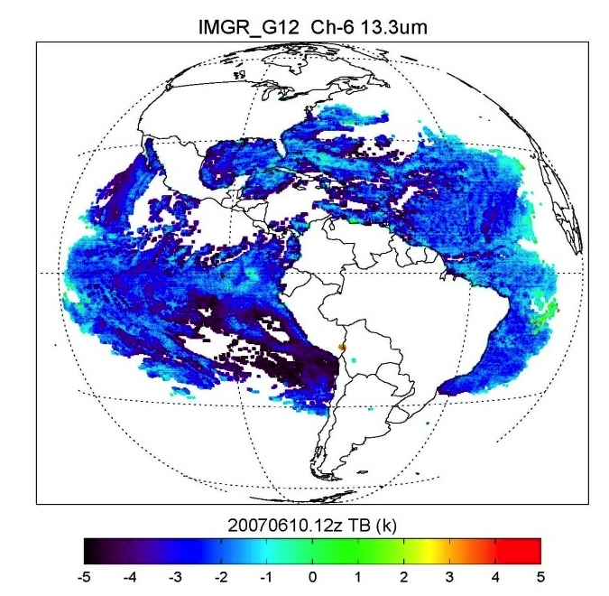
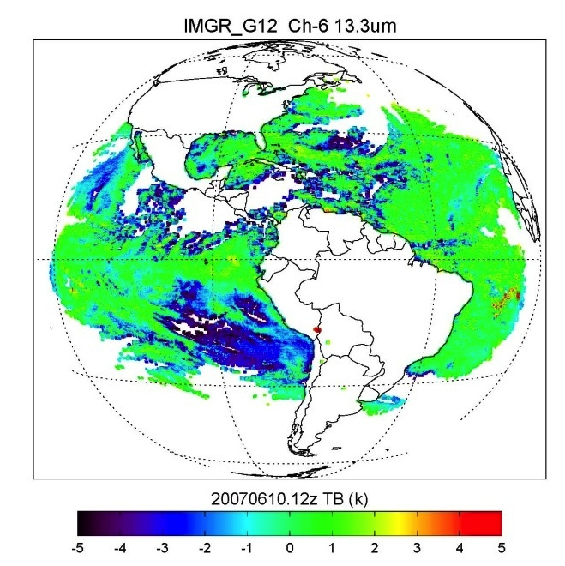
Introduction- GSICS Products
GSICS has 37 Inter-calibration products spanning IR and VIS wavelengths.
Products have bias, offset and uncertainty estimates.
Before Correction 3K Bias
After Correction ~ 0K Bias
Example of application of GSICS Correction on GOES-12 ( Goldberg et. al., 2012)
Products helpful in reducing bias w.r.t stable reference
Applied on GEO( AHI, GOES, MTSAT, SEVIRI, FY-3, INSAT) and LEO (AVHRR)

Slide 4
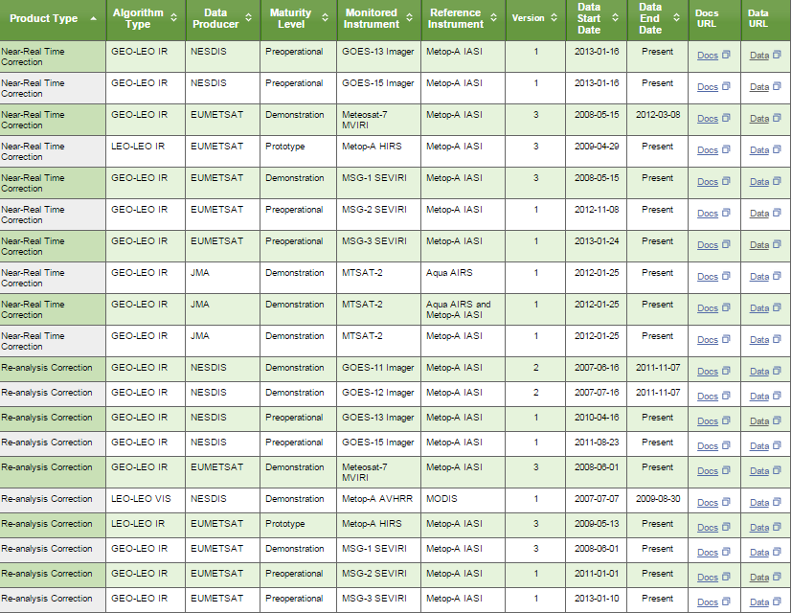
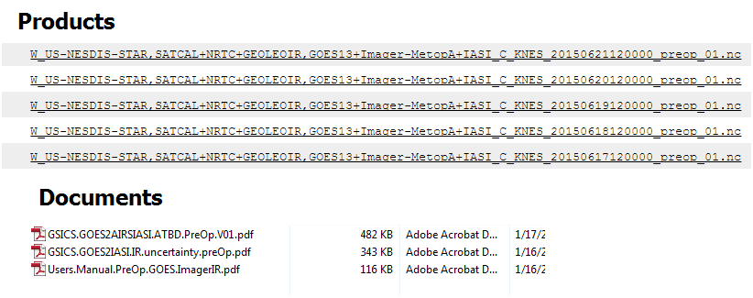
How do we access the GSICS product
GSICS Products are accessed via the GSICS Product Catalog go to http://www.star.nesdis.noaa.gov/smcd/GCC/ProductCatalog.php

Slide 5
GSICS Product Types
NRT ( Near Real Time) Corrections
Re-Analysis Correction (Archive Recalibration Products).
GSICS Correction is computed for every day. To reduce the random component of uncertainty, correction is derived from data over 29- and 15-day time periods for Re-Analysis Correction (RAC) and Near Real Time Correction (NRTC), respectively. The smoothing period for RAC is t - 14 days to t + 14 days, and that for NRTC is t - 14 days to t + 0 days (where t is the date of validity).

Slide 6
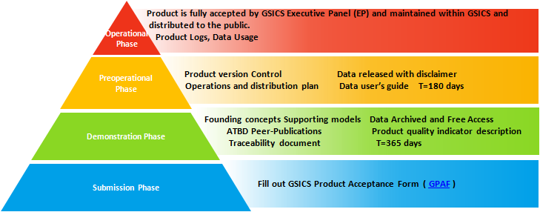
GSICS Product Maturity and Standards
GSICS Products are presented in NetCDF format.
Easy to read by any high level language ( IDL, FORTRAN, MATLAB)
The contents of data file are mainly bias and offset, Uncertainity.
The file contents follow CF 1.6 metadata standards.
Some agencies (eg. EUMETSAT) have included GSICS Coeff. ( bias, offset and uncertainty )
in their L1B data file.
GSICS Procedure for Product Acceptance is a scale used to assign maturity to GSICS Products

Slide 7
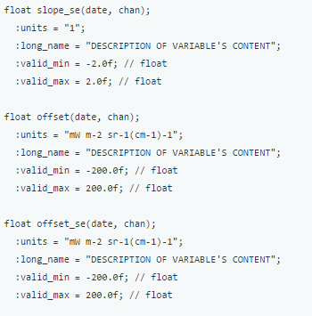
GSICS IR METADATA STANDARD: Global Attributes:
:Conventions = "CF-1.6" ;
:Metadata_Conventions = "Unidata Dataset Discovery v1.0" ;
:standard_name_vocabulary = "CF Standard Name Table (Version 19, 22 March 2012)" ;
:project = "Global Space-based Inter-Calibration System <http://gsics.wmo.int>" ;
:title = "MSG2+SEVIRI vs MetOpA+IASI GSICS Near Real-Time Correction" ;
:summary = "Coefficients of the GSICS Correction for the infrared channels of a GEOstationary imager using a LEO hyperspectral reference instrument"
:institution = "EUMETSAT" ;
:date_created = "2015-01-09T13:16:55Z" ;
:date_modified = "2015-01-09T13:16:55Z" ;
:license = "Calibration information delivered as a GSICS operational product is generated in accordance with GSICS principles and practices.;\n",
"GSICS operational and demonstration products may be used and redistributed freely. Scientific publications using GSICS operational or demonstration products should however acknowledge both GSICS and the relevant producer organization.;\n",
"There is no warranty on the data express or implied, including warranties of merchantability and fitness for a particular purpose, or any assumed legal liability for the accuracy, completeness, or usefulness, of this information. The user of the data do so at their own risk." ;
:naming_authority = "int.eumetsat.gsics" ;
:creator_name = "EUMETSAT - European Organization for the Exploitation of Meteorological Satellites" ;
:creator_email = "ops@eumetsat.int" ;
:creator_url = "http://www.eumetsat.int" ;
:references = "ATBD, Unidata NetCDF, Climate Format Conventions, EUMETSAT IASI 1C Native Format Guide" ;
:
Meta data aims to answer the 6W’s about the data
Who What Where When Why How

Slide 8
Plot a GSICS Product
A Plotting tool has been developed at EUMETSAT. The tool enables on to get a measure of bias and offset computed
Go To: http://gsics.tools.eumetsat.int/plotter/

Slide 9
Apply correction in two easy steps GSICS Product
Step 1. Select the correct combination of GSICS Product data file and L1 data
Meteosat-7 Water vapor radiances and GSICS coefficients
Meteosat-7 clear sky water vapor radiances in bufr format, from EUMETSAT ( www.eumetsat.int) )
METEOSAT7-MVIRI-MTPCSKR-NA-1-20140731030259.000000000Z-1145972.bfr
GSICS correction coefficients in netcdf format, from EUMETSAT (www.eumetsat.int)
W_XX-EUMETSAT-Darmstadt,SATCAL+NRTC+GEOLEOIR,MET7+MVIRI MetOpA+IASI_C_EUMG_20140703000000_demo_03
Courtsey: Randhir Singh, ISRO

Slide 10
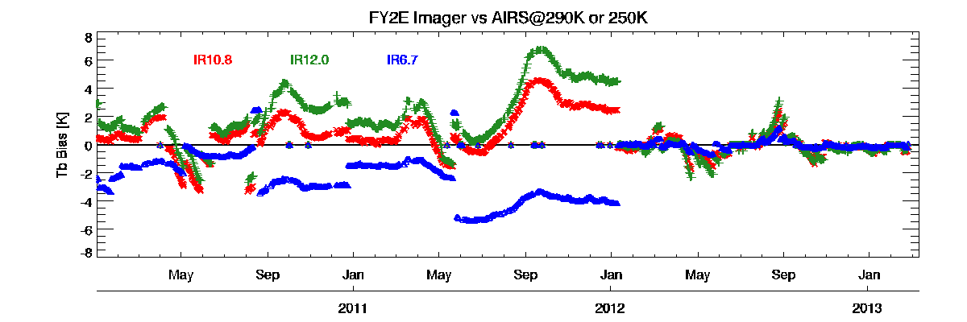
Apply correction in two easy steps GSICS Product
Step 2. Apply the formula to get the corrected radiances
L(LEO)=-offset/slope+(1/slope)*(L(GEO))
GSICS

Slide 11
Upcoming Products Deliverables
VIS – Lunar Calibration Products submitted for GPPA
ISRO product in GPPA ( Kalpana IASI ) cross calibration.
Primary reference product in GPPA
User guides for these products to be available soon
via the product catalog soon.
GSICS is working on making available SNO algorithms , reference data sets and components of FCDR as deliverables.
Take the Survey and help us frame our future

Slide 12
Summary
37 GSICS Inter-Calibration Products
Available online free via the product catalog
Easy to use ( two simple steps)
Matured User guides available for each product
Products Undergo Stringent/Efficient maturity process.
Easy to Visualize via online plotting tool.
Calibration coeff. also available in L1data file ( EUMETSAT)

