Slide 1
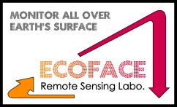
Current status and preliminary results on GSICS-based FCDR of COMS
Chang-Suk Leeª, Kyung-Soo Han^{a†}, Hyunji Kimª, Min-Ji Seoª, Kyeong-Sang Leeª, Do-Hyeong Kim^{b},In-Chul Shin^{b}
ªDept. of Spatial Information System Engineering, Pukyong National University
^{b}National Meteorological Satellite Center, KMA
[GSICS user Workshop 2015, 22, Sep., Meteo-France]
Notes:
Good Afternoon everyone.
I’m Chang Suk Lee from Pukyong National University.
Today I am going to cover the current status and preliminary results on GSICS-based FCDR of COMS.

Slide 2
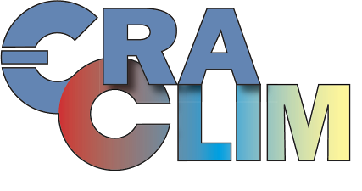
Background
* FCDRs (Fundamental Climate Data Records) * TCDRs (Thematical Climate Data Records)
Global observations for a long-term period are important to analyze the climate and environment change
Remote Sensing is an effective way to obtain global observations with consistent quality
Corrections between the different types and generations of satellites are essential
Notes:
now a day, unusual weather conditions are occurred all over the world. To handle abnormal climatic situation, we need to understand and predict such conditions.
For accurate climate research, corrections is essential between with the difference types and generations of satellite.
The SCOPE-CM is one of the campaign to integrate observations from satellite, its main object is continuously produce of the essential climate variables in global scale with high quality.
The GSICS is pre-process for the SCOPE-CM, that is correction of L1B data by referencing observations.

Slide 3
Background
KMA ECV plan
16 types product from COMS/MI
Primary ECVs of KMA
Cloud Detection (CLD) | Cloud Analysis (CA) | Outgoing Longwave Radiation (OLR) | Sea Surface Temperature (SST)
Atmospheric Motion Vector (AMV) | Land Surface Temperature (LST) | Insolation (INS) | Fog
Upper Tropospheric Humidity (UTH) | Clear Sky Radiance (CSR) | Snow/Sea Ice (SSI) | Precipitation
Rain Intensity (RI) | Aerosol Index (AI) | Aerosol Optical Depth (AOD) | Total Precipitable Water (TPW)
Available immediately adoption of GSICS
[Sea Surface Temperature · Outgoing Longwave Radiation · Insolation]
Secondary ECVs of KMA
Long term plan is required
[Albedo · Precipitation · Snow Cover/Sea Ice ]
Retrieval system exists ?
Mutual algorithm similarity between COMS and other satellites
Similarity of input channel characters
Convenience of validation
albedo
Notes:
Korea Meteorological Agency also has selected several ECVs to apply GSICS among the 16 types of products from COMS/MI.
These ECVs are separated into two categories by a few criteria.
Primary ECVs are able to apply GSICS correction.
Today, I tell you preliminary result of SST and INS and current progress of OLR and Albedo

Slide 4
Background
KMA ECV current status
Product | L1B re-processing | Algorithm Develop/improve | L2/L3 estimation | Re-analysis | Archiving | Distribution service
Sea Surface Temperature
Insolation
Outgoing Longwave Radiation
Surface Albedo
Precipitation
Sea Ice/Snow
Consistency of L2 ECV product between COMS and GEO-KOMPSAT 2A is new issue
Notes:
This table show current status of selected ECV.
Primary ECVs are ongoing to retrieval L3 product.
Between the secondary ECVs, surface albedo is under research for the estimation.

Slide 5
Analysis of GSICS effect
SST, Insolation
Notes:
First part is analysis of GSICS effect

Slide 6
Strategy for analysis of GSICS effect
Synopsis of Test
Processing & Validation
COMS
Level 1B
raw data
GSICS
correction
COMS
Level 1B’
SST
(IR1, IR2)
Buoy
SST
monthly coeff.
annual coeff.
Insolation
(VIS)
Pyranometer
Insolation
Notes:
This slide denoted our outline to examine the GSICS effect.
We compared Level 2 products using original COMS data and GSICS corrected data to examine the effects of GSICS.
SST only use IR channel data.
Insolation use IR and visible channel too. But IR and visible channels are completely separated during the calculation, so we determined INS to examine the effect of visible channel.
All of the products are validated using comparison with in-situ data and their accuracies were also compared with before and after the correction.

Slide 7
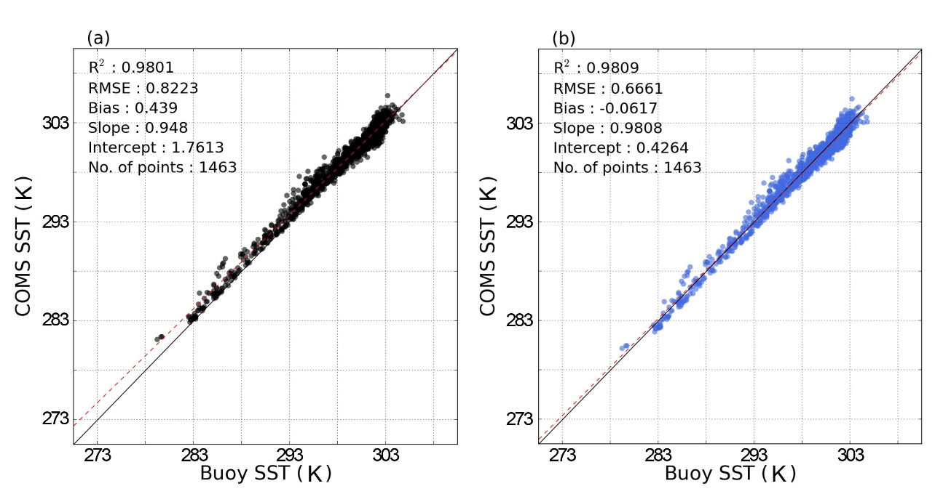
Analysis of GSICS effect (SST)
IR channels, (SST)
Compared COMS SST(existing SST coefficients) vs. GSICS corrected SST(newly SST coefficients):
RMSE and Bias were remarkably improved
Trends line(red dotted) is more close to one-to-one line
GSICS correction positively affects accuracy of SST
Scatter plots of SST and GTS buoy data (as reference data) during the daytime from April 2011–March 2012: original COMS SST (a); GSICS-corrected COMS SST (b) (Park et al., 2015).
Notes:
First is result of SST.
This slide shows comparison of each SST accuracy before and after the GSICS correction in day time.
Left scatter plot(black dots) is SST using uncorrected IR data, and right (blue dots) is SST using GSICS corrected IR data.
Both plots show similar scatter pattern and high determination coefficients with in-situ SST.
After the correction, RMSE and bias decrease about 0.2 and 0.3 K respectively. In addition, trend line by regression analysis is more close to one-to-one line.

Slide 8
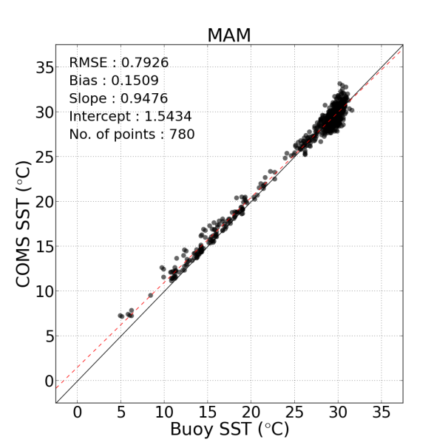
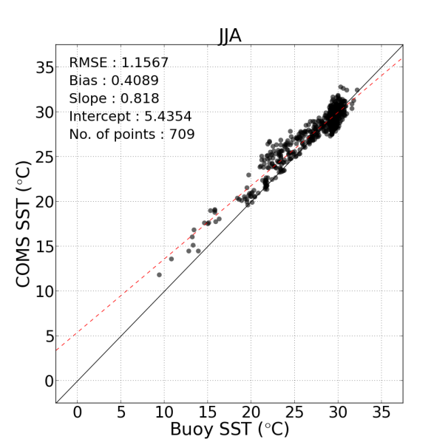
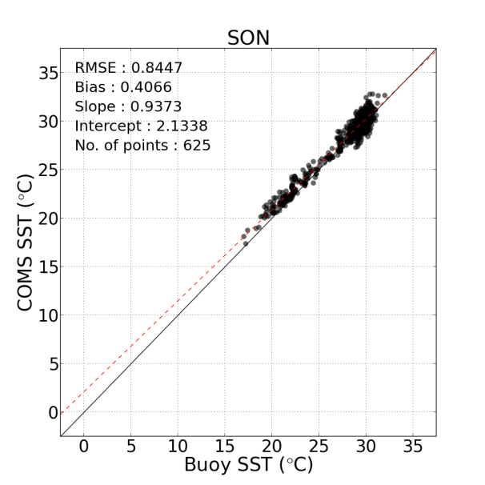
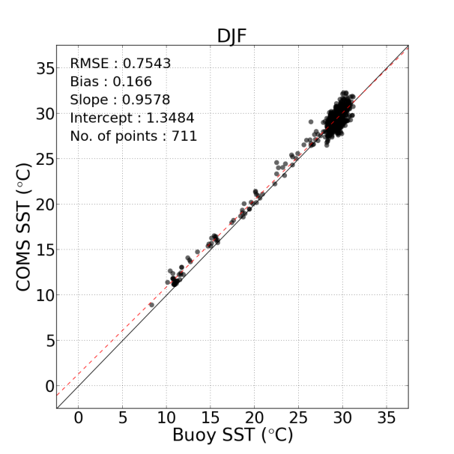
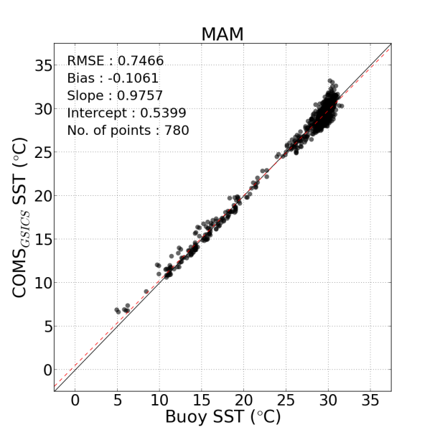
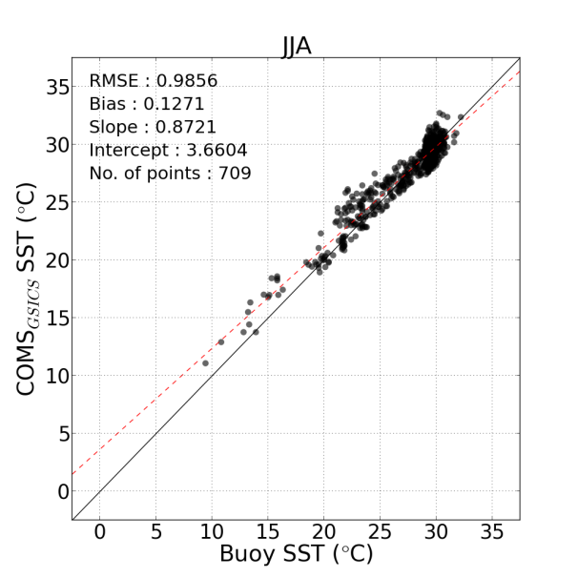
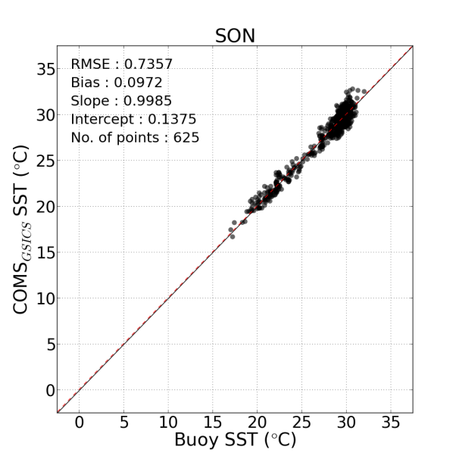
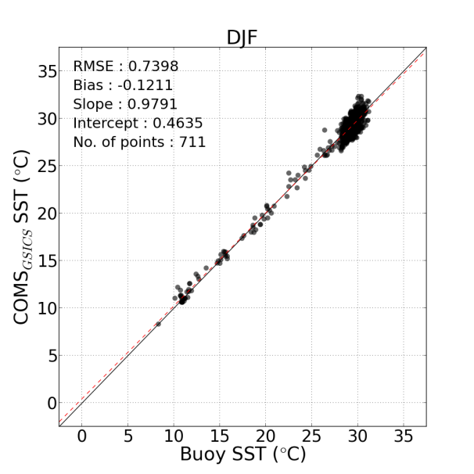
Analysis of GSICS effect (SST)
IR channels, (SST)
Before GSICS
After GSICS
Notes:
We examined accuracy of SST according to season.
All of the graphs show improvement of GSICS correction.
During the summer season, most improved result is shown.

Slide 9
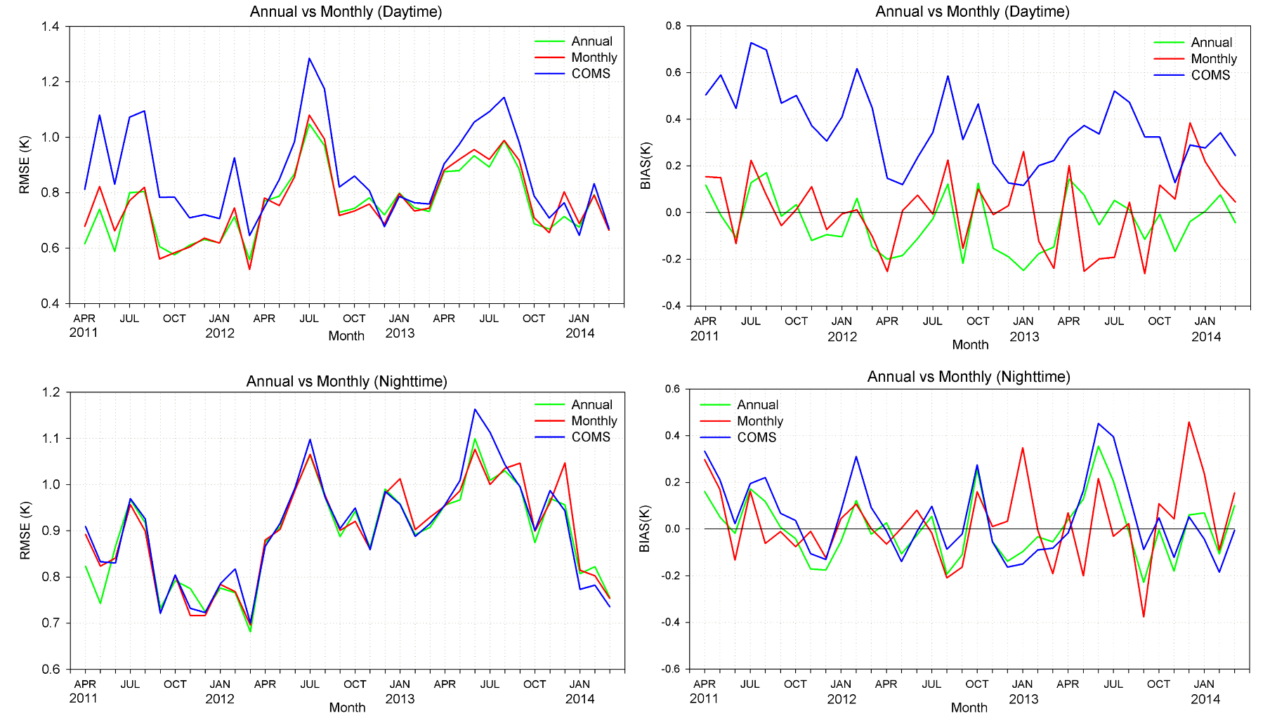
Analysis of GSICS effect (SST)
Analysis effect to IR channels, (SST)
GSICS correction coefficients have produced by month and yearly. Each accuracy of SST compared with buoy SST during Apr. 2011 ~ Mar. 2014.
In general, RMSE and bias were decreased when compared with COMS SST.
Particularly, day time SST have improved (Approx. RMSE: 0.2 K , Bias: 0.3 K).
Notes:
GSICS coefficients were retrieved monthly and annual. So we checked variation of each RMSE and bias (to find out which coefficient is the most effective).
Left two plots show variation of RMSE, and right plots show bias during the Apr. 2011 to Mar. 2014.
According to the analysis, GSICS corrections have more accurate SST than the original’s. they show remarkable improvement in day time. In night-time SST, show little increased accuracy.
Between the GSICS coefficients, annual correction show more stable change trends than the monthly correction in bias.

Slide 10
Analysis of GSICS effect (INS)
Analysis effect to VIS channel, (Insolation)
Original Insolation
Corrected Insolation
RMSE = 91.83
BIAS = -21.98
RMSE = 89.68
BIAS = 2.10
GSICS correction Result:
RMSE is similar but bias is remarkably improved
Particularly, improvement in low insolation value area
Notes:
Next is result of INS.
These two scatter plots show each accuracy of INS. Corrected INS showed decreasing RMSE and bias. Particularly, bias is remarkable improved.
As you can see, corrected INS improved in lower INS area.
This result show the GSICS correction effects attenuation of INS under cloudy condition.

Slide 11
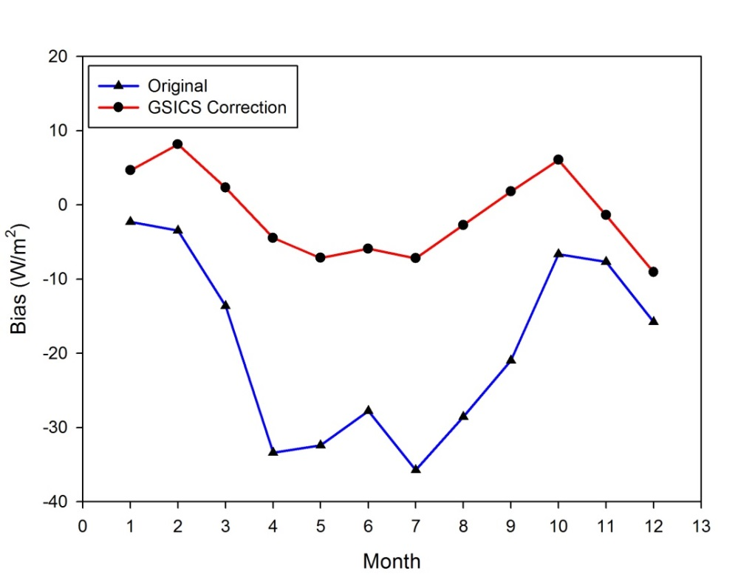
Analysis of GSICS effect (INS)
Analysis effect to VIS channel, (Insolation)
Temporal comparison of biases between CMDPS original insolation and corrected insolation for each month of the year (Yeom et al., 2015)
Difference before correction and after:
After corrected: winter 5~10W/m², summer 25~30W/m²
Bias noticeably improved during the summer (Approx. 30W/m²)
In South Korea, rainy monsoon season appear during the summer
Naturally, insolation is attenuate by high rate cloud
Notes:
this two graphs represent monthly bias trends.
Noticeable improvement showed in summer season.
In south Korea, rainy season appear during the summer.
This period have high rate of cloudiness. This bias trends mean GSICS correction improves INS under cloudy condition.

Slide 12
Current status other ECVs
OLR, Albedo

Slide 13
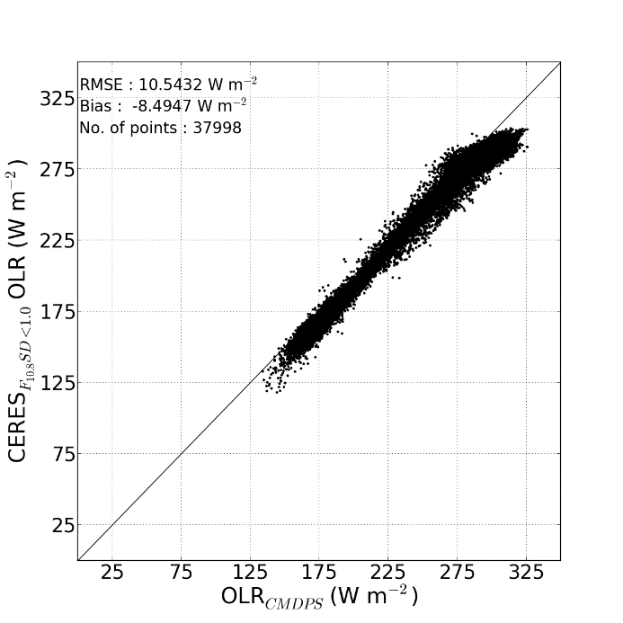
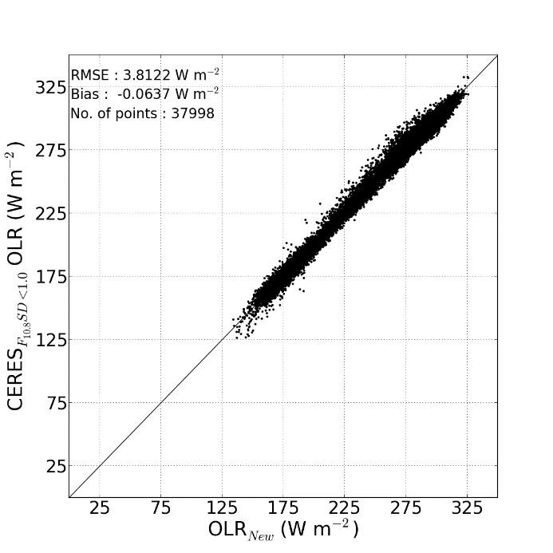
L2 product tuning (OLR)
New OLR method
Homogeneous Pixel
OLR_{CERES}
OLR_{COMS}
OLR_{COMS}
Homogeneity Test applied
OLR_{CERES}
OLR_{new}
OLR_{new}
Notes:
This slide show the result of OLR tuning.
The OLR using new match-up method showed better accuracy both RMSE and bias.
Homogeneity test reduce RMSE 6.741 Wm-2 and bias 8.431 Wm-2. furthermore, abnormal scatter form of high OLR area is removed.
Right line plot show comparison new and original OLR for sample location. Overall, new OLR showed a lot of cold bias were removed.

Slide 14
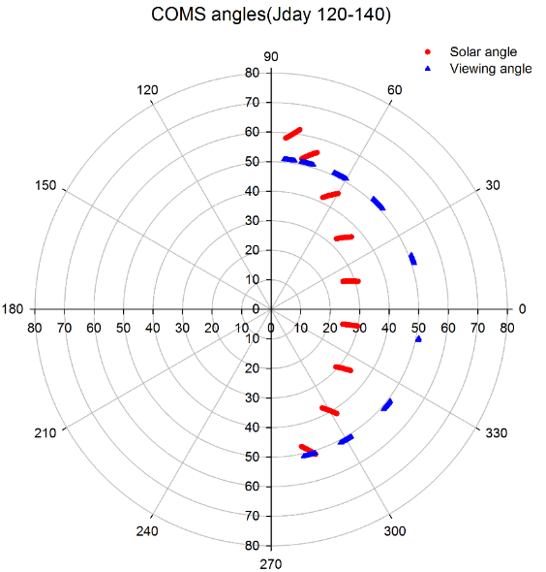
L2 product estimation (Albedo)
Surface albedo
GSICS
Correction
Atmospheric
correction
BRDF modeling
Narrow→Broad
conversion
COMS VIS
(L1B)
GSICS corrected VIS (L1B’)
COMS surface reflectance
Spectral albedo
Broadband albedo
Bi-directional Reflectance Distribution Function(BRDF) modeling
Roujean’s BRDF model
In polar orbit
Geostationary orbit
Notes:
Lastly, the progress of estimation albedo.
This flow chart is procedure of surface albedo estimation based on COMS data.
We will estimate albedo using 6S and semi-empirical BRDF model over Northeast Asia area.
Naturally, Geostationary satellite has fixed viewing zenith angle.
In BRDF normalized process, viewing zenith angle is modulated to nadir but modulation of viewing angle with limited angle information, normalized reflectance are unphysically retrieve.
So we modulate solar zenith and relative azimuth angle except viewing angle.

Slide 15
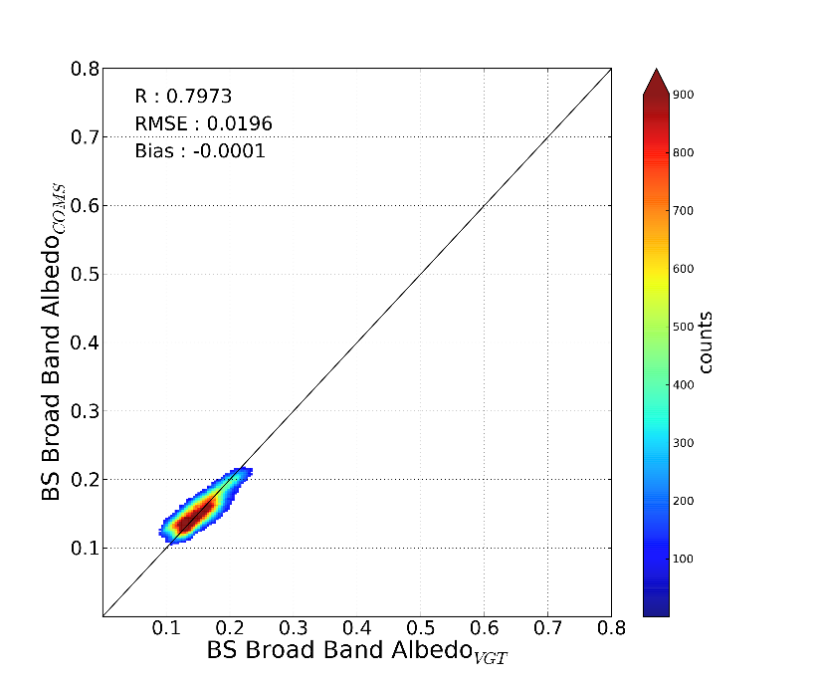
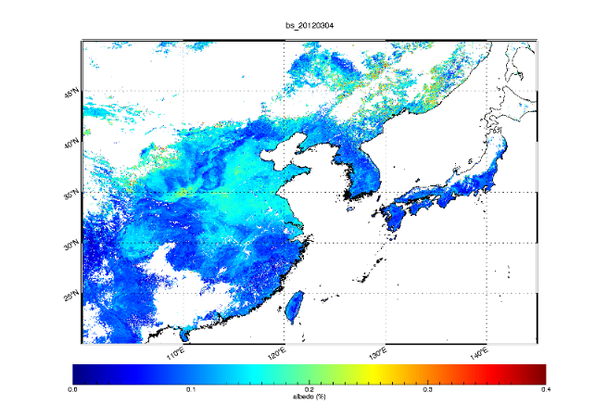
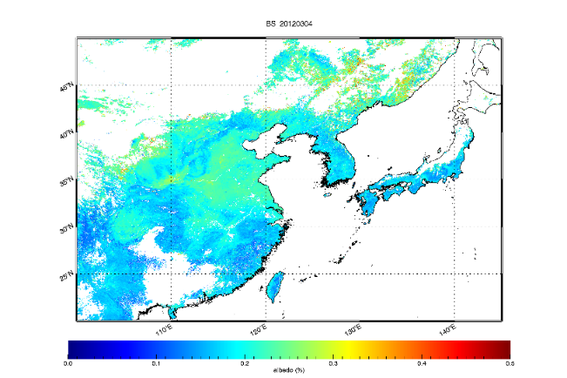
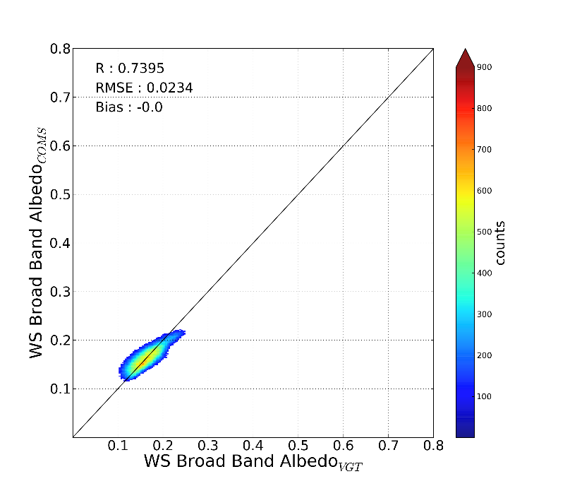
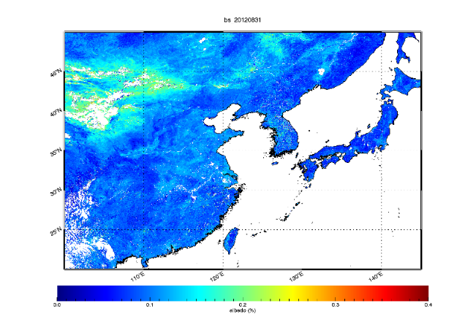
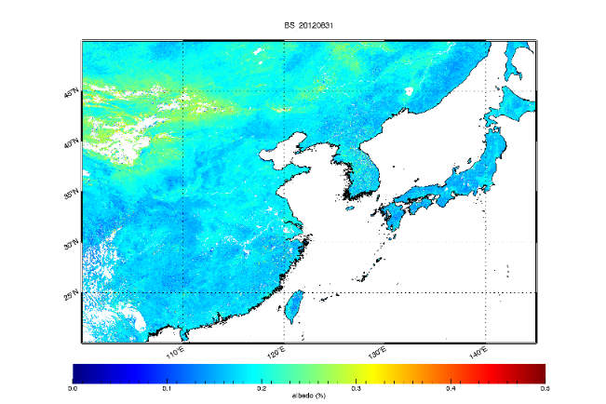
L2 estimation (Albedo)
Preliminary result
$Λ_{bs,ws}=ρ_{bs,ws}∗a+{ρ_{bs,ws}}^{2}∗b+\ln\left(μ_{v}\right)∗c+d$
(Doelling et al., 1998)
Est. BB albedo vs SPOT/VGT albedo
Black Sky: $a$=0.73496, $b$=-0.19615, $c$=0.02658, $d$=0.06344
White Sky: $a$=0.92156, $b$=-1.18063, $c$=0.02867, $d$=0.07480
Mar. 2012
Spectral albedo (BS)
Broadband albedo (BS)
Aug. 2012
Notes:
This graphs are spectral albedo and broadband albedo of black sky using BRDF with fixed viewing angle.
Estimated broadband albedo is compared with SPOT/VGT albedo product.
Both types albedos have high correlation coefficients and low error value.

Slide 16
Summary & Future plan
We examined influence of GSICS correction by comparing L2 products with before and after the correction
GSICS Correction improved accuracy of the L2 products
Day time SST show remarkable improvement (RMSE -0.156, bias -0.5)
Solar insolation have similar RMSE but reduced bias, especially in summer period
Improvement of OLR is complete
Albedo is under research for estimation
ECVs DB and archive under construction
Notes:
We examined influence of GSICS correction by comparing L2 products with before and after the corrections.
All products show improvements.
Especially, SST have significantly improvement in day time.
As the results of analysis, GSICS correction have positive effect on L2 product.
Currently we tuned OLR product and have developed retrieval method of albedo.

Slide 17
Thank you.

Slide 18
GSICS Correction 결과, Bias의 개선
2012.04~2013.03 |  | All | Cloudy | Partially
Original | RMSE | 95.832 | 91.182 | 104.964
 | Bias | 12.136 | 21.979 | 5.308
GSICS Correction | RMSE | 95.772 | 89.677 | 106.137
 | Bias | 2.523 | 2.102 | -1.016
New_CF | RMSE | 97.256 | 91.693 | 107.661
 | Bias | 2.65 | 8.59 | -4.808
2011.04~2012.03 |  | All | Cloudy | Partially
Original | RMSE | 95.576 | 90.806 | 103.952
 | Bias | 6.449 | 16.202 | -3.527
GSICS Correction | RMSE | 95.772 | 89.677 | 106.137
 | Bise | 2.523 | 2.102 | -1.016

Slide 19
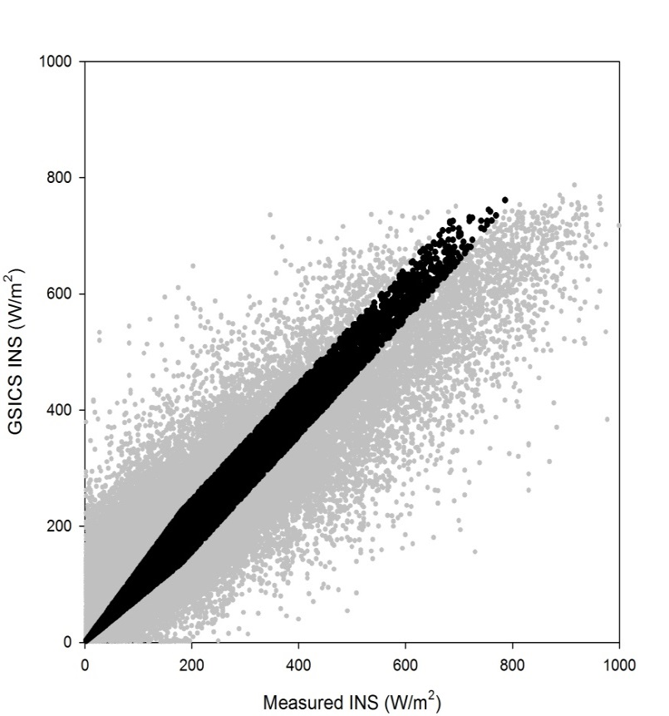
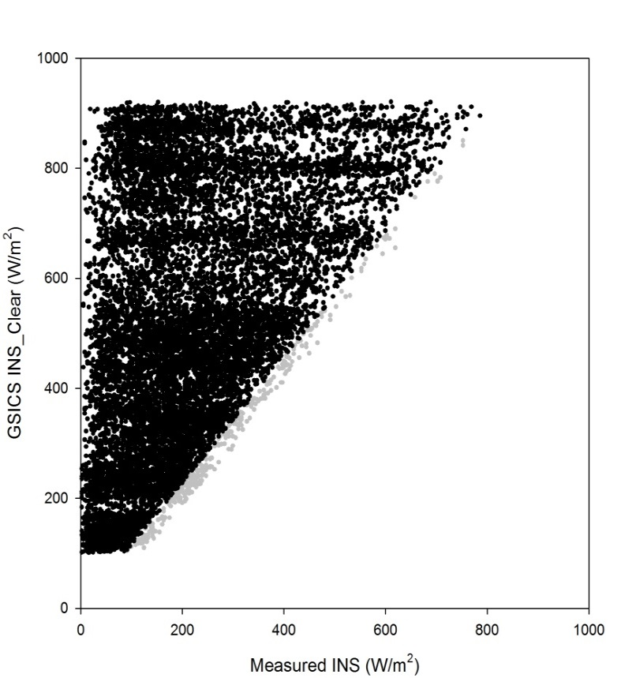
Cloud Factor 생산 : Reference Data set 추출
Condition-1 for Reference Data, lx-yl < 45w/m²
Condition-2 for Reference Data, lx-yl/x < 25%
Condition-3 for Reference Data, x/y < 88%
총 92,527개 Data 중 13,218개 Reference data set 생성
정확도가 높은 Reference data set을 이용하여 Cloud Factor 생산
19

Slide 20
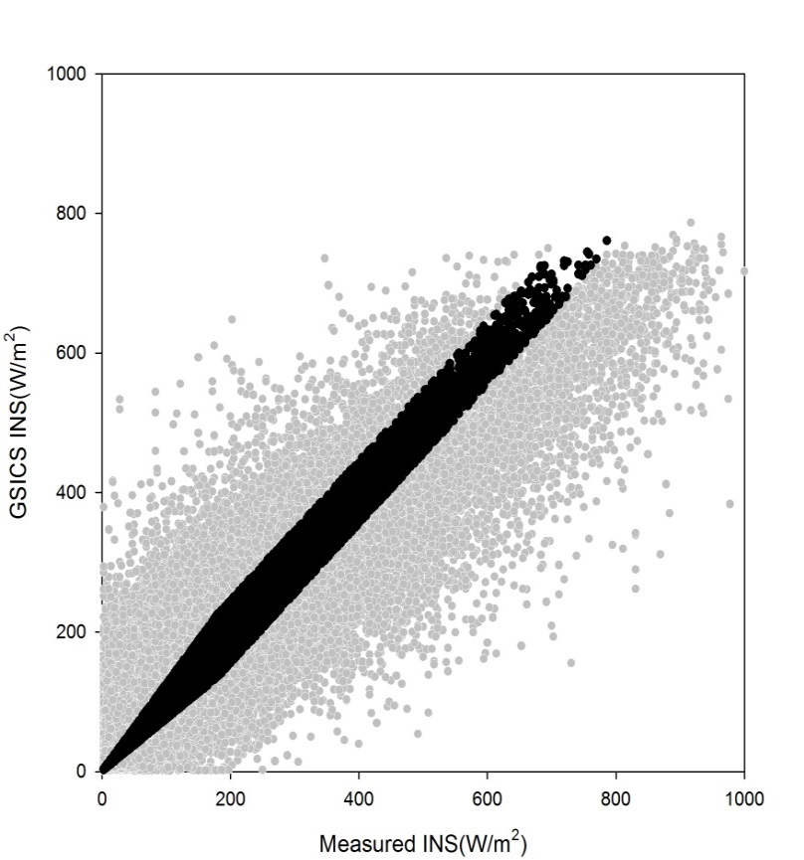
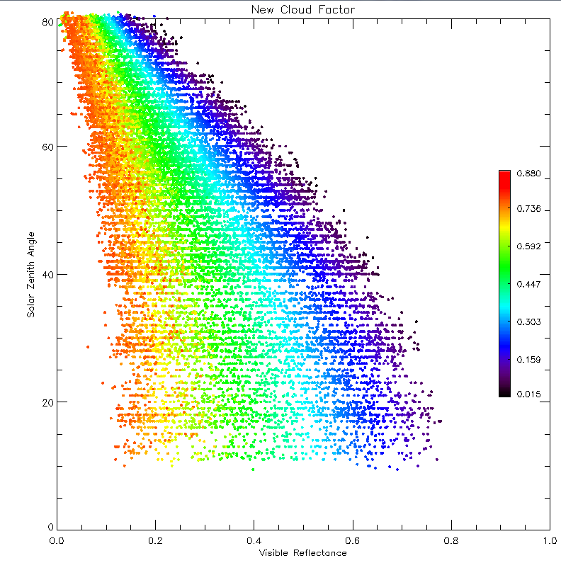
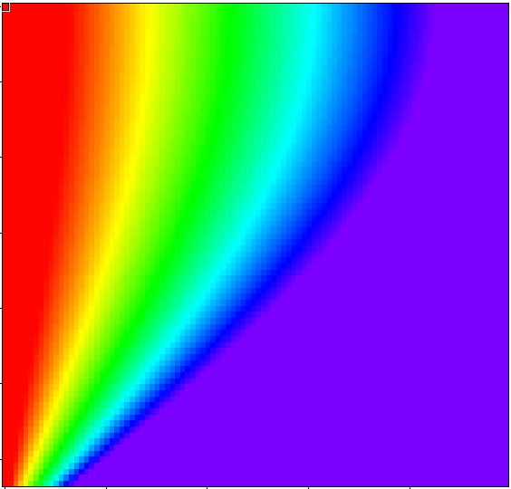
3차원 평면 방정식을 이용한 관계식 산출
R² =0.9050 , SE=0.0695
Cloud Factor=
0.9978-0.9937x( )-0.0699x(cosθ)
θ = Solar Zenith Angle
※ 위 관계식을 이용하여 정규화 된 새로운 Cloud Factor 산출
Reference Data
ρ_{vis}
cosθ
Solar Zenith Angle
Solar Zenith Angle
20
VIS Reflectance
VIS Reflectance

Slide 21
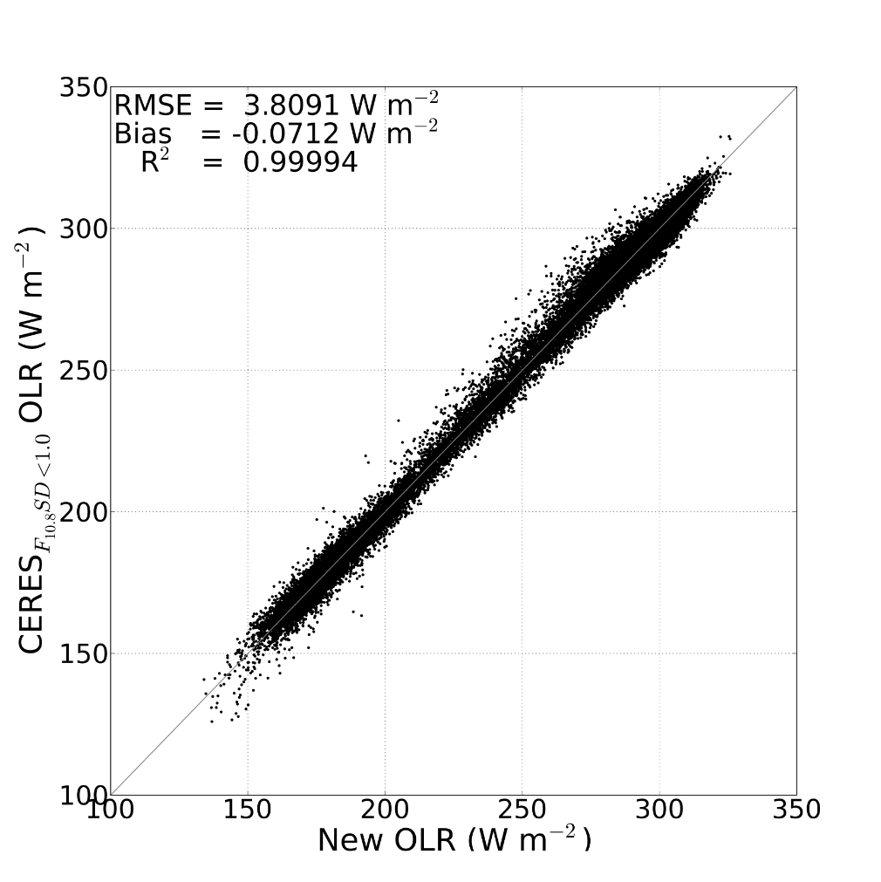
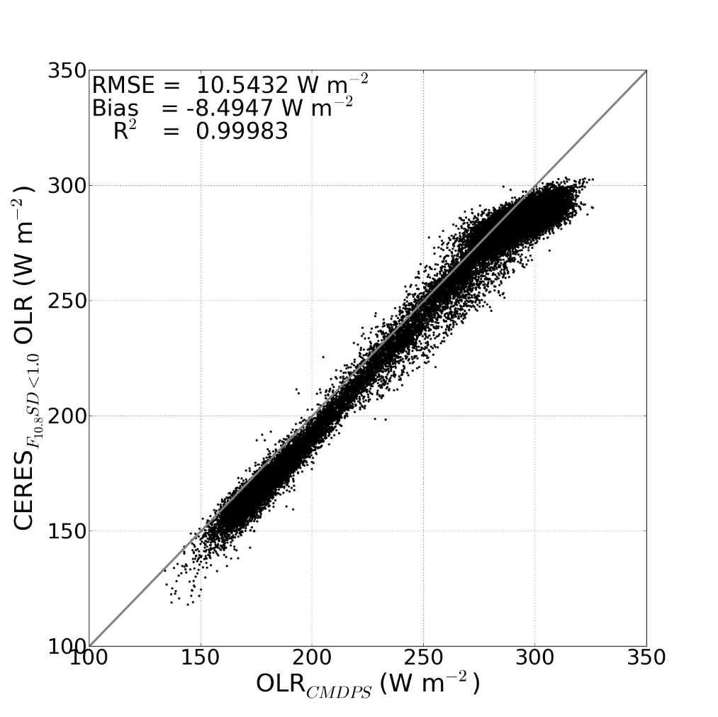
Result (OLR)
OLR_{New}
OLR_{CMDPS}
 | OLR_{New}
RMSE (W m⁻²) | 3.8091
Bias (W m⁻²) | -0.0712
R-squared | 0.99994
Validation Period | 2011.04.01~2014.03.31
OLR_{CMDPS}
10.5432
-8.4947
0.99983
2011.04.01~2014.03.31

Slide 22
Result (OLR)
OLR_{CERES}
OLR_{CMDPS}
OLR_{CERES}
OLR_{New}
Ocean Pixel
165°E, 12.5°N
2012.12~2013.02
Comparison with difference of CERES OLR and OLR
CERES OLR - OLR_{CMDPS}
Homogeneous Pixel
CERES OLR - OLR_{New}

Slide 23
Result (OLR)
OLR_{CERES}
OLR_{CMDPS}
OLR_{CERES}
OLR_{New}
Land pixel
165°E, 12.5°N
2012.12~2013.02
Comparison with difference of CERES OLR and OLR
CERES OLR - OLR
Homogeneous Pixel
CERES OLR - OLR_{New}

