Slide 1
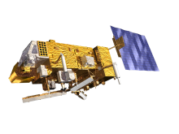
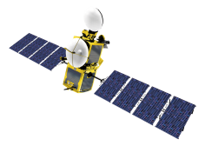
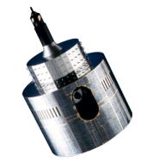
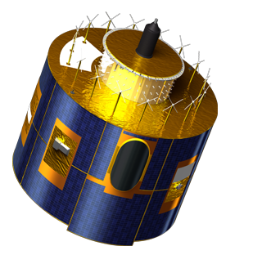
Impact of GSICS calibration coefficients on Meteosat-7 meteorological products derived at EUMETSAT
M. Carranza (GMV Aerospace and Defence S.A.), R. Borde (EUMETSAT) and O. Samain^{1,3} (Moltek Consultants Ltd.)

Slide 2
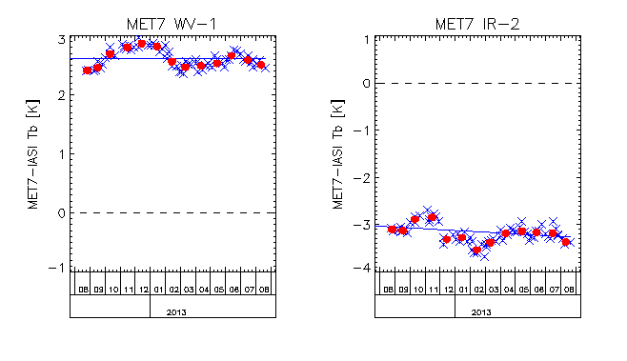
Meteosat First Generation Developments on GSICS impact
Calibration update (following GSICS)
Important biases for both the infrared 10.8 µm and the water vapour 6.2 µm channels of ca. –3.2 K and +2.6 K
Impact on products needs to be analysed, especially in the scope of reprocessing activities.

Slide 3
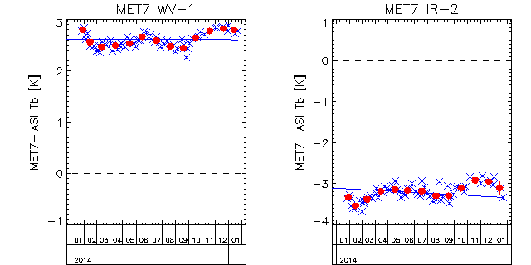
Strategy
A Meteosat/MVIRI cross-calibration against IASI radiances has been applied on the VAL MPEF chain, and the results have been compared to the outputs of the OPE chain (period of 6 days 15⁻20 October 2014).
Original calibration coefficients for the count to radiance conversion have been modified as follows considering data from 6 August 2014:
The modified radiance has then been computed as:
L_{c} = gain_{c} · (image_count – space_count_{c}).
WV channel | IR Channel
gain_{c} = gain / 1.101982 space_count_{c} = space_count – 0.00539 / gain | gain_{c} = gain / 0.9303573 space_count_{c} = space_count + 0.34396 / gain
relatively small changes (<10% of the bias) over this interval

Slide 4
Outputs
Several MFG products tested
Cloud Mask
Cloud Analysis (Cloud amount, Cloud top temperature, Cloud top Pressure)
CSR
Wind vectors (ELV, HWV, HRV, WVW)
Results compiled in EUMETSAT internal report:
EUM/RSP/REP/14/783586

Slide 5
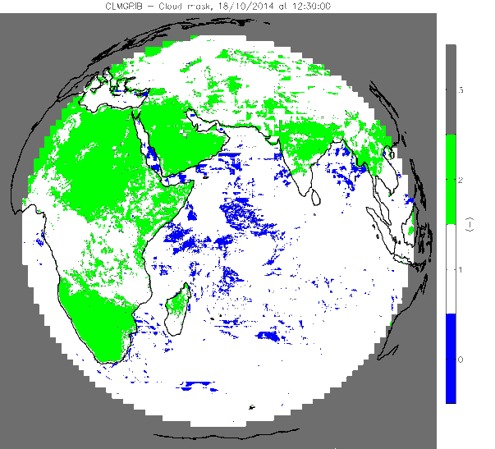
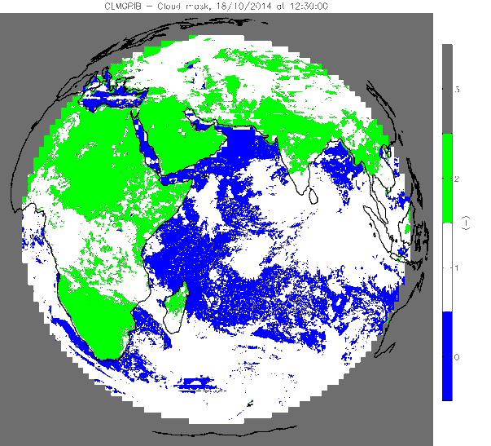
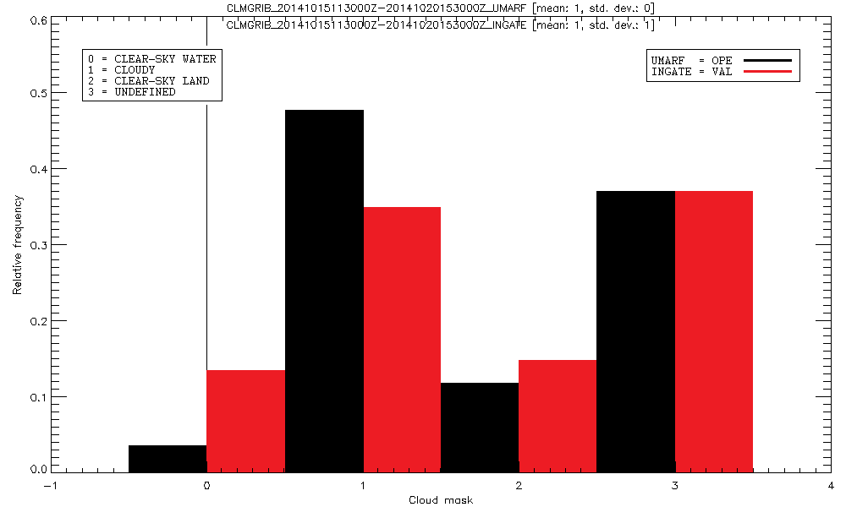
Results
Cloud Mask
OPE
VAL
Amount of cloudy pixels identified is about 20% smaller on VAL than on OPE.

Slide 6
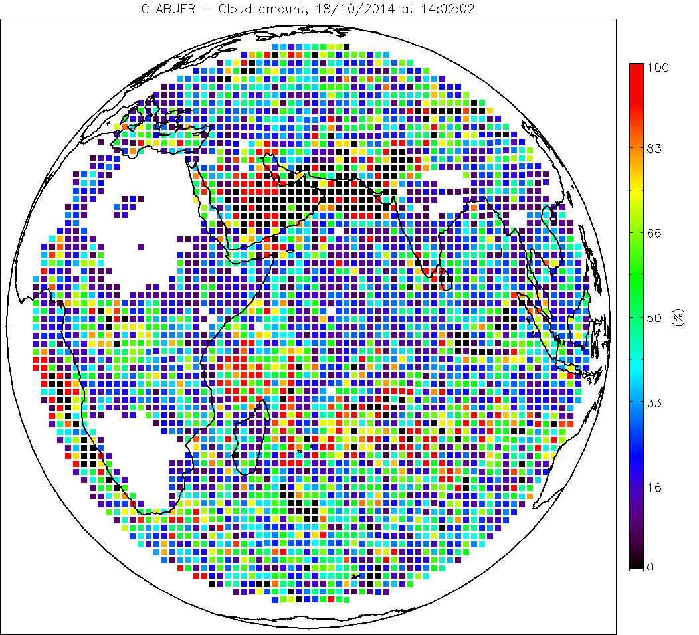
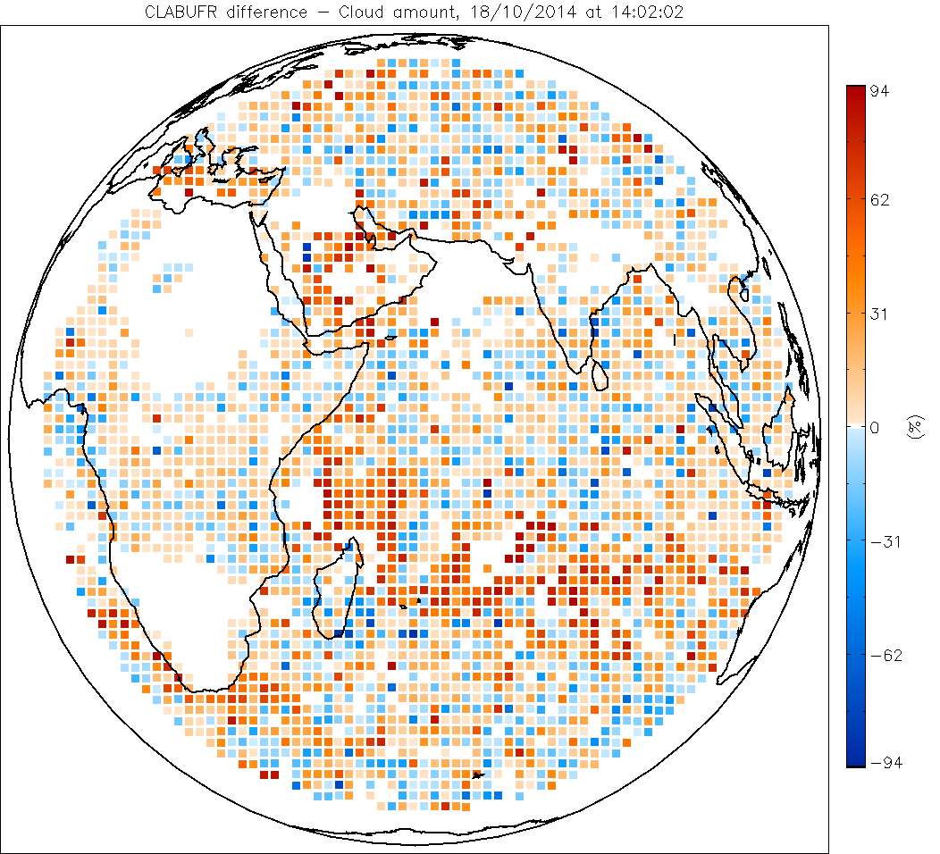
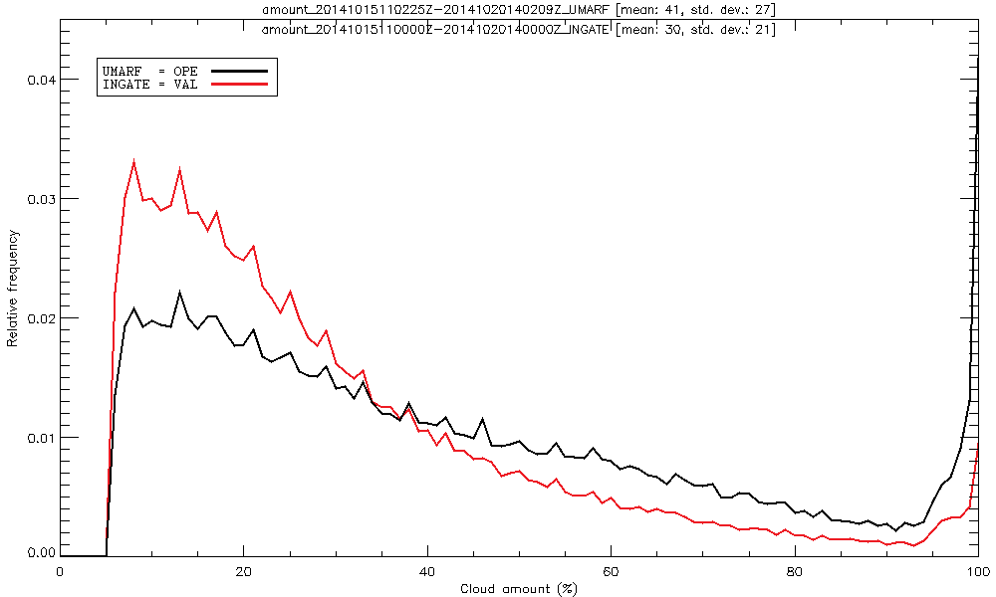
Results
Cloud Amount
OPE
OPE-VAL
The average cloud amount is smaller on VAL (30%) than on OPE (41%).

Slide 7
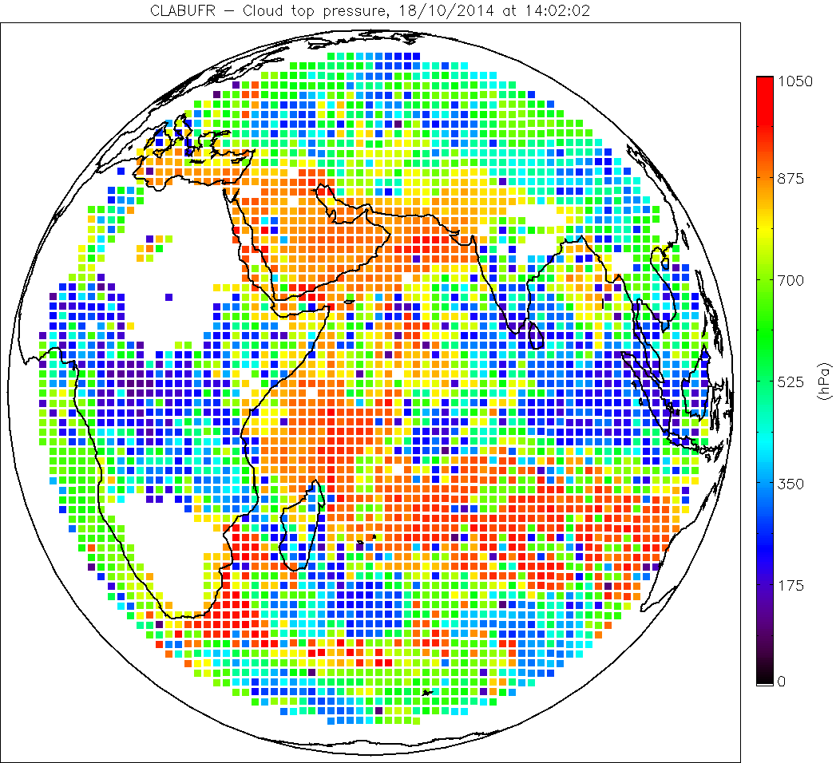
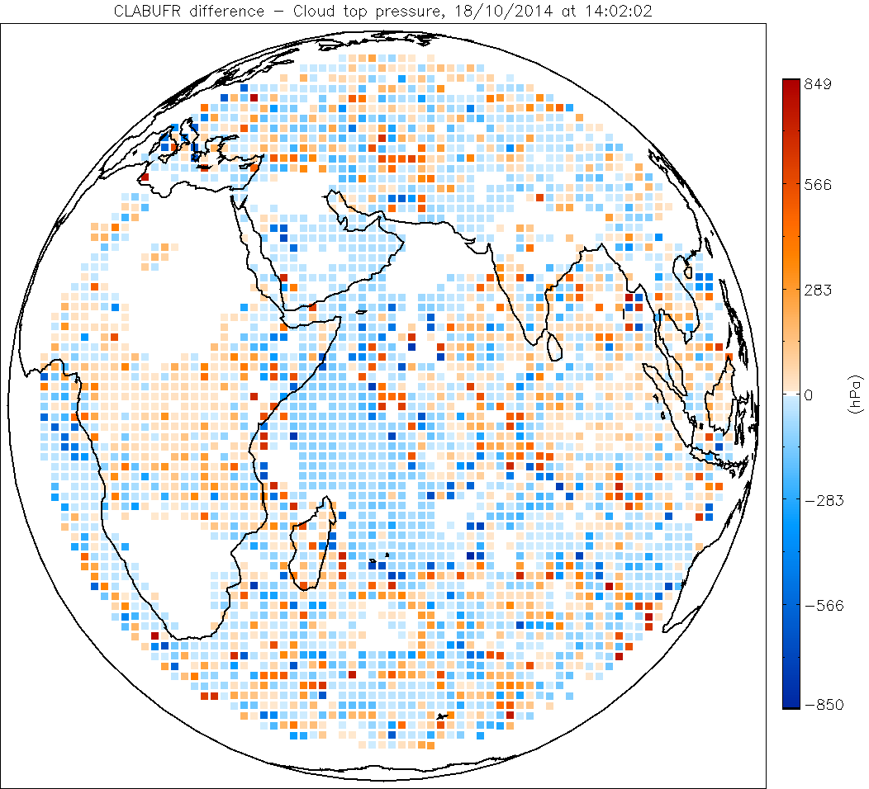
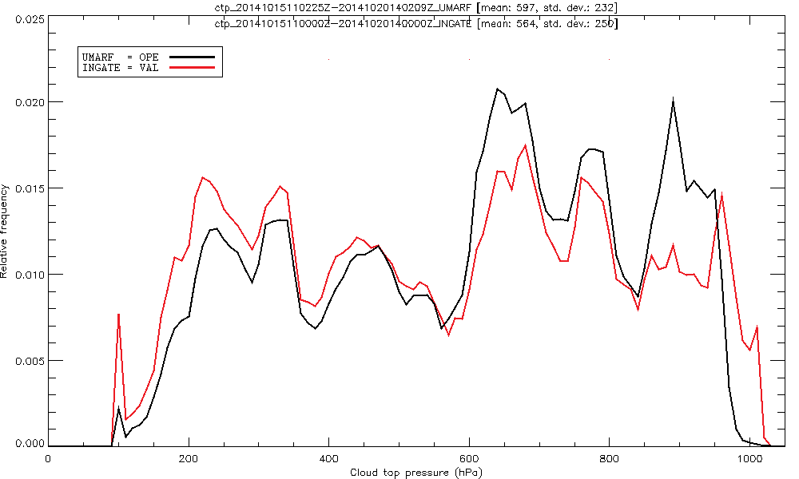
Results
Cloud Top Pressure
OPE
OPE-VAL
The average cloud-top pressure is smaller on VAL (564 hPa) than on OPE (597 hPa).

Slide 8
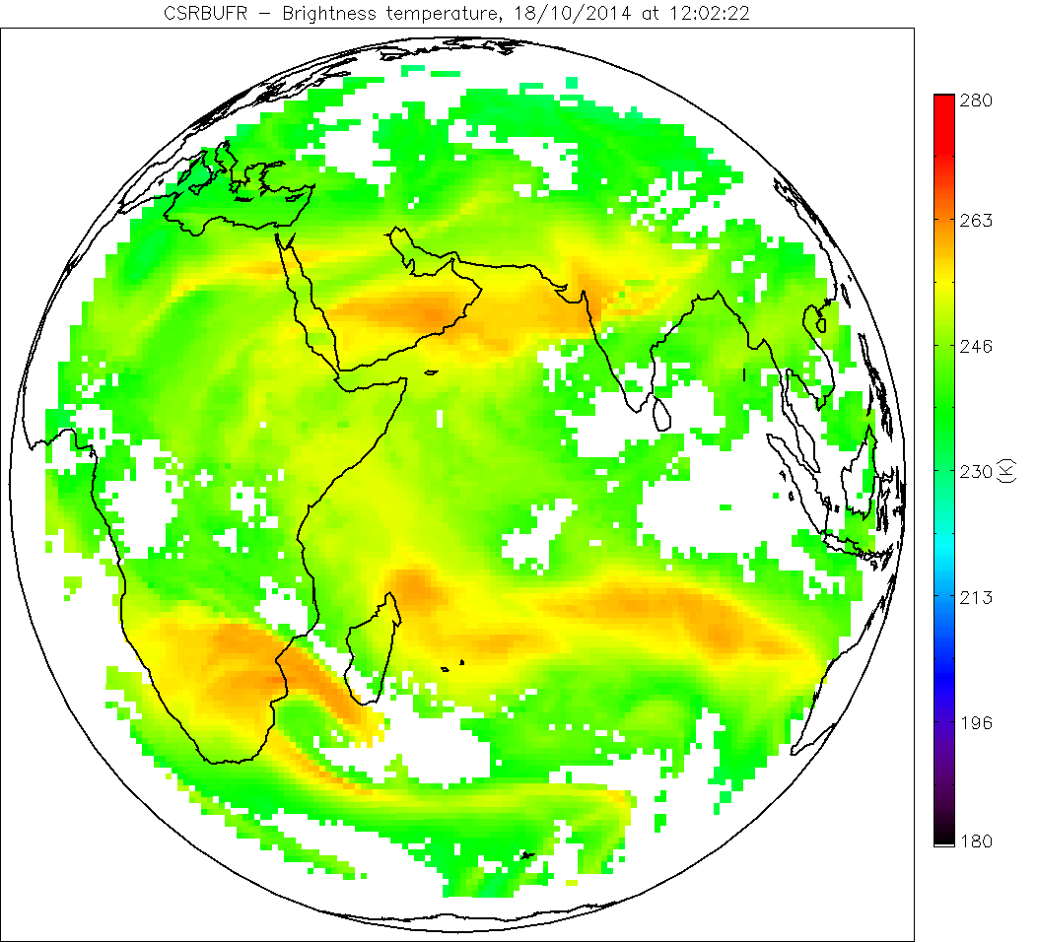
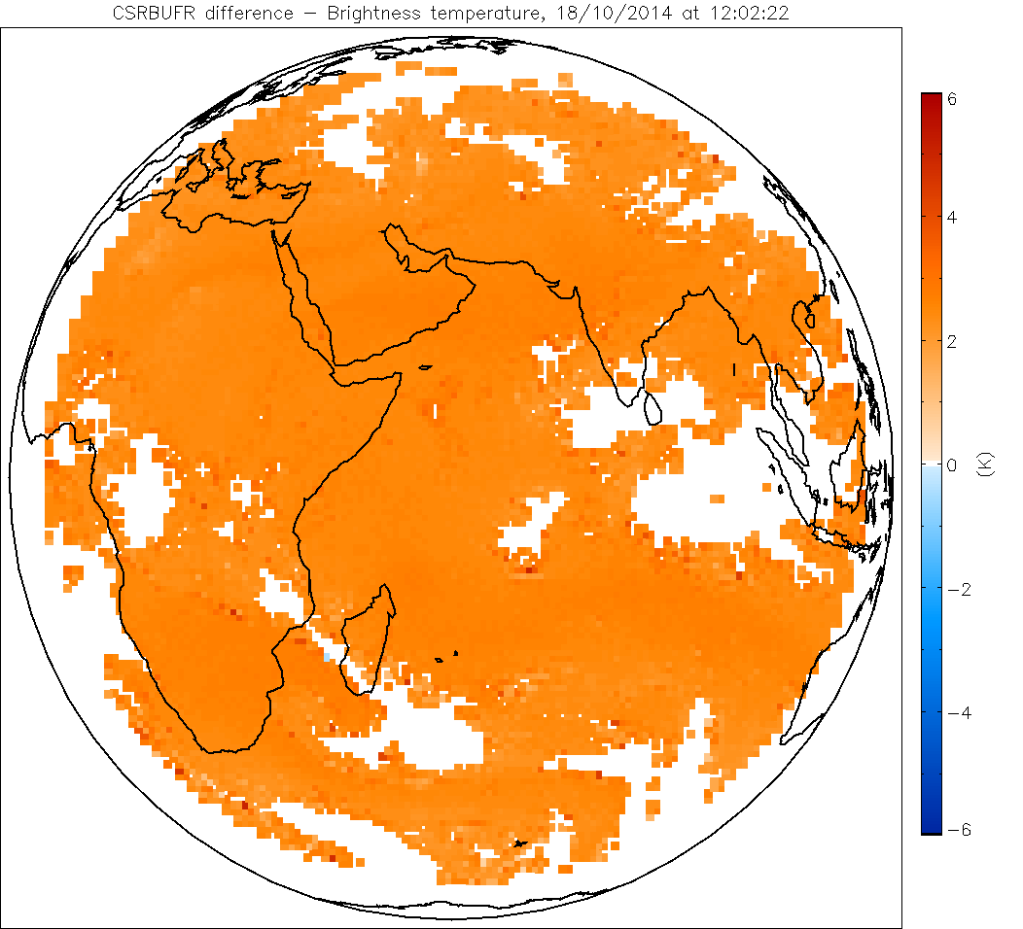
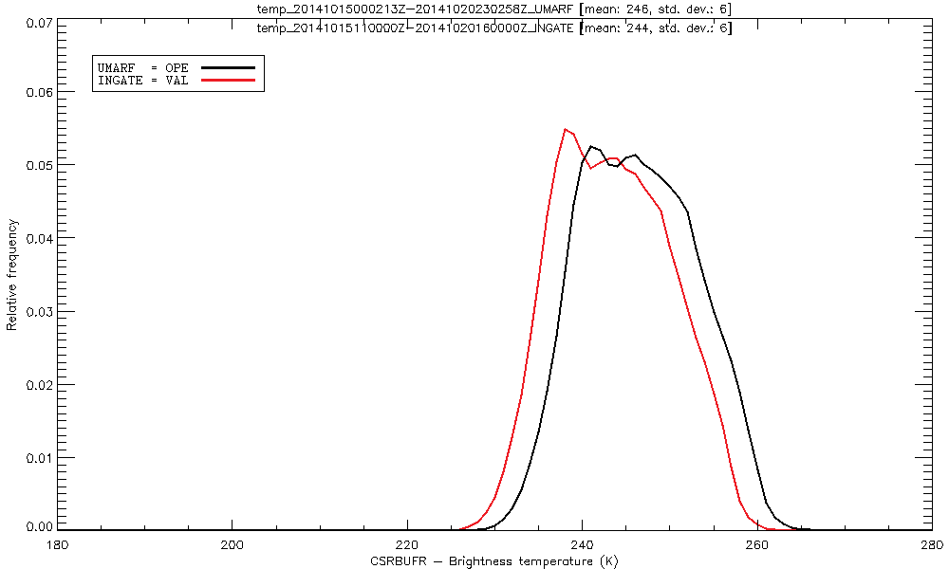
Results
CSR
OPE
OPE-VAL
There is a bias round +2.9 K for the WV 6.2 μm channel and about -1.5 K for IR 10.8 μm channel and

Slide 9
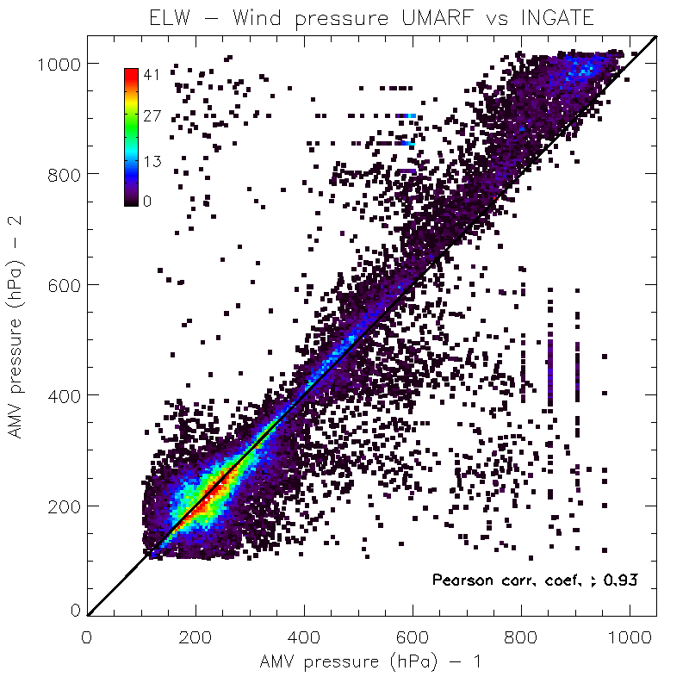
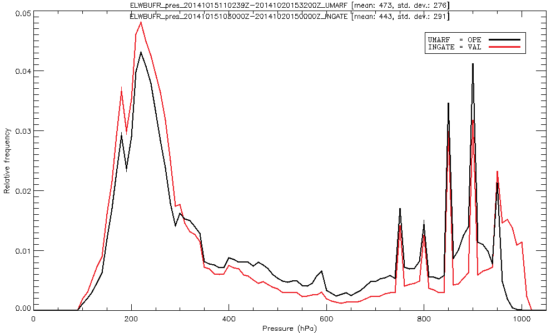
Results
Wind vectors, ELW
ELW provide less winds when GSICS corrections are applied. The HA is also a bit different.. HA nd

Slide 10
Conclusions
GSICS corrections impact a lot some of the meteorological product extracted from Meteosat 7.
It is important to estimate this impact, especially for future reprocessing activities.
Deeper analysis are needed, especially on all the Cloud Products.
Results compiled in EUMETSAT internal report:
EUM/RSP/REP/14/783586
Please have a look at Poster 6.3
M. Carranza, R. Borde and O. Samain; Impact of GSICS calibration coefficients on Meteosat-7 meteorological products derived at EUMETSAT

