Slide 1
Requirements for microwave inter-calibration
Sante Laviola
National Research Council of Italy
Institute of Atmospheric Sciences and Climate - Bologna
GSICS Users Workshop 2015
Group of Satellite Meteorology
GSICS Users Workshop 2015 at EUMETSAT Meteorological Satellite Conference - Toulouse, France, 22 September 2015

Slide 2
GSICS – Global Space-based Inter-Calibration System
An international collaboration to examine data from operational weather satellites to improve climate monitoring and weather forecasting.
… chatting with Ralph Ferraro!

Slide 3
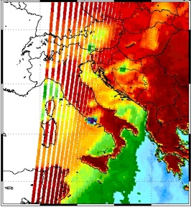
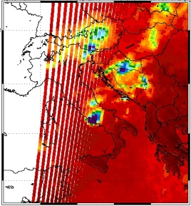
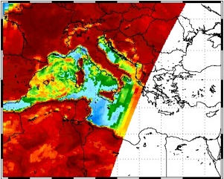
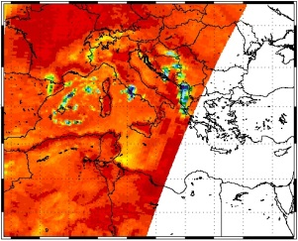
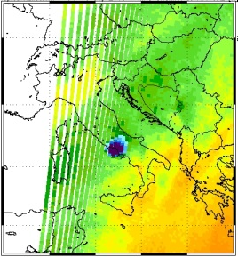
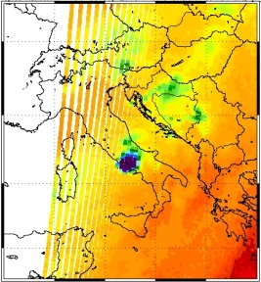
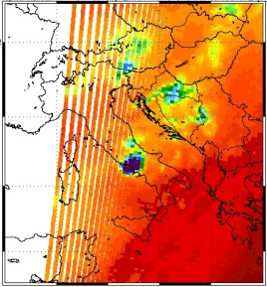
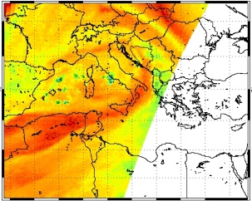
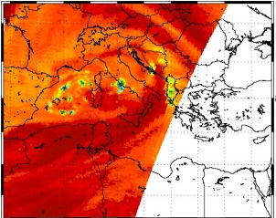
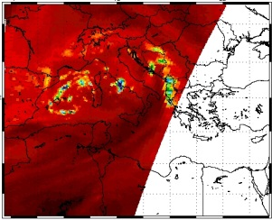
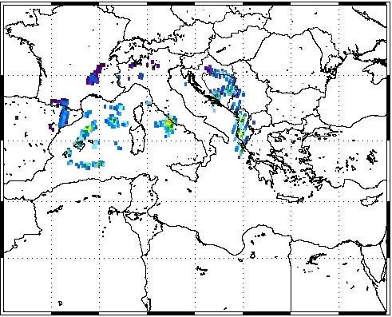
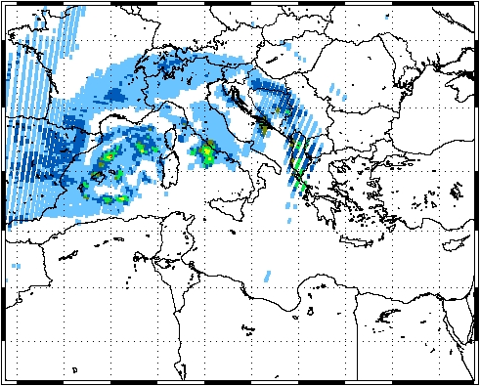
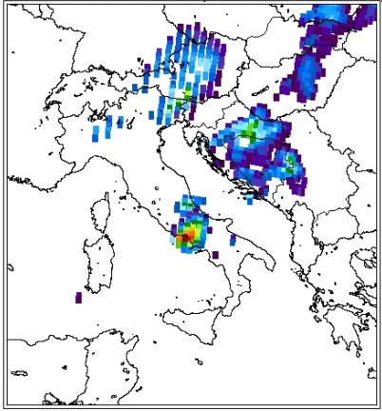
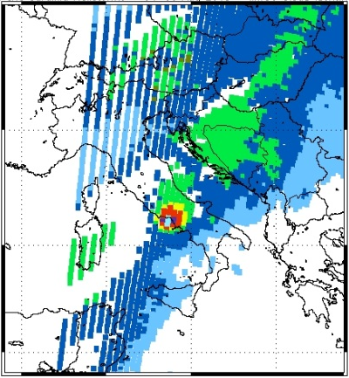
Main research activity (background)
Operational use
(hailstorms, snowstorms, regional scale convection)
Short-term climatology
(≈ last 15 years) (MCS and Tropical-like Cyclones in the Mediterranean Sea)
183-WSL
MWCC
183-WSL
MWCC

Slide 4
Current and future perspective for the 183-WSL and MWCC methods
The plan for my future activity is also focused on the application of the 183-WSL and MWCC methods to other satellite water vapour sounders.
But, I probably need to better know the inter-calibration uncertainties!
AMSU-B (GHz) | MHS (GHz) | SSMIS (conical) | SAPHIR (GHz) | ATMS (GHz) | GMI (conical)
89.9 ± 0.9 | 89.0 |  | 183.31 ± 0.2 | 88.20 | 89
150 ± 0.9 | 157.0 | 150 | 183.31 ± 1.1 | 165.5 | 166
183.31 ± 1.0 | 183.311 ± 1 | 183.31 ± 1.0 | 183.31 ± 2.8 | 183.31 ± 7.0 | 183.31 ± 3.0
183.31 ± 3.0 | 183.311 ± 3 | 183.31 ± 3.0 | 183.31 ± 4.2 | 183.31 ± 4.5 | 183.31 ± 7.0
183.31 ± 7.0 | 190.311 | 183.31 ± 6.6 | 183.31 ± 6.8 | 183.31 ± 3.0
 |  |  | 183.31 ± 11 | 183.31 ± 1.8
 |  |  |  | 183.31 ± 1.0

Slide 5
Main contributors to the uncertainty on MW inter-calibrated product level 1
Scan asymmetry in WV sounding channels. It could be mitigated with an inter-satellite cross-calibration [John et al., 2013];
The accuracy of geolocation of monitored instrument (target) and reference instrument;
Spatial resolution of the inter-calibrated MW products [Ebrahimi et al., 2014]
Homogenization of “native” resolution of radiometers with different scanning geometry (cross-track/conical), taking into account the limb effect!
The observed radiometric biases between measured and simulated 183 GHz data need to be evaluated and minimized [Moradi et al., 2014]
Inter-satellite radiometric errors (SAPHIR/MHS, ATMS/SAPHIR) [Moradi et al., 2015]
The characterization of this information would greatly benefit future activities at my institute

Slide 6
Example of impact of the scan asymmetry bias on the 183-WSL rain rates
The results shown in Table 7 indicate that up to a 15 K bias the effects are well below 1 mm h⁻¹, reaching as high as a 0.64 mm h⁻¹ increase for a −15 K bias. Even though John et al. (2013) did not detect biases larger than ±15 K, computations were extended to 20 and 25 K finding an effect as large as −1.10 mm h⁻¹ for the −25 K bias, which is within the 1 mm h⁻¹ threshold for the low rain intensity detection of the algorithm.
[Laviola, et al., 2013]

Slide 7
Thoughts fueled by GSICS Survey and papers
Are the current inter-calibration procedures for MW (as described in such papers!) being integrated in the GSICS framework?
Did GSICS identify the reference instrument for the inter-calibration of microwave satellite sensors?
Which is the current/estimated uncertainty? For ATMS/SAPHIR: 0.02÷0.07 K [Moradi et al., 2015]
The inter-calibration of the window channels needs a rigorous evaluation of the uncertainty due to the surface emissivity.
It seems that the Double Difference method combined with Vicarious Cold Calibration provides good performances for conical radiometer inter-calibrations [Kroodsma et al., 2012]. That’s true also for combination conical/cross-track?

Slide 8
Thanks for your attention!

Slide 9
Back up slides

Slide 10
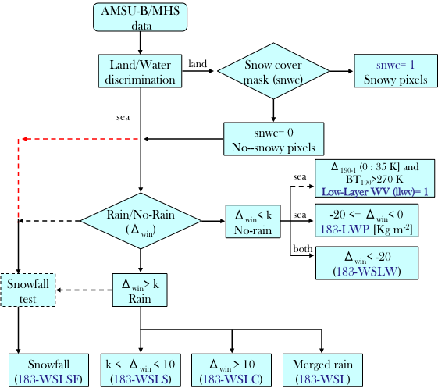
The 183-WSL algorithm^{[1,2]}
The Water vapor Strong Lines 183 GHz (183-WSL) method exploits the complete suite of five channels from 90 to 190 GHz of the cross-track scanning radiometer AMSU-B/MHS flying on the NOAA and MetOp satellites. The nominal field of view at nadir is 1.1° (about 16 km).
The water vapour absorption band at 183.31 GHz (3 channels) is used through the precipitation retrieval method which estimates the precipitation intensity at the ground and classify the rainfall type as convective and stratiform.
[1] Laviola S., and Levizzani V., 2011: The 183-WSL fast rain rate retrieval algorithm. Part I: Retrieval design”. Atmos. Res., 99, 443-461
[2] Laviola S., et al, 2013: The 183-WSL fast rainrate retrieval algorithm. Part II: Validation using ground radar measurements. Atmos. Res., 134, 77-86.

Slide 11
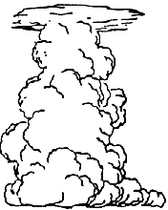
The MicroWave Cloud Classification (MWCC) method
The MicroWave Cloud Classification (MWCC) method is physically based on the impact of clouds (perturbed signal) on the microwave signal at 183.31 GHz respecting to the clear sky condition (unperturbed signal). The perturbation on a certain frequency is evaluated with the ratio between the measurement of radiances and its absolute maximum value (clear sky conditions). All perturbations of different frequencies are combined in a cascade test, which computes the scalar P_{MWCC} indicating the type of clouds for each observed pixel.
Technical details
The MWCC method is based on the water vapor frequencies of the AMSU-B/MHS sensors. An extension to other frequencies is considered for the new version.
The spatial resolution is ≈ 16 km (nadir)
The sensitivity increases for clouds higher than 2 km. The retrieval of low clouds (< 2 km) is really (obviously) problematic.
The MWCC method has been tested at mid-latitudes and now it will be applied on the Tropics.
Higher troposphere
Middle troposphere
Lower troposphere
P_{MWCC}
No clouds
Stratiform-1
Stratiform-2
Stratiform-3
Convection-1
Convection-2
Convection-3

Slide 12
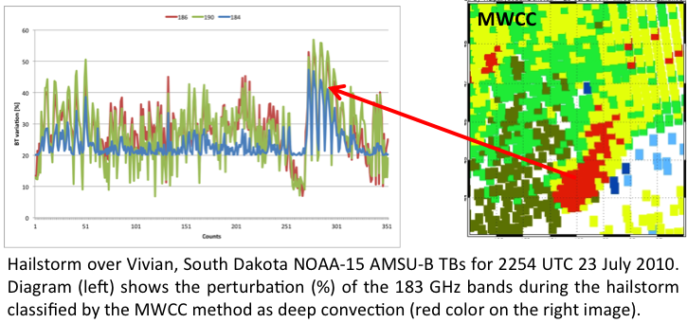
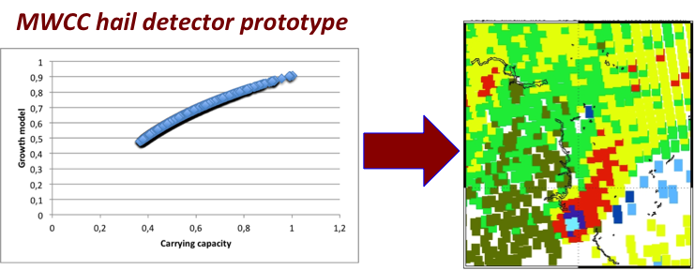
The MicroWave Cloud Classification (MWCC) method - Hail
Recently, the computational scheme of the MWCC was improved with a probability-based prototype algorithm for hail detection.

