Slide 1
Inter-calibration of Himawari-8/AHI using CrIS as a reference
Masaya Takahashi
Japan Meteorological Agency

Slide 2
Contents
Himawari-8/AHI Overview
AHI Specification
Observing Mode
Inter-calibration of Himawari-8/AHI IR bands
Method
Results
Summary and Future Plans
Acknowledgement
JMA is grateful to NOAA for our collaboration on AHI/ABI Cal/Val activities

Slide 3
Advanced Himawari Imager (AHI) on Himawari-8
Band | Central Wavelength [μm] | Spatial Resolution [km] | # of Detectors* | Levels of digital count [bit]
7 | 3.9 | 2 | 332 (6) | 14
8 | 6.2 | 2 | 332 (6) | 11
9 | 6.9 | 2 | 332 (6) | 11
10 | 7.3 | 2 | 332 (6) | 12
11 | 8.6 | 2 | 332 (6) | 12
12 | 9.6 | 2 | 332 (6) | 12
13 | 10.4 | 2 | 408 (6) | 12
14 | 11.2 | 2 | 408 (6) | 12
15 | 12.4 | 2 | 408 (6) | 12
16 | 13.3 | 2 | 408 (6) | 11
Band | Central Wavelength [μm] | Spatial Resolution [km] | # of Detectors* | Levels of digital count [bit]
1 | 0.47 | 1 | 676 (3) | 11
2 | 0.51 | 1 | 676 (3) | 11
3 | 0.64 | 0.5 | 1460 (3) | 11
4 | 0.86 | 1 | 676 (6) | 11
5 | 1.6 | 2 | 372 (6) | 11
6 | 2.3 | 2 | 372 (6) | 11
# of redundant detector columns per side

Slide 4
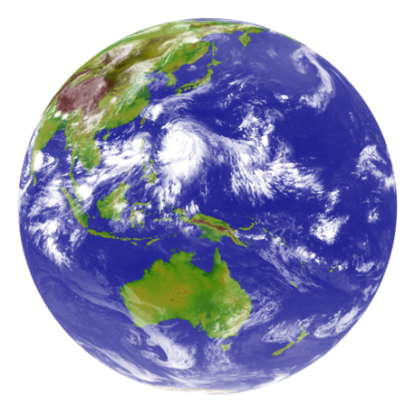
Full Disk / Regional Observation in 10 minutes Repeat Cycle
Preliminary fixed area
Flexible observation area
Full Disk Observation
every 10 min.
Region 1
2000 x 1000km
(NE Japan)
Every 2.5 min.
Region 2
2000 x 1000km
(SW Japan)
Every 2.5 min.
Region 3
1000 x 1000 km
(Target Area)
Every 2.5 min.
Region 4
1000 x 500 km
(Landmark Area)
Every 30 sec.
Region 5
1000 x 500 km
(Landmark Area)
Every 30 sec.
Lunar observation: performed using Landmark Area (Region 5)

Slide 5
Himawari-8/AHI Radiometric Calibration Methods
Band [µm] | Solar Diffuser | Black Body | GSICS (IR) | GSICS (DCC) | GSICS (Moon) | RT simulation | Ray matching | GEO-GEO
Band1 [0.47] | Y |  |  | (Y) | (Y) | Y | Y | Y
Band2 [0.51] | Y |  |  | (Y) | (Y) | Y | Y | Y
Band3 [0.64] | Y |  |  | (Y) | (Y) | Y | Y | Y
Band4 [0.86] | Y |  |  | (Y) | (Y) | Y | Y | Y
Band5 [1.6] | Y |  |  | (Y) | (Y) | Y | Y | Y
Band6 [2.3] | Y |  |  | (Y) | (Y) | Y | Y | Y
Band7 [3.9] |  | Y | Y |  |  |  |  | Y
Band8 [6.2] |  | Y | Y |  |  |  |  | Y
Band9 [6.9] |  | Y | Y |  |  |  |  | Y
Band10 [7.3] |  | Y | Y |  |  |  |  | Y
Band11 [8.6] |  | Y | Y |  |  |  |  | Y
Band12 [9.6] |  | Y | Y |  |  |  |  | Y
Band13 [10.4] |  | Y | Y |  |  |  |  | Y
Band14 [11.2] |  | Y | Y |  |  |  |  | Y
Band15 [12.4] |  | Y | Y |  |  |  |  | Y
Band16 [13.3] |  | Y | Y |  |  |  |  | Y
Inter-calibration of VIS/NIR bands using VIIRS
-> Poster presentation
(Y) : under implementation

Slide 6
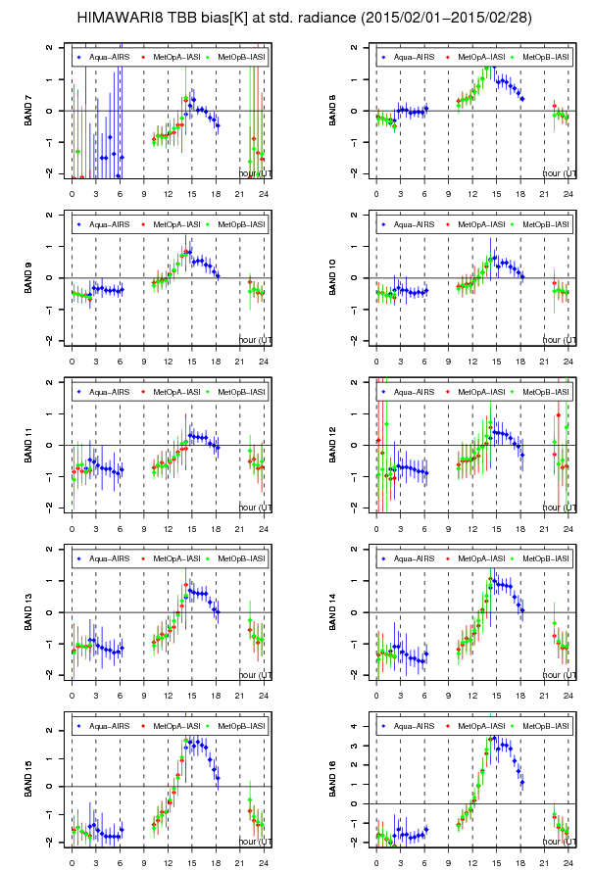
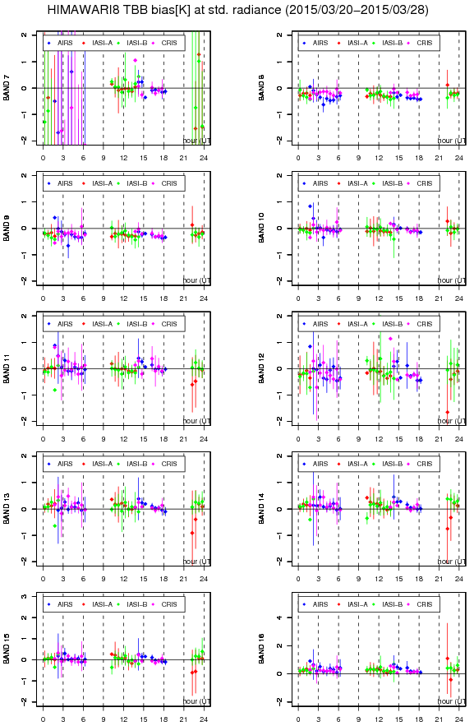
GSICS Approach Helped AHI Commissioning Phase Activity
GSICS approach revealed diurnal variation of IR calibration performance due to a bug of ground processing software
3.9μm
6.2μm
3.9μm
6.2μm
Diurnal variation in commissioning phase data at the earliest stage
6.9μm
7.3μm
6.9μm
7.3μm
8.6μm
9.6μm
8.6μm
9.6μm
10.4μm
11.2μm
10.4μm
11.2μm
12.4μm
13.3μm
12.4μm
13.3μm
TB bias [K]
[UTC]

Slide 7
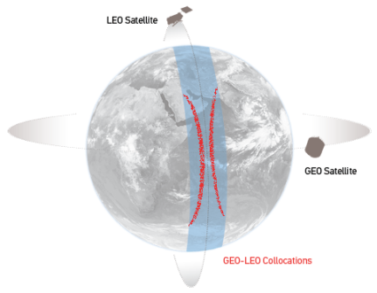
Inter-calibration using LEO Hyper-spectral Sounders as References
Reference instruments
Metop-[A,B]/IASI, Aqua/AIRS, S-NPP/CrIS
GEO/LEO collocation based on SNO approach
Temporal/Spatial/Geometric thresholds
Averaging GEO pixels to be equivalent to LEO FoV size (~12km)
Generation of GEO imager “super-channel”
Convolution of LEO spectra with GEO spectral response
Spectral gap (e.g. AHI 3.9 μm and CrIS):
compensated using “gap-filling” optimization method
Regression of GEO and LEO in radiance
Derivation of radiance correction (i.e. GSICS Correction)
Converted to TB for easy understanding
http://gsicswiki.net/
AHI-CrIS Collocation conditions
Time difference | 5 minutes
Viewing angle diff. | |cos(VZA_{CrIS})/cos(VZA_{AHI}) - 1| < 1 or 3%
Environment uniformity | Stdv. of AHI (18x18 pixels) < thresholds (band/scene dependent)

Slide 8
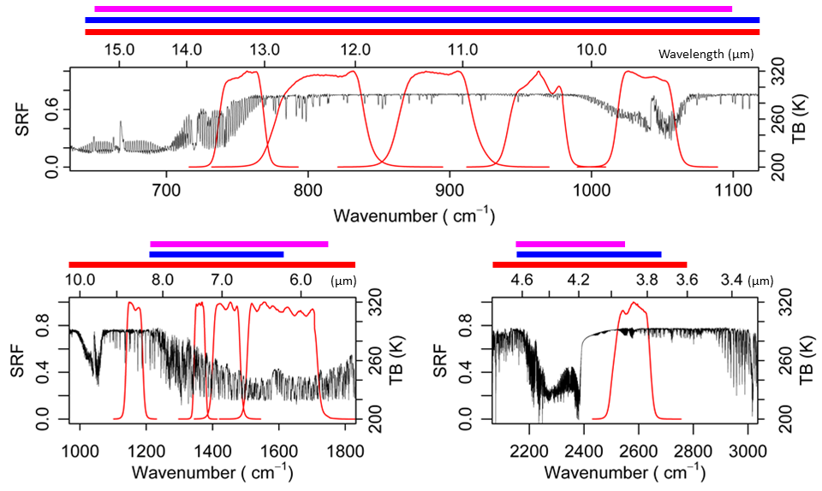
Spectral “Gap-filling” of CrIS to Generate AHI Super-channel
CrIS covers about 40% of AHI Band 7 (3.9μm)
Most spectral range of AHI Band 11 (9.6 μm): not covered by CrIS
CrIS
AIRS
IASI
#16 #15 #14 #13 #12
#10
#9 #8
#11
#7

Slide 9
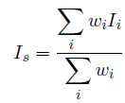
Himawari-8/AHI Band 7 (3.9μm)
S-NPP/CrIS (Valid, Missing channels)
Spectral “Gap-filling” method
(Tahara and Kato, 2009)
Formulation
a
For each GEO channel and each hyper sounder observing point
Log radiance estimated to prevent radiance from being negative
Simulated radiances for 8 model profiles
Tropic, US standard, Mid-latitude winter and summer profiles
Thick cloud at 500 hPa and 200 hPa for Tropics and US std.
Coefficients (c₀, c_{k}) computation
Solving least square problem by applying valid hyper sounder observations and corresponding simulated radiances
No NWP fields, no RT computation in operation
Estimated radiance of missing channel i
Simulated radiance of channel i for model profile k
Computation of GEO super-channel
I_{s}: GEO super channel
wi: weight for LEO channel i

Slide 10
TB Biases Converted from Radiance Regression
TB biases w.r.t. S-NPP/CrIS
(Data from 1-29 June 2016 are used)
B08 (6.2μm)
B07 (3.9μm)
B09 (6.9μm)
B10 (7.3μm)
B11 (8.6μm)
B12 (9.6μm)
TB Bias [K]
TB [K]
B13 (10.4μm)
B14 (11.2μm)
B15 (12.4μm)
B16 (13.3μm)

Slide 11
Time series of AHI TB biases w.r.t S-NPP/CrIS at standard scene
Band 7 (3.9μm)
Band 12 (9.6 μm)
TB Bias [K]
-1.5 0.5 0.5 1.5
TB Bias [K]
-1.5 0.5 0.5 1.5
~40 % of CrIS spectral coverage
Band 8 (6.2 μm)
Band 13 (10.4 μm)
TB Bias [K]
-1.5 0.5 0.5 1.5
TB Bias [K]
-1.0 0.5 0.5 1.0
Band 9 (6.9 μm)
Band 14 (11.2 μm)
TB Bias [K]
-1.5 0.5 0.5 1.5
TB Bias [K]
-1.0 0.5 0.5 1.0
Band 10 (7.3 μm)
Band 15 (12.4 μm)
TB Bias [K]
-1.5 0.5 0.5 1.5
TB Bias [K]
-1.0 0.5 0.5 1.0
Band 11 (8.6 μm)
Band 16 (13.3 μm)
TB Bias [K]
-1.5 0.5 0.5 1.5
Due to CrIS spectral coverage
TB Bias [K]
-1.0 0.5 0.5 1.0
Standard scene: typical scene defined as 1976 US Standard Atmosphere at nadir, at night, in clear sky, over the sea with SST=288.15K and a wind speed= 7m/s

Slide 12
Impacts of “Gap-filling” method on inter-calibration results (AHI 3.9μm)
Gap-filling method efficiently reduces the inter-calibration uncertainty
CrIS (valid, missing ch)
AIRS (valid, no-good, missing ch)
IASI-A (valid ch)

Slide 13
Impacts of “Gap-filling” method on inter-calibration results (AHI 8.6μm)
Gap-filling does not work in case of too big gap
CrIS (valid, missing ch)
AIRS (valid, no-good, missing ch)
IASI-A (valid ch)

Slide 14
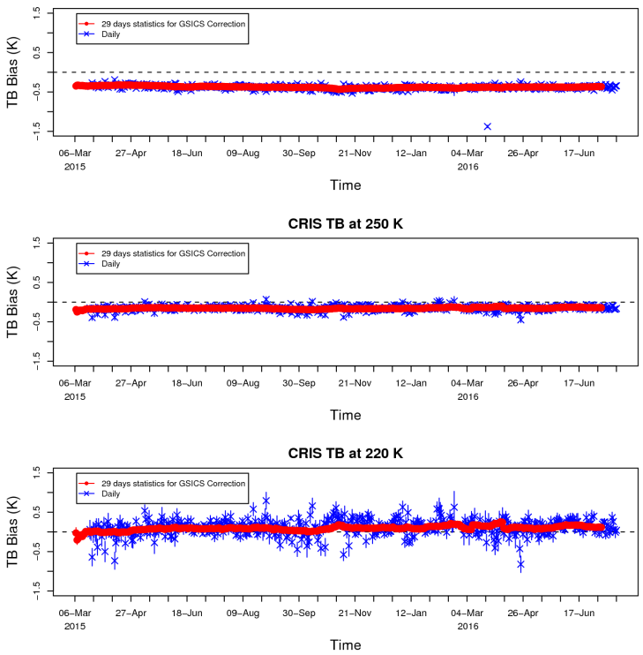
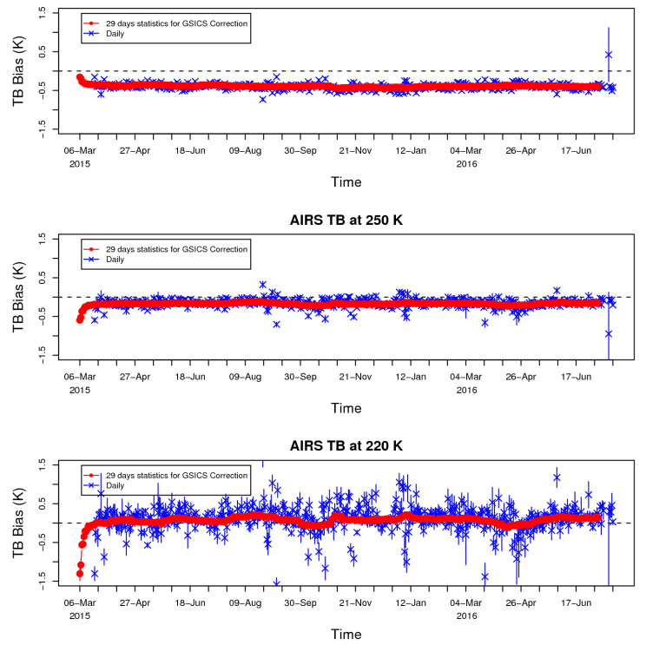
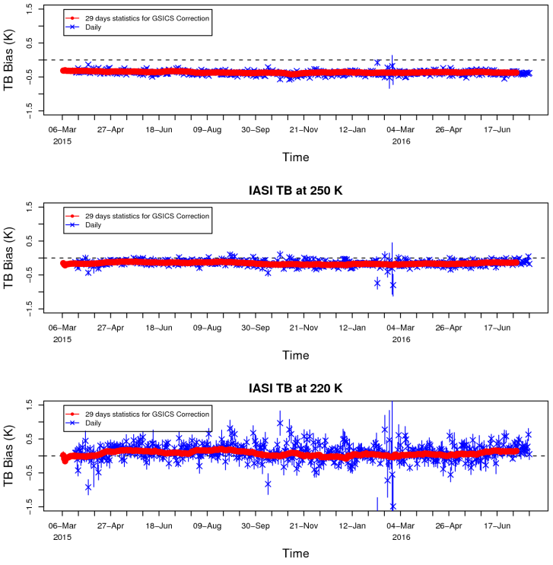
TB Bias Stability at different scenes
Similar results in all hyper sounders
AHI Tb biases: stable w.r.t. CrIS at cold scenes compared with others
Time series of Tb biases between hyper sounders and Himawari-8/AHI Band 12 (9.6μm)
w.r.t. S-NPP/CrIS w.r.t. Aqua/AIRS w.r.t. Metop-A/IASI
at 290K at 290K at 290K
at 250K at 250K at 250K
at 220K at 220K at 220K

Slide 15
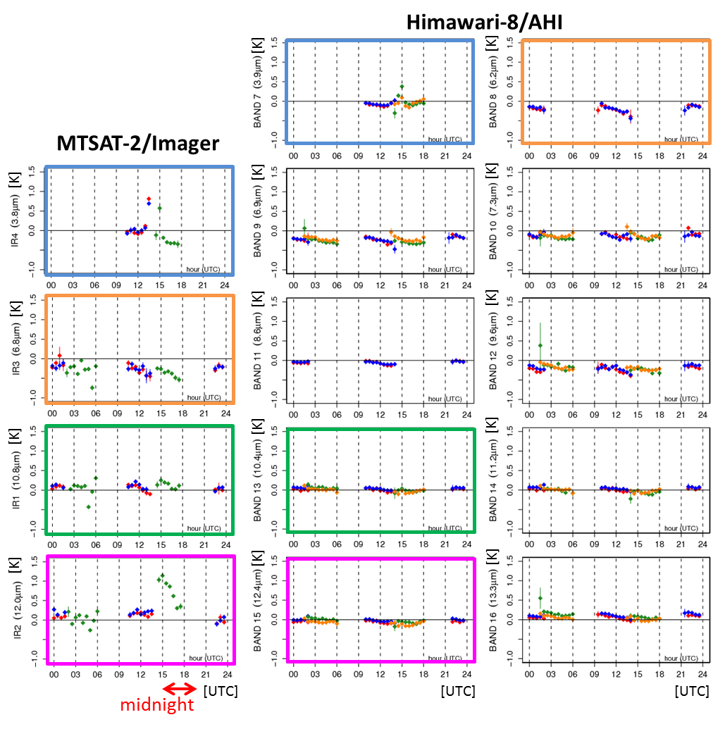
Time Dependence of Tb Biases
3.9μm
6.2μm
MTSAT-2:
Diurnal variation of Tb biases during midnight
Himawari-8
No significant diurnal variation
3.7μm
6.9μm
7.3μm
6.8μm
8.6μm
9.6μm
Multiple references:
very important to validate diurnal calibration biases
11.0μm
10.4μm
11.2μm
Reference sensors:
Metop-A/IASI
Metop-B/IASI
Aqua/AIRS
S-NPP/CrIS
12.0μm
12.4μm
13.3μm
Statistics in February 2016

Slide 16
Summary and Future Plan
Inter-calibration of Himawari-8/AHI IR bands
Method
Metop-[A,B]/IASI, Aqua/AIRS and S-NPP/CrIS as references
Based on SNO approach
Spectral “gap-filling” method is applied if the reference sensor does not cover spectral range of GEO channel
Results
All IR bands are very stable, Tb biases < 0.2K at standard scene
No significant diurnal calibration biases
Multiple references: important/useful to validate them
Future Plans
Inter-calibration results will be included in L1B equivalent data (i.e. Himawari Standard Data) once the product gets GSICS stamp
Generation of “Prime GSICS Correction” (blending multiple references results)

Slide 17
Thanks for Your Attention

Slide 18
IR on-board Calibration
$$Robs = F\left(θ,φ\right)\left(qnC^{2}+mnC+bn\right) − G\left(θ\right)R_{Mns} − H(θ,φ)R_{Mew}$$
q_{n}: pre-launch test value
m_{n}: updated using blackbody observation for each full-disk observation
b_{n}: updated using deep space observation for each swath
R_{obs}: Observed radiance
C: Raw digital count
q_{n}, m_{n}, b_{n}: Coefficients
n: Detector ID
θ, φ : Incidence angle to SM
F(θ, φ), G(θ, φ), Η(θ, φ): Parameters on scan mirror emissivity
R_{Mns}, R_{Mew}: NS/EW scan mirror radiance

