Slide 1
GSICS Research Working Group (GRWG)
Dohyeong Kim, Chair
Tim Hewison, Vice Chair
GSICS Users’ Workshop, College Park, 11 August 2016

Slide 2
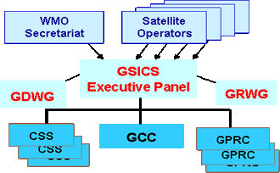
GRWG Structure
NOAA GPRC
User Support
Operation
Data
Web
…
Research
UV
VIS
Lunar
DCC
…
IR
MW
GSICS Research Working Group
Chair: Dohyeong Kim
Vice-Chair: Tim Hewison
Vice-Chair: Scott Hu
UV Sub-Group
Chair: Rose Munro
IR Sub-Group
Chair: Tim Hewison
VIS/NIR Sub-Group
Chair: Dave Doelling
Microwave Sub-Group
Chair: Ralph Ferraro
http://gsics.wmo.int/gsics-structure.html

Slide 3
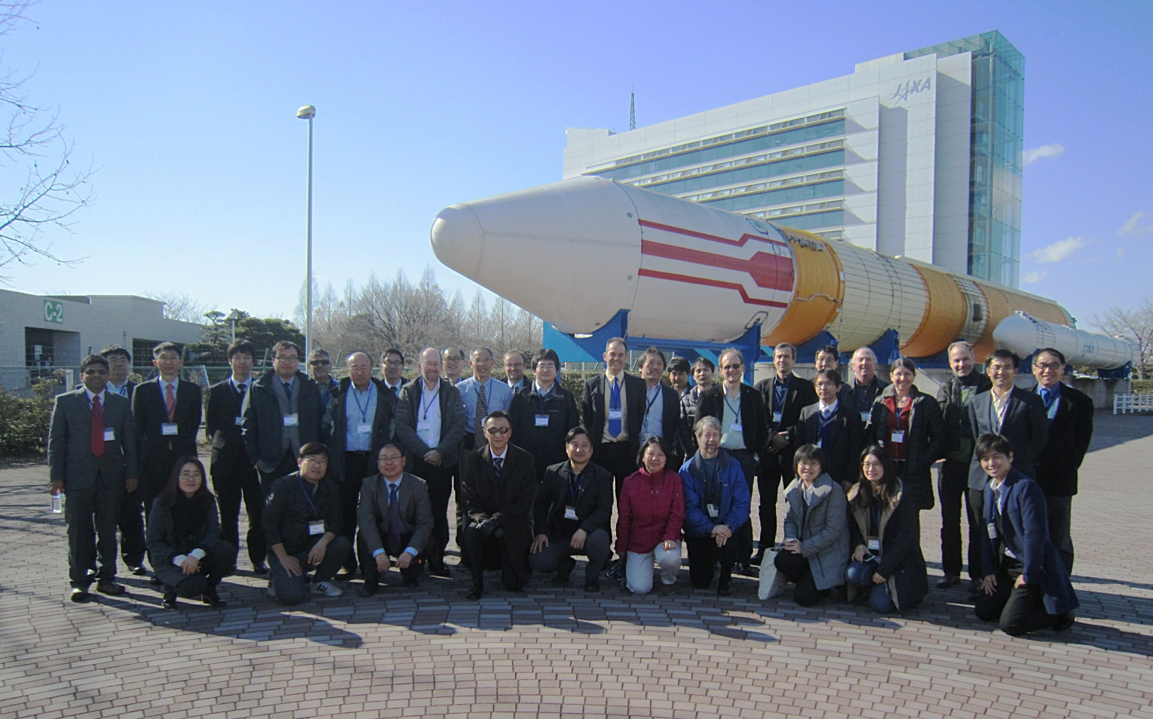
Annual Meeting
Every March since 2007
Monday: Mini Conference
Tuesday: Agency and WG Briefing
Wednesday: GRWG & GDWG split
Thursday: GRWG & GDWG split
Friday: Summary and Actions

Slide 4
 | Mini Conference Agenda
 | Chair: Larry Flynn
9:00 | Tim Hewison | EUMETSAT | Introduction to Mini Conference & GSICS | 1a | 0:20
9:20 | Chu Ishida | JAXA | Welcome to JAXA | 1b | 0:10
9:30 | Yoshiteru Kitamura | JMA | Welcome address | 1c | 0:10
9:40 | Dave Doelling | NASA | CLARREO Pathfinder | 1d | 0:20
10:00 | Rob Roebeling | EUMETSAT | FIDUCEO - Defining FCDR uncertainties | 1e | 0:20
10:20 |  |  | Coffee break |  | 0:30
10:50 | Hu Xiuqing "Scott" | CMA | Progress on ground-based lunar observations | 1f | 0:20
11:10 | Fred Wu | NOAA | Lunar radiance calibration | 1g | 0:20
11:30 | Toru Koyama | AIST | Lunar calibration based on SELENE/SP data | 1h | 0:20
11:50 | Lunch Break |  |  |  | 1:10
 | Chair: Misako Kachi
13:00 | Fougnie Bertrand | CNES | Toward a wider use of the moon for in-flight characterization | 1i | 0:20
13:20 | Seongick Cho | KIOST | Operation and Calibration of GOCI | 1j | 0:20
13:40 | Hiroshi Murakami | JAXA | Himawari-8 Ocean Color and Aerosol | 1k | 0:20
14:00 | Yukio Kurihara | JAXA | Himawari-8 SST | 1l | 0:20
14:20 | Hiroshi Murakami | JAXA | Calibration activities of GCOM-C/SGLI | 1m | 0:20
14:40 | Kei Shiomi | JAXA | Calibration activities of GOSAT | 1n | 0:20
15:00 |  |  | Coffee break |  | 0:30
15:30 | Takeo Tadono | JAXA | Calibration activities of ALOS/AVNIR2 PRISM | 1o | 0:20
15:50 | Takeshi Motooka | JAXA | Calibration activities of ALOS-2/PALSAR | 1p | 0:20
16:10 | Takeshi Masaki | JAXA | Calibration activities of TRMM & GPM Radars | 1q | 0:20
16:30 | Marehito Kasahara | JAXA | Calibration activities of GCOM-W/AMSR2 | 1r | 0:20
16:50 | Ralph Ferraro | NOAA | Intercalibration on ATMS and SAPHIR | 1s | 0:20
17:10 | Shengli Wu (Remote) | CMA | Intercalibration on the FY3/MWRI | 1t | 0:20
17:30 | Takashi Maeda | JAXA | Intercalibration of AMSR2 and PMWs | 1u | 0:20
17:50 | Likun Wang | NOAA | New SNO LoS based fast/acccurate algorithm | 1v | 0:20
18:10 | All |  | Discussion |  | 0:20
18:30 | END

Slide 5
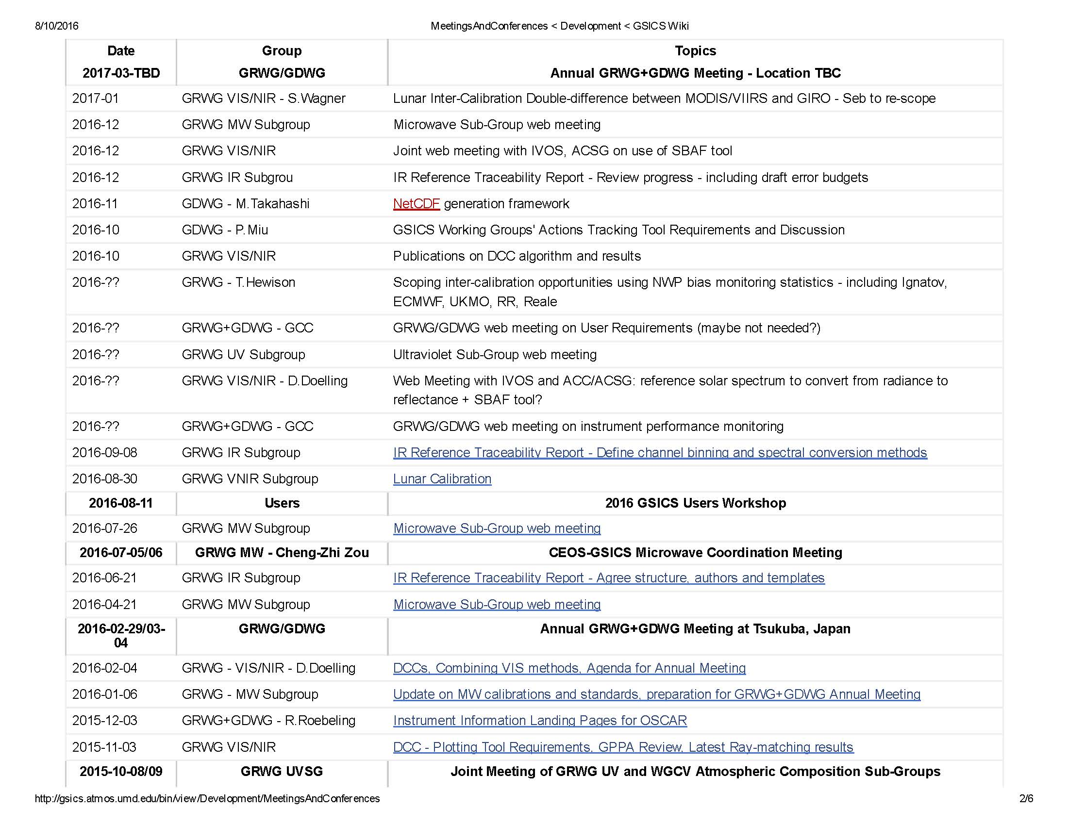

Slide 6
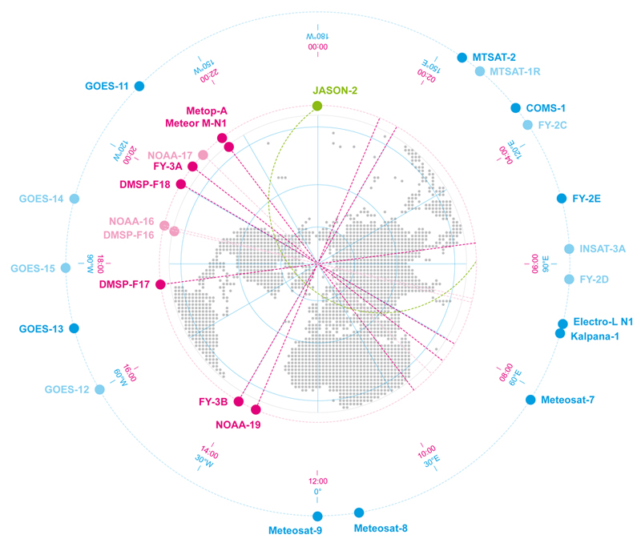
GEO-GEO Comparisons
Based on collocated observations
GEO imager pairs
Need Spectral Band Adjustment Factors (SBAFs)
Hewison, 2016 GSICS Annual Meeting

Slide 7
Comparing GEO-LEO and GEO-GEO Differences
To Validate Uncertainty estimates
Ensure consistency
Generate global L2 products
Hewison, 2016 GSICS Annual Meeting

Slide 8
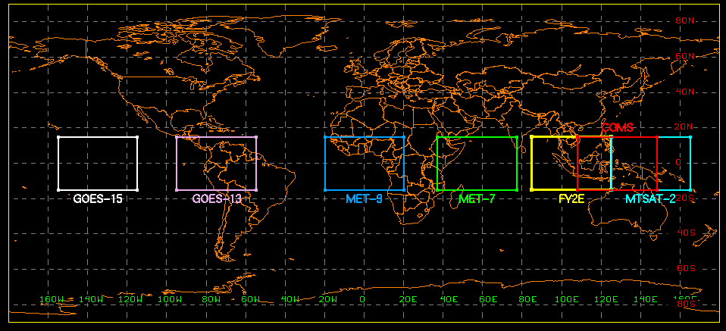
GEO DCC Domain
±15° latitude and ±20°E-W longitude from a GEO’s sub-satellite point.
 | GOES-15 | GOES-13 | MET-9 | MET-7 | FY2E | COMS | MTSAT-2
Orbit | 135°W | 75°W | 0W | 57°E | 105°E | 128°E | 145°E
Doeling, 2016 GSICS Annual Meeting

Slide 9
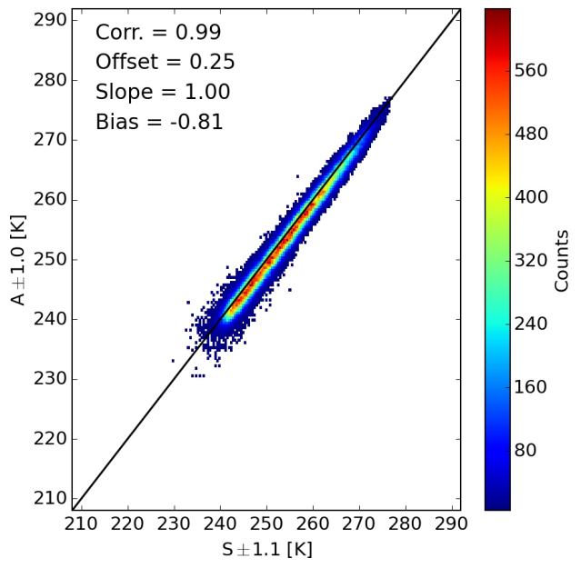
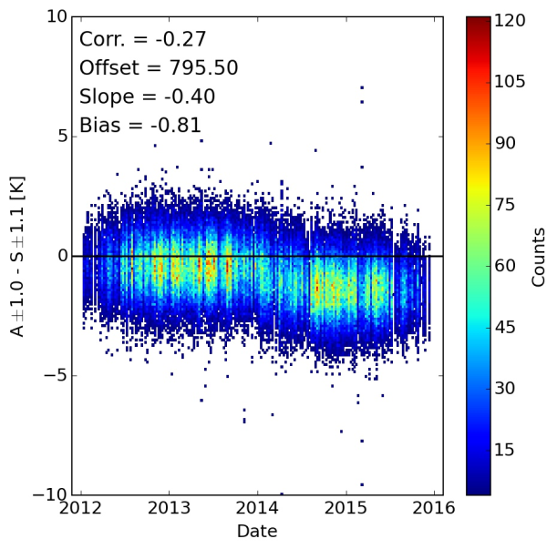
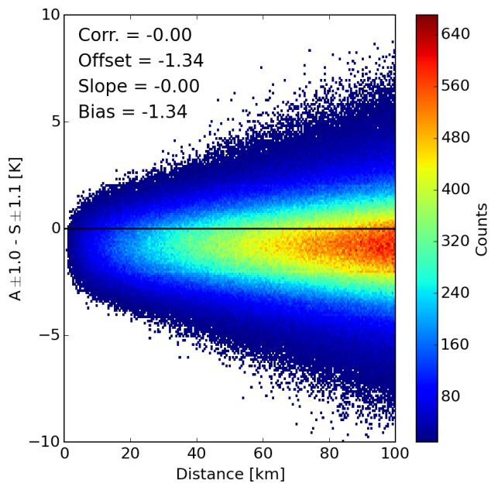
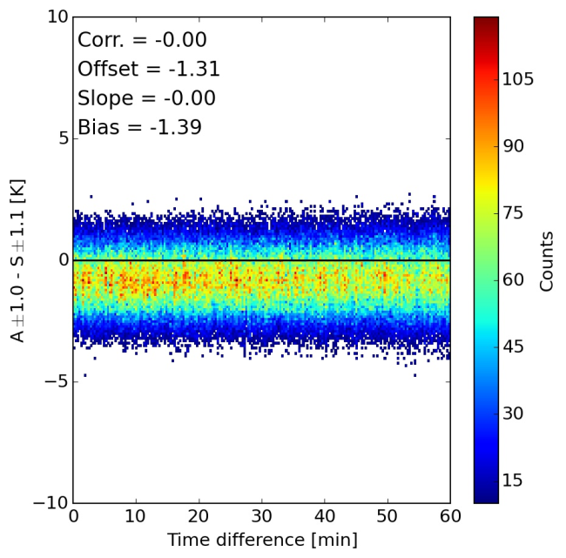
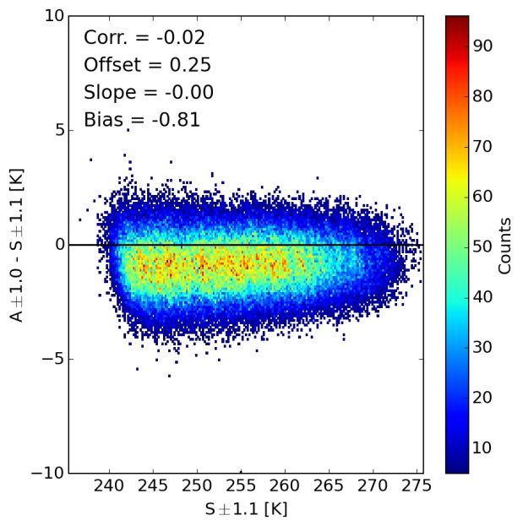
SAPHIR-ATMS Comparison
Plots for all 4 similar
channel pairs are
available
Ferraro, 2016 GSICS Annual Meeting

Slide 10
Solar UV Spectra Project
Same spectral region (300-320 nm) and absolute scale used for all panels in this figure.
Effect of bandpass change between KNMI and SAO is apparent, even with same input data set.
Satellite measurements (bottom two panels) have lower resolution.
WHI spectrum shows change in original instrument resolution when SIM data begin at 310 nm.
Flynn, 2016 GSICS Annual Meeting
Notes:
Matthew DeLand
Science Systems and Applications, Inc. (SSAI) Lanham, Maryland USA
GRWG Meeting – UV Subgroup Darmstadt, GERMANY 27 March 2014

Slide 11
Interaction with CEOS
Joint GRWG-UVSG and CEOS WGCV-ACSG Meeting
Joint Meeting for GSICS Research Working Group UV Sub-Group (GRWG-UVSG) and CEOS Working Group on Calibration and Validation – Atmospheric Composition Sub-Group (CEOS WGCV-ACSG)
NOAA/NCWCP, College Park, MD
8-9 October 2015
User survey to assess the most appropriate focus for GRWG-UVSG
Joint GRWG-MWSG and CEOS WGCVMWSG Meeting
Joint Meeting for GSICS Research Working Group Microwave Sub-Group (GRWG-MWSG) and CEOS Working Group on Calibration and Validation – Microwave Sub-Group (CEOS WGCV-MWSG)
National Space Science Center, Chinese Academy of Sciences, Beijing, China
6-7 July 2016
Cal/Val of S-NPP ATMS and FY-3 MWTS/MWRI/MHTS.
Inter-calibration involving ATMS, SAPHIR, AMSU-B, SSM/T-2, COSMIC RO.
Joint GRWG and CEOS WGCV for the climate monitoring
[Action] The GRWG Chair to invite the CEOS WGCV to work on a joint statement on procedures, best practices and calibration resources required to ensure consistency of data records through accurate and homogeneous calibration, as an input to the Architecture for Climate Monitoring from Space
Notes:
A mini-survey was conducted at the joint GSICS UV sub-group and CEOS WGCV-ASSG meeting in order to define the scope of the UV sub-group.

Slide 12
Prime Correction
Reference-1 (Anchor)
Monitored Instrument
Reference-2
(Secondary)
GSICS Correction, g₁ Mon➔1
GSICS Correction, g₂ Mon➔2
Correcting the Corrections and Blending References
-
Derived by GSICS
Delta
Correction, g_{1/2}
2➔1
+
Action: GRWG.2016.3e.1: Tim Hewison to consider revising terminology used in the current “Primary GSICS Corrections”, during demonstration phase (closed)
Modified
Correction, g_{2,1/2}
Mon ➔2➔1
g̅
Prime GSICS Correction, g₀ Mon➔1
Mon➔Ref1
Applied
by User

Slide 13
Summary
Overview of GSICS Research Working Group (GRWG) activities.
Examples of GRWG sub-group activities.
More details in the sessions for MW, IR, VIS, and UV.
Notes:
A mini-survey was conducted at the joint GSICS UV sub-group and CEOS WGCV-ASSG meeting in order to define the scope of the UV sub-group.

Slide 14
backup

Slide 15
GSICS Research Working Group (GRWG)

Slide 16
Overview
Introduction
GSICS Research Working Group
Sub-Group
IR, VIS/NIR, MW, UV
Issues for GSICS Users

Slide 17
2016 GRWG/GDWG Annual Meeting
Monday: Mini Conference
Tuesday: Sub-Group Briefing Report + Agency Reports(Plenary)
Wednesday: GRWG : Plenary + IR Sub-Group, GDWG
Thursday: GRWG : VIS/NIR Sub-Group (Lunar + DCC) + UV Sub-Group, GDWG
Friday: Wrap-up(Plenary)

Slide 18
 | Mini Conference Agenda
 | Chair: Larry Flynn
9:00 | Tim Hewison | EUMETSAT | Introduction to Mini Conference & GSICS | 1a | 0:20
9:20 | Chu Ishida | JAXA | Welcome to JAXA | 1b | 0:10
9:30 | Yoshiteru Kitamura | JMA | Welcome address | 1c | 0:10
9:40 | Dave Doelling | NASA | CLARREO Pathfinder | 1d | 0:20
10:00 | Rob Roebeling | EUMETSAT | FIDUCEO - Defining FCDR uncertainties | 1e | 0:20
10:20 |  |  | Coffee break |  | 0:30
10:50 | Hu Xiuqing "Scott" | CMA | Progress on ground-based lunar observations | 1f | 0:20
11:10 | Fred Wu | NOAA | Lunar radiance calibration | 1g | 0:20
11:30 | Toru Koyama | AIST | Lunar calibration based on SELENE/SP data | 1h | 0:20
11:50 | Lunch Break |  |  |  | 1:10
 | Chair: Misako Kachi
13:00 | Fougnie Bertrand | CNES | Toward a wider use of the moon for in-flight characterization | 1i | 0:20
13:20 | Seongick Cho | KIOST | Operation and Calibration of GOCI | 1j | 0:20
13:40 | Hiroshi Murakami | JAXA | Himawari-8 Ocean Color and Aerosol | 1k | 0:20
14:00 | Yukio Kurihara | JAXA | Himawari-8 SST | 1l | 0:20
14:20 | Hiroshi Murakami | JAXA | Calibration activities of GCOM-C/SGLI | 1m | 0:20
14:40 | Kei Shiomi | JAXA | Calibration activities of GOSAT | 1n | 0:20
15:00 |  |  | Coffee break |  | 0:30
15:30 | Takeo Tadono | JAXA | Calibration activities of ALOS/AVNIR2 PRISM | 1o | 0:20
15:50 | Takeshi Motooka | JAXA | Calibration activities of ALOS-2/PALSAR | 1p | 0:20
16:10 | Takeshi Masaki | JAXA | Calibration activities of TRMM & GPM Radars | 1q | 0:20
16:30 | Marehito Kasahara | JAXA | Calibration activities of GCOM-W/AMSR2 | 1r | 0:20
16:50 | Ralph Ferraro | NOAA | Intercalibration on ATMS and SAPHIR | 1s | 0:20
17:10 | Shengli Wu (Remote) | CMA | Intercalibration on the FY3/MWRI | 1t | 0:20
17:30 | Takashi Maeda | JAXA | Intercalibration of AMSR2 and PMWs | 1u | 0:20
17:50 | Likun Wang | NOAA | New SNO LoS based fast/acccurate algorithm | 1v | 0:20
18:10 | All |  | Discussion |  | 0:20
18:30 | END

Slide 19
Future GRWG/GDWG Meeting
Full schedule of monthly web meetings
Published on GSICS Development Wiki
2017 GRWG/GDWG Annual Meeting
Possible host in North America

Slide 20
Overview
Introduction
GSICS Research Working Group
Sub-Group
IR, VIS/NIR, MW, UV
Issues for GSICS Users

Slide 21
GRWG Chairing
GSICS Research Working Group
Chair: Dohyeong Kim
Vice-Chair: Tim Hewison
Vice-Chair: Scott Hu
UV Sub-Group
Chair: Rose Munro
IR Sub-Group
Chair: Tim Hewison
VIS/NIR Sub-Group
Chair: Dave Doelling
Microwave Sub-Group
Chair: Ralph Ferraro

Slide 22
Overview
Introduction
GSICS Research Working Group
Sub-Groups
IR, VIS/NIR, MW, UV
Issues for GSICS Users

Slide 23
IR Product Development within GSICS (IR)
GEO-LEO IR hyperspectral
Progress existing products to Operational Status
Promote new products to Demonstration Status
Application of Prime GSICS Correction concept
To merge multiple reference instruments
To allow corrections to cover diurnal cycle
Other Agencies’ plans for Prime GSICS Corrections?
Scope potential new GSICS products/deliverables
Alternative inter-calibration algorithms
Retrieved SRFs
GEO-GEO inter-calibration (part of GEO-ring)
LEO-LEO inter-calibration
Traceability of Reference Instruments
Plans for TANSO-FTS/2 & CLARREO
GSICS IR Reference Sensor Traceability and Uncertainty Report

Slide 24
GEO-GEO Comparisons
Based on collocated observations
GEO imager pairs
Need Spectral Band Adjustment Factors (SBAFs)

Slide 25
Comparing GEO-LEO and GEO-GEO Differences
To Validate Uncertainty estimates
Ensure consistency
Generate global L2 products
Ensure consistency

Slide 26
DCC calibration Status (VIS/NIR)
Started in 2014
NASA Langley provided all GPRCs verification data to validate the proper implementation according to ATBD submitted in 2011
The DCC method has been implemented by all GPRCs by 2015 and reported on their status and issues of the implementation
The DCC methodology provides excellent estimate of the relative degradation of the monitored instrument, however the GEO domain specific DCC methodology noise can be reduced by adjusting DCC methodology components as needed
DCC BRDF
KMA has evaluated BJ Sohn model
CNES has defined the more Lambertian part of the BRDF
DCC deseasonalization
NOAA, EUMETSAT, CMA have developed methods
DCC statistic (mean, mode, median) and identification (to provide sufficient sampling)

Slide 27
Outstanding issues on DCC (VIS/NIR)
Consistent GSICS DCC calibration and DCC ray-matching calibration results (<0.3%)
To work on the uncertainty of the calibration transfer. Comparison of Gridded, DCC (10km), DCC (30km) and DCC (Reg)
MET-9: <0.25%, MTSAT-2 : <0.29%, GOES-15 : <0.21%
GEO-LEO-VISNIR product(s) will enter Demonstration-Phase in 2016
SEVIRI vs. Aqua/MODIS product: in GPPA
At present, NASA DCC method is only available, but products (netCDF) will contain multiple calibration methods’ results in one file in future
NetCDF convention: almost fixed, but need to discuss the use of enhanced data model (grouping function on netCDF-4) within GRWG/GDWG
Requirement documents for GSICS Plotting Tool should be prepared by GRWG
Action: Dave to coordinate the writing of a paper on the GSICS DCC GEO-LEO algorithm.

Slide 28
GEO DCC domain (VIS/NIR)
A fixed DCC domain confined to ±15° latitude and ±20°E-W longitude, and centered at the GEO sub-satellite point is defined for each GEOSat.
 | GOES-15 | GOES-13 | MET-9 | MET-7 | FY2E | COMS | MTSAT-2
Orbit | 135°W | 75°W | 0W | 57°E | 105°E | 128°E | 145°E

Slide 29
Scope of Microwave Sub-Group (MW)
Understanding the users’ requirements for inter-calibration products for microwave instruments
Imagers + sounders – passive only (initially, but eventually consider active if there is a need…)
Retrospective calibration (CDR’s and their components like geolocation, scan biases, inter-satellite)
Forward looking calibration (near-real time uses)
Identifying existing products that could meet those requirements, but first….
Need to define criteria…Reference standards (sensor(s), models, calibration methodologies….)
And then a process that adheres to GSICS principles
Focusing on tools/algorithms like SNO, Double Difference, RTM, etc.
Might be something more feasible in near term?
Define data standards (jointly with GDWG)
Encourage the creators of those products to submit them to the GSICS Procedure for Product Acceptance (GPPA), once its defined for MW
Candidates include Cheng-Zhi Zou (MSU-AMSU), Karsten Fennig (SSMI), GPM X-Cal LUT’s
GSICS Products could be developed within the Microwave Sub-Group
Coordination with other groups (e.g., CEOS WGCV MW, GPM X-Cal) would also be required to generate standards and best practices

Slide 30
Focus Topics for 2016 (MW)
Defining CLEAR PATH for GSICS MW products and algorithms
Methodologies (TBD)
SNO, Double difference, etc.
Reference Standards (TBD)
A particular sensor? Likely to be wavelength dependent (e.g., window, O₂, H₂0);
A RTM?
LUT/Correction Tables (TBD)
Near real-time and climate; they will be different
Tying together other groups/opportunities
Engaging more closely GPM X-Cal (Wes, Rachel)
Formalizing linkages to CEOS MW subgroup (Cheng-Zhi, Xiaolong Dong)
CEOS-GSICS Microwave Coordination Meeting – 2016 July 5-6, Beijing,
China (at time of IGARSS 2016)
Can there be a common definition of standards?
Define some concrete collaborations
Expanding active participation – India, others? (Manik, Ralph)
Participation by subgroup at upcoming meetings of relevance:
GSICS; CEOS;CALCON, Microrad 2016, AMS Sat. Met, EUMESAT Satellite, etc.

Slide 31
GSICS UV Solar Spectra Project (UV)
The purpose of this project is to compare solar measurements from BUV (Backscatter Ultraviolet) instruments.
The first step is to catalog high spectral resolution solar reference spectra and agree on a common one to use for the project
For each instrument, participants should provide the following datasets:
Solar measurement for some date (wavelength scale, irradiance) adjusted to 1 AU
Wavelength scale and bandpass (Δλ, # of points, bandpass centers, normalized bandpass weights)
Synthetic spectrum from common reference (wavelength scale, irradiance)
Synthetic for wavelength scale perturbations (±0.01 nm) from common reference (wavelength scale, irradiance)
Synthetic from alternative reference spectra (wavelength scale, irradiance)
Solar activity pattern (wavelength, relative change)
Mg II index (if 280 nm is covered) Mg II 279.6 Mg I 285.2 (date, index)
Ca H/K index (if 391 nm to 399 nm is covered) CA II 393.4 and 396.8.
Goals:
Agreement at 1% on solar spectra relative to bandpass-convolved high resolution spectra as a transfer after identifying wavelength shifts and accounting for solar activity
Long-term solar spectral measurement drift and instrument degradation by using OMI solar activity pattern (with internal confirmation from Mg II Indices and scale factors)

Slide 32
Project to Compare Solar Measurements (UV)
High resolution solar reference spectra
Reference high resolution solar Spectra (SOLSTICE, SIM, Kitt Peak, etc.
– Everybody has a favorite. How do they compare?)
Mg II Index time series, Scale factors at high resolution
Instrument data bases
Bandpasses, wavelength scales (Shift & Squeeze codes)
Day 1 solar, time series with error bars (new OMI product) (Formats, Doppler shifts, 1 AU adjustments)
Mg II Indices and scale factors at instrument resolution
Reference calibration and validation papers
Using the information from above we can compare spectra from different
instruments and times

Slide 33
Overview
Introduction
GSICS Research Working Group
Sub-Group
IR, VIS/NIR, MW, UV
Issues for GSICS Users

Slide 34
Improving the lunar reference
Improvement of the reference standard for lunar calibration
to improve absolute accuracy
to reduce residual geometry dependencies (phase, librations)
The reference irradiance is generated for each observation of the Moon taken by an instrument by computing the lunar model(ROLO, GIRO)
Requirements for an Absolute Lunar Calibration Reference
reprocessing the ROLO telescope dataset using new algorithms
incorporating reliable new observational data e.g. PLEIADES
lunar radiometry e.g. SNPP VIIRS
collecting new radiometric measurements of the Moon
requirements:
high-accuracy, with traceability to SI
full spectral coverage at moderate spectral resolution
photometric geometry coverage (phase and librations) sufficient for high-precision modeling

Slide 35
Plans for Prime Correction
Proposed reference instruments selection scheme
Metop/IASI meets the essential requirements for all instruments in this class
Aqua/AIRS and SNPP/CrIS do not meet the essential requirements of all the instruments in this class (as they do not provide spectral coverage of the IR8.7 channel of Meteosat/SEVIRI)
Prime GSICS Corrections
Application to inter-calibrate a monitored instrument (lifetime covers multiple reference instruments)
to consider the choice of an anchor reference: based on the uncertainty on the overall time series
Delta Correction: to derive from the double difference between pairs of GSICS Corrections for overlap (from Delta Correction, different reference instruments directly traceable to the anchor reference)
the uncertainties on coefficients of the GSICS Corrections are used to derive weights which are applied to the individual GSICS corrections to merge
to support the generation of FCDR and ensure robust inter-calibration product for near-real-time operational use
EUM will not develop further or progress beyond demo without user

Slide 36
Plans for Prime Correction
Correcting the Corrections and Blending References
Reference-1 (Anchor)
Monitored Instrument
Reference-2
(Secondary)
GSICS Correction, g₁ Mon➔1
GSICS Correction, g₂ Mon➔2
-
Derived by GSICS
Delta
Correction, g_{1/2}
2➔1
+
Modified
Correction, g_{2,1/2}
Mon ➔2➔1
g̅
Prime GSICS Correction, g₀ Mon➔1
Mon➔Ref1
Applied
by User
Action: GRWG.2016.3e.1: Tim Hewison to consider revising terminology used in the current “Primary GSICS Corrections”, during demonstration phase (closed)

Slide 37
User Requirements
GSICS should contribute to architecture for Climate Monitoring from Space
Need to find a clear plan to communicate with users, collect and document the user requirements
To satisfy the split opinion of the user community, FCDRs should preferably provide three data representations that are internally convertible, i.e.:
Raw counts
original counts and associated auxiliary data/measurements
Sensor-equivalent harmonisation
keeping the monitored instruments’ characteristics
Reference-sensor equivalent homogenisation
pretending it behaves like the reference sensor
Action: GCC to coordinate input from GPRCs to attempt to identify at least one user for NRT, RAC and climate applications and interact with users to establish draft user requirements.
Action: Tim Hewison to resolve use of GSICS products for Meteosat IR with FIDUCEO.

Slide 38
Interaction with other groups
Joint GRWG-UVSG and CEOS WGCV-ACSG Meeting
Joint GSICS Research Working Group UV Sub-Group (GRWG-UVSG) and CEOS Working Group on Calibration and Validation - Atmospheric Composition Sub-Group (CEOS WGCV-ACSG) meeting
NOAA/NCWCP, College Park, MD, on the 8th and 9th October 2015
Organised around a set of questions which form the basis of a user survey designed to assess the most appropriate focus for the GSICS sub-group activities:
internal measurements, internal consistency methods, measurement characterizations, external methods and measurements, external resources etc
Joint GRWG and CEOS WGCV for the climate monitoring
[Action] The GRWG Chair to invite the CEOS WGCV to work on a joint statement on procedures, best practices and calibration resources required to ensure consistency of data records through accurate and homogeneous calibration, as an input to the Architecture for Climate Monitoring from Space
Notes:
A mini-survey was conducted at the joint GSICS UV sub-group and CEOS WGCV-ASSG meeting in order to define the scope of the UV sub-group.

