Slide 1
GSICS Data Management and Availability to Users
Masaya Takahashi¹ and Peter Miu²
a
Co-chairs of the GSICS Data Management Working Group
(1) Japan Meteorological Agency (2) EUMETSAT

Slide 2
Outline
Introduction to the GSICS Data Management Working Group
Who We Are / What We Do
GDWG Developments
Collaboration Servers; Each Partner’s GSICS Data and Products Server
Accessing/Visualizing GSICS Products (Demo)
Instrument Event Logging
Future Developments and Challenges

Slide 3
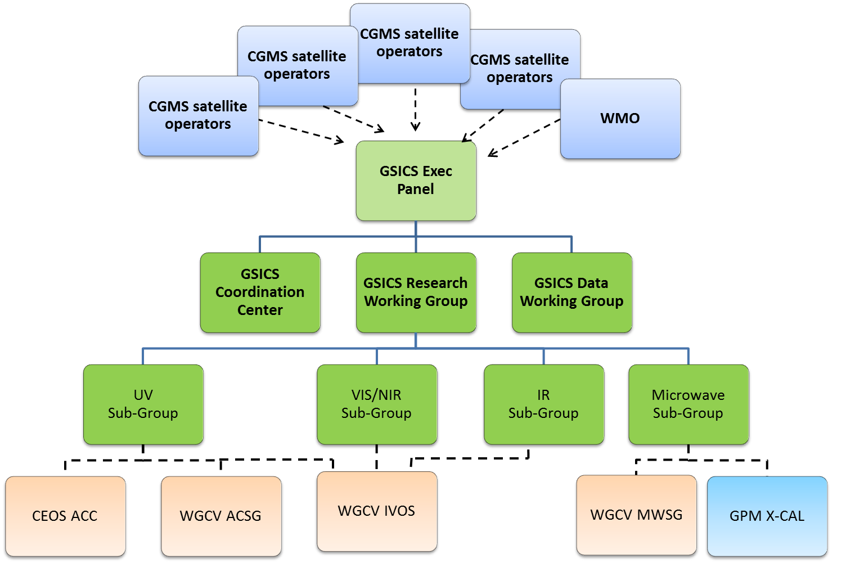
GSICS Data Management Work Group (GDWG)
GSICS Executive Panel (GEP)
Sets strategic priorities, and monitors and evaluates GSICS evolution and operations
GDWG
Advises GEP of the data management needs on the GSICS project as well assists in the planning/implementation of GSICS activities:
Developing specifications for GSICS products’ format, their catalogues and data servers
Coordinating the development and evolution of GSICS software tools
Reviewing/validating the existing GSICS system from a data management point of view
Key drivers for GDWG activities: GSICS Research Working Group & User requirements
Notes:
Well, what is GSICS?
The Global Space-based Inter-Calibration System (GSICS) is an initiative of CGMS and WMO, which aims to ensure consistent calibration and inter-calibration of operational meteorological satellite instruments.
One of the basic strategies of GSICS is to develop an integrated on-orbit cal/val system - initially by LEO-GEO Inter-satellite/inter-sensor calibration.
This will then allow us to provide corrections to improve the consistency between instruments, produce less biased level 1, and therefore, level 2 data, and ultimately, retrospectively re-calibrate archive data, which is of great interest in the climate monitoring community

Slide 4
GDWG Members
CMA | Zhe | Xu
CMA | Yuan | Li
CMA | Min | Min
CMA | Di | Xian
EUMETSAT | Peter | Miu (Co-chair)
EUMETSAT | Simon | Elliott
IMD | R.K. | Giri
JMA | Masaya | Takahashi (Co-chair)
KMA | Woo | JIN
NOAA | Manik | Bali
NOAA | Yuanzheng (Jordan) | Yao
ROSHYDROMET | Sergey | Uspensky
Great international collaboration among the agencies
E.g. Maintaining the GSICS Wiki by NOAA
Good relationship w/ GCC (at NOAA)

Slide 5
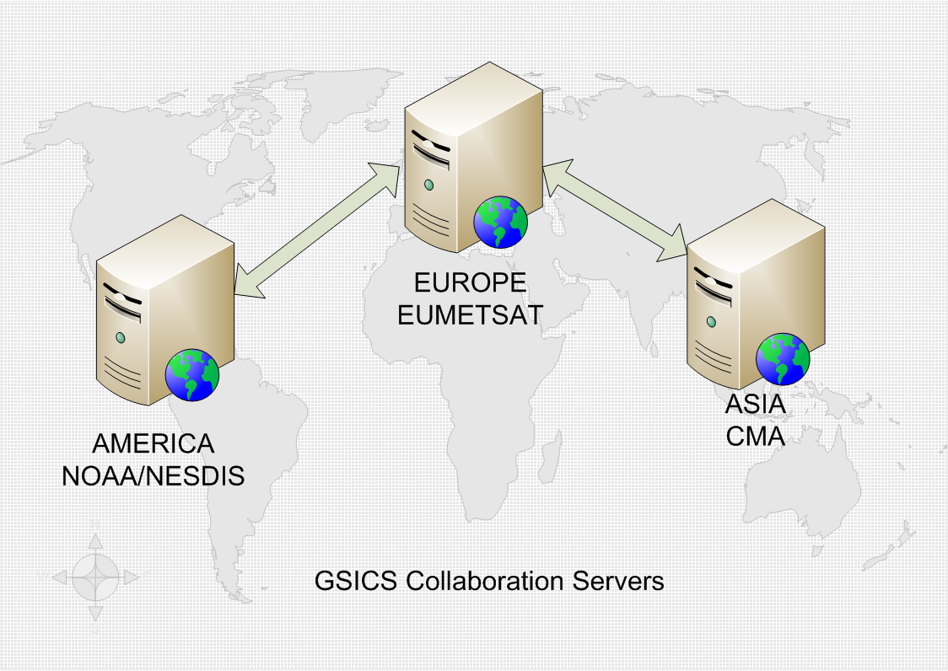
GDWG Developments: Collaboration Servers
What are the GSICS Collaboration Servers?
Individually known as Data and Products server
To provide a set of services for the GSICS user community to support data exchange and access to relevant inter-calibration products
NOAA/EUMETSAT/CMA have been implementing / maintaining the servers
Mirroring among the servers: underway

Slide 6
GDWG Developments: Collaboration Servers
What kinds of data are available on the Collaboration Servers?
Inter-calibration results (e.g. GEO-LEO-IR)
NetCDF, following WMO file naming and CF conventions
Hyperlink to the plotting tool (next slide)
Intermediate data
E.g. GEO-LEO collocation data for inter-calibration
Source data (e.g. IASI L1C in netCDF)
Observation data for inter-calibration

Slide 7
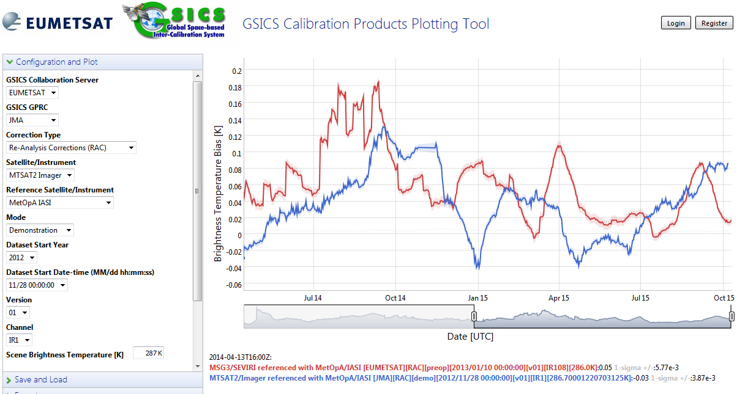
Accessing/Visualizing GSICS Products (Demo)
Collaboration servers (linked from gsics.wmo.int)
http://gsics.eumetsat.int/thredds, http://gsics.nesdis.noaa.gov/thredds
GSICS product plotting tool: http://gsics.tools.eumetsat.int/plotter/
Purpose: to allow product users/developers to quickly assess the GSICS products
Common look and feel among different sensors
GEO-LEO-IR is currently supported
Time series of 11μm channel TB difference w.r.t. Metop-A/IASI
Meteosat-10/SEVIRI 10.8 μm
MTSAT-2/Imager 10.8 μm

Slide 8
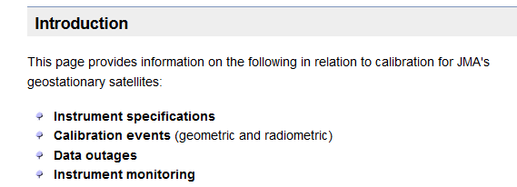
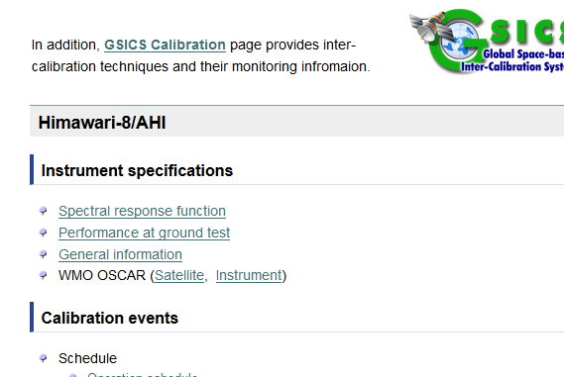
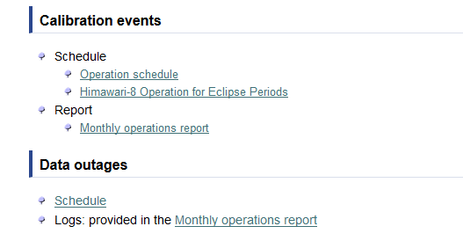
GDWG Developments:
Instrument Event Logging
Goal: to develop a uniform approach for presenting, logging, and monitoring calibration information across satellite operators
First step: to create/maintain stable landing pages
The pages are linked from the WMO-OSCAR
EUMETSAT/JMA/KMA pages are available, other agencies are also in progress
Second step: to adopt nomenclature and standards for instrument events
To identify a common set of parameters across space agencies
JMA’s calibration landing page

Slide 9
Future Developments and Challenges
Specification of GSICS Data Management Guidelines, Conventions and Standards to address the users’ needs for new GSICS products
Satellite events integration into the GSICS universe
Automated dissemination: getting GSICS products to the users in timely fashion
To investigate how to collaborate the development of the GSICS tools, how to coordinate efficiently join developments across different international agencies
User feedback (e.g. what products you would like to see) is very important to us, it helps with focusing on where to concentrate our resources!

Slide 10
Thanks for Your Attention
Questions?

