Slide 1
GSICS Products and Deliverables
Larry Flynn
with extensive input from GSICS Team Members
GSICS Users’ Workshop
August 11, 2016

Slide 2
Disclaimer
“The scientific results and conclusions, as well as any views or opinions expressed herein, are those of the author(s) and do not necessarily reflect the views of NOAA or the Department of Commerce."

Slide 3
Contents
Categorization
Core Products
Concerns and discussion
Examples
Model and Data Sets
Concern and discussion
Examples
Tools
Concern and discussion
Examples
GSICS Documents
GPRC and OSCAR Resources
Proposed Acceptance and Maturity for categorization.

Slide 4
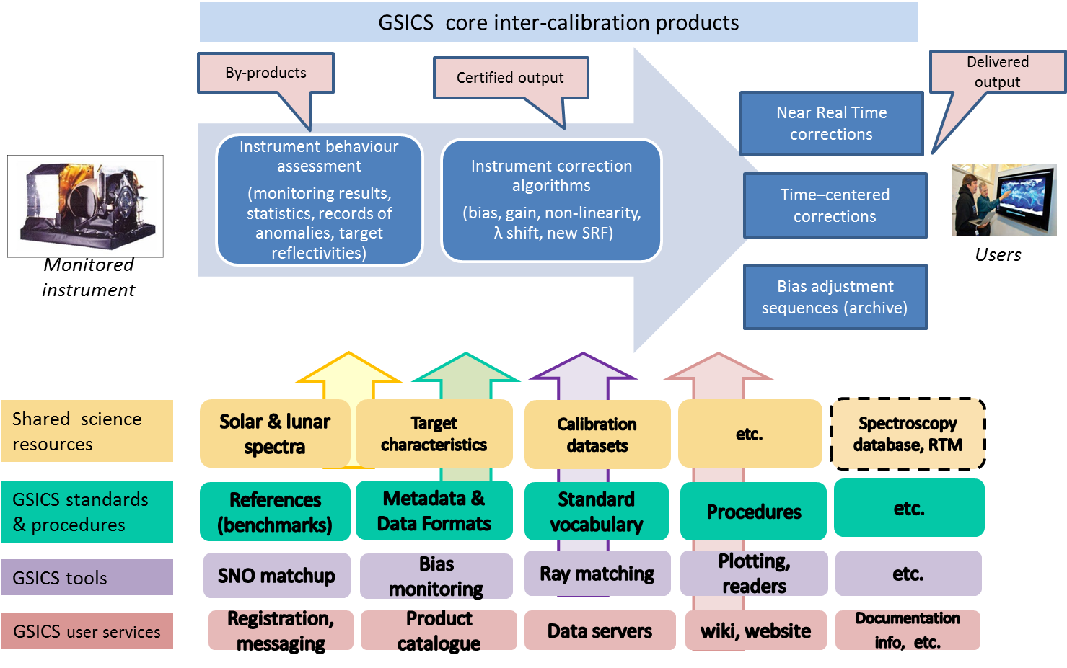
Schematic representation of GSICS holdings and deliverables (from J. Lafeuille)

Slide 5
GSICS inter-calibration products related to specific instruments.
Assessment of instrument behavior (results of instrument monitoring, statistical analysis of these results, records of anomalies, measured reflectivities of known targets, etc.)
Correction algorithms based on these assessments (correction algorithm for bias, gain, non-linearity, wavelength shift, change of SRF, etc.)
Corrections based on these algorithms (generated in near-real time, or time centered, or bias adjustment sequences of archived data). These corrections are either adjusted calibration coefficients, or adjustments to be applied by the user to the operational calibration coefficients . These inter-calibration products are generated by GSICS members in accordance with GSICS practices, standards, procedures and principles. Their compliance is assessed by a strict peer-review process. They are registered in the GSICS Catalogue.
GSICS tools
Infrastructure elements giving access to the data (THREDDS servers, etc.)
Software tools used for the generation of intercalibration products (for Simultaneous Nadir Observation matchup, Bias monitoring, Ray matching)
Software tools used by satellite data users (For example, Plotting)
Software tools to facilitate product development (Format readers, product generator, etc.
GSICS user services
Registration and messaging
Product catalogue
Wiki and websites
Documentation and information on different media to assist satellite data users and GSICS member agencies in understanding GSICS activities and using GSICS services.

Slide 6
GSICS best practices, standards and procedures. These practices, standards and procedures are supporting the generation of inter-calibration products, but may also be more widely applicable. They include for instance:
Metadata and data formats
Standard vocabulary
Procedures (for product acceptance, for versioning, for archiving, for selection of a reference sensor)
Best practices (for instance for pre-launch instrument characterization, or instrument performance monitoring)
Contributions to maintaining resources shared by the calibration community
Selected space-based reference instruments and calibration datasets
Ground-based calibration targets with their characteristics
Solar spectra, lunar spectra
Models and calibration datasets,
The calibration references are either ground-based or space-based, to provide the best possible support to radiometric measurement in the various spectral domains used by the WIGOS space-based component.

Slide 7
Categorization of existing and potential GSICS Holdings / Commodities
Core products
Subject to GPPA (Stamp of Approval)
Models and data sets
These should be reviewed by GSICS prior to recommendation for use.
Tools
These are made available because GSICS members find them useful.
GSICS Documents
These are related to products, protocol and procedures.
GPRC and OSCAR Documents and Resources
GSICS Disclaimer for external website content.

Slide 8
Core Products – Subject to GPPA
Products currently in the Catalog
Estimates of Level 1 changes other than simple biases
Biases with diurnal, seasonal or other variations
Wavelength scale drift estimates
SRF estimates
Estimates from vicarious calibration, especially for stability and transfer
DCC statistics, target reflectivities
Reference instrument records over some period of time
A stand-alone ECVR – E.g., this record is found to have xx accuracy and yy precision and zz stability over 20aa to 20bb for nighttime ocean scenes
Products connected with ECVRs or FCDRs
a sequence of bias adjustments
a record segment that is adjusted from beginning to end and has good error estimates included.
Notes:
LF: Reference instruments:
Agencies will compare to what they know.
Independent records are valuable.
Every user will have their own scorecard for what is “best”.
Stability must be continually monitored. Three reference instruments are good for this.
IR comparisons to Sonde collection, GSPRO and AVIRIS.
SBUV/2 CDR adjustment to NOAA-16 SBUV/2? to SAGE or MLS?
BI: Records from GEO instruments are not usually reprocessed.
LF: Do vicarious calibration methods require RTMs?

Slide 9
GSICS Product Catalog www.star.nesdis.noaa.gov/smcd/GCC/ProductCatalog.php
Product Type | Algorithm Type | Data Producer | Maturity Level | Monitored Instrument | Reference Instrument | Version | Data Start Date | Data End Date | Docs URL | Data URL
Near-Real Time Correction | GEO-LEO IR | EUMETSAT | Operational | MSG-3 SEVIRI | Metop-A IASI | 1 | 2013-01-24 | Present | Docs | Data
Near-Real Time Correction | GEO-LEO IR | NESDIS | Preoperational | GOES-13 Imager | Metop-A IASI | 1 | 2013-01-16 | Present | Docs | Data
Near-Real Time Correction | GEO-LEO IR | NESDIS | Preoperational | GOES-15 Imager | Metop-A IASI | 1 | 2013-01-16 | Present | Docs | Data
Re-analysis Correction | GEO-LEO IR | EUMETSAT | Operational | MSG-3 SEVIRI | Metop-A IASI | 1 | 2013-01-10 | Present | Docs | Data
Near-Real Time Correction | GEO-LEO IR | EUMETSAT | Operational | MSG-2 SEVIRI | Metop-A IASI | 1 | 2012-11-08 | Present | Docs | Data
Near-Real Time Correction | GEO-LEO IR | JMA | Demonstration | MTSAT-2 | Aqua AIRS | 1 | 2012-01-25 | Present | Docs | Data
Near-Real Time Correction | GEO-LEO IR | JMA | Demonstration | MTSAT-2 | Aqua AIRS & Metop-A IASI | 1 | 2012-01-25 | Present | Docs | Data
Near-Real Time Correction | GEO-LEO IR | JMA | Demonstration | MTSAT-2 | Metop-A IASI | 1 | 2012-01-25 | Present | Docs | Data
Re-analysis Correction | GEO-LEO IR | JMA | Demonstration | MTSAT-2 | Aqua AIRS | 1 | 2011-08-31 | Present | Docs | Data
Re-analysis Correction | GEO-LEO IR | NESDIS | Preoperational | GOES-15 Imager | Metop-A IASI | 1 | 2011-08-23 | Present | Docs | Data
Re-analysis Correction | GEO-LEO IR | EUMETSAT | Operational | MSG-2 SEVIRI | Metop-A IASI | 1 | 2011-01-01 | Present | Docs | Data
Re-analysis Correction | GEO-LEO IR | JMA | Demonstration | MTSAT-2 | Aqua AIRS & Metop-A IASI | 1 | 2010-08-03 | Present | Docs | Data
Re-analysis Correction | GEO-LEO IR | JMA | Demonstration | MTSAT-2 | Metop-A IASI | 1 | 2010-08-03 | Present | Docs | Data
Re-analysis Correction | GEO-LEO IR | NESDIS | Preoperational | GOES-13 Imager | Metop-A IASI | 1 | 2010-04-16 | Present | Docs | Data
Re-analysis Correction | LEO-LEO IR | EUMETSAT | Prototype | Metop-A HIRS | Metop-A IASI | 3 | 2009-05-13 | Present | Docs | Data
Near-Real Time Correction | LEO-LEO IR | EUMETSAT | Prototype | Metop-A HIRS | Metop-A IASI | 3 | 2009-04-29 | Present | Docs | Data
Re-analysis Correction | LEO-LEO VIS | NESDIS | Demonstration | NOAA-19 AVHRR | MODIS | 1 | 2009-02-10 | 2009-08-30 | Docs | Data
Re-analysis Correction | GEO-LEO IR | EUMETSAT | Demonstration | Meteosat-7 MVIRI | Metop-A IASI | 3 | 2008-06-01 | Present | Docs | Data
Re-analysis Correction | GEO-LEO IR | EUMETSAT | Demonstration | MSG-1 SEVIRI | Metop-A IASI | 3 | 2008-06-01 | Present | Docs | Data
Near-Real Time Correction | GEO-LEO IR | EUMETSAT | Demonstration | Meteosat-7 MVIRI | Metop-A IASI | 3 | 2008-05-15 | 2012-03-08 | Docs | Data
Near-Real Time Correction | GEO-LEO IR | EUMETSAT | Demonstration | MSG-1 SEVIRI | Metop-A IASI | 3 | 2008-05-15 | Present | Docs | Data
Re-analysis Correction | GEO-LEO IR | NESDIS | Demonstration | GOES-12 Imager | Metop-A IASI | 2 | 2007-07-16 | 2011-11-07 | Docs | Data
Re-analysis Correction | LEO-LEO VIS | NESDIS | Demonstration | Metop-A AVHRR | MODIS | 1 | 2007-07-07 | 2009-08-30 | Docs | Data
Re-analysis Correction | GEO-LEO IR | NESDIS | Demonstration | GOES-11 Imager | Metop-A IASI | 2 | 2007-06-16 | 2011-11-07 | Docs | Data
Re-analysis Correction | LEO-LEO VIS | NESDIS | Demonstration | NOAA-18 AVHRR | MODIS | 1 | 2005-07-07 | 2009-08-30 | Docs | Data
Re-analysis Correction | LEO-LEO VIS | NESDIS | Demonstration | NOAA-17 AVHRR | MODIS | 1 | 2002-07-07 | 2009-08-30 | Docs | Data
Re-analysis Correction | LEO-LEO VIS | NESDIS | Demonstration | NOAA-16 AVHRR | MODIS | 1 | 2001-03-09 | 2009-08-30 | Docs | Data
Re-analysis Correction | LEO-LEO VIS | NESDIS | Demonstration | NOAA-15 AVHRR | MODIS | 1 | 2000-07-07 | 2009-08-30 | Docs | Data
Re-analysis Correction | LEO-LEO VIS | NESDIS | Demonstration | NOAA-14 AVHRR | MODIS | 1 | 1995-01-08 | 2002-01-31 | Docs | Data
Re-analysis Correction | LEO-LEO VIS | NESDIS | Demonstration | NOAA-12 AVHRR | MODIS | 1 | 1991-12-06 | 1998-12-13 | Docs | Data
Re-analysis Correction | LEO-LEO VIS | NESDIS | Demonstration | NOAA-11 AVHRR | MODIS | 1 | 1988-12-05 | 1993-12-29 | Docs | Data
Re-analysis Correction | LEO-LEO VIS | NESDIS | Demonstration | NOAA-10 AVHRR | MODIS | 1 | 1986-12-06 | 1991-01-31 | Docs | Data
Re-analysis Correction | LEO-LEO VIS | NESDIS | Demonstration | NOAA-9 AVHRR | MODIS | 1 | 1985-03-09 | 1988-10-29 | Docs | Data
Re-analysis Correction | LEO-LEO VIS | NESDIS | Demonstration | NOAA-8 AVHRR | MODIS | 1 | 1983-06-07 | 1985-10-13 | Docs | Data
Re-analysis Correction | LEO-LEO VIS | NESDIS | Demonstration | NOAA-7 AVHRR | MODIS | 1 | 1981-10-06 | 1985-01-31 | Docs | Data
Re-analysis Correction | LEO-LEO VIS | NESDIS | Demonstration | NOAA-6 AVHRR | MODIS | 1 | 1980-01-01 | 1980-10-31 | Docs | Data
Re-analysis Correction | LEO-LEO VIS | NESDIS | Demonstration | TIROS-N AVHRR | MODIS | 1 | 1978-12-01 | 1980-01-31 | Docs | Data

Slide 10
Concerns and Discussion
The GPPA needs some modifications for new products.
Who are the users of each product and what are their requirements?
The GPPA demands input for the reviews from users – how do products with the developer as primary user move forward?
How do products that have served their purpose (e.g., were used to make an ECV) identify users?
Do the adjusted ECV record holdings fall under a climate data program’s domain more naturally?

Slide 11
Examples for Discussion
Spectral Response Function (SRF) shift estimates
Sequence of bias adjustments used to merge time series components for ECVs
Reference Instruments (Anchors)
Transitions as instruments are retired
GEO Ring enduring reference
DCC-based Bias Adjustments

Slide 12
Models and Data Sets – Community Standards?
Lunar Spectra / GIRO + GLOD
Reference Solar Spectra
Or do we leave this up to CEOS IVOS or someone else?
Key calibration data sets
Or should these live at GPRCs or OSCAR with links at GSICS?
Target Reflectivity/Emissivity
Or are these possible new products?
Emission Lines and Absorption Constants (e.g., NIST)
How do we agree on the best sources?
Radiative Transfer Models (e.g., JCSDA CRTM)
Are these needed for vicarious calibration?
Notes:
LF: Some of these are related to vicarious calibration products.
LF: Survey the GRWG subgroups as to what they already use.
LF: Does GPSRO provide traceable calibration of IR sensors? Does it need an RTM?
LF: What about GRUAN and other ground-based assets
LF: IGACO has a site on Ozone Absorption

Slide 13
Concerns and Discussion
These should be reviewed/scrutinized by GSICS RWGs and recommended for use. We should require some amount of documentation on the theory and use.
Each one should be considered on a case by case basis as to where they live, who maintains them, what the GSICS associations are, and who will manage licensing and any restrictions on model and data use.
Many key calibration data sets are just accepted as the agency best effort. They may also be discussed for consideration as products. That is, go through elements of the GPPA and other GSICS reviews to establish their uncertainties and error bounds.
Are the primary users for these resources the GRWG members?
Is external versus internal users a helpful classification criterion for what should become GSICS holdings?
Notes:
LF: GSICS has a related action to identify key calibration parameters and characterization.
LF: GDWG has a related action to develop an approach for restricted access.
BI: GPPA for these could just say that they received scrutiny of the community and have documents and other materials appropriate for their use.

Slide 14
Tools – GSICS Recommended?
SNO Matchup software
FOV alignment and Ray matching tools
Bias Monitoring tool
Readers for Level 1 data sets
Or should these live at GPRCs?
SBAF Plotting, Plotting tools, THREDDS servers, product generation environment, wiki, Data processing tools developed within GSICS (e.g., NetCDF, HDF and other kinds of database manipulation)
Observed versus Forecast Models

Slide 15
Concerns and Discussion
Some of these may or may not be available directly from GSICS web sites.
If the developers of tools want them to be recommended / approved for use by GSICS, will we need to review them and may require users’ guides, ATDBs etc.
Can we prescribe a minimum set of tools and documents that should be available for any instrument with measurements used in GSICS? If so, then we could provide a standard set of links to these resources as provide by each agency. Is this a new category tracking instrument maturity?
Notes:
LF: There could be pages for each instrument giving an overview of the maturity of its record. This would evaluate the level of documentation, characterization, verification and validation. There could be different expectations for reference/anchor sensors versus target sensors.
LF: GSICS has a related action to develop instrument landing pages.
LF: The concept of reference instruments (Tim) and instrument/record maturity (Mitch) intersect with the instrument resources.
IB: There could be a review page for each tool for feedback from users.

Slide 16
GSICS Documents
Examples of these are in the current GSICS holdings.
Documents associated with products (e.g., ATBDs, Reviews, Users’ Guides, metadata rules)
Documents associated with GSICS mission, implementation, processes and procedures
Spreadsheet of Action Items and their Outcomes
Quarterly newsletters
Documents associated with meetings (Presentations, Minutes)
GSICS Technical Notes – Approval Process? (e.g., Best Practices)
Websites and WIKI
Some of these documents have procedures for reviews, while others will need approval from the EP as they enter the system or their contents are updated.

Slide 17
Examples of GPRC and OSCAR Documents and Resources
Instrument Landing Pages
Instrument validation and laboratory testing reports
Instrument and platform events and anomaly/status timeline compilation
Instrument specifications and performance (Or are these calibration data sets?)
Product monitoring by instrument operating agency.
Agency comparison and monitoring results not submitted as products
These live at the GPRCs or other locations, e.g., OSCAR or NOAA ICVS. They will be listed (with links) as resources at the GCC. We should interact with the instrument operator to determine what links should be provided for each instrument at GSICS and where the content should live. We should interact with the agencies and the WMO if we think there is a need for additional content.
Notes:
LF: GSCIS has an action on providing event timelines. We should establish a minimum set of information for each instrument. There are actions looking at prelaunch data. The requirements may be difficult given sensor development schedules and vendor proprietary concerns.
LF: Many of these would become part of the Instrument Maturity evaluation materials.

Slide 18
Overarching Concerns
What should each agency commit to provide along with an instrument’s measurements? (E.g., SRFs, readers, FOVs, Pointing, two-line elements – NORAD, …)
How do users and researchers find what they want or even know it exists?
Where should different resources live and who maintains them?
What happens to products after an instrument’s end-of-life?

Slide 19
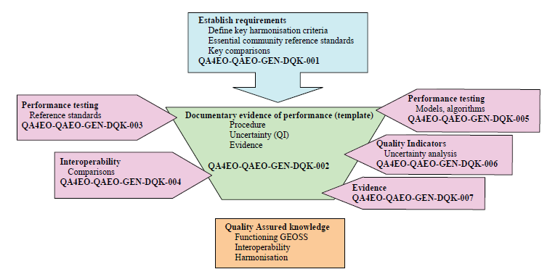
QA4EO - Guidelines
The GSICS Procedure for Product Acceptance (GPPA)
“
The Quality Assurance Framework for Earth Observation consist of ten distinct guidelines linked in the Guidelines Framework
“
Data Producer
(GPAF)
Data
Reviewer
(GPERF)
Data User
( GPERF)
GSICS Executive Panel
Acceptance is through meeting GSICS Goals.
Maturity is Acceptance+ satisfying user
Guidelines address
Quality Indicators
Traceability
Reference (measurement)Standard
Uncertainty
Ref: QA4EO The Guide

Slide 20
Action: b)
Acceptance and maturity for
Proposed Classification of Entities(Talk 2.s)
Core Products: Bias products, new additions, products connected with ECV/FCDR
directly follow the GISCS Conventions.
GSICS Resources and Documents:
GPRCs, ICVS, Corrections not following GSICS convections but meeting GSICS goals.
Models and Data Sets:
GIRO, SBAF, Solar, Lunar, references, Intermediate Datasets used to create core products, Pre-Launch key data sets.
Tools:
SNO Matchup, Bias Monitoring, Display Tools, Readers, SBAF
Acceptance and Maturity of GPPA Can be applied
Acceptance and Maturity of the GPPA Can be applied Partly
Accepted in the subgroup.
One or all conditions to be fulfilled
Models/Data sets published and peer reviewed and internationally accepted.
Have users within the group.
Accepted in the subgroup.
One or all conditions to be fulfilled
Models/Data sets published and peer reviewed and internationally accepted.
Have users within the group.
Notes:
LF: We will have to make it clear what products have passed which levels of scrutiny.
BI: Need to make clear to users and submitters which acceptance and maturity requirements apply to each submission.
LF: May be a table with one dimension components required for acceptance and the other dimension product classes and A or NA entries.

