Slide 1

Well-Calibrated JPSS Instruments as GSICS References
Fuzhong Weng
Satellite Meteorology and Climatology Division (SMCD)
NOAA/NESDIS/Center for Satellite Applications and Research (STAR)

Slide 2
Key Satellite Calibration Parameters: Accuracy/Precision /Stability
Measured y
From G. Stephens, 2001
Accuracy: a
NEΔT
Precision: p
Uncertainty: u = √a²+p²
True y
Accuracy: SDR measurement mean vs. truth
Precision: Noise Equivalent Delta Temperature or Radiance (NEΔT NEDN)
Stability: Change of calibration accuracy with time

Slide 3
Metrics for a Reference Instrument
  The observations from the instrument are used in operations and research
    Suomi NPP SDR data are widely distributed to the international community (e.g. CrIS/ATMS data are assimilated in both global and regional NWP models)
    Suomi NPP data are used for environmental monitoring and climate studies
  The instrument calibration theory should be well established and documented
    Peer reviewed publications
    ATBD, OAD and user manual
  The instrument is well calibrated from the prelaunch tests and meets the specifications
    Radiometric calibration (e.g. non-linearity)
    Calibration accuracy from thermal vacuum data (TVAC)
    Traceable methodology for instrument noise
    Spectrum response function (SRF) measurement
  The instrument performance on orbit is well characterized and meets the specifications
    Performance through trending noise is stable
    On-orbit calibration accuracy is characterized
    Inter-sensor bias with other similar instruments is also estimated
    Geolocation accuracy is defined
    Instrument has an error budget model

Slide 4
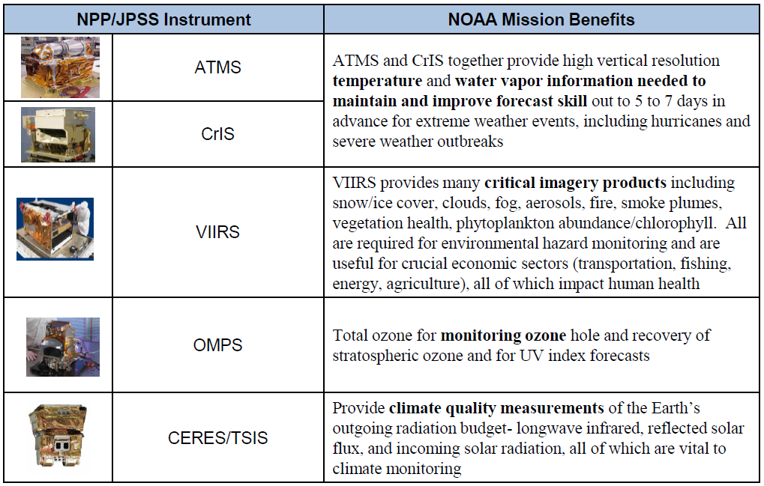
Suomi NPP Instruments and Their Applications
Advanced Technology Microwave Sounder (ATMS)
Cross-track Infrared Sounder (CrIS)
Visible Infrared Imaging Radiometer Suite (VIIRS)
Ozone Mapping and Profiler Suite (OMPS)
Clouds and the Earth's Radiant Energy System (CERES)

Slide 5
Suomi NPP TDR/SDR Algorithm Schedule
Sensor | Beta | Provisional | Validated
CrIS | February 10, 2012 | February 6, 2013 | March 17, 2014
ATMS | May 2, 2012 | February 12, 2013 | March 17, 2014
OMPS | March 7, 2012 | March 12, 2013 | September 17, 2015
VIIRS | May 2, 2012 | March 13,, 2013 | April 17, 2014
Beta
Early release product
Initial calibration applied
Minimally validated and may still contain significant errors (rapid changes can be expected. Version changes will
not be identified as errors are corrected as on-orbit baseline is not established)
Available to allow users to gain familiarity with data formats and parameters
Product is not appropriate as the basis for quantitative scientific publications studies and applications
Provisional
Product quality may not be optimal
Incremental product improvements are still occurring as calibration parameters are adjusted with sensor on-orbit
characterization (versions will be tracked)
General research community is encouraged to participate in the QA and validation of the product, but need to be
aware that product validation and QA are ongoing
Users are urged to consult the SDR product status document prior to use of the data in publications
Ready for operational evaluation
Validated
On-orbit sensor performance characterized and calibration parameters adjusted accordingly
Ready for use in applications and scientific publications
There may be later improved versions
There will be strong versioning with documentation

Slide 6
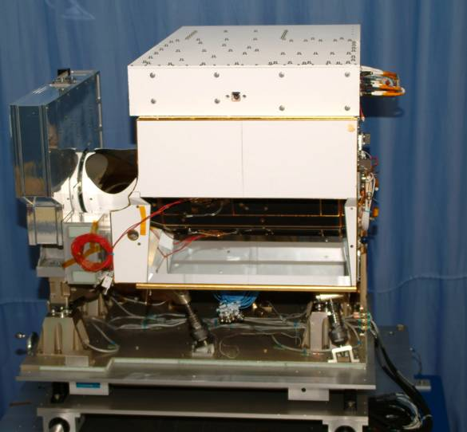
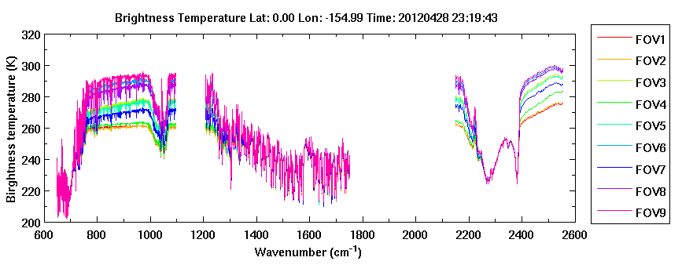
Cross-Track Infrared Sounder (CrIS)
CrIS has 1305 channels (normal spectral resolution) and 2211 channels (full spectral resolution) located in 3 IR wavelength ranges: LWIR (9.14 - 15.38 μm); MWIR (5.71 - 8.26 μm); and SWIR (3.92 - 4.64 μm)
CrIS is a cross-track scanning IR Fourier transform spectrometer with a scan swath width of 2200 km
CrIS is radiometrically and spectrally calibrated well and its on-orbit performance (stability, noise and accuracy) all meet the specification
CrIS SDR data are primarily used by NWP community to improve the global medium-range forecasts
CrIS SDR data are also being tested in thee regional forecast models
CrIS SDR data are used in NUCAPS for deriving a suite of atmospheric and surface products
CrIS SDR data are used by WMO as a reference instrument for cross-calibrating other infrared imagers and sounders

Slide 7
CrIS SDR Requirements vs. Performance
CrIS SDR uncertainties (blue) vs. specifications (black)
Band | NEdN @287K BB mW/m²/sr/cm⁻¹ | Radiometric Uncertainty @287K BB (%) | Frequency Uncertainty (ppm) | Geolocation Uncertainty (km) *
LW | 0.098 (0.14) | 0.12 (0.45) | 3 (10) | 1.2 (1.5)
MW | 0.036 (0.06) | 0.15(0.58) | 3 (10) | 1.2 (1.5)
SW | 0.003 (0.007) | 0.2 (0.77) | 3 (10) | 1.2 (1.5)
Requirements
  Instrument & SDR performances exceed requirements by large margins
SDR software
  Stable & free of errors that could impact data quality since 11/14/2013 (Mx8.0)

Slide 8
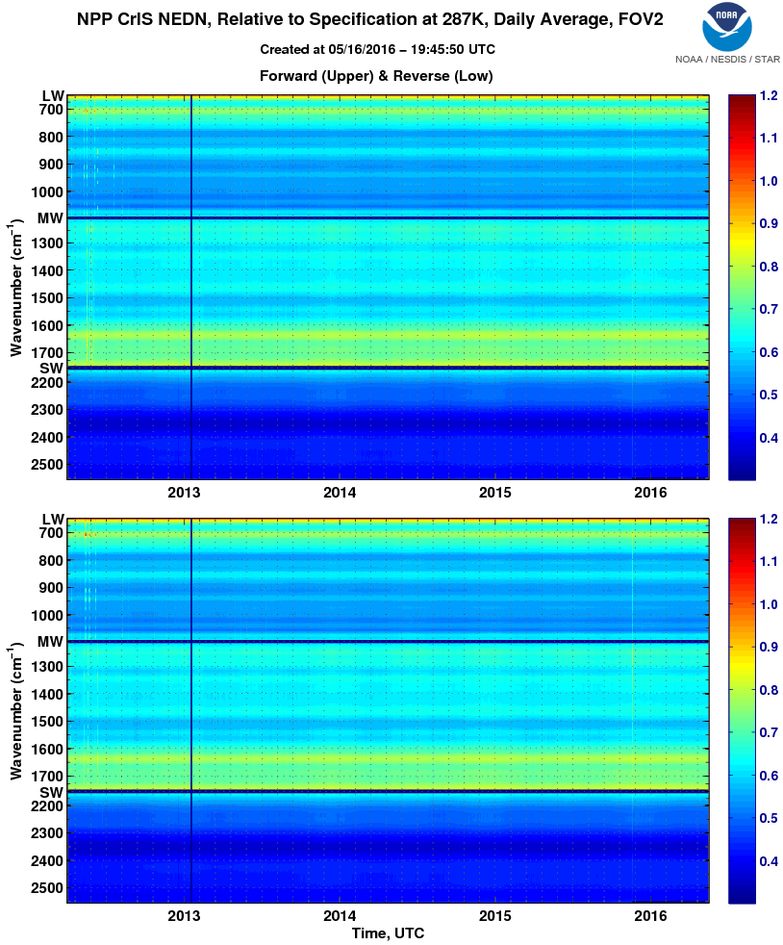
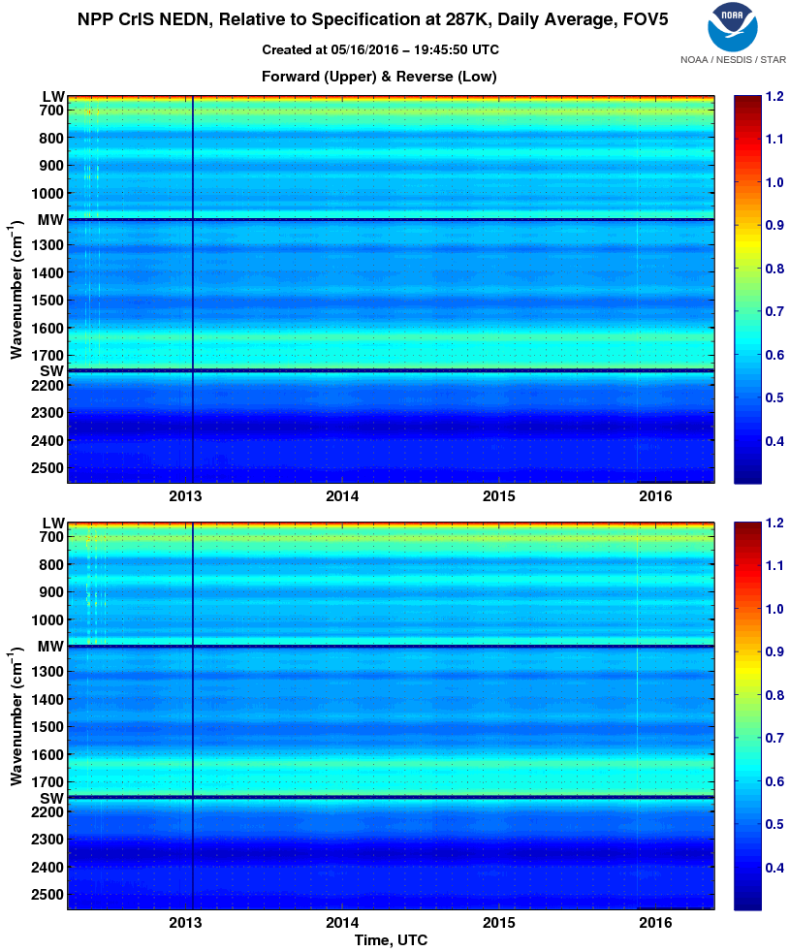
Long-Term Performance of Suomi NPP CrIS (NEDN)

Slide 9
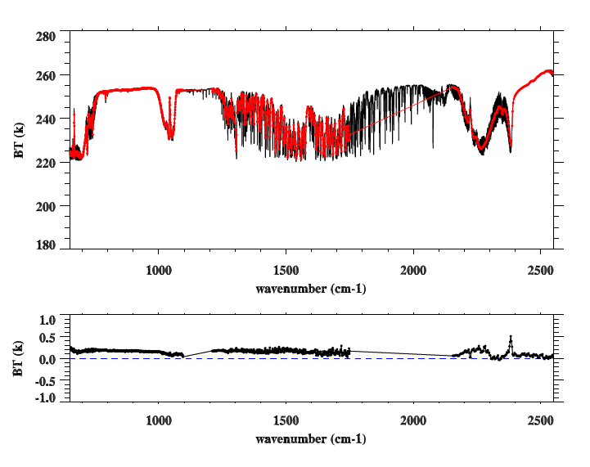
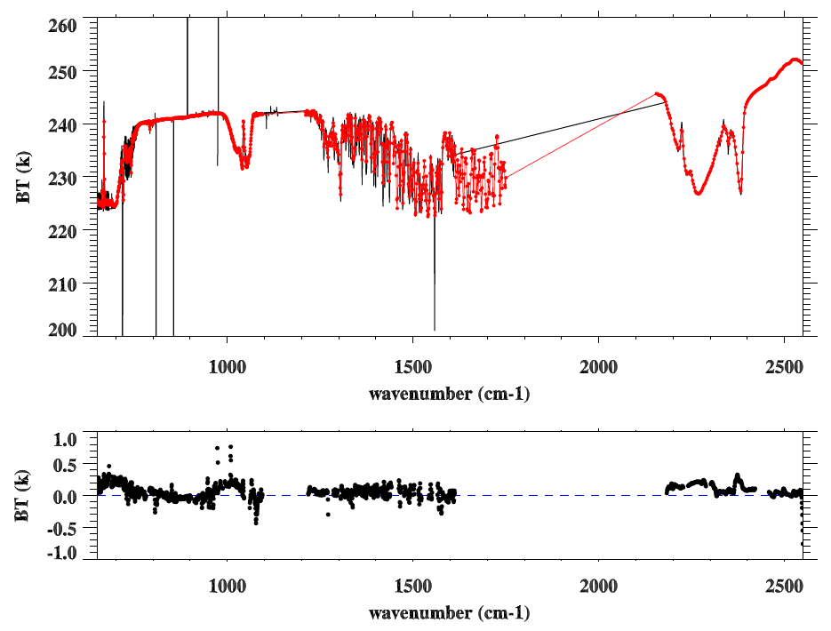
CrIS Radiometric Calibration: Compared to AIRS and IASI
CrIS
CrIS
IASI
AIRS
CrIS-IASI
CrIS-AIRS
CrIS has about 0.2 K warm bias w.r.t. IASI and no bias w.r.t. AIRS from SNO collocated data sets.
In the analysis, IASI data was de-apodized to obtain the original interferogram data and are then resampled using CrIS spectrum resolution, and FFTed back to CrIS-like radiances.

Slide 10
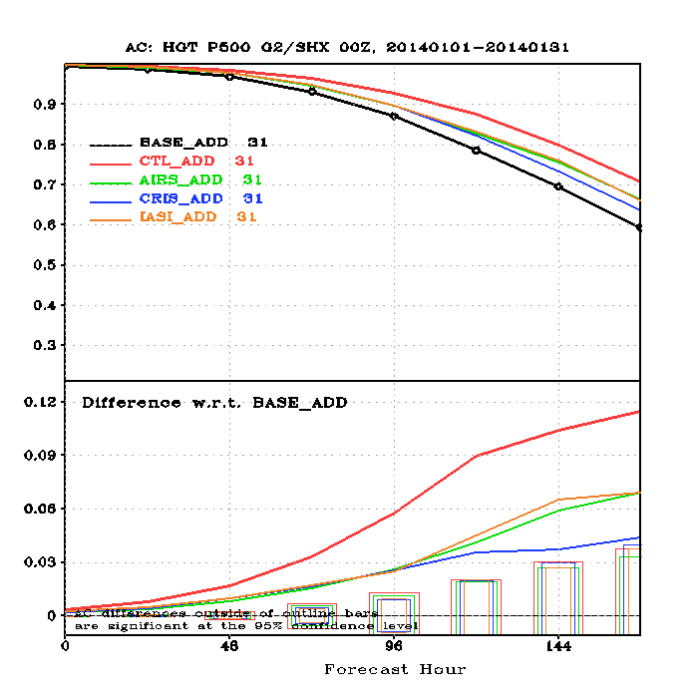
Impacts of CrIS in NCEP GFS
500 hPa Southern Hemisphere AC scores for
20140101 – 20140131 00Z
The impact from assimilation of CrIS radiances in NCEP GFS is smaller, compared to that from AIRS and IASI.
The baseline experiment includes the conventional and GPSRO data and the control experiment includes all the satellite instruments and conversional data.
New quality control is required for better assimilation of CrIS radiances.
10

Slide 11
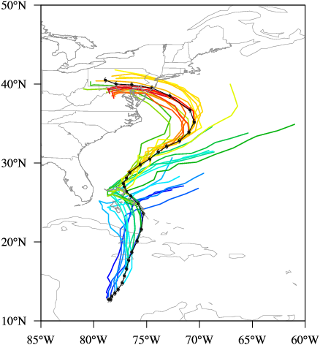
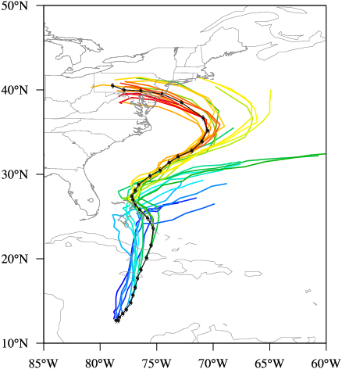
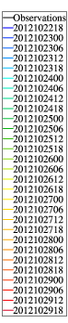
Impacts of CrIS DA on Hurricane Forecasts
Control Run
Control Run +CrIS
Unlike ATMS data, assimilation of CrIS radiance observations in HWRF degraded the forecasts of Superstorm Sandy tracks.
Some fundamental issues related to QC of CrIS data are yet to be resolved!

Slide 12
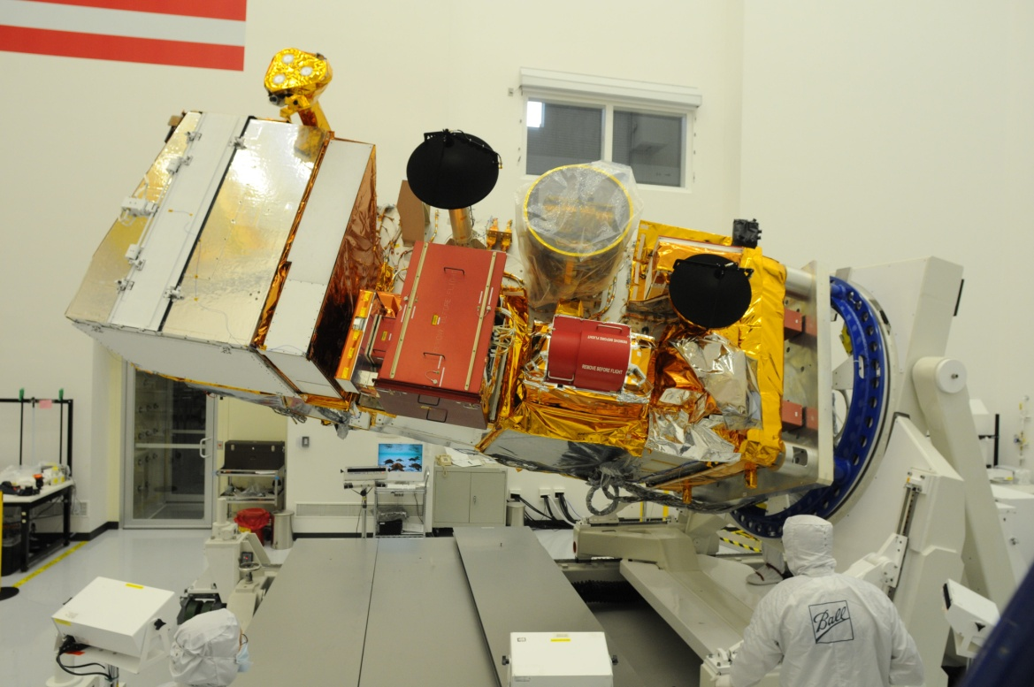
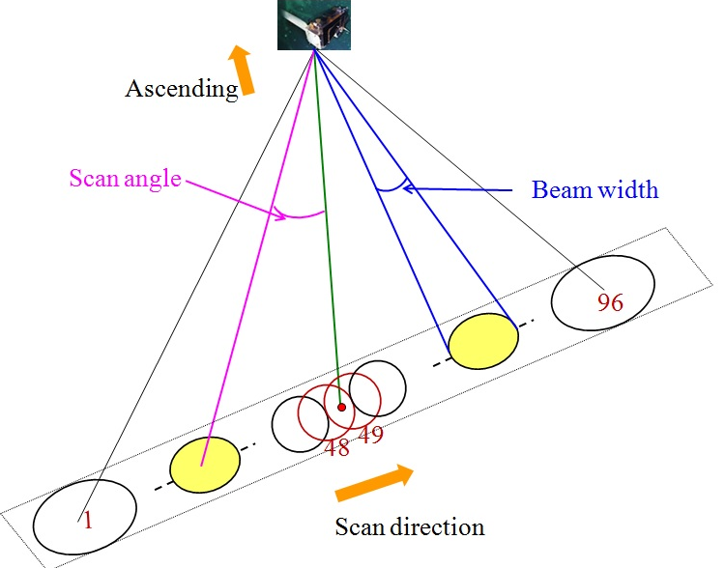
Advanced Technology Microwave Sounder (ATMS)
ATMS has 22 channels located near microwave oxygen and water vapor absorption bands
ATMS is a cross-track scanning microwave sounding instrument with a scan swath width of 2200 km
ATMS’s field of size at oxygen band is much smaller compared to its predecessor, AMSU-A
ATMS is radiometrically calibrated well and its on-orbit performance (stability, noise and accuracy) all meet the specification
ATMS SDR data are primarily used by NWP community to improve the global medium-range forecasts
ATMS SDR data are also being tested in thee regional forecast models
ATMS SDR data are used in microwave integrated retrieval system (MIRS) for deriving a suite of atmospheric and surface products
ATMS SDR data are used for environmental monitoring such as hurricanes and severe storm events
ATMS SDR data are used by WMO as a reference instrument for cross-calibrating other microwave sounders
ATMS Integrated on NPP Spacecraft

Slide 13
ATMS SDR Requirements vs. Performance
Channel | Accuracy (K) On-Orbit/Spec | NEΔT (K) On-Orbit/Spec | Channel | Calibration (K) On-Orbit/Spec | NEΔT (K) On-Orbit/Spec
1 | /1.00 | 0.25/0.5 | 12 | 0.24/0.75 | 0.59/1.0
2 | /1.00 | 0.31/0.6 | 13 | 0.13/0.75 | 0.86/1.5
3 | /0.75 | 0.37/0.7 | 14 | 0.02/0.75 | 1.23/2.2
4 | /0.75 | 0.28/0.5 | 15 | 0.09/0.75 | 1.95/3.6
5 | 0.18/0.75 | 0.28/0.5 | 16 | /1.00 | 0.29/0.3
6 | 0.09/0.75 | 0.29/0.5 | 17 | /1.00 | 0.46/0.6
7 | 0.02/0.75 | 0.27/0.5 | 18 | 0.50/1.00 | 0.38/0.8
8 | 0.06/0.75 | 0.27/0.5 | 19 | 0.36/1.00 | 0.46/0.8
9 | 0.06/0.75 | 0.29/0.5 | 20 | 0.31/1.00 | 0.54/0.8
10 | 0.18/0.75 | 0.43/0.75 | 21 | 0.13/1.00 | 0.59/0.8
11 | 0.22/0.75 | 0.56/1.0 | 22 | 0.40/1.00 | 0.73/0.9

Slide 14
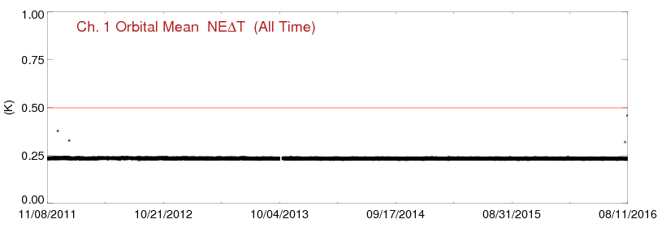
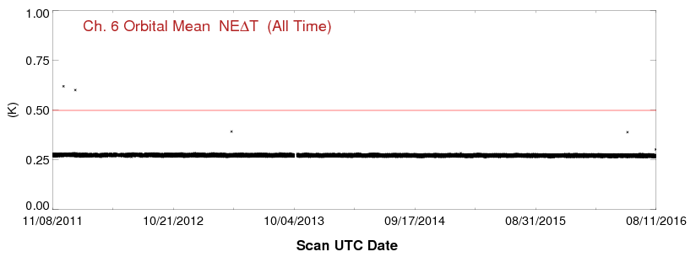
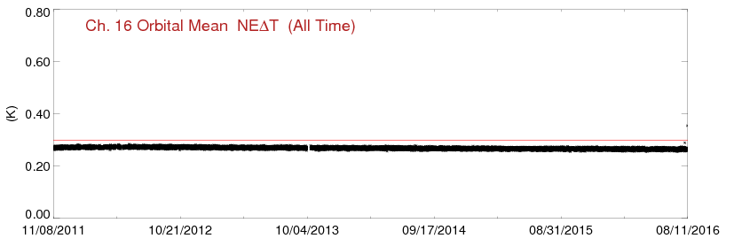
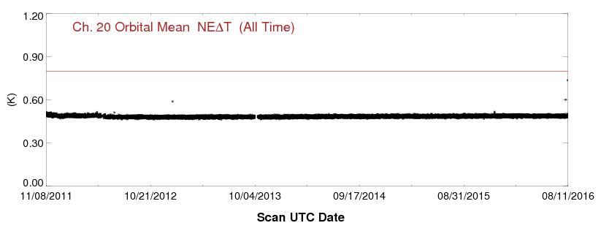
Long-Term Performance of Suomi NPP ATMS (NEDT)

Slide 15
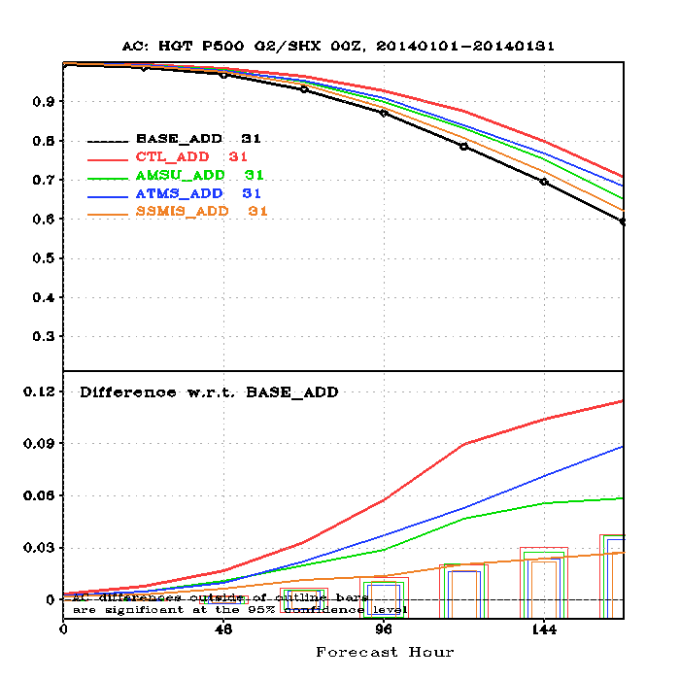
Impacts of US Microwave Sounders in NCEP GFS
500 hPa Southern Hemisphere AC scores for
20140101 – 20140131 00Z
Assimilation of ATMS radiances in NCEP GFS produces a largest impact on global medium-range forecast, especially in southern hemisphere.
The baseline experiment includes the conventional and GPSRO data and the control experiment includes all the satellite instruments and conversional data.

Slide 16
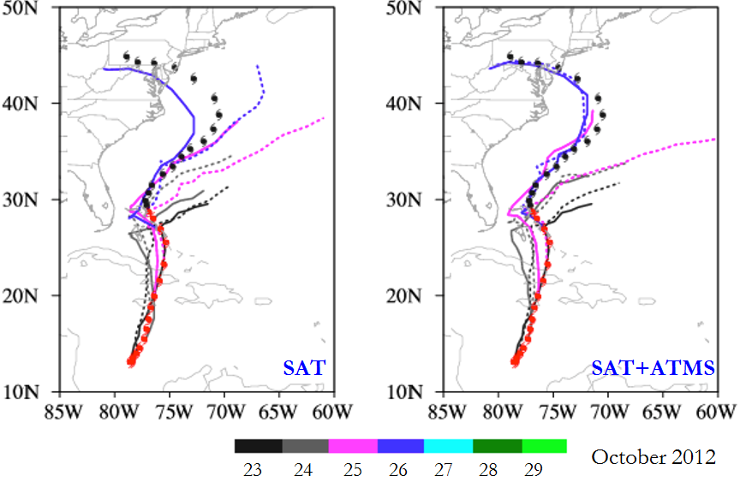
ATMS DA Research Highlighted in Nature
Suomi NPP satellite, launched in 2011, on hurricane forecasts.
The satellite’s microwave instrument measures air temperature and humidity.
Incorporating Suomi data into the government’s hurricane model for four 2012 storms, including Sandy(pictured), made for more accurate forecasts of track and intensity. The work suggests a way to improve the notoriously difficult predictions of storm strength. J. Geophys. Res. Atm., 118, 11558-11576(2013)
ATMS data assimilation in GSI/HWRF results in a consistent positive impact on the track and intensity forecasts of the four landfall hurricanes in 2012.
Data from a US Earth-
observing satellite could
help improve the accuracy
of prediction of hurricane
track and strength.
When generating hurricane
forecasts the US National
Weather Services does not use
real-time information from
weather satellites. But Xiaolei
Zou at Florida State University
in Tallahassee and her
colleagues looked at the effect
of including data from the
Impacts of ATMS Data Assimilation on Track Forecast of Hurricane Sandy
Suomi NPP launch date: October 28, 2011
ATMS into NCEP operational system: May 25, 2012
Impact test completed: Spring 2013
Results published: Fall 2013
Sandy
12 DECEMBER 2013 VOL 504 NATURE [19]

Slide 17
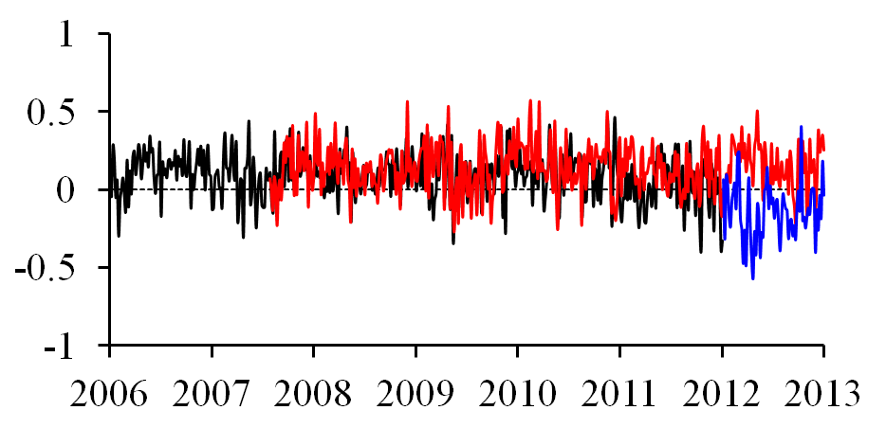
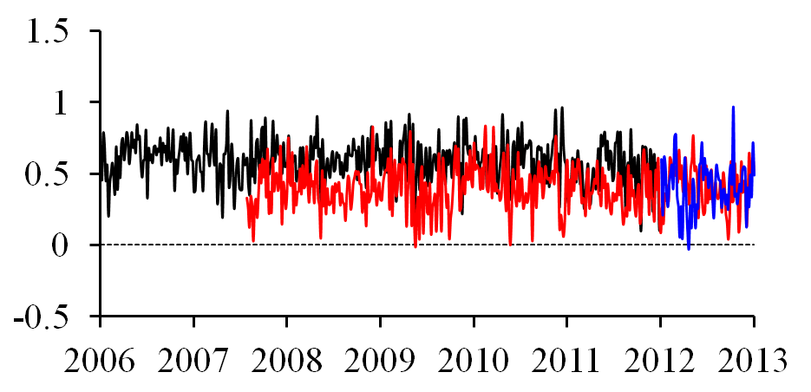
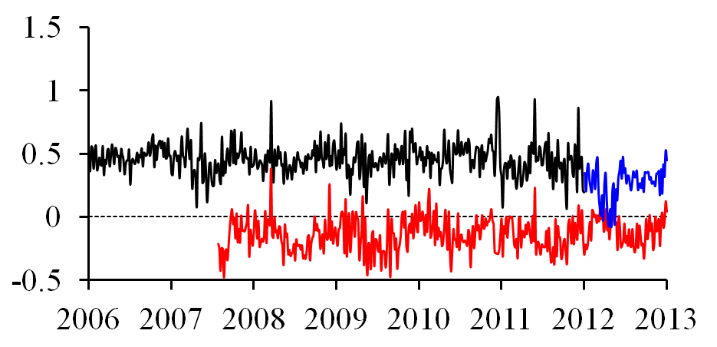
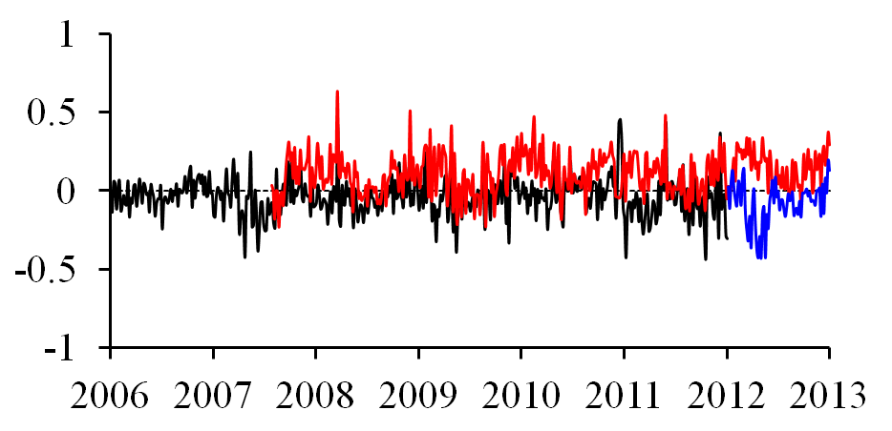
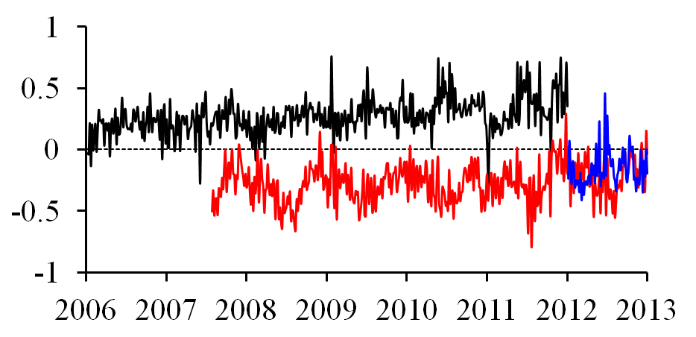
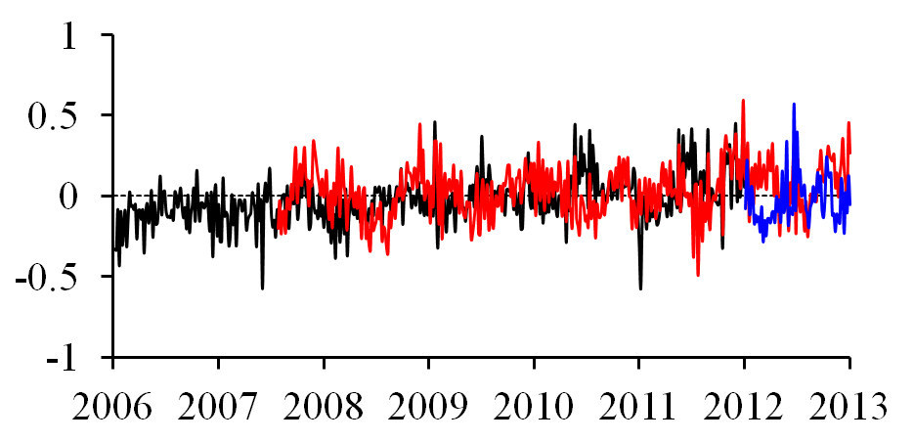
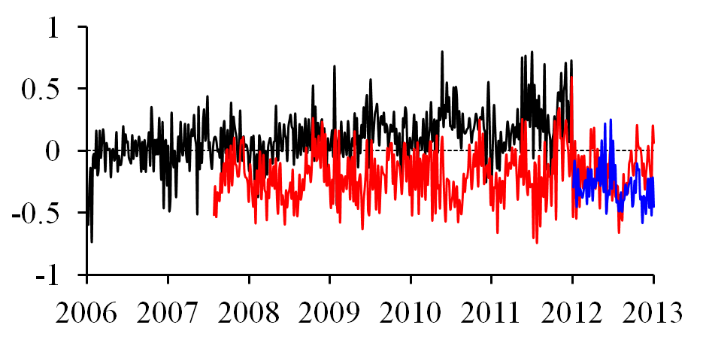
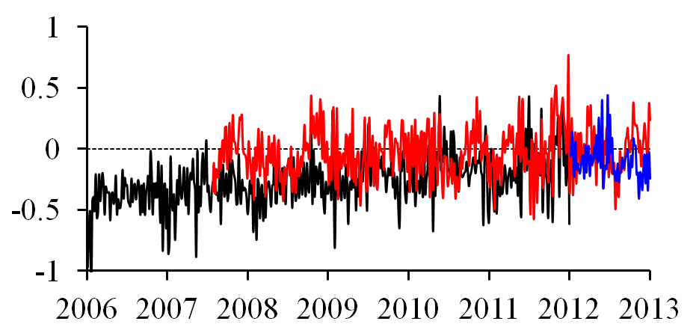
Biases in the Tropics (NOAA-15, MetOp-A, SNPP)
before
after
Bias (K)
ATMS channel 10
Bias (K)
ATMS channel 11
Bias (K)
ATMS channel 13
Bias (K)
ATMS channel 14
NOAA-18 is subtracted. The pentad data set is within ±30º latitudinal band.

Slide 18
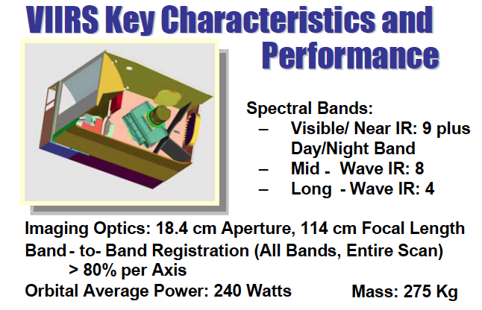
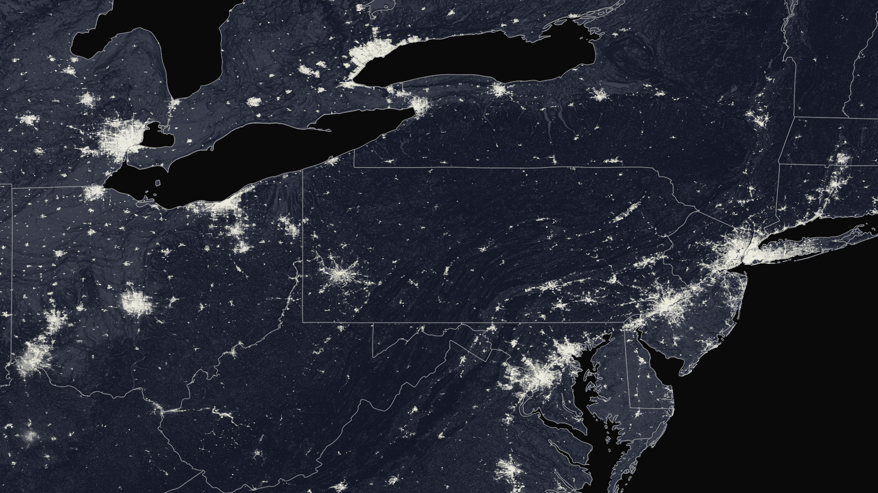
Visible Infrared Imaging Radiometer Suite (VIIRS)
VIIRS has 22 bands from visible/near IR, Day/Night Bands, mid-wave IR, and long-wave IR bands
VIIRS is a scanning radiometer, collects visible and infrared imagery and radiometric measurements of the land, atmosphere, cryosphere and oceans
VIIRS visible bands are calibrated with on-board solar diffuser
VIIRS I bands have the highest resolution to 375 m
VIIRS geolocation accuracy is about 80 m and can be used for validating other instrument geolocation
VIIRS SDR data are used in measuring cloud and aerosol properties, ocean color, sea and land surface temperature, ice motion and temperature, fires and Earth's albedo.
VIIRS SDR data are used by WMO as a reference instrument for cross-calibrating other infrared imagers and sounders
VIIRS DNB imagery

Slide 19
VIIRS SDR Requirements vs. Performance
 | Requirement (absolute uncertainty for uniform scenes) | Prelaunch and onboard calibration | Validation: Relative to MODIS/CrIS/IASI/other thru Inter-comparisons | Note
VIIRS RSB | 2% typical reflectance; 0.3% stability; 0.1% desirable for Ocean Color Applications | 1.2% for M1-M7; 1.5% for M8&9 1.4% for M10 1.3% for I1&I2 1.6% for I3 | 2% (±1%) for matching bands | Except bands with very low signal (ex. M11) Geolocation error: expectation is half I-band pixel; achieved better than quarter I-band pixel (1-s)
VIIRS TEB | M12/M13: 0.7%(0.13K) @270K M14: 0.6% (0.26K) @ 270K M15/M16: 0.4% (0.22K/0.24K) @270K I4: 5% (0.97K) @270K I5: 2.5% (1.5K) @270K | Better than 0.13K for all M bands except M13 (0.14); 0.47K for I4; 0.23K for I5 | 0.1K based on statistical comparison with MODIS and CrIS ER-2/SHIS Aircraft underflight shows excellent agreement M15 0.4 K bias relative to CrIS at 200K (in spec.) | M15 at 190K requirement is 2.1% radiance or 0.56K Geolocation uncertainty: expectation was half I-band pixel; achieved better than quarter I-band pixel (1-s)
VIIRS DNB | 5%, 10%,30% L_{min} (LGS,MGS,HGS) | 3.5%, 7.8%, and 11% (LGS, MGS, HGS) | 4%, 7.7%, 11.8% (LGS, MGS, HGS) | Geolocation error is a ~10th of a pixel (1-s) on the ellipsoid earth but can exceed 1km (up to 24 km at the edges of scan) without terrain correction

Slide 20
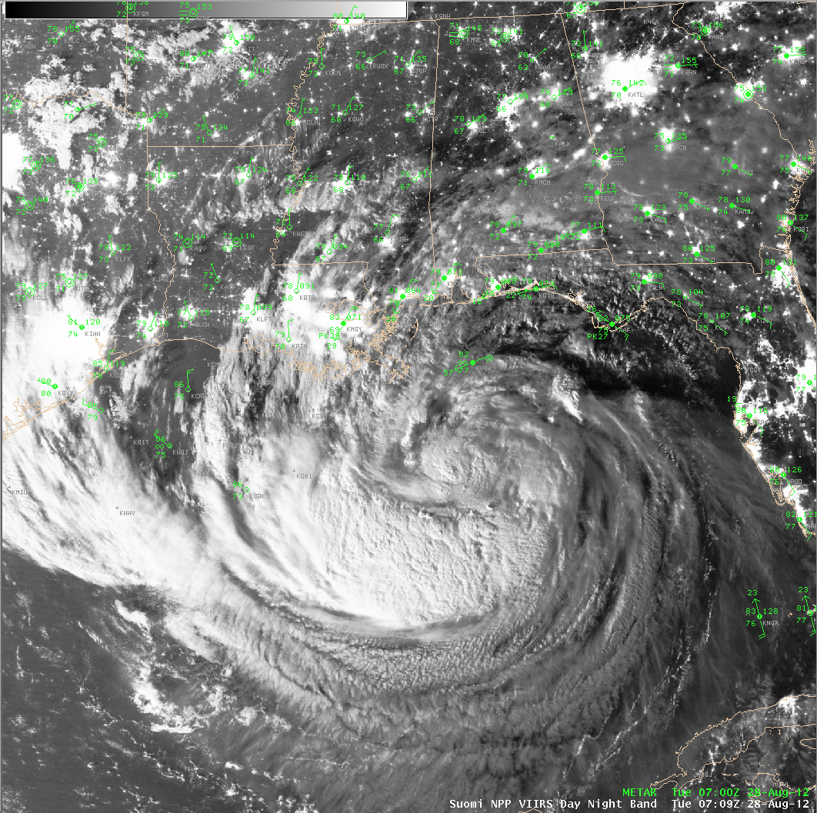
VIIRS SDR Data Used in AWIPS
Tropical Storm Isaac in AWIPS
A unique visible look at a Tropical Storm at night
07:09 UTC
28 Aug 2012
Data captured and processed in real-time at the University of Wisconsin-Madison Space Science and Engineering Center using CSPP Software

Slide 21
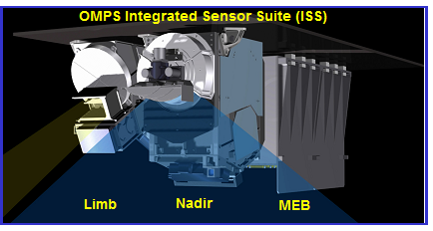
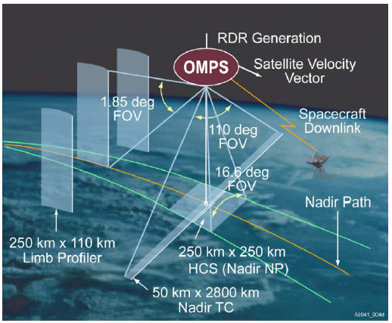
Ozone Mapping and Profiling Suite (OMPS)
OMPS is using an grating spectrometer with CCD
(Charge-coupled device) optical detector
OMPS consists of three spectrometers
  Nadir Mapper Spectrometer covers a 50km x 2800km cross-track swath
  Nadir Profile Spectrometer provides performance over (250km)² cell
  Limb Sensor provides 1 km vertical sampling along three slits enabling ozone profile retrieval (Not on J1)
  OMPS Spectral coverage in UV regions
  NM covers 300 nm to 380 nm
  NP covers 250 nm to 310 nm
  OMPS has on-board calibrators
  Light-emitting diode provides linearity calibration
  Reflective solar diffusers maintain calibration stability

Slide 22
OMPS SDR Requirements and Performance
Budget Term | Requirement/Allocation | On-Orbit Performance
Non-linearity | < 2% full well | < 0.40%
Non-linearity Accuracy | < 0.2% | < 0.2%
On-orbit Wavelength Calibration | < 0.01 nm | <0.01 nm
Stray Light NM Out-of-Band + Out-of-Field Response | For NM ≤ 2 | average < 2%
Intra-Orbit Wavelength Stability | Allocation (flow down from EDR error budget) = 0.02 nm | ~ 0.006 nm
SNR | 1000 | > 1000
Inter-Orbital Thermal Wavelength Shift | Allocation (flow down from EDR error budget) = 0.02 nm | ~0.006 nm
CCD Read Noise | 60 –e RMS | < 25 –e RMS
Detector Gain | 46 | 51
Absolute Irradiance Calibration Accuracy | < 7% | < 7% for majority channels
Absolute Radiance Calibration Accuracy | < 8% | < 8%
Normalized radiance Calibration Accuracy | < 1% | < 2%

Slide 23
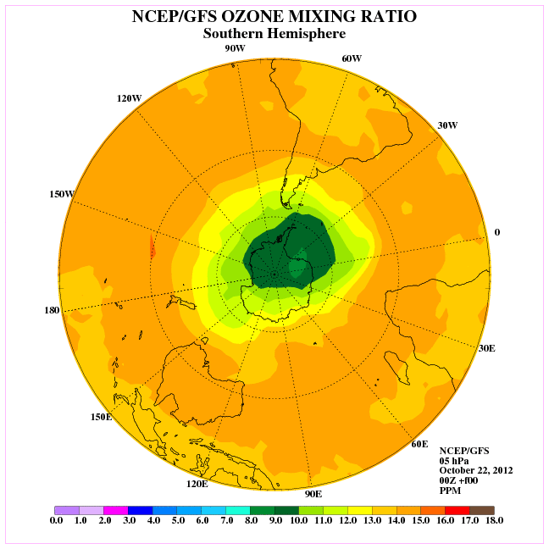
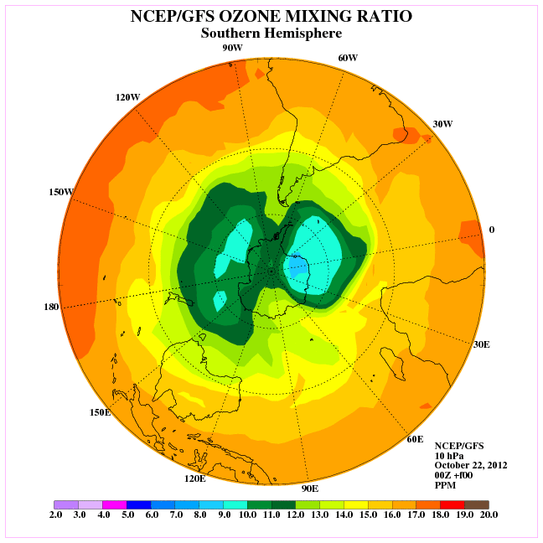
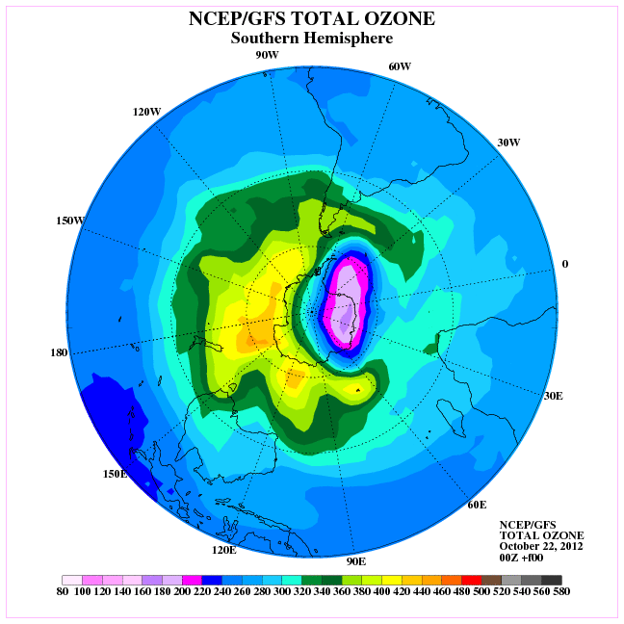
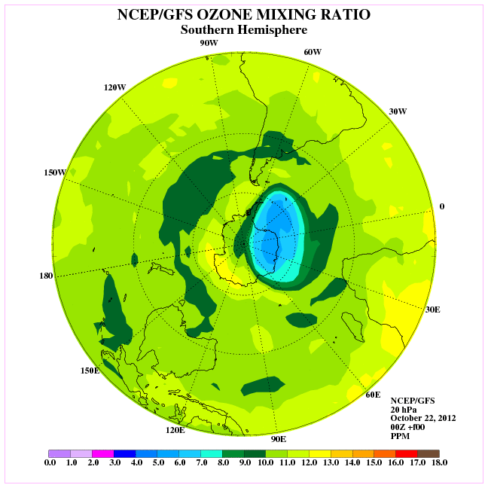
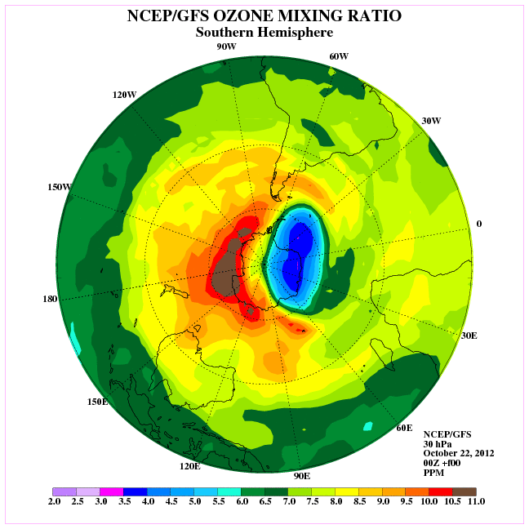
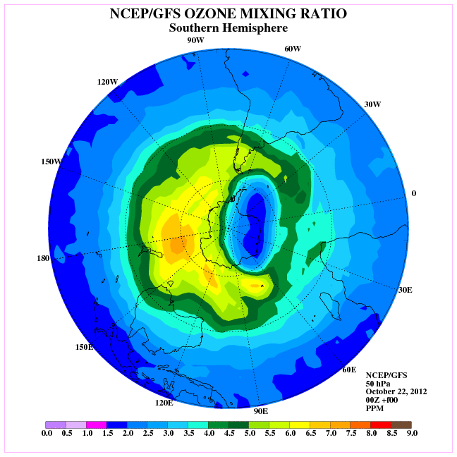
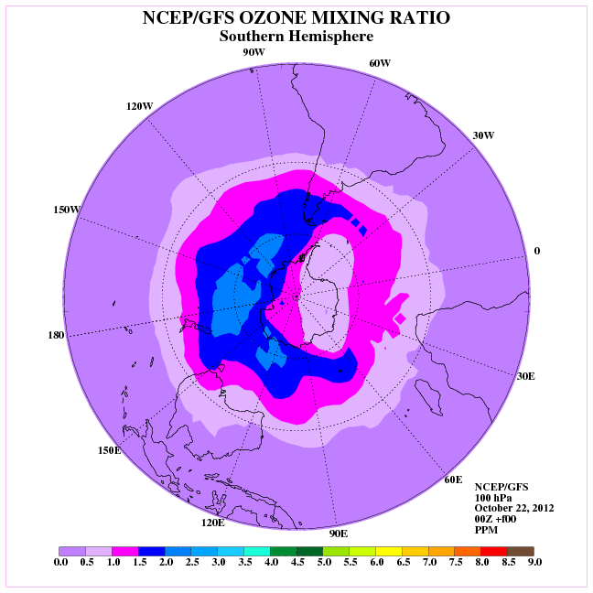
Assimilation of Ozone Products in NCEP GFS
5 hPa
10 hPa
20 hPa
30 hPa
50 hPa
70 hPa
Current GFS Total and O3MR Ozone Analyses

Slide 24
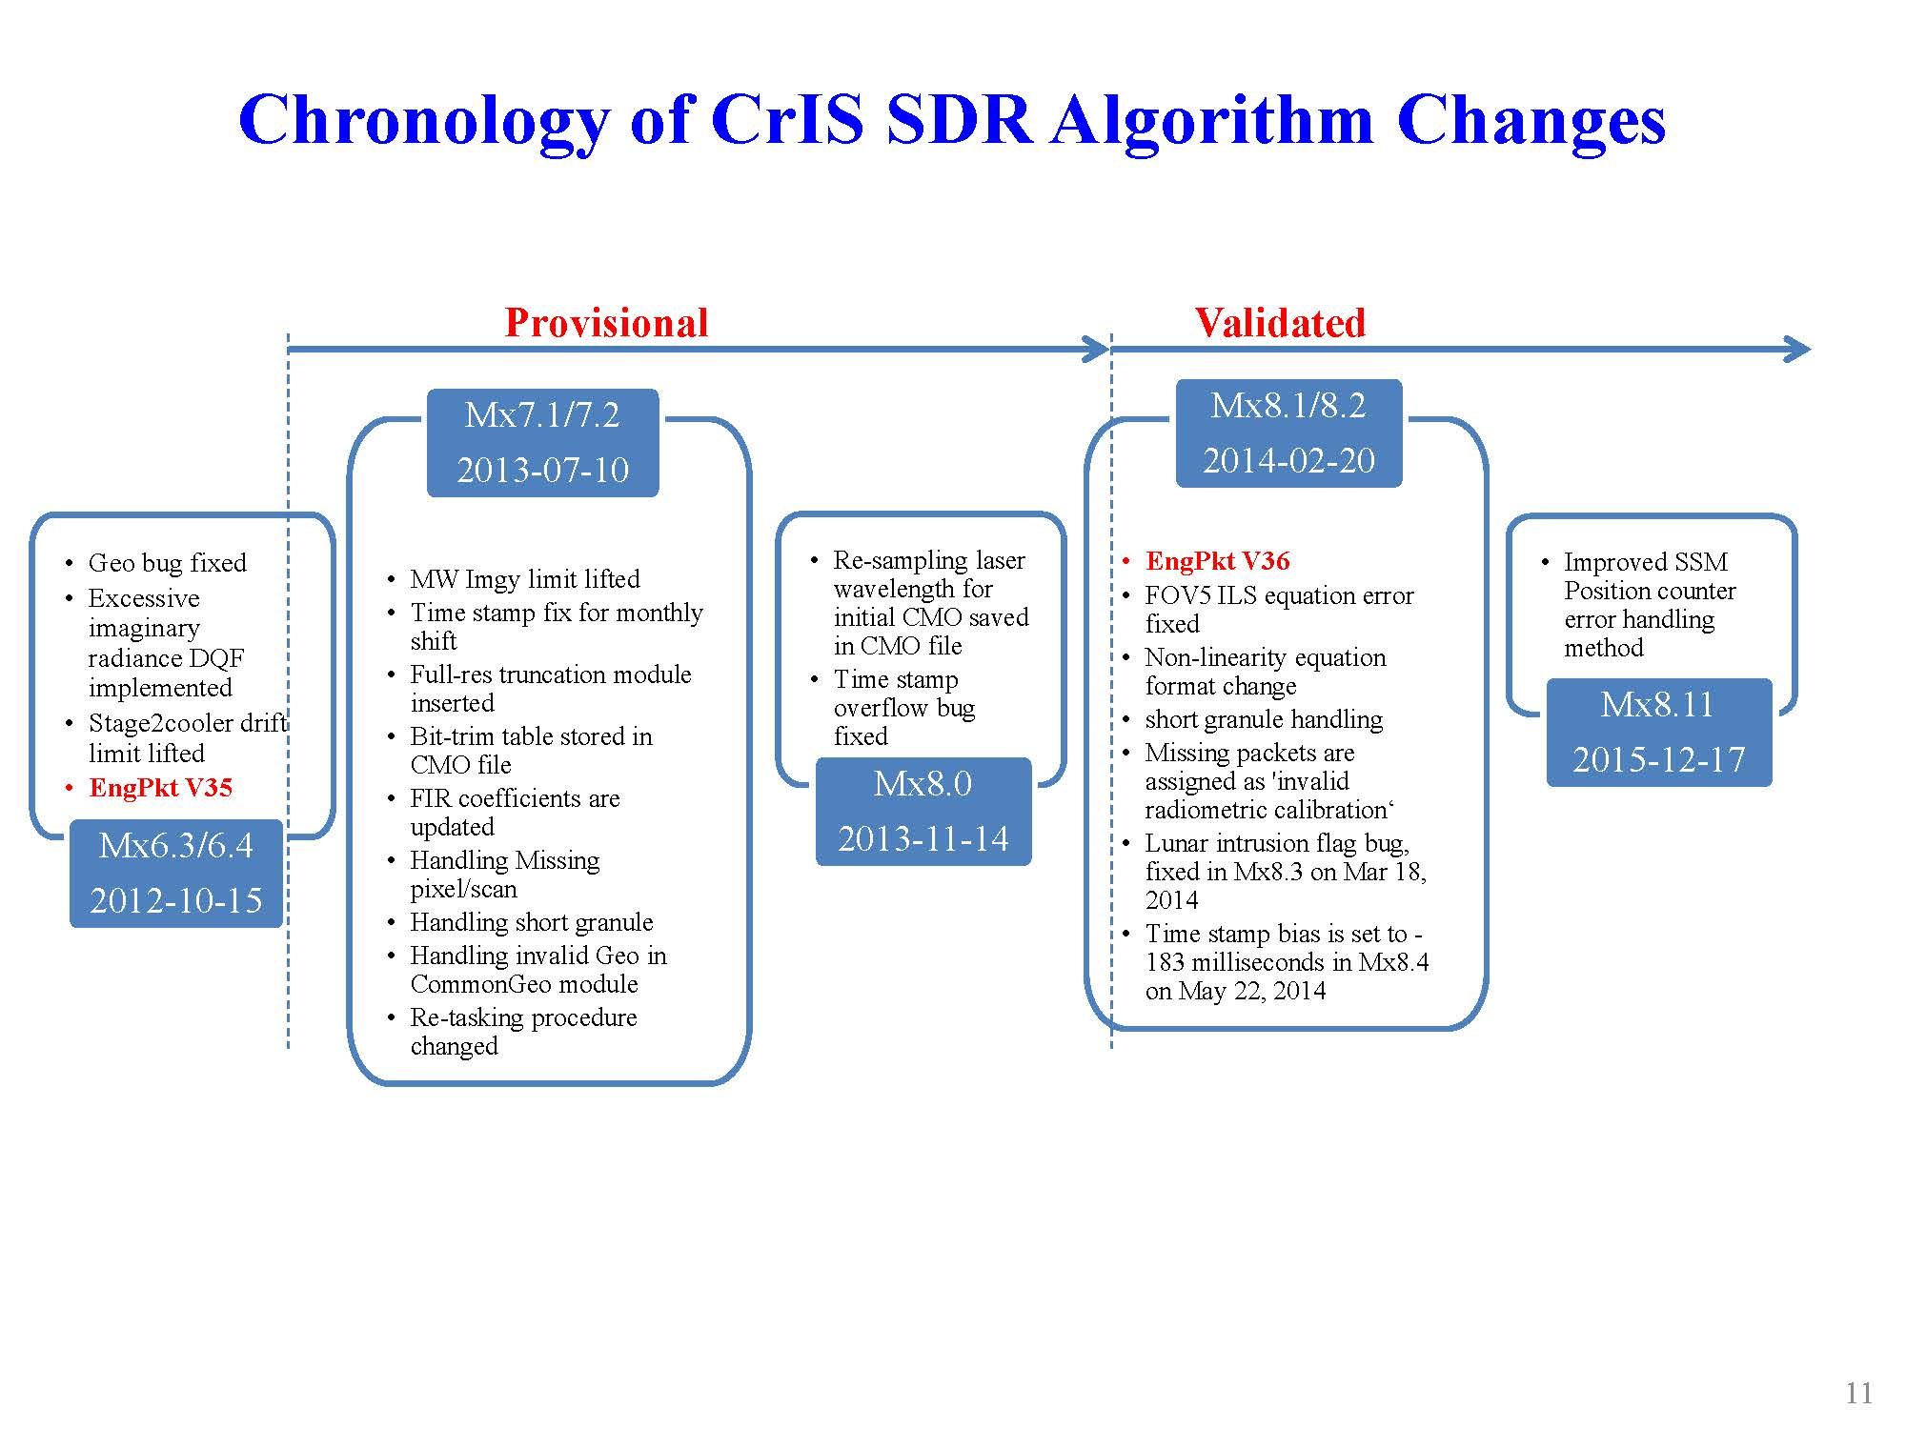
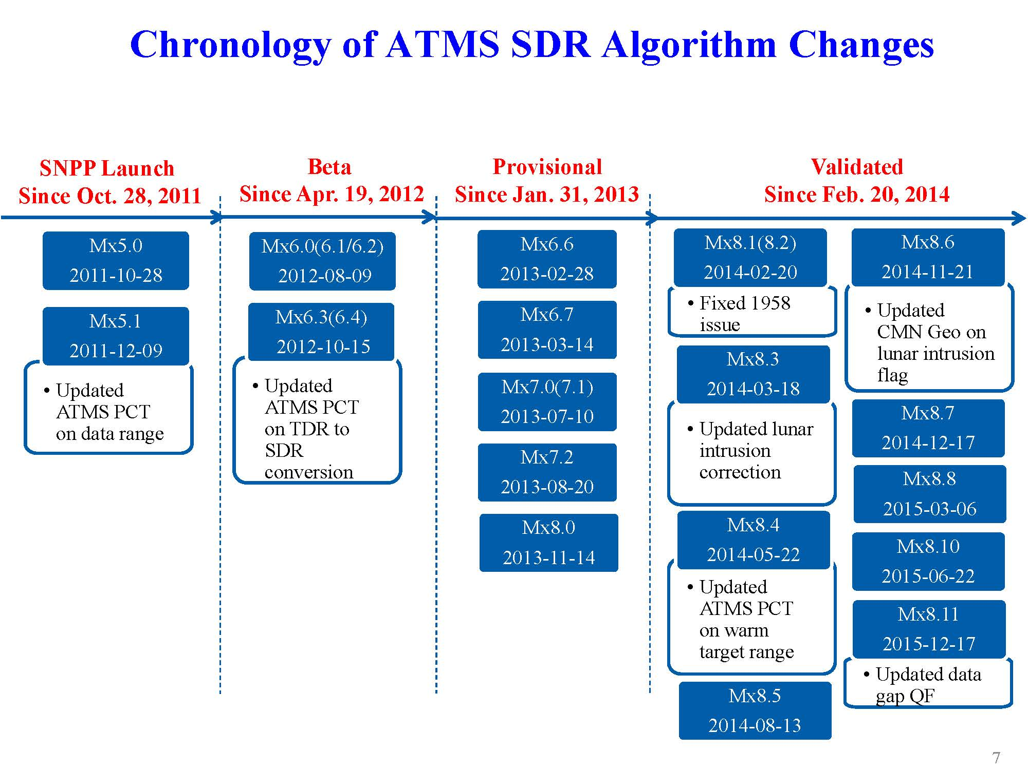
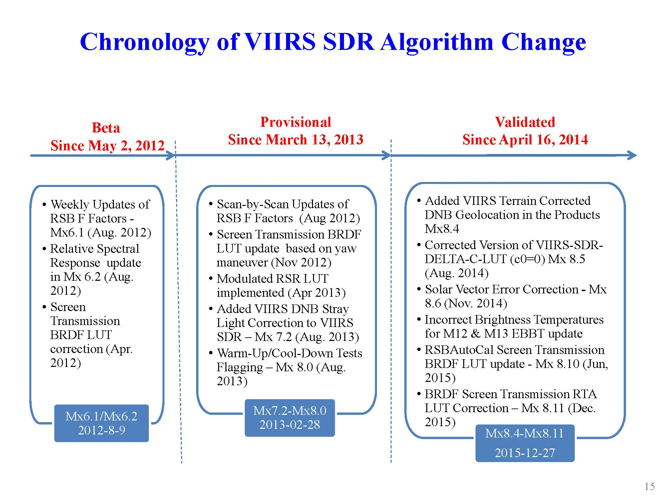
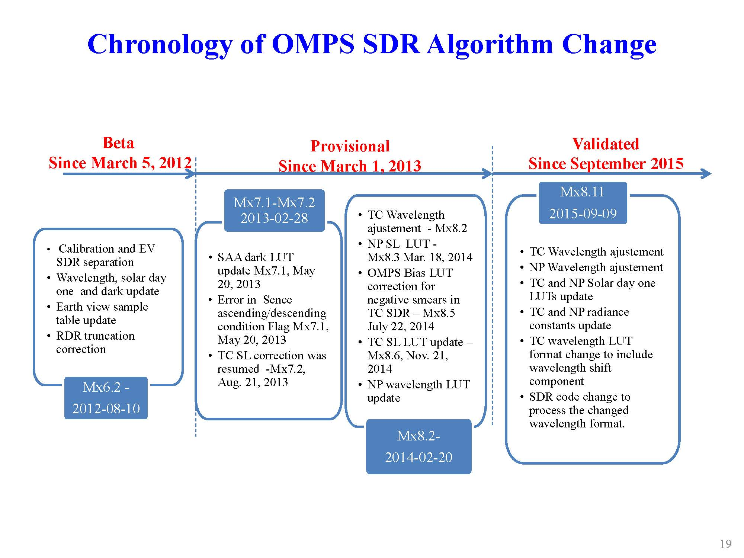
Climate Quality SDR through JPSS Life-Cycle Data Reprocessing
Optimize the algorithms and processing systems to achieve the lowest JPSS data uncertainties
Implement the mission-life consistent sciences to achieve a long-term stability of JPSS data accuracy
Reduce the processing anomalies to the lowest level for preserving the highest integrity of the JPSS data stream
Incorporate the user-oriented algorithm sciences into reprocessing to further augment the society impacts of JPSS datasets

Slide 25
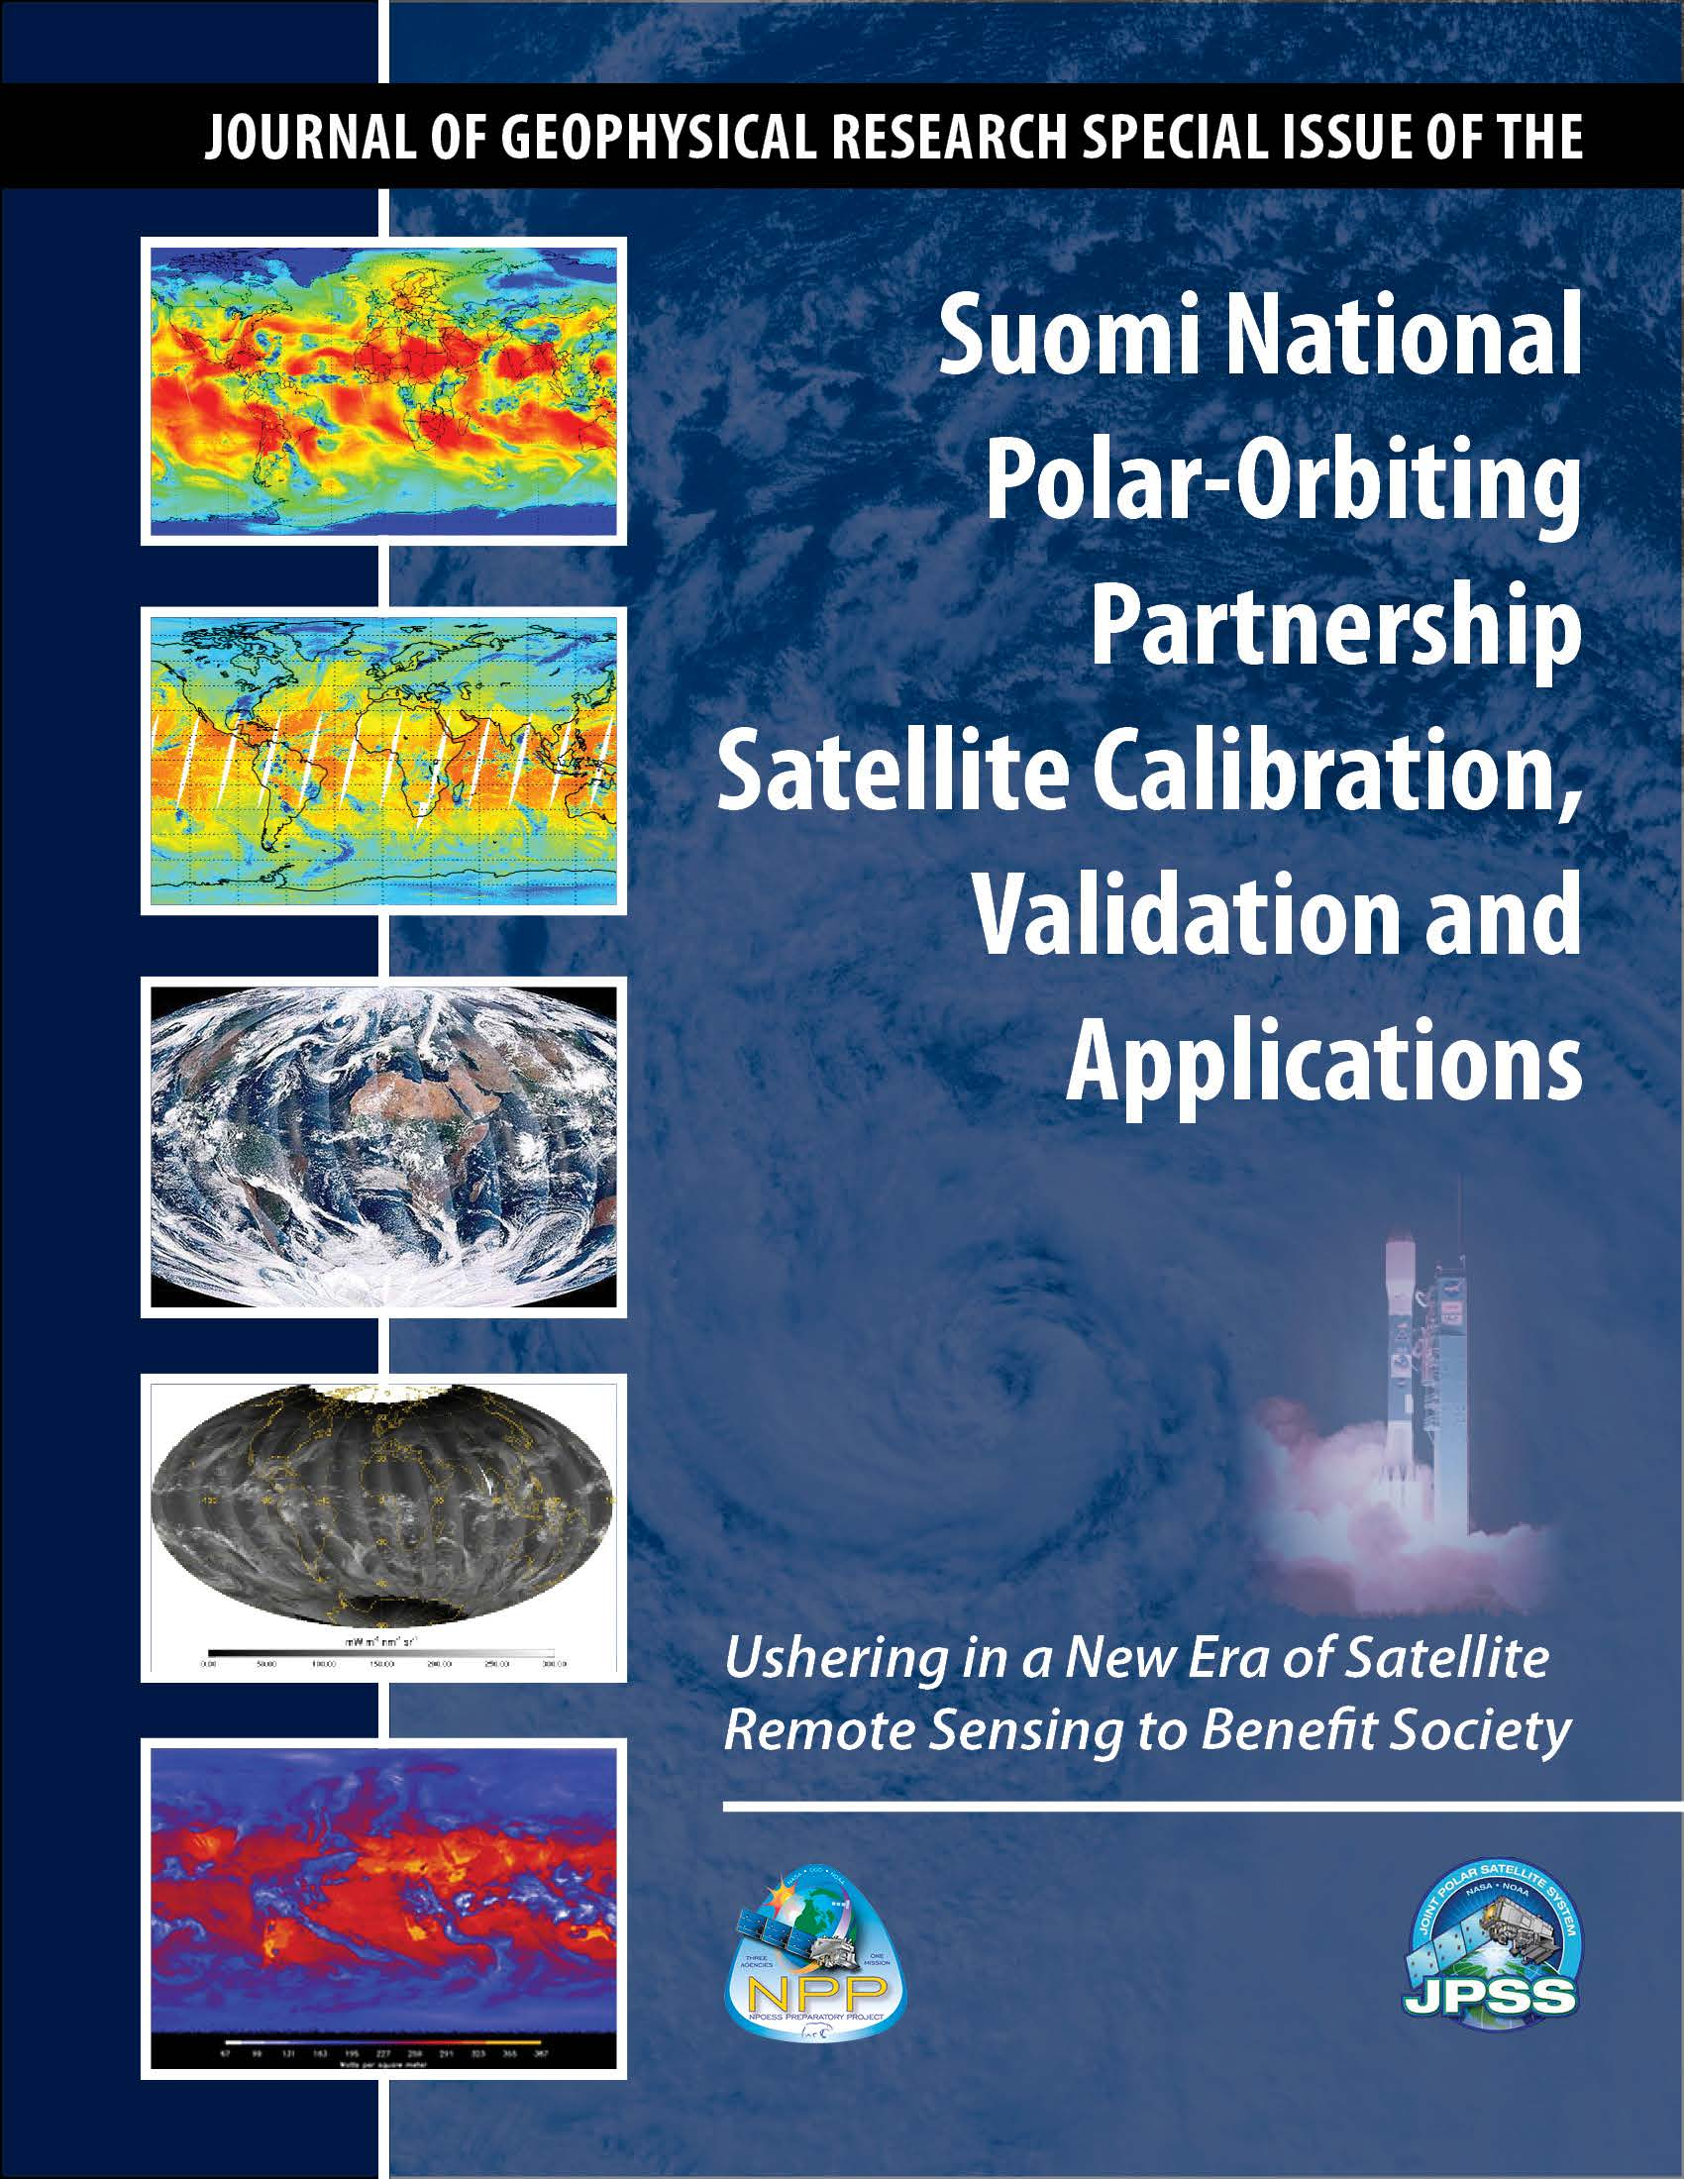
American Geophysical Union (AGU) JGR Special Issue on Suomi NPP CalVal
35 papers have been published in AGU Journal Geophysical Research Special Issue on Suomi NPP satellite calibration, validation and applications.
Guest Editor: Fuzhong Weng

Slide 26
Summary and Conclusions
Suomi NPP instruments are well calibrated and their performances on orbit meet the specifications
Suomi NPP instruments have stable performance on orbit since its launch and all the SDR algorithms have been refined for future JPSS instruments
Suomi NPP inter-sensor biases with other similar instruments are well characterized
JPSS life-cycle reprocessing will deliver the climate-quality SDR for more advanced studies
JPSS instrument calibration and SDR science advances have been published through special issues in JGR (2013) and Remote Sensing (2016), and many other journals

