Slide 1
GSICS Inter-Calibration for Infrared Bands with Hyperspectral Sounder
Xiangqian Wu, NOAA/NESDIS/STAR
GSICS Users Workshop, College Park, MD, 11 August 2016

Slide 2
Outline
Algorithm
Products
Future work

Slide 3
Basis for Inter-Calibration
Calibration – quantifying the instrument responses to known signals.
  Onboard Cal: Blackbody, Solar Diffuser;
  Vicarious Cal: Invariant (desert, Moon) or derived (RTM)
  Inter-Cal: Reference instrument
Premises: two instruments should make identical measurements under identical conditions.
  Concurrent in time;
  Collocated in space (including spatial response);
  Comparable spectral coverage and response; and
  Co-aligned in viewing geometry.
Notes:
There are generally accepted definitions for calibration, but not that clear for inter-calibration. Some thought and status quo.

Slide 4
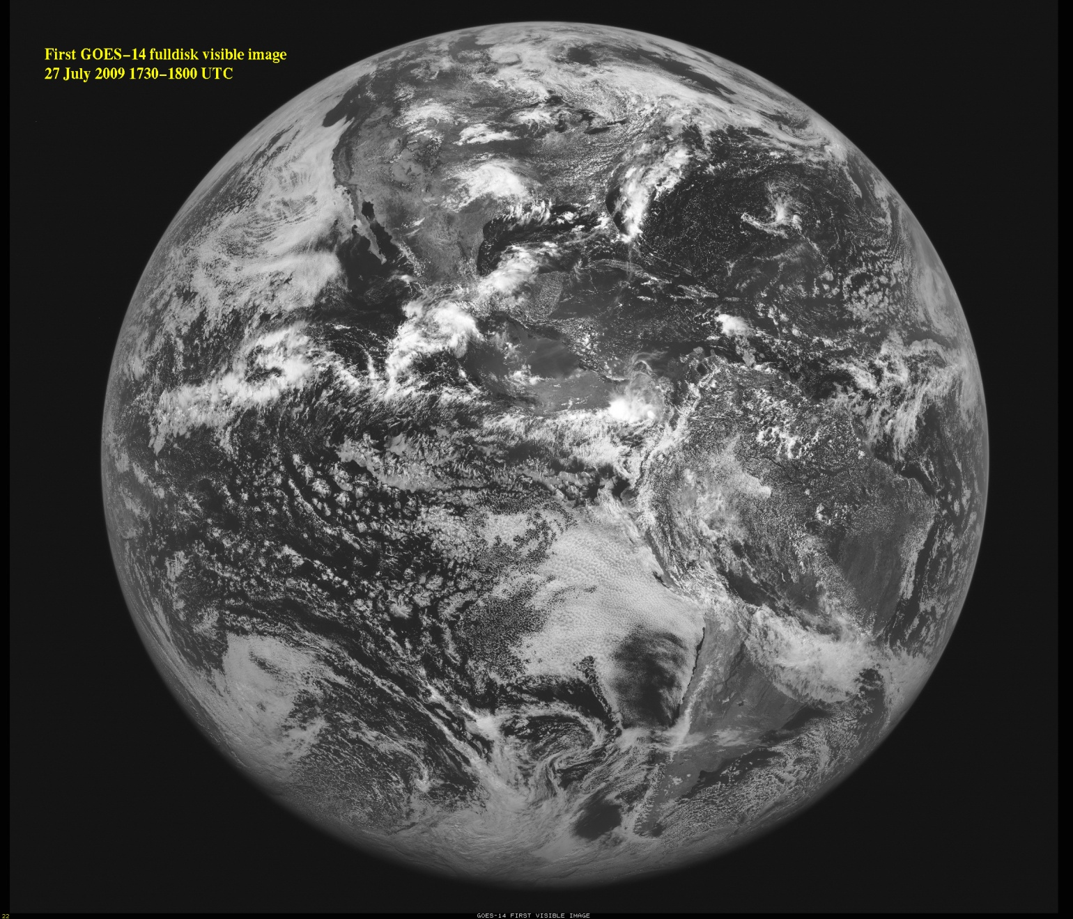
1. Subsetting
Notes:
The animation shows that our knowledge of orbit and instrument tells us when LEO will come into GEO FOR and how much it can "see" (zenith angle). By requirement of collocation in viewing geometry, this means that LEO data outside of the blue circle (~80-90%) cannot be collocated. Those inside of the blue circle, if also concurrent with GEO, is only a small part (orange rectangle, ~10%) of all the GEO data. So simple subsetting eliminates >95% of data that is impossible for collocation.

Slide 5
2. Collocation
Time
  From Telemetry
  Threshold depends on refresh rate and size of data
Location
  Operational geolocation
Angle
  ⎪geo_zen-leo_zen⎪ < threshold – penalize at small angle
  ⎪sec(geo_zen) - sec(leo_zen)⎪ < threshold – penalize at larger angle
  ⎪cos(geo_zen)/cos(leo_zen)-1⎪ < threshold
Notes:
Three choices of geometric alignment. Some considerations of threshold follow.

Slide 6
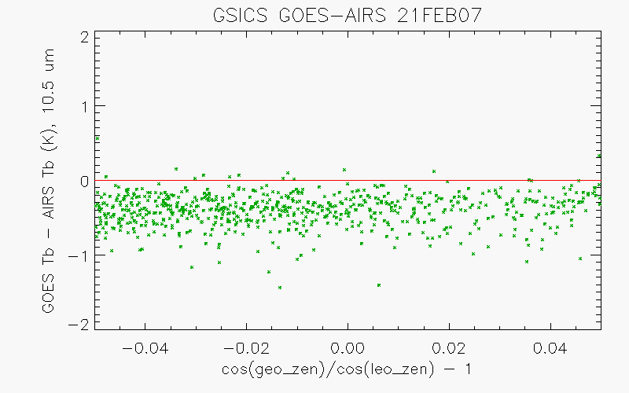
2. Collocation
Notes:
Not much of an issue for window channels …

Slide 7
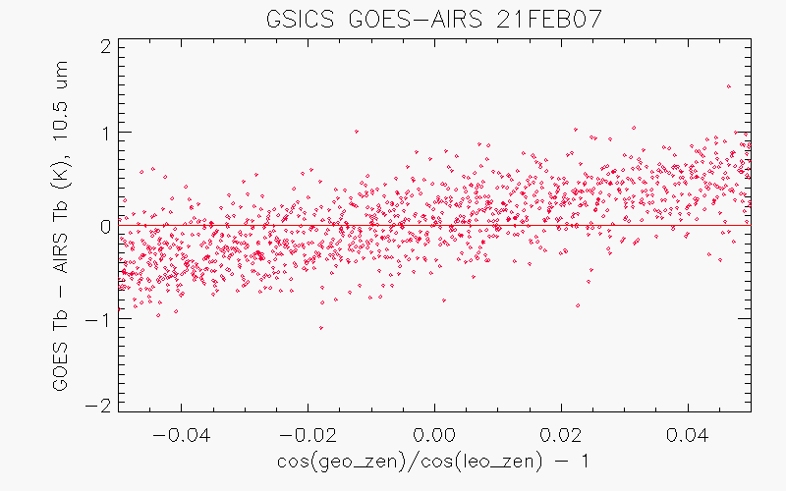
2. Collocation
13.3 um
Empirical correction is helpful, although one cannot depend on that too much since this correction depends on the lapse rate
Notes:
… than for absorptive channels.

Slide 8
3a. Spatial Transform
GEO FOV, may be square or overlapping
Non-uniform features
LEO FOV, relative to GEO FOV
Collocation FOV, may depend on GEO and LEO FOVs
Collocation environment, may depend on time window and wind speed
Notes:
Basic requirement is to average the 3-by-3 GEO FOV for comparison with LEO FOV. But environment stdv matters.

Slide 9
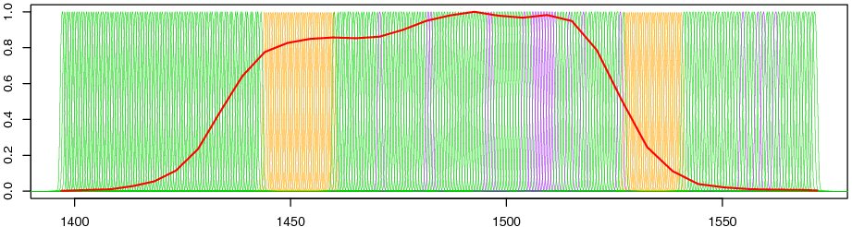
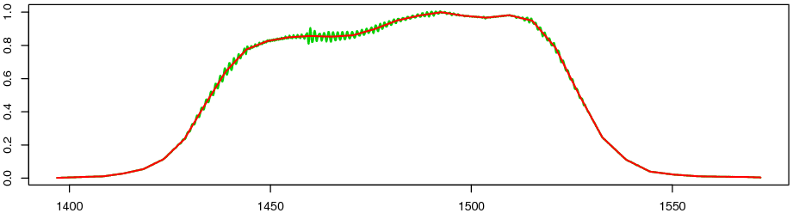
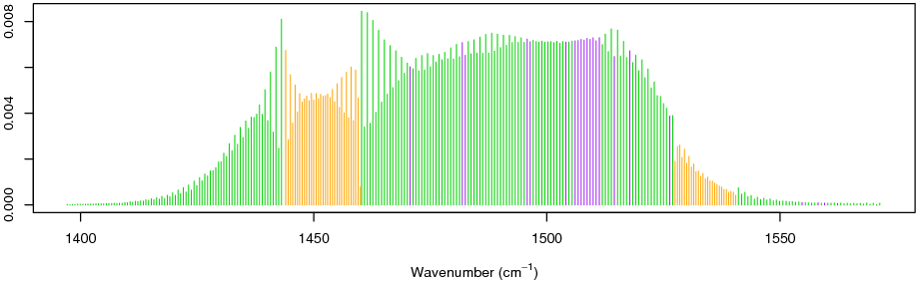
3b. Spectral Transform
MTSAT-1R 6.8-um
AIRS blacklist ch.
SRFs of Gap channels
SRFs of AIRS
SRF of MTSAT
SRF of super channel consists of AIRS and gap channels
Weights of AIRS ch.
Weights of gap ch.
Notes:
Relatively straightforward for IASI.
AIRS has spectral gaps due to design and operation failure. JMA designed algorithm to find the R_v where AIRS measurements are not available.

Slide 10
4. Selection
Several reasons
  Performance under certain conditions, e.g., night
  Narrow down threshold, e.g., time window
  Avoid certain conditions, e.g. sun glint
Weighted average/regression is superior than threshold
ATBD facilitates these options. No specific recommendation/discrimination

Slide 11
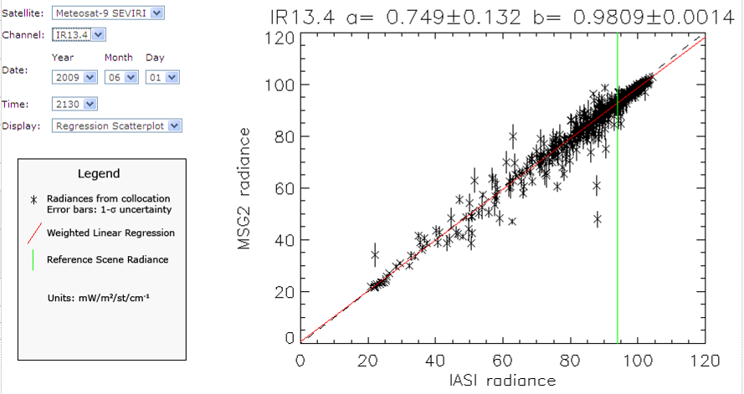
5a. Analysis – Quantify Bias
Notes:
Example of the recommended bias analysis.

Slide 12
5b. Analysis – Correct Bias
GSICS Corrected radiance from GEO operational product
  a, b from weighted regression
Reduced Major Axis – under investigation
Period of regression is critical

Slide 13
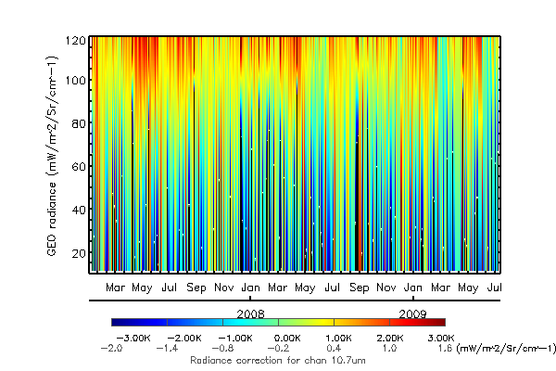
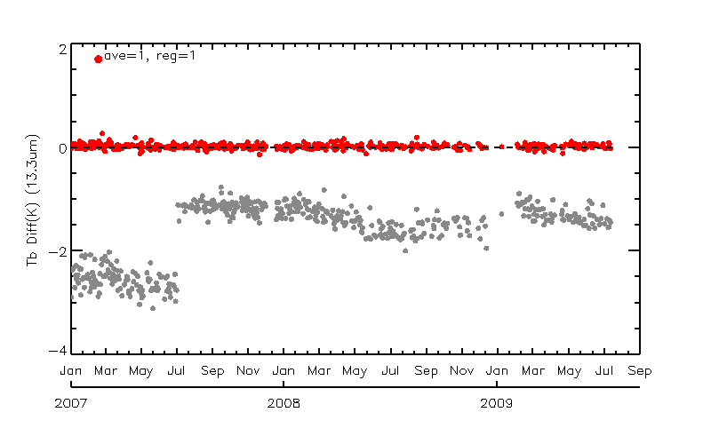
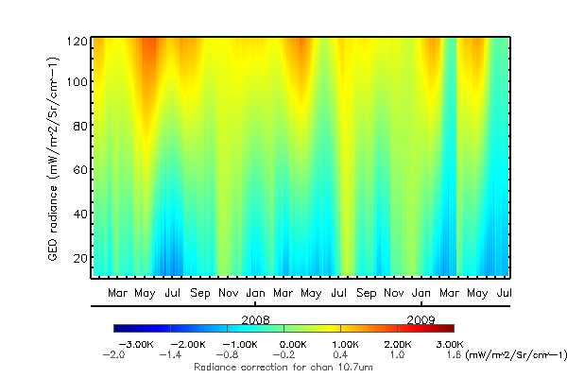
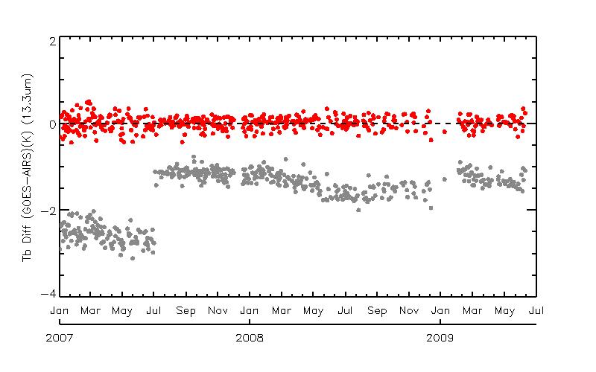
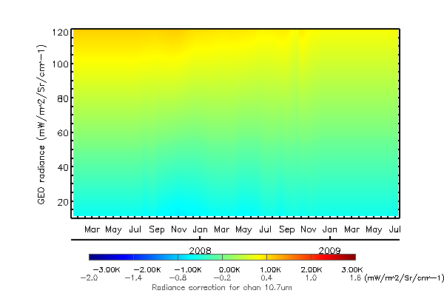
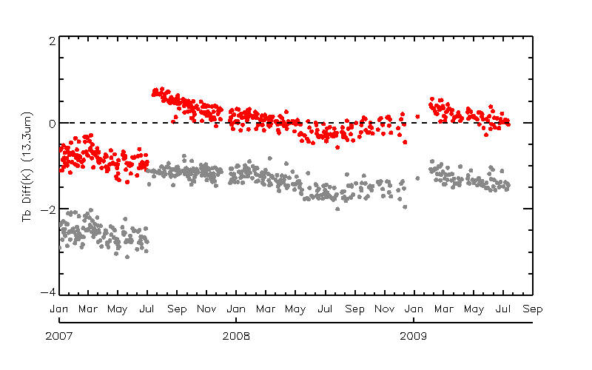
5b. Analysis – Correct Bias
Notes:
Upper panels – 1 day. Theoretical basis/assumption: LEO is perfect; comparison is perfect; GEO is lousy.
Lower panels – 1 year. Theoretical basis/assumption: LEO is perfect; GEO is nearly perfect; comparison is lousy.
Replaced panels – 1 month. Theoretical basis/assumption: LEO is perfect; GEO and comparison are neither perfect nor lousy but have to compromise.

Slide 14
Outline
Algorithm
  Quantify the difference – magnitude and uncertainty
  Correct the difference – empirical removal
  Understand the difference – root cause analysis.
Products and Applications
  Core products: Refer to GCC talk.
  Double Difference (Wang et al.)
  Outgassing
  Spectral Response Function
  Midnight Blackbody Calibration Correction
  Image Navigation and Registration (Yu et al.)
  HIRS
Future work

Slide 15
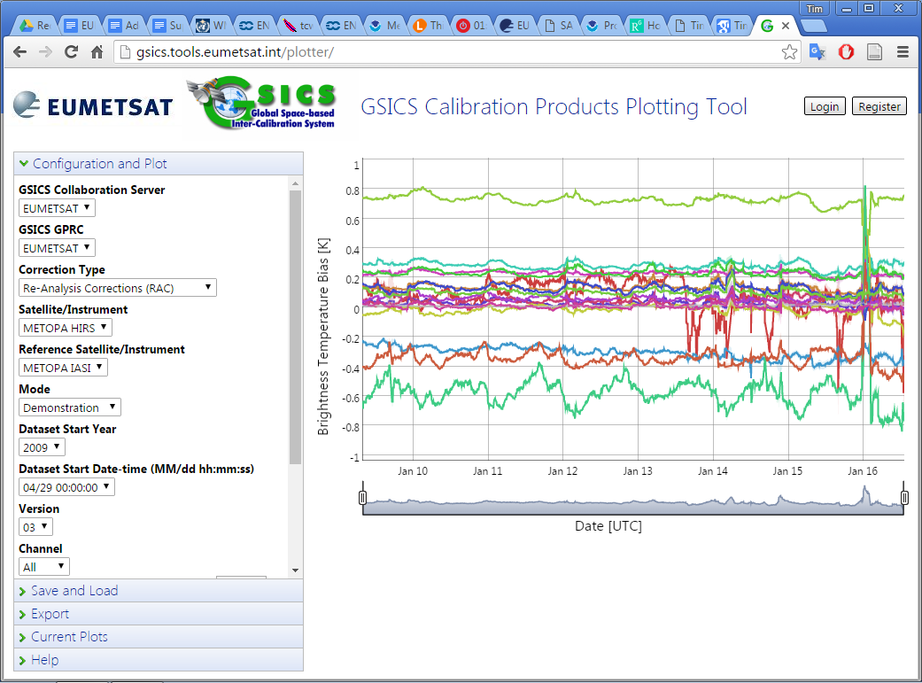
Monitoring HIRS by inter-comparison with IASI
Public Website
Anomaly in Jan 2016 – Filter wheel
Reads data from Server
Metop-A/HIRS Calibration Stable
Prototype Product
Evaluates Bias – Plotted as Time Series
Hewison

Slide 16
Development of GSICS products for HIRS?
Metop/HIRS: Mature Algorithm, based on GEO-LEO IR inter-cal wrt IASI
NOAA/HIRS: Need to implement LEO-LEO collocation system
Suitable for:
  Instrument monitoring
  Near Real-time Corrections
  Re-Analysis Corrections (e.g. case studies)
But no further development without strong user needs
Could also develop
  Archive Re-Calibration – to support FCDR generation
  Harmonising data from all instruments in HIRS series
  Based on activities supporting re-calibration of Meteosat archive
Any beta testers?
Hewison

Slide 17
Outline
Algorithm
Products
Future work

Slide 18
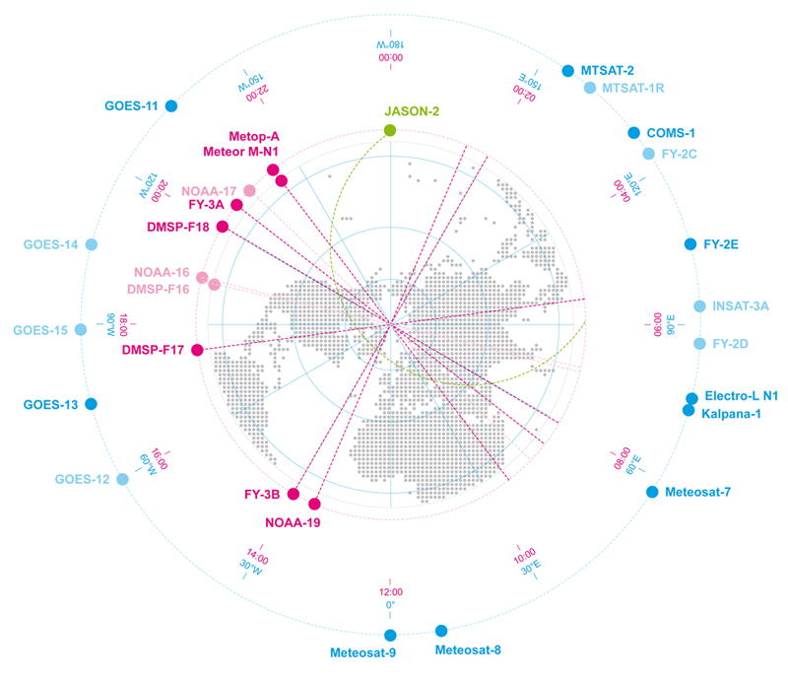
Comparing GEO-LEO and GEO-GEO Differences
To Validate Uncertainty
estimates
Ensure consistency
Generate global L2 products
Hewison, 2016 GSICS Annual Meeting

Slide 19
Prime Correction
Reference-1
(Anchor)
Monitored Instrument
Reference-2
(Secondary)
GSICS Correction, g₁ Mon➔1
GSICS Correction, g₂ Mon➔2
Correcting the Corrections and Blending References
-
Derived by GSICS
Delta
Correction, g_{1/2}
2➔1
+
Action: GRWG.2016.3e.1: Tim Hewison to consider revising terminology used in the current “Primary GSICS Corrections”, during demonstration phase (closed)
Modified
Correction, g_{2,1/2}
Mon ➔2➔1
g̅
Prime GSICS Correction, g₀ Mon➔1
Mon➔Ref1
Applied
by User

Slide 20
IR Reference Sensor Traceability
And Uncertainty Report
Aims
  To support the choice of reference instruments for GSICS and IASI as Anchor
  To provide traceability between reference instruments (IASI, AIRS, CrIS)
  By consolidating pre-launch test results and various in-flight comparisons
  To seek consensus on the uncertainties in the absolute calibration of the reference sensors
Limitations
  No new results, just expressing results of existing comparisons in a common way,
  reformatting where necessary, to allow easy comparisons.
Error Budget & Traceability
  Focus on Radiometric and spectral calibration
  AIRS, IASI, CrIS
Inter-comparisons
  Polar SNOs, Tandem SNOs, Quasi-SNOs, GEO-LEO Double Differencing, NWP Double-Differencing, Regional Averages (“Massive Means”), Aircraft Double-Differences, other
Conclusions
Hewison

Slide 21
Summary
Overview of algorithm, products, and future work.
User comments on planned future work.
User suggestion of new future work.
User feedback on existing products.

