Slide 1
GSICS Vis/NIR Calibration Activities
Special Issue of the IEEE TGRS on “Inter-Calibration of Satellite Instruments”:
Special Issue of the IEEE TGRS on “Inter-Calibration of Satellite Instruments”:
David Doelling (NASA)
(GRWG Vis/NIR Sub-Group Chair)
And the GSICS VIS/NIR sub-group members

Slide 2
Overview
GSICS VIS/NIR calibration strategy
Lunar Calibration status
DCC Calibration status
Solar spectra
Spectral band adjustment factors
Discussion

Slide 3
GSICS GEO VIS/NIR calibration strategy
Use lunar (ROLO model) and Deep Convective Clouds (DCC) calibration to determine the stability of the sensor and to tie the calibration to an absolute reference
All GEOs observe the moon and DCC
Combine lunar and DCC visible calibration gains as the final GSICS calibration
Consistent multiple calibration results validates all techniques
The combined gain will have a smaller uncertainty than any individual method gain
Individual method gains will be made available so that the user may determine calibration method best suited for the application

Slide 4
GSICS VIS/NIR reference calibration strategy
Use Aqua-MODIS Band 1 Collection 6 radiances as the absolute reference
Migrate to NPP-VIIRS
Have an unbroken chain of traceable calibration reference records
The reference record chain is then tied to an SI-traceable on-orbit calibration system sensor, such as CLARREO or TRUTHS

Slide 5
GSICS VIS/NIR SBAF strategy
Use SCIAMACHY based spectral band adjustment factors (SBAF) to take into account spectral differences between the reference and target instrument
If there were a well-calibrated hyper-spectral sensor there would be no need for SBAF
The SBAF need to be unique to the spectra used over the GEO and reference sensor intercalibration site
Lunar spectra available from ROLO model and SCIAMACHY

Slide 6
Lunar Calibration
GSICS Implementation of the ROLO model (GIRO) / GSICS Lunar Observation Dataset (GLOD)
Intellectual Property Right being cleared in order to distributed to the Lunar Calibration Community members upon agreement with the usage police and the license.
Infra-structure for GIRO/GLOD expected in 2016 Q4.
Activities planned with USGS to formalise the traceability to the ROLO
Inter-calibration using the Moon
Scheme proposed by EUMETSAT at the last GSICS Annual Meeting in Tsukuba – Japan.
On-going study on the validation of SBAF using hyperspectral measurements from SCIAMACHY ➔ Final Presentation in November 2016
Interactions between JMA and EUMETSAT on AHI lunar data
Organisation of a second Lunar Calibration Workshop (still to be confirmed)
Co-organised and hosted by the Chinese Meteorological Administration
Probably second half 2017
Main topics still to be defined
GSICS web meeting on 30 August 2016 to initiate the preparation
Courtesy of EUMETSAT

Slide 7
GSICS VNIR product for Meteosat SEVIRI VIS0.6 channel
GSICS VNIR product in demonstration phase (reference = Aqua MODIS)
Currently based on Deep Convective Clouds only.
Applies to VIS0.6 channel on Meteosat-10.
Near-Real Time and Re-Analysis products generated on a daily basis ➔ stored on EUMETSAT GSICS data server.
Dataset available on request for Meteosat-9 VIS0.6 (till December 2012).
Future work:
Change the reference from Aqua MODIS to Suomi NPP VIIRS in order to process more bands (VIS0.8 for instance).
Complement the DCC method with other methods such as lunar inter-calibration (some questions still to be resolved to blend the product).
Courtesy of EUMETSAT

Slide 8
Where to get the data?
NetCDF format
Follows GSICS standards (based on WMO standards + CF conventions)
Updated once per day (Near Real Time + Re-Analysis)
A product user’s manual soon available
For NRT + RA ➔ see http://gsics.eumetsat.int
Courtesy of EUMETSAT

Slide 9
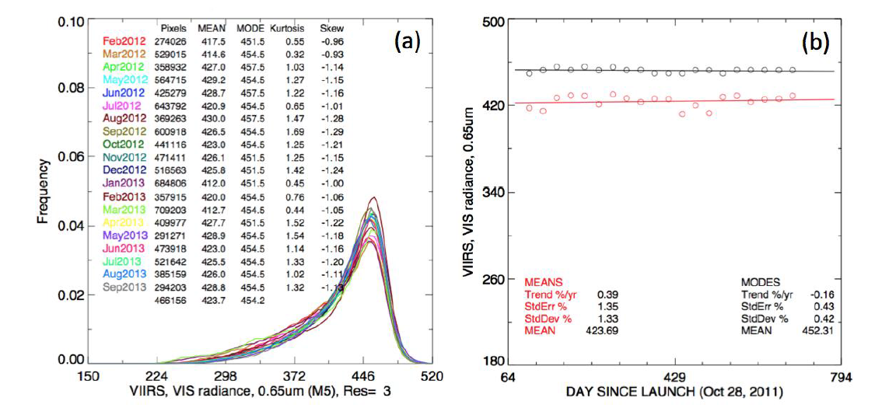
VIIRS I1 (0.65µm) DCC mode radiances
Bhatt et al. 2014
• The VIIRS I1 band NASA LandPeate calibrated radiances seem stable over time

Slide 10
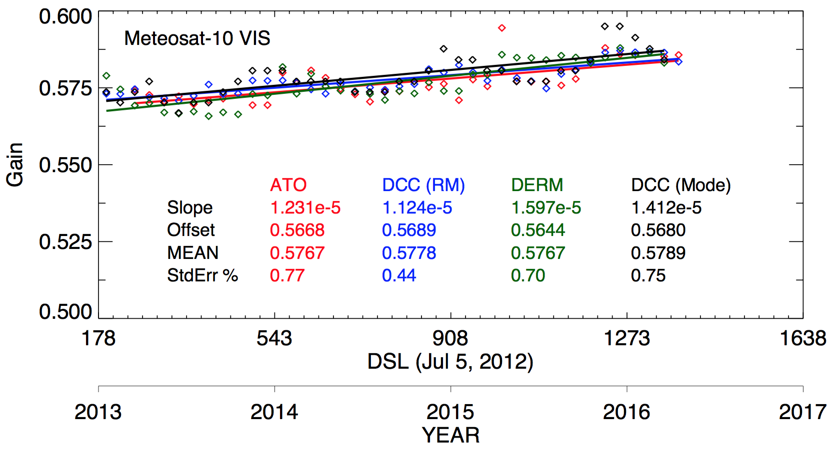
Comparison of Met-10 VIS/NIR calibration methods
Validate that the AquaMODIS DCC mode radiance equals the Meteosat-10 DCC mode radiance over the Met-10 domain
thereby validating that the DCC mode algorithm properly transfer the calibration reference
Also all calibration methods are within 0.4%
ATO: All-Sky Ocean Ray Matching
DCC (RM): DCC ray-matching
Libya-4: Based on Met-9 Libya-4 model
DCC (Mode): DCC mode radiance method (GSICS)
Libya-4

Slide 11
GSICS Solar Spectra Recommended Reference
Many available solar spectra available
SORCE, daily varying
Thuillier, MCST, IDPS
Radiative transfer enhanced datasets
Work with CEOS IVOS to recommend the best available solar spectra for the wavelength range needed
Spectral resolution
Absolute calibration
Work with Nigel Fox, Greg Kopp
Have GSICS/CEOS IVOS web meeting, beginning this year

Slide 12
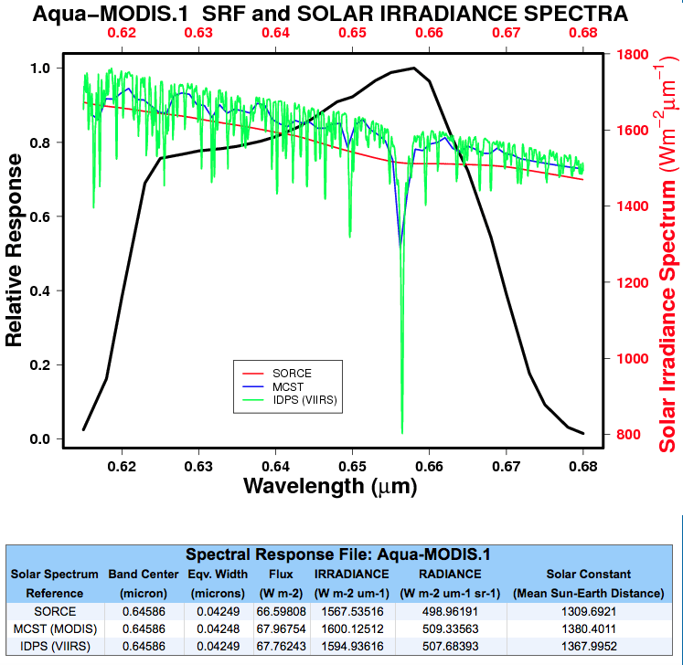
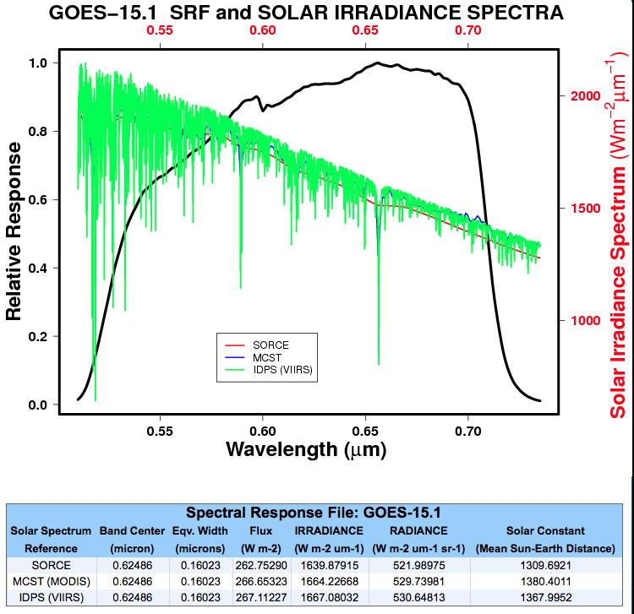
Solar Constant Comparison
• Absolute calibration within 1.7%
* When using the same solar spectra dataset, the band ratios are very consistent

Slide 13
Spectral Band Adjustment Factor (SBAF)
Web site available for SBAF over many SCIAMACHY based Earth reflected spectra
http://www-pm.larc.nasa.gov/cgi-bin/site/showdoc?mnemonic=SBAF
Future Plans
Incorporate Hyperion, and GOME-2 observations

Slide 14
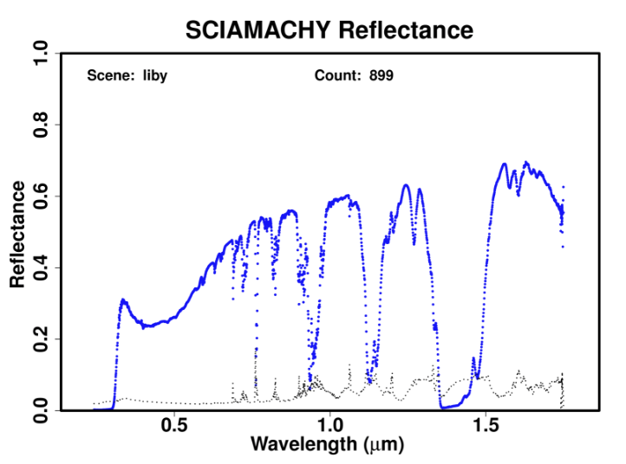
Libya-4 SCIAMACHY spectra

Slide 15
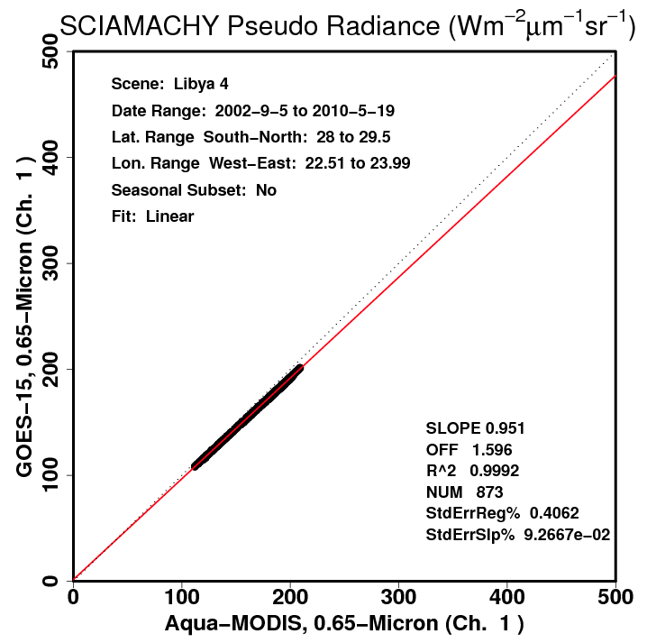
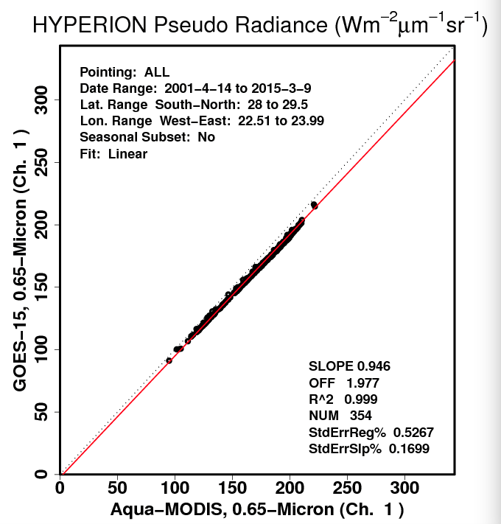
Comparison of SBAF over Libya-4

Slide 16
Thank You
Any thoughts for Discussion
Notes:
16

