Slide 1
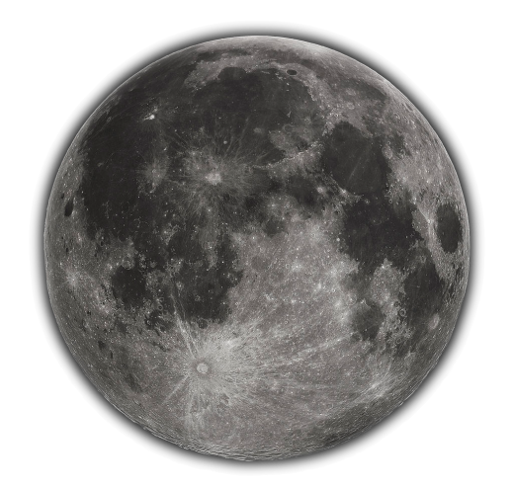
Preliminary SCIAMACHY Lunar observations as intercalibration source
That’s no moon,
It’s a calibration source
Ralph Snel
Matthijs Krijger

Slide 2
SCIAMACHY
SCIAMACHY Lunar Observations
SCIAMACHY Degradation
SCIAMACHY Calibration
Future

Slide 3
SCIAMACHY on ENVISAT

Slide 4
Primary purpose
The main objectives of the SCIAMACHY mission are
to improve our knowledge of global atmospheric composition,
its change in response to both natural and anthropogenic activity and the processes associated to it, as well as
the related global issues of importance to the chemistry and physics of our atmosphere
Monitor the Earth atmosphere (gases, aerosols, clouds) in reflected sunlight

Slide 5
The instrument
Imaging spectrometer
Spatial dimensions through scan mirror(s):
IFoV: 0.045 degrees by 1.8 degrees
Spectral dimension through 8-channel spectrometer, 8192 wavelengths:
214 nm to 1773 nm
1934 nm to 2044 nm
2259 nm to 2386 nm
Nadir, Limb, sub-solar, solar occultation and lunar occultation views
Many in-flight calibration and monitoring modes

Slide 6
SCIAMACHY viewing modes

Slide 7
Lunar observations
2 types of lunar observation:
Lunar pointing using sun/moon follower (state ID 56 and 57)
Lunar scanning, using sun/moon follower + superimposed scan of 0.66 degrees edge to edge (state ID 54)
State IDs 56 and 57 show only a slice of the moon, not suited for this study
State ID 54 shows the entire moon in the scans, 1-dimensional “image” in elevation direction:
2 pixels high in 8192 wavelengths
80 pixels high in 7 Polarisation Measurement Devices (PMDs), broadband linear polarisation, 6 wavelengths, 2 polarisation directions (90 and 45 degrees)

Slide 8
Number of lunar spectra
1112 orbits with State ID 54 (between 2002-12-16 and 2012-04-07)
Focus here on 400 orbits between beginning 2003 and beginning 2008
Dedicated lunar calibration campaign mid to end 2006 included
Total number of spectra over the 400 orbits about 26000 spectra, 1 second per spectrum

Slide 9
Lunar phase angle coverage (1)

Slide 10
Lunar phase angle coverage (2)

Slide 11
Lunar libration angle coverage

Slide 12
SCIAMACHY lunar albedo (1)

Slide 13
SCIAMACHY lunar albedo (2)

Slide 14
SCIAMACHY lunar albedo fit RMS

Slide 15
SCIAMACHY Degradation

Slide 16
SCIA Lunar Degradation (1)

Slide 17
SCIA Lunar Degradation (2)

Slide 18
SCIA Lunar Degradation (3)

Slide 19
SCIA Lunar Degradation (4)

Slide 20
SCIA Lunar Degradation (5)

Slide 21
SCIA Phase Angle (1)

Slide 22
SCIA Phase Angle (2)

Slide 23
SCIA ASM Angle (1)

Slide 24
SCIA ASM Angle (2)

Slide 25
SCIA ASM angle (3)
On-ground
Calibrated

Slide 26
Future
SCIAMACHY ASM-dependence
SCIAMACHY Polarization
SCIAMACHY Absolute Calibration
Put the moon to good use

Slide 27
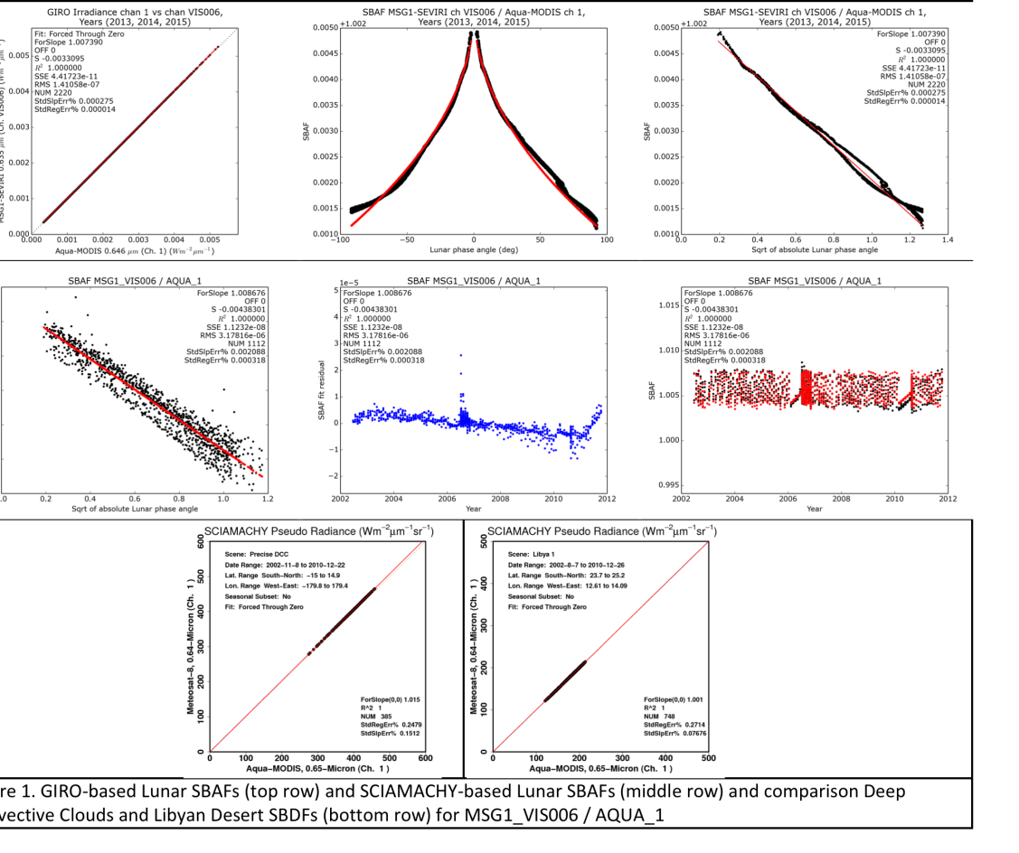
Potential uses:
SBAFs:
MSG1 Vis 006 –
Aqua Ch 1

Slide 28
Summary
SCIAMACHY
High (0.25nm) resolution lunar spectrum
Precise (<0.5%) lunar spectrum
Many (~1100) lunar measurements
Different geometries
New improved calibration (mirror model)
Good (relative) agreement ROLO/GIRO (<0.5%)

Slide 29
Thank you

