Slide 1
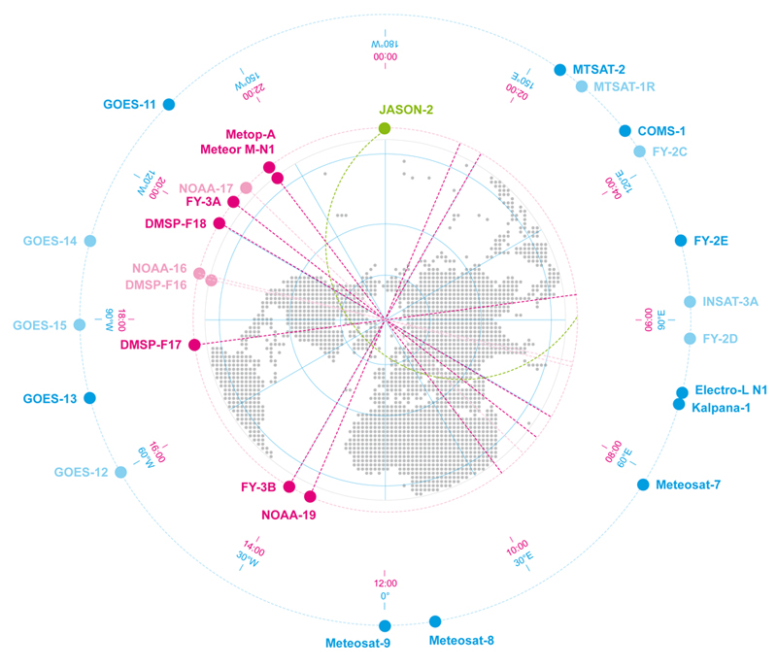
Highlights from the 17th Executive Panel Meeting Kenneth HOLMLUND (GSICS-EP Vice-Chair)

Slide 2
Outline
GSICS purpose and organization
Highlights of recent activities
Recommendations

Slide 3
Why GSICS?
Space-based observations from various satellite missions and agencies must be precisely calibrated with similar methods against common references to be reliable and interoperable.
Poor or inhomogeneous calibration results in degraded performance and lower benefits
CGMS members are collaborating within GSICS to develop and apply “best practices” for homogeneous calibration
GSICS provides: references, guidelines, methodologies and tools enabling satellite operators to evaluate and improve their calibration and to deliver intercalibration adjustments (GSICS Corrections).

Slide 4
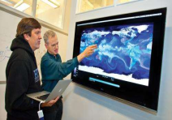
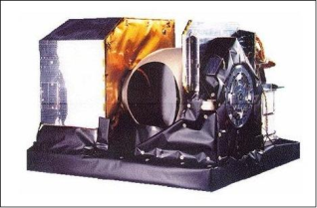
GSICS deliverables
Core GSICS inter-calibration products
Instrument behaviour assessment
Instrument correction algorithms
Near Real Time corrections
Time–centered corrections
Users
Monitored instrument
Bias adjustment sequences (archive)
Science resources
Solar & lunar spectra
Target characteristics
Calibration datasets
etc.
Spectroscopy database, RTM
Standards & procedures
References (benchmarks)
Metadata & Data Formats
Standard vocabulary
Procedures
etc.
GSICS tools
SNO matchup
Bias monitoring
Ray matching
Plotting, readers
etc.
User services
Registration, messaging
Product catalogue
Data servers
wiki, website
Documentation info, etc.

Slide 5
Who benefits from GSICS ?
Satellite operators participating in GSICS
Sharing development effort and resources (calibration references, datasets, software tools)
Capacity building (best practices for instrument monitoring, traceability, sensor comparison and correction)
Improved instrument assessment, faster identification and correction of anomalies, facilitating commissioning and operation
Interoperability within the CGMS constellation,
Satellite data users
Improved calibration
Interoperability through inter-calibration
Assessments, reports, for better understanding
Algorithms enabling to reprocess data records
GSICS leverages the value of individual missions

Slide 6
GSICS Members
WMO
EUMETSAT
ROSHYDROMET
CNES
USGS/NOAA
NASA/NIST
KMA
JMA/JAXA
CMA
IMD/ISRO
Obs. ESA + CEOS
ASSO. GPX
14 Members Worldwide

Slide 7
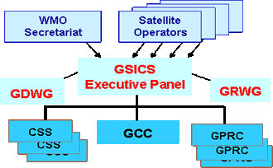
GSICS Structure
CMA
EUMETSAT IMD
JMA
KMA NOAA ROSHYDROMET
GSICS Research Working Group
IR Sub-Group
VIS/NIR Sub-Group
Microwave Sub-Group
UV Sub-Group
Future Sub-Groups...
WGCV IVOS
WGCV MWSG
GPM X-CAL
WGCV ACSG
CEOS ACC

Slide 8
Outline
GSICS purpose and organization
Highlights of recent activities
Recommendations

Slide 9
GCC Highlights
GSICS Coordination Center continues to support and coordinate exchanges of ideas within GSICS.
Review of MSG-2,-3/IASI-A products was completed and Products are in Operational Status.
Review of DCC and Prime product completed at GPPA.
List of GCC focused discussions at this meeting
Promotion of products to pre-operational or operational stage
Status of GSICS User Requirements and discussion
Catalogue and definition of GSICS deliverables
GSICS documentation and outreach

Slide 10
GSICS GEO-LEO IR Product Status 2016-02 (IR)
GPRC | Monitored Instrument | Reference Instrument | GSICS NRT Correction | GSICS Re-Analysis Correction | GSICS Bias Monitoring
EUMETSAT | Meteosat-9, -10* Meteosat-7 | Metop-A/IASI* | Operational Demo | Operational Demo | Plots RAC*
JMA | MTSAT-1R } MTSAT-2 } | IASI (+ AIRS) | Demo | Demo | Plots RAC
NOAA | GOES-13 & -15 Imager GOES-11 & -12 Imager | IASI (+ AIRS) | Pre-op | Pre-op Demo | Prototype
 | GOES Sounder | IASI (+ AIRS) | Development | Development | In development
CMA | FY2C – E | IASI (+ AIRS) | Development | Development | Prototype
KMA | COMS-1 | IASI | Prototype | Prototype
ISRO | INSAT-3D | IASI | Prototype | Prototype
For the first time we will be able to inter-calibrate the geostationary ring to the same reference!

Slide 11
Near-term GCC Goals for 2016-2017
Evolution of the GSICS Procedure for Product Acceptance
Support inclusion of New Products
Coordination
Continue to coordinate efforts to establish the GSICS baseline algorithms, especially those for the GEO solar reflective channels,
Continue to provide communication between the developing group and users
Publish the GSICS Quarterly Newsletter
Continue to create and distribute this important link to the GSICS community.
Support Reviews of GSICS Products, Deliverables and Resources
Meeting Support
Joint Meeting, GSICS Web Meetings and QA4EO telcons.
Organization of GSICS 7th Users Workshop at NCWCP, USA
Gather more user requirements

Slide 12
Outreach
A user survey was performed with in order to improve services:-> To be followed-up by the WGs
CEOS WGCV plenary 5-7.9. Tokyo
GSICSWiki.net
GHRSST using IASI CrIS and AHI!!

Slide 13
Engaging with users
Invitation to GHRSST to evaluate the impact of GSICS corrections on AHI data for SST retrieval

Slide 14
Overall GSICS Coordination Issues Near-term goals for GSICS Coordination Center
Keep coordinating the product acceptance process
Bring more products to pre-ops and operational stage
Streamline communication with EP to speed up the procedure
Complete Review of GSICS Deliverables
Define relevant acceptance procedure for new deliverables
Expand catalogue (or equivalent ) for new deliverables
Complete draft Guide to GSICS Products and Services
Gather more, and more detailed, user requirements
Including from climate community
Support communication with users and developers
Continue publishing the GSICS Quarterly Newsletter
Support Joint meeting, web meetings,
Prepare7th Users workshop

Slide 15
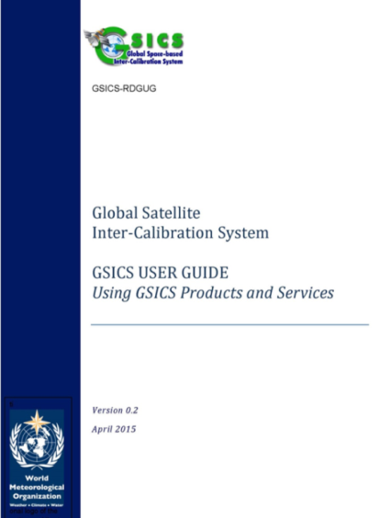
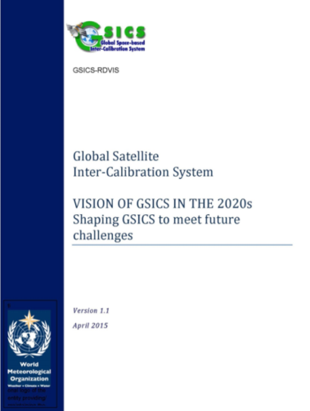
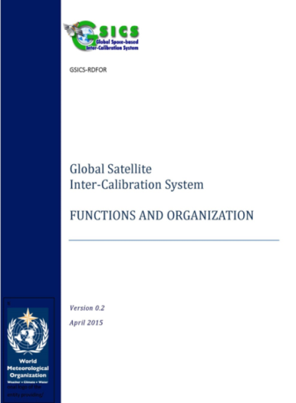
GSICS Reference Documents
Introduction to GSICS (Draft under review)
Vision of GSICS (published)
Terms of Reference (Published)
Guide to GSICS Products and Services (draft in progress)
To promote shared vision among GSICS members
For more visibility, and external recognition of GSICS, e.g. within WIGOS and within the Architecture for Climate Monitoring from Space

Slide 16
Product Endorsement Process
Process including required documentation agreed
Approach for Families of instruments agreed
Reference instrument discussion
Set of reference instruments exist and the agencies are hence encouraged to implement operational product for all references

Slide 17
Responding to CGMS HLPP Targets
3.1 Establish a fully consistent calibration of relevant satellite instruments across CGMS agencies, recognizing the importance of collaboration between operational and research CGMS agencies;
Establish within GSICS a consistent inter-calibration for thermal IR channels using hyper-spectral sounders as reference. The implementation will be done successively by the individual satellite operators.
Establish within GSICS a consistent inter-calibration for solar channels using instruments with adequate in-orbit calibration and vicarious methods as reference. The implementation will be done successively by the individual satellite operators.

Slide 18
Status of CGMS HLPP Targets
IR is currently being performed by most agencies operating geostationary imagers – albeit at different levels of maturity. Operational for 2 satellites (+4 in pre-ops stage).The algorithm is also being rolled out to LEO platforms by some agencies. So not yet “fully achieved” – however roughly 90% achieved
VIS/NIR is still in development, with the first demonstration GSICS products for the VIS channel of geostationary imagers, based on Deep Convective Clouds, and referenced to MODIS to start in 2016. Counterpart products for other satellites will follow. The algorithm will then be extended to include the Moon as a calibration transfer, which is also applicable to channels in the NIR. Roughly 50% achieved

Slide 19
Operational coordination: GSICS Procedure for Product Acceptance
Submission Phase
ISRO (INSAT/IASI)
EUM (DCC, Prime)
4 EUMETSAT
17 NOAA
Pre-operational Phase
4 NOAA products (GOES-11,12,13,15 / IASI,AIRS)
6 JMA
Operational Phase
4 EUMETSAT products (Meteosat 9-10/IASI)
Demonstration Phase
KMA (COMS/IASI)
CMA (FY-2/IASI)

Slide 20
DevelopmentHighlights (1)
IR Inter-calibration available through the whole GEO ring
Comparing GEO-LEO and GEO-GEO Differences
To validate uncertainty estimates and ensure L1 data consistency
To generate globally consistent L2 products

Slide 21
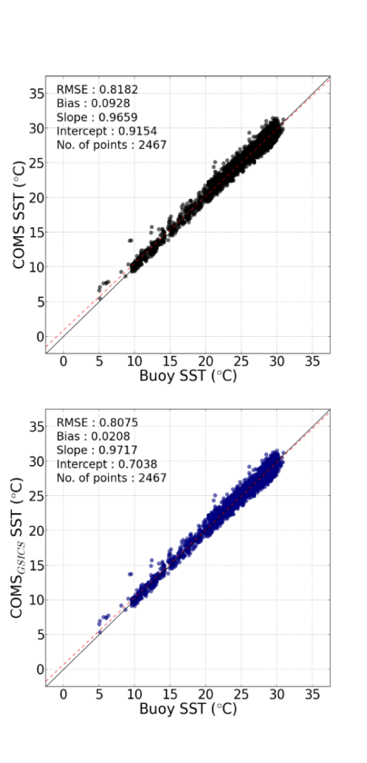
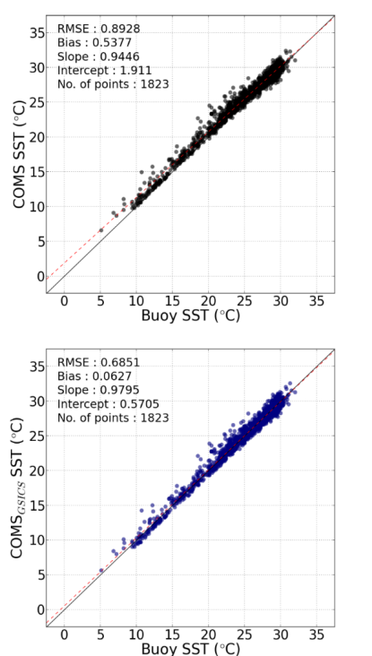
Highlight of KMA
Application of GSICS correction to SST (Sea Surface Temperature)
Daytime SST
Nighttime SST
Bias=0.5377
Before Correction
Bias=0.0928
Before Correction
Bias=0.0627
After Correction
Bias=0.0208
After Correction

Slide 22
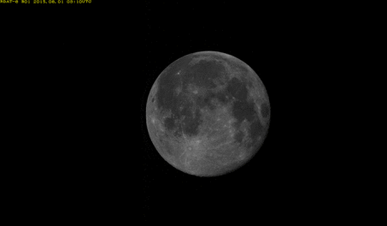
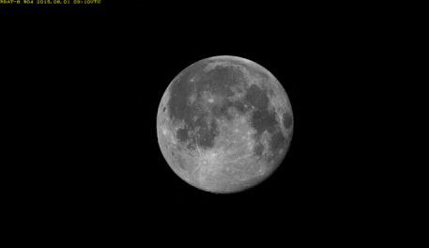
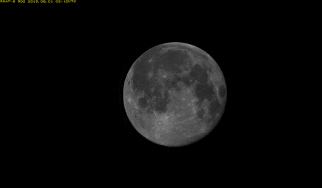
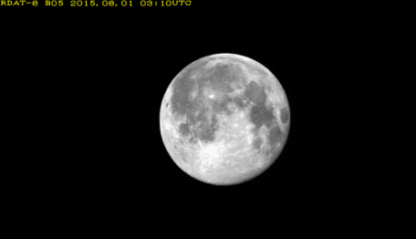
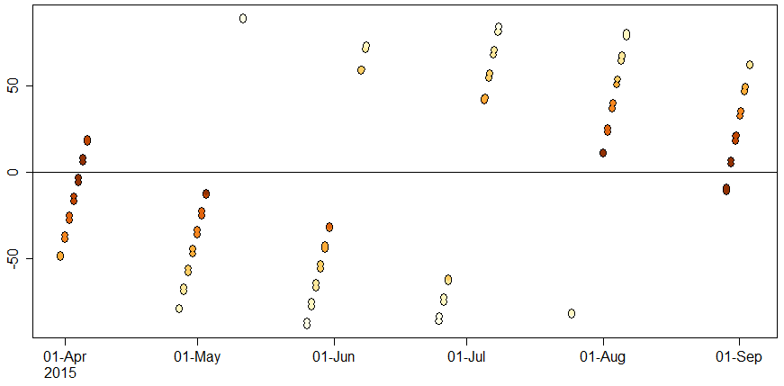
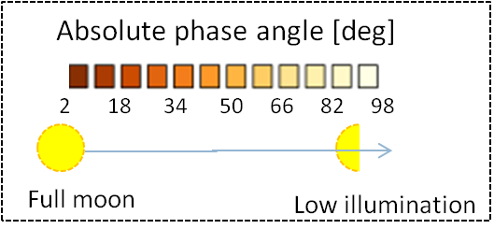
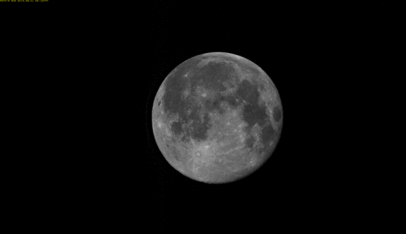
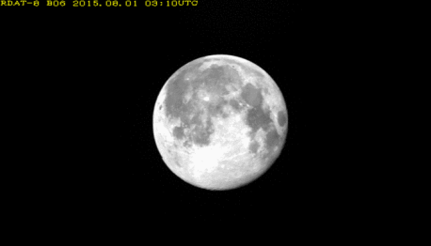
AHI Lunar Observation for GIRO Slide from JMA
2979 useful lunar observations for the GIRO within the applicable phase angle:
2 deg <= |phase angle| <= 92 deg
47 days data
→ 60-70 lunar observation / day on average
2015-08-01T03:03:26Z (phase angle: 10.5deg)
B01 (0.47μm)
B04 (0.86μm)
Time series of AHI lunar phase angle [deg]
B02 (0.51μm)
B05 (1.6μm)
[deg]
B03 (0.64μm)
B06 (2.3μm)

Slide 23
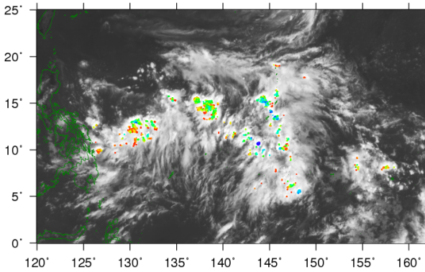
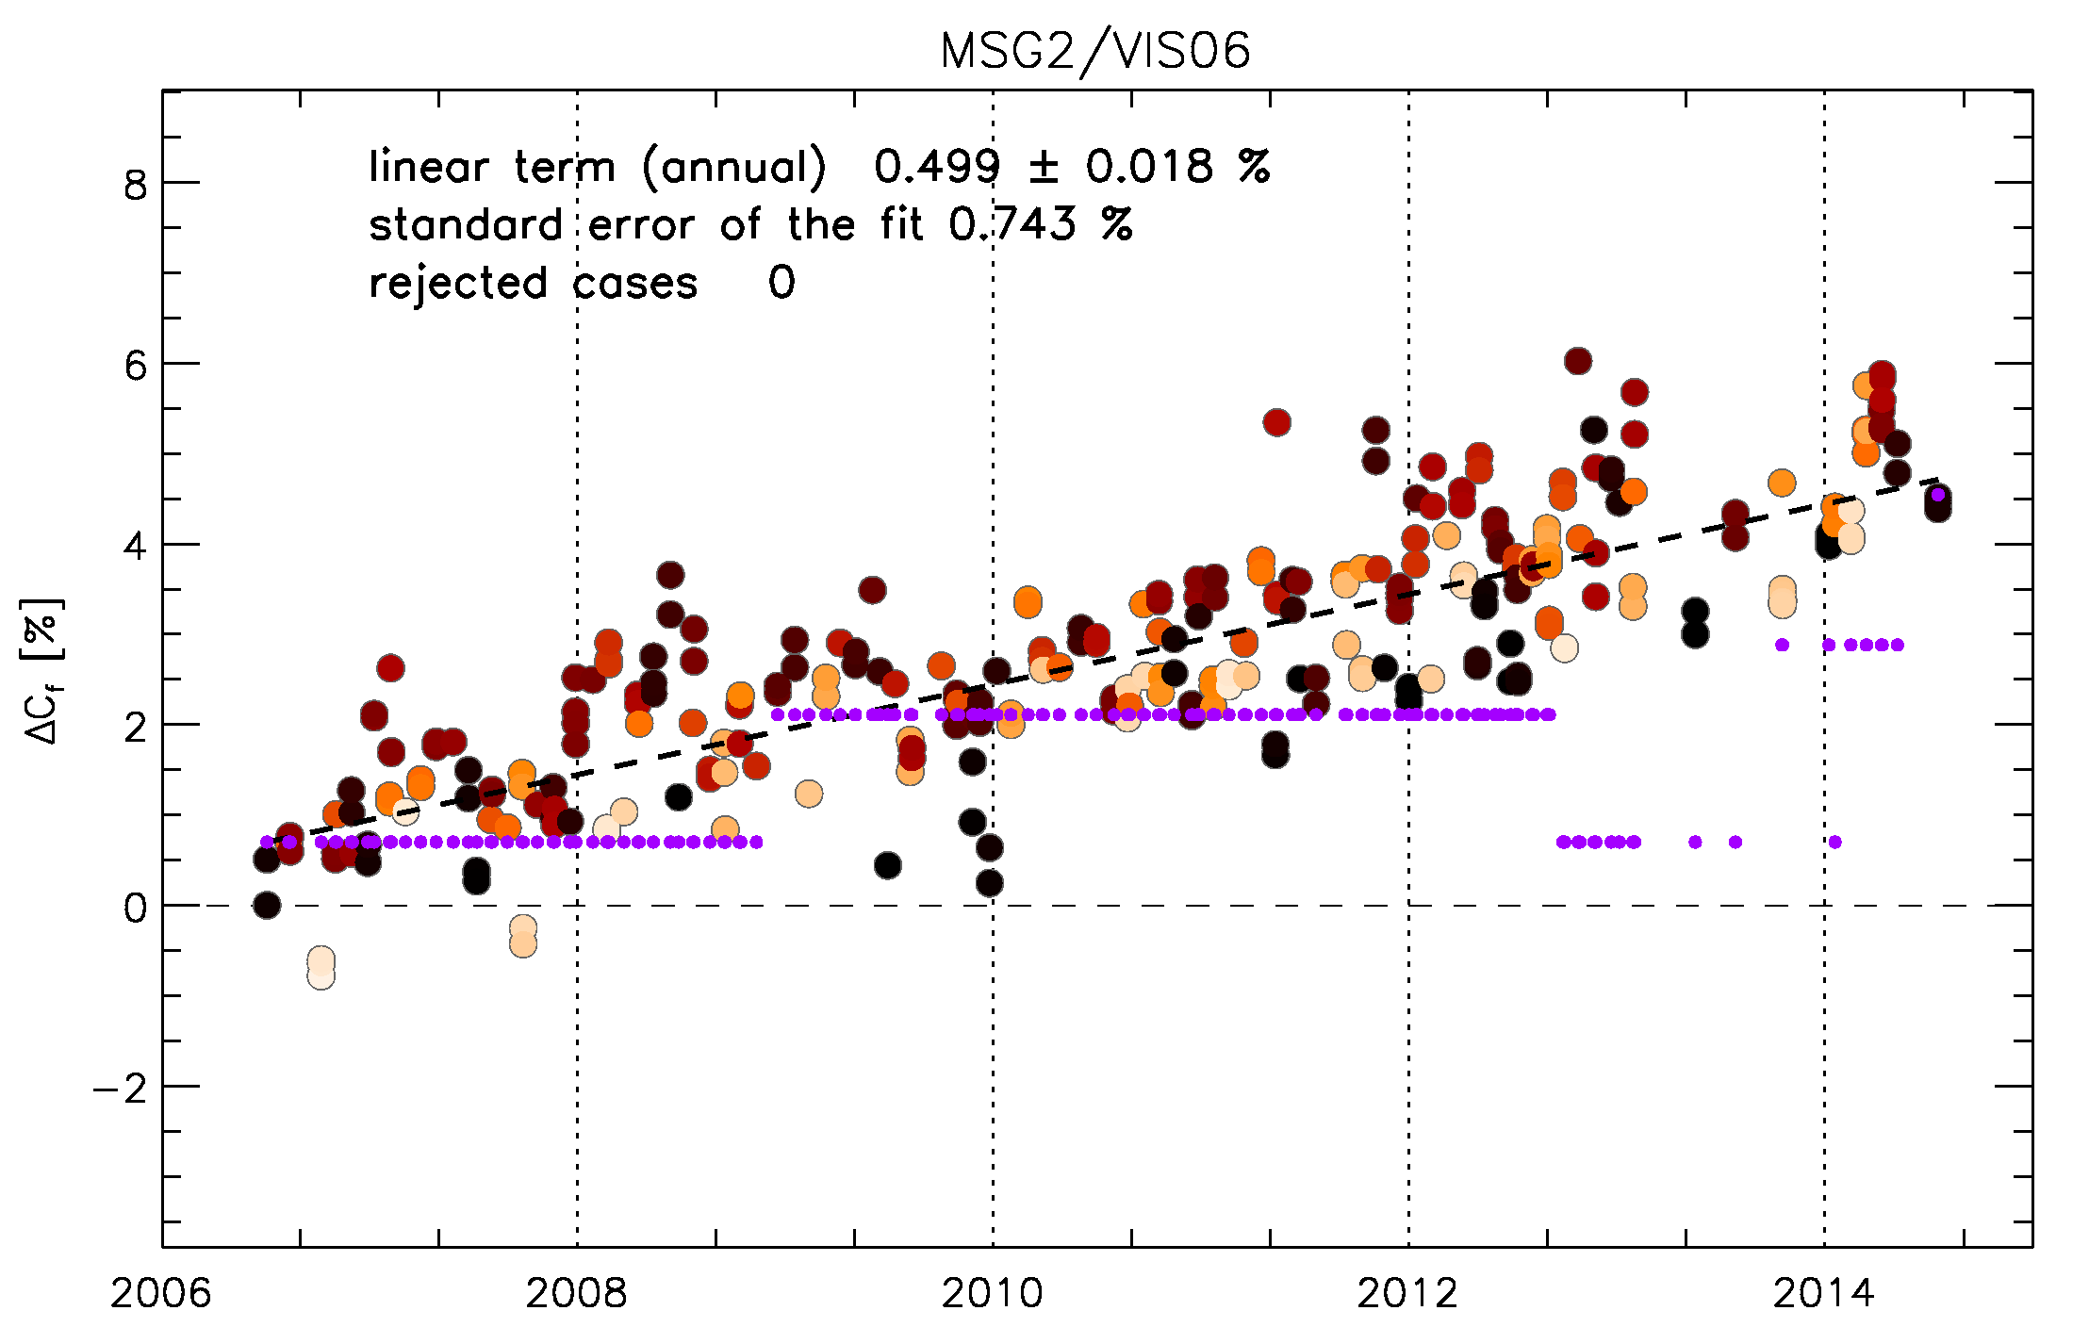
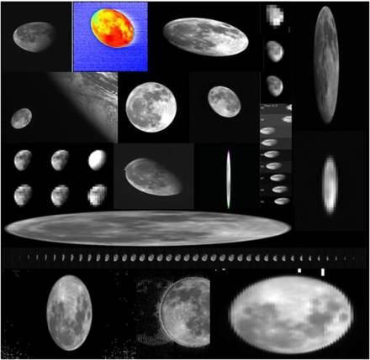
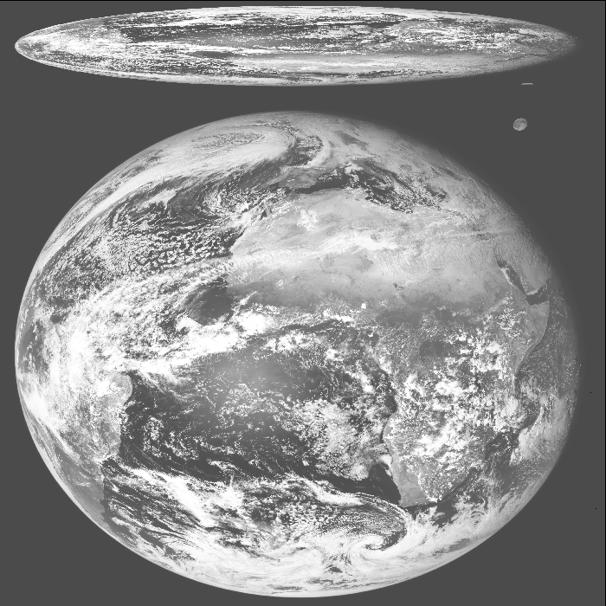
GEO-LEO VIS/NIR
Development Highlights (2)
MTSAT-2 DCC detection 2012-07-01T04
Currently two main activities on-going:
Inter-calibration of GEO imagers with MODIS using Deep Convective Clouds as transfer target
Lunar calibration : and using the Moon for inter-calibration.
10.8μm TB [K]
SEVIRI L1.0 image
Meteosat-9/VIS06 Bias Change
wrt ROLO Model Lunar Irradiance
(after phase angle correction)

Slide 24
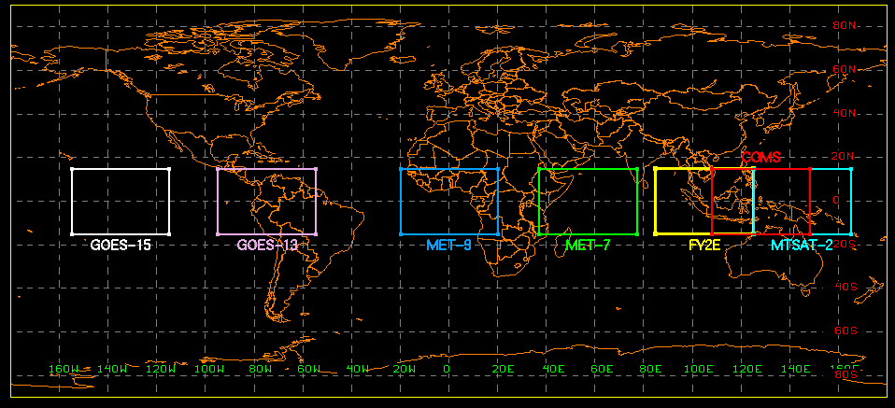
VIS-NIR intercalibration of GEO to LEO (MODIS) using DCC as transfer standard
DevelopmentHighlights (3)
Soon in demonstration phase

Slide 25
Additional
Agencies report in generally good progress
Examples
CMA launch schedule – future CLARREO type mission (2022)
JMA products web site
Roshydromet IKFS-2 performancce
Roshydromet preparing new web-site

Slide 26
Requirements for an absolute Lunar Calibration reference
Actions and Recommendations for an absolute lunar calibration reference
Satellite instrument operators should establish requirements to observe the Moon with VIS/NIR channel sensors.
Satellite operating agencies should support proposals and programs to acquire high-accuracy characterization measurements of the Moon, to develop a new, high accuracy, SI-traceable lunar reference standard for reflected solar wavelengths.
Long-term continuity of absolute solar spectral irradiance measurement with SI-traceable accuracy should be ensured.
Conclusions
The availability of a high-accuracy lunar reference standard: significant impact on Earth observation datasets acquired from space (by way of improved consistency and inter-operability across sensors and platforms)
provide benefits to climate monitoring programs & satellite operating agencies worldwide
Requirements
collecting a new, high-accuracy set of characterization measurements of the Moon
redeveloping the lunar reference using this improved dataset

Slide 27
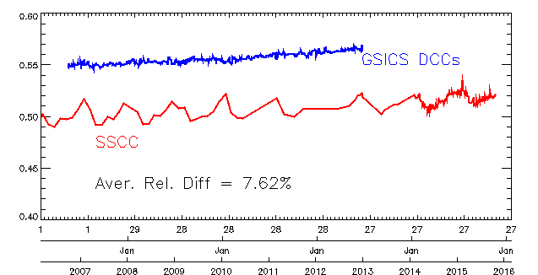
New phase of GSICS VIS/NIR products (demonstration mode)
Meteosat-9 VIS0.6
After deployment in the OPE monitoring system
Need for reprocessing
VIS0.6 Calibration Coefficient from inter-calibration w.r.t. Aqua MODIS using Deep Convective Clouds shows good agreement with user feedback

Slide 28
GRWG Work plan 2016-2017
Further development of GEO-LEO IR and DCC products
To progress existing products to Operational Status
To promote new products to Demonstration Status
Development of lunar inter-calibration & merging with DCC
To finalize implementation and monitor the GSICS VIS/NIR product
To put in place an algorithm using the Moon as a transfer target
GEO-ring demonstrator
to recalibrate IR and WV radiances for multiple GEO satellites
to support the generation of SCOPE-CM FCDRs
to analyse GEO-ring test dataset and SBAF tool
Application of “Prime GSICS Correction” concept
to merge multiple reference instruments and multiple methods
to allow corrections to cover diurnal cycle

Slide 29
GRWG Issues presented to CGMS WG II
Using the Moon as transfer standard for VIS/NIR calibration, combined with ground-based Moon observation and space-based solar observations
Requirements for lunar calibration (CGMS-44_GSICS-WP-02)
Strategy for calibration reference standards
Use of merged references to ensure a robust, representative, stable and continuous calibration «Prime reference» concept (CGMS-44_GSICS-WP-02)

Slide 30
Other on-going developments
Uncertainty evaluation
Microwave intercalibration
Need references..
UV activities
Evaluation of reference spectrometers

Slide 31
GDWG Highlights
GSICS Website Review; identification of minimum requirement / updates
Roll out of the GSICS Wiki on a New Server (gsicswiki.net)
Process for bringing the GIRO Deliverables to their Users
Realising Collaboration Software Development to preserve GSICS products
Finalising the Instrument information landing page for the WMO OSCAR
New Meta-data, conventions and template for existing and new GSICS Products; GEO-LEO-IR (existing), GEO-LEO-VNIR (new)

Slide 32
GDWG Work Plan 2016/2017
Updating collaboration server products’ structure.
Updating current GSICS product plotting tool to support new GSICS products
Exchange of GSICS products between collaboration servers (To Be Tested)
New GSICS product templates
GSICS products checker tool (maybe)

Slide 33
GDWG Membership Encouragement
To encourage GPRCs to nominate their personnel to contribute towards the GDWG membership, the benefits of GDWG membership should be clarified. These are:
Be informed of GSICS guidelines, conventions and standards that can be by their own organisational work that are already familiar to the user community.
Contribute towards the development of conventions and standards, with a view to submitting them for inclusion to International conventions and standards organisation e.g. OGC (Open Geospatial Consortium), CF (Climate and Forecast metadata), etc.
Data Management development skills can be transferred between collaboration partners.
Encourage collaboration through exchange visits to build partnerships.

Slide 34
Data Management Highlights
Progress made
Defined metadata conventions, templates for new data types
Tools (product generator, product checker, plotting, ..)
Configuration of collaborative servers : automation
Issues
Ensure actual participation of members to GDWG activities: to be informed of, contribute to, and benefit from the collaboration
GSICS reaching the operational stage, requires operational support from GDWG (e.g. administration of THREDDS servers) in addition to the advisory and development role
Need to prepare successors to lead GDWG

Slide 35
GDWG Work Plan
Review of Terms of Reference
Actual scope is wider than originally foreseen
Updates collaboration server products’ structure.
Update current GSICS product plotting tool.
Exchange of GSICS products between collaboration servers (To Be Tested)
New GSICS product templates
GSICS products checker tool (maybe)
Manual action tracking process

Slide 36
Outline
GSICS purpose and organization
Highlights of recent activities
Recommendations

Slide 37
Recommendations/challenges
Engagement of GSICS members
There is broad participation of GSICS members in GRWG, but more engagement of is expected for faster progress and early benefits
More active participation is necessary in GDWG to be informed of, contribute to, and benefit from the standardization effort and development of tools.
User requirements
Encourage external and internal users to clarify their requirements to help GSICS to focus on the high impact issues

Slide 38
ISCCP and SCOPE-CM
Project to be formulated where ISCCP is using GSICS methodologies and data for generating an new ISCCP data set
SCOPE-CM IOGEO endorsed
Schedule(need re-planning)
Data set analysis
SBAF

Slide 39
GSICS Input to WIGOS Vision for 2040
Component 1: Backbone system with specified orbital configuration and measurement approaches
Instruments | Geophysical variables and phenomena
High-accuracy solar/lunar VIS/NIR imaging spectrometer and Solar spectral irradiance sensor, as on-orbit VIS/NIR reference standard | VIS/NIR absolute calibration using the Moon's reflectance as transfer standard.
High-accuracy phase-change cell black-body IR spectrometer as on-orbit IR reference standard | TIR absolute calibration
Component 2. Backbone system – Open measurement approaches
Instruments | Geophysical variables and phenomena
On-orbit passive MW measurement reference standards | Passive MW absolute calibration of atmospheric channels
On-orbit UV measurement reference standards | UV absolute calibration

Slide 40
Summary
First GSICS products are declared operational !
Very good user feedback in particular from satellite operators
Members to strengthen their engagement in GSICS and in particular in GDWG
All CGMS Members invited to join GSICS
Members to analyze their requirements for calibration
Support inclusion of calibration references in the Vision 2040
Support GSICS engagement with CEOS/WGCV in the Architecture for Climate Monitoring from Space
Support GSICS efforts for outreach: to further document GSICS and communicate to ensure visibility and full benefit

