Slide 1
2020 Annual GSICS Calibration Report - GEO
Na Xu, Xiuqing Hu, Hanlie Xu, Chengli Qi
Qiang Guo, Boyang Chen, Lin Sun
National Satellite Meteorological Center(NSMC), CMA
2020 GSICS Webmeeting,
16, Apr, 2020

Slide 2
2019 Geo Calibration work in CMA
Major satellite/Instrument events of FY-2 & FY-4 relevant to calibration and the impact on the radiance quality
FY-4/GIIRS status updates in 2019 and performance of V3 L1 data.
Radiometric calibration performance for FY-2 & FY-4 Imagers using GSICS inter-calibration/inter-comparison
Table/Figure summarizing bias/unc: average of last one year or typical time period
Time series chart of bias/unc: since operation start or last one year
Scene Dependent Bias: Scatterplot of scene dependent bias

Slide 3
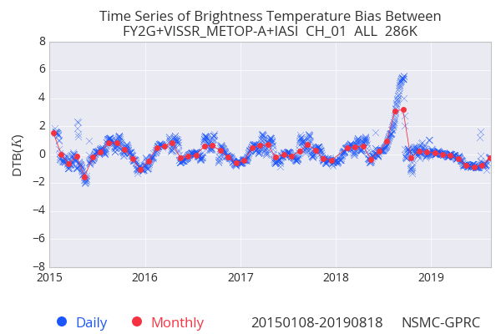
FY-2 Calibration Events in 2019
http://planet.rssi.ru
Satellite (status) |  | Current Location | Launch Date | Operation Date
FY-2E | (11, Jan 2019 disengaged) |  | 23, Dec 2008 | Feb 2009
FY-2F | （Op） | 112°E | 13, Jan 2012
FY-2G | （Op） | 105°E | 31, Dec 2014 | 1, Jul 2015
FY-2H | （Op） | 79°E | 5, Jun 2018 | 11, Jan 2019
Major Calibration Related Events | FY-2F | FY-2G | FY-2H
New calibration algorithm (source free) implementation | January, 2020 | January, 2019
FengYun satellite operation information and announcements:
http://www.nsmc.org.cn/en/NSMC/Channels/100029.html

Slide 4
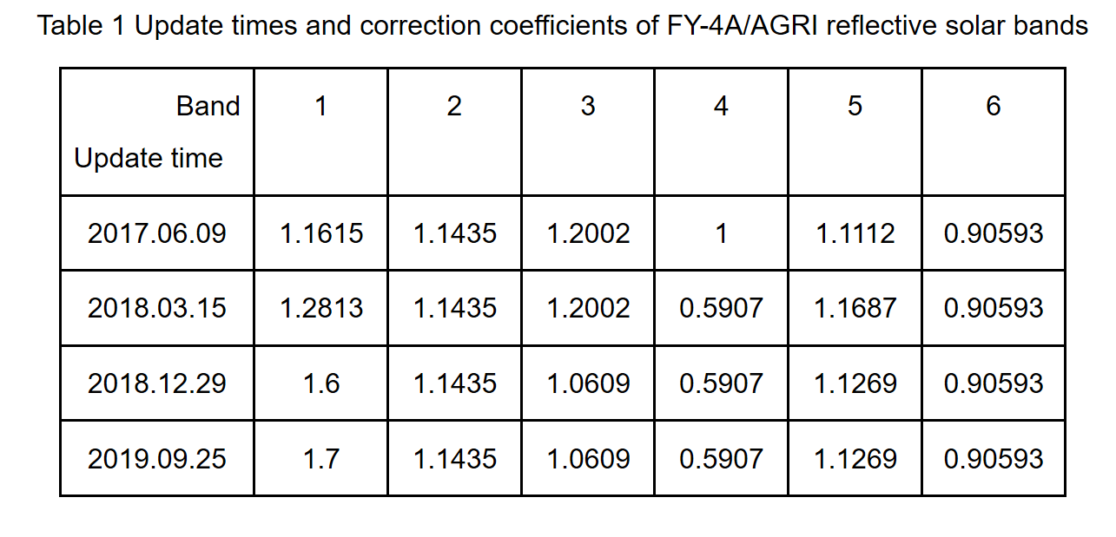
FY-4 Calibration Events in 2019
http://planet.rssi.ru
Satellite (status) |  | Current Location | Launch Date | Operation Date
FY-4A | (Op) | E104.7 | 2016-12-11
Major Calibration Related Events | FY-4A/AGRI
Improvement of De-stripping algorithm | 08/11/2019
reflective solar bands (RSB) calibration correction coefficients updates | 09/25/2019

Slide 5
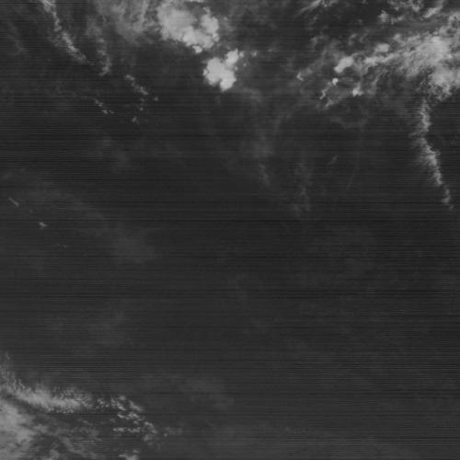
Improvement of radiance consistency in different detectors
Wave Length (um) | Sensitivity | Stripe Noise
3.5L | 0.1K
5.8 | 0.09K | Visiable in image
6.9 | 0.12K
8.0 | 0.06K | Visialbe in products
10.3 | 0.07K
11.5 | 0.14K
13.2 | 0.6K | Visiable in image
13.2-13.8um
Stripping in absorption channels are more obvious, main contribution from inconsistent SRFs.
The maximum equivalent noise can reach 2K, improved algorithm has been preliminarily developed.
The requirement of quantification is getting higher, systematic design needs to be strengthened and the image quality needs to be improved continuously

Slide 6
Improvement of radiance consistency in different detectors
Before de-stripping
After de-stripping
SST
Cloud Mask

Slide 7
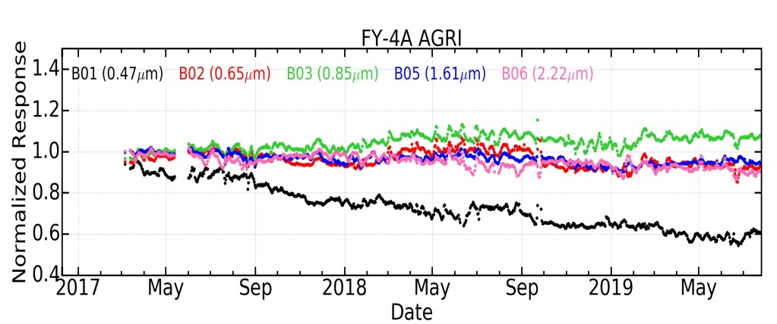
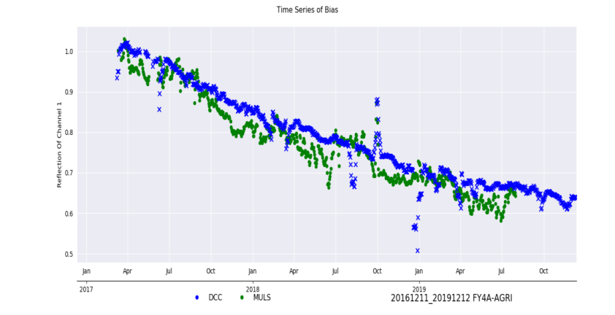
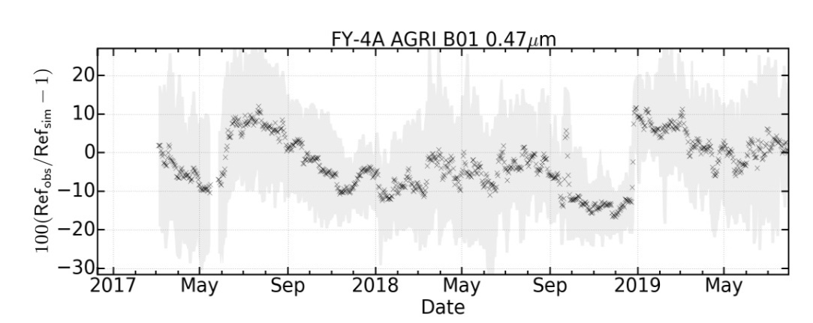
Monitoring and calibration updates using stable target
FY-4A AGRI RSB
band | Wavelength (um) | Total attenuation rate(%) | Annual attenuation rate(%)
1 | 0.47 | 40.3 | 14.36
2 | 0.65 | 6.62 | 2.36
3 | 0.82 | -8.56 | -3.05
5 | 1.61 | 6.53 | 2.33
6 | 2.85 | 9.62 | 3.43
Reflection of Ch1 at DCC and Multi station are consistent;

Slide 8
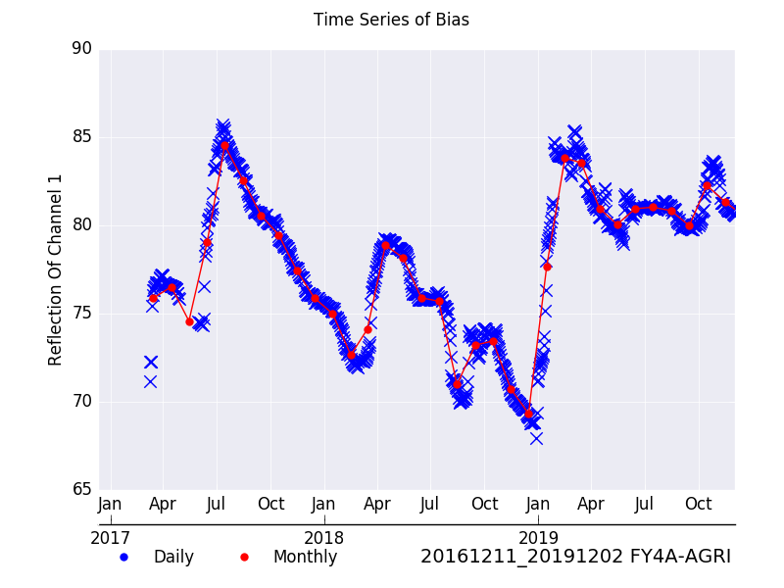
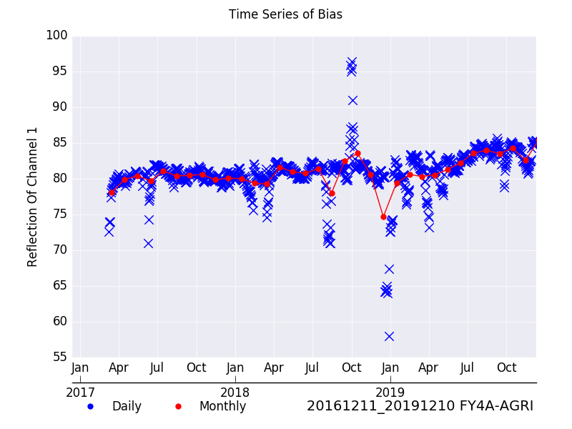
DCC reflectance of operational VS recalibrated
DCC reflectance (operational)
15% fluctuation in Operational calibration results
DCC reflectance (recalibrated)
Fluctuation was greatly decreased in recalibrated results

Slide 9
Milestones of FY-4/GIIRS L1 Data (Operation, Distribution and Application)
2016.12~2017.10: Commissioning and Preliminary Validation
2017.11~2018.04: User Readiness (i.e. observation mode optimization, training)
2018.05~2018.11: Experimental Application (i.e. NWP and retrieval)
2018.12: Operational Application in GRAPES (direct radiation assimilation)
2019.01: V1 Data Distribution to International Users;
2019.08: V2 Data in Operation
2019.10: V2+ available (spectral coding error corrected)
2019.11.07: V3 Data in Operation (diurnal BT biases variation corrected)

Slide 10
Key Improvements of GIIIRS L1 Data in V3
Abnormal Observations (bad graduals) Correction
Spectral Optimization
Off-axis effects correction (for 32×4 detector array)
Accurate spectral shift correction
Radiometric Optimization
ZPD-aligning improvement
New calibration model for diurnal-varying on GEO platform
Processing Efficiency Optimization
Fast DFT for GIIRS utilization (increased by 8~10 times)
Optional Apodization upon L1 Data
0813~0828: Hamming Apodization
0829~ : Unapodized

Slide 11
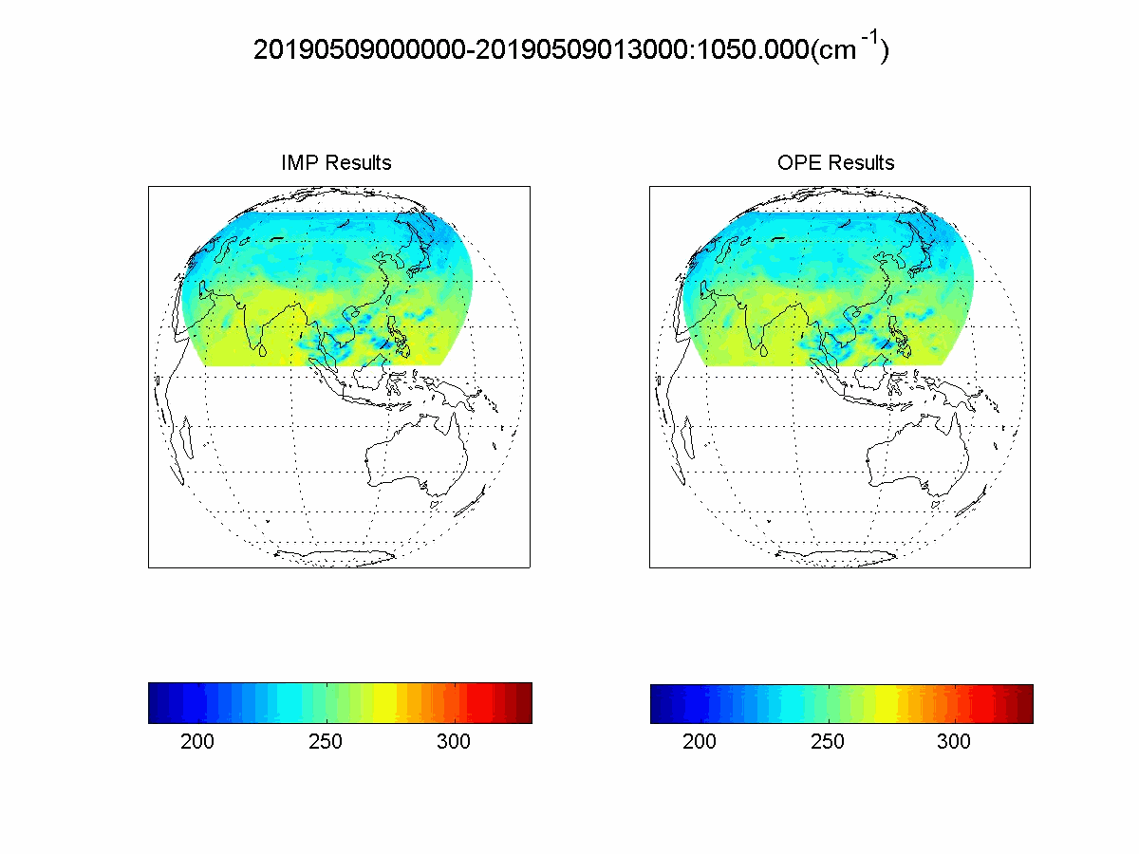
Bad granules occurred in V1 has been overcome completely: 11/350≈3%
V2/V3 V1

Slide 12
FY4A/GIIRS spectral and radiometric asessment
SSEC/UW Assessments of V3 Spectral Shifts
< 5ppm
< 10ppm
ECMWF Assessments of V3 Radiance (O-B): channel7 (~100hPa)
V1
V3
Less than 1K for most channels in LW band

Slide 13
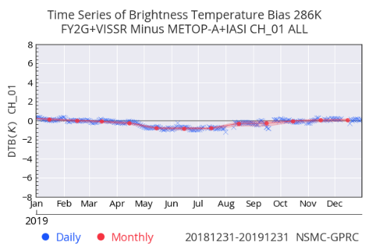
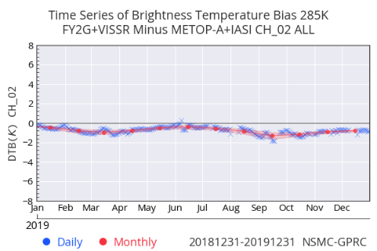
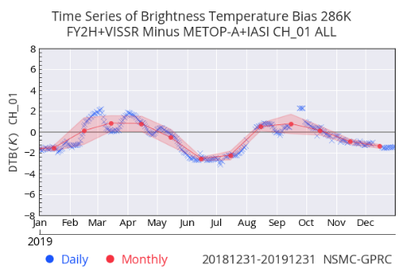
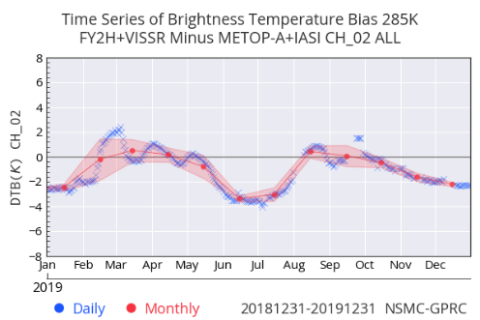
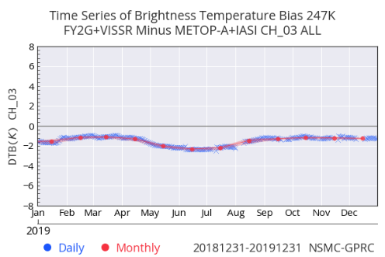
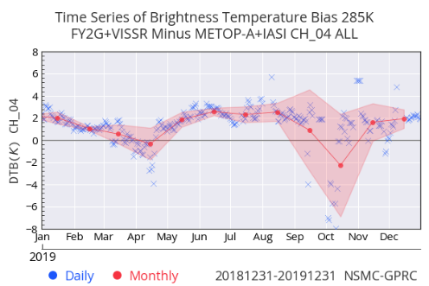
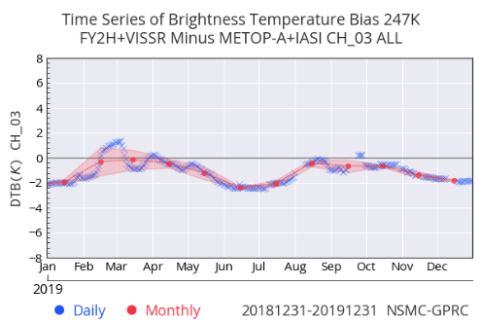
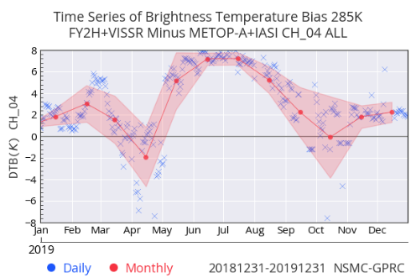
FY-2G/H IR Rad. Calibration Performance (2019)
FY-2G
FY-2H
 | IR1_11.0 (286K) | IR2_12.2 (285K) | IR3_6.9 (247K) | IR4_3.8 (285K)
Metop-A/IASI | -0.2593 | -0.7841 | -1.4897 | 1.1197
Metop-B/IASI | -0.2194 | -0.7426 | -1.4335 | 0.9641
 | IR1_11.0 (286K) | IR2_12.2 (285K) | IR3_6.9 (247K) | IR4_3.8 (285K)
Metop-A/IASI | -0.4519 | -1.0307 | -1.1022 | 2.9536
Metop-B/IASI | -0.4653 | -1.0320 | -0.9186 | 1.8630
Ref: IASI-A
Ref: IASI-A
IR1
IR2
IR1
IR2
IR3
IR4
IR3
IR4
Bias at window channels are less than 1k (FY-2G) and 1.5k (FY-2H)
FY-2G/H’s Tb bias at standard Tb show seasonal variation;

Slide 14
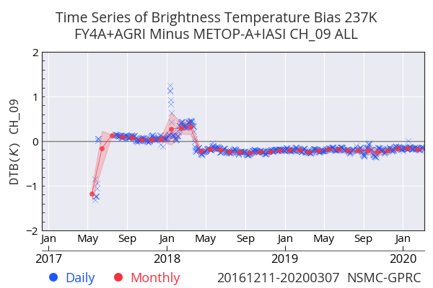
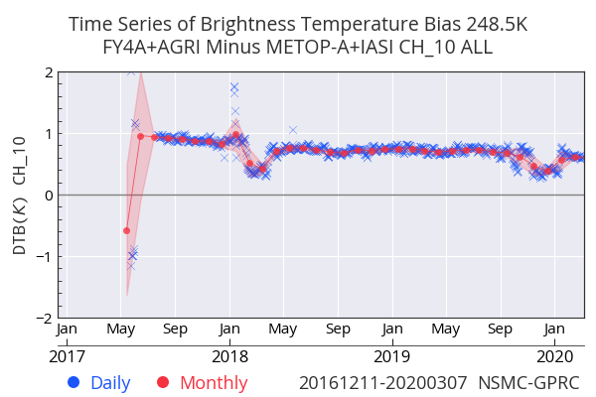
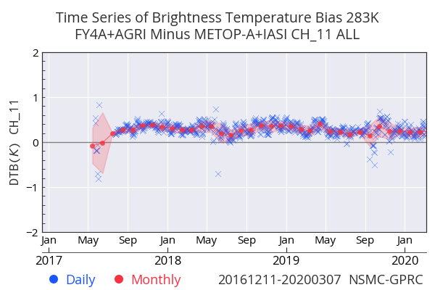
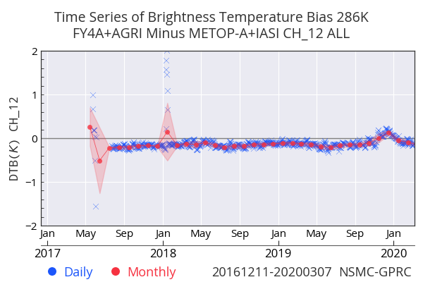
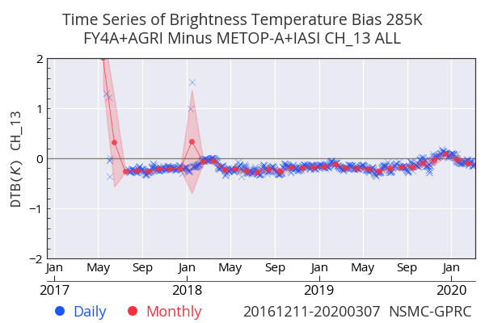
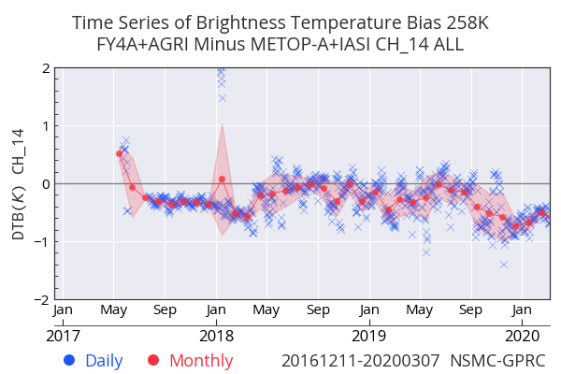
FY-4A/AGRI IR Rad. Calibration Performance
 | CH8_3.8 (286K) | CH9_6.25 (237K) | CH10_7.1 (248.5K) | CH11_8.5 (283K) | CH12_10.8 (286) | CH13_12.0 (285) | CH14_13.5 (258)
Metop-A/IASI | -3.5927 | -0.2230 | 0.6527 | 0.3048 | -0.1227 | -0.1447 | -0.2635
Metop-B/IASI | -3.5148 | -0.2223 | 0.6303 | 0.2745 | -0.1419 | -0.1776 | -0.2756
*Average bias in 2019;
CH 9
CH 10
CH 11
CH 12
CH 13
CH 14
Tb bias are less than 0.7 k (operation phase);
Scene dependent is much more better than FY-2G/H;
No strong seasonal variation;

Slide 15
Future work
Add GSICS monitoring of FY-4/GIIRS using GSICS inter-calibration/inter-comparison
Bias at reference temperature
Uncertainty of Tb bias at reference temperature
FY-4A/AGRI IR gsics correction products development
FY-4A/AGRI reflective solar bands (RSB) calibration monitoring.

