Slide 1
SNO uncertainties from Variograms and Synthetic Random Fields
Tim Hewison (EUMETSAT)
+ Your contributions are welcome!

Slide 2
SNO Uncertainty
Comparing 2 samples
  Of radiance observed over finite areas
  At non-identical time/space
Estimate uncertainty introduced by differences
  Propagation to uncertainty on relative bias
  Allows optimisation of inter-calibration algorithm
Possible if high-resolution proxy available
  E.g. Dave Tobin et al., 2016 used MODIS IR data to estimate SNO uncertainty for CLARREO-CrIS comparisons
  Also possible using Rapid Scan Service data from Meteosat/SEVIRI
  Difficult for microwave!

Slide 3
Review Existing SNO Methods*
Started Shared Spreadsheet
Summarising basic elements of different SNO Methods
  Based on publications over the last 20 years
  Collocation area - area over which observations are compared
  Collocation criteria:
    ds (km) - Maximum separation between collocation centres
    dt (min) - maximum time difference between instruments
    dVZA(°/%) - maximum difference in Viewing Zenith Angle
    VZAmax(°) - maximum VZA
  Basic Method, Filters, Applicable Spectral Bands & Instruments
* Review includes some NWP Double-Difference and Vicarious Inter-calibration methods – please feel free to copy!

Slide 4
Example Collocation Areas

Slide 5
Snapshot of Spreadsheet
Class | Reference | Collocation Area (km) | ds (km) | dt (s) | n | VZAmax (°) | Method | Filter | L | C | X | K | V | W |  | D | G |  | J | Applicable Sensors | Uncertainty
 |  |  |  |  |  |  |  |  | 1.4 | 6.8 | 10.65 | 12-40 | 50-60 | ~89 | ~118 | ~157 | ~183 | ~229 | ~325
Temp Sounders | Zou et al. 2006 | 1x1 | 111 | 100 |  | 5° | SNO |  |  |  |  |  | X |  |  |  |  |  |  | MSU Ch2
Temp Sounding | Iacovazzi & Cao, 2007 | 4SDP x 5TDP | 100 | 30 |  | 5° | SNO + bilinear Interpolaton |  |  |  |  | a | X | a |  | a | a |  |  | AMSU-A | 0.09K /SNO
 | Iacovazzi & Cao, 2008 | 4SDP x 5TDP | 100 | 30 |  | 5° | SNO + bilinear Interpolaton | SD<3xNEdT |  |  |  | X | X | a |  | a | a |  |  | AMSU-A, ATMS | 0.07K /SNO
Temp Sounders | Zou and Wang 2011 | 1x1 | 45 | 50 |  | 5° | SNO |  |  |  |  |  | X |  |  |  |  |  |  | AMSU-A , ATMS
Temp+ Humidity Sounding | Ackermann 2020 | 1SDP x 1TDP | 10 | 30 | 10° 3.6° | 10° | SNO + B-G resample |  |  |  |  | X | X | X |  | X | X |  |  | AMSU-A AMSU-B+MHS
Humidity Sounding | Moradi et al. 2015 |  | 50 | 3600 |  | Nadir | SNO |  |  |  |  |  |  |  |  |  | X |  |  | ATMS SAPHIR
 | John et al. 2012 | 3SDP x 3TDP | 5 | 300 |  | 3.9° | SNO |  |  |  |  |  |  |  |  |  | X |  |  | MHS | 1-2K /SNO
 | EUMETSAT MHS FCDR 2023 |  | 10 | 300 3600 | 5% | 15° | SNO | SD(3x3)<NEDT *sqrt(2) |  |  |  |  |  |  |  |  | X |  |  | MHS
 | Dou et al. 2022 | 1SDP x 1TDP | 3 | 1200 |  | 5° | SNO | +SD(3x3)<1K |  |  |  |  |  |  |  |  | X |  |  | MWHS-MHS
Window SNO | Yan & Weng, 2008 | 1SDP x 1TDP | 12.5 | 60 |  | All | SCO | SD<1K |  |  |  | X | X | X |  |  |  |  |  | SSMIS-SSM/I
 | Song Yang et al., 2011 |  | 3 | 120 |  | All | SCO | SD<2K, |dTb|<10K |  |  |  | X |  | X |  |  |  |  |  | SSM/I
 | Zou et al. 2014 |  | 15 | 60 |  |  | SNO + B-G resample | +1-sigma |  |  |  | X | X | X |  |  |  |  |  | AMSU-ATMS
 | Yang et al., 2020 "IMICA" | 2SDP x 1TDP | 50-75 | 50 |  | 3.3° | SNO | +SD |  |  |  | X |  | X |  |  |  |  |  | AMSU-A
 | Yan et al., 2020 |  | 30 | 80 |  |  | SNO | +SD<2K |  |  |  | X | X | X |  |  |  |  |  | AMSU
Generic SNO | Hewison 2023 - Proposal for Sterna inter-calibration (STC) |  | 7.5 | 900 | 5° /1?° | 5° /55?° | SNO+OCTM /SCO |  |  |  |  |  | X | X |  | X | X |  | X | Sterna-MWS/ATMS Sterna-ICI
OCTM | Buehler et al. 2020 | 1SDP x 1TDP | 30 | 8h/30d | 2.8° |  | OCTM |  |  |  |  |  |  |  |  |  | X |  |  | MHS

Slide 6

Expected Temporal Variogram
Log(Semi-variogram)
The temporal variogram 2γt(Δt) is calculated between brightness temperatures Tbs sampled at different intervals Δt from an extended time series Tb(t)
Seasonal Variations (6m max, 1y min)
Diurnal Variations (12h max, 24h min)
Convective
Scale ~1min
Effective Range (95% sill)
Nugget (Noise)
log(lag(time))
6

Slide 7

Expected Spatial Variogram
The temporal variogram 2γt(Δt) is calculated between brightness temperatures Tbs sampled at different intervals Δt from an extended time series Tb(t)
Similarly, spatial variogram:
Log(Semi-variogram)
Log(Semi-variogram)
Global Scale
(10000km max,
20000km min)
Synoptic
Scale ~300km
Convective
Scale ~1km
Effective Range (95% sill)
Nugget (Noise)
Nugget (Noise)
log(lag(distance))

Slide 8
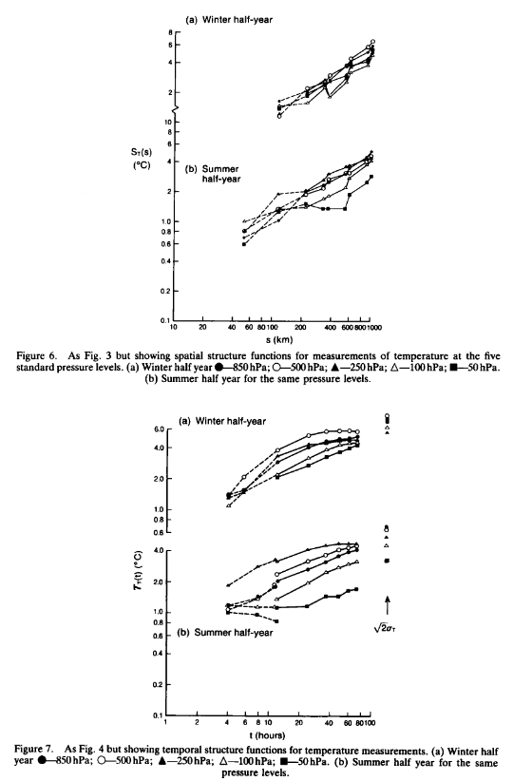
Radiosonde Variograms
Kitchen, M.: Representativeness errors for radiosonde observations. Q. J. R. Meteorol. Soc., 115: 673-700.689 https://doi.org/10.1002/qj.49711548713, 1989.

Slide 9
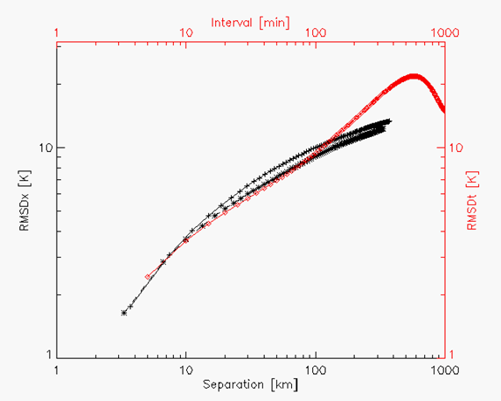
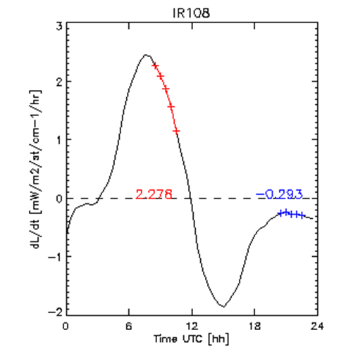
SEVIRI IR Variograms
Hewison, T. J., 2013: An Evaluation of the Uncertainty of the GSICS SEVIRI-IASI Inter-Calibration Products", IEEE Trans. Geosci. Remote Sens., vol. 51, no. 3, Mar. 2013, doi:10.1109/TGRS.2012.2236330.
The temporal variogram 2γt(Δt) is calculated between brightness temperatures Tbs sampled at different intervals Δt from an extended time series Tb(t)
Similarly, spatial variogram:

Slide 10
Towards Uncertainty Analysis
Quantify differences between centres of Collocation Areas
  + Scale spatial variability accordingly?
  Statistics from aircraft measurements – e.g. COSMIR on ER-2 ~1km²
E.g. analysis of Sentinel-6/AMR data…
  1-D case

Slide 11
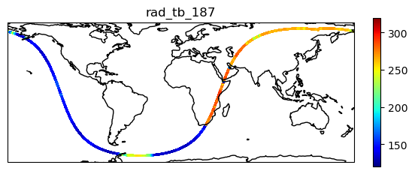
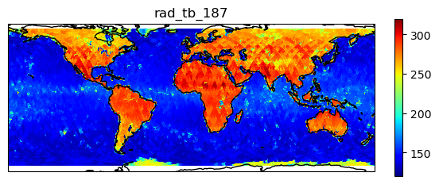
Spatial Variability from S6/AMR
Sentinel-6 “Michael Freilich” Orbital Characteristics (ref)
Type | non-synchronous
Altitude | 1336km
Inclination | 66.039°
Repeat cycle | 9.9156 days
Ground track velocity | 5.8 km/s
Channel/GHz | 18.7 | 23.8 | 34 | 89 | 130 | 166
Bandwidth/MHz | 200 | 400 | 700 | 5000 | 5000 | 5000
NEDT | 0.13? |  |  | <0.1 | <0.1 | <0.1
Swath | Nadir only |  |  | Nadir+x° only
FWHM/km | 40 | 34 | 31 | 5 | ~4 | ~3
Sampling/Hz | 16/8 |  |  | 16
Sampling/km | 0.36/0.72 |  |  | 0.36
High spatial sampling (up to 360m)
High radiometric resolution (TBC)
But 1-D sampling only!
Not in protected bands – prone to RFI
10 days’ coverage (2024-05-10/19)

Slide 12
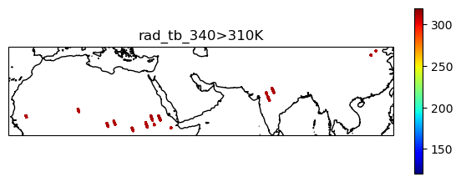
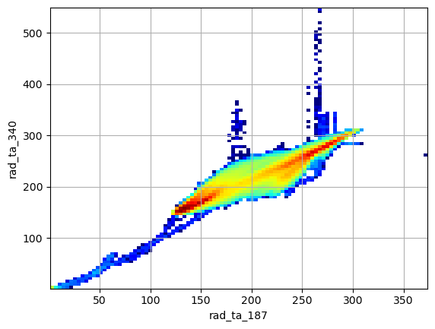
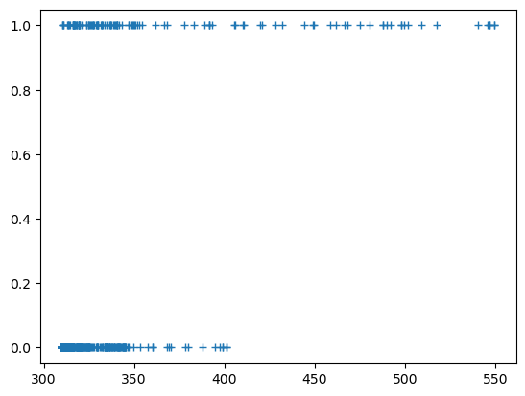
Example of RFI at 34GHz
Not all bands protected
34GHz prone to RFI
Not always flagged as bad radiometric quality
Only use unflagged data from now…

Slide 13
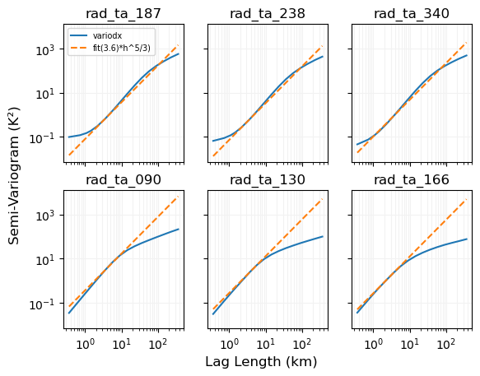
Variogram Analysis
Evaluate variability
Using Variograms
RMSD of Tb differences sampled over various intervals
  In time
  Equivalently, space
Slope=5/3
  Kolmogorov cascade
  Turbulent sub-range?
Noise Floor

Slide 14
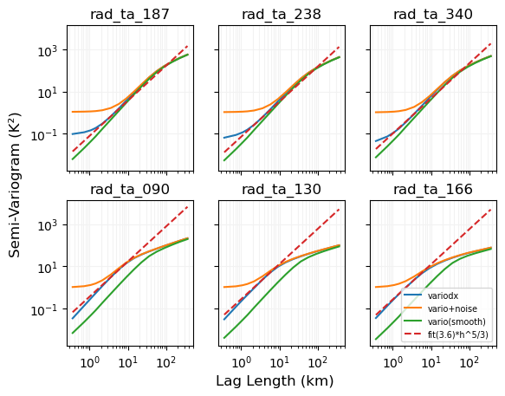
Adding Noise, Smoothing, …
Conclusions:
Adding white noise increase variogram at short lags,
  to a new higher nugget value, corresponding to the noise level
Applying smoothing acts as a low-pass filter, suppressing high-frequency components
  Reducing the variogram for lags <~averaging period
  Lags < FWHM already include this effect
Short lag variograms tend to follow 5/3 slope
  90GHz and 130GHz have slightly steeper slope on the shortest scales - why?!
AMR-C channels (18.7, 23.8, 34.0GHz) have higher nugget value
  Due to higher noise?!
  Or oversampling - although I expected this to result in less variability on small scales!

Slide 15
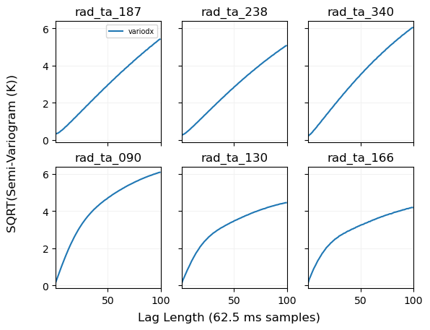
SNO Uncertainty due to spatial variability
How much uncertainty on collocation due to misalignment?
Plotted on linear scale
E.g. 50 samples = 18km,
  SQRT(variogram) ~4K
At 10 samples = 3.6km,
  SQRT(variogram) ~1K
Includes ocean & land
  Clear & cloudy
Only 1-D
  Repeat with 2-D data
  LPF to mimic larger FOV

Slide 16
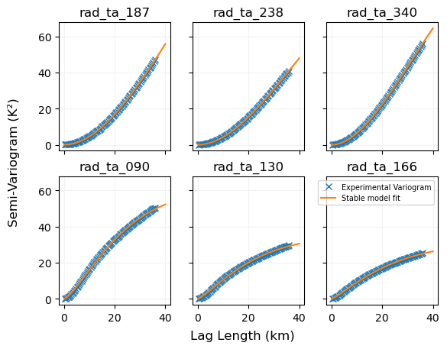
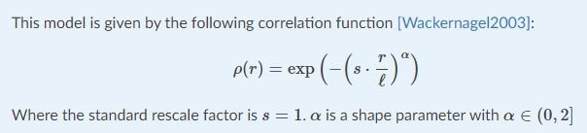
Fitting Models to Experimental Variograms
GeostatTools contains useful functions to fit various models to experimental variograms
“Stable Model” shown here
  fits an exponential function with 3 parameters, r, l, alpha

Slide 17
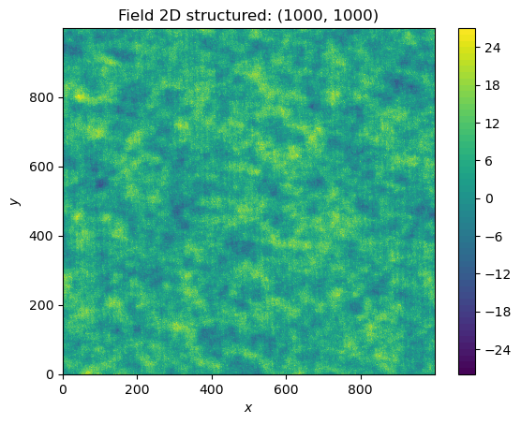
Generate Synthetic 2-D Image
Spatial Random Field Generation
  The core of this library is the generation of spatial random fields. These fields are generated using the randomisation method, described by Heße et al. 2014.
  From fitted 1-D variogram model
Used to evaluate uncertainty
  For different collocation areas
  Overlaps with various lags

Slide 18
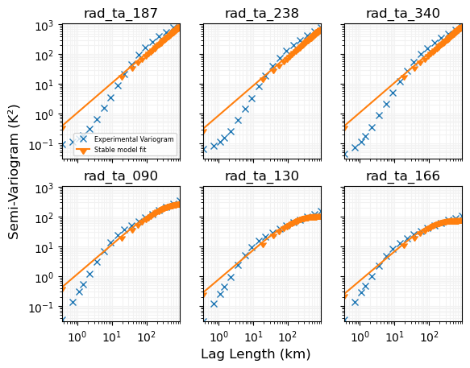
Fitting Models to Experimental Variograms
Attempted to fit variograms on logarithmic scale hit problems
But no model accurately fits observed variograms
Alternative approach:
  Abandon one-size-fits-all approach with log fitting
  Instead, use linear fitting on a scale appropriate for the collocation box area
  This is slower, as it means recalculating the variograms for each scale

Slide 19
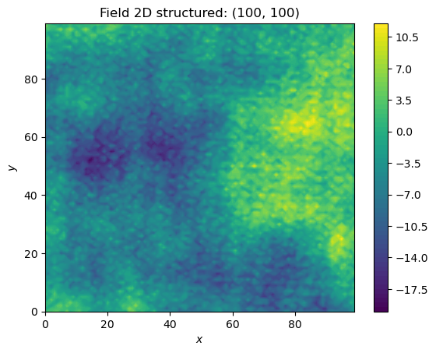
Generate Synthetic 2-D Image
Repeat generation of Synthetic Random Fields
On different scales
To calculate uncertainty due to sampling differences

Slide 20
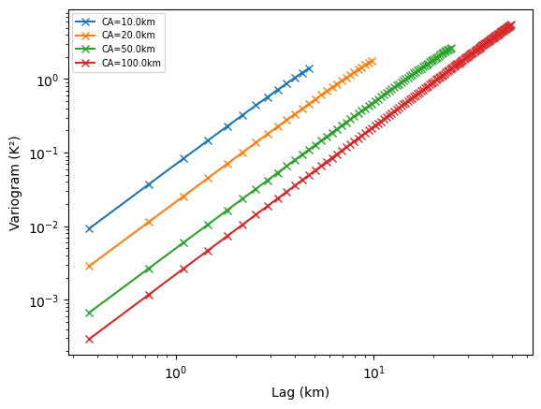
Estimate SNO Uncertainty from Synthetic Random Field
Generate Synthetic Random Fields
  For range of spatial scales
Divide SRF
  Into Collocation Areas
  Separated by different distances (“lag”)
Calculate rms difference between Collocation Areas
  Variograms again!
  Plot as function of lag
Repeat for all channels…

Slide 21
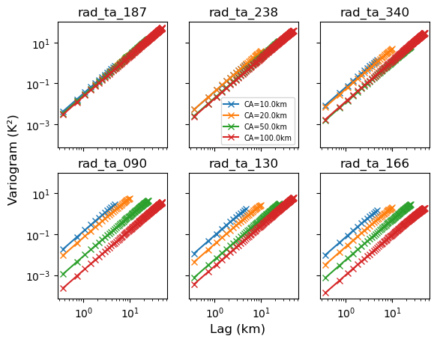
Estimate SNO Uncertainty - Conclusions so far
Variability on larger scales is proportionately less than on convective scale
But slope of CA variograms is ~independent of CA size!
Convective scales show variograms slope ~5/3
But uncertainty/CA slope ~2 on all scales
And uncertainty/100km² slope ~2 on all scales
So is slope of uncertainties
Now it seems that increasing the Collocation Area does reduce the overall uncertainty
Although that is a trade-off against the dynamic range

Slide 22
SNO Uncertainty due to temporal variability
In principle can analyse temporal variability
  in same way as spatial
But don’t have MWRs staring at same scene
Could use balloon-borne radiometers?
Could use aircraft observations
  E.g. when flying in a circle, observing at an angle
  In discussion with NASA-GSFC for ER-2/COSMIR
  As part of WH²yMSIE campaign Oct/Nov 2024

