Slide 1
Prelaunch calibration of the FY-4 Geostationary Interferometric Infrared Sounder(GIIRS)
Libing Li¹, Zhanhu Wang¹, Lu Lee²,Yaopu Zou¹, Qiwen Quan¹, Jieling Yu¹,
Changpei Han¹ , Lei Ding¹, et al.
1. Shanghai Institute of Technical Physics(SITP), CAS
2. National Satellite Meteorological Center(NSMC), CMA
GSICS Annual Meeting 17-21 March 2025 in Changchun, Jilin Province, China

Slide 2
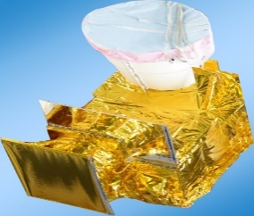
Content
GIIRS Instrument overview
On-ground calibration setup
Prelaunch spectral calibration
Prelaunch radiometric calibration
Summary

Slide 3
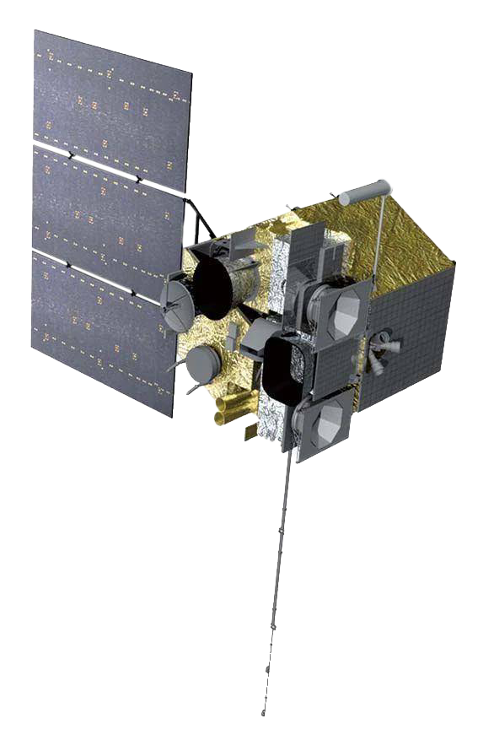
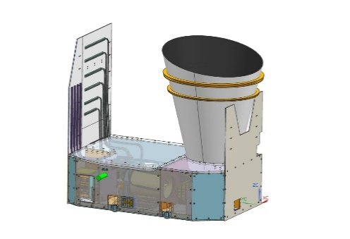
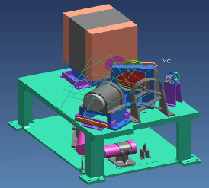
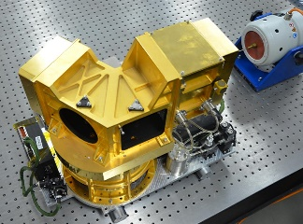
GIIRS Instrument Overview
GIIRS is an infrared hyper-spectral vertical sounder and a key payload on FengYun-4 satellite, which is the second generation geostationary meteorological satellites of China to take measurements of three dimensional atmospheric structure.
History and Development Status：
2016.12: FY-4A was launched,
2021.6: FY-4B was launched
FY-4C will be launched in 2025.
FY-4A GIIRS
1998
2004
2010
2014
2016.12
2021.6
2025
Conceptual Design of Interferometer
Interferometer product prototype
Prototype of GIIRS and First TVAC test
FY-4A launch
FY-4B launch
FY-4C will be launched

Slide 4
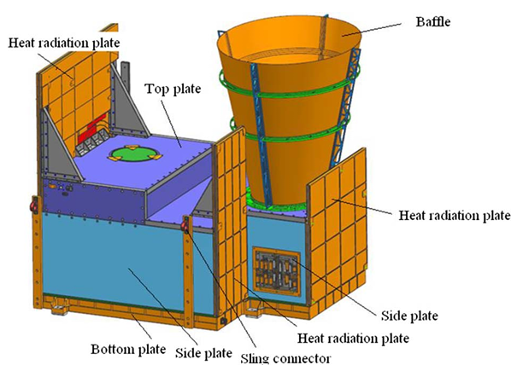
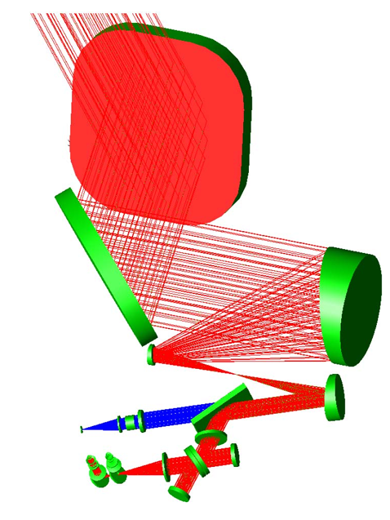
GIIRS Instrument Overview
GIIRS is a Fourier Transform Spectrometer.
GIIRS is composed of five main sub-elements:
The Front Optical Assembly (include tow scan mirror and telescope) that scans the Earth and collects radiances and visible light from the Earth.
The Blackbody that provides reference scenes for radiometric calibration.
The flat moving mirror Interferometer that modulates the scene radiances.
The After Optical Assembly with Detection and Electronics in cryostat.
The visible optical assembly with CCD and Electronics

Slide 5
GIIRS Instrument Overview
Main performance indexes of GIIRS
Satellite | FY-4A | FY-4B | FY-4C（Required value）
Bands | LWIR: 700∼1130cm⁻¹ MWIR: 1650∼2250cm⁻¹ VIS: 0.55∼0.75μm | LWIR: 680∼1130cm⁻¹ MWIR: 1650∼2250cm⁻¹ VIS: 0.55∼0.75μm | LWIR: (650)680∼1130cm⁻¹ MWIR: 1650∼2250cm⁻¹ VIS: 0.55∼0.75μm
Spectral resolution | 0.8cm⁻¹ | 0.625cm⁻¹ | 0.625cm⁻¹
Sensitivity（mW/m²*sr*cm⁻¹） | LWIR: ＜0.5~1.1 r.u. MWIR:＜0.1~0.14 r.u. | LWIR: ＜0.5 r.u. MWIR:＜0.1 r.u. | LWIR: ＜0.5 r.u. MWIR:＜0.1 r.u.
Spatial resolution | Infrared: 16×16km Visible: 2×2km | Infrared: 12×12km Visible: 1×1km | Infrared: 8×8km Visible: 0.5×0.5km
Detectors Size | 32×4 | 16×8 | 64×64
Radiometric calibration accuracy | 1K | 0.7K | 0.5K
Spectral calibration accuracy | 10ppm | 7ppm | 5ppm

Slide 6
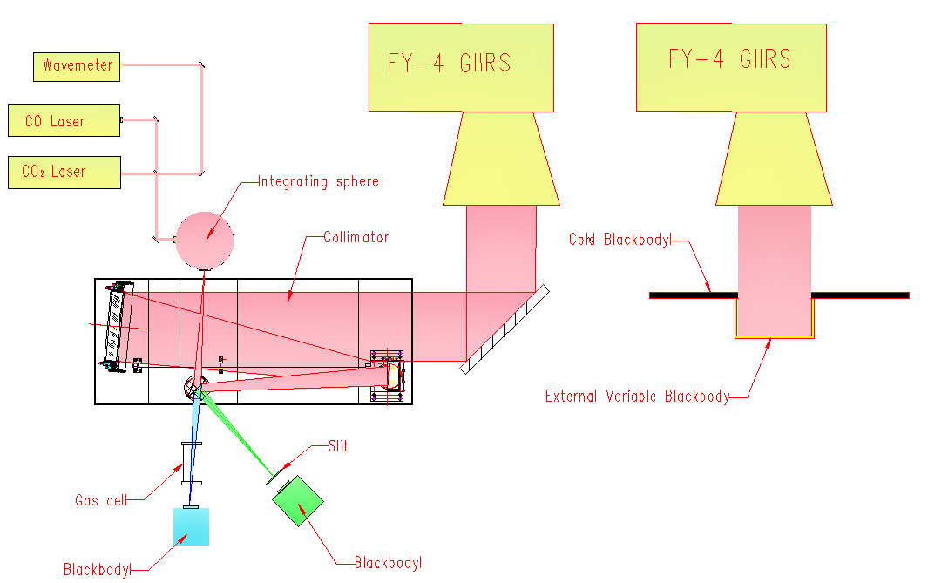
On-ground Calibration Setup
Prelaunch spectral and radiometric calibration for measurement and validation of instrument performance are key campaigns.
For the on-ground calibration and optical performance requirements, a Innovative system was developed.
Including spectral and radiometric calibration assemblies.
Exchange Mechanism
Ambient
LN2 Pipe
Vacuum Chamber

Slide 7
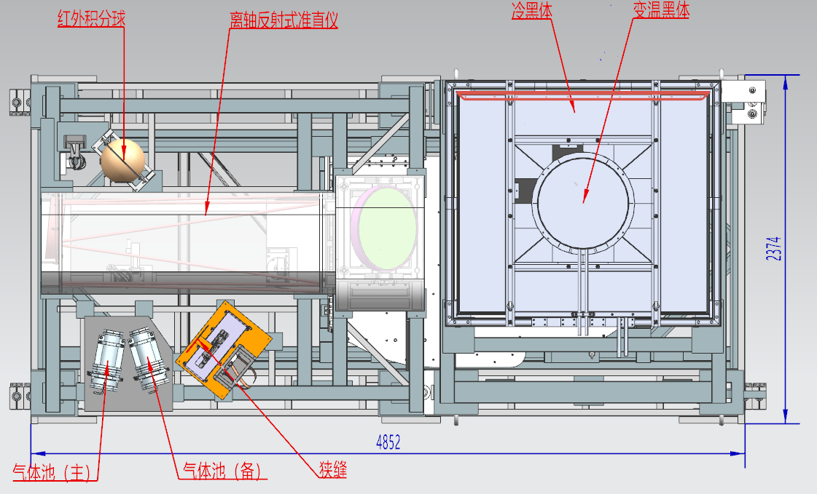
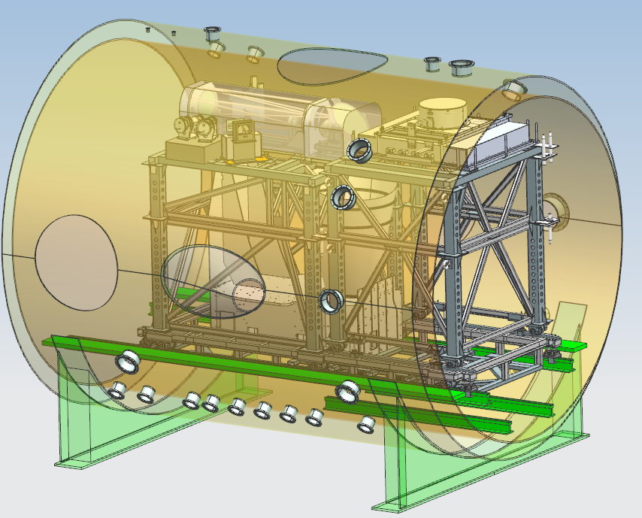
On-ground Calibration Setup
Model of On-ground Infrared Calibration System in Vacuum Chamber
Integrating
sphere
Collimator
Cold Blackbody
External Variable Blackbody
Gas Cell A
Gas Cell B
Slit and Blackbody
Slit

Slide 8
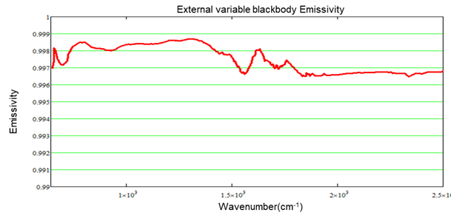
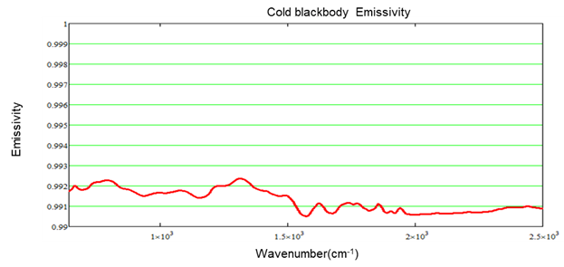
On-ground Calibration Setup
Radiometric Calibration Assembly
External Variable Blackbody
Temperature uniformity is better than 0.1K;
Temperature stability is better than 0.05K;
Emissivity is better than 0.996
Cold Blackbody
Temperature uniformity is better than 0.1K;
Temperature stability is better than 0.05K;
Emissivity is better than 0.99

Slide 9
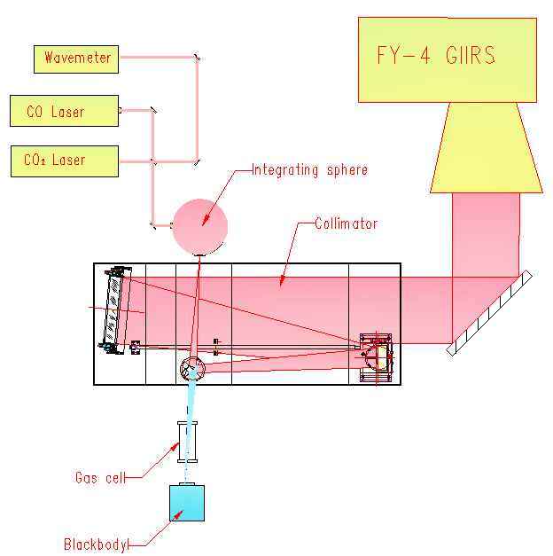
Prelaunch Spectral Calibration
In the prelaunch spectral calibration phase, there are two measurements for the spectral characterization of the instrument.
Firstly, CO Laser (1842.8103cm⁻¹) and CO₂ Laser (971.9267cm⁻¹ ) illuminate the integrating sphere for characterize the Instrument Line Shape (ILS). Additionally, we can also obtain:
Spectral Resolution from ILS data;
Spectral stability can be obtained, by counting the wavelengths of multiple ILS peak values and calculate standard deviation;
Initial spectral scale shifts factor depending on the pixel position in the FOV to be measured.

Slide 10
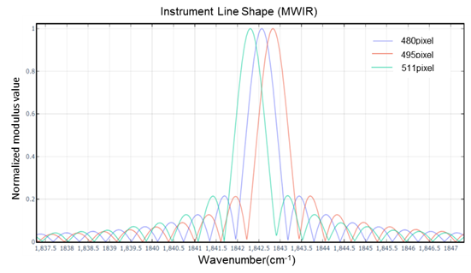
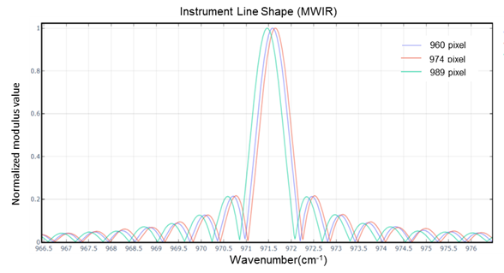
Prelaunch Spectral Calibration
Spectral Performance of FY-4C GIIRS Prototype
Instrument Line Shape(Normalize the modulus)
Spectral Resolution are better than 0.62cm⁻¹ for all pixels
Spectral stability is 2.5ppm@MWIR and 5ppm@LWIR for 99.6% of pixels
Spectral Resolution | <0.62cm⁻¹
Spectral Stability | 2.5ppm (MWIR)
 | 5ppm (LWIR)

Slide 11
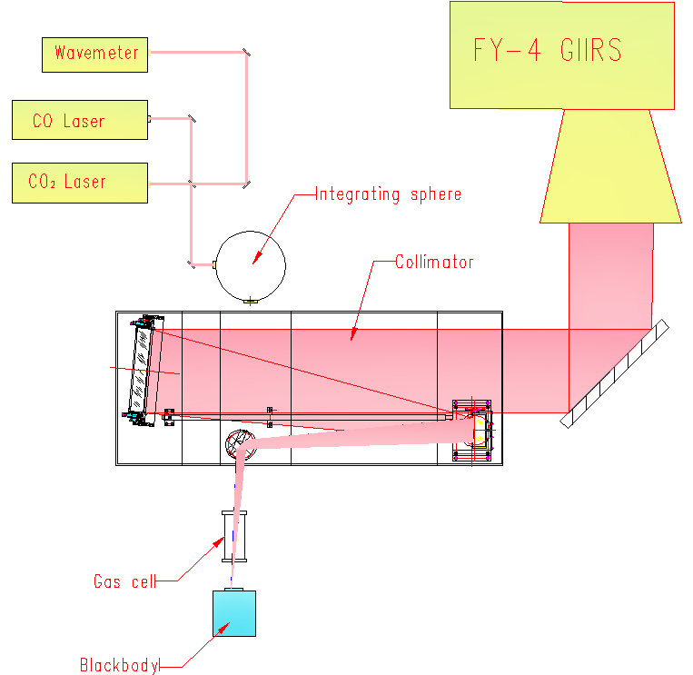
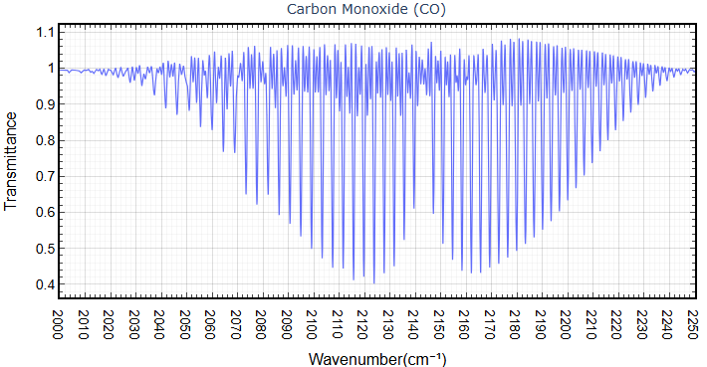
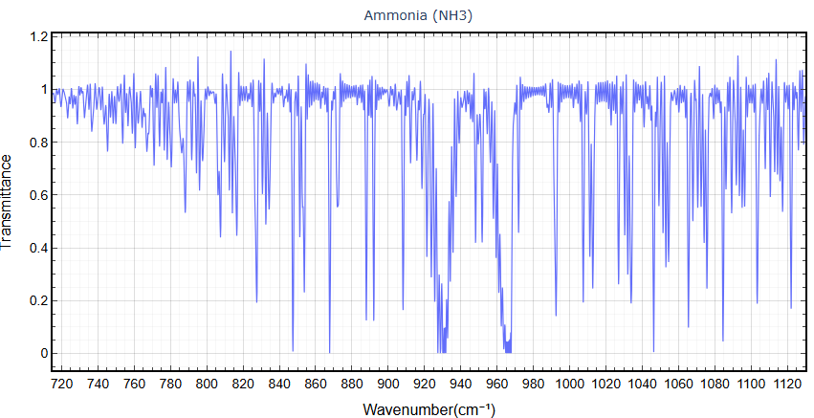
Prelaunch Spectral Calibration
Observing the gas cell and testing the gas spectrum is another important test in the spectral calibration phase, with this spectral test Initial spectral scale shifts factor will be Updated and spectral calibration accuracy can be evaluated.
Gas Cell filled with Carbon Monoxide (CO) and Ammonia (NH₃) at a pressure of a few kPa;
Transmittance spectra are derived by measuring four types of radiance spectra for each gas:
S_{FH}： Cell full，hot blackbody
S_{EH} ： Cell empty，hot blackbody
S_{FC} ： Cell full，cold blackbody
S_{EC} ： Cell empty ，cold blackbody
$$τ_{gas}=\frac{S_{FH}−S_{FC}}{S_{EH}−S_{EC}}$$
Notes:
another important test in the spectral calibration phase is observing the gas cell and getting the gas spectrum, with this spectral test, initial spectral scale shifts factor will be Updated and spectral calibration accuracy is assessed
For GIIRS prelaunch spectral calibration in TVAC test, the Carbon Monoxide (CO) and Ammonia (NH3) were used, which have strong spectral absorption in the midwave and longwave bands.
And a 200 mm long gas cell whose gas composition, pressure, and temperature can be controlled in ambient ,it was placed in a vacuum chamber between the collimator and a blackbody maintained at the cold and hot temperatures 300 K and 330 K.
The spectral transmittance are derived by measuring four types of radiance for each gas: that is cell full with hot blackbody , cell empty with hot blackbody , cell full with cold blackbody , and cell empty with cold blackbody .

Slide 12
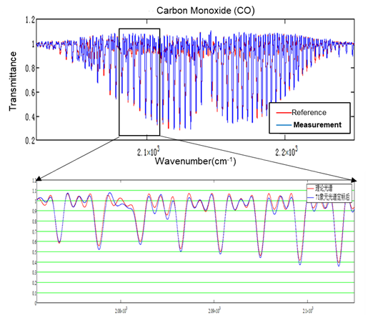
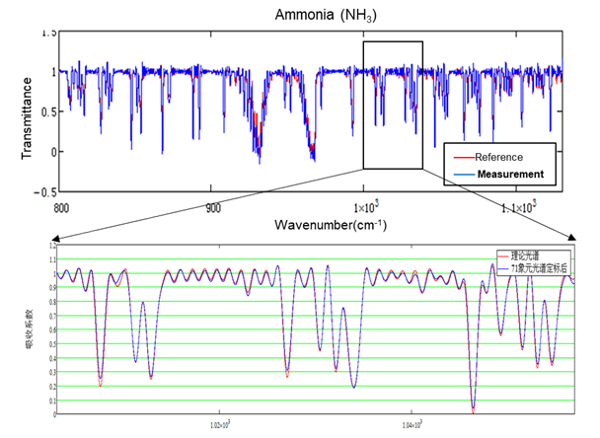
Prelaunch Spectral Calibration
Method for obtaining more accurate spectral scale shifts factor
Initial spectral scale shifts factor must be iteratively adjusted to minimize the residual between the measured spectrum and the reference spectrum which is computed with simulated data.
Spectral Accuracy: Better than 7ppm at prelaunch spectral calibration test of GIIRS.

Slide 13
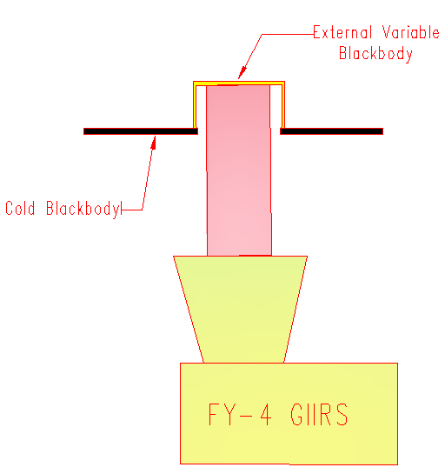
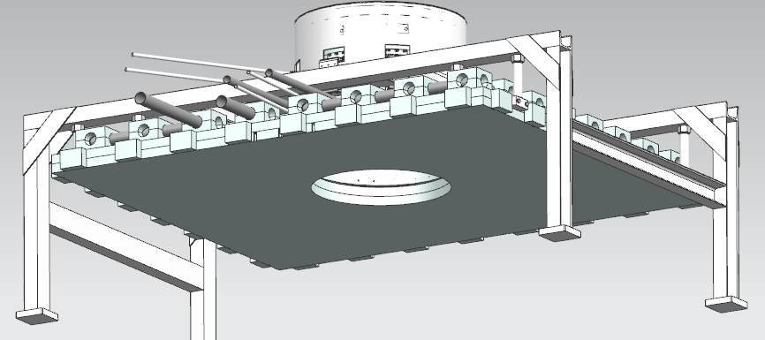
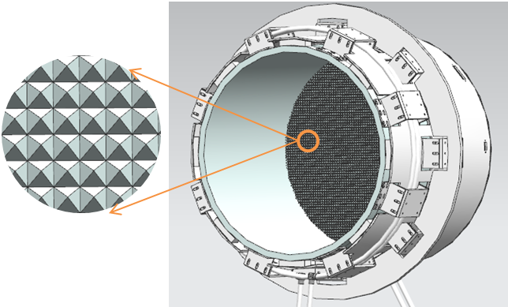
Prelaunch Radiometric Calibration
Characteristics of on-ground radiometric calibration requirements.
Radiometric calibration need to cover full optical path, and aperture:
Prelaunch Radiometric Calibration Accuracy is better than 0.5K.
For the requirements, an on-ground Radiometric Calibration Assembly is designed, which includes a large aperture cavity blackbody and a large micro pyramid blackbody.
Nadir
Deep space
ϕ480mm

Slide 14
Prelaunch Radiometric Calibration
Three radiation targets at different temperatures.
Internal blackbody(ICT) work at temperature of 300K;
cold blackbody(CCT) work at temperature of less than 100K.
External blackbody(ECT) work at temperature between 180K~315K
Linear radiometric calibration model.
$${L_{b}^{ict}}^{′}\left(σ\right)=ε_{b}^{ict}\left(σ\right)B\left(σ,〈T_{ict}〉\right)+\left(1−ε_{b}^{ict}\left(σ\right)\right)\left(\sum_{i}^{n}{{A_{I}}^{i}ε^{i}B\left(σ,〈T^{i}〉\right)}\right)$$
$${\tilde{S}}_{b}^{e}（σ）={\tilde{G}}_{b}（σ）（L_{b}^{e}\left(σ\right)+O_{b}^{in}\left(σ\right)+n_{b}^{noise}（σ））$$
Where ${\tilde{S}}_{b}^{e}（σ）$is the raw spectrum of target, ${\tilde{G}}_{b}（σ）$ is the instrument radiation gain, $L_{b}^{e}\left(σ\right)$ is the radiation of target, $O_{b}^{in}\left(σ\right)$ is the radiation of internal stray radiation, $n_{b}^{noise}（σ）$ is the radiation of noise(std=NEdR)
ICT:
$${\tilde{S}}_{b}^{ict}（σ）={\tilde{G}}_{b}（σ）L_{b}^{ict}\left(σ\right)+{\tilde{Q}}_{in}（σ）$$
$$L_{b}^{ect}\left(σ\right)=\frac{{\tilde{S}}_{b}^{ect}\left(σ\right)−{\tilde{S}}_{b}^{cct}\left(σ\right)}{{\tilde{S}}_{b}^{ict}\left(σ\right)−{\tilde{S}}_{b}^{cct}\left(σ\right)}L_{b}^{ict}\left(σ\right)+\frac{{\tilde{S}}_{b}^{ict}\left(σ\right)−{\tilde{S}}_{b}^{ect}\left(σ\right)}{{\tilde{S}}_{b}^{ict}\left(σ\right)−{\tilde{S}}_{b}^{cct}\left(σ\right)}L_{b}^{cct}\left(σ\right)$$
CCT:
$${\tilde{S}}_{b}^{cct}（σ）={\tilde{G}}_{b}（σ）L_{b}^{cct}\left(σ\right)+{\tilde{Q}}_{in}（σ）$$
ECT:
$${\tilde{S}}_{b}^{ect}（σ）={\tilde{G}}_{b}（σ）L_{b}^{ect}\left(σ\right)+{\tilde{Q}}_{in}（σ）$$

Slide 15
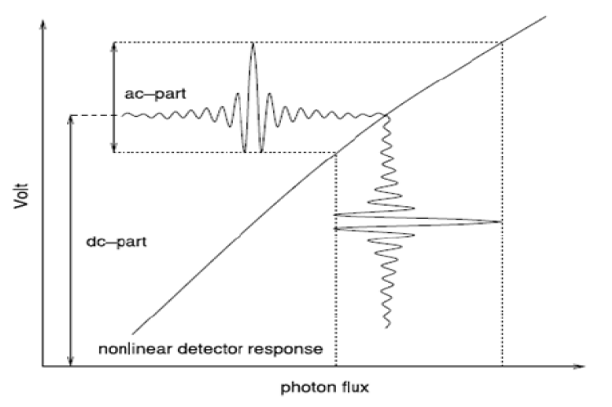
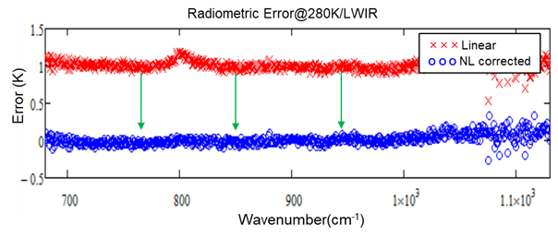
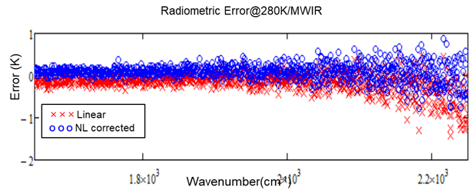
Prelaunch Radiometric Calibration
Nonlinear Interference Signal and Correction
GIIRS infrared detectors have non-ignorable nonlinearity, Long wave is particularly severe and cannot be ignored
The nonlinearity coefficient is determined from the raw spectra when the instrument observes the ECT at a set of different temperatures.

Slide 16
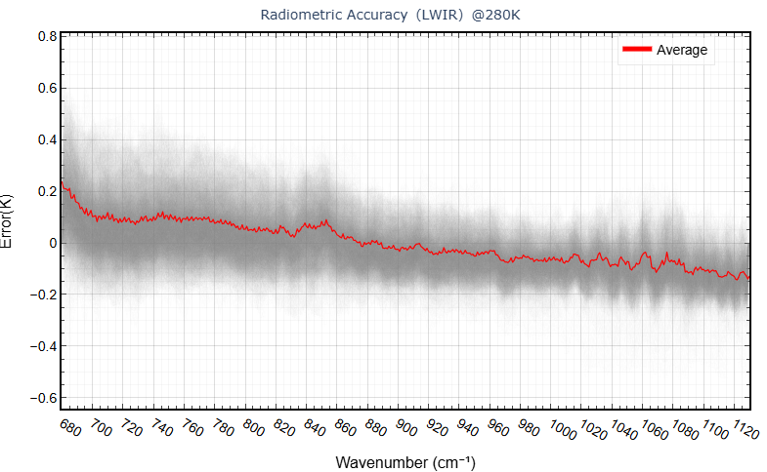
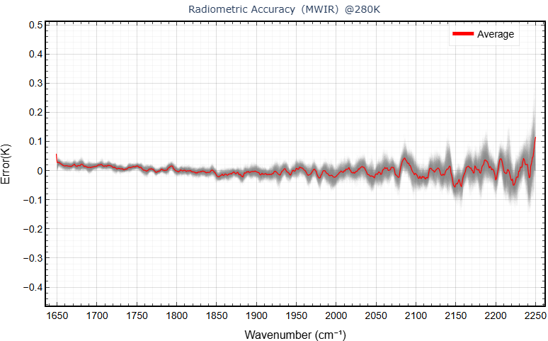
Prelaunch Radiometric Calibration
Radiometric Accuracy and Noise Performance
Radiometric Accuracy:

Slide 17
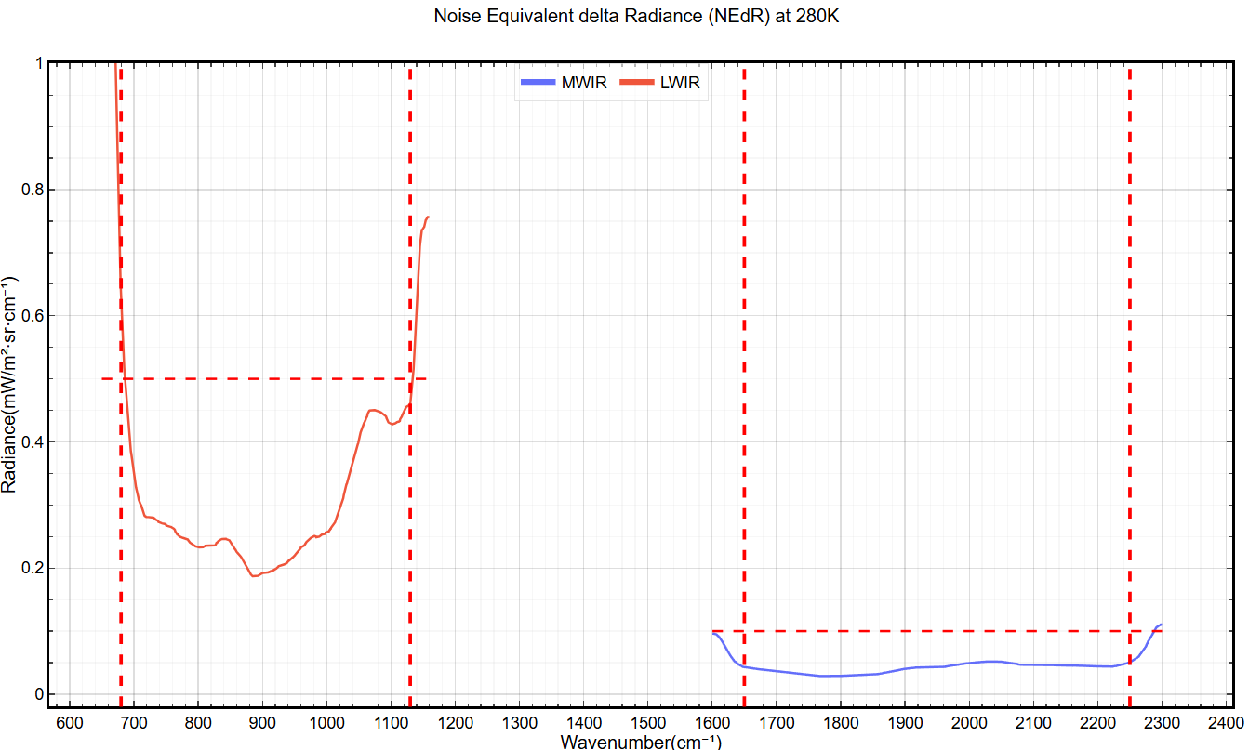
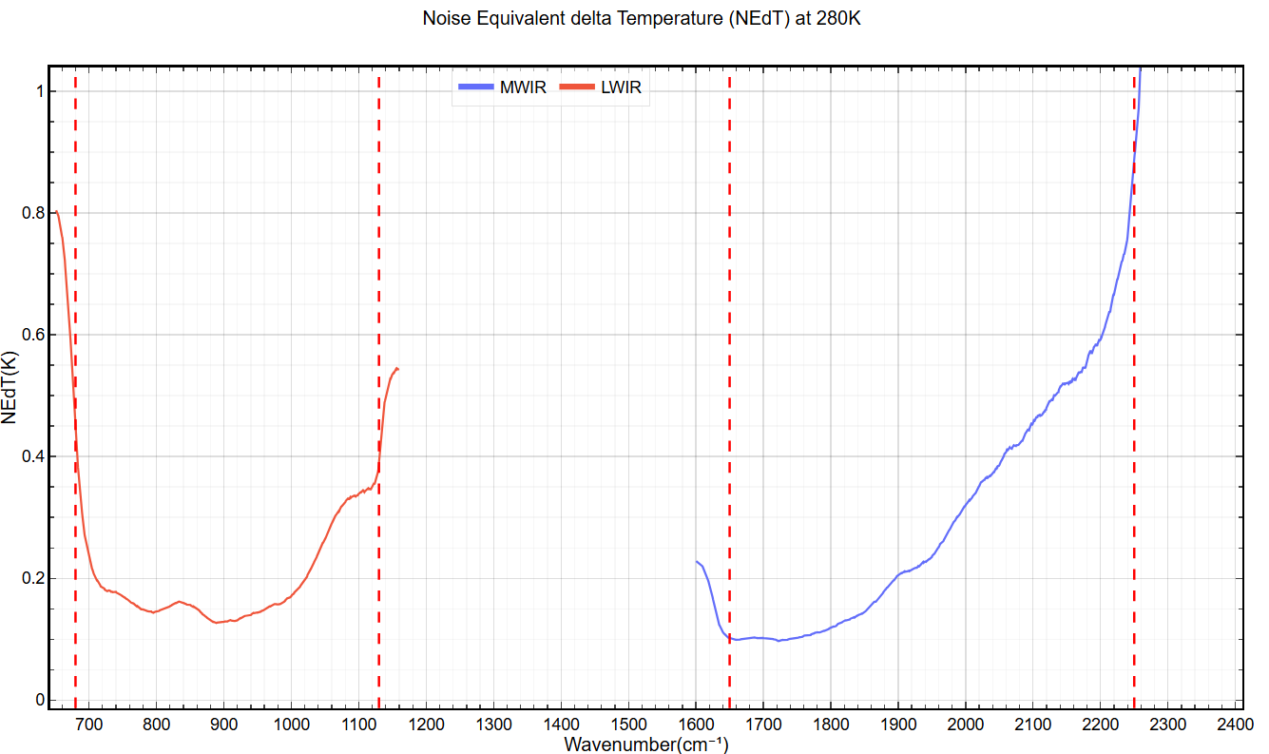
Prelaunch Radiometric Calibration
Radiometric Accuracy and Noise Performance
Noise Performance ：NEdR and NEdT

Slide 18
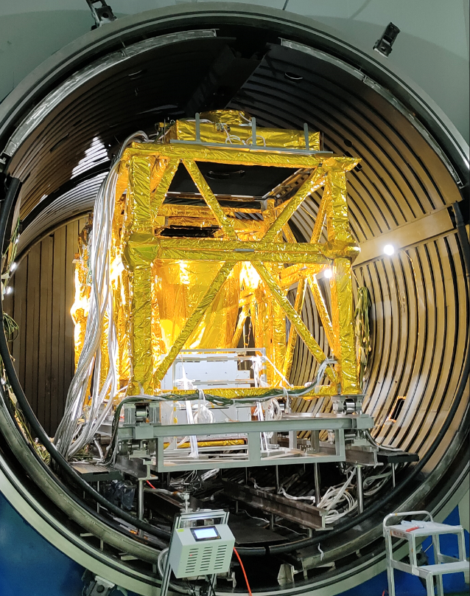
Summary
An on-ground calibration setup was developed for prelaunch calibration of GIIRS, which allows measurement and verification of all performances of the GIIRS within a single test campaign.
The method for prelaunch calibration for GIIRS is effective and constantly improving.
Spectral Stability: MWIR≤2.5ppm，LWIR ≤5ppm.
Spectral accuracy :≤ 7ppm,
Radiometric accuracy and noise performance are better than specification.
FY-4C GIIRS launch is currently planned for the end of 2025.

Slide 19
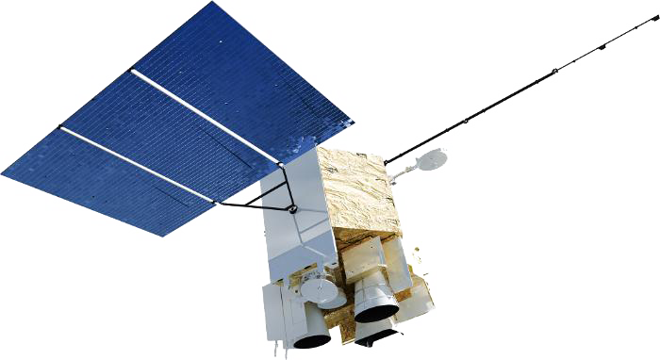
Thanks for your attention!
Email: lilibing@mail.sitp.ac.cn
GSICS Annual Meeting 17-21 March 2025 in Changchun, Jilin Province, China

