Slide 1
GSICS Annual Meeting 2025
IR Breakout Session
Research progress on space infrared radiation reference SI-traceable subsystem
Reporter： Shijie Xin¹
Lei Ding¹, Mingjian Gu¹, Xiaopeng Hao², Jian Song², Xuerong Xu¹, Ruiheng Sima², Tianyu Yan¹
1. Shanghai Institute of Technical Physics, Chinese Academy of Sciences
2. National Institute of Metrology, China
Mar. 20 Changchun · China
Notes:
Hello everyone! I will now present the research progress report on the SI-traceable radiation source part in the infrared benchmark payload.

Slide 2
Outline
Research Background
Research Objectives
Technical Approach
Test Results
Conclusion
Notes:
Report will be presented from five aspects.

Slide 3
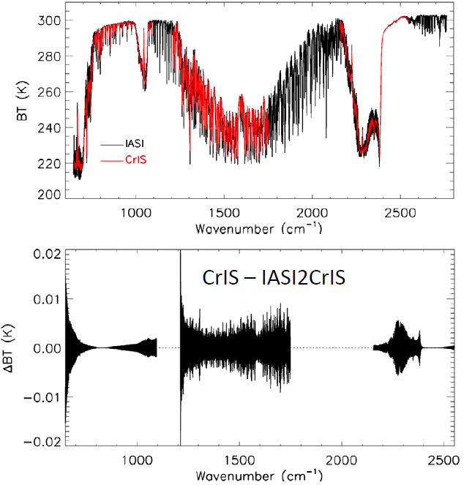
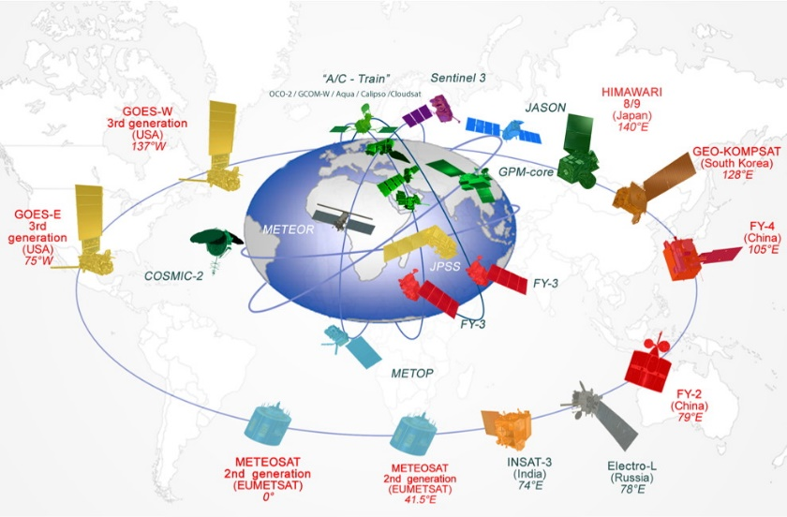
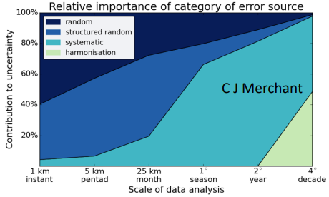
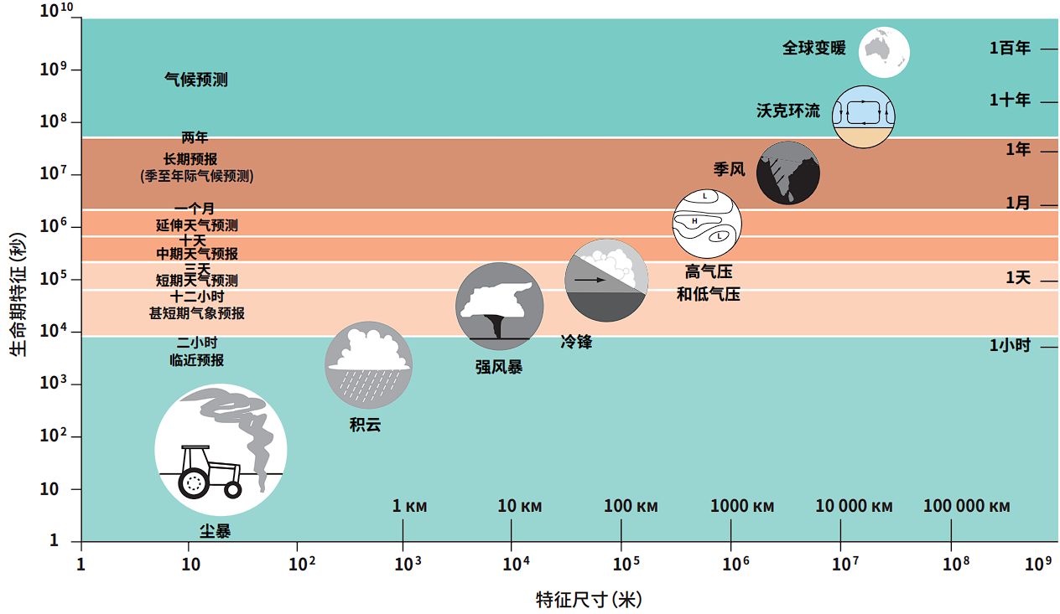
Research Background
*: Inter-Comparison of Suomi NPP CrIS with AIRS and IASI toward Infrared Hyperspectral Benchmark Radiance Measurements,2014.
*: Importance of error sources in climate data on different analysis scales. C. J. Merchant, 2015.
Development of science and technology
Key
Points
Remote sensing data from different sources have calibration differences
Needs
High-precision quantification
& SI-traceability
Global Operational Meteorological Satellite Observation System
CrIS v.s. IASI
As the time and space scales increase, systematic uncertainties become dominant
Meteorological events can be observed over a century
Climate change science data comes from different payloads
Cannot truly reflect the slight changes in climate observed
Great significance:
Large difference between payloads’ absolute radiometric calibration
A common radiation benchmark
Reduce the cost of remote sensing satellites
Provide reliable data
China, the United States and Europe: Lets get IR benchmark payloads!
Notes:
Climate change science data is sourced from various payload instruments, which exhibit significant differences in radiometric calibration accuracy. This leads to biases in the results of climate models using such data, preventing an accurate reflection of subtle changes in the observed objects. Consequently, it becomes challenging to provide stable and reliable remote sensing data for the observation of meteorological events spanning a century. Therefore, establishing a radiometric calibration benchmark holds considerable scientific significance.

Slide 4
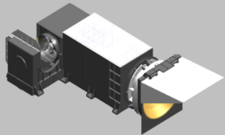
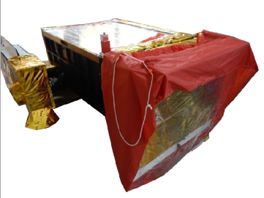
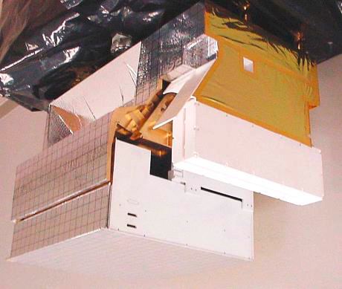
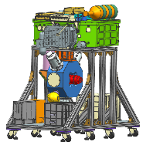
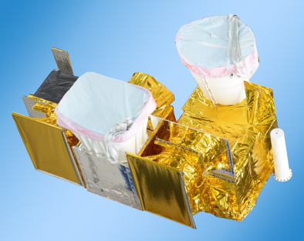
Research Background
 | IASI | CrIS | VIIRS | GIIRS | MERSI-II | HIRAS | IASI-NG | ARI | IR benchmark prototype
Project | METOP-A | S-NPP | S-NPP | FY-4 | FY-3 | FY-3 | METOP-NG | CLARREO
Country | EU | US | US | China | China | China | EU | US | China
State | On-orbit | On-orbit | On-orbit | On-orbit | On-orbit | On-orbit | Planning | Lab | Lab
Band Range | 3.62-15.5μm 645-2760cm⁻¹ | 3.92-15.38μm 650-2550cm⁻¹ | 0.41-12.5μm | 3.92-14.7μm 680-2550cm⁻¹ | 0.412-12.0μm | 3.92-15.38μm 650-2550cm⁻¹ | 3.62-15.5μm 645-2760cm⁻¹ | 200-3000cm⁻¹ | 600-2700cm⁻¹
Uncertainty | ≤0.3K | 0.3K | 2%（0.4-2.28μm）0.2K-0.5K（3.55-12.428μm） | 0.5K | 3.45%（0.402-1.04μm）4.76%（1.37-2.155μm）优于0.39K（3.71-12.5μm） | 0.3-0.5K | 0.25K | ≤0.2K | ≤0.2K
Sensitivity | 0.2-0.3K@280K (645-1210cm⁻¹) 0.2-0.5K@280K (1210-2000cm⁻¹) 0.5-2.0K@280K (2000-2760cm⁻¹) | 0.1-1.5K@250K | 22-628(0.4-2.28μm)0.03-0.4K(3.55-12.428μm) | 0.5mW/m²srcm⁻¹ | 151-751 （0.402-1.04μm） 117-288 （1.37-2.155μm）0.114-0.273K（3.71-12.5μm） | 0.1-0.4K@280K (667-1150cm⁻¹) 0.04-0.1K@280K (667-1150cm⁻¹) 0.04-0.1K@280K (667-1150cm⁻¹) | 0.08-0.18K@280K (645-1136cm⁻¹) 0.03-0.38K@280K (1210-1750cm⁻¹) 0.08-0.5K@280K (2150-2550cm⁻¹) | ≤0.1K(k=3) | ≤0.1K@270K
Spectral resolution | 0.25cm⁻¹ | 0.625cm⁻¹ (645-1136cm⁻¹) 1.25cm⁻¹ (1210-1750cm⁻¹) 2.5cm⁻¹ (2150-2550cm⁻¹) | 0.5μm | 0.625cm⁻¹ | 1μm | 0.625cm⁻¹ | 0.25cm⁻¹ | 0.5cm⁻¹ | 0.5cm⁻¹
High-precision traceable radiation sources and infrared hyperspectral detection are the main technical paths to achieve radiation benchmark measurement
Notes:
High-precision traceable radiation sources and infrared hyperspectral detection are the main technical paths to achieve radiation benchmark measurement
On the right side of the table are the parameter of the IR benchmark prototype.

Slide 5
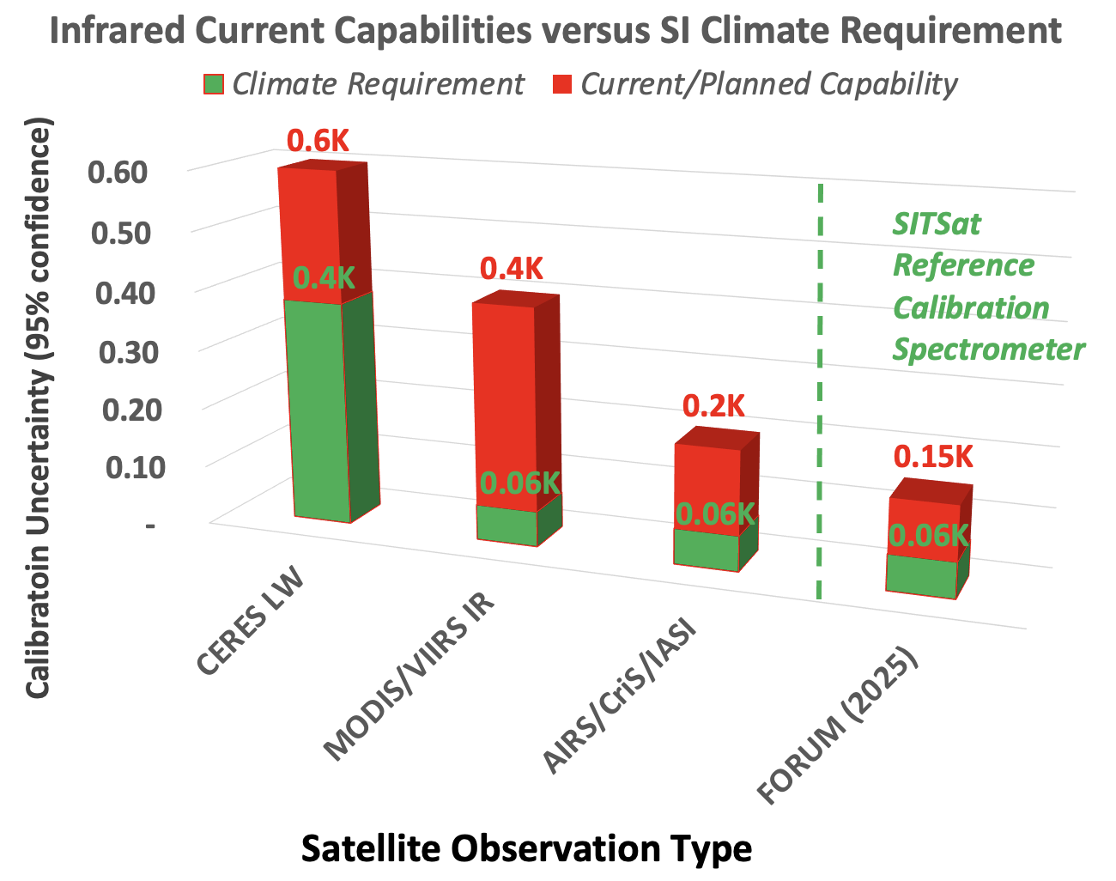
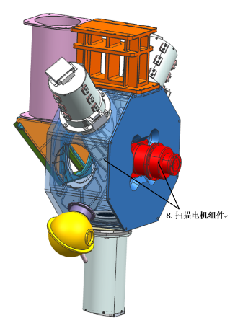
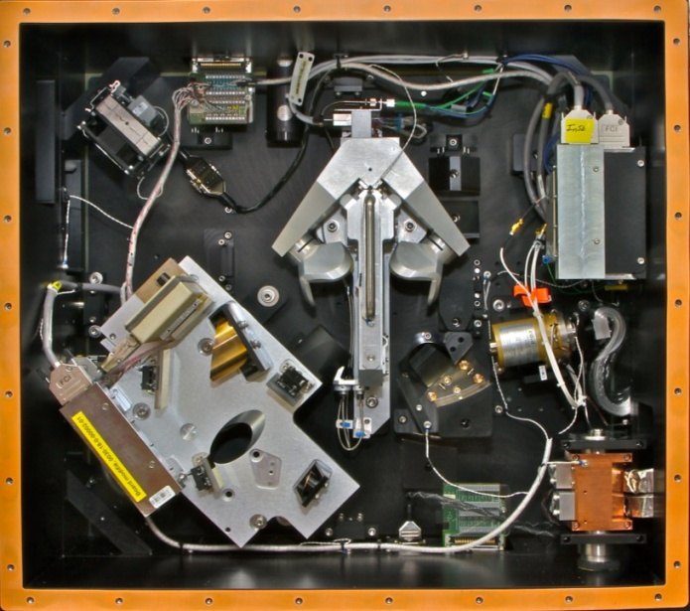
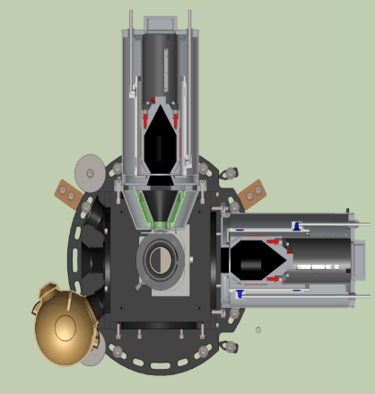
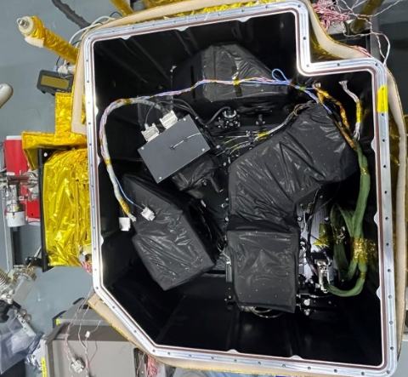
Research Background
 | IASI | CrIS | VIIRS | GIIRS | MERSI-II | HIRAS | IASI-NG | ARI | IR benchmark prototype
Project | METOP-A | S-NPP | S-NPP | FY-4 | FY-3 | FY-3 | METOP-NG | CLARREO
Country | EU | US | US | China | China | China | EU | US | China
State | On-orbit | On-orbit | On-orbit | On-orbit | On-orbit | On-orbit | Planning | Lab | Lab
Band Range | 3.62-15.5μm 645-2760cm⁻¹ | 3.92-15.38μm 650-2550cm⁻¹ | 0.41-12.5μm | 3.92-14.7μm 680-2550cm⁻¹ | 0.412-12.0μm | 3.92-15.38μm 650-2550cm⁻¹ | 3.62-15.5μm 645-2760cm⁻¹ | 200-3000cm⁻¹ | 600-2700cm⁻¹
Uncertainty | ≤0.3K | 0.3K | 2%（0.4-2.28μm）0.2K-0.5K（3.55-12.428μm） | 0.5K | 3.45%（0.402-1.04μm）4.76%（1.37-2.155μm）优于0.39K（3.71-12.5μm） | 0.3-0.5K | 0.25K | ≤0.2K | ≤0.2K
Sensitivity | 0.2-0.3K@280K (645-1210cm⁻¹) 0.2-0.5K@280K (1210-2000cm⁻¹) 0.5-2.0K@280K (2000-2760cm⁻¹) | 0.1-1.5K@250K | 22-628(0.4-2.28μm)0.03-0.4K(3.55-12.428μm) | 0.5mW/m²srcm⁻¹ | 151-751 （0.402-1.04μm） 117-288 （1.37-2.155μm）0.114-0.273K（3.71-12.5μm） | 0.1-0.4K@280K (667-1150cm⁻¹) 0.04-0.1K@280K (667-1150cm⁻¹) 0.04-0.1K@280K (667-1150cm⁻¹) | 0.08-0.18K@280K (645-1136cm⁻¹) 0.03-0.38K@280K (1210-1750cm⁻¹) 0.08-0.5K@280K (2150-2550cm⁻¹) | ≤0.1K(k=3) | ≤0.1K@270K
Spectral resolution | 0.25cm⁻¹ | 0.625cm⁻¹ (645-1136cm⁻¹) 1.25cm⁻¹ (1210-1750cm⁻¹) 2.5cm⁻¹ (2150-2550cm⁻¹) | 0.5μm | 0.625cm⁻¹ | 1μm | 0.625cm⁻¹ | 0.25cm⁻¹ | 0.5cm⁻¹ | 0.5cm⁻¹
The infrared radiation quantification accuracy represented by meteorological satellite imaging and detection payloads has reached 0.2K.
Still cannot meet the 0.06K climate change monitoring needs
High-precision traceable radiation sources and infrared hyperspectral detection are the main technical paths to achieve radiation benchmark measurement
*: SI-traceable space-based climate observation system: a CEOS and GSICS workshop, National Physical Laboratory, London, UK, 9-11 Sept 2019.
Notes:
The left figure shows the gap between current satellite observation capabilities and climate record requirements within the infrared emission band. It is shows that, the infrared radiation quantification accuracy represented by meteorological satellite imaging and detection payloads has reached 0.2K.
But still cannot meet the climate change monitoring needs.

Slide 6
Research Background
Development route of Chinese infrared benchmark payload
Complex environment
Chatter
Performance degradation
Heat flow
Non-idealization
Non-ideal parameters
Stray light
Atmospheric Path
Detector nonlinearity
When it comes to on-orbit engineering applications, adapting to the environment and non-ideal parameters become the main issues
6
Notes:
This is development route of Chinese IR benchmark payload. We finished IR radiation reference source and finished IR benchmark prototype. And now, we are working on IR benchmark payload. And in the future, on-orbit IR radiation benchmark transfer of course.
So When it comes to on-orbit engineering applications, adapting to the environment and non-ideal parameters become the main issues
Such as heat flow, detector nonlinearity, and so on

Slide 7
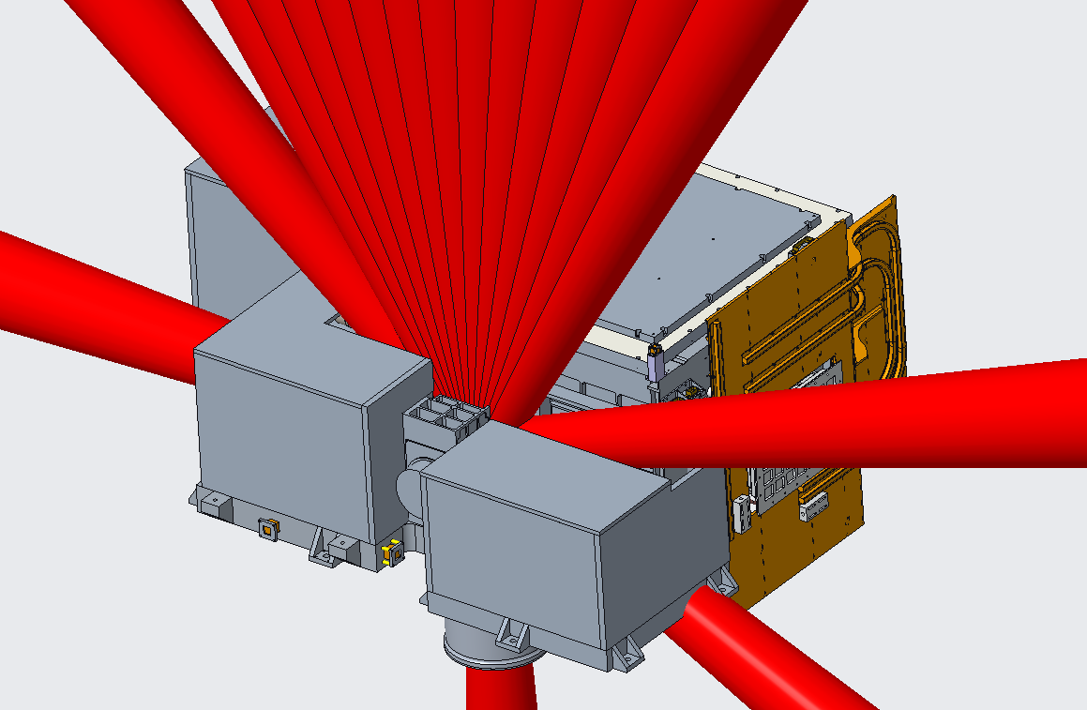
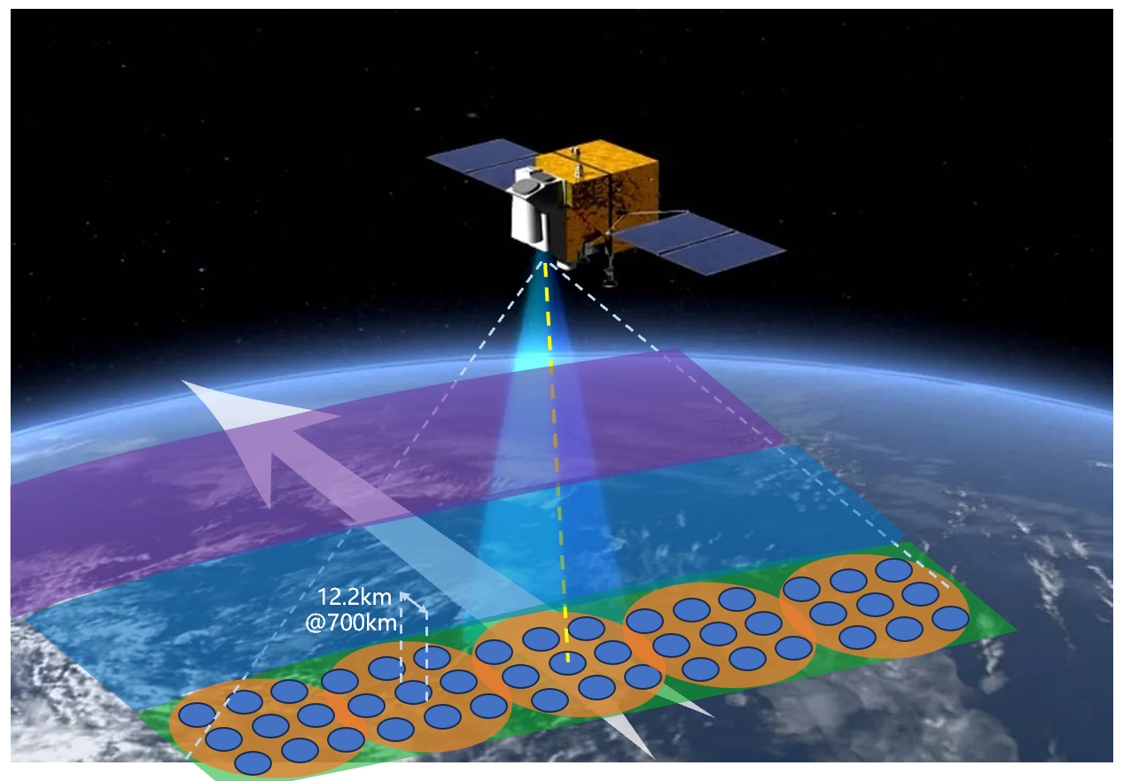
Technical Approach
Low temperature BB
Variable temperature BB
Interferometer
Scanning mirror
Key and difficult issues in high-precision SI-traceable radiation sources:
Engineering implementation
Long-term reliability verification
On-orbit radiation transfer method
Telescope
Gallium fixed point BB
Mechanical Refrigerator
Cold Box
Notes:
This is a schematic diagram of the payload structure, which is divided into several components: Gallium fixed point blackbody, Variable temperature blackbody, low-temperature blackbody, telescope, cold box, Mechanical Refrigerator, scanning mirror, and the interferometer.
The Key and difficult issues in high-precision SI-traceable radiation sources is:
Engineering implementation
Long-term reliability verification
On-orbit radiation transfer method

Slide 8
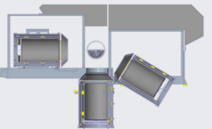

Technical Approach
Overview of infrared radiation reference SI-traceable subsystem
Low temperature BB(with 3 micro phase change fixed point)
Heated Halo
Variable temperature BB
Temperature range：220K~330K
aperture：130mm
Emissivity：0.999
Temperature uniformity @bottom：20mK
Reproducibility of phase transition temperature ：20mK
Scanning mirror
Variable temperature BB(with 3 micro phase change fixed point)
Low temperature BB
Temperature range：220K~330K
aperture：130mm
Emissivity：0.999
Temperature uniformity @bottom：20mK
Reproducibility of phase transition temperature ：20mK
Gallium fixed point BB
Temperature range ：270K~320K
aperture ：130mm
Emissivity ：0.999
Reproducibility of phase transition temperature ：20 mK
Gallium fixed point BB
Notes:
This is Overview of infrared radiation reference SI-traceable subsystem
Both the low-temperature blackbody and the variable-temperature blackbody has three micro phase change fixed points. And it’s temperature range from 220K to 330K, emissivity is 0.999.
The temperature uniformity at bottom is 20mK
And the reproducibility of phase transition temperature is 20mK
so This can serve as a non-linear calibration radiation source for the payload, as well as function as a blackbody for radiometric calibration in Earth observation.
As for Gallium fixed point blackbody, The base of this blackbody contains a substantial amount of gallium, enabling it to provide a reference radiation source at the gallium phase transition temperature point.

Slide 9
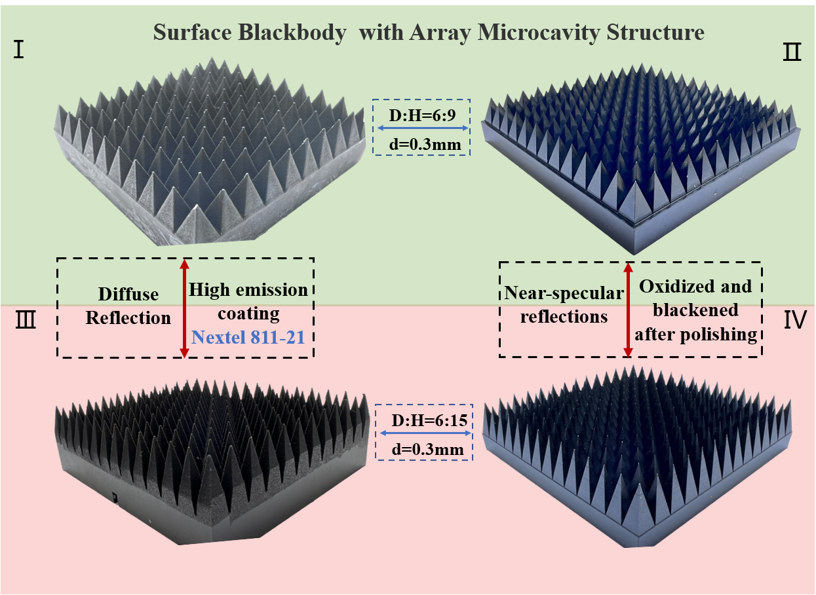
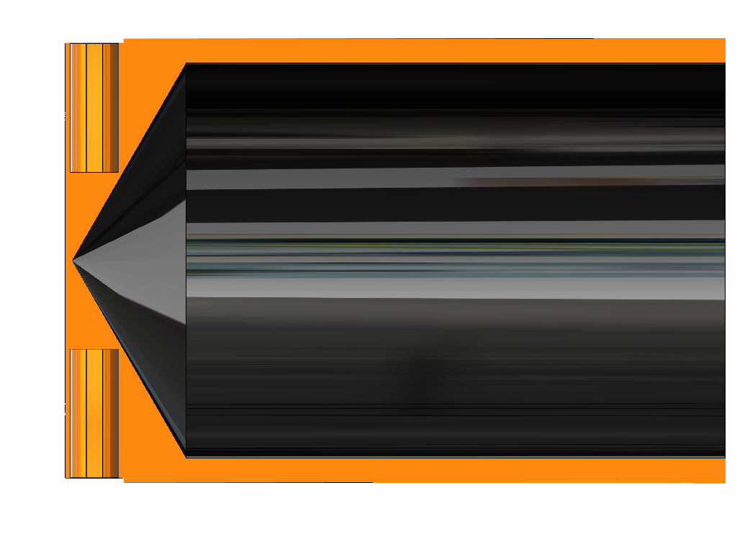
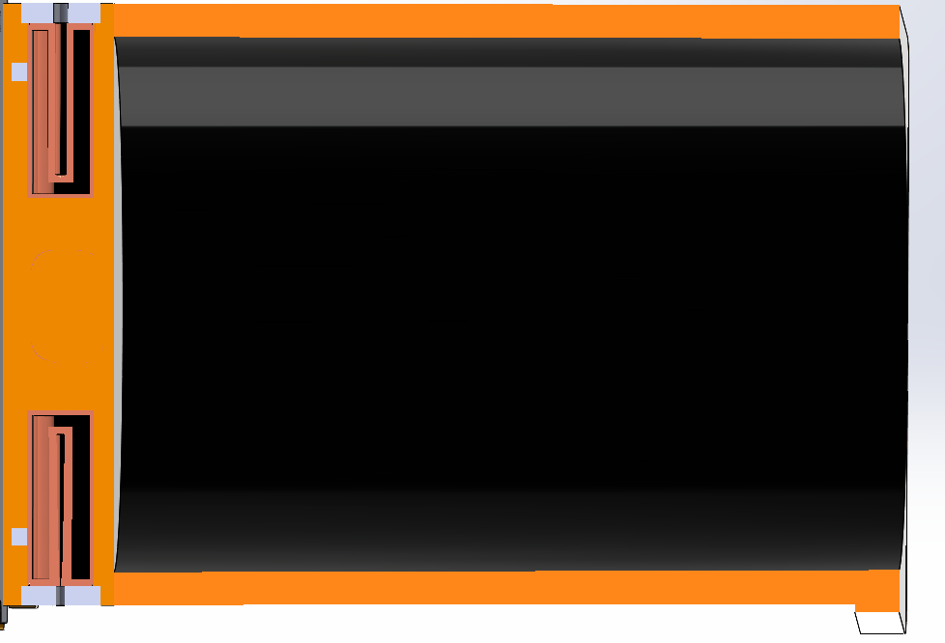
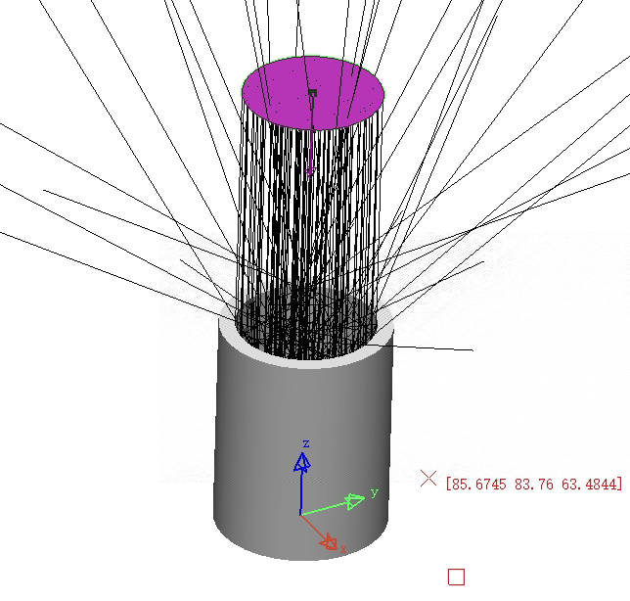
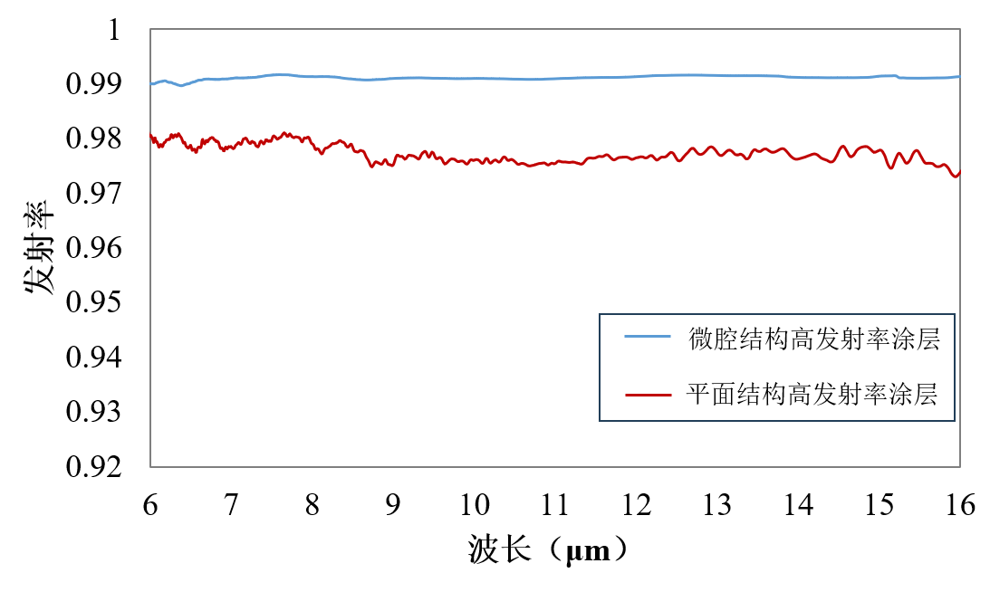
Technical Approach
Large-aperture, high-emissivity blackbody lightweight design
120°Cone Angle
Pyramid Array
 | 120°Cone Angle | Pyramid Array
aperture/mm | 130 | 130
Blackbody cavity depth/mm | 250 | 250
Weight/Kg | 1.2 | 1.1
Emissivity | 0.9976 | 0.9993
—Pyramid Array
—120°Cone Angle
Notes:
Here, for large-aperture, high-emissivity blackbodies, we have a lightweight design by utilizing a pyramid array
An emissivity of 0.999 is achieved under the same weight conditions.

Slide 10
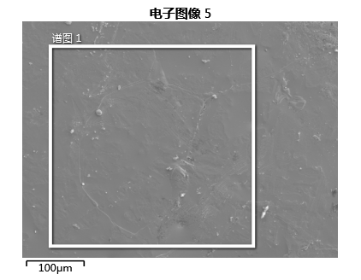
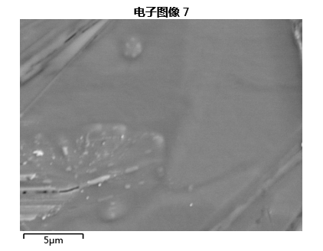
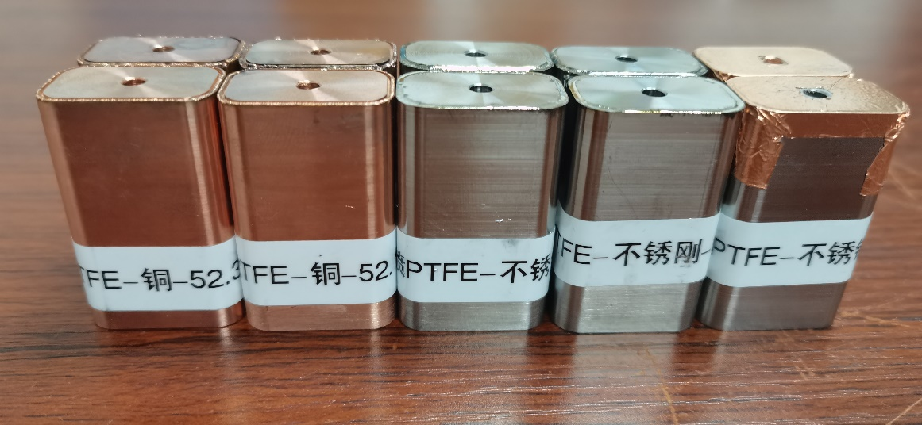
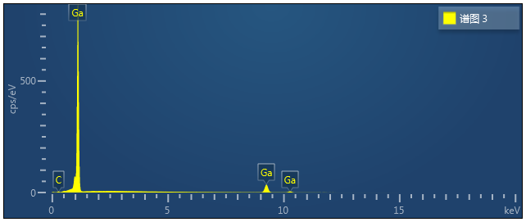
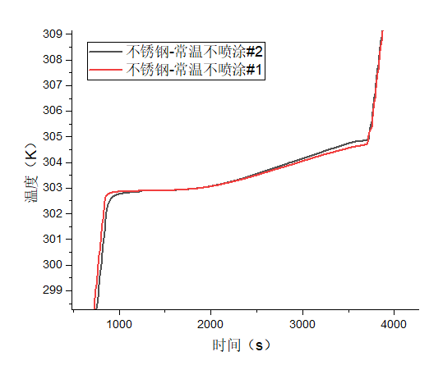
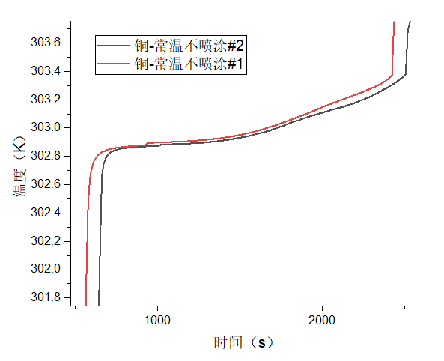
Technical Approach
Micro phase change fixed point:
package shell material study
Electronic scanning
Electronic scanning
Mass spectrometry results
Gallium-Stainless steel
Gallium-Copper
Notes:
This is the design of a micro phase change fixed point. Due to the potential for corrosion between the phase change material and the metal casing, research on package shell materials is necessary. Here are the test results between gallium and stainless steel as well as copper materials. Utilizing Electronic scanning and mass spectrometry results, it can be concluded that both materials serve as excellent package shell materials for gallium.

Slide 11
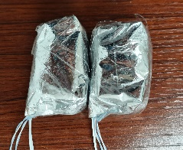
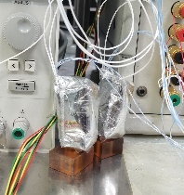
Technical Approach
Micro Fixed Point Phase Transition Test：
Copper Crucible
Micro Fixed Point Phase Transition Test:
Stainless Steel Crucible
At different heating powers:
phase transition temperature 302.911K
Reproducibility ≤1mK
At different heating powers:
phase transition temperature 302.917K
Reproducibility ≤2mK
Notes:
Phase transition tests were conducted on a copper-package shell micro phase change fixed point. The results indicate that, under varying heating powers, the repeatability of the phase transition temperature can be less than 1 mK. Similarly, the repeatability of a stainless steel package shell can be less than 2 mK.

Slide 12
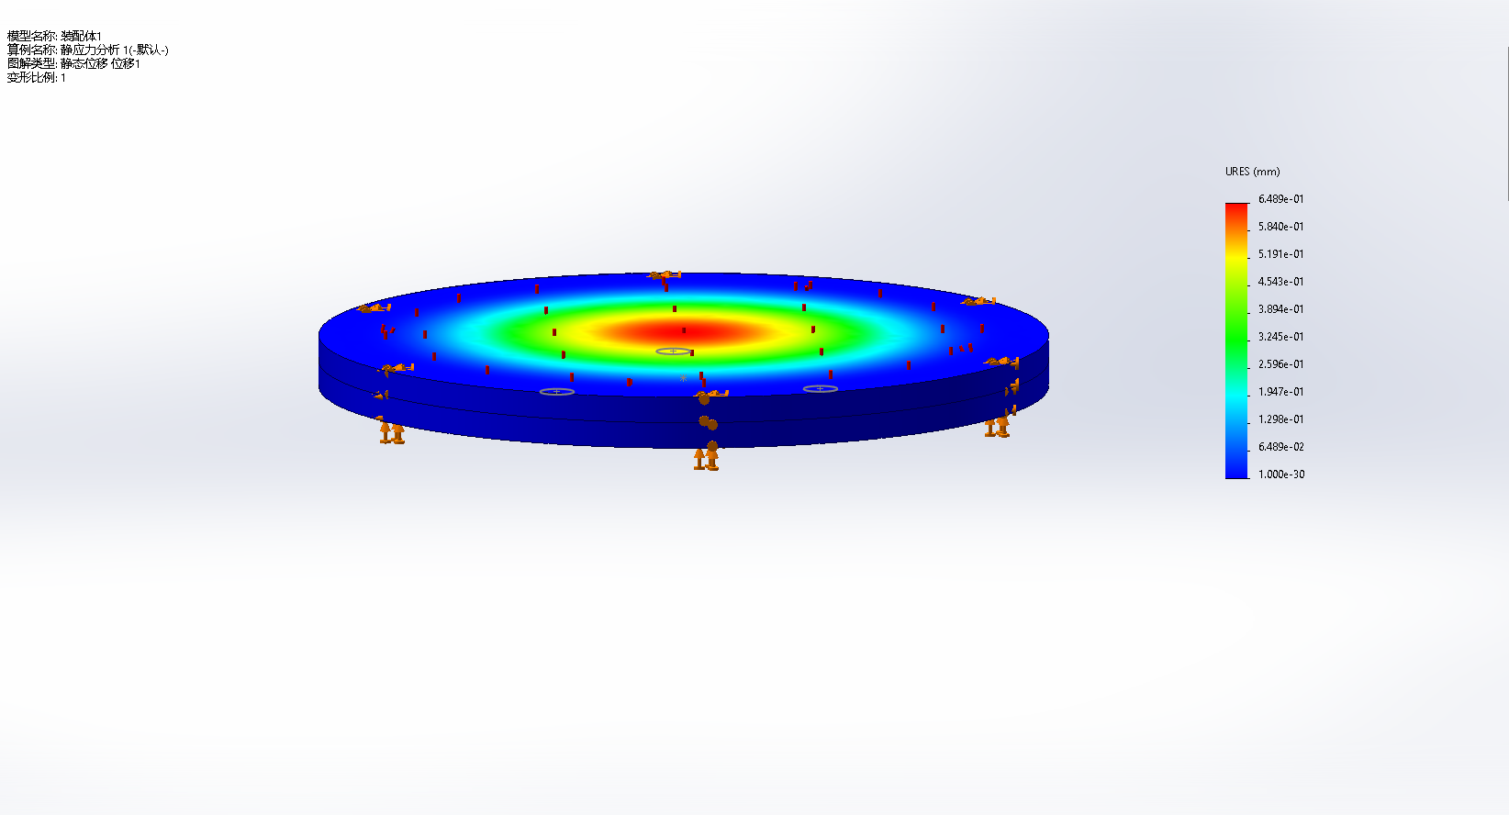
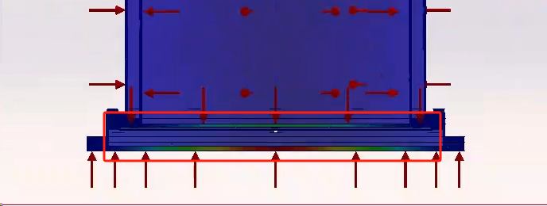
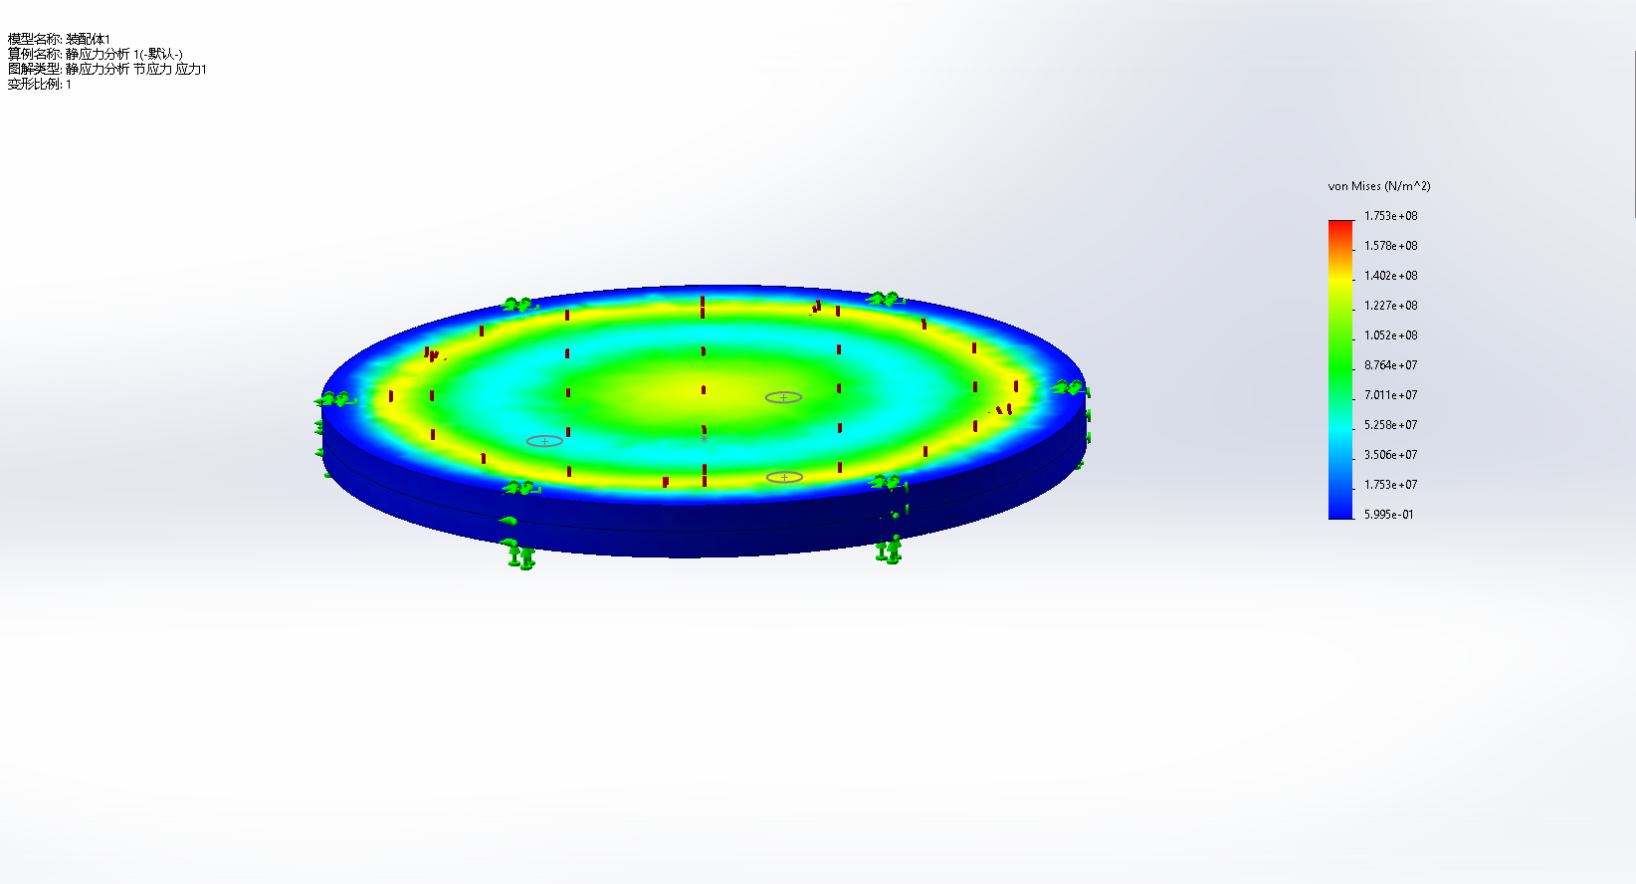
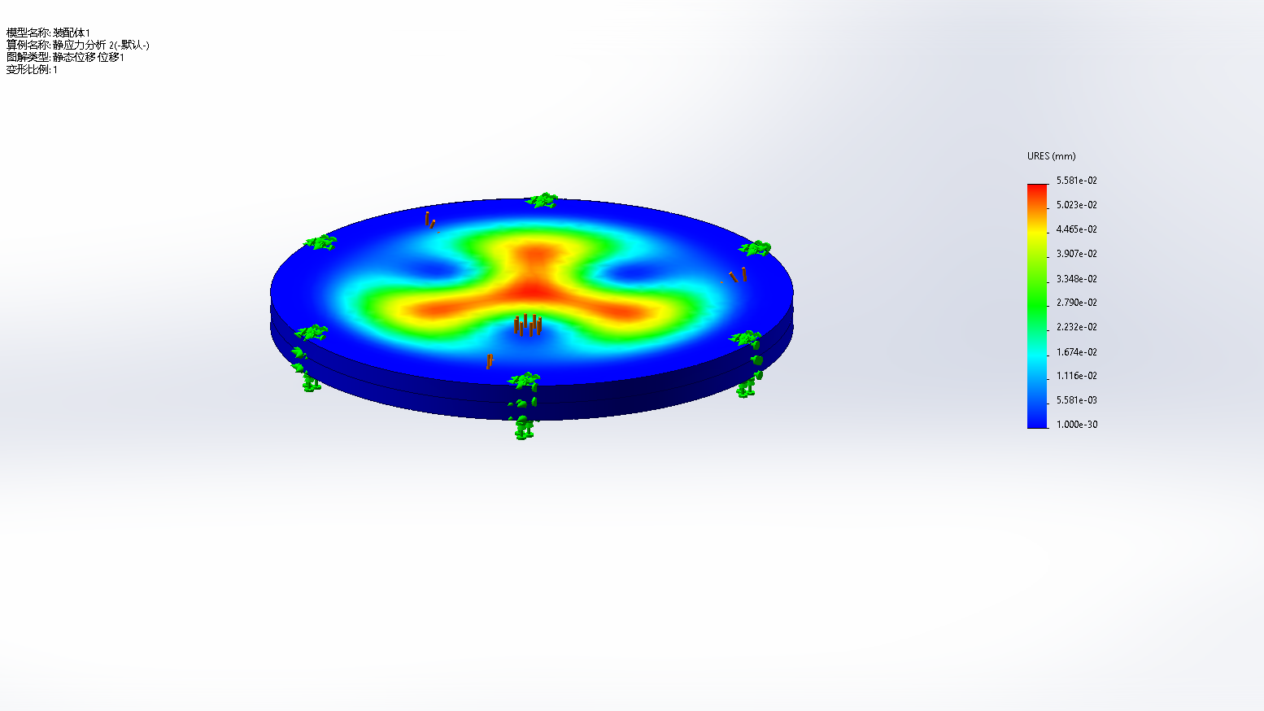
Technical Approach
Gallium fixed point BB:
The influence of volume change of a large amount of gallium on the bottom structure of a blackbody cavity
Without pillar & 1.5mm
Without pillar & 2mm
Gallium solidification
material | thickness | Stress max（pa） | Yield Strength（pa） | Displacement max（mm）
304 | 1.5mm | 5.149e+08 | 2.068e+08 | 2.100e+00
304 | 2mm | 2.561e+08 | 2.068e+08 | 1.109e+00
304 | 2.5mm | 1.565e+08 | 2.068e+08 | 7.147e-01
304 | 3mm | 1.373e+08 | 2.068e+08 | 4.649e-01
With pillar & 2mm
Notes:
Since the volume of phase change materials undergoes changes during the phase transition process, For gallium fixed point blackbody, we have investigated The influence of volume change of a large amount of gallium on the bottom structure of the blackbody.
So, the thickness of the blackbody's bottom structure was increased, and structural support was reinforced.

Slide 13
Technical Approach
Effect of Annealing on Precision Platinum Resistance Temperature Sensor
Long-term stability:
4 hours@353 K, 4hours@233K
Temperature change of thermometer at triple point of water
4 hours@353 K, 4hours@213K
Temperature change of thermometer at triple point of water
2 hours@353 K, 2 hours@77K
Temperature change of thermometer at triple point of water
Adequate annealing is very important for the stability of the precision platinum resistance thermometer.
The stability of the thermometer at the water triple point temperature after annealing is also the basis screening a large number of thermometers.
3-year long-term stability results:
4.7mK@273.16K
4.3mK@341.15K
2.7mK@234.32K
Notes:
The temperature measurement of the blackbody relies heavily on high-precision platinum resistance thermometers. We found annealing is very important for the stability of the precision platinum resistance thermometer.
Long-term stability tests have shown that the prepared thermometers exhibit stability better than 5 mK at various temperature points over a period of three years.

Slide 14
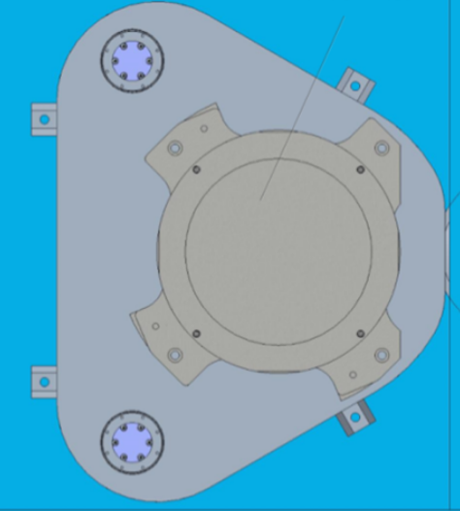

Technical Approach
Stepper Motor
Gold plated bezel
Heated halo
Support structure
Each blackbody has a gold plated bezel and heated halo:
Isolate external heat flow
Maintain phase change process stability
Measure emissivity
Gallium fixed point BB
Stepper Motor
Support structure
Notes:
Each blackbody has a gold plated bezel and heated halo:
for Isolate external heat flow
And Maintain phase change process stability
And Measure emissivity

Slide 15
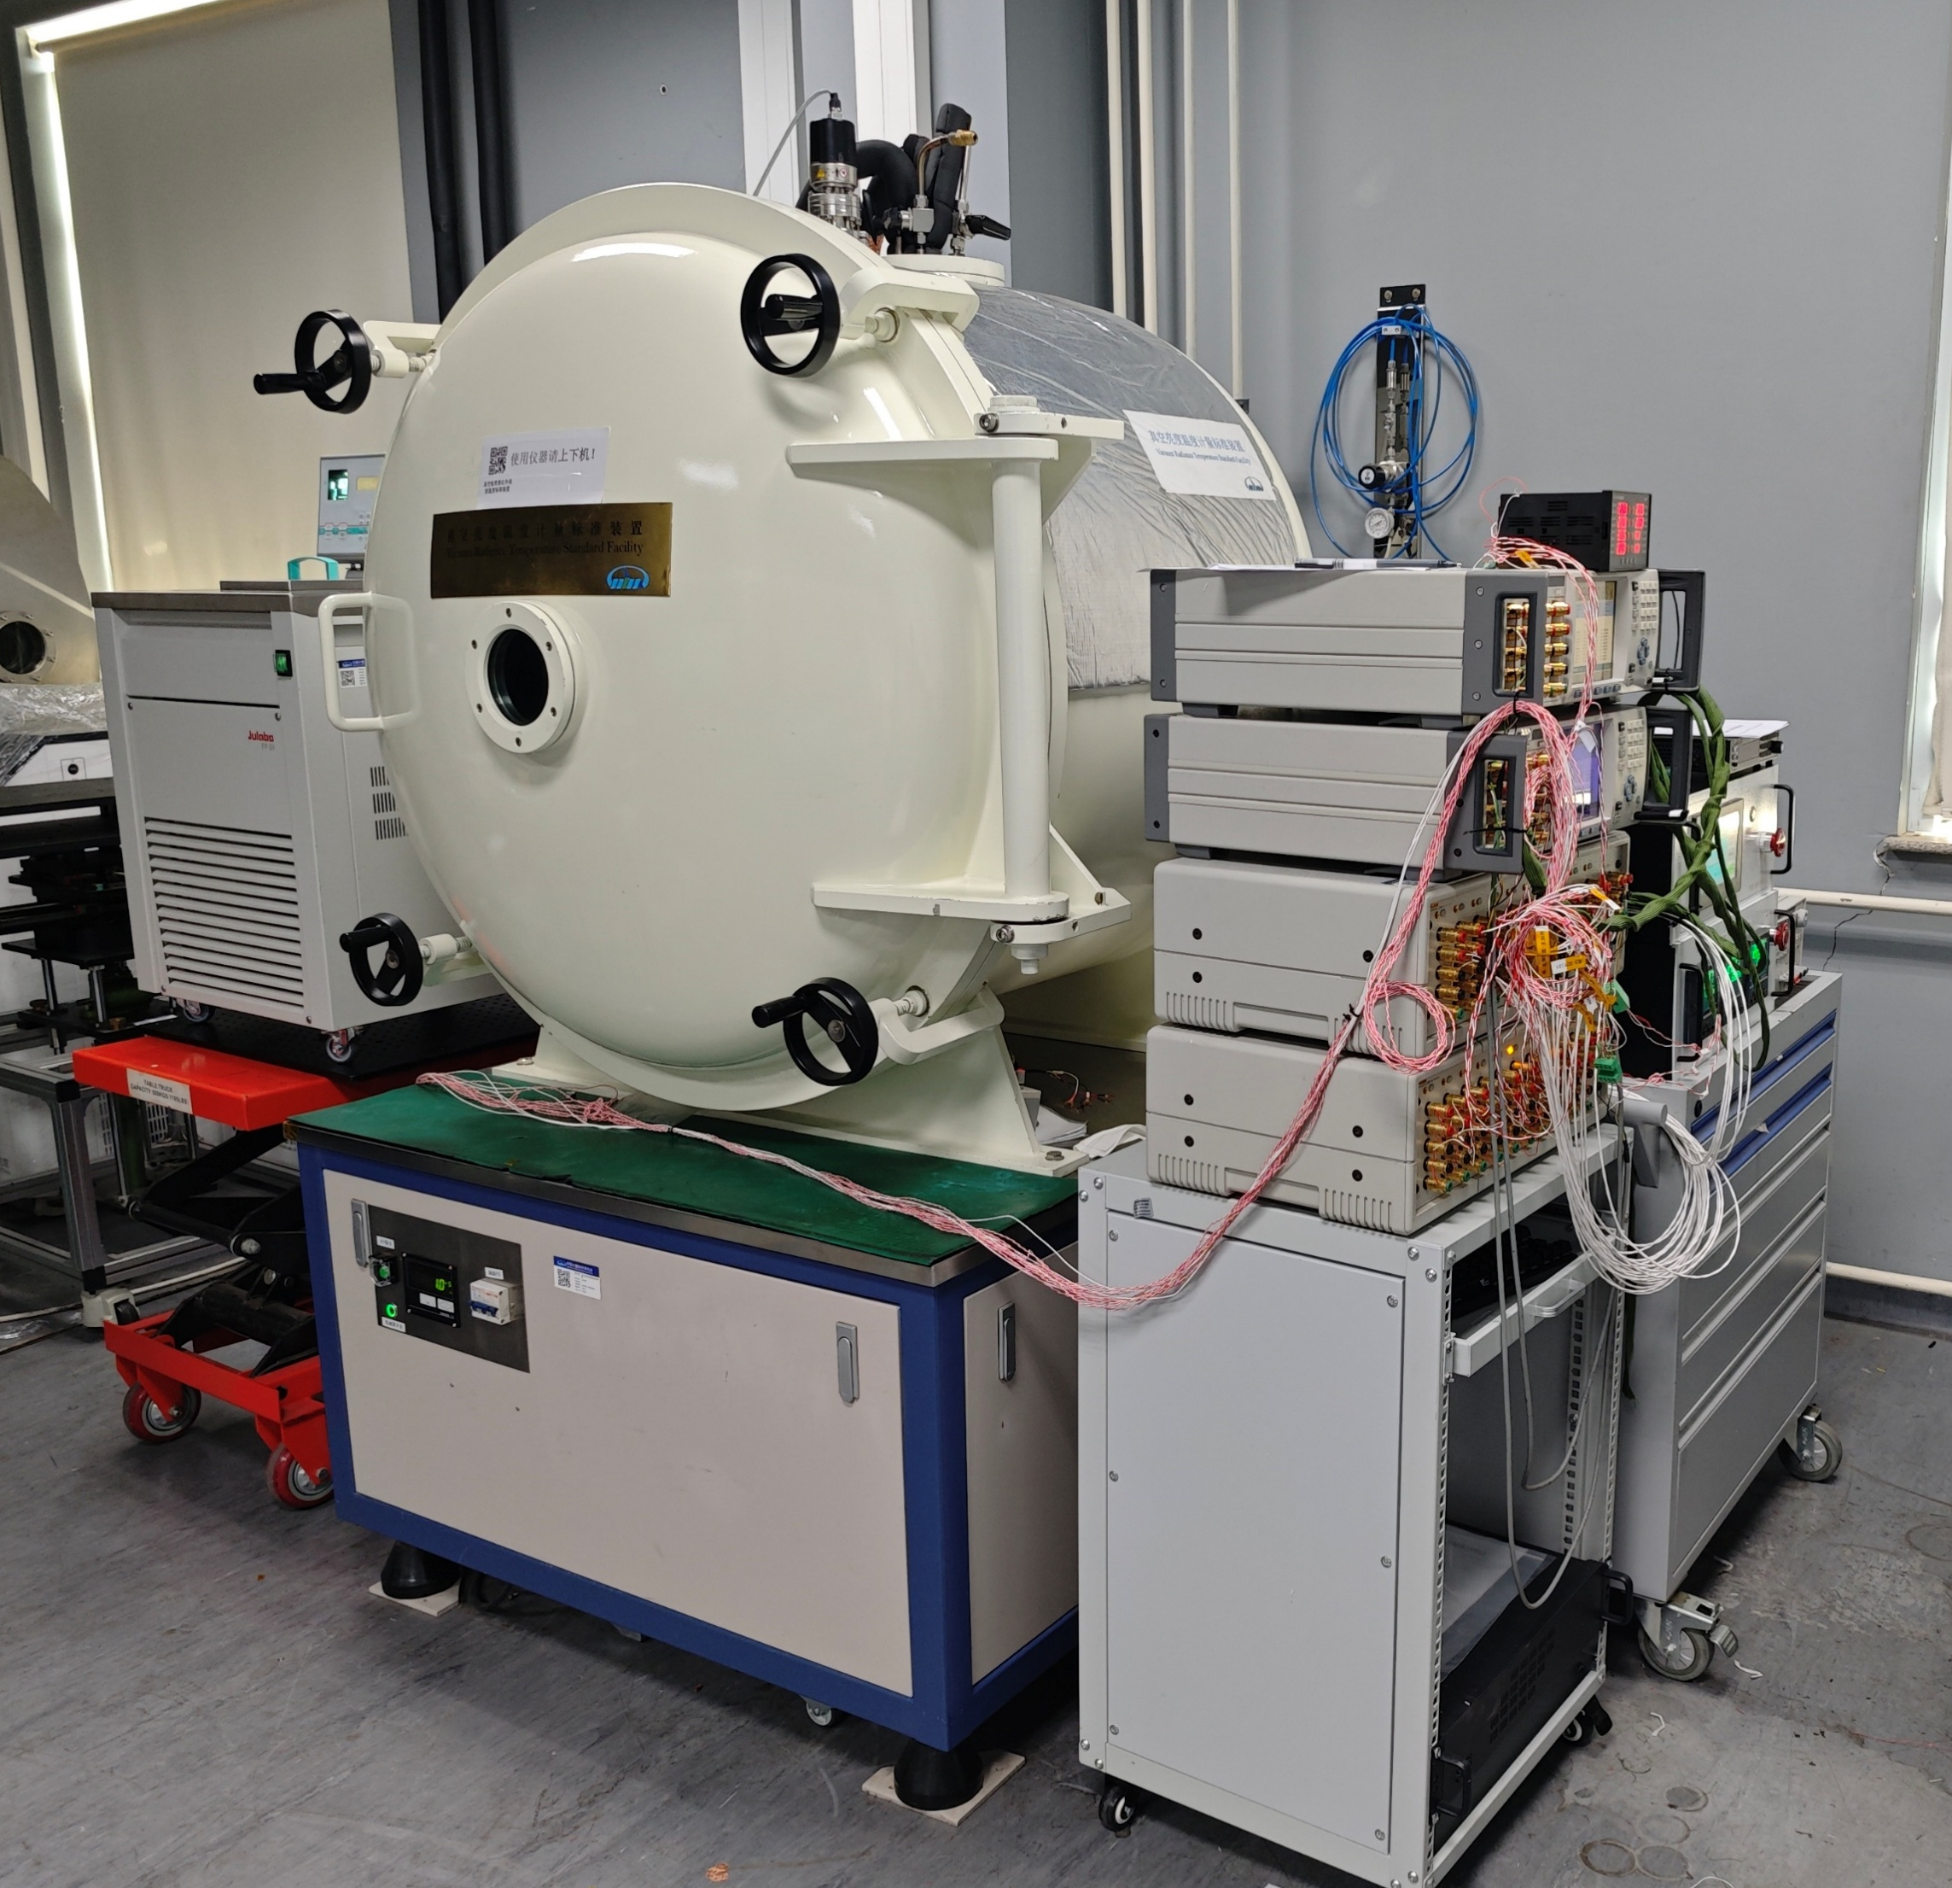
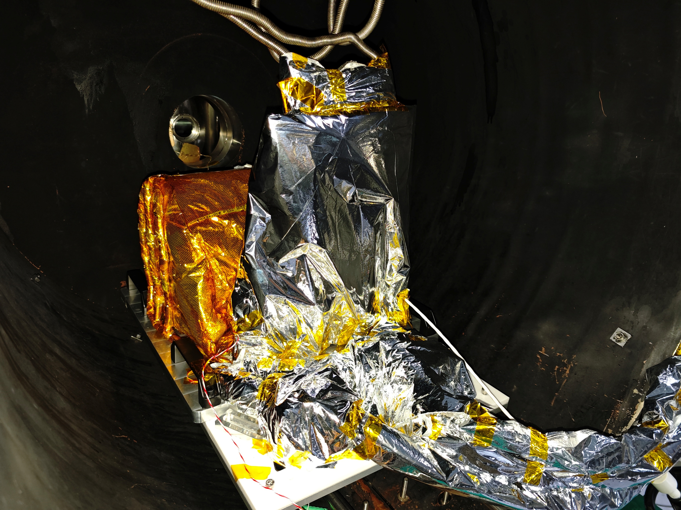
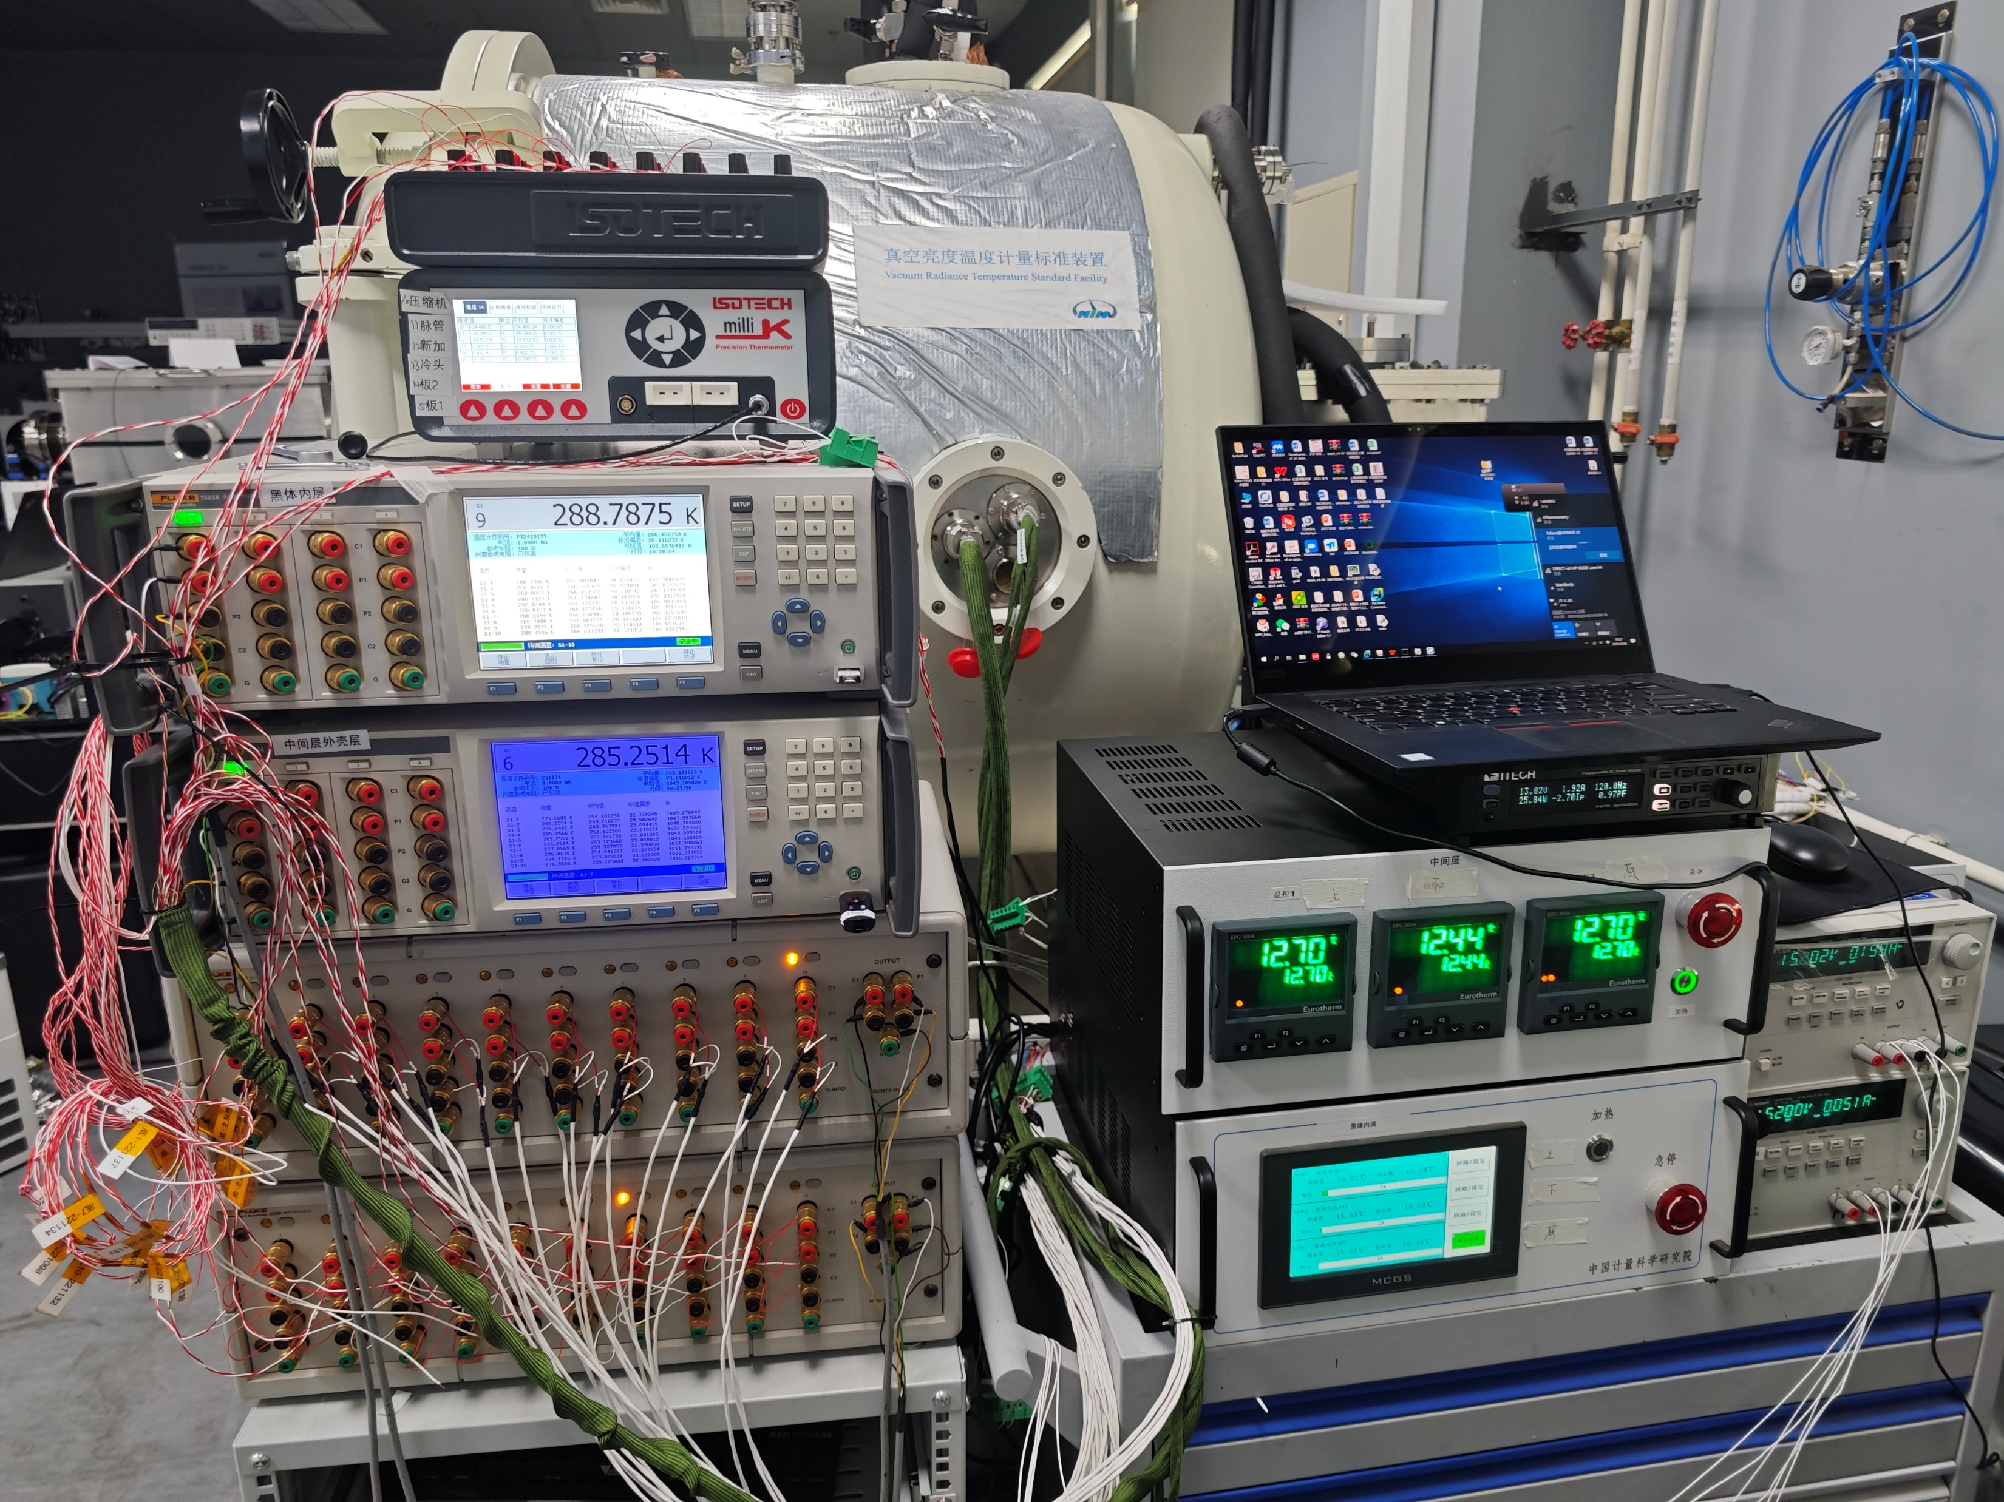
Test Results
Variable temperature BB
Cold plate
Wires
Cold plate sink
Refrigerator
Vacuum tank
Measurement and control system
Refrigerator temperature measurement
Data Recording
Constant current power supply
Blackbody temperature measurement
Blackbody temperature control
Notes:
We conducted performance tests on the variable-temperature blackbody by placing it inside a vacuum chamber and utilizing a high-precision testing system to perform temperature control tests on the blackbody.
Here are the diagrams of the experimental setup and the test site.

Slide 16
Test Results
Experimental Status
BlackBody(use PID): 220 K
Middle Layer(use PID): 217 K
Outer shell(no control): 205 K
@blackbody interface part
@blackbody sidewall & bottom
@blackbody interface part
Temperature uniformity and stability within 30 minutes(Unit: K)
ID code | S1-1 | S1-2 | S1-3 | S1-4 | S1-5 | S1-6 | S1-7 | S1-8 | S1-9 | S1-10
Name | Bottom 1 | Bottom 2 | Bottom 3 | Bottom 4 | Bottom 5 | Bottom 7 | Sidewall 1 | Sidewall 2 | Sidewall 3 | Sidewall 4
Position | In the crucible | In the crucible | In the crucible | Bottom | Bottom | Middle of the bottom | Top of sidewall | Top of sidewall | Under of sidewall | Under of sidewall
Mean temperature | 220.0133 | 220.0144 | 220.0153 | 220.0154 | 220.0172 | 220.0161 | 220.0303 | 219.9908 | 220.0123 | 220.0170
Stability (standard deviation) | 0.0016 | 0.0015 | 0.0017 | 0.0015 | 0.0014 | 0.0014 | 0.0011 | 0.0012 | 0.0015 | 0.0015
Max temperature difference of bottom: 0.0038 |  |  | Standard deviation of bottom: 0.0013 |  |  | Max temperature difference of blackbody: 0.0394 |  |  | Standard deviation of blackbody: 0.0096
Notes:
First, we utilized a refrigeration unit to lower the temperature of the outer shell layer to 205K, while the middle layer was PID temperature-controlled at 217K, and the blackbody layer was PID temperature-controlled at 220K.
As you can see, The temperature difference at the junction between the blackbody layer and the middle layer is relatively significant, reaching 40 mK.
But the Max temperature difference of bottom is 3.8mK
STD of bottom is 1.3mK
Max temperature difference of blackbody is 39.4mK
STD of blackbody is 9.6mK

Slide 17
Test Results
Experimental Status
BlackBody(use PID): 233.8 K
Middle Layer(use PID): 231.8K
Outer shell(no control): 218 K
@blackbody interface part
@blackbody sidewall & bottom
@blackbody interface part
Temperature uniformity and stability within 30 minutes(Unit: K)
ID code | S1-1 | S1-2 | S1-3 | S1-4 | S1-5 | S1-6 | S1-7 | S1-8 | S1-9 | S1-10
Name | Bottom 1 | Bottom 2 | Bottom 3 | Bottom 4 | Bottom 5 | Bottom 7 | Sidewall 1 | Sidewall 2 | Sidewall 3 | Sidewall 4
Position | In the crucible | In the crucible | In the crucible | Bottom | Bottom | Middle of the bottom | Top of sidewall | Top of sidewall | Under of sidewall | Under of sidewall
Mean temperature | 233.8315 | 233.8335 | 233.8330 | 233.8341 | 233.8364 | 233.8359 | 233.8410 | 233.7976 | 233.8257 | 233.8307
Stability (standard deviation) | 0.0025 | 0.0025 | 0.0025 | 0.0025 | 0.0025 | 0.0025 | 0.0011 | 0.0011 | 0.0023 | 0.0023
Max temperature difference of bottom: 0.0049 |  |  | Standard deviation of bottom: 0.0018 |  |  | Max temperature difference of blackbody: 0.0434 |  |  | Standard deviation of blackbody: 0.0120
Notes:
Similarly, we PID temperature-controlled the blackbody at 233.8K.
the Max temperature difference of bottom is 4.9mK
STD of bottom is 1.8mK
Max temperature difference of blackbody is 43.4mK
STD of blackbody is 12mK

Slide 18
Test Results
Experimental Status
BlackBody(use PID): 288.0 K
Middle Layer(use PID): 285.15K
Outer shell(no control): 276 K
@blackbody interface part
@blackbody sidewall & bottom
@blackbody interface part
Temperature uniformity and stability within 30 minutes(Unit: K)
ID code | S1-1 | S1-2 | S1-3 | S1-4 | S1-5 | S1-6 | S1-7 | S1-8 | S1-9 | S1-10
Name | Bottom 1 | Bottom 2 | Bottom 3 | Bottom 4 | Bottom 5 | Bottom 7 | Sidewall 1 | Sidewall 2 | Sidewall 3 | Sidewall 4
Position | In the crucible | In the crucible | In the crucible | Bottom | Bottom | Middle of the bottom | Top of sidewall | Top of sidewall | Under of sidewall | Under of sidewall
Mean temperature | 288.0035 | 288.0059 | 288.0040 | 288.0070 | 288.0089 | 288.0083 | 288.0361 | 287.9782 | 287.9979 | 288.0051
Stability (standard deviation) | 0.0003 | 0.0003 | 0.0003 | 0.0003 | 0.0003 | 0.0003 | 0.0009 | 0.0009 | 0.0004 | 0.0005
Max temperature difference of bottom: 0.0054 |  |  | Standard deviation of bottom: 0.0022 |  |  | Max temperature difference of blackbody: 0.0578 |  |  | Standard deviation of blackbody: 0.0140
Notes:
and, we PID temperature-controlled the blackbody at 288K.
the Max temperature difference of bottom is 5.4mK
STD of bottom is 2.2mK
Max temperature difference of blackbody is 57.8mK
STD of blackbody is 14mK

Slide 19
Test Results
Experimental Status
BlackBody(use PID): 302.4 K
Middle Layer(use PID): 299.4 K
Outer shell(no control): 294 K
@blackbody interface part
@blackbody sidewall & bottom
@blackbody interface part
Temperature uniformity and stability within 30 minutes(Unit: K)
ID code | S1-1 | S1-2 | S1-3 | S1-4 | S1-5 | S1-6 | S1-7 | S1-8 | S1-9 | S1-10
Name | Bottom 1 | Bottom 2 | Bottom 3 | Bottom 4 | Bottom 5 | Bottom 7 | Sidewall 1 | Sidewall 2 | Sidewall 3 | Sidewall 4
Position | In the crucible | In the crucible | In the crucible | Bottom | Bottom | Middle of the bottom | Top of sidewall | Top of sidewall | Under of sidewall | Under of sidewall
Mean temperature | 302.4019 | 302.4039 | 302.4029 | 302.4056 | 302.4068 | 302.4051 | 302.4443 | 302.3918 | 302.4068 | 302.4159
Stability (standard deviation) | 0.0012 | 0.0012 | 0.0012 | 0.0012 | 0.0012 | 0.0012 | 0.0020 | 0.0019 | 0.0011 | 0.0011
Max temperature difference of bottom: 0.0049 |  |  | Standard deviation of bottom: 0.0018 |  |  | Max temperature difference of blackbody: 0.0524 |  |  | Standard deviation of blackbody: 0.0139
Notes:
and, we controlled the blackbody at 302.4K.
the Max temperature difference of bottom is 4.9mK
STD of bottom is 1.8mK
Max temperature difference of blackbody is 52.4mK
STD of blackbody is 13.9mK

Slide 20
Test Results
@blackbody interface part
Experimental Status
BlackBody(use PID): 330.0 K
Middle Layer(use PID): 327.0K
Outer shell(no control): 326 K
@blackbody sidewall & bottom
@blackbody interface part
Temperature uniformity and stability within 30 minutes(Unit: K)
ID code | S1-1 | S1-2 | S1-3 | S1-4 | S1-5 | S1-6 | S1-7 | S1-8 | S1-9 | S1-10
Name | Bottom 1 | Bottom 2 | Bottom 3 | Bottom 4 | Bottom 5 | Bottom 7 | Sidewall 1 | Sidewall 2 | Sidewall 3 | Sidewall 4
Position | In the crucible | In the crucible | In the crucible | Bottom | Bottom | Middle of the bottom | Top of sidewall | Top of sidewall | Under of sidewall | Under of sidewall
Mean temperature | 330.0379 | 330.0394 | 330.0404 | 330.0413 | 330.0421 | 330.0389 | 330.0915 | 330.0529 | 330.0487 | 330.0566
Stability (standard deviation) | 0.0015 | 0.0015 | 0.0015 | 0.0015 | 0.0015 | 0.0016 | 0.0023 | 0.0020 | 0.0012 | 0.0012
Max temperature difference of bottom: 0.0042 |  |  | Standard deviation of bottom: 0.0016 |  |  | Max temperature difference of blackbody: 0.054 |  |  | Standard deviation of blackbody: 0.0162
Notes:
and, we PID temperature-controlled the blackbody at 330K.
the Max temperature difference of bottom is 4.2mK
STD of bottom is 1.6mK
Max temperature difference of blackbody is 54mK
STD of blackbody is 16.2mK

Slide 21
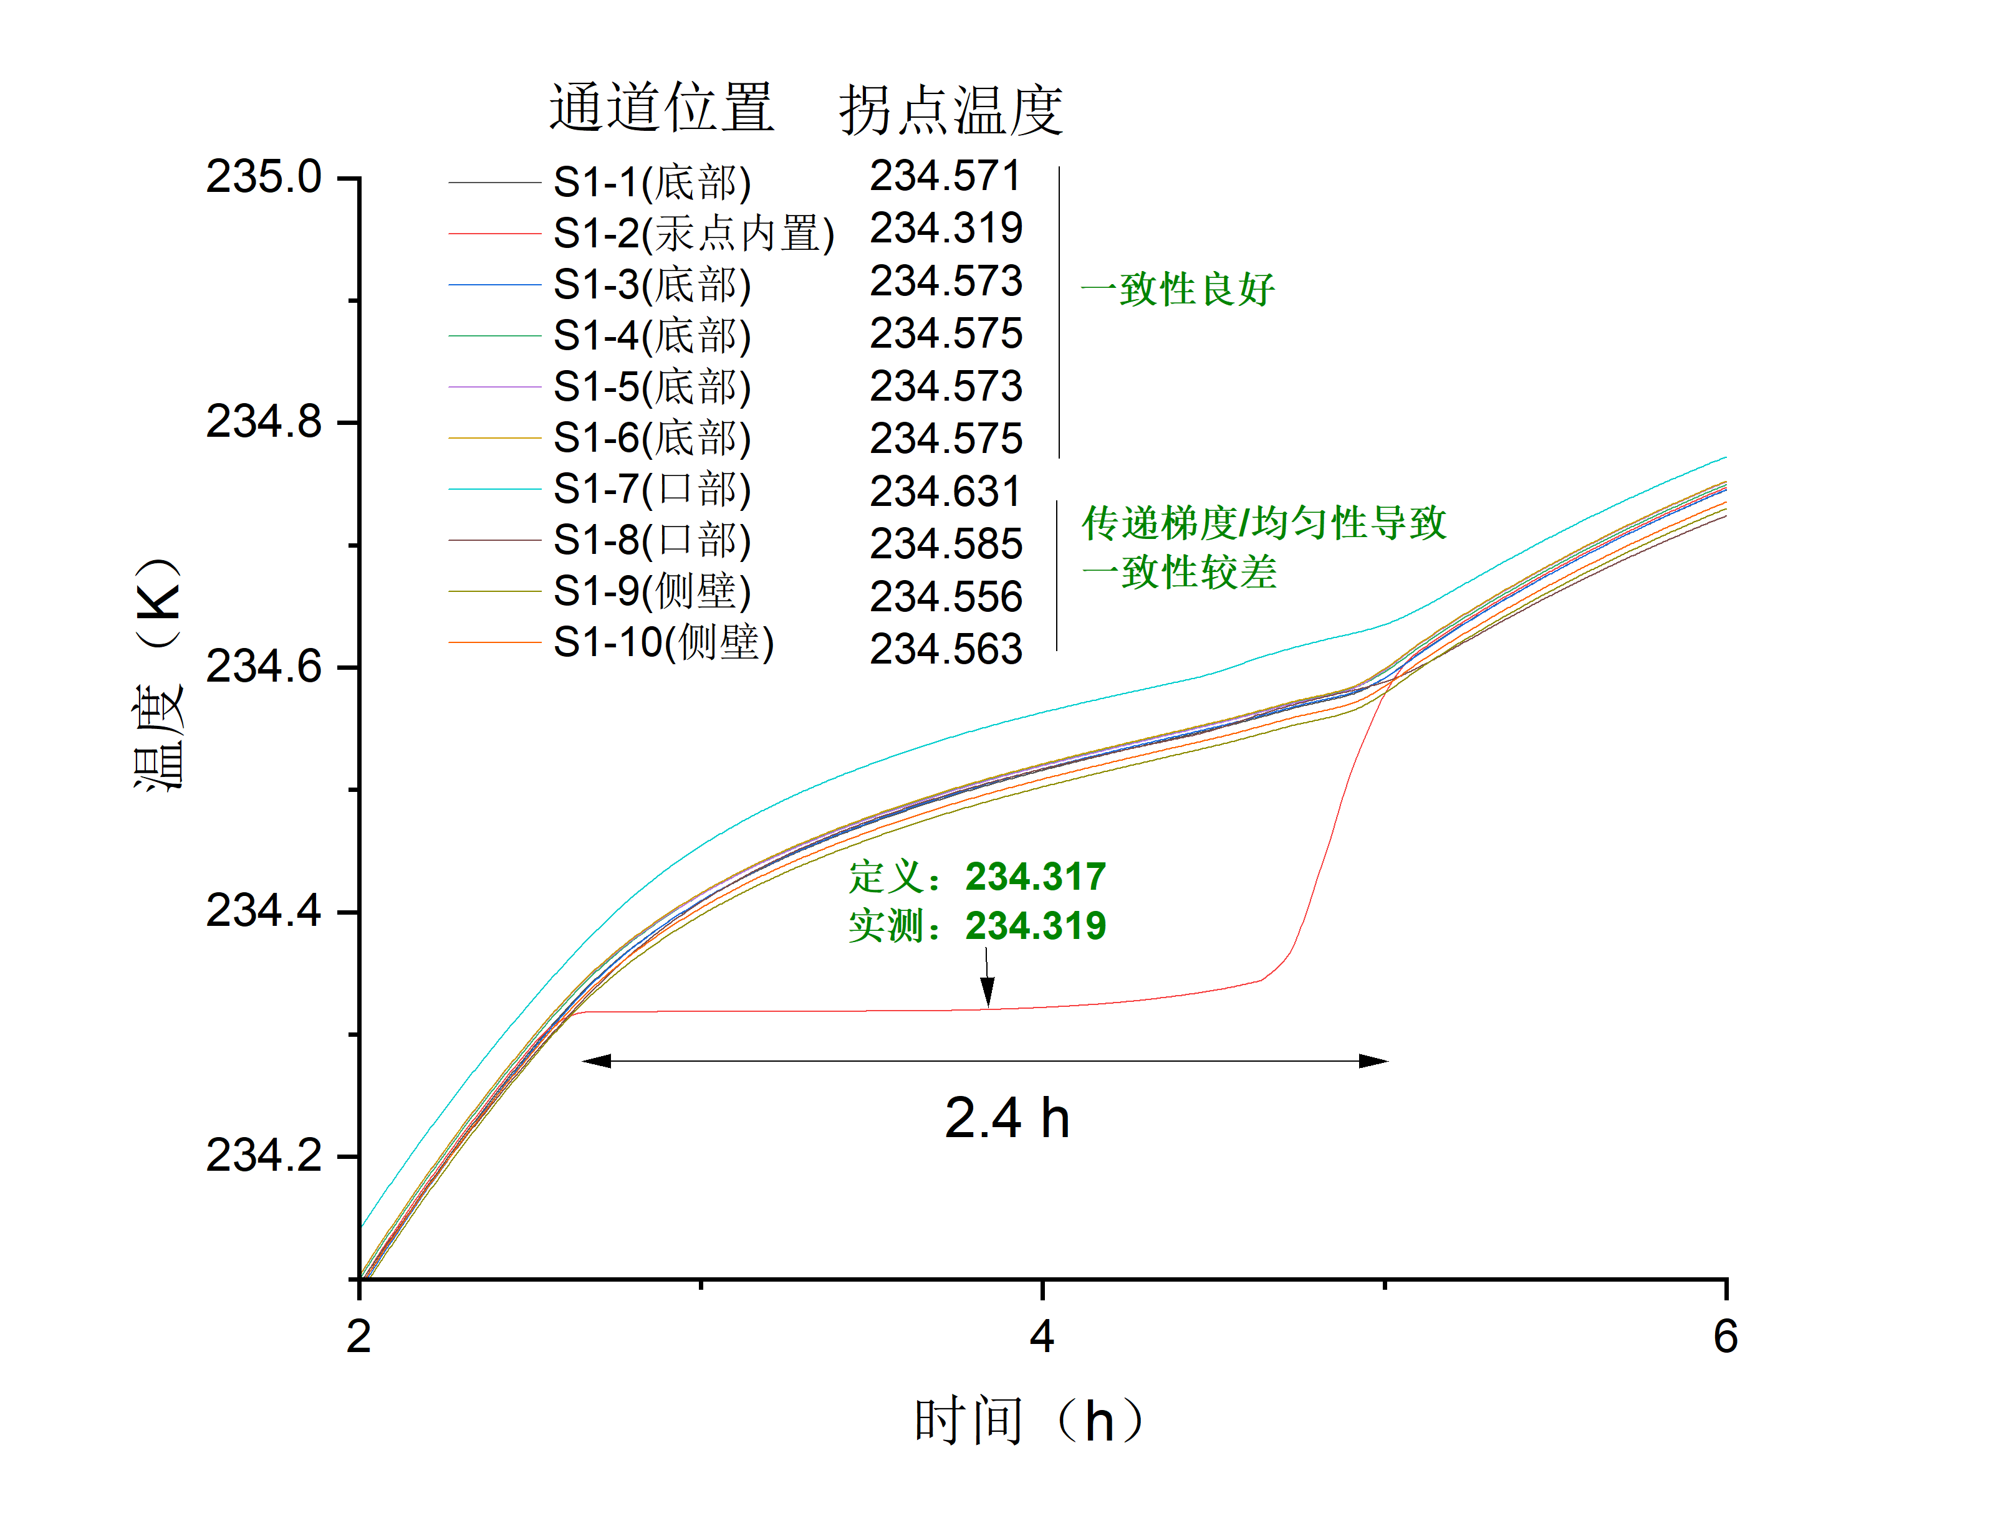
Test Results
Experimental procedures
Middle Layer(use PID): 231.3K
Blackbody(use PID): 233.8K
Blackbody(net power): 0.60W
Position
Temperature
Good consistency
Temperature(K)
Bad consistency
(because of ΔT)
Phase transition temperature of Hg： 234.318K
Measured temperature: 234.319K
Time(h)
Notes:
We tested the phase transition temperature of mercury. It can be observed that the thermometer inside the micro phase change fixed point displayed an excellent phase transition curve, with the measured value deviating by only 1 mK. However, due to the influence of temperature differences, the phase transition curves of the other thermometers at the bottom of the blackbody were not as flat.
However, since the temperature control uniformity at the bottom of the blackbody is relatively good, we can use this thermometer to calibrate the other thermometers at non-phase transition temperatures, such as the phase transition temperature minus 0.5K.

Slide 22
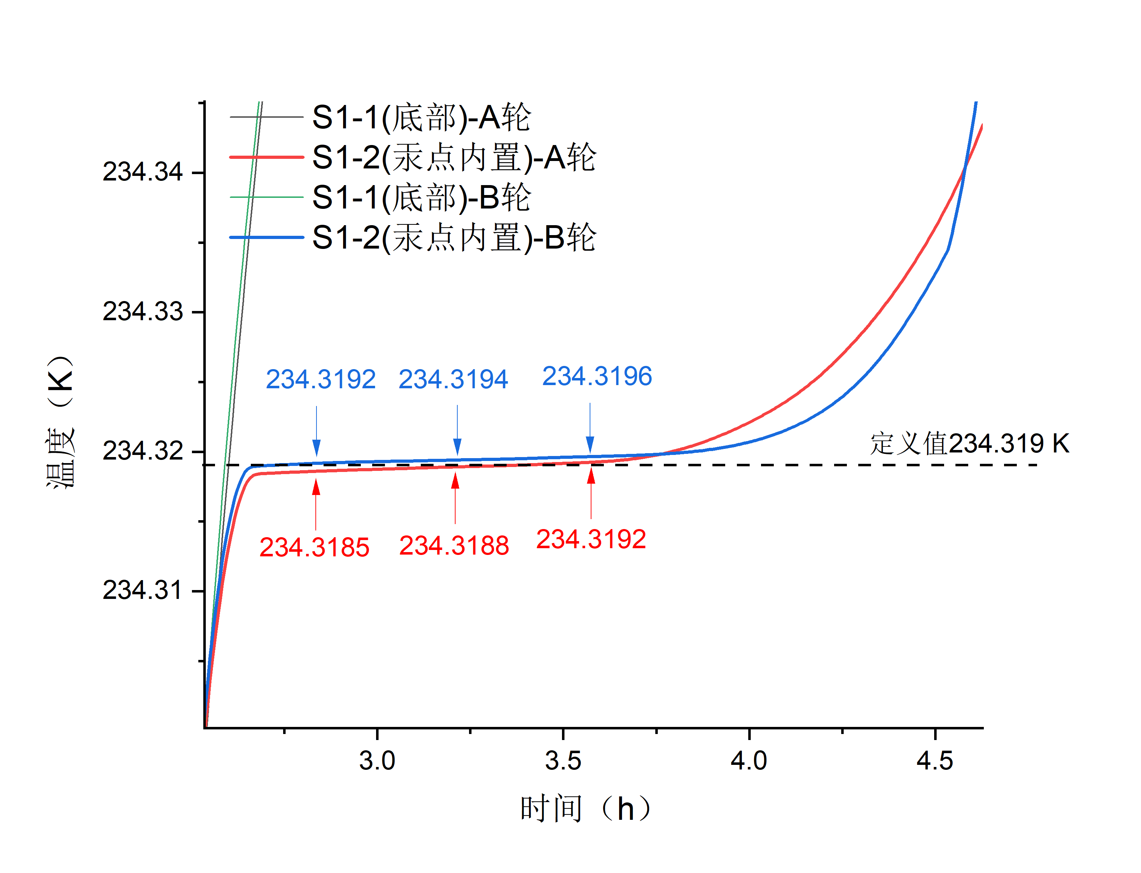
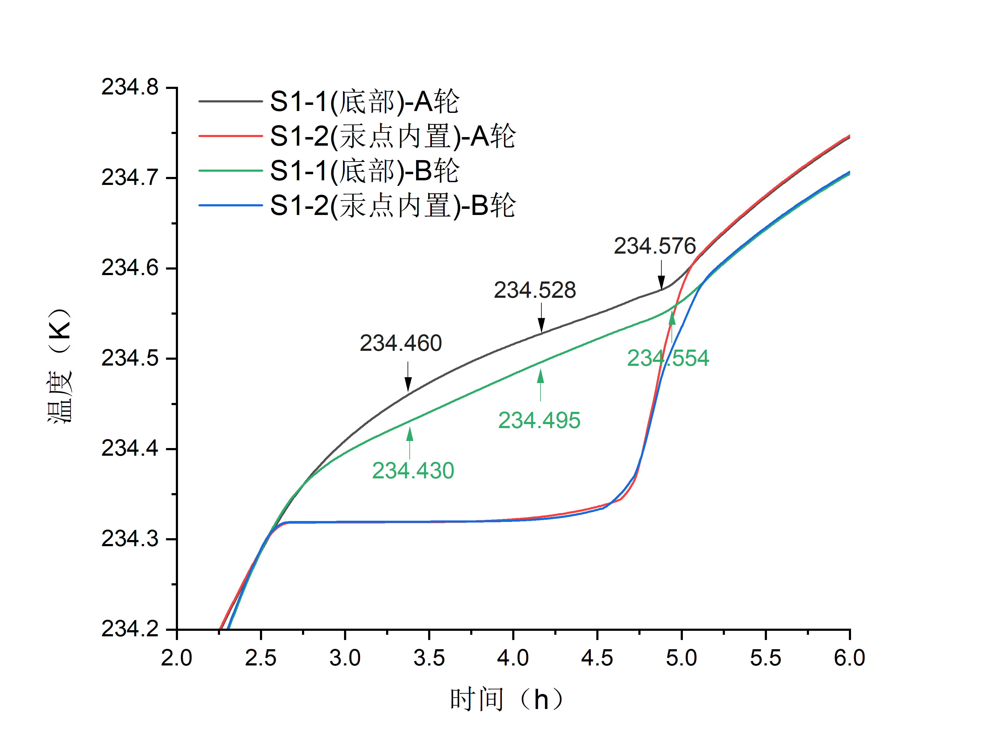
Test Results
Bottom @ first test
Bottom @ first test
In the crucible @ first test
In the crucible @ first test
Temperature(K)
Bottom @ second test
Bottom @ second test
In the crucible @ second test
Temperature(K)
In the crucible @ second test
Time(h)
Time(h)
Difference between phase transition temperature of Hg and thermometer in crucible： ≤1mK
Reproducibility of thermometer in crucible: ≤1mK
Notes:
The heating and cooling tests on the blackbody were conducted twice. The Difference between phase transition temperature of mercury and thermometer in crucible is better than 1mK
Reproducibility of thermometer in crucible is better than 1mK

Slide 23
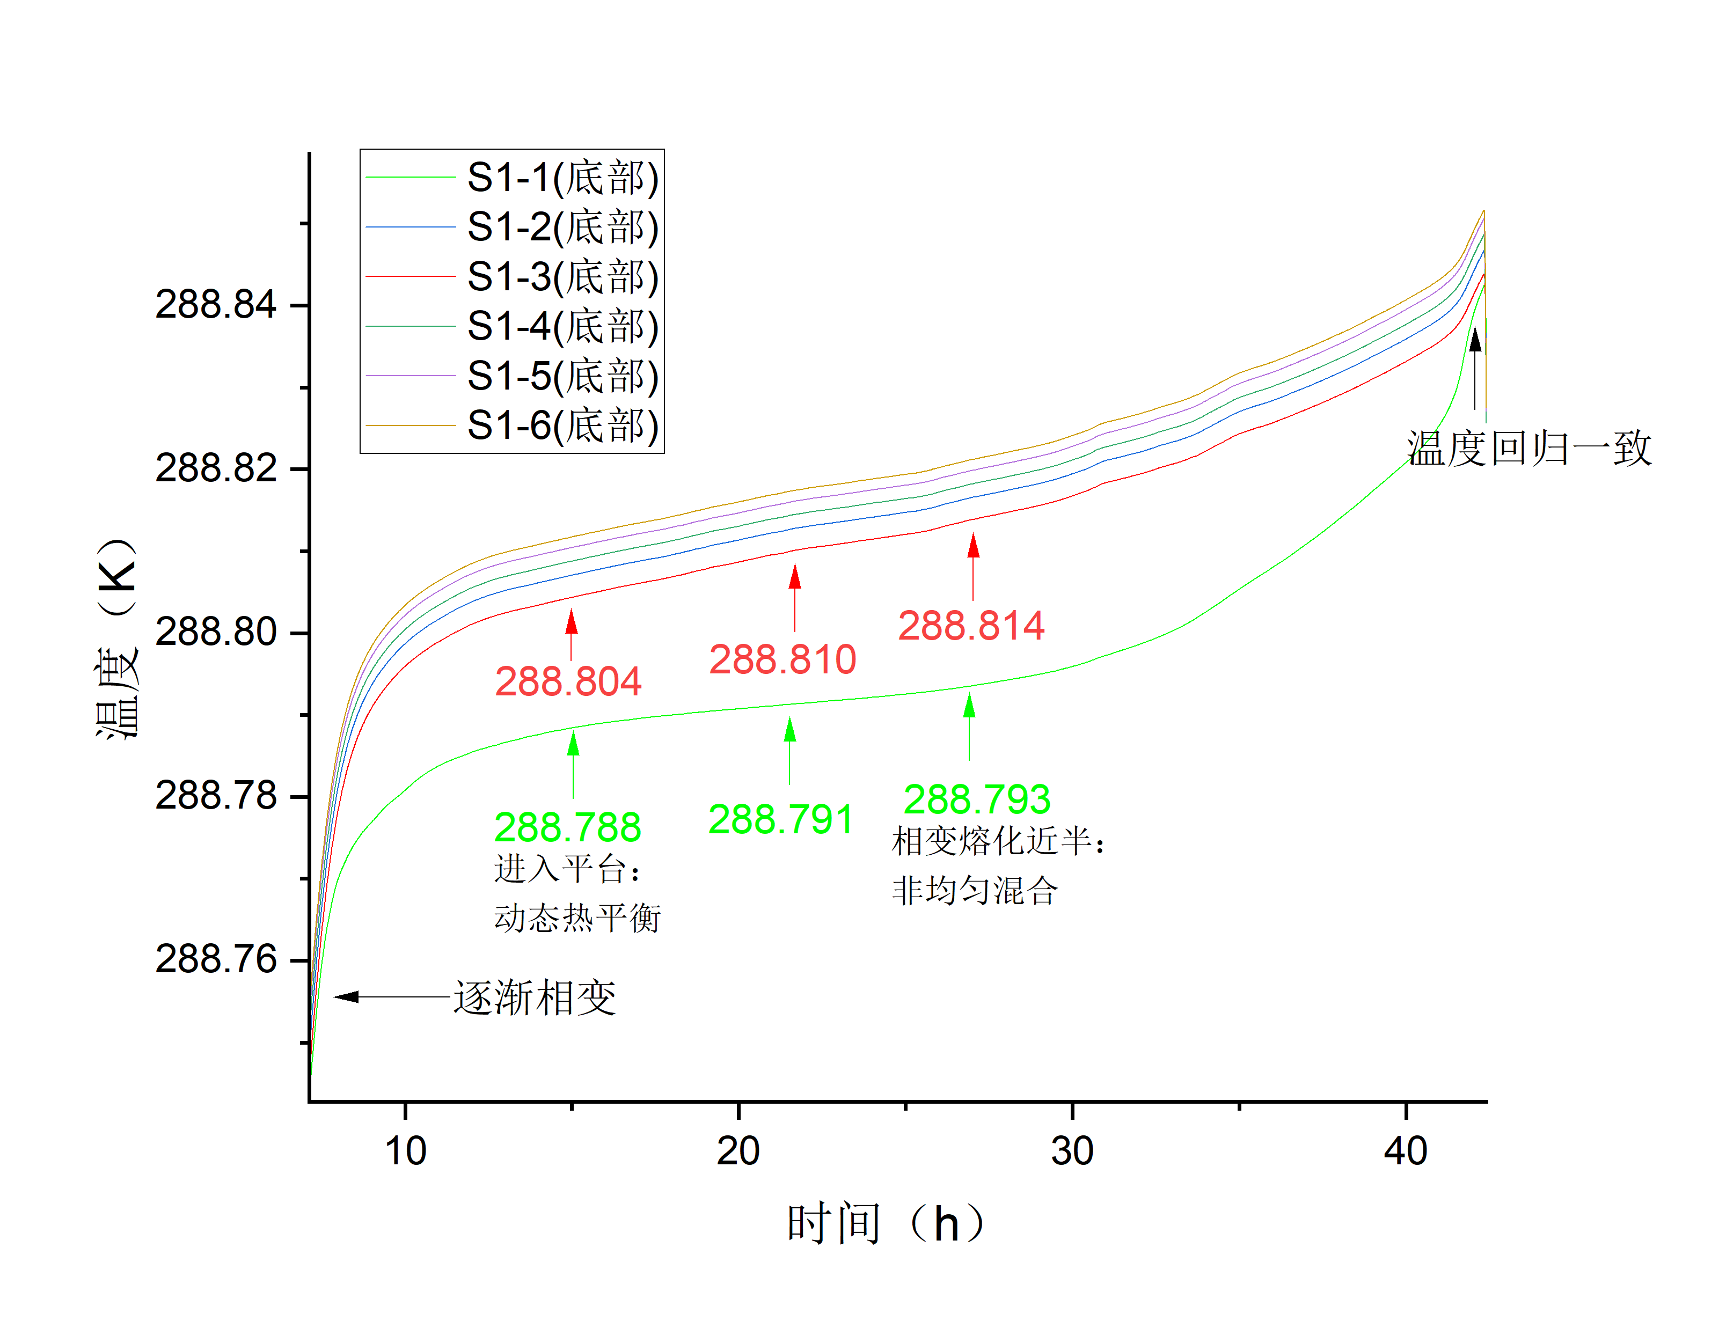
Test Results
Experimental procedures
Middle Layer(use PID): 285.25K
Blackbody(use PID): 288.25K
Blackbody(net power): 0.49W
Position
Temperature(K)
Temperature returns to consistency
Begin phase change
Gallium & Indium mixture
Time(h)
Notes:
Similarly, We tested the phase transition temperature of Gallium & Indium mixture.

Slide 24
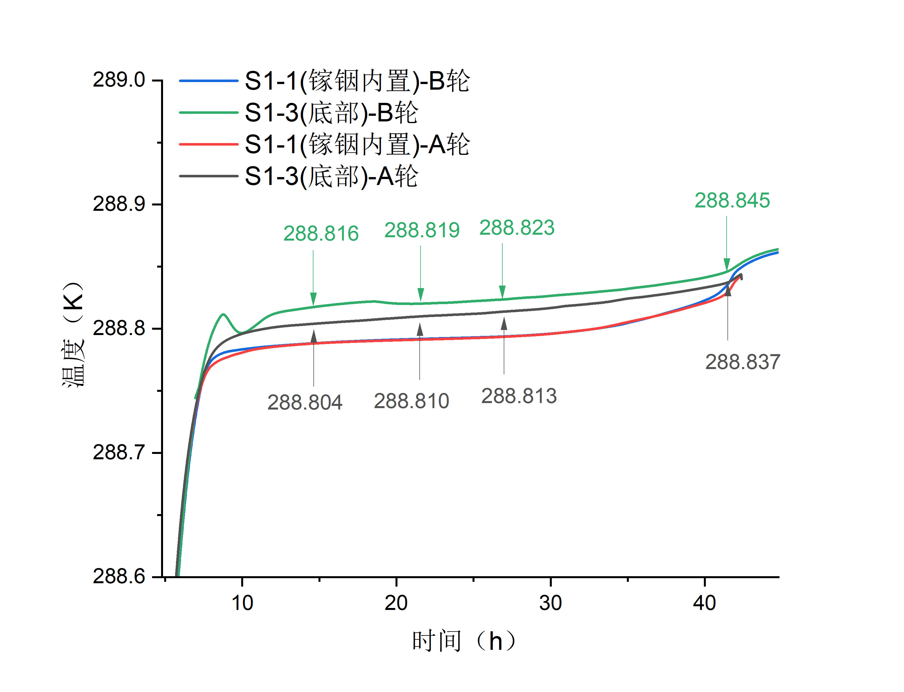
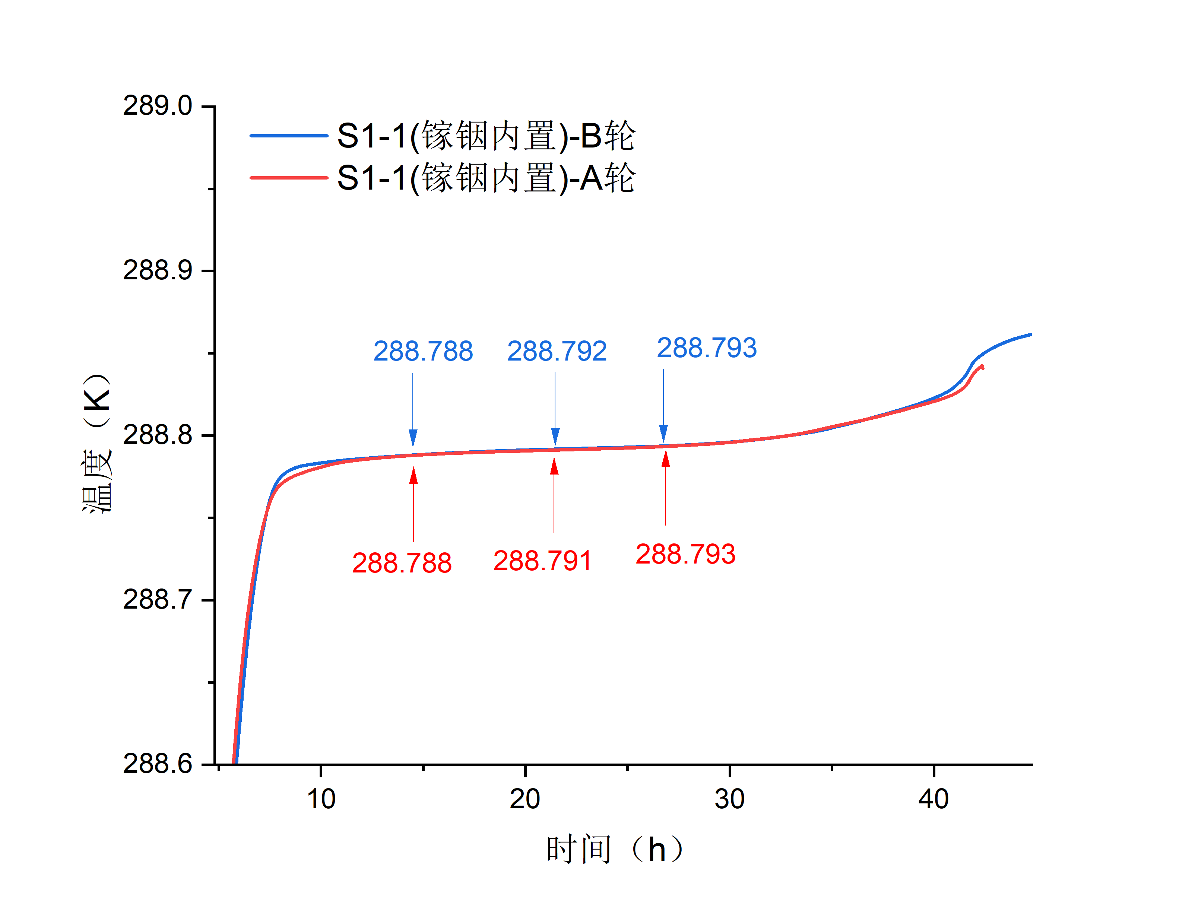
Test Results
In the crucible @ first test
Bottom @ first test
In the crucible @ first test
In the crucible @ second test
In the crucible @ second test
Temperature(K)
Bottom @ second test
Temperature(K)
Time(h)
Time(h)
Max difference within whole phase change： 5mK
Reproducibility of thermometer in crucible: ≤1mK
Notes:
Max difference within whole phase change： 5mK
Reproducibility of thermometer in crucible: ≤1mK

Slide 25
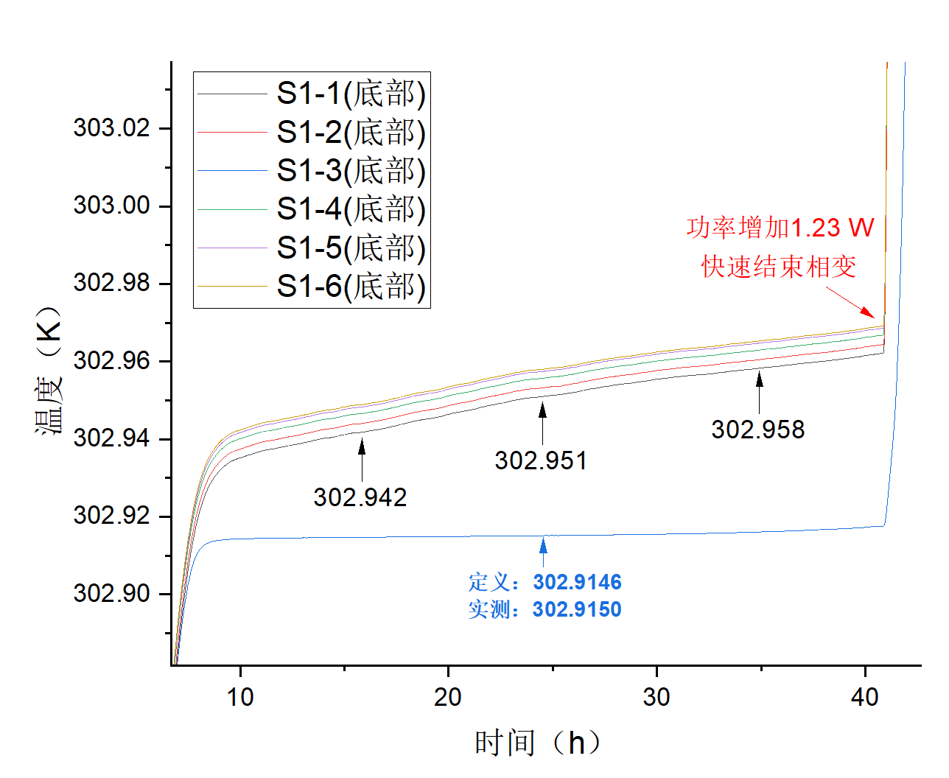
Test Results
Experimental procedures
Middle Layer(use PID): 299.4K
Blackbody(use PID): 302.4K
Blackbody(net power): 0.57W
Position
Temperature(K)
Net Power add to 1.23W:
To make phase change ends quickly
Phase transition temperature of Ga： 302.9146K
Measured temperature: 302.9150K
镓点定义值
Time(h)
Notes:
Finally, We tested the phase transition temperature of Gallium

Slide 26
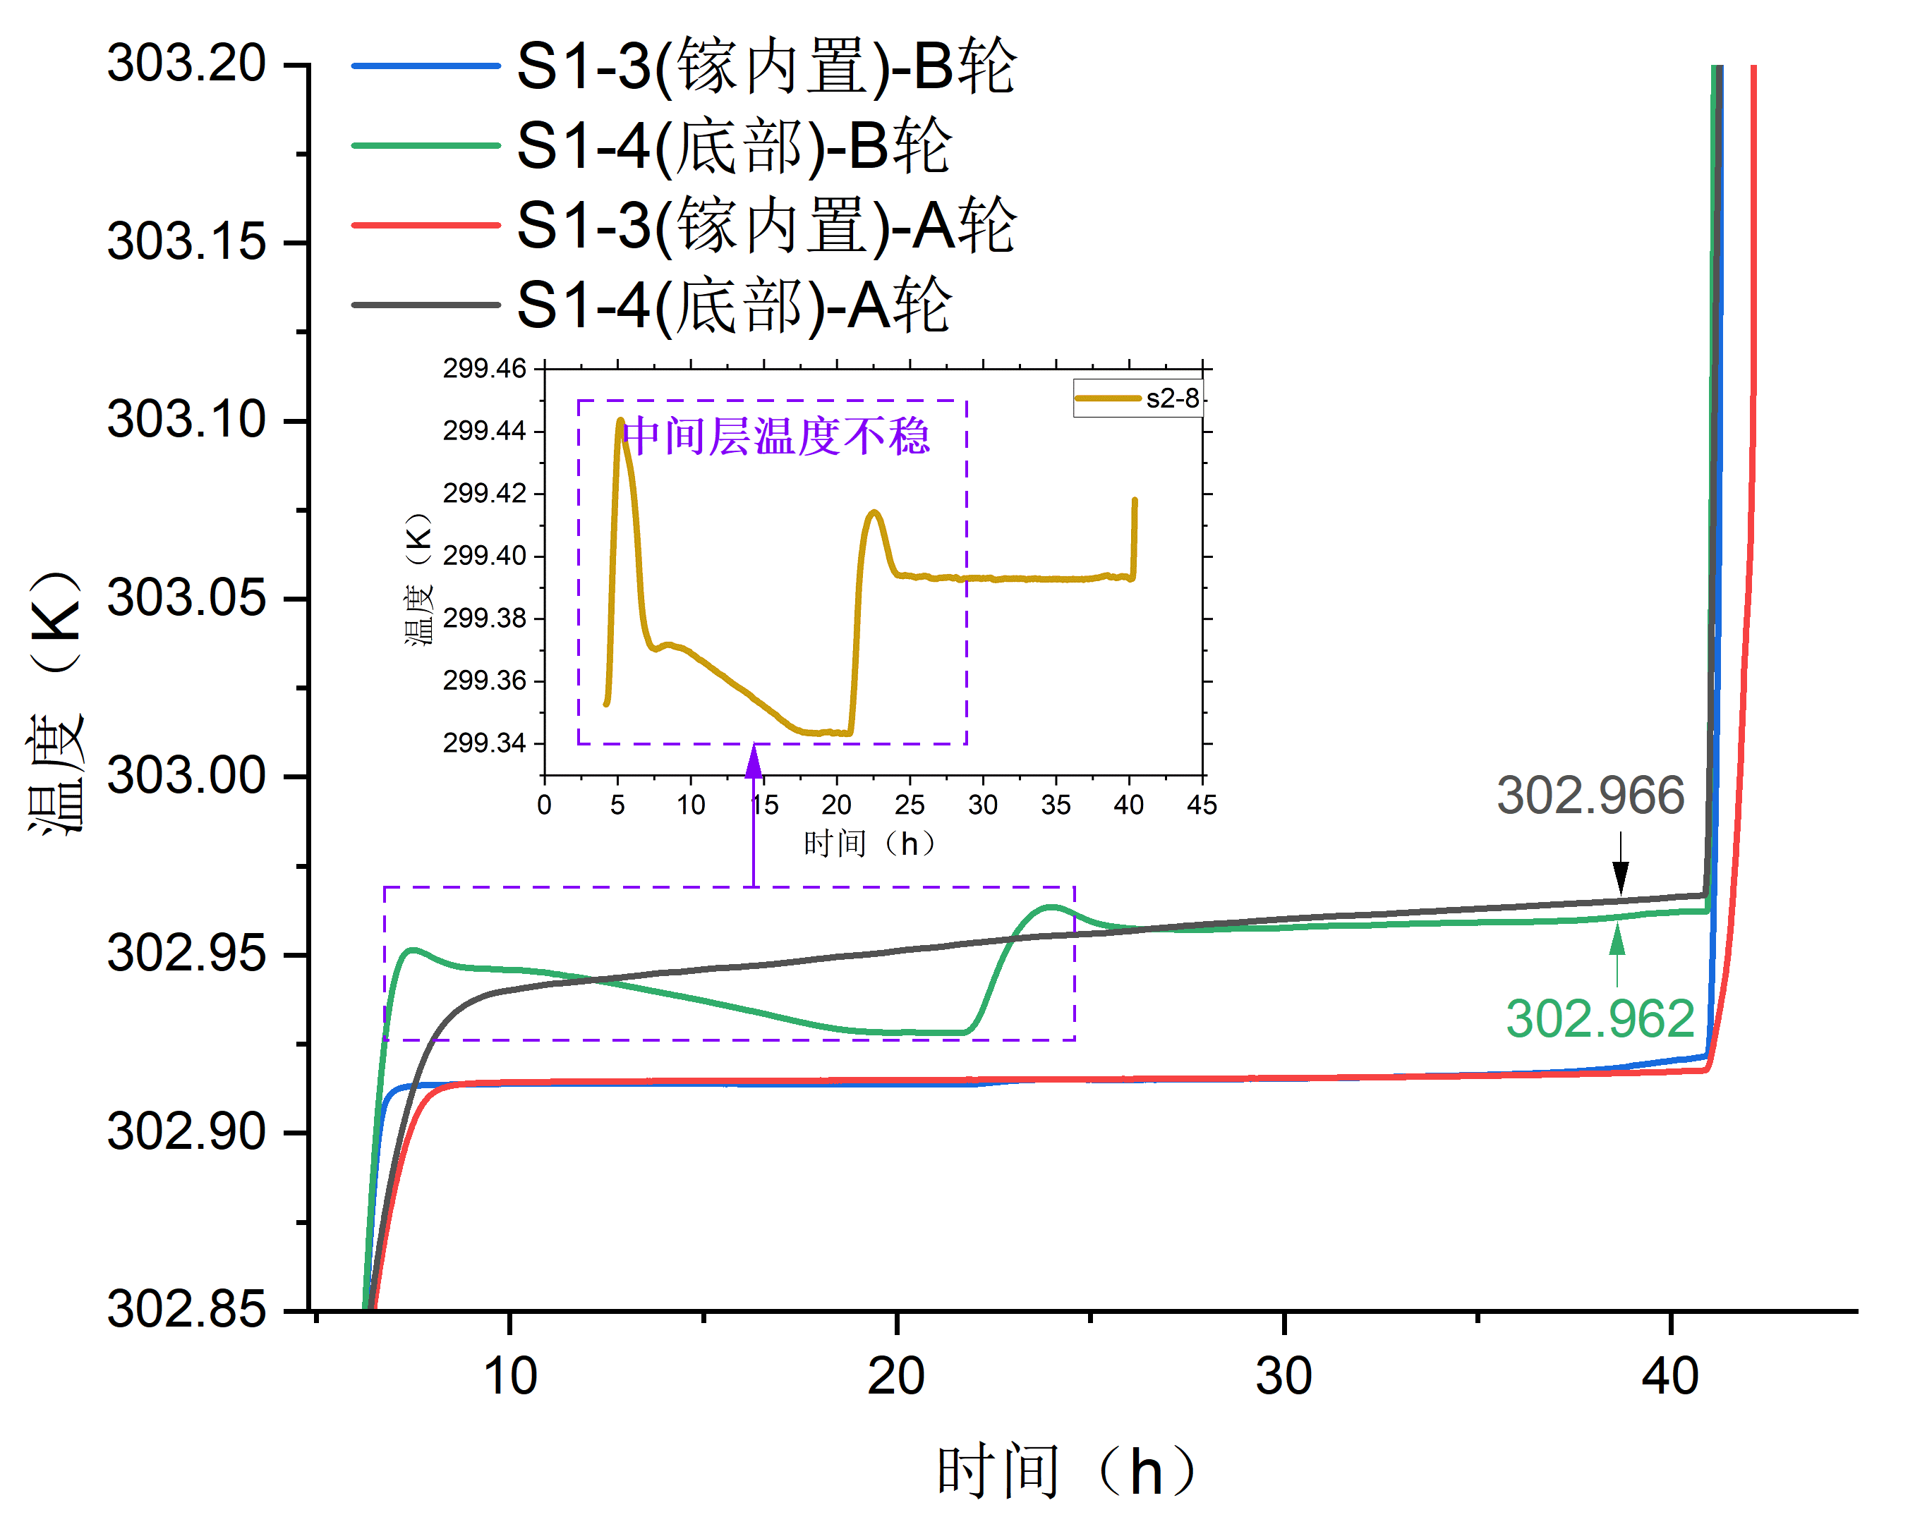
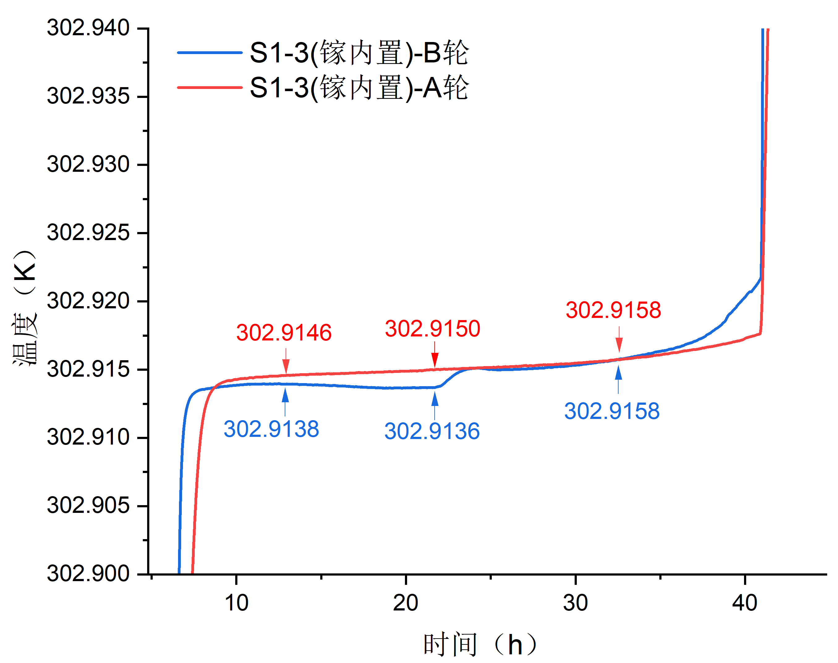
Test Results
In the crucible @ first test
Bottom @ first test
In the crucible @ first test
In the crucible @ second test
In the crucible @ second test
Temperature(K)
Bottom @ second test
Middle layer temperature fluctuation: 0.1K
Temperature(K)
Time(h)
Time(h)
Max difference within whole phase change： 2mK
Reproducibility of thermometer in crucible: ≤2mK
Notes:
Max difference within whole phase change： 2mK
Reproducibility of thermometer in crucible: ≤2mK
During the first test, a minor error occurred. It can be observed that the middle layer PID temperature control exhibited a fluctuation of 0.1K, resulting in a 1.4 mK change in the phase transition temperature. However, this error precisely reflects the technical specifications of the middle layer temperature control.

Slide 27
Conclusion
Three blackbody design:
Gallium fixed point BB provides radiation benchmark at gallium phase transition temperature
Low temperature BB provides Earth observation radiation source for daily use
Variable temperature BB provides nonlinear calibration radiation source
Each blackbody has a gold plated bezel and heated halo:
Isolate external heat flow
Maintain phase change process stability
Measure emissivity
Temperature uniformity and phase change test results show that the blackbody has good performance
As a backup
Notes:
Gallium fixed point BB provides radiation benchmark at gallium phase transition temperature
Low temperature BB provides Earth observation radiation source for daily use
Variable temperature BB provides nonlinear calibration radiation source
These two blackbodies can serve as backups for each other.
Each blackbody has a gold plated bezel and heated halo:
Can Isolate external heat flow
And Maintain phase change process stability
And Measure emissivity
Temperature uniformity and phase change test results show that the blackbody has good performance

Slide 28
THANK YOU！
Shijie Xin¹ , Lei Ding¹, Mingjian Gu¹, Xiaopeng Hao², Jian Song², Xuerong Xu¹, Ruiheng Sima², Tianyu Yan¹
1. Shanghai Institute of Technical Physics, Chinese Academy of Sciences
2. National Institute of Metrology, China
Mar. 20 Changchun · China
Notes:
That’s all, thank you.

