Slide 1
GSICS Data and Product Server migration from THREDDS proposal
Luca Garegnani (EUMETSAT)
GSICS Annual Meeting 2025-03-17/21

Slide 2
Agenda
What we are proposing
Why we are proposing it
EUMETSAT Data Store overview
GSICS data in EUMETSAT Data Store
Impacts of the migration and mitigation actions

Slide 3
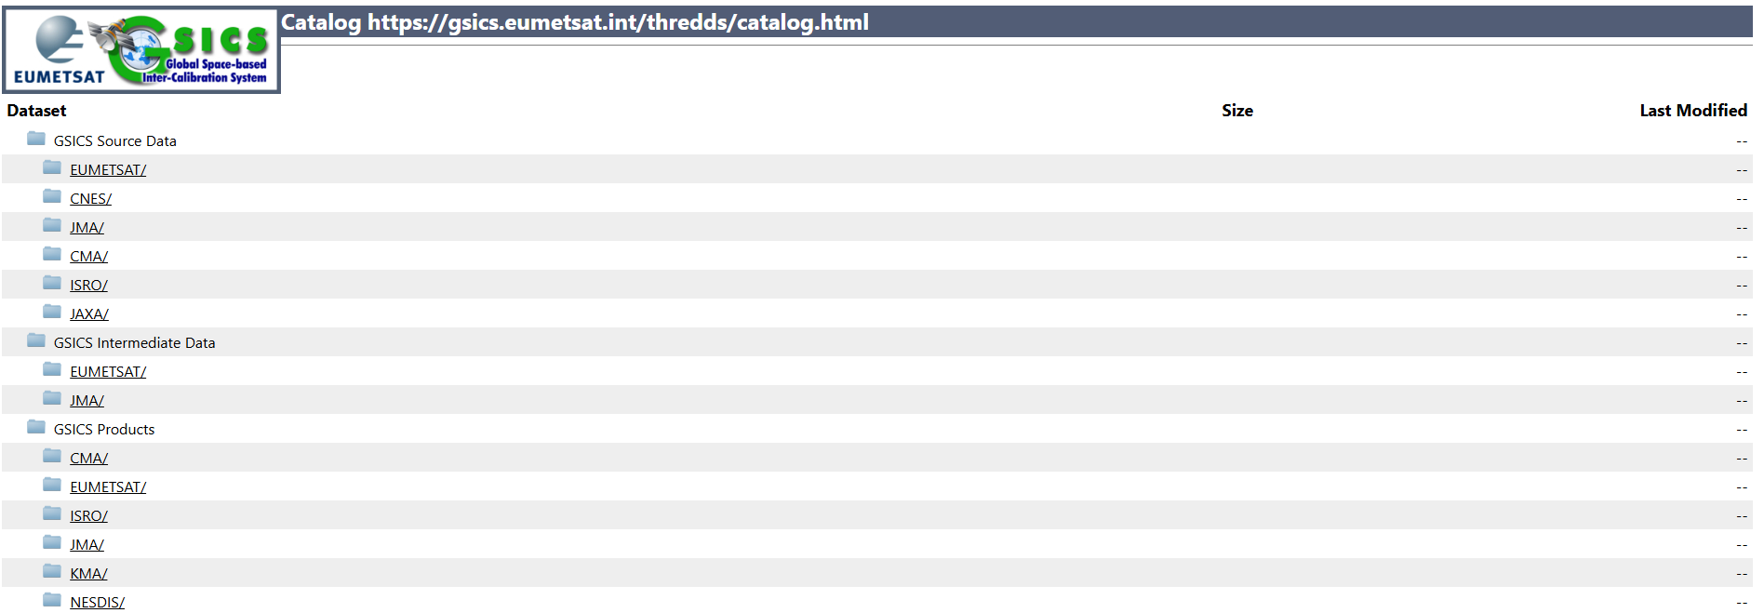
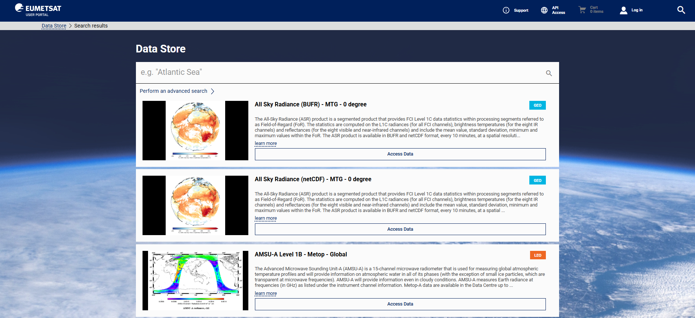
What are we proposing
Migration of the GSICS service from the current THREDDS-based system to the EUMETSAT Data Store

Slide 4
Why we are proposing it
Current THREDDS-based system
Only used for GSICS
Becoming difficult to maintain
Technology is becoming obsolete and represent a security threat
Major re-engineering is required
EUMETSAT
Data Store
Better data exposure/discoverability
Long-term maintenance
Standard restful protocols

Slide 5
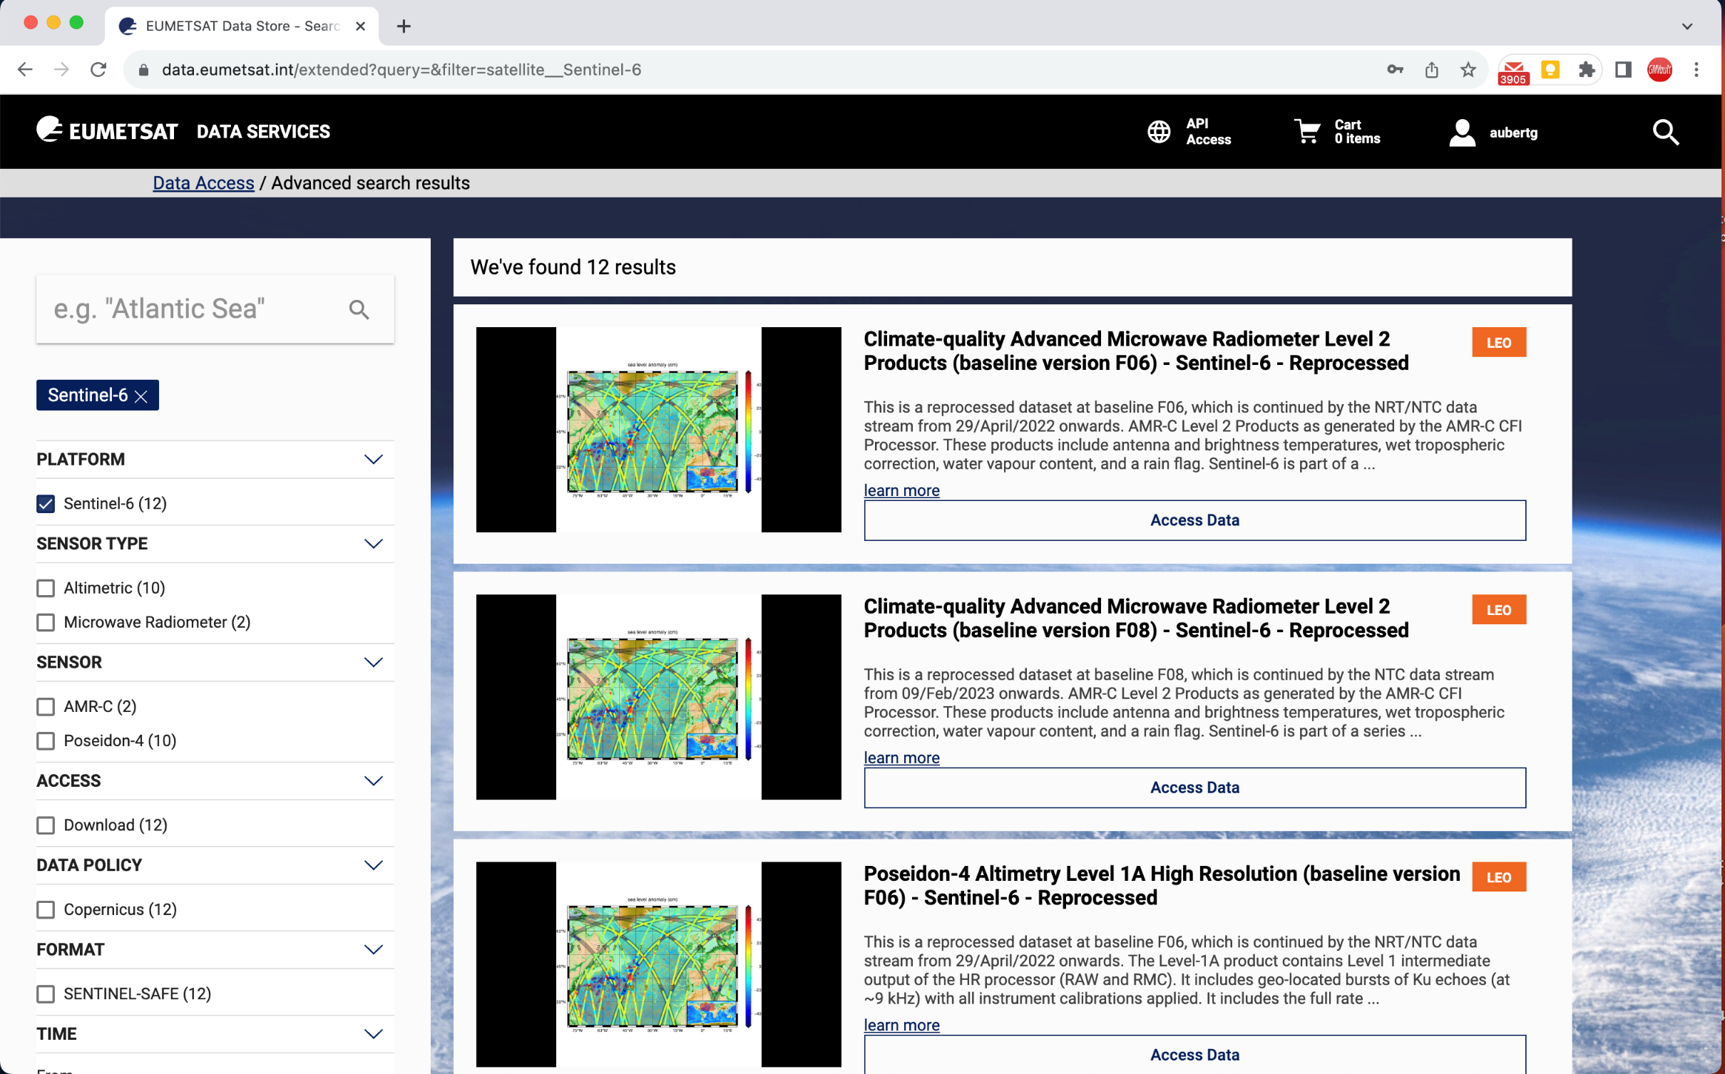
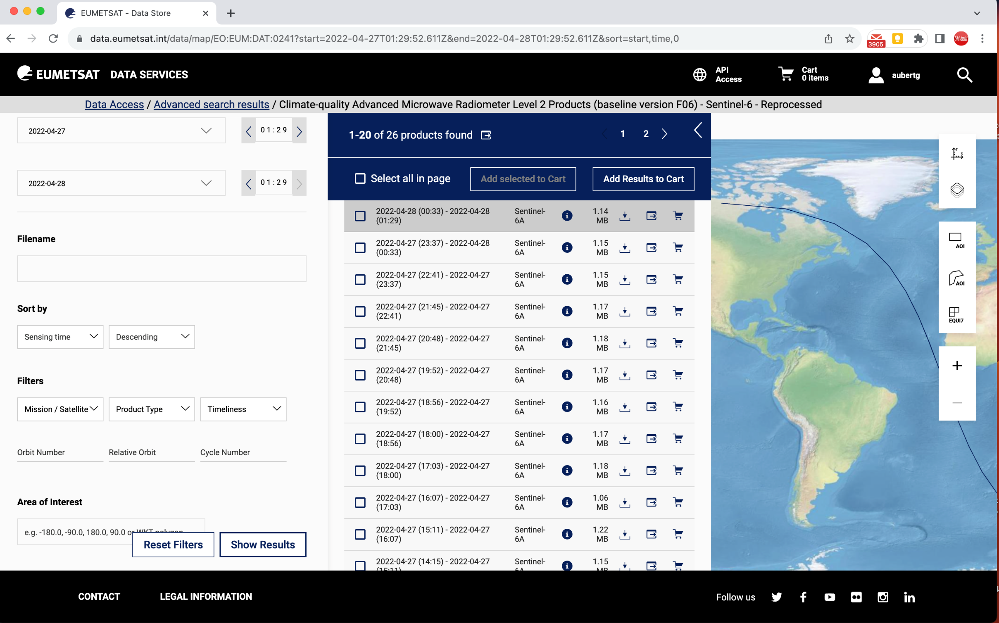
EUMETSAT Data Store overview
Single access point to the EUMETSAT online data holdings and data products
Web User Interface (WebUI)
REST Application Programming Interfaces (APIs) (Download, Subscription, etc.)
Dedicated standalone client (EUMDAC)
Data Store key features:
The Data Store does not host any data itself
but manages access to the data hosted in the Data Lake
Data Discovery, Search, Browse
Data Downloads (via Data Lake)
User Cart
Enforcement of Data Access Policies
Subscriptions and Notifications
Integrate Customisations (via Data Tailor)
Highly-scalable system architecture
Data provided as SIP package (data stored in native format)
Data Store content:
Near Real-Time products
Historic Products
Climate Data Records
Declared operational OCT 2021

Slide 6
EUMETSAT Data Store overview
EUMDAC is the EUMETSAT Data Access Client. It provides access to EUMETSAT data from a variety of satellite missions. As a Python library, it comes with many methods and helpers to use EUMETSAT APIs and services, like Data Store and the Data Tailor. It also provides a variety of useful command-line utilities for data search, download, and customisation.

Slide 7
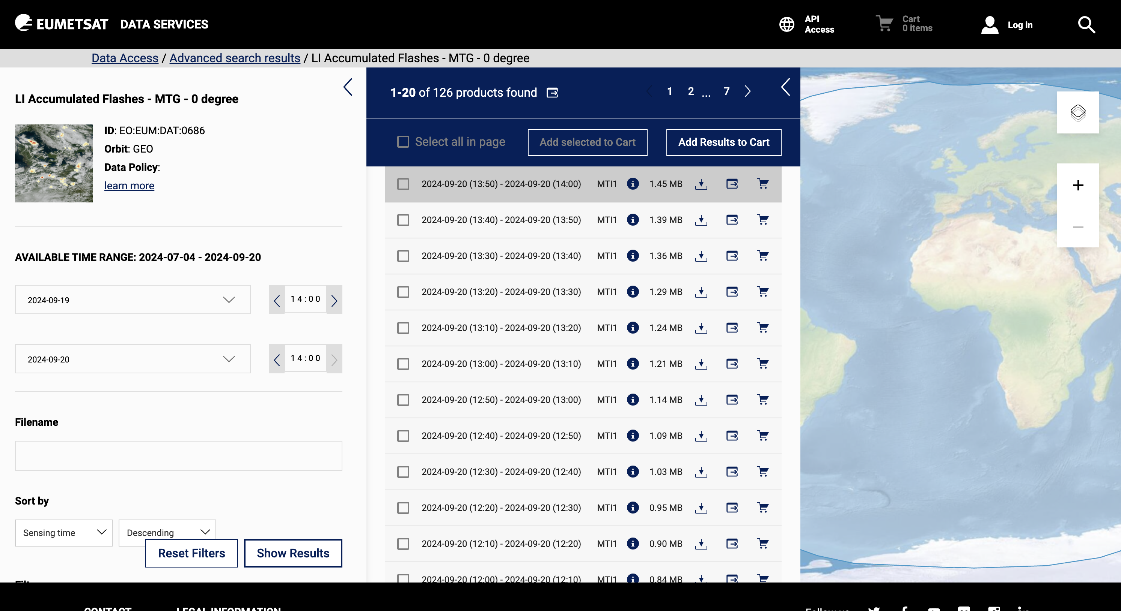
EUMETSAT Data Store overview
On 1st of Sept. 2024
76.75 Million
685
Number of products
available on the data lake
Average monthly data volume in TB
delivered from the Data Store
Over the last 6 months
2.96 Million
877
Average monthly number of ingested products
Over the last 3 months
Average monthly Data Store unique users
Over the last 6 months
8.2 MILLION
99.66 %
Average monthly successfully delivered data download requests from Data Store
Over the last 6 months
Average monthly availability of the Data Store
Over the last 6 months
6.634
1338
Total volume of net data
on the Data Lake in TB
Collections (buckets)
on the Data Lake
755 with data
129 publicly visible in the catalogue
Shall reach 100 PB in 2030!

Slide 8
EUMETSAT Data Store overview
Data inside the EUMETSAT Data Store is organised in collections. A collection is an aggregate of products sharing the same characteristics
Data inside a collection can be searched via different filtering options, like filename, time range, satellite, product type, …

Slide 9
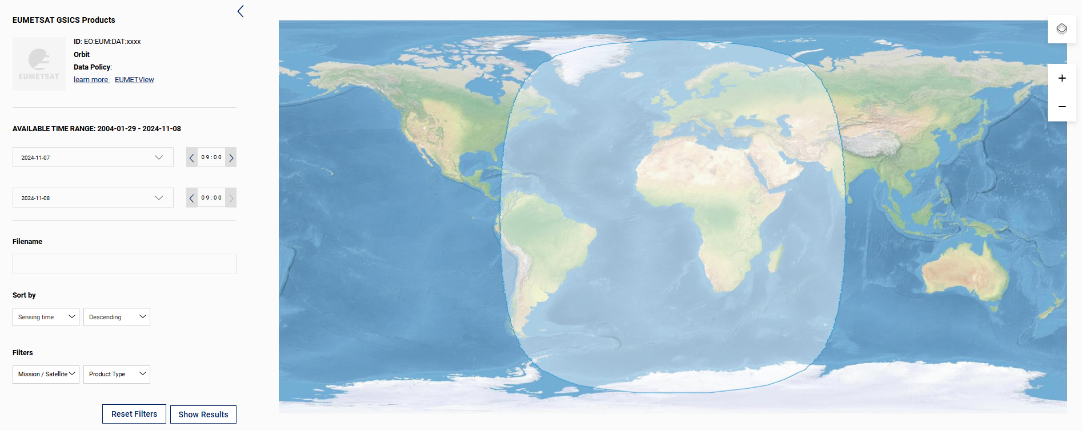
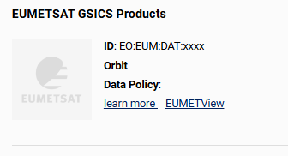
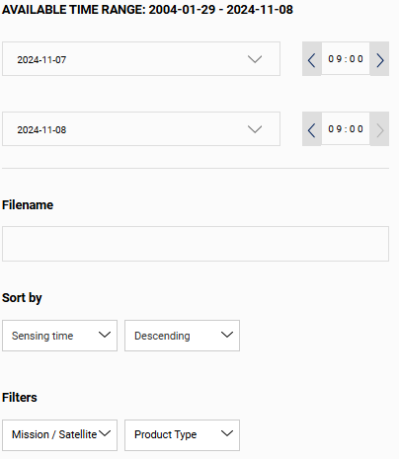
EUMETSAT Data Store overview

Slide 10
GSICS data in EUMETSAT Data Store
One or more collections dedicated to GSICS products can be added, depending on whether separated collections are needed for the different data providers and/or for demo/preoperational and operational products
It is proposed to make available only GSICS products, not source and intermediate data, as
GSICS Source Data (e.g. IASI L1c in GSICS netCDF) is already available from EUMETSAT Data Store + Data Tailor
GSICS Intermediate Data will be retired (no users)

Slide 11
Impacts of the migration and mitigation actions
Impacts of the migration:
Tools currently relying on THREDDS (e.g. GSICS Plotting Tool) will need to be replaced/adapted
OPeNDAP will not be offered anymore for accessing GSICS data, as the EUMETSAT Data Store does not provide that functionality
EUMETSAT pick up point for partner’s GSICS data will change
Links in the GSICS Product Catalog will need to be updated
Support can be provided to partners for the transition to the new system. Tentatively, the migration could take place in Q3/Q4 2025

Slide 12
Impacts of the migration and mitigation actions
Users will be informed on the migration via
GSICS User Messaging Service
Banner on current THREDDS servers
Email to identified users
A short transition period with parallel dissemination of GSICS data via both systems will be considered

Slide 13
References
EUMETSAT Data Store
EUMETSAT Data Store user guide
EUMETSAT Data Access Client guide
Data Tailor guide

Slide 14
Thank you!
Questions are welcome.

