Slide 1

GSICS Agency Report
2025
Caroline Bès
Contributions from CNES colleagues: Thierry Amiot, François Bermudo, Camille Desjardins, Christel Guy, Elsa Jacquette, Denis Jouglet, Dimitrios Kilymis, Philippe Landiech, Sébastien Marcq, Aimé Meygret, Olivier Vandermarcq, Adrien Deschamps, Carole Deniel, Murielle Lafaye
CNES

Slide 2
Presentation Overview
IASI status and on-going studies
IASI-NG development status
C²OMODO French contribution to AOS
MicroCarb development status and cal/val
MUSCLE-NEO Multi Sensor Calibration Environment

Slide 3
IASI status and on-going studies
IASI-B and IASI-C instruments are currently operational and stable.
Radiometric inter-comparisons routinely performed at CNES between IASI-B, IASI-C and with CrIS/NOAA-20 and CrIS/NOAA-21 (since October 2023).
IASI-B / IASI-C inter-comparison
  Very good bias between IASI-B and IASI-C ≤ ± 0.1 K
  A small variation around 700cm⁻¹ and 2400cm⁻¹ can be noticed ; it results probably from the drift of the Metop-B orbit plane which has not been maintained any longer since mid of 2022.

Slide 4
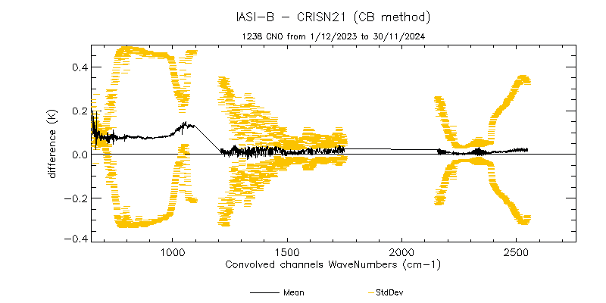
IASI status and on-going studies
Inter-comparisons between IASI and CrIS
  Bias between IASI-B and C and CrIS/NOAA-20 very consistent and stable ≤ ± 0.15 K
  Bias between IASI-B and C and CrIS/NOAA-21 very consistent and stable ≤ ± 0.15 K

Slide 5
IASI : planned activities in 2025
Inter-comparisons : integration of IASI-NG products in CNES software
  IASI-NG Vs IASI-B/C
  IASI-NG Vs CrIS/NOAA-20 and CrIS/NOAA-21
Release of the radiometric performance budget
Decision of the list of experiments planned in 2027 / 2028 for IASI-B End Of Life.
EUMETSAT post-processing of non-linearities of IASI-A (up to 30/09/2019) and IASI-B (up to 02/08/2017) L1C products
  data validated in 2024
  data release by EUMETSAT expected by mid of 2025.

Slide 6
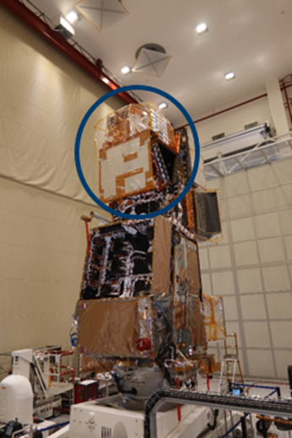
IASI-NG Program Status : Instrument & Ground Activities
Performances Pre-Flight evaluations show an excellent agreement with User Requirement Specifications with only few residual non conformances (NEdT..) confirmed to be acceptable.
Final preparation of the launch campaign on going
L1C Processor V3 Version for Commissioning phase provided early 2025 for integration in the Temporary Ground Segment developed by EUMETSAT to perform the Cal/Val
IASTEC (IASI-NG Technical Expertise Center) : Version for commissioning phase expected in March 2025
Transport of the MetOp SG A1 Satellite to the CNES Guyana Space Center planned early June 2025
Launch with Ariane 6 V3 planned Mid August 2025
IASI-NG instrument on board MetOp SG A1 Satellite (Airbus DS Courtesy)

Slide 7
IASI-NG Program Status :
SIOV/CALVAL Global Overview
Launch
1st Spectra
Start of L1 early dissemination
Level 1 nominal dissemination
SIOV
CAL/VAL PART A
EARLY VALIDATION OF L1 PRODUCTS
CAL/VAL PART B
IN DEPTH VALIDATION OF L1 PRODUCTS
IASI TANDEM FLIGHT
9 WEEKS
16 WEEKS
15 WEEKS.
SYSTEM IN ORBIT VERIFICATION MAIN OBJECTIVES :
• End of the SIOV activities :
1st IASI-NG spectra
CAL/VAL PHASE A MAIN OBJECTIVES :
• End of phase A : start of early dissemination of L1 products to selected users
CAL/VAL PHASE B MAIN OBJECTIVES :
• End of phase B : Conclusion of IASI-NG Cal/Val activities and start of the routine operation

Slide 8

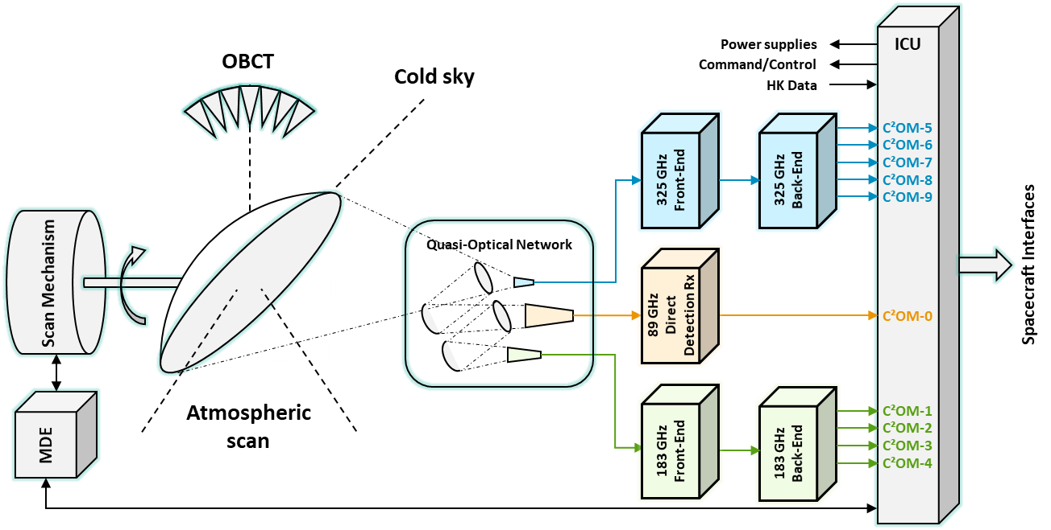
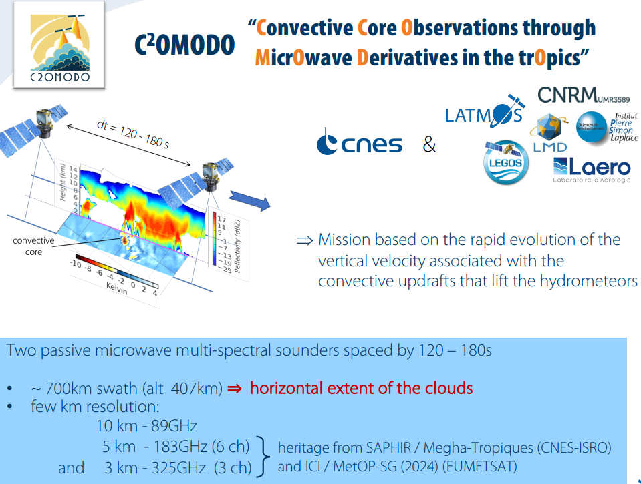
Atmosphere Observing System (AOS) led by NASA to characterize and link aerosols, clouds and precipitations, storms and convection
C²OMODO (Convective Core Observations through MicrOwave Derivatives in the trOpics)
  Based on a tandem of microwave radiometers aboard C²OMODO-Sat (NASA) and PMM (JAXA)
  To observe deep convection in order to monitor and characterize storm formation
Operational processing chains for level-1 products provided to NASA and JAXA mission centers
Processing and distribution of level-2 (and higher) products by French AERIS mission center
Expertise center for instrument and data monitoring
C²OMODO instrument
functional diagram
C²OMODO for deep convection
characterization

Slide 9
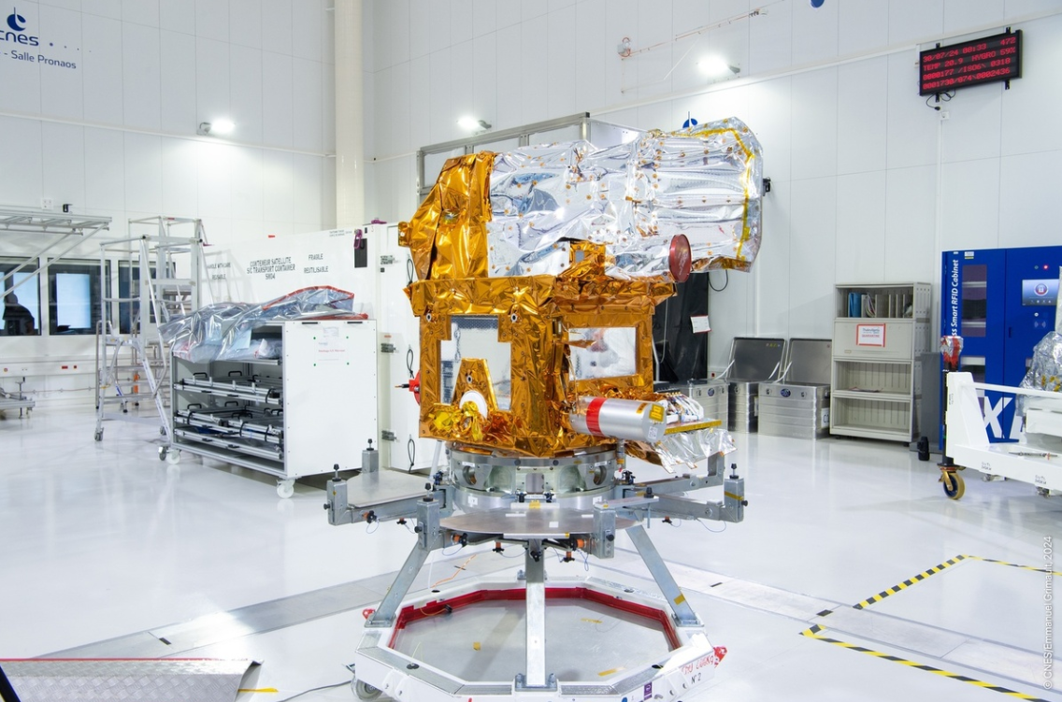
MicroCarb Status : launch preparation, Calibration and Validation Strategy
Satellite ready for transport to Guiana
Launch planned on VEGA-C in July-2025, from CNES Guiana Space Center
Calibration/Validation Strategy – 1 year schedule
  Mission Performances CALVAL assessment Key point held February 2024
  Three scales
    Massive operational comparisons.
    Casual manned measurements.
    Campaigns (e.g., MAGIC in France)
Everybody (French labs, abroad entities) is invited to contribute to measurements and analysis
    CNES will support and participate
Open data distribution through AERIS portal after CALVAL
Satellite final preparation

Slide 10
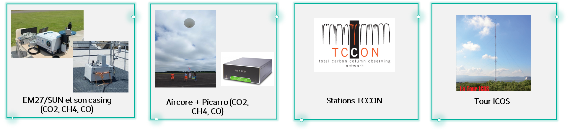
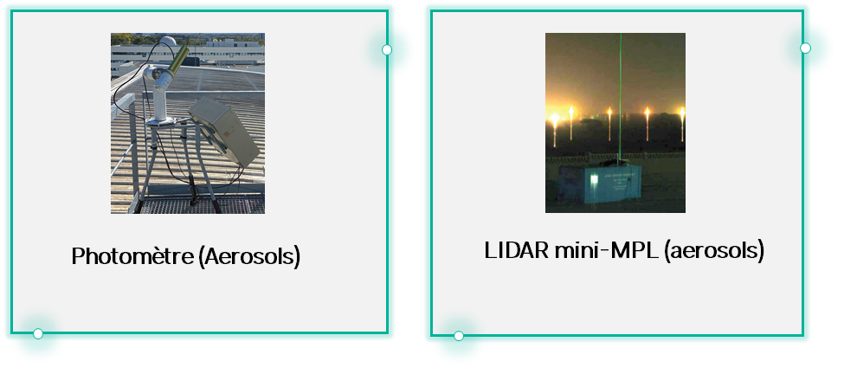
MicroCarb Calibration and Validation
Ground based instruments :
French Processing chain
French Processing chain
Aerosols products
(Aeronet)
TCCON products
EM27 products
Aircore products
CNES Mission segment
ICOS products
For other missions
or scientists
All products
AERIS
MicroCarb products
Others Satellite
OCO-2, GOSAT, etc..
MicroCarb Technical Expertise Center
Satellites products

Slide 11
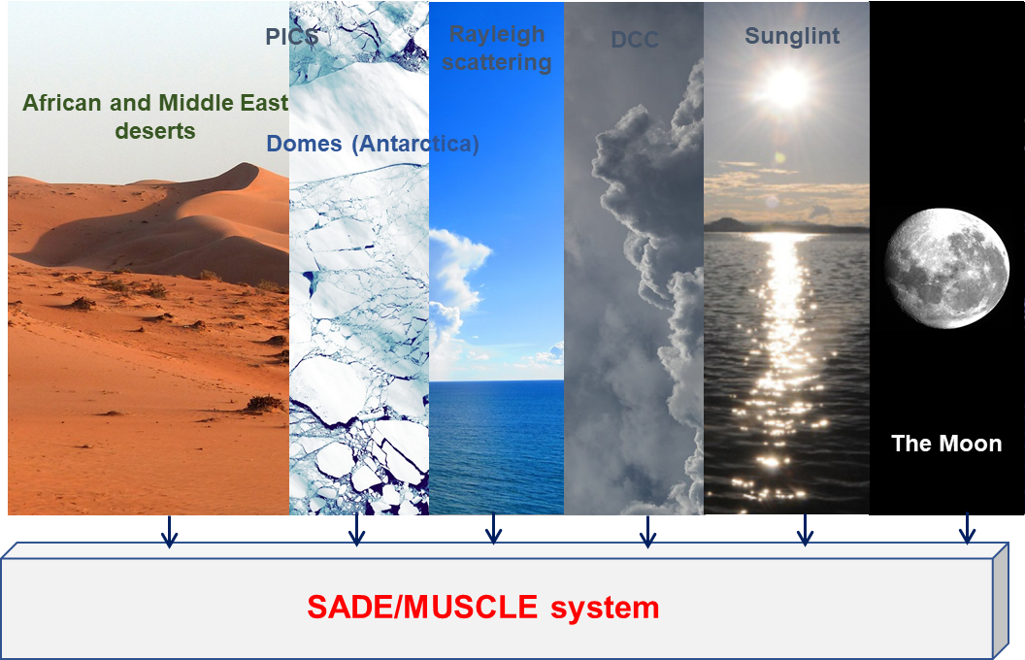
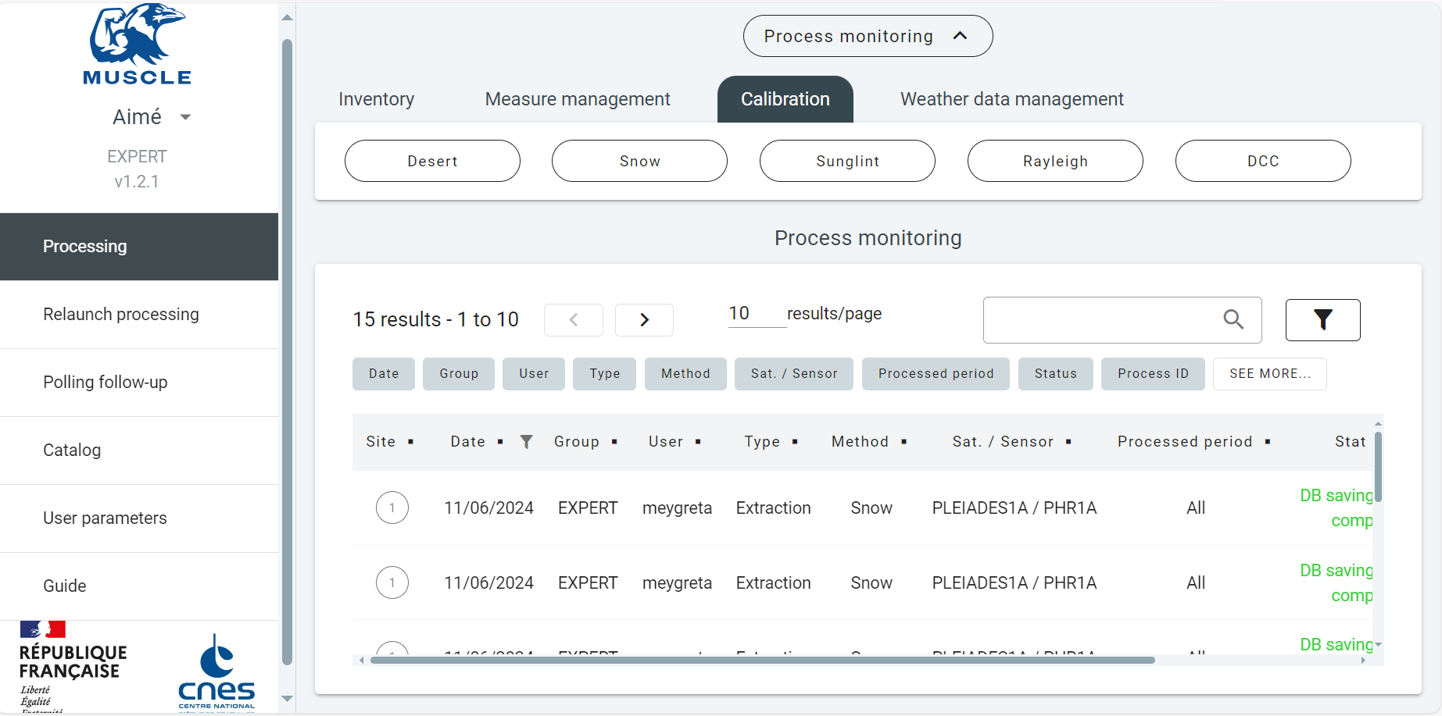
VSWIR CNES multi-mission operational monitoring facilities for the radiometric calibration of optical sensors
Calibration methods are :
  based on physical principles
  statistical methods: they use several acquisitions on natural targets
Principle of all methods: to compare a sensor measurement to a simulated one (from a model or reference sensor)
Our vicarious calibration methods are integrated into a unified tool called MUSCLE linked to a large database named SADE (49 sensors, more than 33 million of calibration measurements, operational for 23 years, oldest data: 1982) allowing to perform massive cross-comparisons and assure traceability
New version -> MUSCLE-NEO
delivery in Oct 2025 : external access via web service
Open to CNES external partners

Slide 12
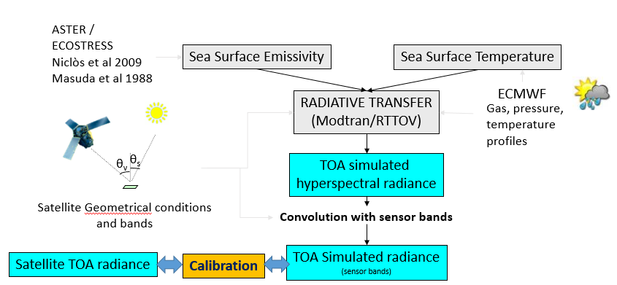
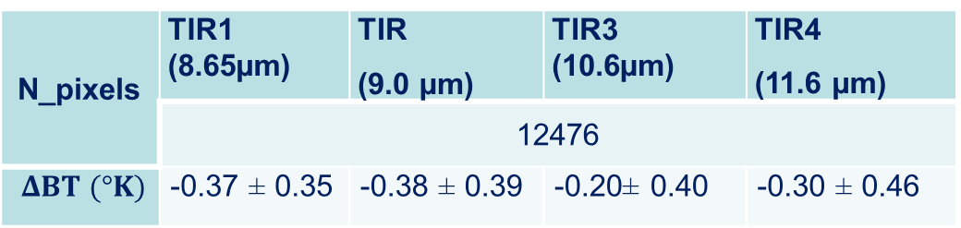
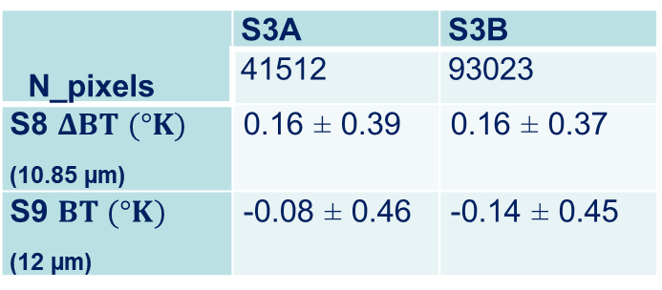
TIR L1 absolute calibration
Comparison to simulated radiances over the ocean (RT using ECMWF data)
« Inter-calibration » with ECMWF
Application to Sentinel3/SLSTR
N_pixels | S3A | S3B
 | 41512 | 93023
S8 $ΔBT (°K)$ (10.85 µm) | 0.16 ± 0.39 | 0.16 ± 0.37
S9 $BT (°K)$ (12 µm) | -0.08 ± 0.46 | -0.14 ± 0.45
$$ΔBT(K)=BT\left(sensor\right)−BT(simulation)$$
N_pixels | TIR1 (8.65µm) | TIR (9.0 µm) | TIR3 (10.6µm) | TIR4 (11.6 µm)
 | 12476
$$ΔBT (°K)$$ | -0.37 ± 0.35 | -0.38 ± 0.39 | -0.20± 0.40 | -0.30 ± 0.46
Application to IASI, convoluted with TRISHNA bands
Excellent consistency → Good validation method for TRISHNA

Slide 13
Any question ?

Slide 14

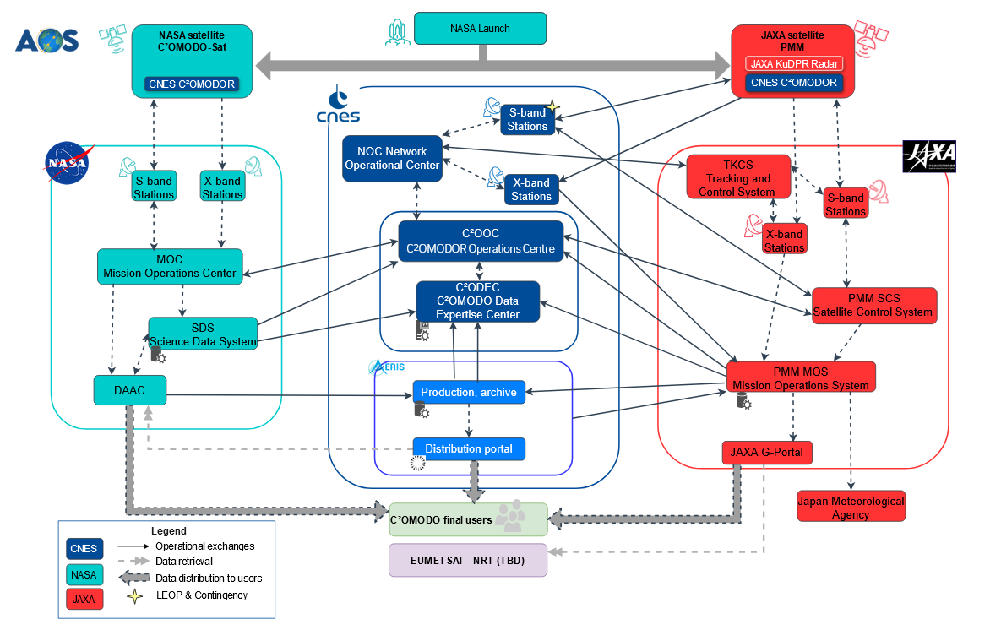
C²OMODO, a trilateral organization
CNES – NASA – JAXA
CNES Phase BCDE1 began in July 24
Co-launch of C²OMODO-Sat and PMM
scheduled in March 2030

Slide 15
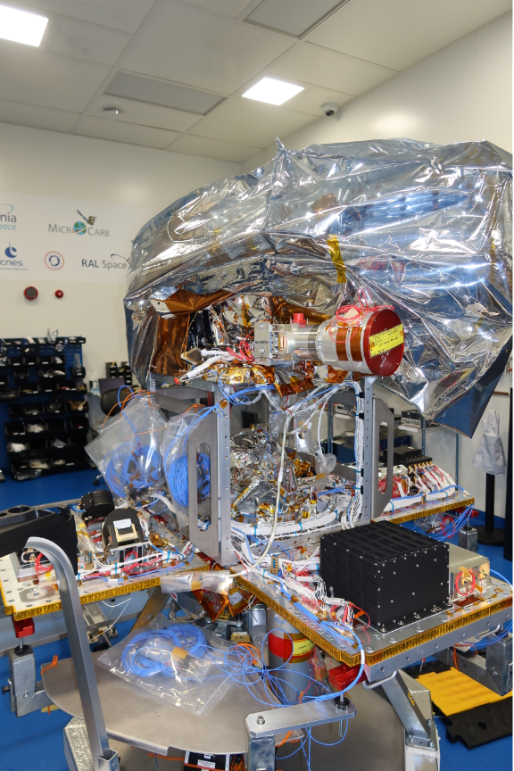
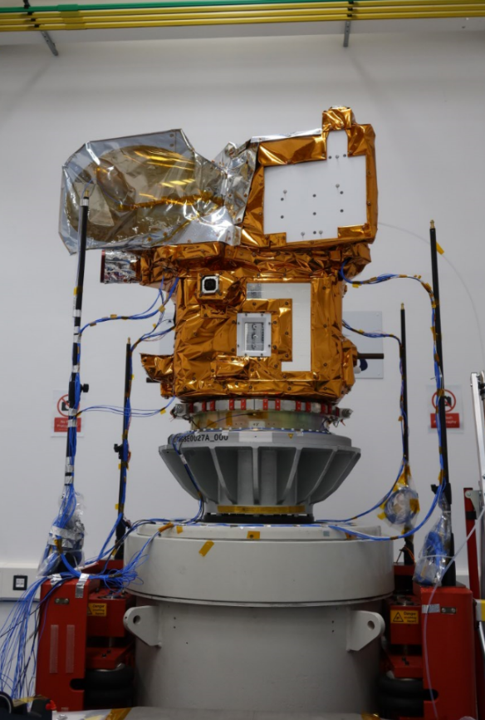
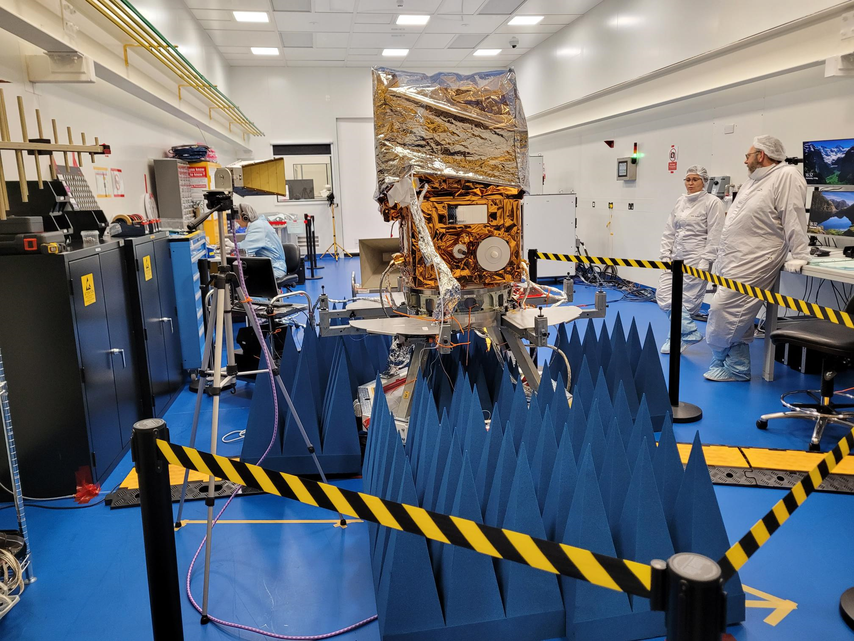
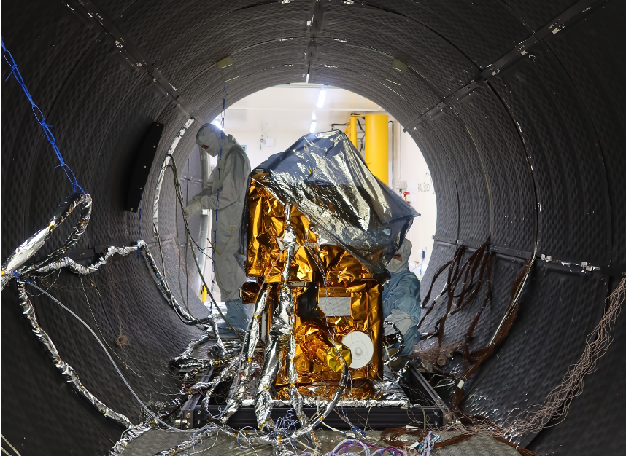
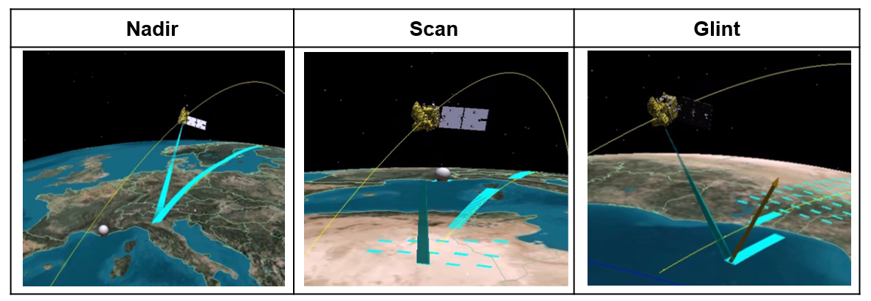
MicroCarb Status, launch preparation
Satellite Integration Status:
  Completed in January 2024.
  Currently under preparation after storage before transport
  to Guyana
Launch Perspective:
  Planned on VEGA-C in July-2025, on VEGA-C VV27 paired with CO3D
Operation Center Readiness:
  Prepared for various operation modes.
  Mission data processing chains tested and Mission Center infrastructure ready >3000 computers cluster at EUMETSAT
Open data distribution through AERIS portal after CALVAL
Satellite AIT major steps:
instrument integration,
mechanical qualification,
EMC,
Thermal Vacuum
Satellite final preparation

